Slide 1
Trophic control
Group: Amalia Bogri, Christian Berrig & Jonas Bolduan

Slide 2
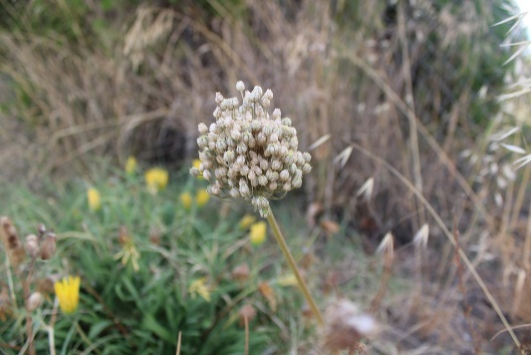
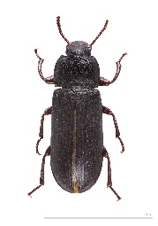
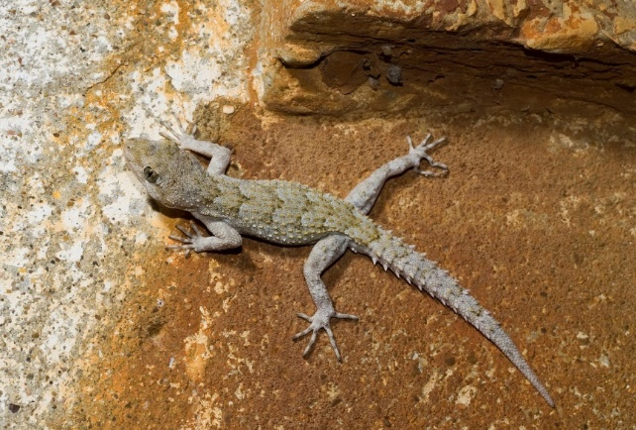
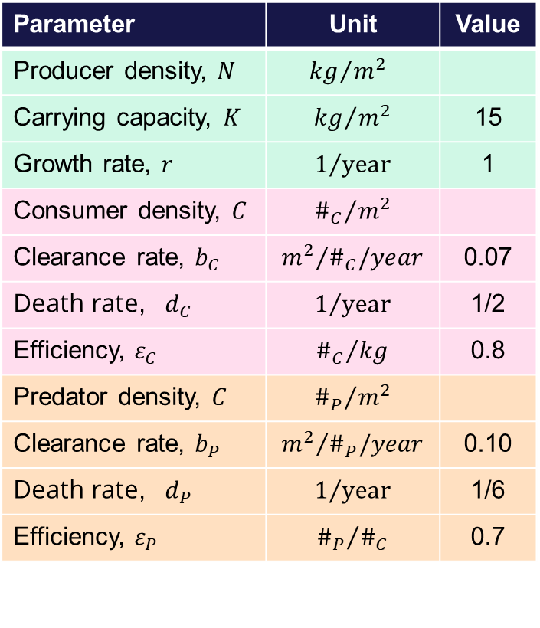
Trophic chain: model parameters
Parameter | Unit | Value
Producer density, $N$ | $${kg}/{m^{2}}$$
Carrying capacity, $K$ | $${kg}/{m^{2}}$$ | 15
Growth rate, $r$ | $$1/{year}$$ | 1
Consumer density, $C$ | $${\#_{C}}/{m^{2}}$$
Clearance rate, $b_{C}$ | $${m^{2}}/{\#_{C}/year}$$ | 0.07
Death rate, $d_{C}$ | $$1/{year}$$ | 1/2
Efficiency, $ε_{C}$ | $${\#_{C}}/{kg}$$ | 0.8
Predator density, $C$ | $${\#_{P}}/{m^{2}}$$
Clearance rate, $b_{P}$ | $${m^{2}}/{\#_{P}/year}$$ | 0.10
Death rate, $d_{P}$ | $$1/{year}$$ | 1/6
Efficiency, $ε_{P}$ | $${\#_{P}}/{\#_{C}}$$ | 0.7
PRODUCERS -Plants
CONSUMER -Beetle
PREDATOR -Lizard

Slide 3


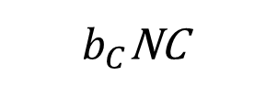
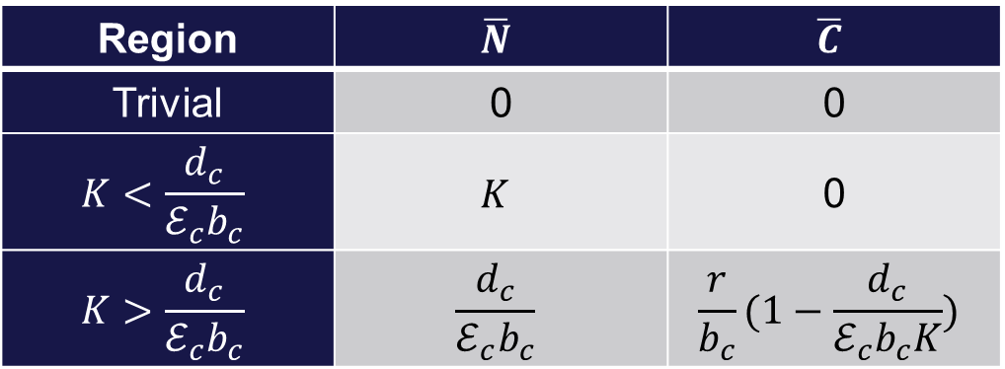
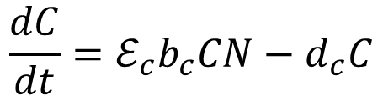
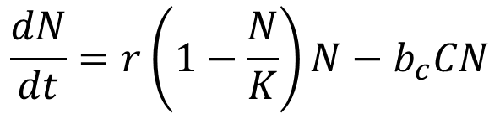
Lotka-Volterra equations: Producers-Consumers
$$\frac{dN}{dt}=r\left(1−\frac{N}{K}\right)N−b_{c}CN$$
$b_{C}$NC
N
C
times $ε_{C}$
$$d_{C}C$$
$$\frac{dC}{dt}=ℰ_{c}b_{c}CN−d_{c}C$$
r
Region | $$\overline{N}$$ | $$\overline{C}$$
Trivial | 0 | 0
$$K<\frac{d_{c}}{ℰ_{c}b_{c}}$$ | $$K$$ | 0
$$K>\frac{d_{c}}{ℰ_{c}b_{c}}$$ | $$\frac{d_{c}}{ℰ_{c}b_{c}}$$ | $$\frac{r}{b_{c}}(1−\frac{d_{c}}{ℰ_{c}b_{c}K})$$
3

Slide 4
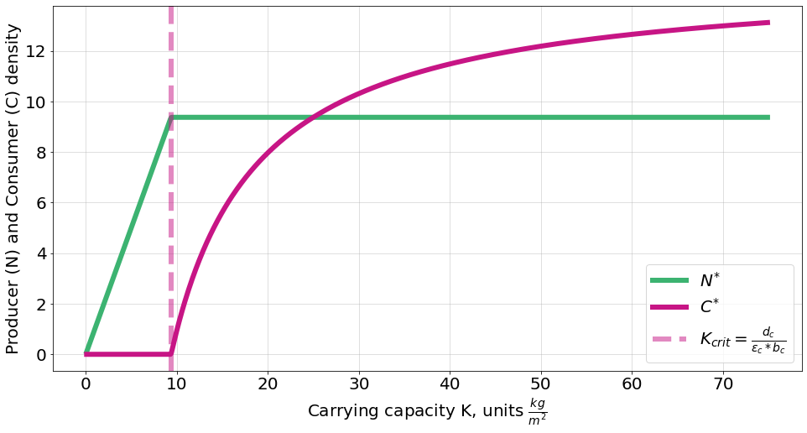
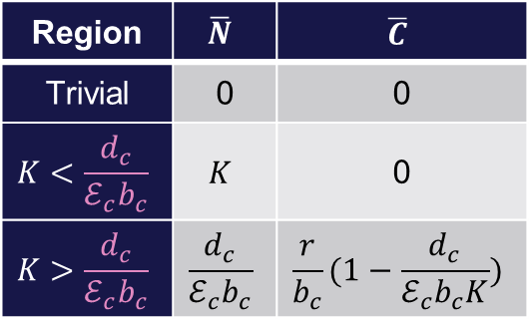


Bifurcation diagram (K): Producers-Consumers
Bottom-up
Top-down
$$\frac{dN}{dt}=r\left(1−\frac{N}{K}\right)N−b_{c}CN$$
$$\frac{dC}{dt}=ℰ_{c}b_{c}CN−d_{c}C$$
Bifurcation at critical K: 9.4
Region | $$\overline{N}$$ | $$\overline{C}$$
Trivial | 0 | 0
$$K<\frac{d_{c}}{ℰ_{c}b_{c}}$$ | $$K$$ | 0
$$K>\frac{d_{c}}{ℰ_{c}b_{c}}$$ | $$\frac{d_{c}}{ℰ_{c}b_{c}}$$ | $$\frac{r}{b_{c}}(1−\frac{d_{c}}{ℰ_{c}b_{c}K})$$
4

Slide 5
Python code
# Question 2: Making bifurcation diagram
N_star, C_star = K, 0.02 # initial N and C are very close to equilibrium, so that the computations are faster
k_list = np.arange(0.1, 75, 0.1) # make array of K values
eq_list = [] # make list to place the values of N and C when they reach equilibrium
for k in k_list:
params = (r, k, bc, epsc, dc)
state_init = np.array([N_star, C_star])
ns = odeint(deriv, state_init, t, args=params)
N, C = ns.T
N_star, C_star = N[-1], C[-1]
# assuming that all runs reached equilibrium, we save the last value of N and C as the equilibria
eq_list.append([N_star, C_star])
N_star += 0.1
# Then we pertrub a bit, because if we start from the exact equilibrium, the simulation gets stuck
C_star += 0.1
N_eq, C_eq = np.array(eq_list).T # Put the list of equilibria in an array, and transpose
fig, ax = plt.subplots(figsize=(16,8))
ax.plot(k_list, N_eq, label="$N^{*}$", color = 'mediumseagreen')
ax.plot(k_list, C_eq, label="$C^{*}$", color = 'mediumvioletred')
ax.set_xlabel("Carrying capacity K, units $\\frac{kg}{m^{2}}$")
ax.set_ylabel("Producer (N) and Consumer (C) density")
ax.axvline(K_crit, alpha=0.5, linestyle="--", color='mediumvioletred', label="$K_{crit} = \\frac{d_{c}}{\\varepsilon_{c}*b_{c}}$")
ax.legend()
ax.grid(alpha = 0.5)
# Import stuff:
from scipy.integrate import odeint
import matplotlib.pyplot as plt
import numpy as np
from sympy import Symbol
from sympy.solvers import solve
fs_label = 20
parameters = {
'figure.titlesize': fs_label+6,
'axes.labelsize': fs_label,
'axes.titlesize': fs_label+4,
'xtick.labelsize': fs_label,
'ytick.labelsize': fs_label,
'legend.fontsize': fs_label,
'lines.linewidth': 6,
}
plt.rcParams.update(parameters)
# Question 1.
t = np.linspace(0, 1000, 10000)
# we run it for so long bc we want to be sure the system reaches equilibrium
r = 1 # Growth rate of producers. Dimension: 1/t, Unit: 1/year
K = 15 # Carrying capacity of producers. Dimension: weight/area, Unit: kg/sqm
bc = 1/15 # Clearance rate of consumers. Dimension: area/time/consumer, Unit: sqm/year/#consumers
dc = 1/2 # Death rate of consumers. Dimension: 1/t, Unit: 1/year
epsc = 0.8 # Efficiency of consumption. Dimension: consumers/producers, Unit: #consumers/kg
def deriv(state, t, *params):
N, C = state
r, K, bc, epsc, dc = params
dNdt = r*(1-N/K)*N - bc*C*N
dCdt = epsc*bc*C*N - dc*C
return np.array([dNdt, dCdt])
5

Slide 6


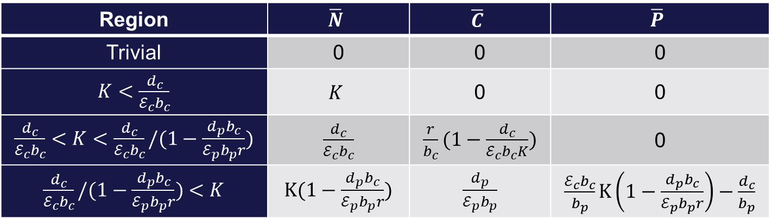



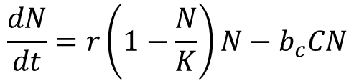
Lotka-Volterra equations: Producers-Consumers-Predators
$$\frac{dN}{dt}=r\left(1−\frac{N}{K}\right)N−b_{c}CN$$
$b_{C}$NC
$b_{P}$CP
N
C
P
times $ε_{C}$
times $ε_{P}$
$$\frac{dC}{dt}=ℰ_{c}b_{c}CN−d_{c}C−b_{p}CP$$
$$d_{C}C$$
$$d_{P}P$$
r
$$\frac{dP}{dt}=ℰ_{p}b_{p}CP−d_{p}P$$
Region | $$\overline{N}$$ | $$\overline{C}$$ | $$\overline{P}$$
Trivial | 0 | 0 | 0
$K<\frac{d_{c}}{ℰ_{c}b_{c}}$ | $$K$$ | 0 | 0
$\frac{d_{c}}{ℰ_{c}b_{c}}<K<\frac{d_{c}}{ℰ_{c}b_{c}}/(1−\frac{d_{p}b_{c}}{ℰ_{p}b_{p}r})$ | $\frac{d_{c}}{ℰ_{c}b_{c}}$ | $\frac{r}{b_{c}}(1−\frac{d_{c}}{ℰ_{c}b_{c}K})$ | 0
$\frac{d_{c}}{ℰ_{c}b_{c}}/(1−\frac{d_{p}b_{c}}{ℰ_{p}b_{p}r})$ $<K$ | $K(1−\frac{d_{p}b_{c}}{ℰ_{p}b_{p}r})$ | $\frac{d_{p}}{ℰ_{p}b_{p}}$ | $\frac{ℰ_{c}b_{c}}{b_{p}}K\left(1−\frac{d_{p}b_{c}}{ℰ_{p}b_{p}r}\right)−\frac{d_{c}}{b_{p}}$
6

Slide 7
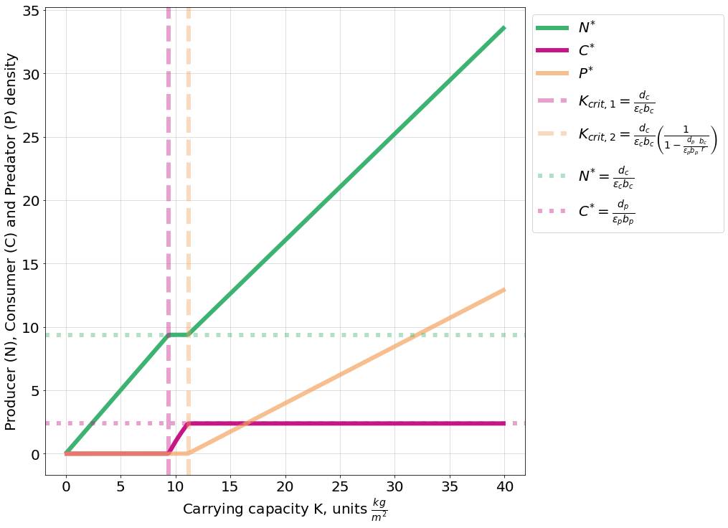
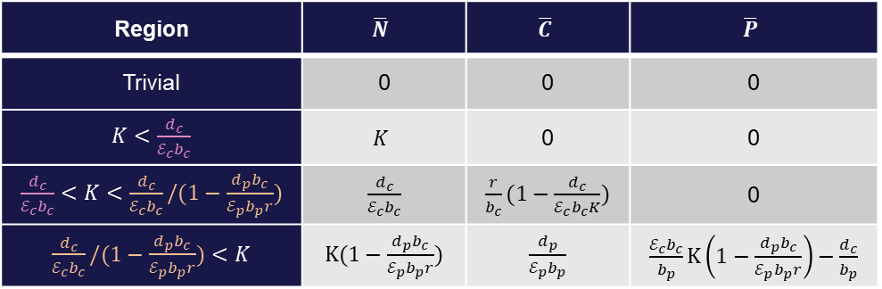
Bifurcation diagram (K): Producers-Consumers-Predators
Top-down from predators
Bottom-up
Top-down from consumers
1st bifurcation at critical K: 9.4
2nd bifurcation at critical K: 11.2
Region | $$\overline{N}$$ | $$\overline{C}$$ | $$\overline{P}$$
Trivial | 0 | 0 | 0
$K<\frac{d_{c}}{ℰ_{c}b_{c}}$ | $$K$$ | 0 | 0
$\frac{d_{c}}{ℰ_{c}b_{c}}<K<\frac{d_{c}}{ℰ_{c}b_{c}}/(1−\frac{d_{p}b_{c}}{ℰ_{p}b_{p}r})$ | $\frac{d_{c}}{ℰ_{c}b_{c}}$ | $\frac{r}{b_{c}}(1−\frac{d_{c}}{ℰ_{c}b_{c}K})$ | 0
$\frac{d_{c}}{ℰ_{c}b_{c}}/(1−\frac{d_{p}b_{c}}{ℰ_{p}b_{p}r})$ $<K$ | $K(1−\frac{d_{p}b_{c}}{ℰ_{p}b_{p}r})$ | $\frac{d_{p}}{ℰ_{p}b_{p}}$ | $\frac{ℰ_{c}b_{c}}{b_{p}}K\left(1−\frac{d_{p}b_{c}}{ℰ_{p}b_{p}r}\right)−\frac{d_{c}}{b_{p}}$
7

Slide 8
Python code
r_krit = (bc*dp)/(epsp*bp)
K_crit1 = dc/(epsc*bc)
K_crit2 = (dc/(epsc*bc))/(1-C_star*bc/r)
C_crit = dp/(epsp*bp)
N_crit = K_crit1
fig, ax = plt.subplots(figsize=(12,12))
ax.plot(k_list, N_eq, label="$N^{*}$", color = 'mediumseagreen')
ax.plot(k_list, C_eq, label="$C^{*}$", color = 'mediumvioletred')
ax.plot(k_list, P_eq, label="$P^{*}$", color = 'sandybrown', alpha = 0.7)
crit_line_style = {"alpha":0.4, "linestyle":"--"}
ax.axvline(K_crit1, **crit_line_style, color='mediumvioletred',
label="$K_{crit, 1} = \\frac{d_{c}}{\\varepsilon_{c} b_{c}}$")
ax.axvline(K_crit2, **crit_line_style, color='sandybrown',
label="$K_{crit, 2} = \\frac{d_{c}}{\\varepsilon_{c} b_{c}} \\left( \\frac{1}{1-\\frac{d_{p}}{\\varepsilon_{p} b_{p}} \\frac{b_{c}}{r}} \\right)$")
crit_line_style = {"alpha":0.4, "linestyle":":"}
ax.axhline(N_crit, **crit_line_style, color = 'mediumseagreen',
label="$N^{*} = \\frac{d_{c}}{\\varepsilon_{c} b_{c}}$")
ax.axhline(C_crit, **crit_line_style, color = 'mediumvioletred',
label="$C^{*} = \\frac{d_{p}}{\\varepsilon_{p} b_{p}}$")
ax.legend(bbox_to_anchor=(1,1))
ax.grid(alpha = 0.5)
ax.set_xlabel("Carrying capacity K, units $\\frac{kg}{m^{2}}$")
ax.set_ylabel("Producer (N), Consumer (C) and Predator (P) density")
# Question 3: Add a predator
t = np.linspace(0, 1000, 10000)
r = 1 # Growth rate of producers. Dimension: 1/t, Unit: 1/year
K = 15 # Carrying capacity of producers. Dimension: weight/area, Unit: kg/sqm
bc = 1/15 # Clearance rate of consumers. Dimension: area/time/consumer, Unit: sqm/year/#consumers
dc = 1/2 # Death rate of consumers. Dimension: 1/t, Unit: 1/year
epsc = 0.8 # Efficiency of consumption. Dimension: consumers/producers, Unit: #consumers/kg
bp = 1/10 # Clearance rate of predators. Dimension: area/time/predator, Unit: sqm/year/#predators
dp = 1/6 # Death rate of consumers. Dimension: 1/t, Unit: 1/year
epsp = 0.7 # Efficiency of consumption. Dimension: predators/consumers, Unit: #predators/#consumers
def deriv_predator(state, t, *params):
N, C, P = state
r, K, bc, epsc, dc, bp, epsp, dp = params
dNdt = r*(1-N/K)*N - bc*C*N
dCdt = epsc*bc*C*N - dc*C - bp*C*P
dPdt = epsp*bp*C*P - dp*P
return np.array([dNdt, dCdt, dPdt])
N_star, C_star, P_star = K, 0.01, 0.01
k_list = np.arange(0.1, 40, 0.1)
eq_list = []
for k in k_list:
params = (r, k, bc, epsc, dc, bp, epsp, dp)
state_init = np.array([N_star, C_star, P_star])
ns = odeint(deriv_predator, state_init, t, args=params)
N, C, P = ns.T
N_star, C_star, P_star = N[-1], C[-1], P[-1]
eq_list.append([N_star, C_star, P_star])
N_star += 0.1
C_star += 0.1
P_star += 0.1
N_eq, C_eq, P_eq = np.array(eq_list).T
8

Slide 9
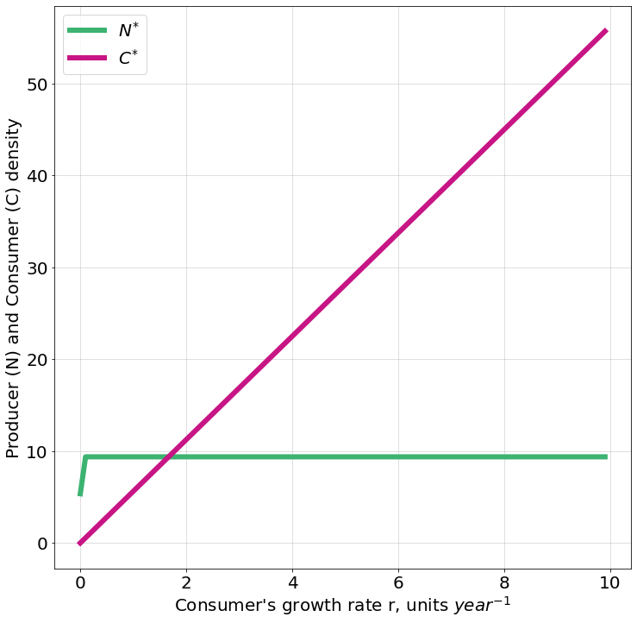

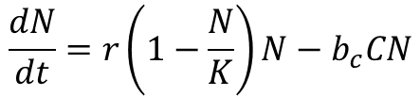
Bifurcation diagram (r): Producers-Consumers
K = 15
$$\frac{dN}{dt}=r\left(1−\frac{N}{K}\right)N−b_{c}CN$$
$$\frac{dC}{dt}=ℰ_{c}b_{c}CN−d_{c}C$$
Consumers can eat more and more as the growth rate of producers increases
After r=0.2, the producers are limited by their carrying capacity
9

Slide 10
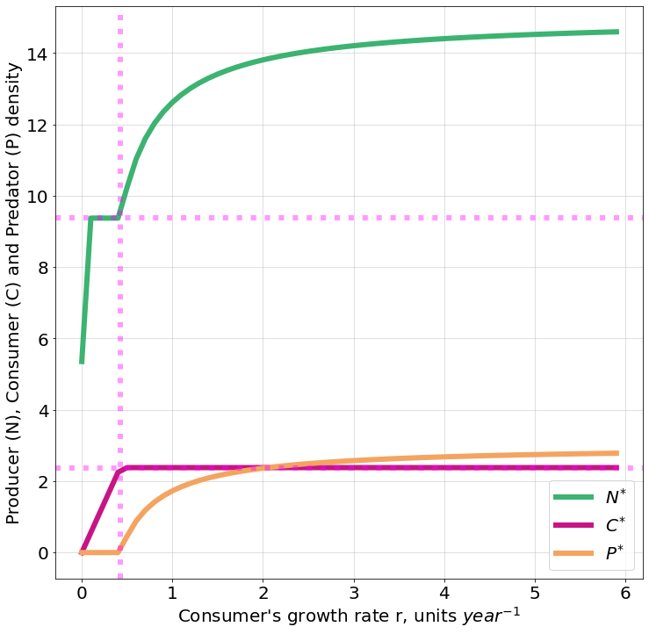

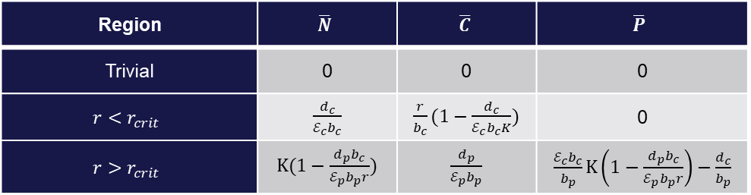
Bifurcation diagram (r): Producers-Consumers-Predators
Critical r = 0.4
Top-down from predators
K = 15
After critical r, the producers grow until limited by their carrying capacity
$N_{crit}=\frac{d_{c}}{ℰ_{c}b_{c}}$, $C_{crit}=\frac{d_{p}}{ℰ_{p}b_{p}}$, $r_{crit}=$ ${C_{crit}b}_{c}/(1−\frac{N_{crit}}{K})$
Region | $$\overline{N}$$ | $$\overline{C}$$ | $$\overline{P}$$
Trivial | 0 | 0 | 0
$$r<r_{crit}$$ | $\frac{d_{c}}{ℰ_{c}b_{c}}$ | $\frac{r}{b_{c}}(1−\frac{d_{c}}{ℰ_{c}b_{c}K})$ | 0
$$r>r_{crit}$$ | $K(1−\frac{d_{p}b_{c}}{ℰ_{p}b_{p}r})$ | $\frac{d_{p}}{ℰ_{p}b_{p}}$ | $\frac{ℰ_{c}b_{c}}{b_{p}}K\left(1−\frac{d_{p}b_{c}}{ℰ_{p}b_{p}r}\right)−\frac{d_{c}}{b_{p}}$
After critical r, the consumers are limited by the predators
10

Slide 11
Python code
#Producer-Consumer-Predator
N_star, C_star, P_star = K, 0.01, 0.01
r_list_predator = np.arange(0.0, 6, 0.1)
r_eq_list_predator = []
for r_tmp in r_list_predator:
params = (r_tmp, K, bc, epsc, dc, bp, epsp, dp)
state_init = np.array([N_star, C_star, P_star])
ns = odeint(deriv_predator, state_init, t, args=params)
N, C, P = ns.T
N_star, C_star, P_star = N[-1], C[-1], P[-1]
r_eq_list_predator.append([N_star, C_star, P_star])
N_star += 0.1
C_star += 0.1
P_star += 0.1
N_eq, C_eq, P_eq = np.array(r_eq_list_predator).T
r_crit1 = bc/(1-N_crit/K)*C_crit
C_crit = dp/(epsp*bp)
N_crit = dc/(epsc*bc)
fig, ax = plt.subplots(figsize=(12,12))
ax.plot(r_list_predator, N_eq, label="$N^{*}$", color = 'mediumseagreen')
ax.plot(r_list_predator, C_eq, label="$C^{*}$", color='mediumvioletred')
ax.plot(r_list_predator, P_eq, label="$P^{*}$", color = 'sandybrown')
#ax.plot(r_list_predator[:50], r_list_predator[:50]*C_crit2, label="$P^{*}$", alpha=0.5, linestyle=":")
ax.axvline(r_crit1, **crit_line_style, color="magenta")
ax.axhline(C_crit, **crit_line_style, color="magenta")
ax.axhline(N_crit, **crit_line_style, color="magenta")
ax.legend()
ax.grid(alpha = 0.5)
ax.set_xlabel("Consumer's growth rate r, units ${year^{-1}}$")
ax.set_ylabel("Producer (N), Consumer (C) and Predator (P) density")
# Question 4: Bifurcation along another parameter
# Producer-consumer
N_star, C_star = K, 0.01
r_list = np.arange(0.0, 10, 0.1)
r_eq_list = []
for r_tmp in r_list:
params = (r_tmp, K, bc, epsc, dc)
state_init = np.array([N_star, C_star])
ns = odeint(deriv, state_init, t, args=params)
N, C = ns.T
N_star, C_star = N[-1], C[-1]
r_eq_list.append([N_star, C_star])
N_star += 0.1
C_star += 0.1
N_eq, C_eq = np.array(r_eq_list).T
fig, ax = plt.subplots(figsize=(12,12))
ax.plot(r_list, N_eq, label="$N^{*}$", color = 'mediumseagreen')
ax.plot(r_list, C_eq, label="$C^{*}$", color='mediumvioletred')
ax.legend()
ax.set_xlabel("Consumer's growth rate r, units ${year^{-1}}$")
ax.set_ylabel("Producer (N) and Consumer (C) density")
ax.grid(alpha = 0.5)
11

