Slide 3
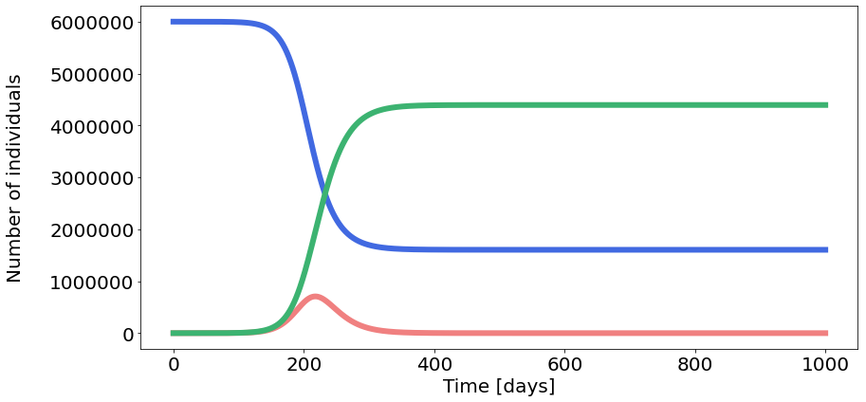
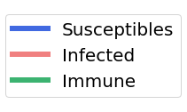




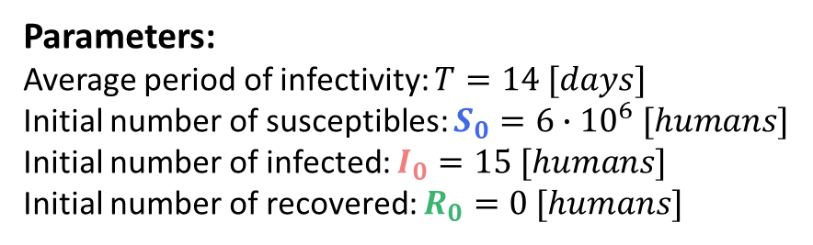
Parameters:
Average period of infectivity: $T=14 [days]$
Initial number of susceptibles: $S_{0}=6∙{10}^{6} [humans]$
Initial number of infected: $I_{0}=15 [humans]$
Initial number of recovered: $R_{0}=0 [humans]$
Total population: $N=S_{0}+$ $I_{0}$ + $R_{0}$
Intrinsic reproductive number: $Q_{0}=1.8 [humans]$
Recovery rate: $v=1/T=1/{14}≈0.07 [1/{days}]$
Transmission rate: $β={Q_{0}∙ν}/{N≈2.1∙{10}^{−8}}[1/{days}]$
Duration of simulation: $t_{max}=1000 [days]$
a.
$$\frac{dS}{dt}=−βIS$$
$$\frac{dI}{dt}=βIS −vI$$
$$\frac{dR}{dt}=vI$$
Appropriate font size

Slide 4
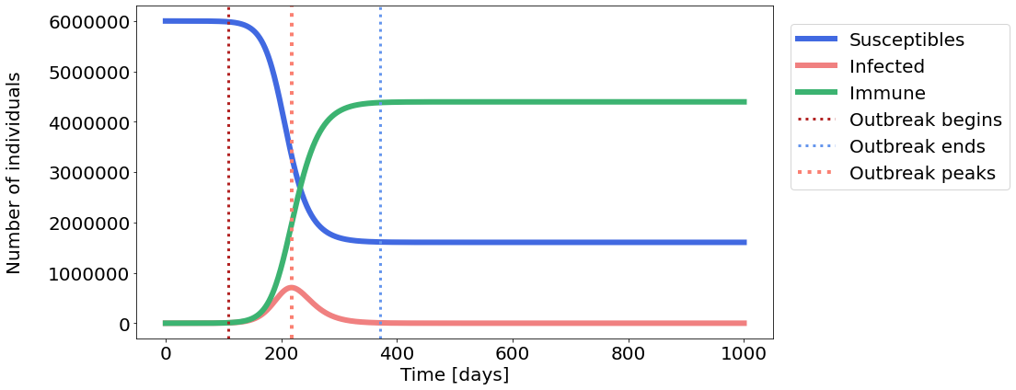
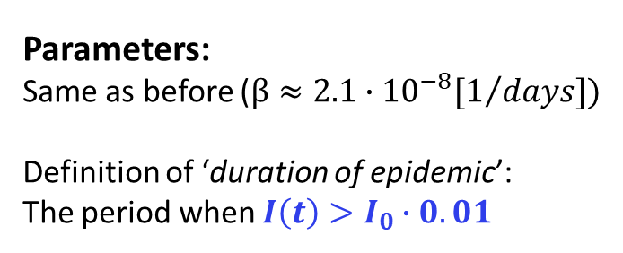




Parameters:
Same as before ($β≈2.1∙{10}^{−8}[1/{days}])$
Definition of ‘duration of epidemic’:
The period when $I\left(t\right)>I_{0}∙0.01$
Results:
Epidemic lasted: $263 days$
Epidemic peaked at: $day 218 ,$with $I_{max}=707359$
Avoided getting sick: $26.76\%$of Danish population
b.
$$\frac{dS}{dt}=−βIS$$
$$\frac{dR}{dt}=vI$$
$$\frac{dI}{dt}=βIS −vI$$
Appropriate font size

Slide 5
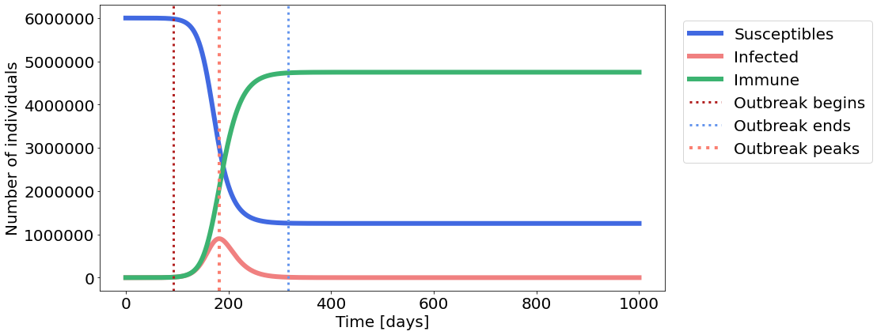
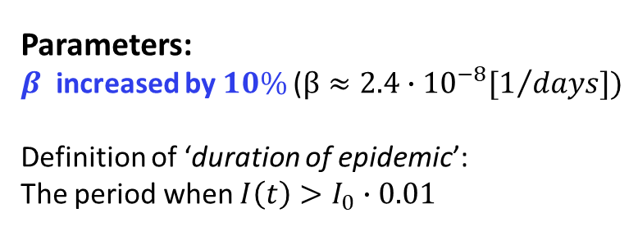
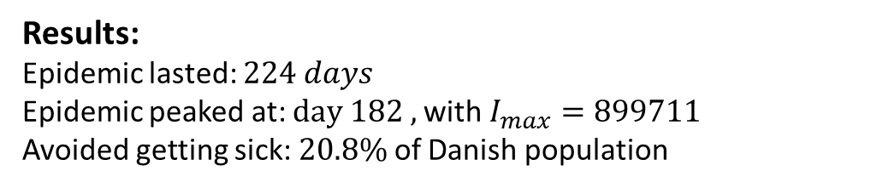
less!
earlier!
Parameters:
$β$ increased by $10\%$($β≈2.4∙{10}^{−8}[1/{days}])$
Definition of ‘duration of epidemic’:
The period when $I\left(t\right)>I_{0}∙0.01$
Results:
Epidemic lasted: $224 days$
Epidemic peaked at: $day 182 ,$with $I_{max}=899711$
Avoided getting sick: $20.8\%$of Danish population
b.
less!
$$\frac{dS}{dt}=−βIS$$
$$\frac{dR}{dt}=vI$$
$$\frac{dI}{dt}=βIS −vI$$
Appropriate font size

Slide 6
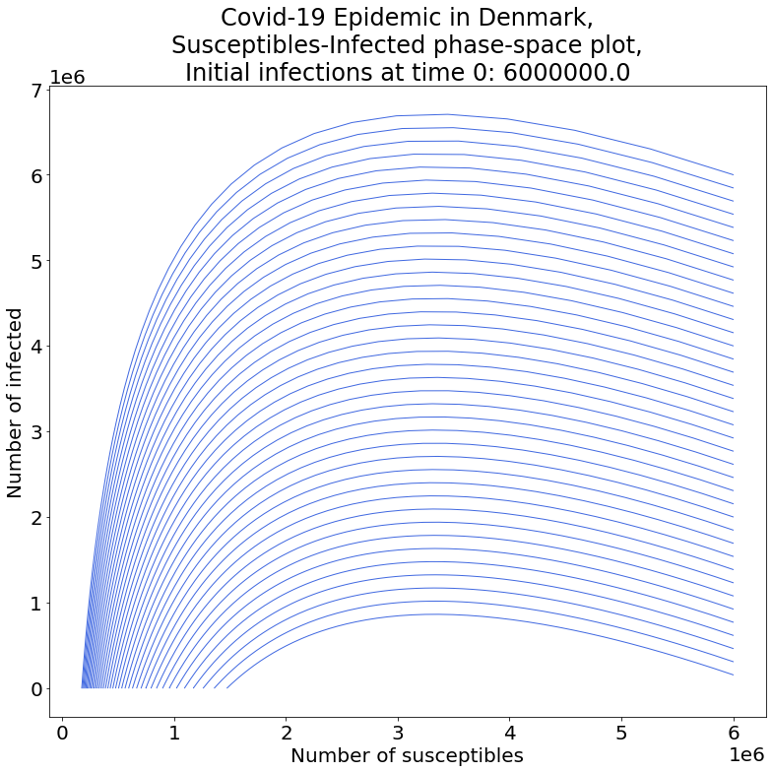
less!
earlier!
Parameters:
$β$ increased by $10\%$($β≈2.4∙{10}^{−8}[1/{days}])$
Definition of ‘duration of epidemic’:
The period when $I\left(t\right)>I_{0}∙0.01$
Results:
Epidemic lasted: $224 days$
Epidemic peaked at: $day 182 ,$with $I_{max}=899711$
Avoided getting sick: $20.8\%$of Danish population
c.
less!
I have to rerun the code!
$$\frac{dS}{dt}=−βIS$$
$$\frac{dR}{dt}=vI$$
$$\frac{dI}{dt}=βIS −vI$$
Appropriate font size

Slide 7
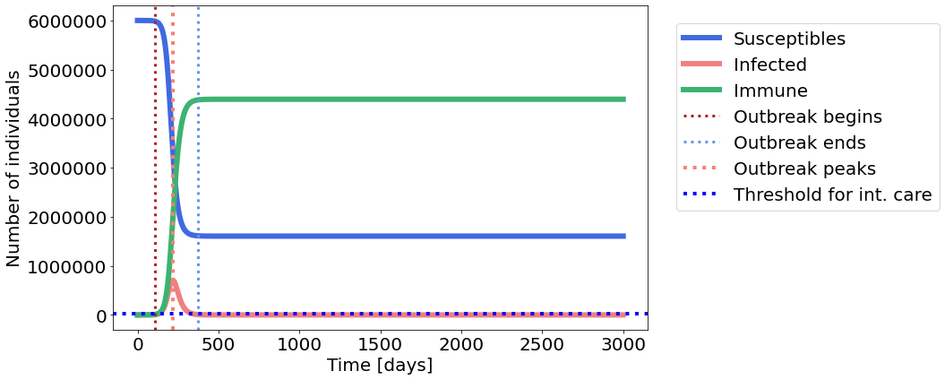
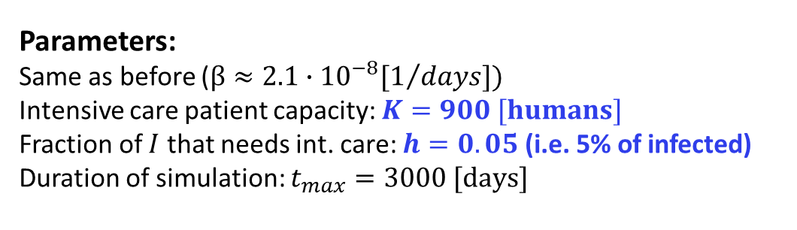




Parameters:
Same as before ($β≈2.1∙{10}^{−8}[1/{days}])$
Intensive care patient capacity: $K=900 [humans]$
Fraction of $I$ that needs int. care: $h=0.05$ (i.e. 5% of infected)
Duration of simulation: $t_{max}=3000 [days]$
Results:
With the initial conditions, not all critically ill patients can get admitted to intensive care at the peak of the epidemic ($I_{cr}=35368$).
d.
$$\frac{dS}{dt}=−βIS$$
$$\frac{dR}{dt}=vI$$
$$\frac{dI}{dt}=βIS −vI$$
Appropriate font size

Slide 8
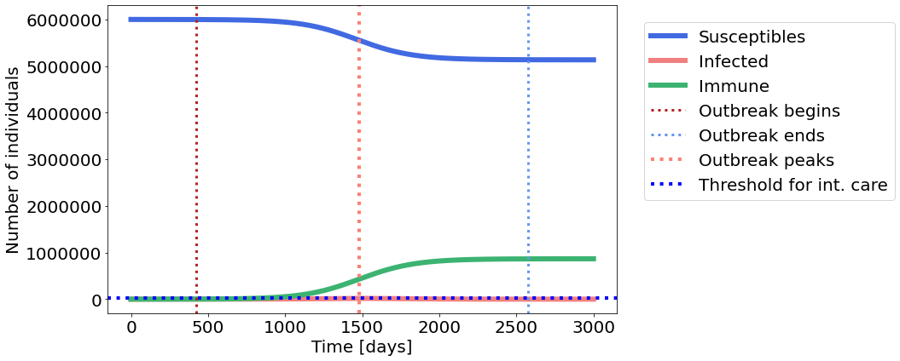

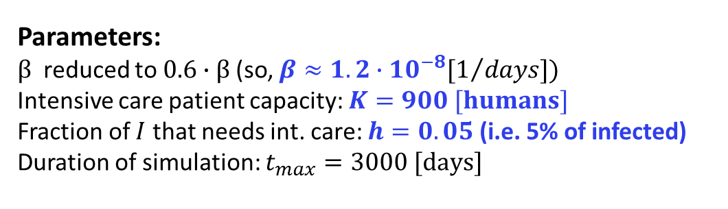
Parameters:
$β$ reduced to $0.6∙β$(so, $β≈1.2∙{10}^{−8}[1/{days}])$
Intensive care patient capacity: $K=900 [humans]$
Fraction of $I$ that needs int. care: $h=0.05$ (i.e. 5% of infected)
Duration of simulation: $t_{max}=3000 [days]$
Results:
With the new $β$, all critically ill patients can get admitted to intensive care at the peak of the epidemic ($I_{cr}=844$).
d.
Considerations:
1.
2.
3.
Appropriate font size

Slide 9
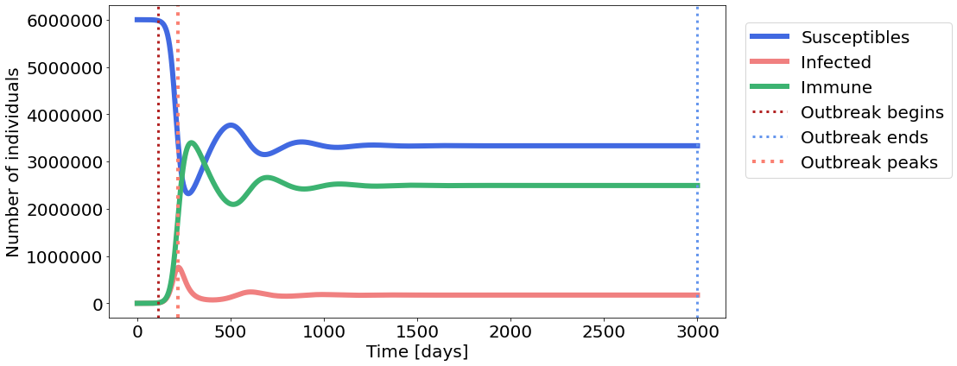



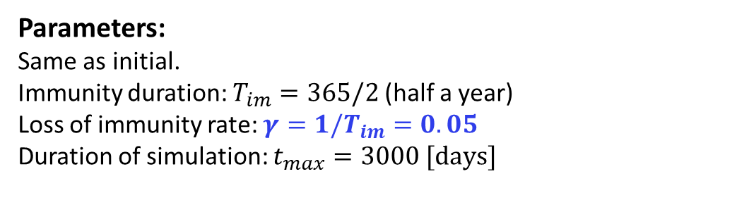
Parameters:
Same as initial.
Immunity duration: $T_{im}=365/2$ (half a year)
Loss of immunity rate: $γ=1/T_{im}=0.05$
Duration of simulation: $t_{max}=3000 [days]$
Results:
With
e.
$$\frac{dS}{dt}=−βIS+γR$$
$$\frac{dR}{dt}=vI−γR$$
$$\frac{dI}{dt}=βIS −vI$$
Appropriate font size

