Slide 1
Covid-19 epidemic by SIR models
Group: Amalia Bogri, Christian Berrig & Jonas Bolduan

Slide 2
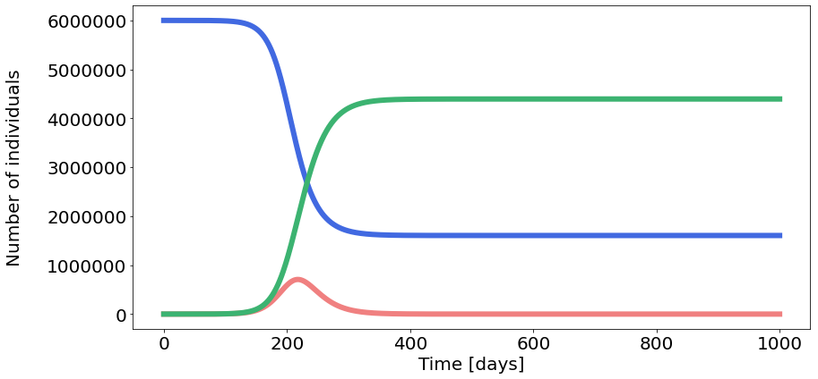
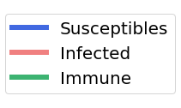




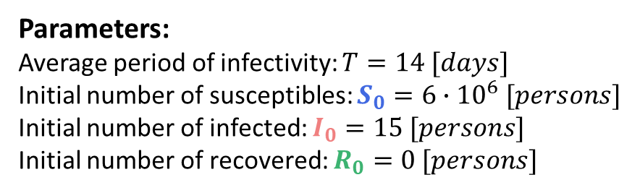
Parameters:
Average period of infectivity: $T=14 [days]$
Initial number of susceptibles: $S_{0}=6∙{10}^{6} [persons]$
Initial number of infected: $I_{0}=15 [persons]$
Initial number of recovered: $R_{0}=0 [persons]$
Total population: $N=S_{0}+$ $I_{0}$ + $R_{0}$
Intrinsic reproductive number: $Q_{0}=1.8 [persons]$
Recovery rate: $v=1/T=1/{14}≈0.07 [1/{days}]$
Transmission rate: $β={Q_{0}∙ν}/{N≈2.1∙{10}^{−8}}[1/{days}]$
Duration of simulation: $t_{max}=1000 [days]$
a.
$$\frac{dS}{dt}=−βIS$$
$$\frac{dI}{dt}=βIS −vI$$
$$\frac{dR}{dt}=vI$$

Slide 3
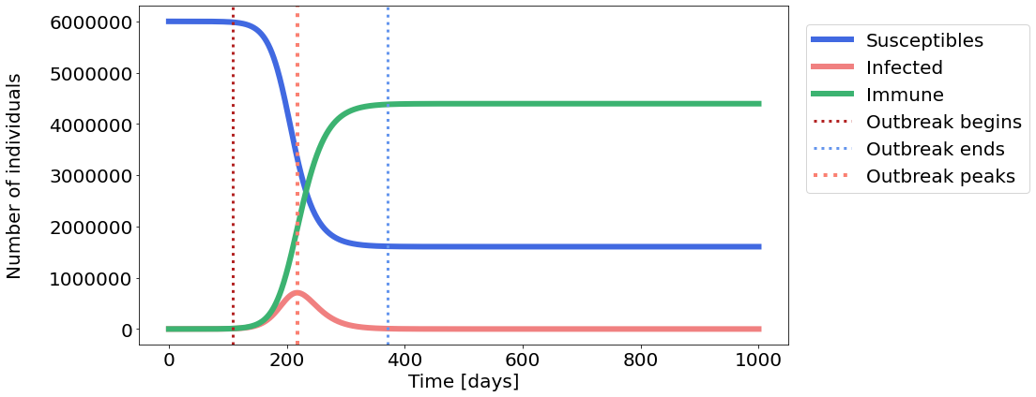
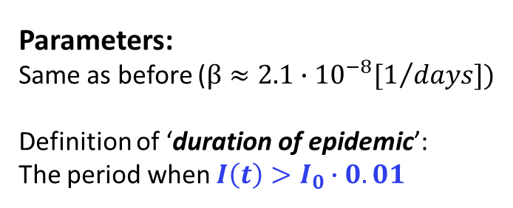



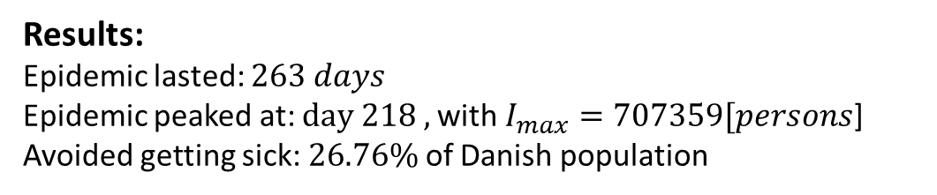
Parameters:
Same as before ($β≈2.1∙{10}^{−8}[1/{days}])$
Definition of ‘duration of epidemic’:
The period when $I\left(t\right)>I_{0}∙0.01$
Results:
Epidemic lasted: $263 days$
Epidemic peaked at: $day 218 ,$with $I_{max}=707359[persons$]
Avoided getting sick: $26.76\%$of Danish population
b.
$$\frac{dS}{dt}=−βIS$$
$$\frac{dR}{dt}=vI$$
$$\frac{dI}{dt}=βIS −vI$$

Slide 4
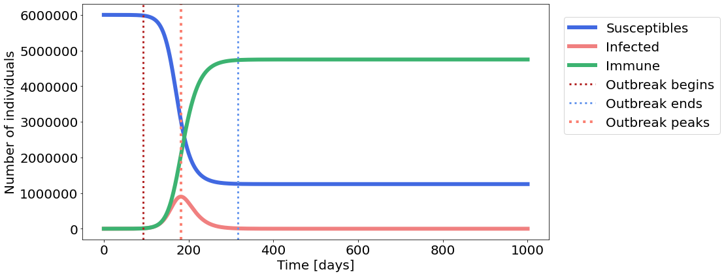
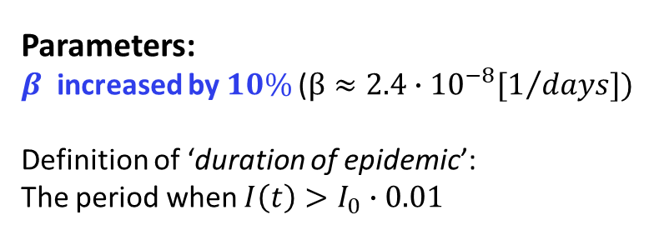
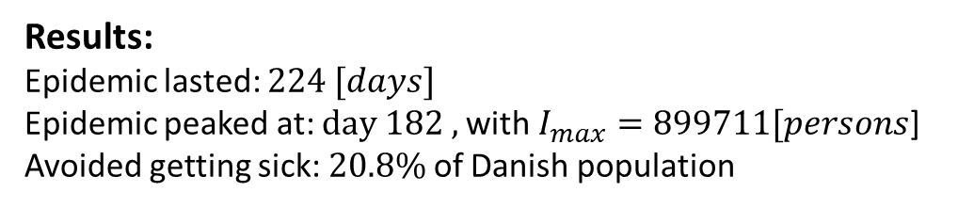
less!
earlier!
Parameters:
$β$ increased by $10\%$($β≈2.4∙{10}^{−8}[1/{days}])$
Definition of ‘duration of epidemic’:
The period when $I\left(t\right)>I_{0}∙0.01$
Results:
Epidemic lasted: $224 [days]$
Epidemic peaked at: $day 182 ,$with $I_{max}=899711[persons$]
Avoided getting sick: $20.8\%$of Danish population
b.
More got sick
$$\frac{dS}{dt}=−βIS$$
$$\frac{dR}{dt}=vI$$
$$\frac{dI}{dt}=βIS −vI$$

Slide 5
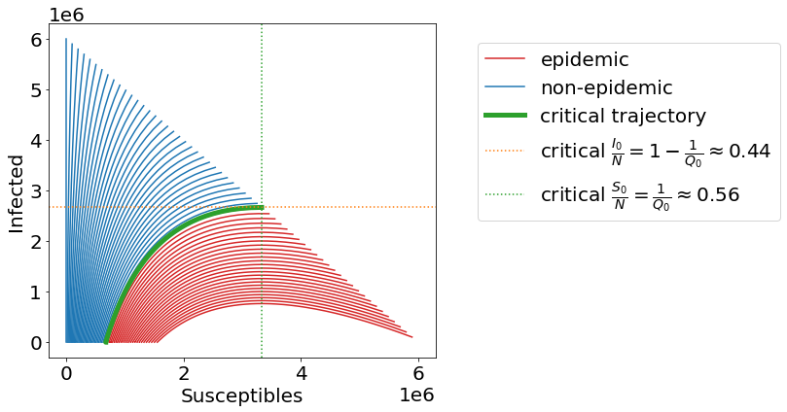

Parameters:
$$I_{0}∈[0, 6∙{10}^{6}]$$
Herd immunity at:$p=1−1/{Q0}≈0.44$
Critical for immunity $I_{0}=\left(1−1/{Q0}\right)∙N=2640000 [persons]$
c.
$$\frac{dS}{dt}=−βIS$$
$$\frac{dR}{dt}=vI$$
$$\frac{dI}{dt}=βIS −vI$$

Slide 6
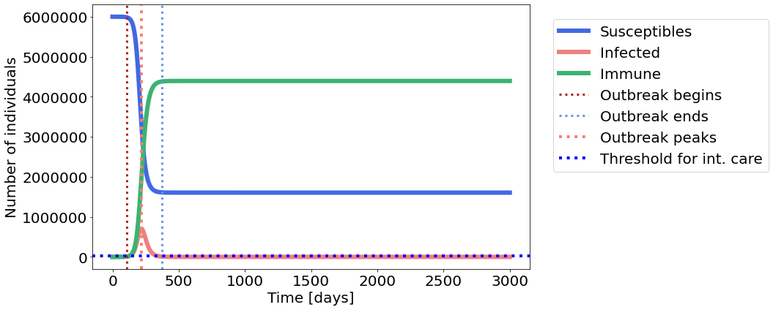
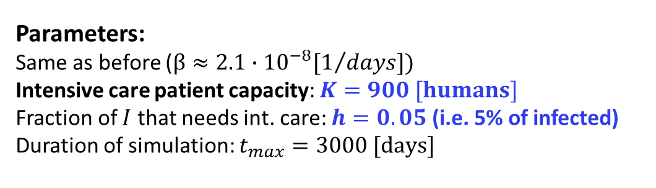



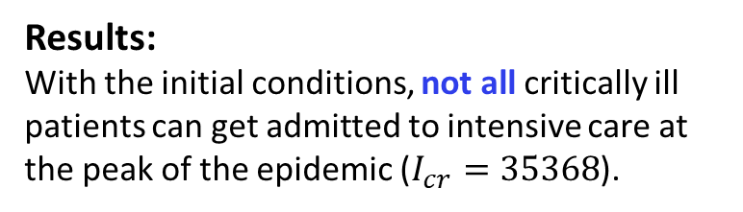
Parameters:
Same as before ($β≈2.1∙{10}^{−8}[1/{days}])$
Intensive care patient capacity: $K=900 [humans]$
Fraction of $I$ that needs int. care: $h=0.05$ (i.e. 5% of infected)
Duration of simulation: $t_{max}=3000 [days]$
Results:
With the initial conditions, not all critically ill patients can get admitted to intensive care at the peak of the epidemic ($I_{cr}=35368$).
d.
$$\frac{dS}{dt}=−βIS$$
$$\frac{dR}{dt}=vI$$
$$\frac{dI}{dt}=βIS −vI$$

Slide 7
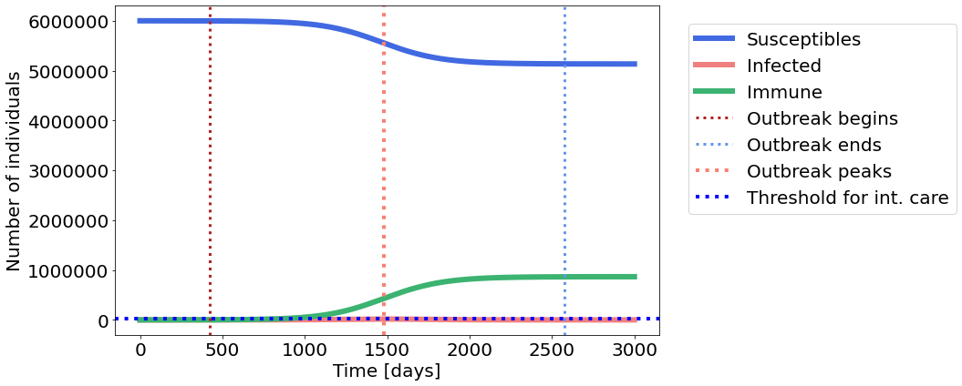
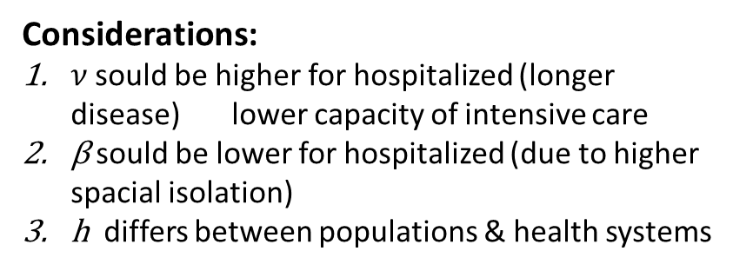
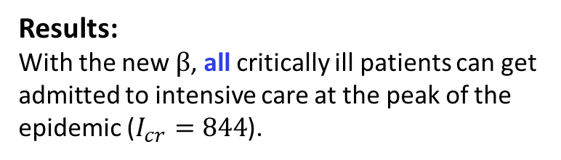
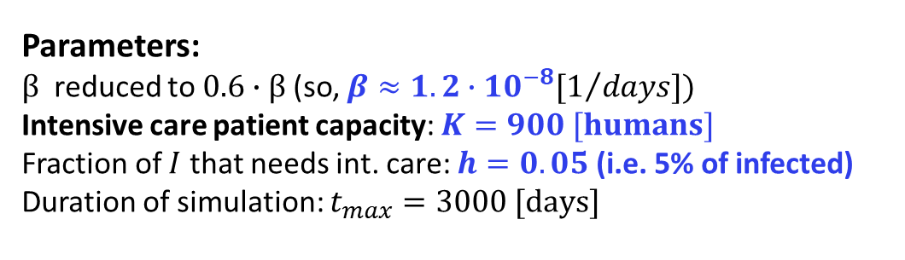
Parameters:
$β$ reduced to $0.6∙β$(so, $β≈1.2∙{10}^{−8}[1/{days}])$
Intensive care patient capacity: $K=900 [humans]$
Fraction of $I$ that needs int. care: $h=0.05$ (i.e. 5% of infected)
Duration of simulation: $t_{max}=3000 [days]$
Results:
With the new $β$, all critically ill patients can get admitted to intensive care at the peak of the epidemic ($I_{cr}=844$).
d.
Considerations:
$ν$sould be higher for hospitalized (longer disease) lower capacity of intensive care
β sould be lower for hospitalized (due to higher spacial isolation)
h differs between populations & health systems
Notes:
We could have made a 4th compartment for our hospitalized I, but we thought this is outside the scope.

Slide 8
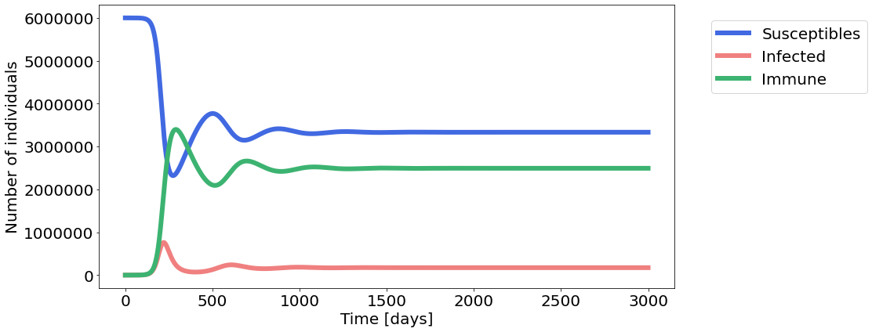
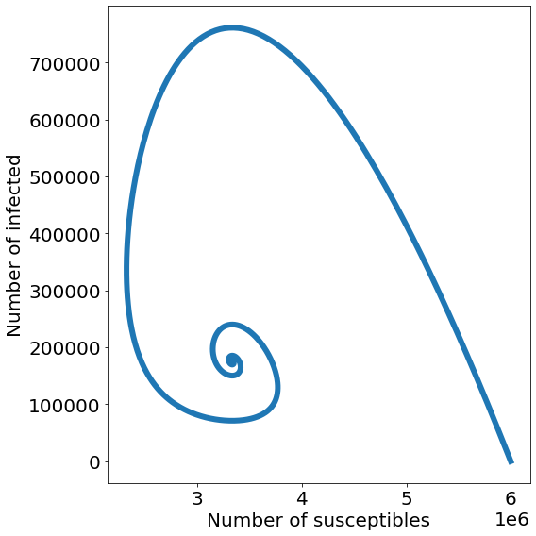


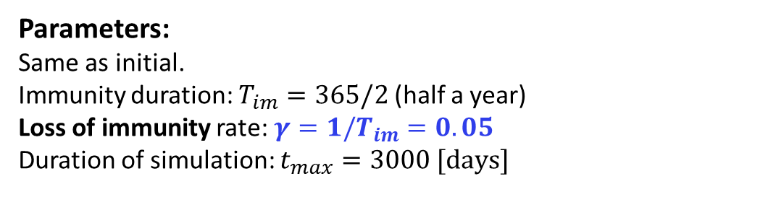

Parameters:
Same as initial.
Immunity duration: $T_{im}=365/2$ (half a year)
Loss of immunity rate: $γ=1/T_{im}=0.05$
Duration of simulation: $t_{max}=3000 [days]$
e.
$$\frac{dS}{dt}=−βIS+γR$$
$$\frac{dI}{dt}=βIS −vI$$
$$\frac{dR}{dt}=vI−γR$$

Slide 9
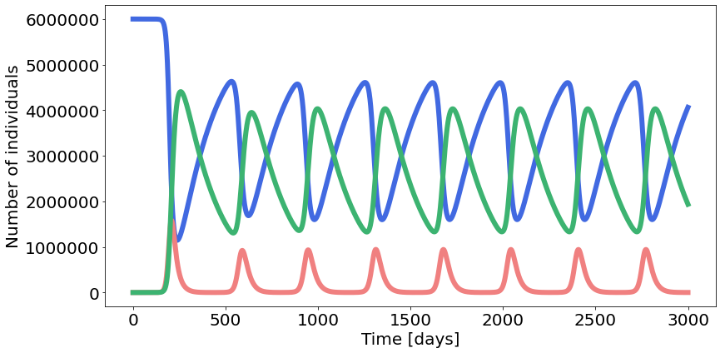
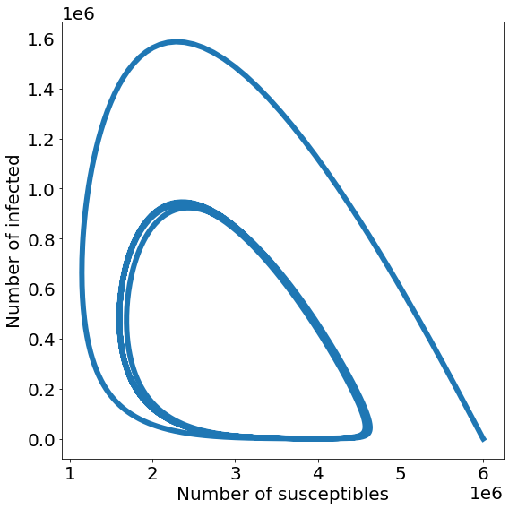


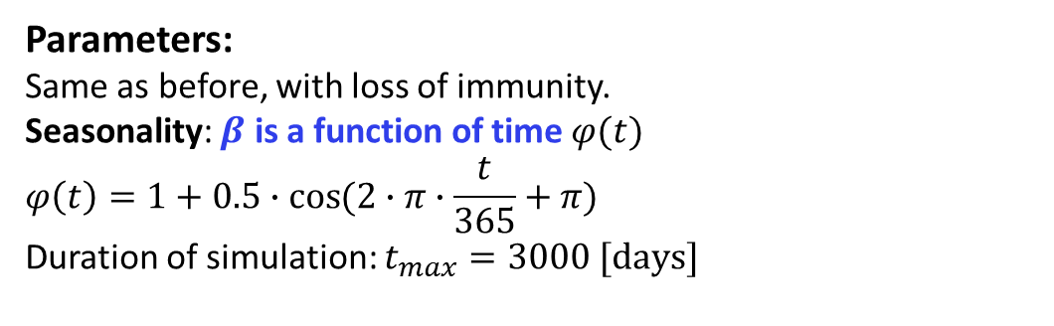
Parameters:
Same as before, with loss of immunity.
Seasonality: $β$ is a function of time $φ(t)$
$$φ\left(t\right)=1+0.5∙\cos{(2∙π∙\frac{t}{365}+π)}$$
Duration of simulation: $t_{max}=3000 [days]$
f.
$$\frac{dS}{dt}=−(βφ)IS+γR$$
$$\frac{dI}{dt}=(βφ)IS −vI$$
$$\frac{dR}{dt}=vI−γR$$

Slide 10
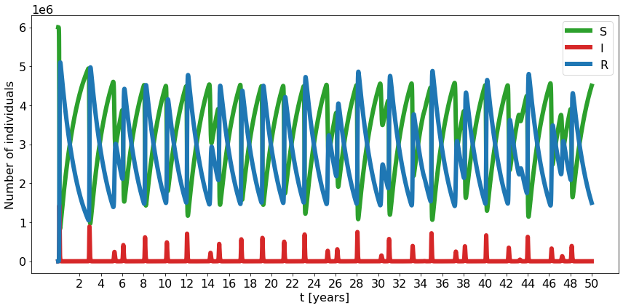
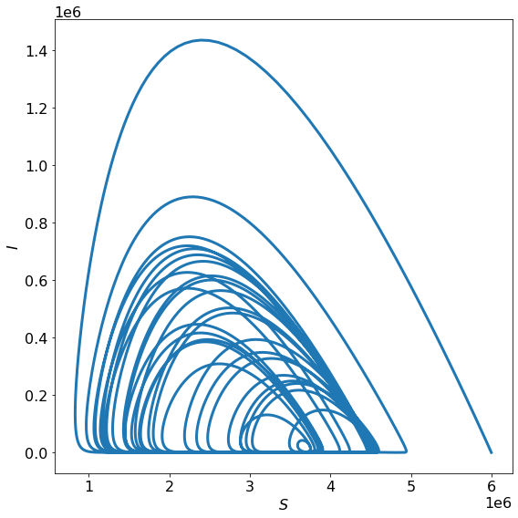
Interesting case of seasonality:
With a (very) different set of initial parameters, we observed chaotic behaviour, and a strange attractor behaviour in the phase plane.
f.
$$\frac{dS}{dt}=−(βφ)IS+γR$$
$$\frac{dI}{dt}=(βφ)IS −vI$$
$$\frac{dR}{dt}=vI−γR$$

Slide 11
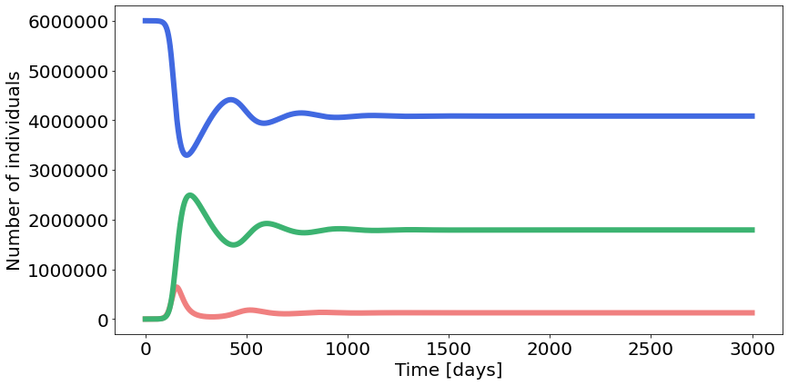
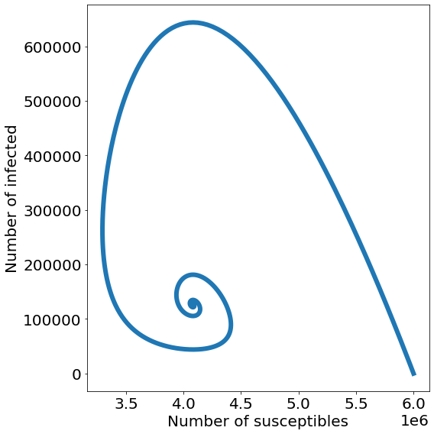
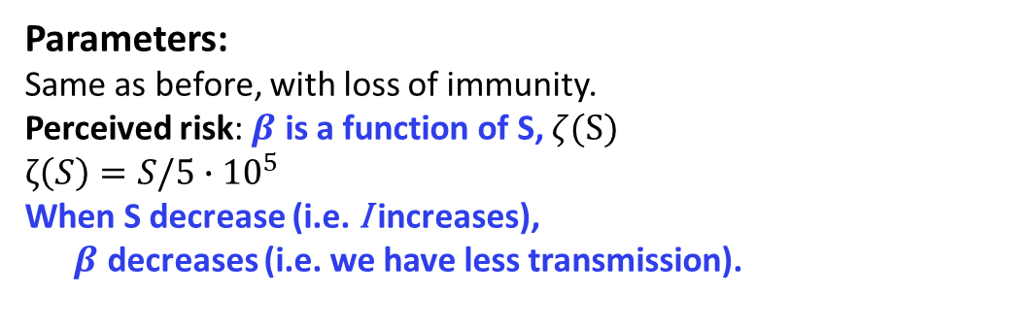


Parameters:
Same as before, with loss of immunity.
Perceived risk: $β$ is a function of S, $ζ(S)$
$$ζ\left(S\right)=S/5∙{10}^{5}$$
When S decrease (i.e. I increases),
$β$ decreases (i.e. we have less transmission).
g.
$$\frac{dS}{dt}=−(βζ)IS+γR$$
$$\frac{dI}{dt}=(βζ)IS −vI$$
$$\frac{dR}{dt}=vI−γR$$

Slide 12
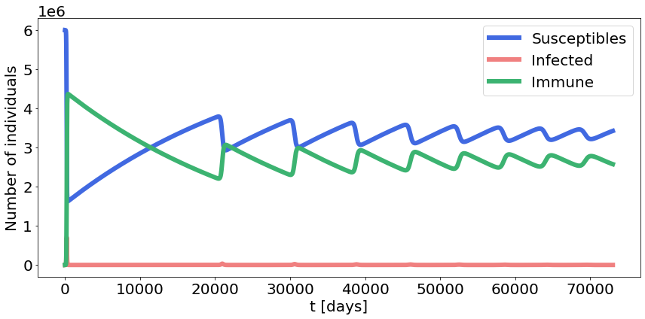
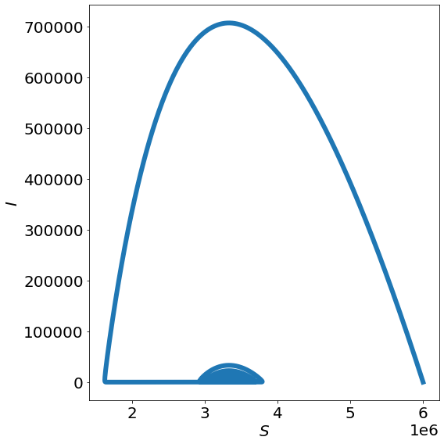




SIR with vital dynamics:
Same as initial.
We introduce new rate to account for deaths:
$μ=1/(80∙365)$
Duration of simulation: $t_{max}=70000 [days]$
j.
$$\frac{dS}{dt}=μN−βIS−μS$$
$$\frac{dI}{dt}=βIS −vI−μI$$
$$\frac{dR}{dt}=vI−μR$$

Slide 13
Code in Python:
fig, ax = plt.subplots(figsize=(16,6), tight_layout=True)
for i, c in enumerate(ns.T):
ax.plot(t, c, color = clr[i], label = lbl[i], linewidth=6)
ax.ticklabel_format(useOffset=False, style='plain')
ax.set_xlabel('Time [days]')
ax.set_ylabel('Number of individuals\n')
ax.legend(loc='upper center', bbox_to_anchor=(1.15, 1), borderaxespad=1)
print_parameters()
# Calculate outbreak numbers:
outbreak_start = np.amin(np.where(I > np.amax(I)*0.01))
outbreak_end = np.amax(np.where(I > np.amax(I)*0.01))
outbreak_peak = t[np.argmax(I)] # when does it peak?
Imax = np.int(np.amax(I)) # maximum infected
outbreak_duration = outbreak_end - outbreak_start # how long does it last?
not_sick = np.int(np.amin(S)) # number of susceptible people at equilibrium
not_sick_percentage = np.round(100 * not_sick / N0, 2) # find the persentage of not sick and round to 2 decimals
equilibrium_start = np.amin(np.where(S < np.int((np.amin(S))+1))) # day when equations reach equilibrium
def print_parameters():
print(f'Transmission rate β: {b}.')
print(f'Epidemic peaks at day {np.int(outbreak_peak)}.')
print(f'At peak, {Imax} persons were infected per day.')
print(f'Epidemic lasts {outbreak_duration} days (I > 0.01 of Imax).')
print(f'{not_sick} persons did not get sick, i.e. {not_sick_percentage}% of the Danish population.')
a.
# Import modules:
from scipy.integrate import odeint
import matplotlib.pyplot as plt
import numpy as np
# Define a function with the three SIR equations:
def S_I_R(z, t, b, v):
S, I, R = z
dSdt = -b * S * I
dIdt = b * S * I - v * I
dRdt = v * I
dzdt = np.array([dSdt, dIdt, dRdt])
return dzdt
# Parameters
T = 14 # average period of infectivity
S0 = 6e6 # total susceptibles at the beginning of pandemic in Denmark
I0 = 15 # initial number of infected
R0 = 0 # initial number of recovered
N0 = S0 + I0 + R0 # total population number
z0 = np.array([S0, I0, R0]) # put all the initial conditions in an array
Q0 = 1.8 # reproductive number at the start of the pandemic in Denmark
v = 1/T # calculate recovery rate (v)
b = Q0 * v / N0 # calculate transmission rate (b)
par = (b, v) # put parameters in a tuple to use in the ODE
t_max = 1000 # days
t = np.linspace(0, t_max, t_max + 1) # range for time
# I used t_max + 1 for the step number so that I get exactly t_max days as timesteps, without funny decimal points
# Solve the differential equation
ns = odeint(S_I_R, z0, t, args = par)
S, I, R = ns.T
clr = ['royalblue', 'lightcoral', 'mediumseagreen']
lbl = ['Susceptibles', 'Infected', 'Immune']
b.
fig, ax = plt.subplots(figsize=(16,6), tight_layout=True)
for i, c in enumerate(ns.T):
ax.plot(t, c, color = clr[i], label = lbl[i], linewidth=6)
ax.axvline(outbreak_start, color='firebrick', linestyle=':',linewidth=3, label='Outbreak begins')
ax.axvline(outbreak_end, color='cornflowerblue', linestyle=':',linewidth=3, label='Outbreak ends')
ax.axvline(outbreak_peak, color='salmon', linestyle=':',linewidth=4, label='Outbreak peaks')
ax.ticklabel_format(useOffset=False, style='plain') # just to show the full numbers and not raised to power
ax.set_xlabel('Time [days]')
ax.set_ylabel('Number of individuals\n')
ax.legend(loc='upper center', bbox_to_anchor=(1.2, 1), borderaxespad=1)
print_parameters()
# For the 10% increase we did exactly the same as above just using b_incr instead of b:
b_incr = b + b*0.1
par = (b_incr, v)
# I will not copy paste the same code

Slide 14
Code in Python:
c.
# c. Phase space plot:
# Parameters
N = 6e6 # total population number
T = 14 # average period of infectivity
R0 = 0 # initial number of recovered
Q0 = 1.8 # reproductive number at the start of the pandemic in Denmark
v = 1/T # calculate recovery rate (v)
b = Q0 * v / N0 # calculate transmission rate
t_max = 1000 # days
t = np.linspace(0, t_max, t_max + 1) # range for time
print(f"heard immunity at I=1-1/Q0={1-1/Q0}")
fig, ax = plt.subplots(figsize=(14,6), tight_layout=True)
I0s = np.linspace(0, int(6e6), 60)
for I0 in I0s:
S0 = N-I0 # total susceptibles at the beginning of pandemic in Denmark
col_cond = (I0/N >= 1-1/Q0)
c = int(col_cond)*"tab:blue" + (1-int(col_cond))*"tab:red"
#state_init = np.array([N-I0, I0, 0])
z0 = np.array([S0, I0, R0])
params = (b, v)
num_sol = odeint(S_I_R, z0, t, args=params).T
S, I, R = num_sol
final_size = 1 - S[-1]/N
lab = int(I0 == I0s[0])*"epidemic"+int(I0 == I0s[-1])*"non-epidemic"
ax.plot(S, I, color=c, label=lab)
heard_immune = (1-1/Q0)
I0 = (1-1/Q0)*N
S0 = N-I0 # total susceptibles at the beginning of pandemic in Denmark
z0 = np.array([S0, I0, R0])
params = (b, v)
num_sol = odeint(S_I_R, z0, t, args=params).T
S, I, R = num_sol
ax.plot(S, I, color="tab:green", linewidth=5, alpha=1,
label="critical trajectory")
ax.axhline(N*(1-1/Q0), color="tab:orange", linestyle=":",
label="critical $\\frac{I_{0}}{N}=1-\\frac{1}{Q_{0}} \\approx $" + str(round(1-1/Q0,2)))
ax.axvline(N/Q0, color="tab:green", linestyle=":",
label="critical $\\frac{S_{0}}{N}=\\frac{1}{Q_{0}} \\approx$"+str(round(1/Q0,2)))
ax.set_xlabel("Susceptibles")
ax.set_ylabel("Infected")
ax.legend(loc='upper center', bbox_to_anchor=(1.5, 1), borderaxespad=1)

Slide 15
Code in Python:
d.
# d. Intensive care
# Parameters
T = 14 # average period of infectivity
S0 = 6e6 # total susceptibles at the beginning of pandemic in Denmark
I0 = 15 # initial number of infected
R0 = 0 # initial number of recovered
N0 = S0 + I0 + R0 # total population number
z0 = np.array([S0, I0, R0]) # put all the initial conditions in an array
Q0 = 1.8 # reproductive number at the start of the pandemic in Denmark
v = 1/T # calculate recovery rate (v)
b = (Q0 * v / S0) # I just tried different numbers! not sure if this is what they wanted!
par = (b, v) # put parameters in a tuple to use in the ODE
t_max = 3000
t = np.linspace(0, t_max, t_max + 1) # range for time
K = 900 # intensive care patient capacity
h = 0.05 # 5% of infected need intensive care
# Solve the differential equation
ns = odeint(S_I_R, z0, t, args = par)
S, I, R = ns.T
# Calculate outbreak numbers:
outbreak_start = np.amin(np.where(I > np.amax(I)*0.01))
outbreak_end = np.amax(np.where(I > np.amax(I)*0.01))
outbreak_peak = t[np.argmax(I)]
Imax = np.int(np.amax(I))
outbreak_duration = outbreak_end - outbreak_start
not_sick = np.int(np.amin(S))
not_sick_percentage = np.round(100 * not_sick / N0, 2)
equilibrium_start = np.amin(np.where(S < np.int((np.amin(S))+1)))
# Plot:
fig, ax = plt.subplots(figsize=(16,6), tight_layout=True)
for i, c in enumerate(ns.T):
ax.plot(t, c, color = clr[i], label = lbl[i], linewidth=6)
ax.axvline(outbreak_start, color='firebrick', linestyle=':',linewidth=3, label='Outbreak begins')
ax.axvline(outbreak_end, color='cornflowerblue', linestyle=':',linewidth=3, label='Outbreak ends')
ax.axvline(outbreak_peak, color='salmon', linestyle=':',linewidth=4, label='Outbreak peaks')
ax.axhline(18000, color='blue', linestyle=':',linewidth=4, label='Threshold for int. care')
ax.ticklabel_format(useOffset=False, style='plain')
ax.set_xlabel('Time [days]')
ax.set_ylabel('Number of individuals')
ax.legend(loc='upper center', bbox_to_anchor=(1.3, 1), borderaxespad=1) # place legend outside the graph
print_parameters()
critically_ill = np.int(Imax * h)
if critically_ill <= K:
print(f'All critically ill patients ({critically_ill}) can get intentsive care')
else:
print(f'Not all critically ill patients ({critically_ill}) can get intensive care')
# Then, we did the same for b = (Q0 * v / S0)*0.6, and I am not showing this code

Slide 16
Code in Python:
e.
# Calculate outbreak numbers:
outbreak_start = np.amin(np.where(I > np.amax(I)*0.01))
outbreak_end = np.amax(np.where(I > np.amax(I)*0.01))
outbreak_peak = t[np.argmax(I)]
Imax = np.int(np.amax(I))
outbreak_duration = outbreak_end - outbreak_start
not_sick = np.int(np.amin(S))
not_sick_percentage = np.round(100 * not_sick / N0, 2)
equilibrium_start = np.amin(np.where(S < np.int((np.amin(S))+1)))
# Plot:
fig, ax = plt.subplots(figsize=(16,6), tight_layout=True)
for i, c in enumerate(ns.T):
ax.plot(t, c, color = clr[i], label = lbl[i], linewidth=6)
ax.ticklabel_format(useOffset=False, style='plain')
ax.set_xlabel('Time [days]')
ax.set_ylabel('Number of individuals')
ax.legend(loc='upper center', bbox_to_anchor=(1.2, 1), borderaxespad=1) # place legend outside the graph
plt.show()
print_parameters()
critically_ill = np.int(Imax * h)
if critically_ill <= K:
print(f'All critically ill patients ({critically_ill}) can get intentsive care')
else:
print(f'Not all critically ill patients ({critically_ill}) can get intensive care')
# Making phase-plane plot:
fig, ax = plt.subplots(figsize=(8,8), tight_layout=True)
ax.ticklabel_format(useOffset=True)
ax.plot(S, I, linewidth = 6)
ax.set_xlabel("Number of susceptibles")
ax.set_ylabel("Number of infected")
plt.show()
# e. Loss of Immunity
# Define a function with the three SIR equations:
def S_I_R_immunity(z, t, b, v, g):
S, I, R = z
dSdt = -b * S * I + g * R
dIdt = b * S * I - v * I
dRdt = v * I - g * R
dzdt = np.array([dSdt, dIdt, dRdt])
return dzdt
# Parameters
T = 14 # average period of infectivity
S0 = 6e6 # total susceptibles at the beginning of pandemic in Denmark
I0 = 15 # initial number of infected
R0 = 0 # initial number of recovered
N0 = S0 + I0 + R0 # total population number
z0 = np.array([S0, I0, R0]) # put all the initial conditions in an array
Q0 = 1.8 # reproductive number at the start of the pandemic in Denmark
v = 1/T # calculate recovery rate (v)
b = Q0 * v / N0 # calculate transmission rate (b) with data from the beginning of the pandemic
g = 0.005 # 1/(365/2)
par = (b, v, g) # put parameters in a tuple to use in the ODE
t_max = 3000 # days
t = np.linspace(0, t_max, t_max + 1) # range for time
# Solve the differential equation
ns = odeint(S_I_R_immunity, z0, t, args = par)
S, I, R = ns.T

Slide 17
Code in Python:
f.
# Calculate outbreak numbers:
outbreak_start = np.amin(np.where(I > np.amax(I)*0.01))
outbreak_end = np.amax(np.where(I > np.amax(I)*0.01))
outbreak_peak = t[np.argmax(I)]
Imax = np.int(np.amax(I))
outbreak_duration = outbreak_end - outbreak_start
not_sick = np.int(np.amin(S))
not_sick_percentage = np.round(100 * not_sick / N0, 2)
equilibrium_start = np.amin(np.where(S < np.int((np.amin(S))+1)))
# Plot:
fig, ax = plt.subplots(figsize=(16,6), tight_layout=True)
for i, c in enumerate(ns.T):
ax.plot(t, c, color = clr[i], label = lbl[i], linewidth=6)
ax.ticklabel_format(useOffset=False, style='plain')
ax.set_xlabel('Time [days]')
ax.set_ylabel('Number of individuals')
ax.legend(loc='upper center', bbox_to_anchor=(1.2, 1), borderaxespad=1)
plt.show()
print_parameters()
critically_ill = np.int(Imax * h)
if critically_ill <= K:
print(f'All critically ill patients ({critically_ill}) can get intentsive care')
else:
print(f'Not all critically ill patients ({critically_ill}) can get intensive care')
# Making phase-plane plot:
fig, ax = plt.subplots(figsize=(8,8), tight_layout=True)
ax.plot(S, I, linewidth = 6)
ax.set_xlabel("Number of susceptibles")
ax.set_ylabel("Number of infected")
plt.show()
# f. Seasonality
# Define a function with the three SIR equations:
def S_I_R_seasonality(z, t, b, v, g):
#season = 0.31*(np.sin(((t/365)*2*np.pi)+200)+2) # amalia's
season = 1 + 0.5*np.cos(2*np.pi*t*1/365 + np.pi) # christian's
S, I, R = z
dSdt = -(b*season) * S * I + g * R
dIdt = (b*season) * S * I - v * I
dRdt = v * I - g * R
dzdt = np.array([dSdt, dIdt, dRdt])
return dzdt
# Parameters
T = 14 # average period of infectivity
S0 = 6e6 # total susceptibles at the beginning of pandemic in Denmark
I0 = 15 # initial number of infected
R0 = 0 # initial number of recovered
N0 = S0 + I0 + R0 # total population number
z0 = np.array([S0, I0, R0]) # put all the initial conditions in an array
Q0 = 1.8 # reproductive number at the start of the pandemic in Denmark
v = 1/T # calculate recovery rate (v)
b = Q0 * v / N0 # calculate transmission rate (b) with data from the beginning of the pandemic
g = 0.005 # 1/(365/2)
par = (b, v, g) # put parameters in a tuple to use in the ODE
t_max = 3000 # days
t = np.linspace(0, t_max, t_max + 1) # range for time
# Solve the differential equation
ns = odeint(S_I_R_seasonality, z0, t, args = par)
S, I, R = ns.T

Slide 18
Code in Python:
j.
# (j) SIR w. vital dynamics
T = 14 # average period of infectivity
S0 = 6e6 # total susceptibles at the beginning of pandemic in Denmark
I0 = 15 # initial number of infected
R0 = 0 # initial number of recovered
N0 = S0 + I0 + R0 # total population number
z0 = np.array([S0, I0, R0]) # put all the initial conditions in an array
Q0 = 1.8 # reproductive number at the start of the pandemic in Denmark
v = 1/T # calculate recovery rate (v)
b = Q0 * v / N0 # calculate transmission rate (b) with data from the beginning of the pandemic
g = 0.005 # 1/(365/2)
par = (b, v, g) # put parameters in a tuple to use in the ODE
yr = 365
mu = 1/(80*yr)
I0 = 15
t_max = yr*200
t = np.linspace(0, t_max, 50*t_max) # range for time
def deriv(state, t, beta, nu, mu):
S, I, R = state
dS_dt = mu*N - b*S*I - mu*S
dI_dt = b*S*I - v*I - mu*I
dR_dt = v*I - mu*R
return np.array([dS_dt, dI_dt, dR_dt])
z0 = np.array([S0, I0, R0])
params = (b, v, mu)
num_sol = odeint(deriv, z0, t, args=params).T
S, I, R = num_sol
final_size = 1 - S[-1]/N
# Making a nice plot:
fig, ax = plt.subplots(figsize=(12,6), tight_layout=True)
for i, c in enumerate(num_sol):
ax.plot(t, c, color=clr[i], label=lbl[i], linewidth=6)
ax.set_xlabel("t [days]")
ax.set_ylabel("Number of individuals")
# ax.set_yscale("log")
ax.legend()
# Making phase-plane plot:
fig, ax = plt.subplots(figsize=(8,8), tight_layout=True)
ax.plot(S, I, linewidth=6)
ax.set_xlabel("$S$")
ax.set_ylabel("$I$")
# ax.set_yscale("log")
# ax.legend()

