Slide 1
Tragedy of the commons
Group: Amalia Bogri, Christian Berrig & Jonas Bolduan

Slide 2
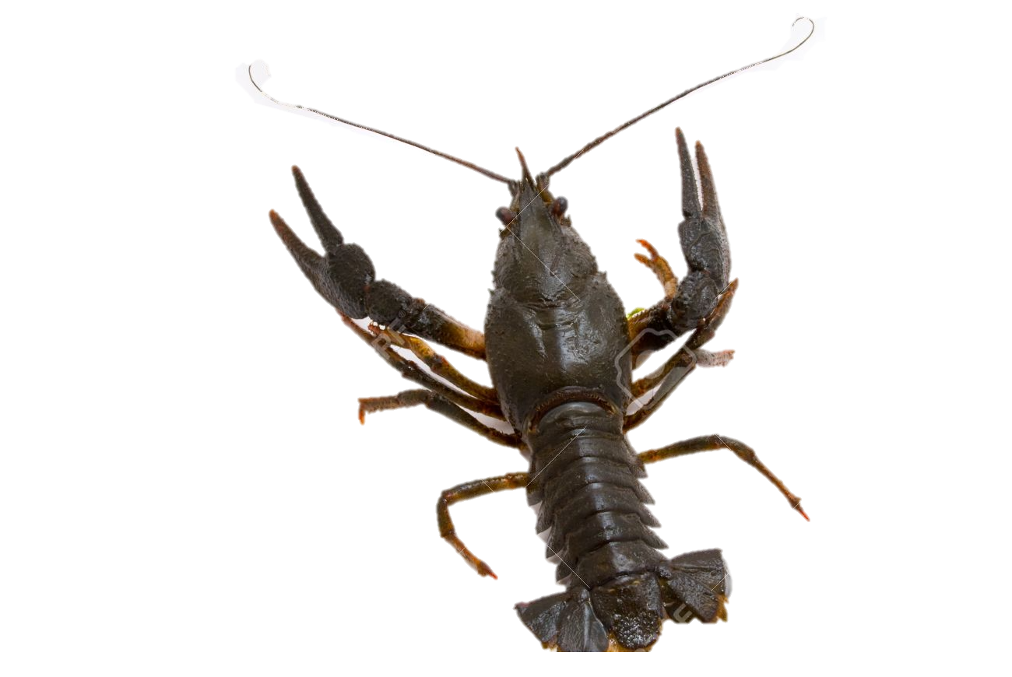
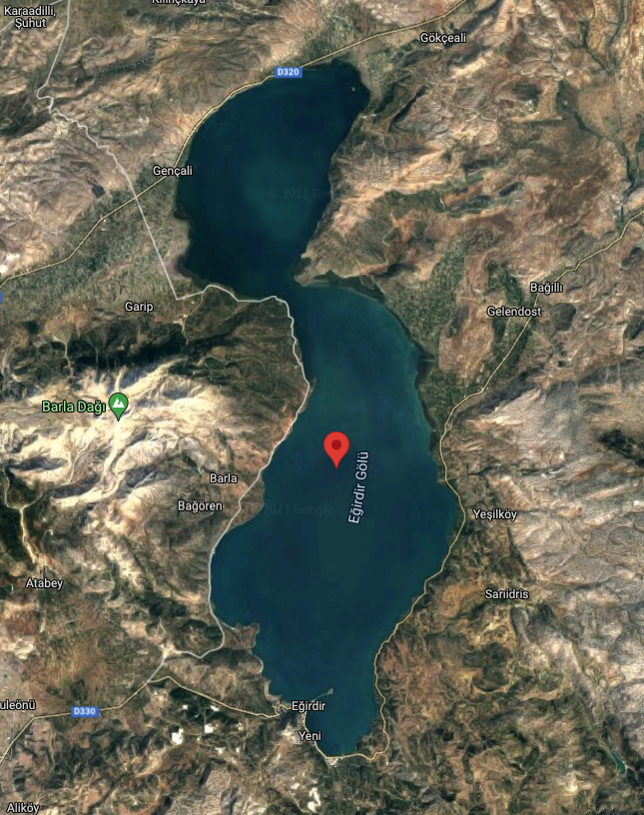
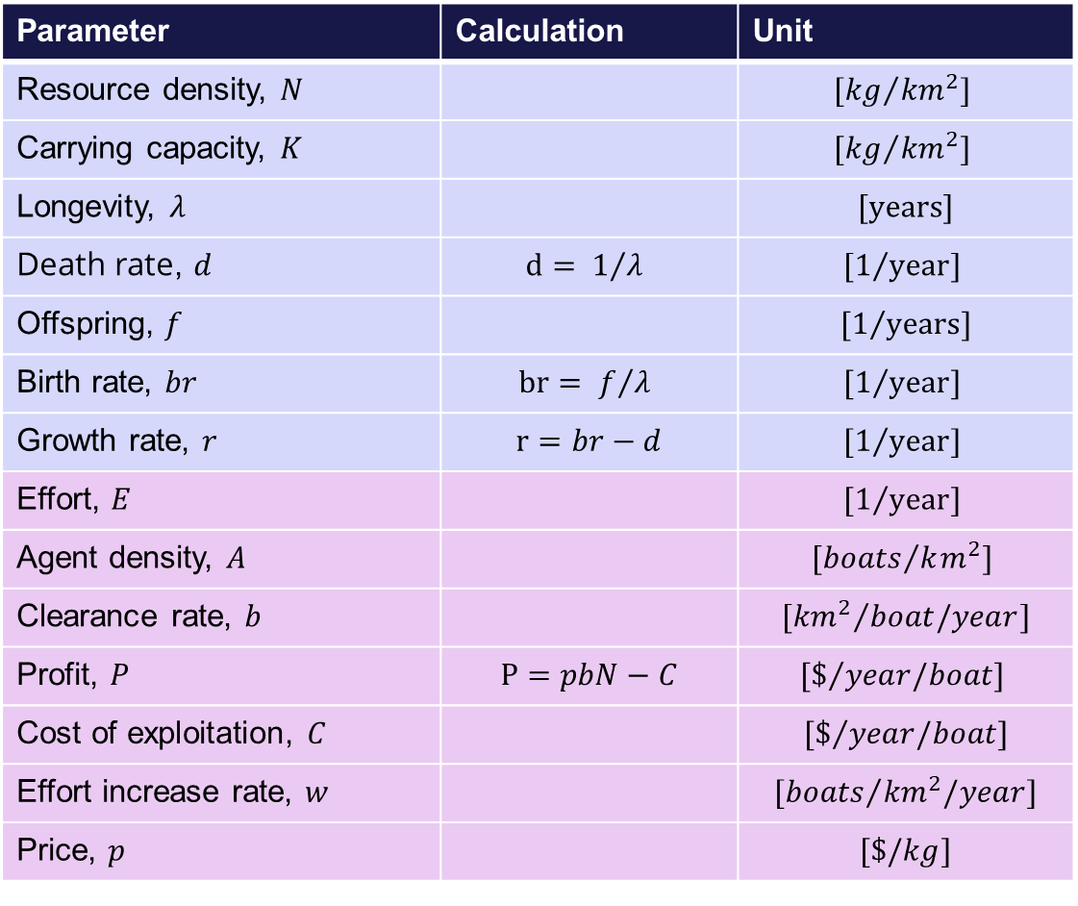
General model parameters
Parameter | Calculation | Unit
Resource density, $N$ |  | $${[kg}/{{km}^{2}}]$$
Carrying capacity, $K$ |  | $${[kg}/{{km}^{2}}]$$
Longevity, $λ$ |  | $$[years]$$
Death rate, $d$ | $$d= 1/{λ }$$ | $${[1}/{year}]$$
Offspring, $f$ |  | $${[1}/{years}]$$
Birth rate, $br$ | $$br= f/{λ }$$ | $${[1}/{year}]$$
Growth rate, $r$ | $$r=br−d$$ | $${[1}/{year}]$$
Effort, $E$ |  | $${[1}/{year}]$$
Agent density, $A$ |  | $${[boats}/{km^{2}}]$$
Clearance rate, $b$ |  | $${[{km}^{2}}/{boat/year}]$$
Profit, $P$ | $$P=pbN−C$$ | $${[\$}/{year/boat}]$$
Cost of exploitation, $C$ |  | $${[\$}/{year/boat}]$$
Effort increase rate, $w$ |  | $${[boats}/{{km}^{2}/year}]$$
Price, $p$ |  | $$[\$/kg]$$
Crayfish
(Astacus leptodactylus)
Lake Eğirdir (180km north of Antalya, Turkey) size (area): 482 km²

Slide 3
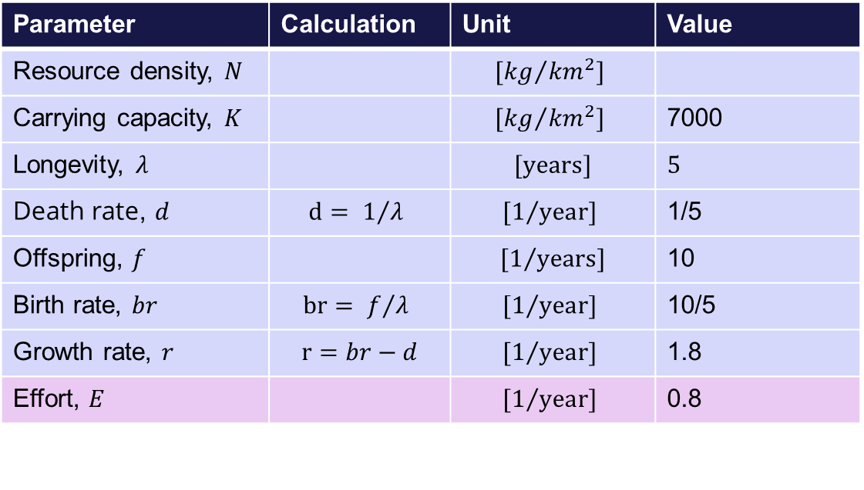
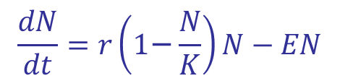
Exploitation with constant effort model
Crayfish: N
Parameter | Calculation | Unit | Value
Resource density, $N$ |  | $${[kg}/{{km}^{2}}]$$
Carrying capacity, $K$ |  | $${[kg}/{{km}^{2}}]$$ | 7000
Longevity, $λ$ |  | $$[years]$$ | 5
Death rate, $d$ | $$d= 1/{λ }$$ | $${[1}/{year}]$$ | 1/5
Offspring, $f$ |  | $${[1}/{years}]$$ | 10
Birth rate, $br$ | $$br= f/{λ }$$ | $${[1}/{year}]$$ | 10/5
Growth rate, $r$ | $$r=br−d$$ | $${[1}/{year}]$$ | 1.8
Effort, $E$ |  | $${[1}/{year}]$$ | 0.8
$$\frac{dN}{dt}=r\left(\text{1}\text{−}\frac{N}{K}\right)N−EN$$
3

Slide 4
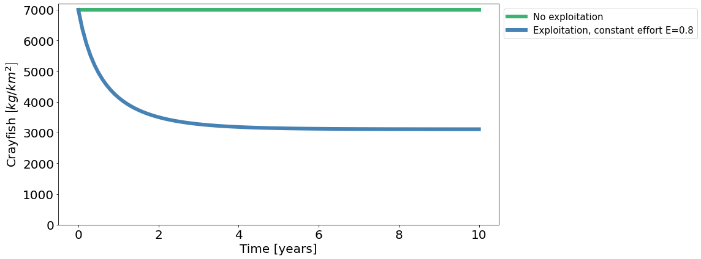
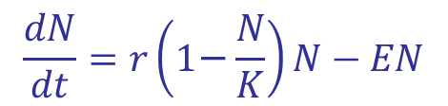
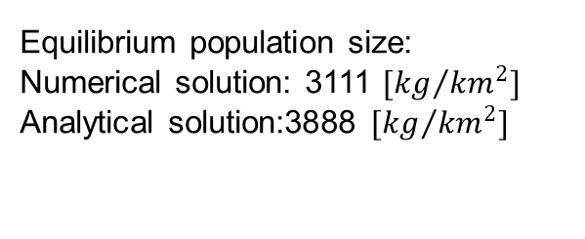

Exploitation with constant effort model
$$\frac{dN}{dt}=r\left(\text{1}\text{−}\frac{N}{K}\right)N−EN$$
The population size decreases as a function of time.
Equilibrium population size:
Numerical solution: 3111 ${[kg}/{{km}^{2}}]$
Analytical solution:3888 ${[kg}/{{km}^{2}}]$
$$\overline{N}=K\left(\text{1}\text{−}\frac{E}{r}\right)$$
4

Slide 5
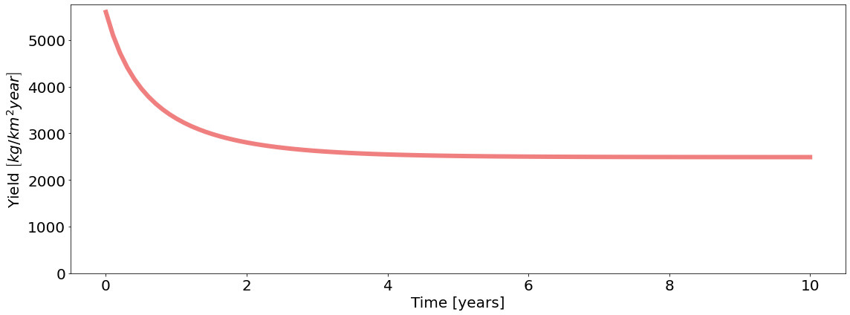

Exploitation with constant effort model
$$\frac{dN}{dt}=r\left(\text{1}\text{−}\frac{N}{K}\right)N−EN$$
The yield decreases as a function of time.
$$Y=EN$$
5

Slide 6
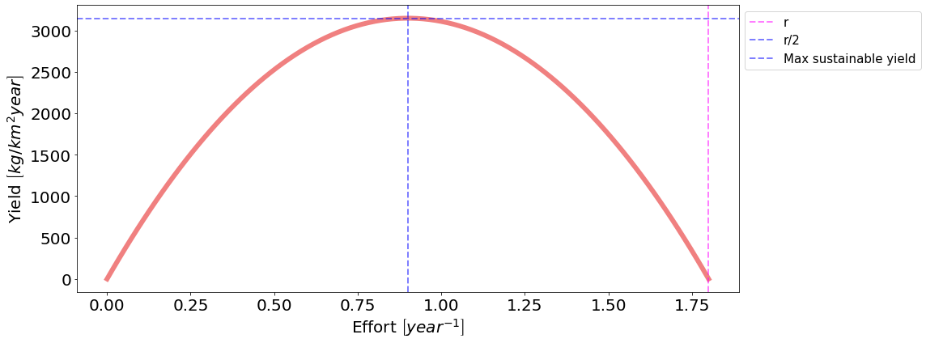

Exploitation with constant effort model
$$\frac{dN}{dt}=r\left(\text{1}\text{−}\frac{N}{K}\right)N−EN$$
$$Y=EN$$
Maximum sustainable yield at r/2
6

Slide 7
Exploitation with constant effort model, python code
# # -------- Logistic equation with exploitation factor---------
def deriv_e(N, t, r, K, E):
return r*N*(1-(N/K))-E*N
# Question 2: Consider N0 = K, and constant effort E. How does population size vary as function of time?
# Parameters:
K = 7000 # Carrying capacity # Unit: [kg crayfish/ km^2]
b = 10/5 # Birth rate # Unit: [1 / year]
d = 1/5 # Death rate # Unit: [1 / year]
r = b-d # Growth rate # Unit: [1 / year] # r = 1.8
N0 = K # Initial population equal to Carrying capacity # Unit: [kg crayfish/ km^2]
t = np.linspace(0, 10, 100) # in years
E = 0.8 # Effort # Exploitation # Unit: [1/year]
par = (r, K, E)
E = 0
par = (r, K, E)
ns_e0 = odeint(deriv_e, N0, t, args=par) # numerical solution for exploitation
E = 1
par = (r, K, E)
ns_e1 = odeint(deriv_e, N0, t, args=par) # numerical solution for exploitation
fig, ax = plt.subplots(1,1, figsize=(16, 6), tight_layout=True)
ax.plot(t, ns_e0, label = 'No exploitation', color='mediumseagreen')
ax.plot(t, ns_e1, label = 'Exploitation, constant effort E=0.8', color='steelblue')
ax.set_ylim(bottom=0)
ax.set_ylabel('Crayfish $\\left[kg/km^{2}\\right]$')
ax.set_xlabel('Time [years]')
ax.legend(bbox_to_anchor=(1.0, 1), loc=2, borderaxespad=0.5, fontsize=15)
plt.show()
print(f'Steady state at {min(ns_e1)} kg crayfish/sqkm')
# Question 3: How does yield vary with time?
E=0.8
fig, ax = plt.subplots(1,1, figsize=(16, 6), tight_layout=True)
ax.plot(t, ns_e1*E, color = 'lightcoral')
ax.set_ylim(bottom=0)
ax.set_ylabel('Yield $\\left[kg/km^{2} year\\right]$')
ax.set_xlabel('Time [years]')
plt.show()
print(f'Steady state at yield {min(ns_e1*E)}')
Es = np.linspace(0, r, 100)
Y = Es*(-K*(Es - r)/r)
fig, ax = plt.subplots(1,1, figsize=(16, 6), tight_layout=True)
ax.plot(Es, Es*(-K*(Es - r)/r), color = 'lightcoral')
ax.axvline(r, alpha=0.5, linestyle="--", color="magenta", linewidth=2, label='r')
ax.axvline(r/2, alpha=0.5, linestyle="--", color="blue", linewidth=2, label='r/2')
ax.axhline(max(Es*(-K*(Es - r)/r)), alpha=0.5, linestyle="--", color="blue", linewidth=2, label='Max sustainable yield')
ax.set_ylabel('Yield $\\left[kg/km^{2} year\\right]$')
ax.set_xlabel('Effort $\\left[year^{-1}\\right]$')
ax.legend(bbox_to_anchor=(1.0, 1), loc=2, borderaxespad=0.5, fontsize=15)
plt.show()
print(f'Max sustainable yield at {max(Es*(-K*(Es - r)/r))}')
# Question 4. Does equilibrium population size and yeld converge to the exact analytical equilibrium?
# Analytical solutions for steady states:
# Solve for the equilibrium abundances of prey and predator
Ns = Symbol('Ns')
Nstar = solve([r*Ns*(1-(Ns/K))-E*Ns])
print(Nstar)
# Let's try with the full analytical solution, to be sure:
Ns = Symbol('Ns')
rs = Symbol('rs')
Ks = Symbol('Ks')
Es = Symbol('Es')
Nstar_symb = solve([(rs*(1-(Ns/Ks))-Es)*Ns], Ns)
print(Nstar_symb)
print(-K*(E - r)/r)
7

Slide 8
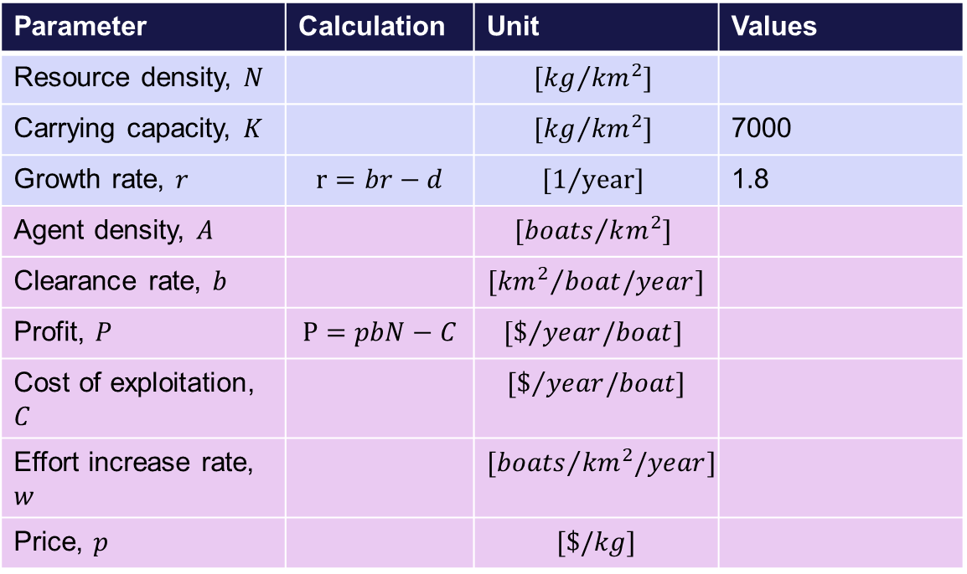
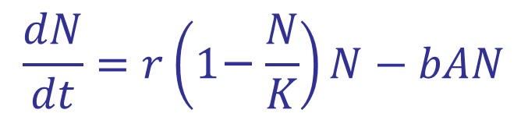
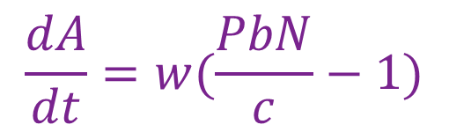
Exploitation by agents
Crayfish: N
Parameter | Calculation | Unit | Values
Resource density, $N$ |  | $${[kg}/{{km}^{2}}]$$
Carrying capacity, $K$ |  | $${[kg}/{{km}^{2}}]$$ | 7000
Growth rate, $r$ | $$r=br−d$$ | $${[1}/{year}]$$ | 1.8
Agent density, $A$ |  | $${[boats}/{km^{2}}]$$
Clearance rate, $b$ |  | $${[{km}^{2}}/{boat/year}]$$
Profit, $P$ | $$P=pbN−C$$ | $${[\$}/{year/boat}]$$
Cost of exploitation, $C$ |  | $${[\$}/{year/boat}]$$
Effort increase rate, $w$ |  | $${[boats}/{{km}^{2}/year}]$$
Price, $p$ |  | $$[\$/kg]$$
$$\frac{dN}{dt}=r\left(\text{1}\text{−}\frac{N}{K}\right)N−bAN$$
AGENTS – Fishers: A
$$\frac{dA}{dt}=w(\frac{PbN}{c}−1)$$
8

Slide 9
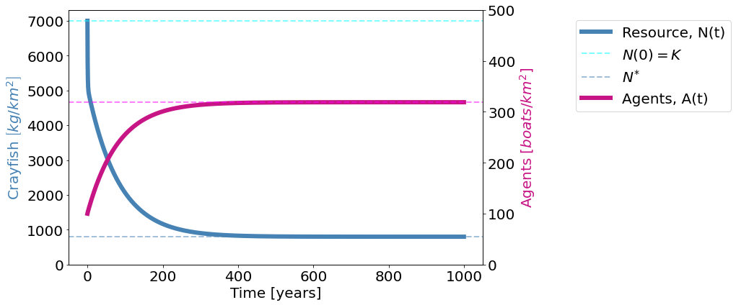
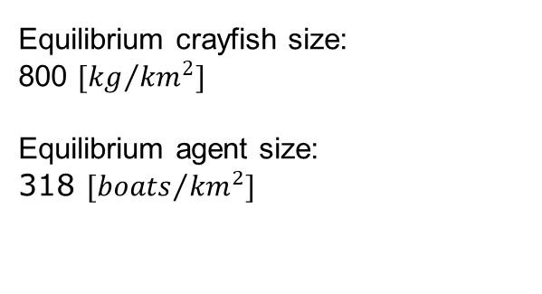
Exploitation by agents
Equilibrium crayfish size:
800 ${[kg}/{{km}^{2}}]$
Equilibrium agent size:
318 ${[boats}/{{km}^{2}}]$
9

Slide 10
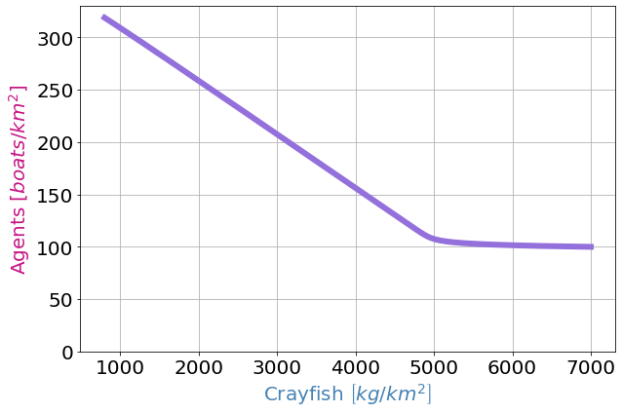
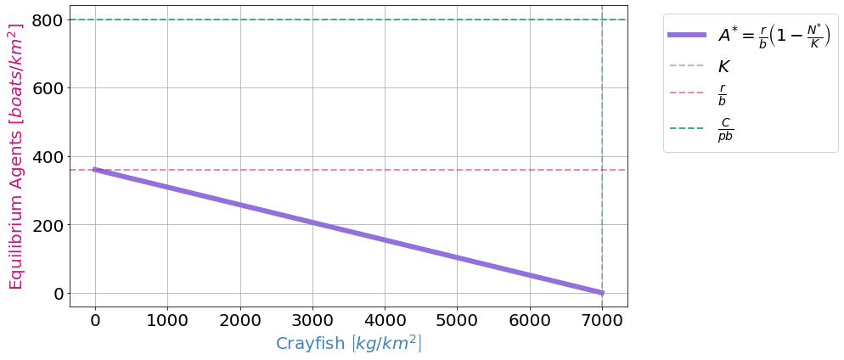
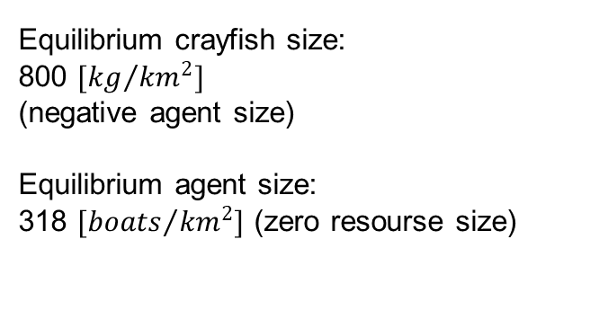
Exploitation by agents
Equilibrium crayfish size:
800 ${[kg}/{{km}^{2}}]$
(negative agent size)
Equilibrium agent size:
318 ${[boats}/{{km}^{2}}]$(zero resourse size)
10

Slide 11
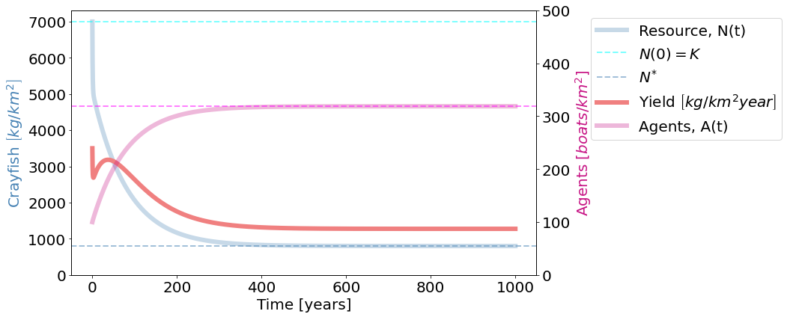
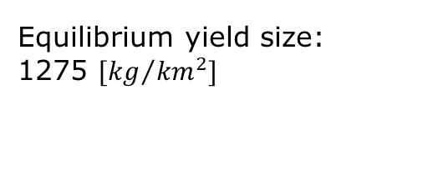

Exploitation by agents
$$Y=bAN$$
Equilibrium yield size:
1275 ${[kg}/{{km}^{2}}]$
11

Slide 12
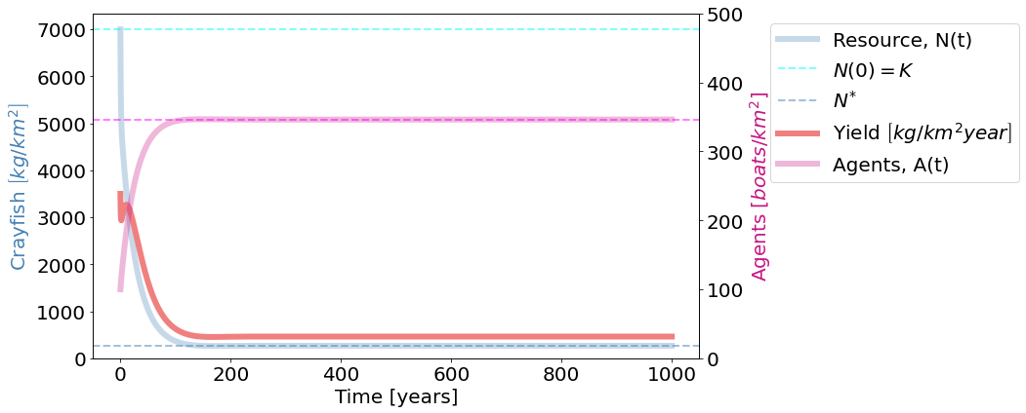
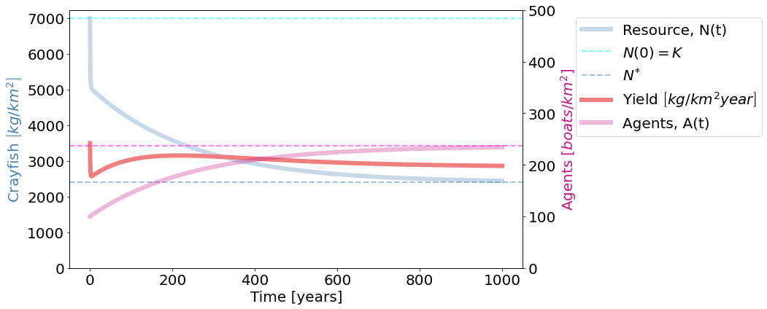
Exploitation by agents
If the price triples (p = 15), the agents are doing better and have higher yield
If the cost triples (C = 60), the crayfish are doing better, and the agents have lower yield and numbers
12

Slide 13
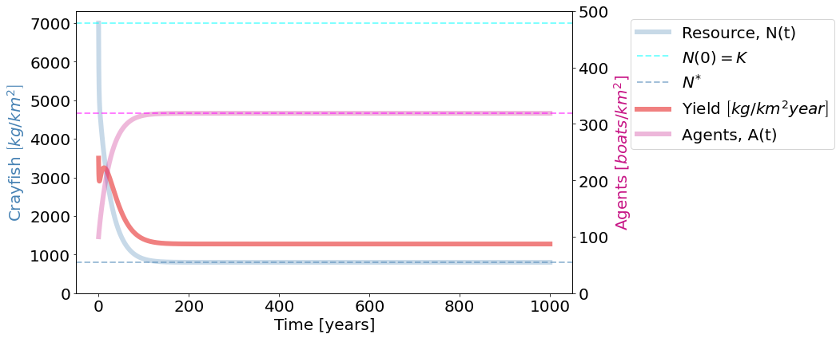
Exploitation by agents
If the rate at which effort is increased triples (w = 1.5), the system reaches equilibrium faster
13

Slide 14
Exploitation by agents, python code
# Parameters:
K = 7000 # Carrying capacity
b = 10/5 # Birth rate # Unit: [1 / year]
d = 1/5 # Death rate # Unit: [1 / year]
r = b-d # Growth rate # Unit: [1 / year] # r = 1.8
N0 = K # Initial population equal to Carrying capacity
t = np.linspace(0, 1000, 10000) # in years
E = 0.8 # Effort # Exploitation # Unit: [1/year]
w = 0.5 # rate at which effort is increased # Unit: [boat/sqkm/year]
b = 0.005 # clearance rate # Unit: [km^2/ boat/year]
p= 5 # price per catch # Unit: [dollar/ crayfish]
C = 20 #cost of exploitation per agent per time # Unit [dollar/year/boat]
params = (r, K, E, w, b, p )
init_state = [K, 100]
solve([r*(1-(Ns/K))*Ns - Ns*As*b, w*(p*b*Ns/C - 1)])
Y = lambda N, A: b*N*A
Ndot = lambda N: r*(1 - N/K)*N
Nstar_pred = lambda : C/(p*b)
Astar_pred = lambda Nst: (r/b)*(1-Nst/(K))
PI = lambda n: p*b*n - C # profit
def deriv_pred(state, t, *params):
N, A = state
r, K, E, w, b, p = params
# dN_dt = (r*(1 - N/K) - E)*N
dN_dt = Ndot(N) - Y(N, A)
dA_dt = w*PI(N)/C
return np.array([dN_dt, dA_dt])
sol = odeint(deriv_pred, init_state, t, params).T
N, A = sol
fig, ax1 = plt.subplots(1,1, figsize=(15, 6), tight_layout=True)
ax2 = ax1.twinx()
ax1.plot(t, N, label="Resource, N(t)", color='steelblue')
ax1.axhline(N[0], alpha=0.5, linestyle="--", color="cyan", linewidth=2, label="$N(0) = K$")
ax2.plot(t, A, label="Agents, A(t)", color='mediumvioletred')
ax1.axhline(Nstar_pred(), alpha=0.5, linestyle="--", color='steelblue', linewidth=2, label="$N^{*}$")
ax2.axhline(Astar_pred(Nstar_pred()), alpha=0.5, linestyle="--", color="magenta" , linewidth=2, label="$A^{*}$")
ax1.plot(t, Y(N,A), label='Yield $\\left[kg/km^{2} year\\right]$', color = 'lightcoral')
ax1.set_ylabel('Crayfish $\\left[kg/km^{2}\\right]$', color='steelblue')
ax2.set_ylabel('Agents $\\left[boats/km^{2}\\right]$', color='mediumvioletred')
ax1.set_xlabel('Time [years]')
ax1.plot([], [], color='mediumvioletred', label="Agents, A(t)")
ax1.legend(bbox_to_anchor=(1.2, 1.), loc=2, borderaxespad=0.7, fontsize=20)
ax1.set_ylim(bottom=0)
ax2.set_ylim(bottom=0)
ax2.set_ylim(0, 500)
fig, ax1 = plt.subplots(1,1, figsize=(9, 6), tight_layout=True)
ax1.plot(N, A, color='mediumpurple')
ax1.set_xlabel('Crayfish $\\left[kg/km^{2}\\right]$', color='steelblue')
ax1.set_ylabel('Agents $\\left[boats/km^{2}\\right]$', color='mediumvioletred')
ax1.set_ylim(bottom=0)
ax1.grid()
plt.show()
print(min(N))
print(max(A))
print(Nstar_pred())
print(Astar_pred(Nstar_pred()))
ns = np.linspace(0, K, 1001)
fig, ax1 = plt.subplots(1,1, figsize=(14, 6), tight_layout=True)
ax1.plot(ns, Astar_pred(ns), color='mediumpurple', label="$A^{*} = \\frac{r}{b} \\left( 1- \\frac{N^{*}}{K} \\right)$")
ax1.axvline(K, alpha=0.5, linestyle="--", color='steelblue', linewidth=2, label="$K$")
ax1.axhline(r/b, alpha=0.5, linestyle="--", color='mediumvioletred', linewidth=2, label="$\\frac{r}{b}$")
ax1.axhline(C/(p*b), linestyle="--", color='mediumseagreen', linewidth=2, label="$\\frac{C}{pb}$")
ax1.set_xlabel("$N^{*}$")
ax1.set_xlabel('Crayfish $\\left[kg/km^{2}\\right]$', color='steelblue')
ax1.set_ylabel('Equilibrium Agents $\\left[boats/km^{2}\\right]$', color='mediumvioletred')
ax1.legend(bbox_to_anchor=(1.05, 1.), loc=2, borderaxespad=0.5, fontsize=20)
ax1.grid()
14

Slide 15
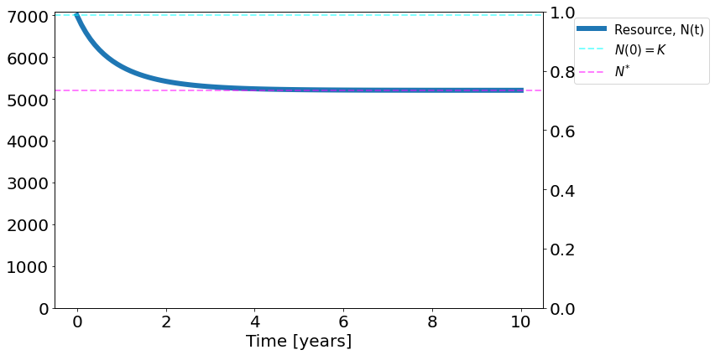
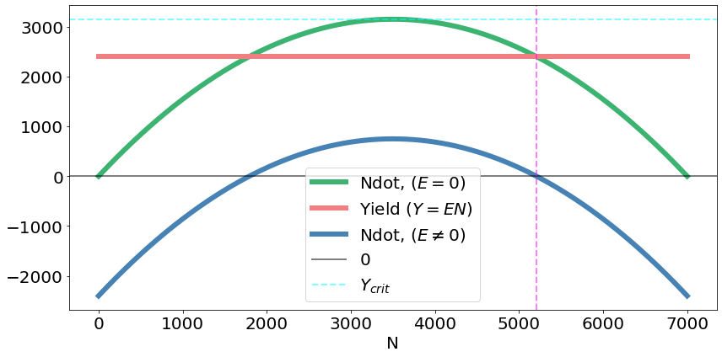
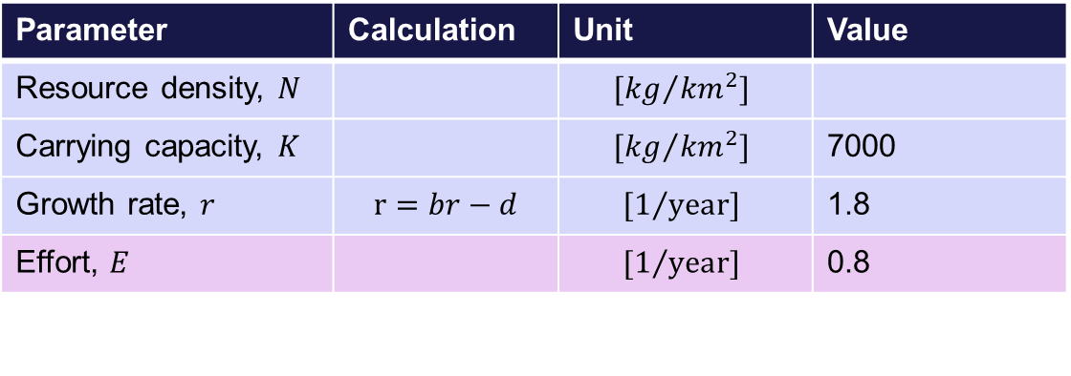
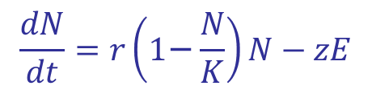
Yield independent of abundance
Crayfish: N
Parameter | Calculation | Unit | Value
Resource density, $N$ |  | $${[kg}/{{km}^{2}}]$$
Carrying capacity, $K$ |  | $${[kg}/{{km}^{2}}]$$ | 7000
Growth rate, $r$ | $$r=br−d$$ | $${[1}/{year}]$$ | 1.8
Effort, $E$ |  | $${[1}/{year}]$$ | 0.8
$$\frac{dN}{dt}=r\left(\text{1}\text{−}\frac{N}{K}\right)N−zE$$
The system reaches equilibrium relatively fast.
15

Slide 16
Exploitation by agents, python code
fig, ax1 = plt.subplots(1,1, figsize=(12, 6), tight_layout=True)
ax2 = ax1.twinx()
# ax1.grid()
ax1.plot(t, N, label="Resource, N(t)")
ax1.axhline(N[0], alpha=0.5, linestyle="--", color="cyan", linewidth=2, label="$N(0) = K$")
# ax1.plot(t, A, label="Agents, A(t)")
ax1.axhline(Nstar_const_Y(), alpha=0.5, linestyle="--", color="magenta", linewidth=2, label="$N^{*}$")
#ax1.axhline(Astar_pred(Nstar_pred()), alpha=0.5, linestyle="--", color="lime", linewidth=2, label="$A^{*}$")
# ax1.set_ylabel('Resources [FILL]')
# ax2.set_ylabel('Agents [FILL]', color = 'mediumseagreen')
ax1.set_xlabel('Time [years]')
ax1.set_ylim(bottom=0)
ax1.legend(bbox_to_anchor=(1.05, 1.), loc=2, borderaxespad=0.5, fontsize=15)
ns = np.linspace(0, K, 1001)
Y_crit = K*r/4 # for higher yields than y_crit,
# no real solutions exists => no stabile real fixed-points,
# everything is exterminated
fig, ax1 = plt.subplots(1,1, figsize=(12, 6), tight_layout=True)
ax1.plot(ns, Ndot(ns), label="Ndot, ($E = 0$)", color='mediumseagreen')
ax1.plot(ns, [Y()]*len(ns), label="Yield ($Y = E N$)", color = 'lightcoral')
ax1.plot(ns, Ndot(ns) - Y(), label="Ndot, ($E \\neq 0$)", color='steelblue')
ax1.axhline(0, alpha=0.5, linestyle="-", color="black", linewidth=2, label="0")
ax1.axhline(Y_crit, alpha=0.5, linestyle="--", color="cyan", linewidth=2, label="$Y_{crit}$")
# ax1.plot(ns, Ndot(ns) - Y(), label="Ndot, ($E \\neq 0$)")
ax1.axvline(Nstar_const_Y(), alpha=0.5, linestyle="--", color="magenta", linewidth=2, )
ax1.set_xlabel('N')
ax1.legend()
# Parameters:
K = 7000 # Carrying capacity
b = 10/5 # Birth rate # Unit: [1 / year]
d = 1/5 # Death rate # Unit: [1 / year]
r = b-d # Growth rate # Unit: [1 / year] # r = 1.8
N0 = K # Initial population equal to Carrying capacity
t = np.linspace(0, 10, 100) # in years
E = 0.8 # Effort # Exploitation # Unit: [1/year]
w = 0.5 # rate at which effort is increased # Unit: [boat/sqkm/year]
b = 0.005 # clearance rate # Unit: [km^2/ boat/year]
p= 5 # price per catch # Unit: [dollar/ crayfish]
C = 20 #cost of exploitation per agent per time # Unit [dollar/year/boat]
params = (r, K, E, w, b, p )
init_state = [K, 100]
Y = lambda : 3000*E ## TODO: choose parameters wisely!
Ndot = lambda N: r*(1 - N/K)*N
Nstar_const_Y = lambda : (1/2)*(K + np.sqrt((K*K) - 4*K*Y()/r))
# Astar_const_Y = lambda Nst: (r/b)*(1-Nst/(K))
#PI = lambda n: p*b*n - C # profit
def deriv_const_Y(state, t, *params):
N, A = state
r, K, E, w, b, p = params
# dN_dt = (r*(1 - N/K) - E)*N
dN_dt = Ndot(N) - Y()
dA_dt = w*PI(N)/C
return np.array([dN_dt, dA_dt])
params = (r, K, E, w, b, p)
sol = odeint(deriv_const_Y, init_state, t, params).T
N, A = sol
16

