Slide 1
Structured population models
Group: Amalia Bogri, Christian Berrig & Jonas Bolduan
General model parameters

Slide 2
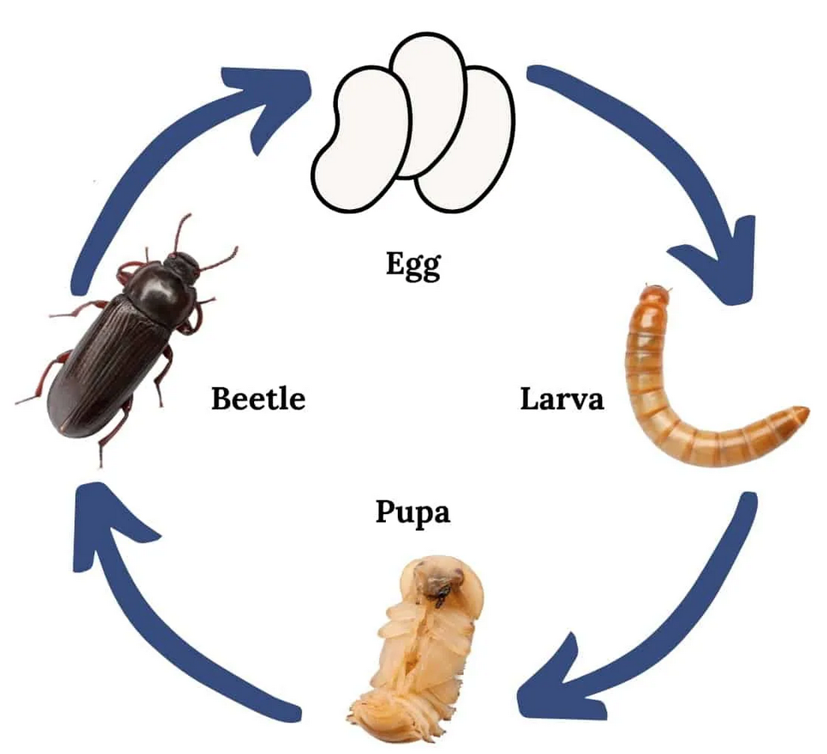
Stage-structured population: Tenebrio molitor
Beetles are holometabolous insects,
they go through metamorphosis
The four life stages are:
egg, larva, pupa and adult beetle
We will use a stage-structured model
Our time step is 15 days (half a month)
Only the adults are sexually mature
We assume that each adult produces 25 eggs
Dimension of each life stage: number of individuals
2 months
15 days
4 timesteps
1 timestep
15 days
3 months
1 timestep
6 timesteps
Image source: https://www.heritageacresmarket.com/mealworm-farm/

Slide 3





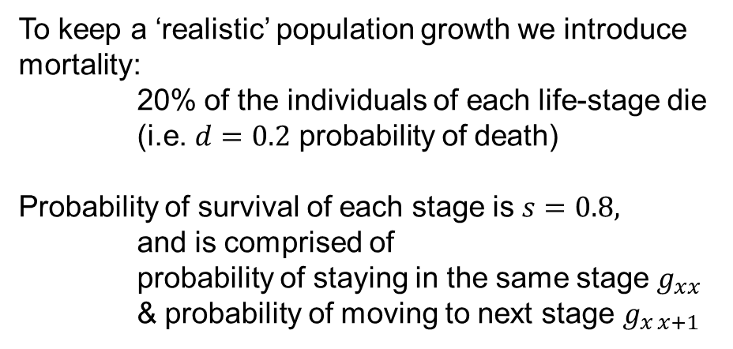



Stage-structured population: Tenebrio molitor
Zero probability of staying an egg
(die or become larva)
To keep a ‘realistic’ population growth we introduce mortality:
20% of the individuals of each life-stage die (i.e. $d=0.2$ probability of death)
Probability of survival of each stage is $s=0.8,$
and is comprised of
probability of staying in the same stage $g_{xx}$
& probability of moving to next stage $g_{x x+1}$
$$g_{11}=0$$
$$F_{4}=25×\frac{1}{4}×0.8$$
$$g_{12}=0.8$$
$$g_{22}=\frac{5}{6}×0.8$$
The transition from larva to pupa takes 6 timesteps.
We translate this into a 1/6 chance of the larvae to transform in one time step,
and 5/6 to remain larvae.
$$g_{22}=\frac{3}{4}×0.8$$
$$g_{23}=\frac{1}{6}×0.8$$
$$g_{34}=0.8$$
Zero probability of staying a pupa
$$g_{33}=0$$
It takes 4 timesteps for adults to produce eggs, thus they have ¼ chance of producing 25 eggs in each time step
Image source: https://www.heritageacresmarket.com/mealworm-farm/

Slide 4


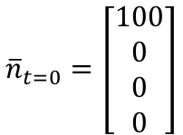
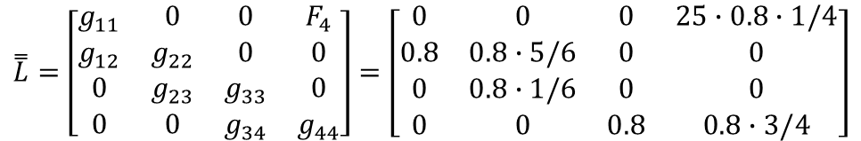

Stage-structured population: Tenebrio molitor
Matrix with model parameters:
4 stage structures:
$$\overset{̿}{L}=\left[\begin{matrix}g_{11} & 0 & 0 & F_{4} \\ g_{12} & g_{22} & 0 & 0 \\ 0 & g_{23} & g_{33} & 0 \\ 0 & 0 & g_{34} & g_{44}\end{matrix}\right]=\left[\begin{matrix}0 & 0 & 0 & 25∙0.8∙1/4 \\ 0.8 & 0.8∙5/6 & 0 & 0 \\ 0 & 0.8∙1/6 & 0 & 0 \\ 0 & 0 & 0.8 & 0.8∙3/4\end{matrix}\right]$$
$$g_{11}=0$$
$$F_{4}=25×\frac{1}{4}×0.8$$
$$g_{12}=0.8$$
$${\overline{n}}_{t=0}=\left[\begin{matrix}100 \\ 0 \\ 0 \\ 0\end{matrix}\right]$$
Initial conditions:
$$g_{22}=\frac{5}{6}×0.8$$
$$g_{22}=\frac{3}{4}×0.8$$
The eigenvalues of the matrix $\overset{̿}{L}$ are complex numbers, so we expect oscillatory behaviour.
-0.55151171+0$i$
0.31639741+0.74332683$i$
0.31639741-0.74332683$i$
1.18538356+0$i$
The largest eigenvalue is >1, so we expect the population to grow in time.
$$g_{23}=\frac{1}{6}×0.8$$
$$g_{34}=0.8$$
$$g_{33}=0$$
Image source: https://www.heritageacresmarket.com/mealworm-farm/

Slide 5
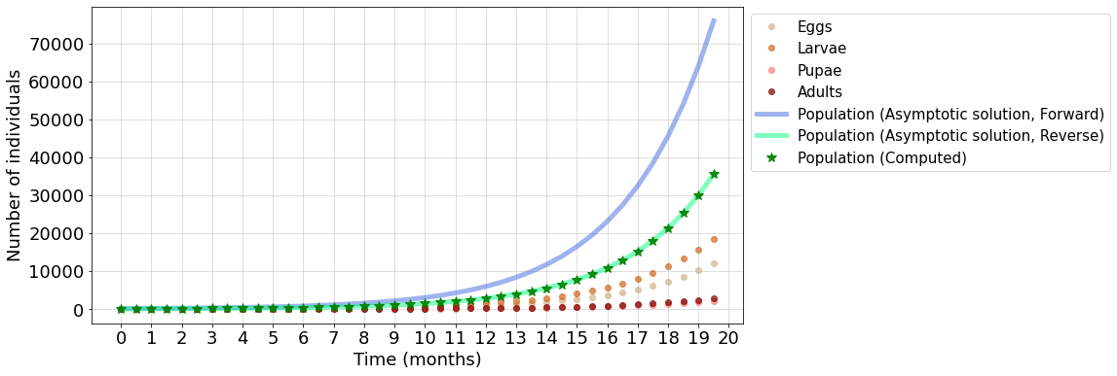
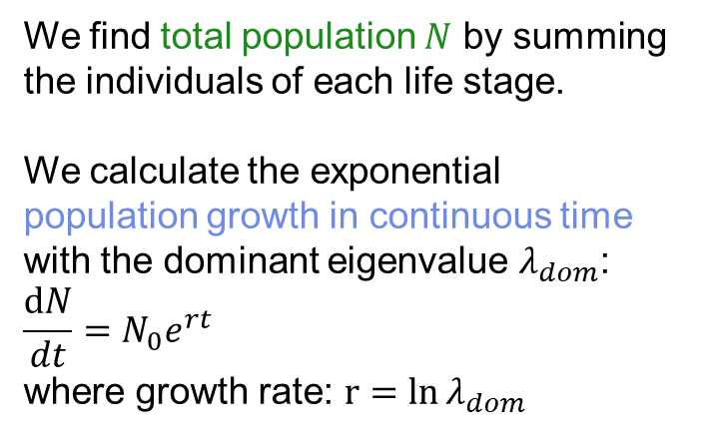
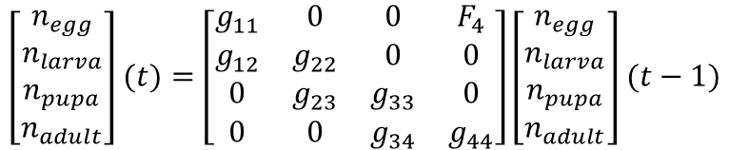
Stage-structured population: Tenebrio molitor
We calculate the number of individuals at each stage by iterating for 40 steps (i.e. 20 months) through:
$$\left[\begin{matrix}n_{egg} \\ n_{larva} \\ n_{pupa} \\ n_{adult}\end{matrix}\right](t)=\left[\begin{matrix}g_{11} & 0 & 0 & F_{4} \\ g_{12} & g_{22} & 0 & 0 \\ 0 & g_{23} & g_{33} & 0 \\ 0 & 0 & g_{34} & g_{44}\end{matrix}\right]\left[\begin{matrix}n_{egg} \\ n_{larva} \\ n_{pupa} \\ n_{adult}\end{matrix}\right](t−1)$$
Using the dominant eigenvalue overestimates the growth of the population
We find total population $N$ by summing the individuals of each life stage.
We calculate the exponential
population growth in continuous time
with the dominant eigenvalue $λ_{dom}$:
$$\frac{dN}{dt}=N_{0}e^{rt}$$
where growth rate: $r=\ln{λ_{dom}}$
We also used exponential decay, based on the last step, to calculate a more accurate continuous-time growth curve.
Image source: https://www.heritageacresmarket.com/mealworm-farm/

Slide 6
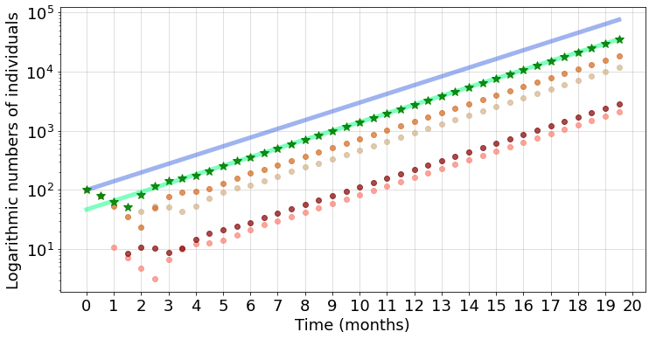
Stage-structured population: Tenebrio molitor
Using semi-logarithmic axes, we can see that after the stable stage-structure is reached, the growth of each life stage on the ln-scale becomes linear and the lines become parallel.

Slide 7
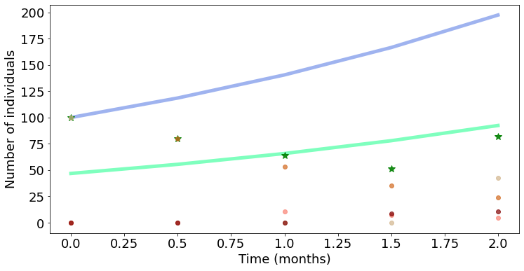
Stage-structured population: Tenebrio molitor
Zooming in the first 2 months of the simulation, we can observe the oscillation(s) of the system.

Slide 8
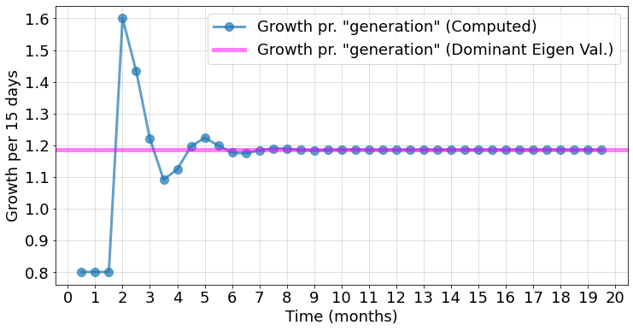
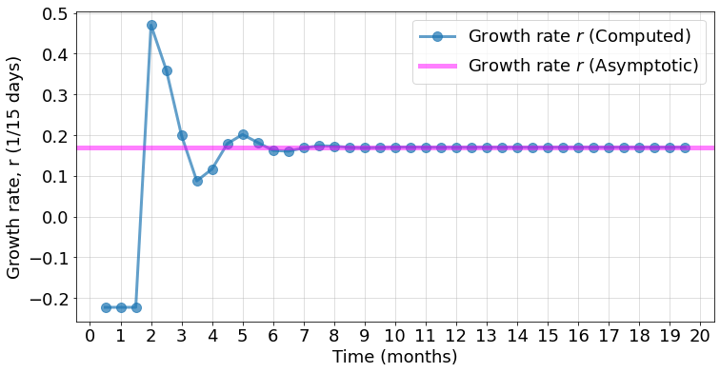
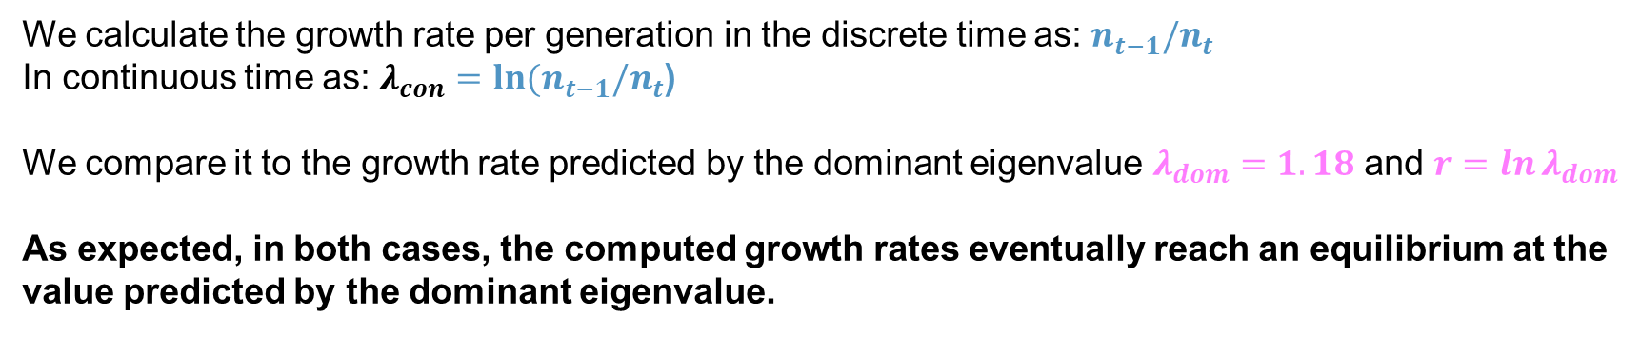
Stage-structured population: Tenebrio molitor
We calculate the growth rate per generation in the discrete time as: $n_{t−1}/n_{t}$
In continuous time as: $λ_{con}=ln{{(n}_{t−1}/n_{t}}$)
We compare it to the growth rate predicted by the dominant eigenvalue $λ_{dom}=1.18$ and $r=\ln{λ_{dom}}$
As expected, in both cases, the computed growth rates eventually reach an equilibrium at the value predicted by the dominant eigenvalue.

Slide 9
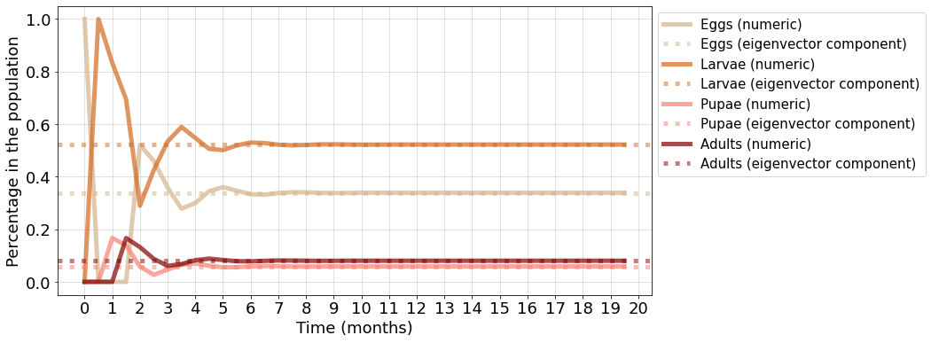
Stage-structured population: Tenebrio molitor
Plotting the ratio of each life stage in the population, it is clear that the stable stage-structure is reached.
The stable ratios for each stage coincide with the ratio of the eigenvector of the dominant eigenvalue to the sum of these eigenvectors, for each life stage.
Ratio in the population

Slide 10
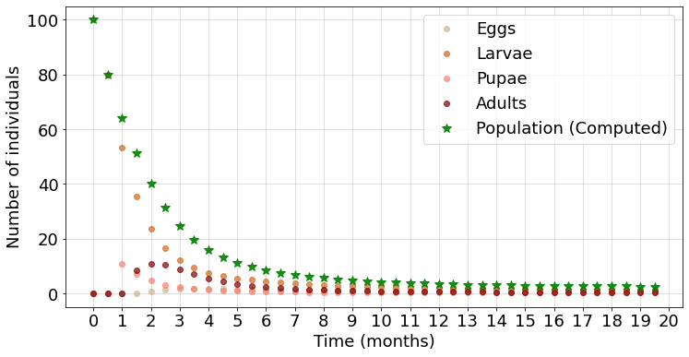
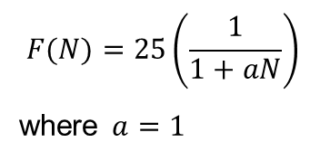
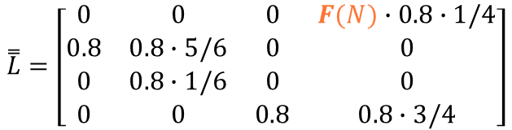
Stage-structured population: Density dependence
We attempt to introduce a density dependence in the fecundity term. Now fecundity is defined as by:
$$F(N)=25\left(\frac{1}{1+aN}\right)$$
where $a=1$
$$\overset{̿}{L}=\left[\begin{matrix}0 & 0 & 0 & F(N)∙0.8∙1/4 \\ 0.8 & 0.8∙5/6 & 0 & 0 \\ 0 & 0.8∙1/6 & 0 & 0 \\ 0 & 0 & 0.8 & 0.8∙3/4\end{matrix}\right]$$
With the current choice of parameters, the population declines in time.
Image source: https://www.heritageacresmarket.com/mealworm-farm/

Slide 11
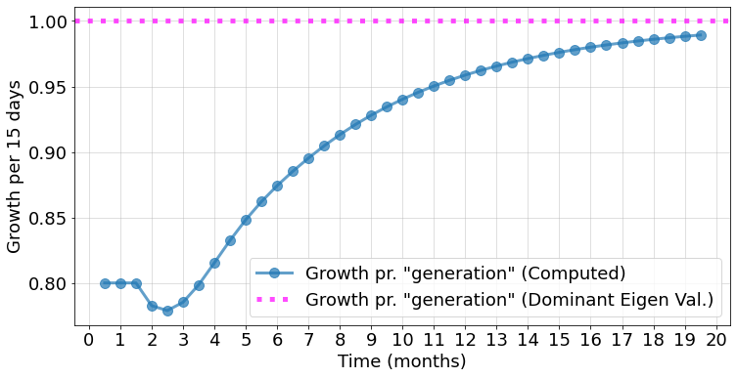
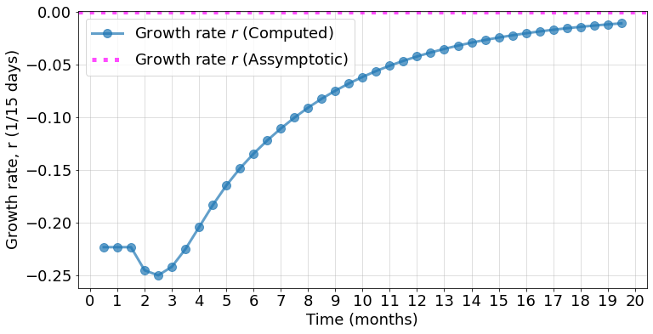
Stage-structured population: Density dependence
For this system, the equilibrium condition is achieved at a dominant eigenvalue $λ_{dom}=1$ (since the system stops growing and r should be zero).
Examining the growth rates in discrete and continuous time, we see, again, that they eventually approach the dominant eigenvalue and its respective r.
Image source: https://www.heritageacresmarket.com/mealworm-farm/

Slide 12
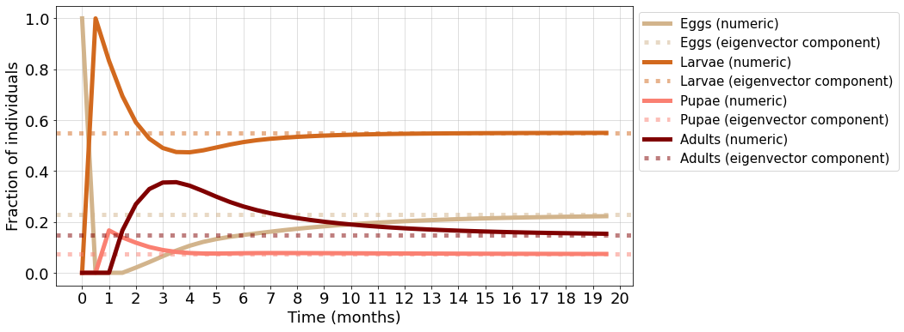
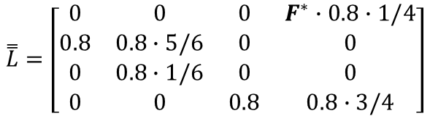
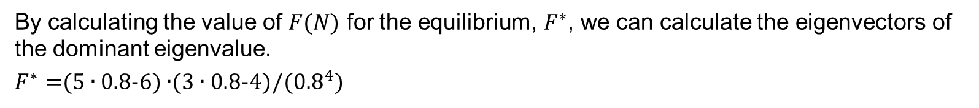
Stage-structured population: Density dependence
By calculating the value of $F(N)$ for the equilibrium, $F^{∗}$, we can calculate the eigenvectors of the dominant eigenvalue.
$F^{∗}=$(5 ∙ 0.8-6) ∙(3 ∙ 0.8-4)/(${0.8}^{4}$)
$$\overset{̿}{L}=\left[\begin{matrix}0 & 0 & 0 & F^{∗}∙0.8∙1/4 \\ 0.8 & 0.8∙5/6 & 0 & 0 \\ 0 & 0.8∙1/6 & 0 & 0 \\ 0 & 0 & 0.8 & 0.8∙3/4\end{matrix}\right]$$
As before:
plotting the ratio of each life stage in the population, it is clear that the stable stage-structure is reached.
The stable ratios for each stage coincide with the ratio of the eigenvector of the dominant eigenvalue to the sum of these eigenvectors, for each life stage.
Image source: https://www.heritageacresmarket.com/mealworm-farm/

Slide 13
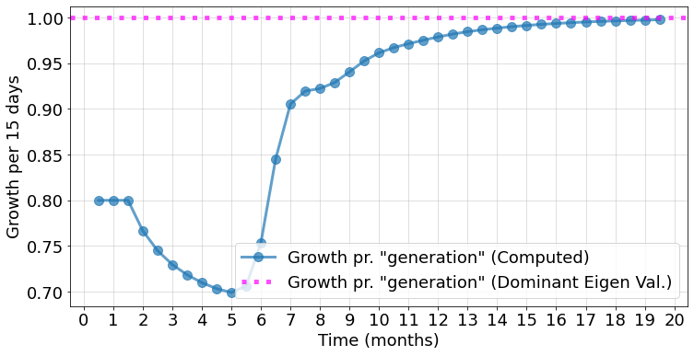
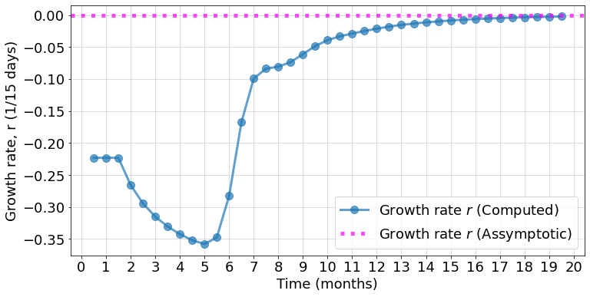


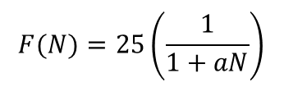
Stage-structured population: Density dependence
Notably, the value of ${ F}^{∗}$ is the what matters for the values of the system in the stable stage structure, and not the actual form of $F(N)$. Of course, though, the transient stage is dependent on $F\left(N\right).$
We compare the previous results with the ones using the new equation
$F\left(N\right)=25e^{−aN},$where $a=1$
$$F(N)=25\left(\frac{1}{1+aN}\right)$$
$$F\left(N\right)=25e^{−aN}$$
Transient phases different, stable phases very similar.
Image source: https://www.heritageacresmarket.com/mealworm-farm/

Slide 14
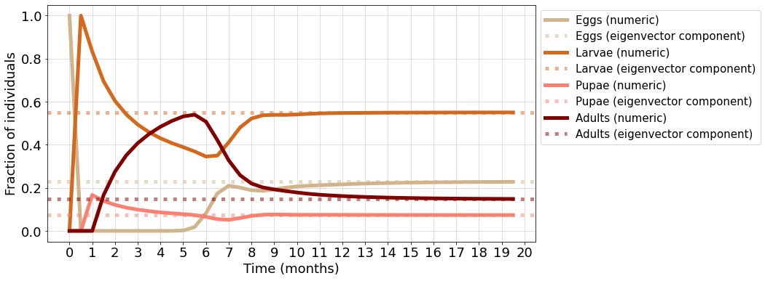

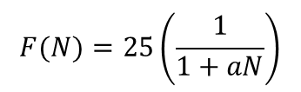
Stage-structured population: Density dependence
$$F(N)=25\left(\frac{1}{1+aN}\right)$$
$$F\left(N\right)=25e^{−aN}$$
Transient phases different, stable phases very similar.
Image source: https://www.heritageacresmarket.com/mealworm-farm/

Slide 15
Code in Python
def time_series(n0, t_end=10):
ret = np.zeros((t_end, len(lams)))
n = n0
ret[0] = n0
for t in range(1, t_end):
n = np.matmul(L, n)
ret[t] = n
return ret
# Fix time:
t_end = 40 # how many steps
t = np.arange(t_end) # make array with 40 steps
xx_ticks = np.linspace(0, 40, 21)
xx_labels = [int(i/2) for i in xx_ticks] # for plot: make the labels for the x axis ticks
state_init = np.array([100, 0, 0, 0]) # set initial number of individuals for the 4 stages
sim_res = time_series(state_init, t_end=t_end) # solve the function
pop = np.sum(sim_res, axis=1) # find total population:
growth = pop[1:]/pop[:-1] # find growth rate:
proportions = np.array([s/np.sum(s) for s in sim_res]) # find the proportions of each stage
discrete_style = {"linestyle":None, "linewidth":0, "marker":'o', "markersize":6, "alpha":0.7}
labels = ["Eggs", "Larvae", "Pupae", "Adults"]
colors = ['tan', 'chocolate', 'salmon', 'maroon']
fig, ax = plt.subplots(figsize=(12, 6))
for i, state in enumerate(sim_res.T):
ax.plot(t, state, label=labels[i], color=colors[i], **discrete_style)
ax.plot(t, pop[0]*np.exp(r*t), label="Population (Asymptotic solution, Forward)", color="royalblue", alpha=0.5)
ax.plot(t, pop[-1]*np.exp(-r*t)[::-1], color='springgreen', label="Population (Asymptotic solution, Reverse)", alpha=0.5)
ax.plot(t, pop, label="Population (Computed)", color='green', marker = '*', markersize = 10,alpha = 0.9, linewidth = 0)
ax.set_xticks(xx_ticks)
ax.set_xticklabels(xx_labels)
ax.legend(bbox_to_anchor=(1.0, 1), loc=2, borderaxespad=0.5, fontsize=15)
ax.set_xlabel("Time (months)")
ax.set_ylabel("Number of individuals")
ax.grid(alpha = 0.5)
ax.set_yscale('log') # for second graph only!
from scipy.integrate import odeint
import matplotlib.pyplot as plt
import numpy as np
# This is for reasonable fontsize universally defined:
fs_label = 18
parameters = {
'figure.titlesize': fs_label+6,
'axes.labelsize': fs_label,
'axes.titlesize': fs_label+6,
'xtick.labelsize': fs_label,
'ytick.labelsize': fs_label,
'legend.fontsize': fs_label,
'lines.linewidth': 5,
}
plt.rcParams.update(parameters)
L = np.array([
[0, 0, 0, 25*0.8*1/4],
[0.8, 0.8*5/6, 0, 0],
[0, 0.8/6, 0, 0],
[0, 0, 0.8, 0.8*3/4]
])
# getting eigen vals + vects
eig_res = np.linalg.eig(L)
lams, vecs = eig_res # extract the arrays into variables
# getting only the dominatingeigen vals + corresponding eigrn vect.
id_max = max(enumerate([abs(x) for x in lams]), key=lambda x: x[1])[0] #gives index of max eigenvalue
lam_dom, vec_dom = lams[id_max], vecs[:, id_max]
#defining max growth-rate
r = np.log(lam_dom)

Slide 16
Code in Python
fig, ax = plt.subplots(figsize=(12, 6))
ax.plot(t[1:], growth, label="Growth pr. \"generation\" (Computed)", alpha=0.7, marker=".", markersize=20, linewidth=3)
ax.axhline(lam_dom, label="Growth pr. \"generation\" (Dominant Eigen Val.)", alpha=0.5, color="magenta")
ax.legend()
ax.set_xticks(xx_ticks)
ax.set_xticklabels(xx_labels)
ax.set_xlabel("Time (months)")
ax.set_ylabel("Growth per 15 days")
ax.grid(alpha = 0.5)
fig, ax = plt.subplots(figsize=(12, 6))
ax.plot(t[1:], np.log(growth), label="Growth rate $r$ (Computed)", alpha=0.7, marker=".", markersize=20, linewidth=3)
ax.axhline(r, label="Growth rate $r$ (Asymptotic)", alpha=0.5, color="magenta")
ax.legend()
ax.set_xticks(xx_ticks)
ax.set_xticklabels(xx_labels)
ax.set_xlabel("Time (months)")
ax.set_ylabel("Growth rate, r (1/15 days)")
ax.grid(alpha = 0.5)
fig, ax = plt.subplots(figsize=(12, 6))
for i, v in enumerate(vec_dom):
num_prop = ax.plot(t, np.array(proportions).T[i], color=colors[i], label=labels[i]+" (numeric)", alpha = 0.7)
ax.axhline(v/sum(vec_dom), alpha=0.5, linestyle=":", color=num_prop[0].get_color(), label=labels[i]+" (eigenvector component)")
ax.set_xticks(xx_ticks)
ax.set_xticklabels(xx_labels)
ax.legend(bbox_to_anchor=(1.0, 1), loc=2, borderaxespad=0.5, fontsize=15)
ax.set_xlabel("Time (months)")
ax.set_ylabel("Percentage in the population")
ax.grid(alpha = 0.5)
# disregard warning, imaginary part is zero...
# Zoom in the plot
end_tmp = 5
xx_ticks2 = np.linspace(0, 4, 9)
xx_labels2 = [i/2 for i in xx_ticks2]
fig, ax = plt.subplots(figsize=(12, 6))
ax.plot(t[:end_tmp], pop[0]*np.exp(r*t)[:end_tmp], label="Population (Assymptotic solution, Forward)", color="royalblue", alpha=0.5)
ax.plot(t[:end_tmp], pop[-1]*np.exp(-r*t)[::-1][:end_tmp], label="Population (Assymptotic solution)", color='springgreen', alpha=0.5)
ax.plot(t[:end_tmp], pop[:end_tmp], label="Population (Computed)",color='green', marker = '*', markersize = 10,alpha = 0.9, linewidth = 0)
for i, state in enumerate(sim_res.T):
ax.plot(t[:end_tmp], state[:end_tmp], label=labels[i], color=colors[i], **discrete_style)
ax.set_xticks(xx_ticks2)
ax.set_xticklabels(xx_labels2)
ax.set_xlabel("Time (months)")
ax.set_ylabel("Number of individuals")
ax.legend(bbox_to_anchor=(1.0, 1), loc=2, borderaxespad=0.5, fontsize=15)

Slide 17
Code in Python
fig, ax = plt.subplots(figsize=(12, 6))
for i, state in enumerate(sim_res.T):
ax.plot(t, state, label=labels[i],color=colors[i], **discrete_style)
ax.plot(t, pop, label="Population (Computed)", color='green', marker = '*', markersize = 10,alpha = 0.9, linewidth = 0)
ax.legend()
ax.set_xticks(xx_ticks)
ax.set_xticklabels(xx_labels)
ax.set_xlabel("Time (months)")
ax.set_ylabel("Number of individuals")
ax.grid(alpha = 0.5)
# found the fecundity for eigenvalue=1, that is equilibrium condition.
f_star = (5*0.8-6)*(3*0.8-4)/(0.8**4)
L_star = np.array([
[0, 0, 0, f_star*0.8*1/4],
[0.8, 0.8*5/6, 0, 0],
[0, 0.8*1/6, 0, 0],
[0, 0, 0.8, 0.8*3/4]
])
e, v = np.linalg.eig(L_star)
e_dom, v_dom = e[3], v[:,3]
# THEN WE DID THE SAME PLOTS AS BEFORE (IN THE PROVIDED CODE), SO I WILL NOT WRITE IT AGAIN HERE AS IT IS LONG
# AFTERWARDS WE DID THE SAME THING WITH THE SECOND F EQUATION AND PLOTTED WITH THE EXACT SAME WAY
# Question 3: Density dependence
#This defines the fecundity:
a = 1
# f = lambda N: 25*np.exp(-a*N)
f = lambda N: 25*(1/(1 + a*N))
#...and use this functional dependency in the "next-gen" matrix.
L = lambda N: np.array([
[0, 0, 0, f(N)*0.8*1/4],
[0.8, 0.8*5/6, 0, 0],
[0, 0.8*1/6, 0, 0],
[0, 0, 0.8, 0.8*3/4]
])
def time_series_density(n0, t_end=10):
ret = np.zeros((t_end, len(lams)))
n = n0
ret[0] = n0
for t in range(1, t_end):
N = np.sum(n)
n = np.matmul(L(N), n)
ret[t] = n
return ret
state_init = np.array([100, 0, 0, 0])
sim_res = time_series_density(state_init, t_end=t_end)
pop = np.sum(sim_res, axis=1)
growth = pop[1:]/pop[:-1]
proportions = np.array([s/np.sum(s) for s in sim_res])

