Slide 1
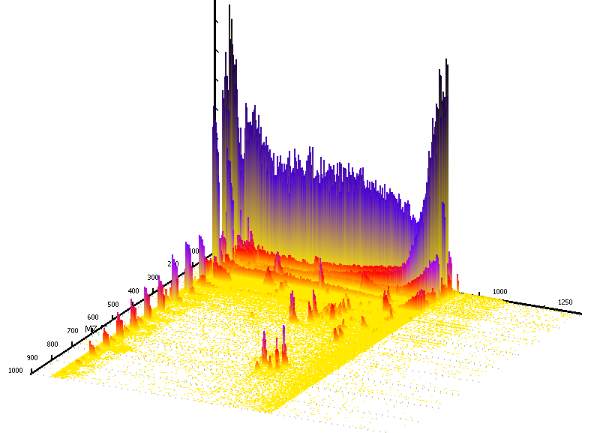


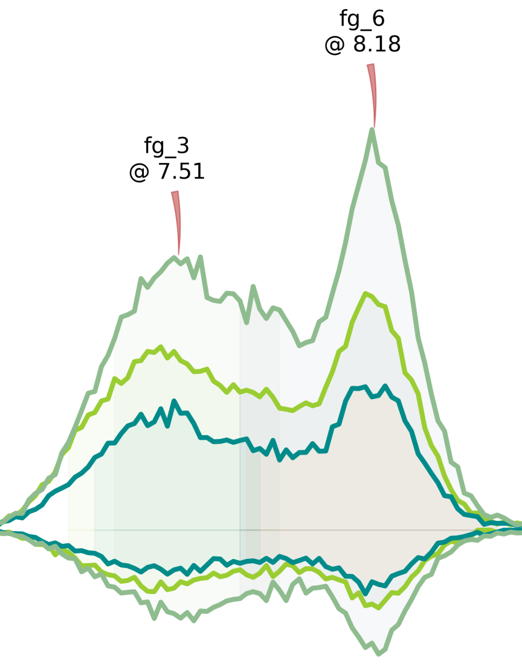
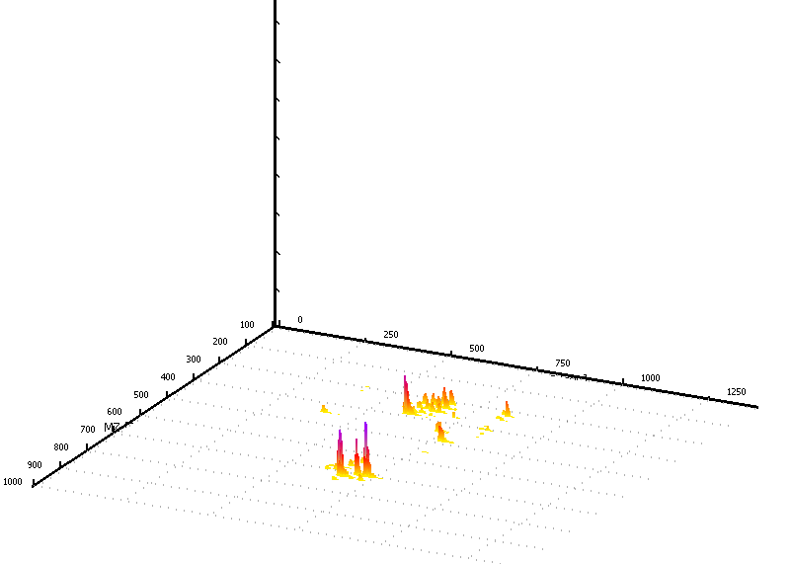
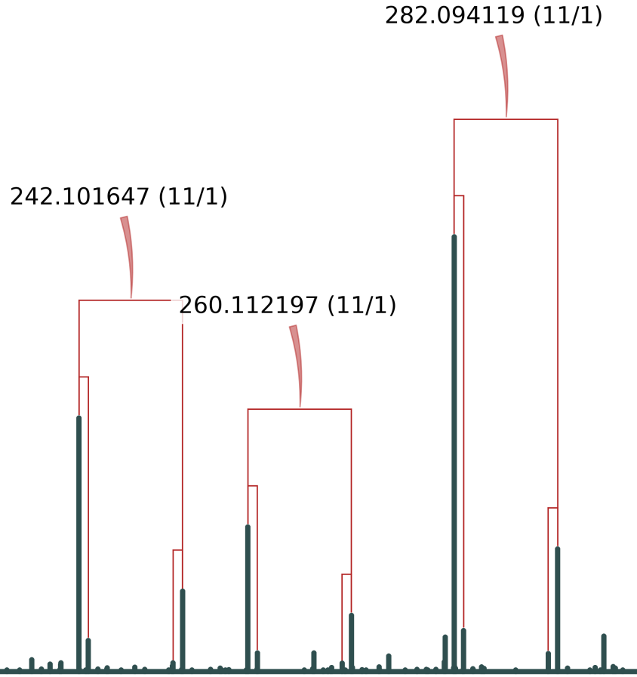




MetExtract: A software tool for the automated data analysis of LC-HRMS data derived from in vivo isotopically labelled samples
Christoph Bueschl, Bernhard Kluger, Nora Neumann, Rainer Schuhmacher
Correspondence: rainer.schuhmacher@boku.ac.at
Center for Analytical Chemistry, IFA-Tulln University of Natural Resources and Life Sciences Vienna Konrad Lorenz Straße 20, 3430 Tulln, Austria
Introduction
LC-HRMS Data
We developed a new software tool MetExtract [5] for the automated evaluation of Liquid Chromatography High Resolution Mass Spectrometry (LC-HRMS) data derived from natural (¹²C) and stable isotopically labelled (¹³C) sample material. Our software uses the unique mirror symmetric isotopic distribution gained from 1:1 (v:v) mixtures of the two isotopologue forms to distinguish between biological relevant and non-relevant sample material. Additionally, the chromatographic information is used to verify this extraction process. Using this technique we are also able to determine the correct number of labelled carbon atoms for each metabolite ion.
The algorithm was verified using 19 standard substances (¹²C and ¹³C forms) spiked into a complex biological fungi matrix. MetExtract was able to extract 17 of the standards. Furthermore, different ion forms of the spiked substances were extracted by the developed algorithm and automatically clustered together.
The performance of the algorithm is exemplified with two biological experiments:
Full metabolome labelling of the fungi Fusarium graminearum
Metabolisation of deoxynivalenol in wheat plants
Intensity
Intensity *10⁶
¹²C
Intensity
Δm/z ≙ C_{n}
¹³C
R_{t}
m/z
m/z
Fig. 1: LC-HRMS chromatogram (ESI pos. mode) obtained from the verification experiment. The analysed sample contained ¹²C- and ¹³C-mycotoxins. Mass spectra show signals of both native and fully labelled mycotoxins (e.g. black circle). Different carbon isotopologues are not separated during chromatography
Algorithm details
1. Pre-processing
2. Ion pair selection
3. Peak picking
4. Feature grouping
5. Alignment
MS-Full scan profile mode
HRMS data
obtained from stable isotopically labelled samples
Mass difference is proportional to the number of labelled C-atoms in the ion
Extract EIC for each m/z value group and separate chromatographic peaks using MassSpecWavelet [3]
Verify corresponding isotopologues by calculating their correlation coefficient
Use chromatographic peak profile to cluster features based on their similarity
Annotate relationship between features in group
Group features found in different measurements (replicates, conditions, ..)
Perform alignment if necessary (Polynomial Time warping [6])
?
?
?
?
Intensity
Threshold
Centroidation
m/z
¹²C
Intensity
¹³C
0 Intensity
m/z
!
∆ m/z
Intensity
¹²C
Statistical analysis
Intensity
Retention Time
Biological replicates
Technical replicates
Time series analysis
Comparison wild type & mutant(s)
..
m/z
Peak 1
Peak 2
¹³C
Intensity
Retention Time
m/z
m/z
Fig. 2: LC/MS chromatogram (ESI pos. ionisation mode) after processing the data from Fig. 1 with MetExtract. As one can see in the black circle, the double peaks resulting from different labelled structural isotopologues are removed as are unspecific MS signals
[M+Na]⁺
Further analysis
Conversion
Vendor specific file format
mzXML [1]
(open data format)
R_{t}
[M-H₂O+H]⁺
[M+H]⁺
Intensity
m/z
Experimental section
Experimental Setup & Results
Experimental Setup & Results
Experimental Setup & Results
Verification of the algorithms performance was done using 19 mycotoxin substances available as ¹²C- and ¹³C- labelled pure standards
17 have been correctly assigned in the LC-HRMS data. Various adduct ions have been recorded in both, positive and negative, ESI mode. The correct number of C-atoms was assigned to each extracted feature by the developed algorithm
Verification of the algorithms performance was done using 19 mycotoxin substances available as ¹²C- and ¹³C- labelled pure standards
17 have been correctly assigned in the LC-HRMS data. Various adduct ions have been recorded in both, positive and negative, ESI mode. The correct number of C-atoms was assigned to each extracted feature by the developed algorithm
Verification of the algorithms performance was done using 19 mycotoxin substances available as ¹²C- and ¹³C- labelled pure standards
17 have been correctly assigned in the LC-HRMS data. Various adduct ions have been recorded in both, positive and negative, ESI mode. The correct number of C-atoms was assigned to each extracted feature by the developed algorithm
Acknowledgements
This work was supported by the Austrian Science Fund (project SFB Fusarium 3706-B11), The WWTF (project Toxi-Genome 9793008037) and the Federal Country Lower Austria in co-operation with the European Regional Development Fund (ERDF) of the European Union.
References
[1] Pedrioli PG. et al. (2004). Nat Biotechnol. DOI: 10.1038/nbt1031
[2] Lehner S. et al. (2011). Food Add. Contam. DOI: 10.1080/19440049.2011.599340
[3] Du P. et al. (2006). Bioinformatics. DOI: 10.1093/bioinformatics/btl355
[4] Kluger B. et al. (2013). Anal Bioanal Chem. DOI: 10.1007/s00216-012-6483-8
[5] Bueschl C. et al. (2012). Bioinformatics. DOI: 10.1093/bioinformatics/bts012
[6] Wehrens R. et al. (2011). Springer. DOI: 10.1007/978-3-642-17841-2

Slide 2
MetExtract: A software tool for the automated data analysis of LC-HRMS data derived from in vivo isotopically labelled samples
Christoph Bueschl, Bernhard Kluger, Nora Neumann, Rainer Schuhmacher
Correspondence: rainer.schuhmacher@boku.ac.at
Institute for Analytical Chemistry, IFA-Tulln University of Natural Resources and Life Sciences Vienna Konrad Lorenz Straße 20, 3430 Tulln, Austria
Introduction
LC-HRMS Data
We developed a new software tool, MetExtract [5], to extract only information originating from natural and stable isotopically labelled pendants of a substance. The algorithm was verified using 19 standard substances (¹²C and ¹³C forms) spiked into a complex biological fungi matrix. MetExtract was able to extract 17 of the standards. Furthermore, different ion forms of the spiked substances were extracted by the developed algorithm and automatically clustered together.
After verification of its capabilities, the algorithm was used to analyse the extracellular metabolome of F. graminearum extract. Preliminary results suggest a total of 1348 features in the 3 epigenetic mutants (unpublished data).
More recently the MetExtract algorithm was also used to search for detoxification products of the mycotoxin deoxynivalenol in wheat using ¹²C and ¹³C deoxynivalenol and Orbitrap LC-HRMS [4].
Fig. 1: LC-HRMS chromatogram (ESI pos. mode) obtained from verification experiment. The analysed sample contained ¹²C- and ¹³C-mycotoxins. Mass spectra show signals of both native and fully labelled mycotoxins (e.g. black circle). Different carbon isotopologues are not separated during chromatography
Intensity
¹²C
Intensity
Δm/z ≙ C_{n}
Intensity *10⁶
¹³C
m/z
R_{t}
m/z
Algorithm details
1. Pre-processing
2. Ion pair selection
3. Peak picking
4. Feature grouping
Statistical analysis
MS-Full scan profile mode
HRMS data
obtained from stable isotopically labelled samples
Mass difference is proportional to the number of labelled C-atoms in the ion
Extract EIC for each m/z value group and separate chromatographic peaks using MassSpecWavelet [3]
Verify corresponding isotopologues by calculating their correlation coefficient
Use chromatographic peak profile to cluster features based on their similarity. Allows to group different ion forms (known and unknown)
Biological replicates
Technical replicates
Time series analysis
Comparison wild type & mutant(s)
..
?
?
?
?
Intensity
Threshold
Centroidation
m/z
¹²C
[M+H]⁺
Mass difference
C-atom number
¹³C
Further analysis
Intensity
!
Intensity
[M+K]⁺
[M-?+?]⁺
m/z
Intensity
∆ m/z
Retention Time
m/z
Peak 1
Peak 2
Alignment
Group features found in different measurements (replicates, conditions, ..)
Intensity
m/z
Fig. 2: LC/MS chromatogram (ESI pos. ionisation mode) after processing the data from Fig. 1 with MetExtract. As one can see in the black circle, the double peaks resulting from different labelled structural isotopologues are removed as are unspecific MS signals
Conversion
Vendor specific file format
mzXML [1]
(open data format)
R_{t}
m/z
Verification of MetExtract
Experimental Setup & Results
 | Metabolite | Formula | Mass accuracy (ppm) | RT (min) | Assigned adduct ions
01 | Nivalenol | C₁₅H₂₀O₇ | 0.06 | 5.07 | [M+HCOO]⁻
02 | Deoxynivalenol | C₁₅H₂₀O₆ | 0.41 | 6.67 | [M+HCOO]⁻, [M+Cl]⁻
03 | Tetracycline | C₂₂H₂₄N₂O₈ | 1.69 | 6.69 | [M+H]⁺
04 | Oxytetracycline | C₂₂H₂₄N₂O₉
05 | 3-Acetyldeoxynivalenol | C₁₇H₂₂O₇ | 0.18 | 9.26 | [M+HCOO]⁻, [M+Cl]⁻
06 | Roquefortine C | C₂₂H₂₃N₅O₂ | 1.50 | 10.01 | [M+H]⁺
07 | Aflatoxin G2 | C₁₇H₁₄O₇ | 1.54 | 10.17 | [M+H]⁺, [M+Na]⁺, [2M+Na]⁺
08 | Aflatoxin G1 | C₁₇H₁₂O₇ | 1.59 | 10.58 | [M+H]⁺, [M+Na]⁺, [2M+Na]⁺
09 | Aflatoxin B2 | C₁₇H₁₄O₆ | 1.71 | 10.86 | [M+H]⁺, [M+Na]⁺, [2M+Na]⁺
10 | Fumonisin B1 | C₃₄H₅₉NO₁₅ | 1.20 | 11.05 | [M+H]⁺
11 | Aflatoxin B1 | C₁₇H₁₂O₆ | 1.80 | 11.19 | [M+H]⁺, [M+Na]⁺
12 | Fumonisin B2 | C₃₄H₅₉NO₁₄ | 1.10 | 11.67 | [M+H]⁺, [M+Na]⁺, [2M+Na]⁺
13 | Fumonisin B3 | C₃₄H₅₉NO₁₄ | 1.08 | 12.14 | [M+H]⁺
14 | HT-2 toxin | C₂₂H₃₂O₈ | 1.98 | 12.26 | [M+H]⁺, [M+Na]⁺
15 | T2 Toxin | C₂₄H₃₄O₉ | 1.98 | 12.96 | [M+Na]⁺, [2M+Na]⁺, [M+HCOO]⁻, [M+Cl]⁻
16 | Zearalenone | C₁₈H₂₂O₅ | 1.61 | 13.84 | [M+Na]⁺
17 | Sterigmatocystin | C₁₈H₁₂O₆ | 1.07 | 14.07 | [M+H]⁺, [M+Na]⁺
18 | Ochratoxin A | C₂₀H₁₈NO₆Cl | 1.25 | 14.16 | [M+H]⁺, [M+Na]⁺
19 | Patulin | C₇H₆O₄
Material & methods
Verification of the algorithms performance was done using 19 mycotoxin substances available as ¹²C- and ¹³C- labelled pure standards
17 have been correctly assigned in the LC-HRMS data. Various adduct ions have been recorded in both, positive and negative, ESI mode. The correct number of C-atoms was assigned to each extracted feature by the developed algorithm
Standard preparation: Mixed standard solutions (methanol/water, (1+1, v+v)) containing the native ¹²C- and fully ¹³C-labelled metabolites. Each of the metabolites was measured at a concentration level of 500 µg/L, except the aflatoxins (250 µg/L).
LC-HRMS conditions: Orbitrap Instrumentation and HPLC parameters were identical as described by Lehner et al. [2]. MS: Full scan resolving power 60,000 (FHWM @ m/z 400), scan range m/z 100-1,000.
MetExtract processing: Selected settings: Intensity threshold 1,000; Retention time range (min) 2.00-37.00; Number of C-atoms min 4; max 70.
Acknowledgements
This work was supported by the Austrian Science Fund (project SFB Fusarium 3706-B11), The WWTF (project Toxi-Genome 9793008037) and the Federal Country Lower Austria in co-operation with the European Regional Development Fund (ERDF) of the European Union.
References
[1] Pedrioli PG. et al. (2004). Nat Biotechnol. DOI: 10.1038/nbt1031
[2] Lehner S. et al. (2011). Food Add. Contam. DOI: 10.1080/19440049.2011.599340
[3] Du P. et al. (2006). Bioinformatics. DOI: 10.1093/bioinformatics/btl355
[4] Kluger B. et al. (2012). TODO
[5] Bueschl C. et al. (2012). Bioinformatics. DOI: 10.1093/bioinformatics/bts012

Slide 3
PyMetExtract: From Raw data to features [I]
The first step in the presented software is to extract interesting m/z ratios from the measurements mass spectra. Each mass peak in a spectra is checked, if it fulfils some requirements like ¹²C ¹³C ratio (in tracer experiments), isotopic abundance according to the labelling degree and a certain mass accuracy.
?
?
?
Intensity
?
3..n Carbon atoms
m/z
Intensity
m/z
1) Iterate over all recorded mass spectra
2) Iterate over all detected m/z ratio above threshold
3) Iterate over allowed labelling element counts (3..n)
[Parameters: Intensity threshold, Scan Range, Number of X atoms, Max. Loading]
34 Carbon atoms
Allowed m/z error (e.g: 3 ppm)
Mass accuracy
Intensity
m/z
4) Check, if a calculated m/z ratio is present
[Parameters: Max. mass deviation (+/-) ppm]
34 Carbon atoms
Intensity
Allowed ratio (e.g: 1:1)
m/z
34 Carbon atoms
5) Check, if the ratio of the two mono isotopic m/z peaks is within the specified settings (only in tracer mode)
[Parameters: Setup tracers: Monoisotopic ratio is calculated from Element count, Purity natural, Purity labelled, Amount natural, Amount labelled, Lower error, Higher error]
Relative intensity accuracy
Intensity
Theoretical abundance
m/z
6) Check, if the abundance of the first carbon isotopologue in the ¹²C form is within its expected boundaries (C_{n}, Isotopic purity)
[Parameters: Intensity abundance error Non-labelled ion]
34 Carbon atoms
Intensity
Theoretical abundance
m/z
34 Carbon atoms
7) Check, if the abundance of the first carbon isotopologue in the ¹³C form is within its expected boundaries (C_{n}, Isotopic purity)
[Parameters: Intensity abundance error Labelled ion]
!
Intensity
m/z
8) Mass peak has n carbon atoms, is valid and will further processed

Slide 4
PyMetExtract: From Raw data to features [II]
Mass peak grouping aim is to find found m/z values and cluster them together to avoid multiple m/z value peak picking therefore reducing the computational effort required. To perform this step, a hierarchical clustering algorithm is used. First, all extracted m/z ratios having the same number of carbon atoms are clustered together. During the tree splitting step only those clusters remain which have a delta ppm difference between their highest and lowest m/z ration less than a user defined value (typical setting: a multiple of the machine mass accuracy). This is repeated for all number of carbon atoms allowed for the data analysis.
Parameters: Min. Spectra, Clust PPM]
mz bin
mz bin
m/z
mz bin
mz bin
Time

Slide 5
PyMetExtract: From Raw data to features [III]
The third step in the presented software is to chromatographic peaks denoting to one ion from the measurements. This task is accomplished using the Wavelet implementation of Du et.al. (2006) and R
N Carbon atoms
¹²C @ x min
¹³C @ x min
Intensity
R_{t}
Peak width used to calculate the peak correlation
Peak_1 @ y min
m/z
Peak is ignored
Peak_2 @ z min
M’
Peak is ignored
M
References
Du, P.; Kibbe, W. A. & Lin, S. M. Improved peak detection in mass spectrum by incorporating continuous wavelet transform-based pattern matching. Bioinformatics, Robert H. Lurie Comprehensive Cancer Center, Northwestern University Chicago, IL 60611, USA., 2006, 22, 2059-2065

Slide 6
PyMetExtract: From Raw data to features [IV]
The fourth step in the presented software is to find groups of features belonging to the same metabolite. Such different features are commonly in-source fragmentation products, different adducts and polymer ions. The untargeted grouping is performed using the Pearson correlation coefficient. To try and explain the relationship in the group a sum formula generation based on the features m/z distance is performed.
12.a) Untargeted feature grouping is based on the fact that ions from the same metabolite have to have identical (or at least very similar) chromatographic peaks as the peak shape is determined before ionisation during the chromatography. Using the Pearson correlation coefficient, extracted features are compared. If their correlation is above a certain threshold, the features are put in the same group
12.b) Using the m/z ratio difference between two grouped features, possible losses and gains are calculated to determine the relationship between the features. Over conventional approaches having no labelled material the relationship can be further refined using the number of extracted carbon atoms.
[Parameters: Feature grouping]
Note: Graphical illustration may not suggest high correlations between the features. However, it should
[M+H]⁺ → [N+Na]⁺
Feature_1 C_{n}=34
corr=0.89
Feature_3 C_{n}=34
corr=0.92
-H₂O
Feature_2 C_{n}=34
corr=0.98
Feature_1 @ 5 min
Feature group 1
3 features
R_{t}: 5 min
Feature_2 @ 5.03 min
Feature_3 @ 4.98 min
Intensity
R_{t}
m/z

