Slide 1






Instructions
Seasonality analysis
Export results
Diagnosing seasonality
A shiny app to product comprehensive data visualisation and statistical test for detecting and analysing seasonality patterns in clinical datasets.
Funding: This work is funded by the National Plan for Scientific and Technical Research and Innovation of the Ministry of Science and Innovation, Spain (project reference: PID2021-124067OB-C22).

Slide 2
Instructions
Upload data
Visualizations
Seasonality analysis
Run analysis
Decomposition and seasonal indices
Seasonality analysis using Autoregression
Two-sample difference tests
Export results
https://chrglez.shinyapps.io/seasonal-ts/

Slide 3
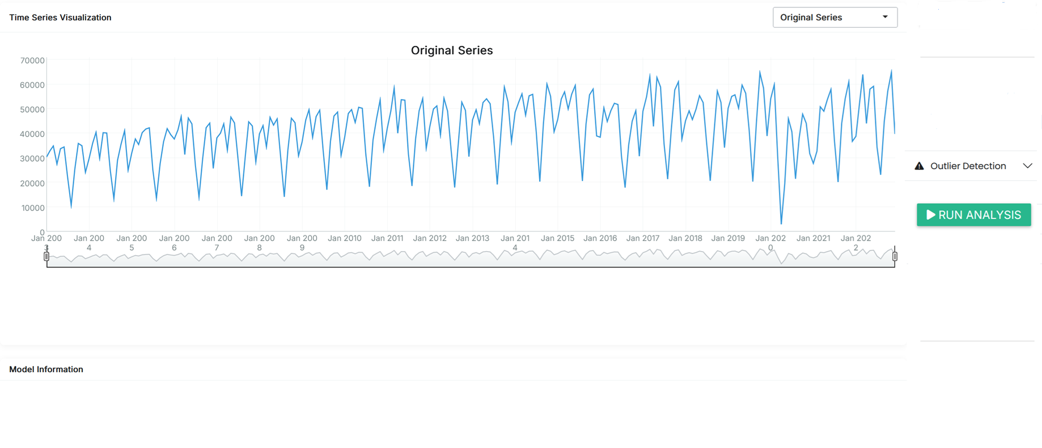
Analysis Export results
Visualization

Slide 4
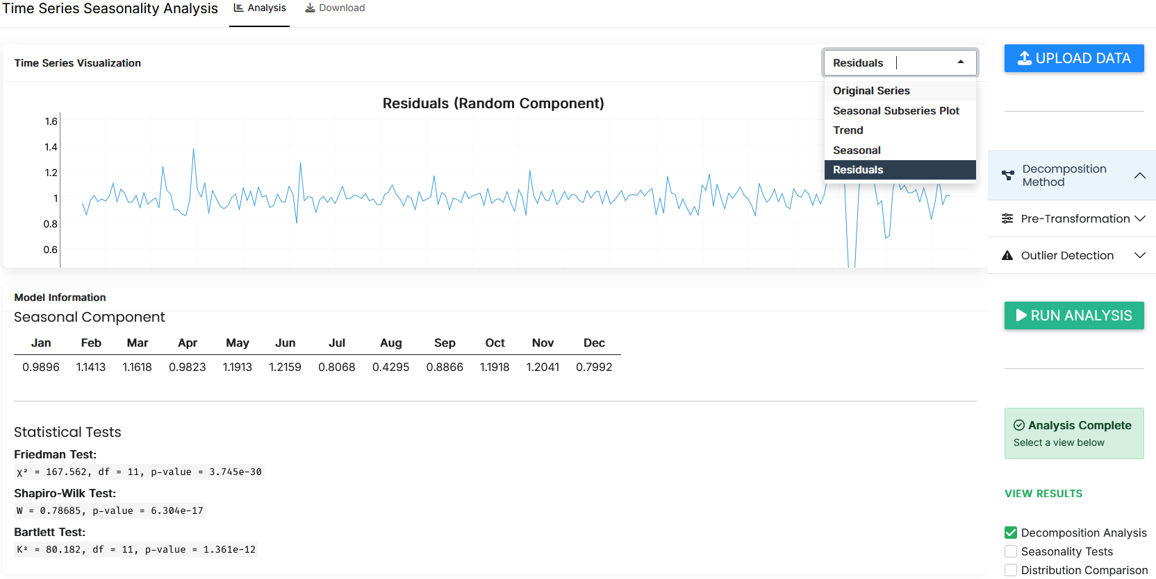

Slide 5
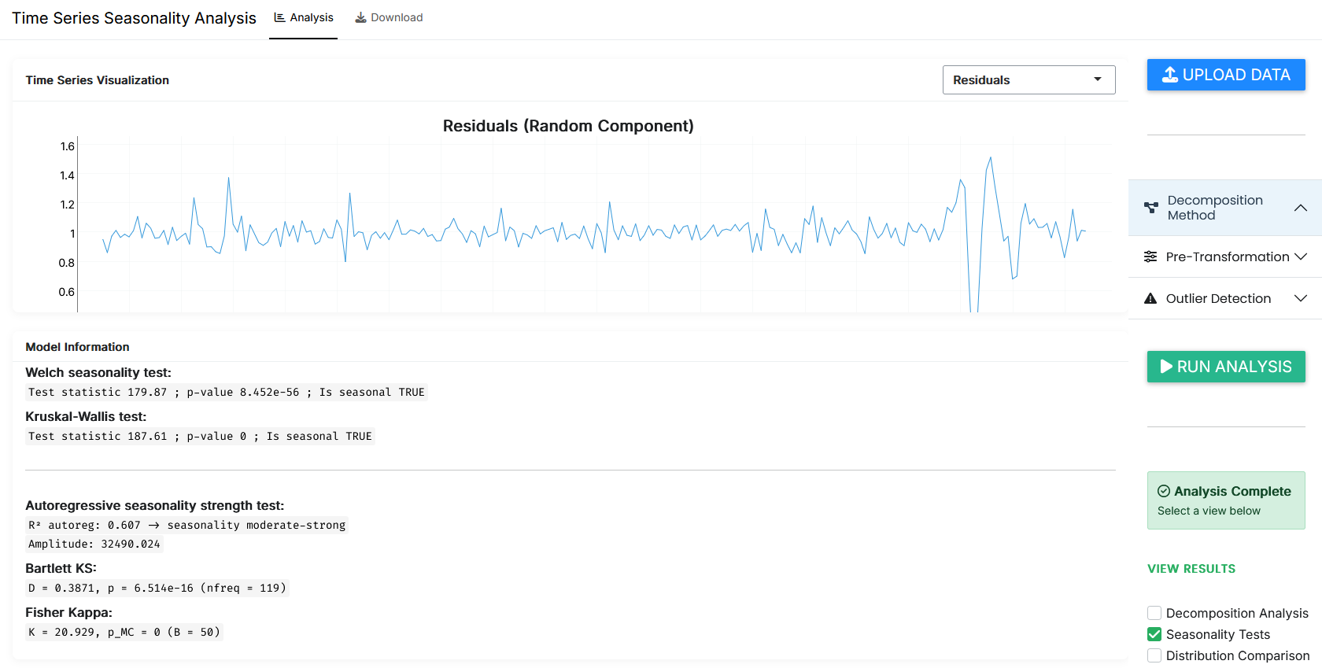

Slide 6
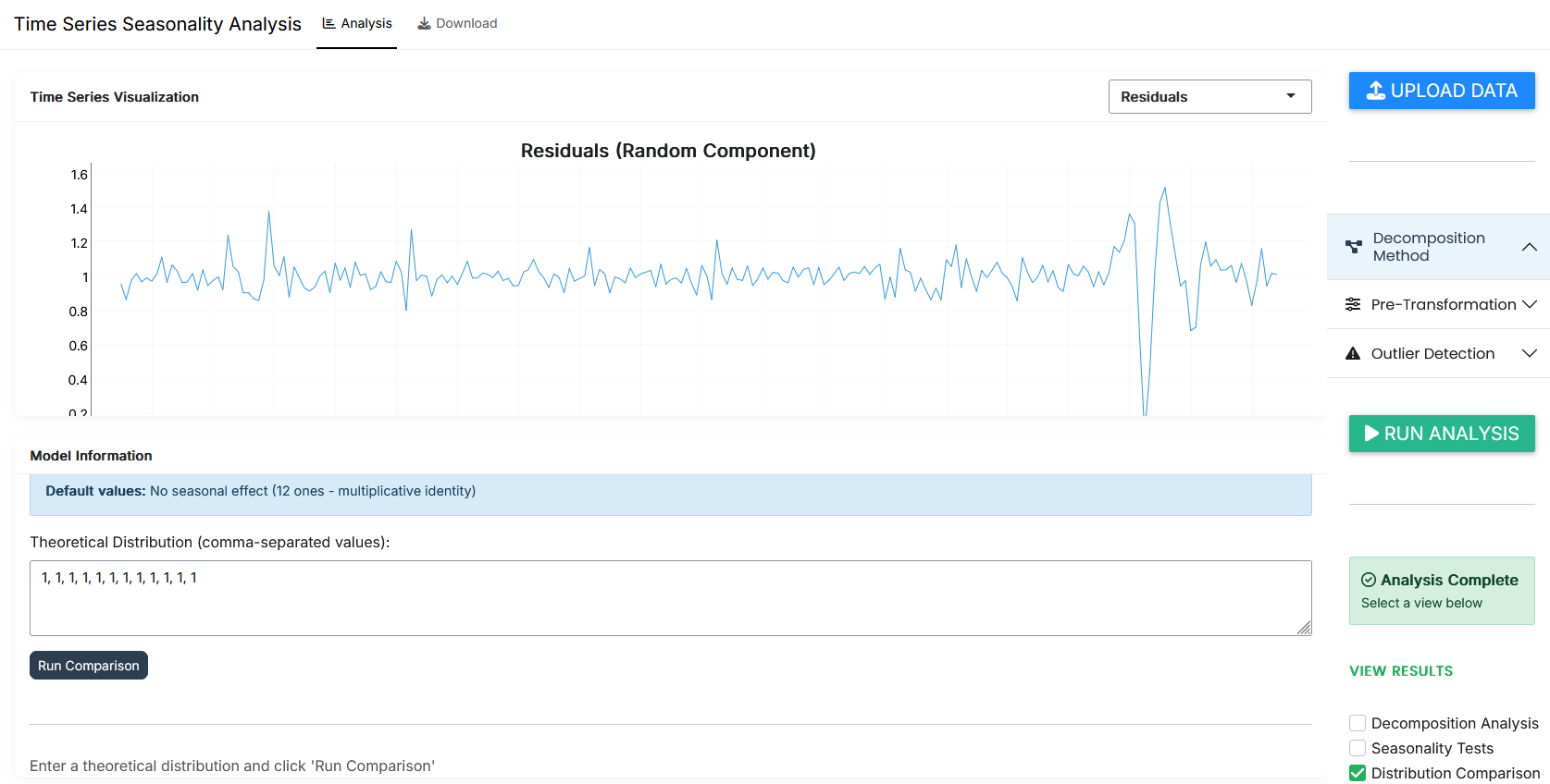

Slide 7
