Slide 1
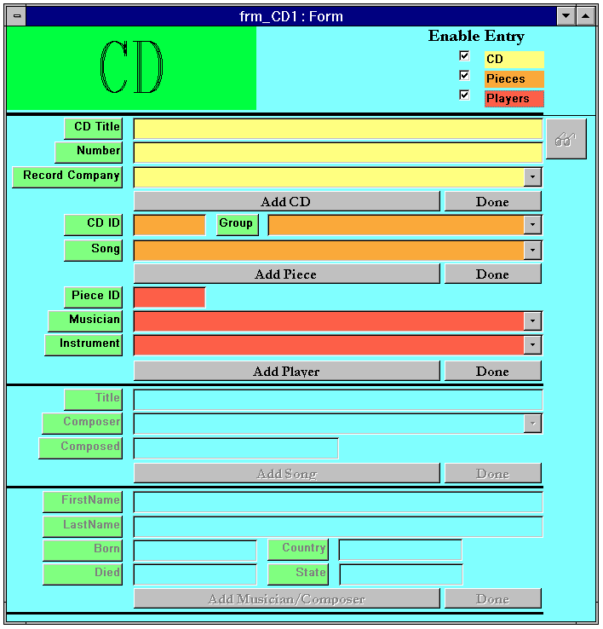
lblCD
chkEnableCD
chkEnablePieces
chkEnable Players
lblEnableEntry
lblEnableCD
lblEnablePieces
lblEnable Players
txtCDTitle
lblCDTitle
lblNumber
lblRecordCompany
lblCDID
lblSong
lblGroup
lblPieceID
lblMusician
lblInstrument
lblTitle
lblComposer
lblComposed
lblFirstName
lblLastName
lblBorn
lblDied
lblCountry
lblState
txtNumber
cmbRecordCompany
cmdAddCD
cmdDoneAddCD
cmdAddPiece
cmdDoneAddPiece
cmdAddPlayer
cmdDoneAddPlayer
cmdAddSong
cmdDoneAddSong
cmdAddMusician
cmdDoneAddMusician
txtCDID
cmbGroup
cmbSong
txtPieceID
cmbMusician
cmbInstrument
txtTitle
txtComposer
txtComposed
txtFirstName
txtLastName
txtBorn
txtCountry
txtDied
txtState
white = 16777215 yellow = 8454143
blue = 16777088 orange = 3844602
red = 4743165

Slide 2
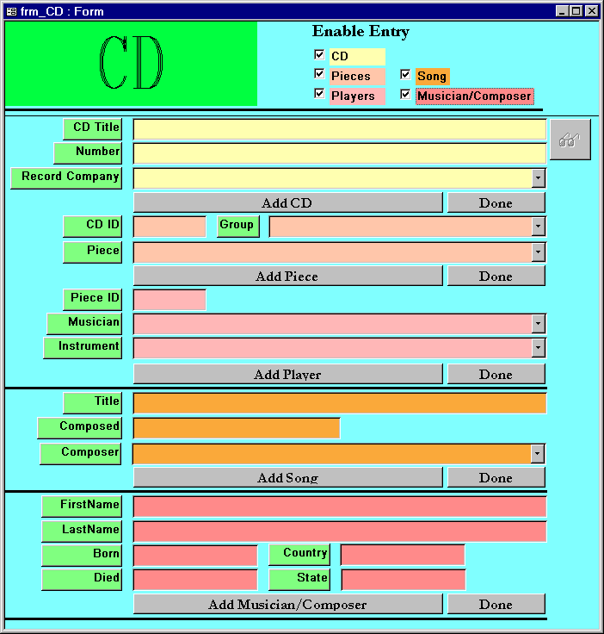
chkEnableCD
chkEnablePieces
chkEnable Players
chkEnableSong
chkEnableMusician
lblCD
lblEnableEntry
lblEnableCD
lblEnablePieces
lblEnable Players
lblEnableSong
lblEnableMusician
txtCDTitle
lblCDTitle
lblNumber
lblRecordCompany
lblCDID
lblSong
lblGroup
lblPieceID
lblMusician
lblInstrument
lblTitle
lblComposer
lblComposed
lblFirstName
lblLastName
lblBorn
lblDied
lblCountry
lblState
txtNumber
cmbRecordCompany
cmdAddCD
cmdDoneAddCD
cmdAddPiece
cmdDoneAddPiece
cmdAddPlayer
cmdDoneAddPlayer
cmdAddSong
cmdDoneAddSong
cmdAddMusician
cmdDoneAddMusician
txtCDID
cmbGroup
cmbPiece
txtPieceID
cmbMusician
cmbInstrument
txtTitle
txtComposed
cmbComposer
txtFirstName
txtLastName
txtBorn
txtCountry
txtDied
txtState
white = 16777215 yellow = 8454143
blue = 16777088 orange = 3844602
red = 4743165

