Slide 1



Designed and Developed By Christopher Walters

Slide 2
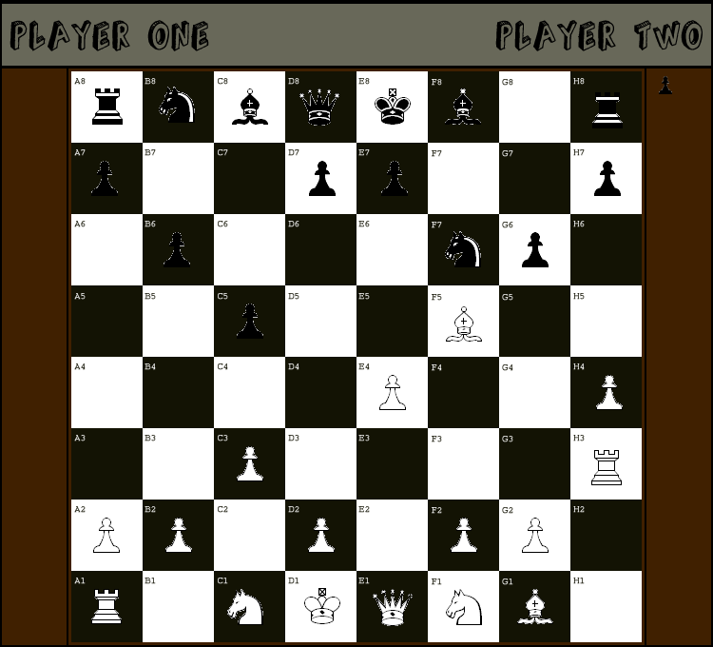
The Game
Standard Chess Rules Apply

Slide 3
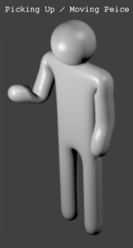

Interactions
Speech
Sequences of speech used to determine desired interaction.
For Example:
‘A2’ -> ‘Move To’ -> ‘B3’ -> ‘Confirm’.
‘Resign’ -> ‘Confirm
‘Return Piece’
Speech
Gestures
Gestures
CREDIT: http://opengameart.org/content/stick-man

Slide 4
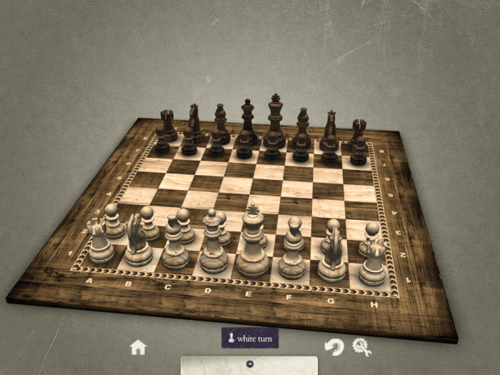
Future Development
CREDIT: http://ichess-3d.en.softonic.com/mac
3D Graphical Feedback
More Gestures
3D visuals enhances realism.
Gestures allowing camera control.
Allows access to various other technologies.

Slide 5
Any Questions?
Thanks for Listening!

