Slide 1
Virtual Shelf
Browse, explore, find, read, borrow, bookmark and annotate books.
Raphaël Tuor
Christoph Reinhart
Nicolas Spycher

Slide 2
Interfaces
1st Interface:
- 2 Modalities: Speech & Gestures
- Possible functions:
- Point at a book and say open
- Search with voice commands: “Show me all books about dinosaurs”
- Sort books with voice commands
- Mark text with your finger
- Mark text and copy it to another application with voice commands
- Mark books as favorite, set bookmarks

Slide 3
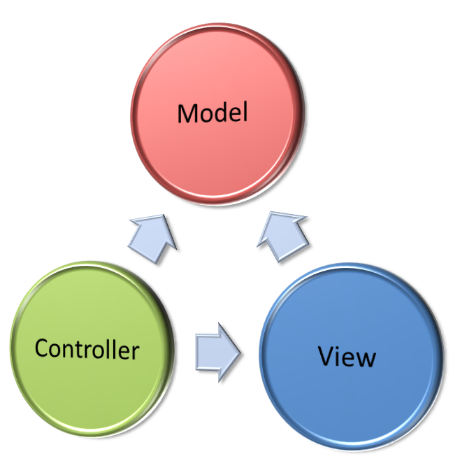
Interaction

Slide 4
1st Interface
Technical details:
Kinect for Gesture- and Speech recognition
Fusion:
- Store the position of the right hand (cursor position) as a global value whenever a new frame is produced by the camera
- If a speech command occurs, call the specific method and look up the position of the cursor

Slide 5
CASE model
Depending on the command either:
Combined, Parallel = Synergistic
Point at a book and say bookmark
Independent, Parallel = Concurrent
Open a book by moving your hand forward or open it by saying open

Slide 6
CARE model
Depending on the command either:
Complementary
You can only bookmark by using a combination of speech and gesture
Equivalent / Redundant
You can open a book just with gestures or by a combination of gesture and speech
Assignment
You can mark Text only with gestures

Slide 7
Interfaces
2nd Interface:
- 2 Modalities: Text, Point & Click (Mouse and Keyboard)

Slide 8
Hypothesis
Can progressive interfaces enhance the experience and the productivity of an user compared to an interface he is already accustomed to?
Test the two different modalities with a evaluation scenario:
- Exp. Search for a certain book, open it, go to a certain page,
mark a certain line of text
- Compare the time with each modality. Test on different kinds of users
- Create a survey to measure the satisfaction of the user

