Slide 1
On the Habitability of Titan
Five studies, one moon: interior to atmosphere
Crick · Nicolaides · Castlevetro · Meadows · Islam Rahim
Notes:
~15 s. Set the frame: one moon, five layers, one question.

Slide 2
Why Titan?
• Life needs three things: a liquid solvent, organic building blocks (CHNOPS), an energy source
• Titan is the only body with a candidate for all three
• The catch: they are kept apart (organics on top, water below ~100 km of ice)
Notes:
~45 s. 'The whole question is whether Titan ever brings them together.'

Slide 3
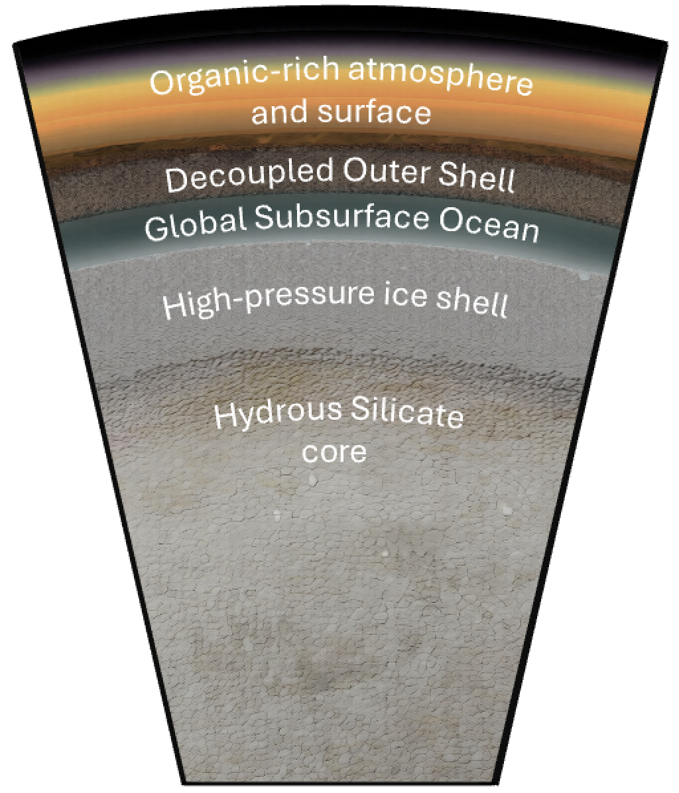
The team's map
• Five studies tile Titan from the deep interior outward:
• Ocean & deep interior — Crick (tidal heating: is there an ocean?)
• Ice shell — Nicolaides (impact melt) + Castlevetro (brine-pocket chemistry)
• Surface — Meadows (Bayesian habitability map)
• Atmosphere — Islam Rahim (vertical profiles)
Titan interior cross-section (team poster figure).
Notes:
~45 s. 'We descend to the ocean, then climb back out to the sky.'

Slide 4
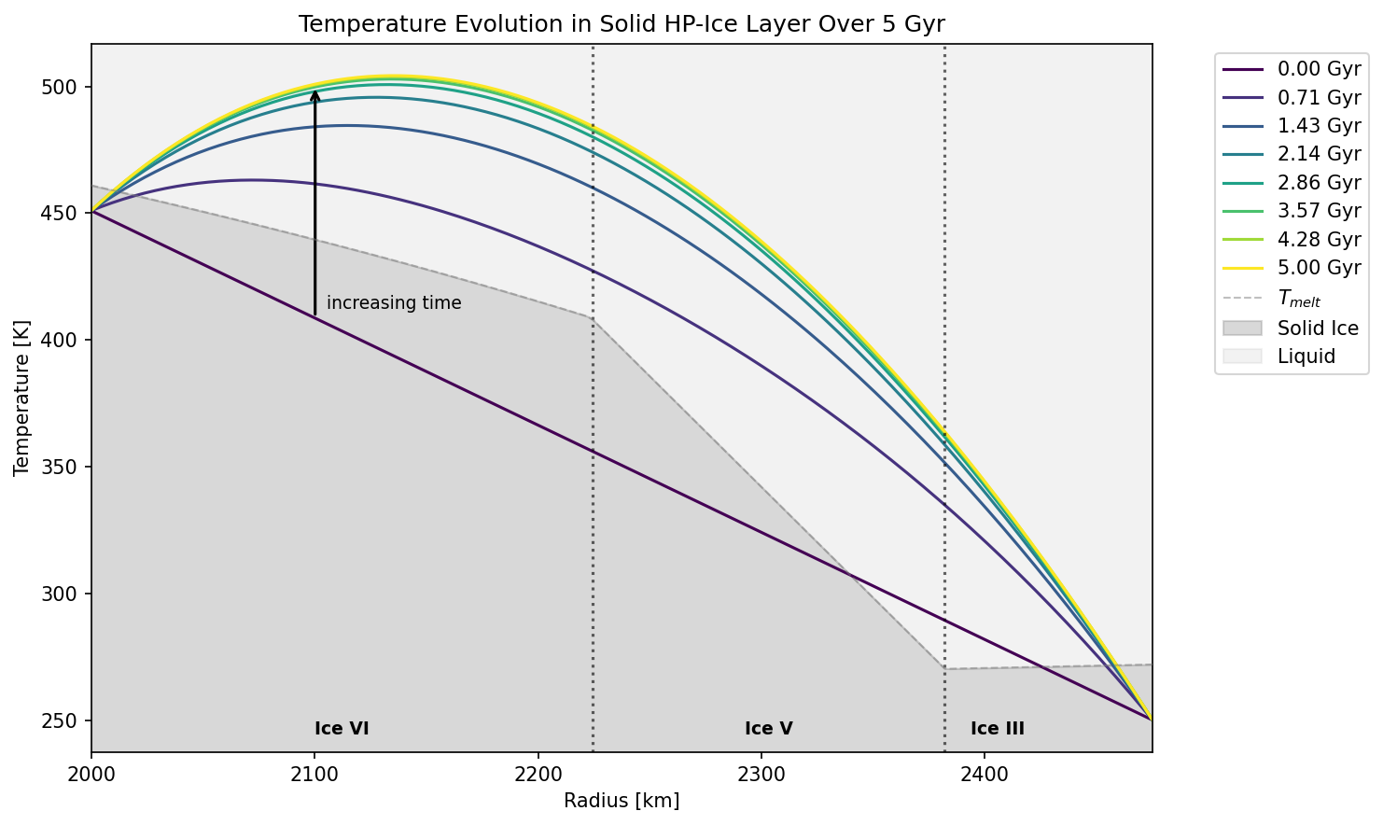
The deep interior: is there an ocean? (Charlotte)
• k₂ = 0.616 ± 0.067 (high) vs 0.375 ± 0.06 (low); PyALMA3 across three interiors (A/B/C)
• All three fit the high k₂; none fit the low → observations still allow an ocean
• Even a solid Titan grows a liquid layer within 0.71 Gyr, sustained to the red giant
• Plant the flag: a 2025 result says there may be no ocean at all — we return to this
Figure: C. Crick (2026), Fig. 6 — tidal-heating melt over 5 Gyr.
Notes:
~60 s. Legend shows the ocean appearing by 0.71 Gyr. Raises the ocean question slide 10 pays off.

Slide 5
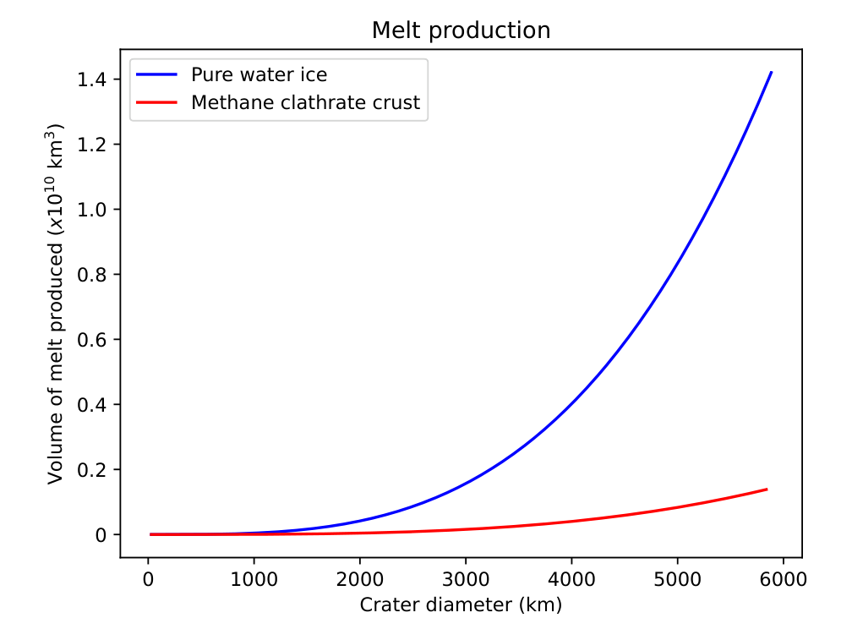
The ice shell: impacts as the bridge (Helena)
• Bombardment history: 339 impacts, most in the early giant-planet instability
• Only ~24 reach the surface; melt 8.98 × 10⁶ km³ (ice) vs 8.75 × 10⁵ (clathrate) — 10×
• ~23% of melt can drain to the ocean; the rest makes surface / shell melt pools
• Catch: pools freeze in 10²–10⁴ yr → habitable, but on the clock
Figure: H. Nicolaides (2026), Fig. 6 — melt volume, water ice vs clathrate.
Notes:
~60 s. The order-of-magnitude gap is the point; clathrate is the conservative case.

Slide 6
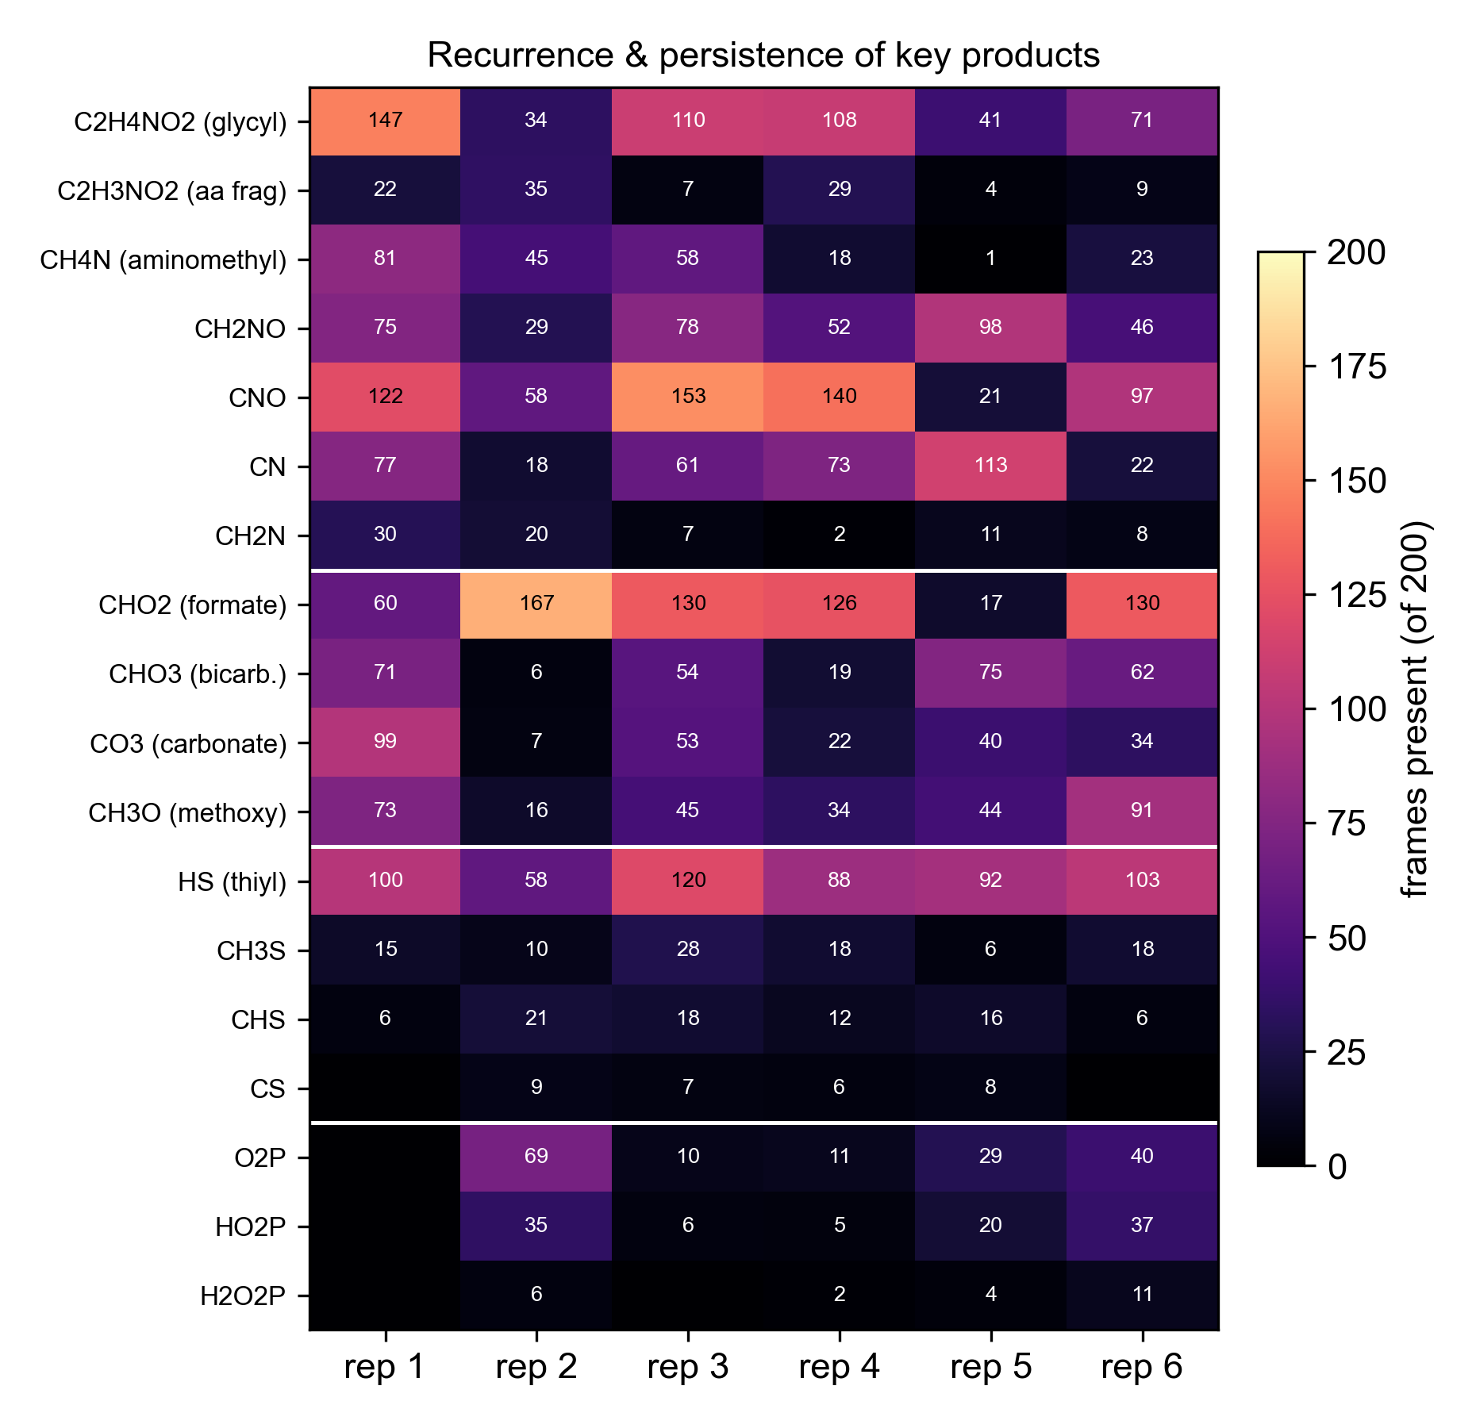
Inside a brine pocket: does chemistry start? (Lucca)
• 1.5 km comet → ~16.6 km crater → warm brine (83% water, 12% methane, tholins, organics)
• Reactive MD (GFN2-xTB), 6 replicas: spontaneous C–N bonds, glycine mobilised, P → phosphate, S chemistry
• Prebiotic first steps appear reproducibly (heatmap: products across rep 1–6)
• Caveat: run hot (1000 K) and tiny (311 atoms) → a screen for possible chemistry, not rates
Figure: L. Castlevetro (2026), Fig. 6 — recurrence of key products across 6 replicas.
Notes:
~60 s. Glycyl in all 6 replicas is the headline; state the caveat plainly.

Slide 7
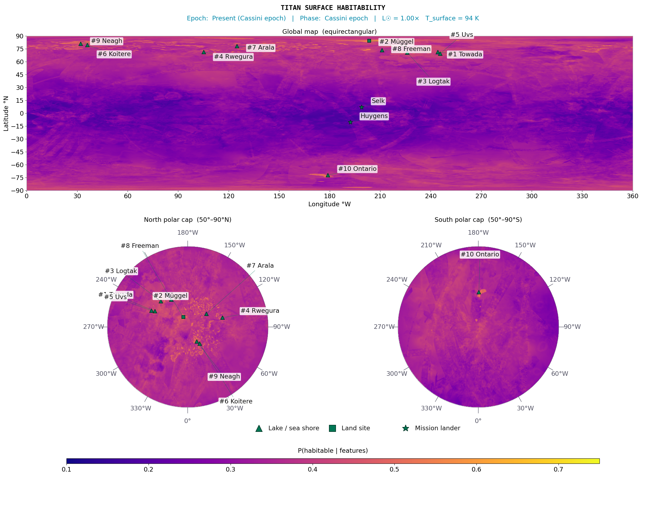
The surface: where is it most habitable? (Chris)
• Bayesian habitability map, whole disc (~6.5M pixels), 8 weighted features, 5 epochs (LHB → red giant)
• North-polar lake shores rank highest; global median P(H) ≈ 0.32 now, ≈ 0.53 in the red-giant future
• Selk (Dragonfly's site) scores low (≈ 0.21): the map backs the mission via geomorphological diversity, not aggregate score
• Map is ocean-agnostic — it scores the surface either way
Figure: C. Meadows (2026) — present-epoch posterior mean P(H) map.
Notes:
~60 s. Equal weight: one of five, not the climax. Selk scores LOW (~0.21) — do not call it a top site.

Slide 8
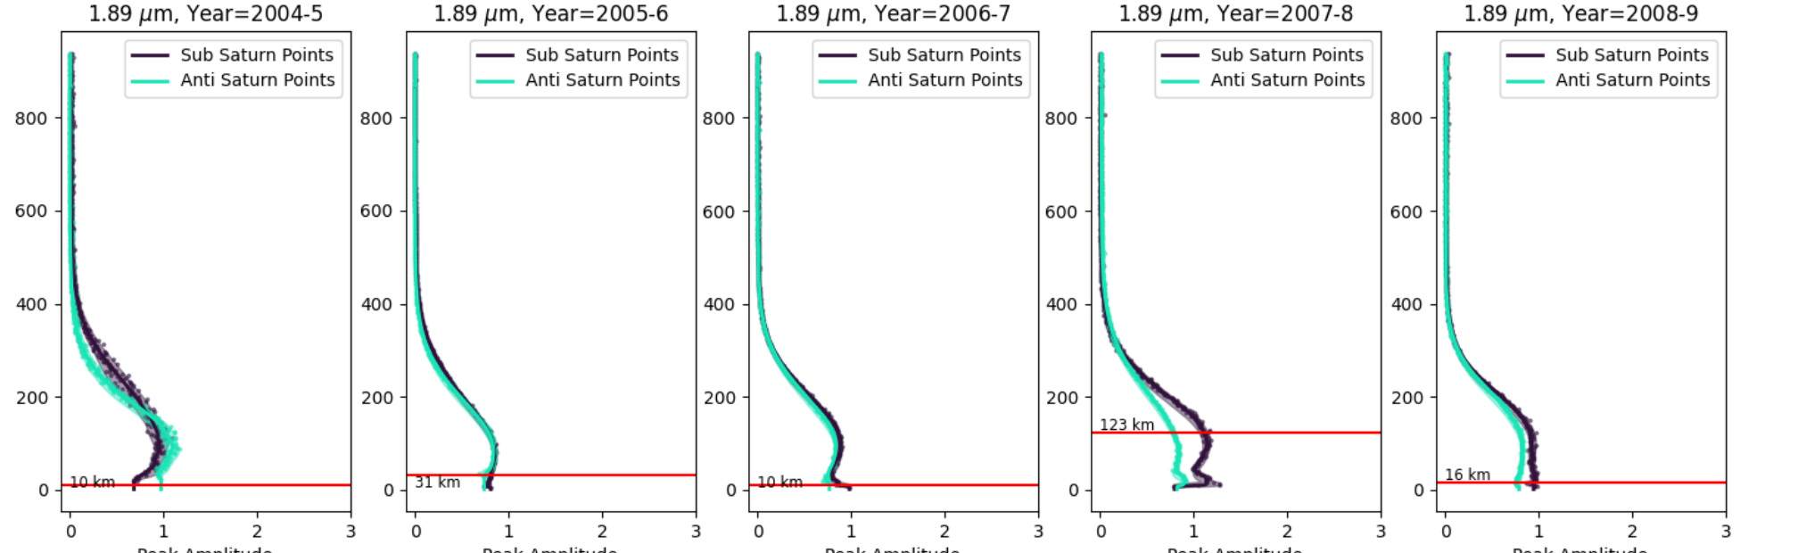
The atmosphere: can we see any of this from orbit? (Imaan)
• Cassini VIMS-IR limb, 2004–2017: two distinct vertical profiles, Sub- vs Anti-Saturn (120° transition)
• Varies over years (equinox minimum 2009); drivers: magnetosphere (favoured), tides, seasonal insolation
• Sharp implication: tidally-locked worlds may not be longitudinally uniform — matters for exoplanets too
Figure: I. Islam Rahim (2026), Fig. 5 — Sub- vs Anti-Saturn profiles at 1.89 µm, 2004–2009.
Notes:
~60 s. Sub-Saturn (dark) vs Anti-Saturn (cyan) diverge, e.g. 123 km in 2007-8. Ends the outward climb.

Slide 9
Where we agree
• Impact cratering is the master bridge (Nicolaides + Castlevetro + Meadows all hinge on it)
• Habitability may not need the global ocean: shell pockets and melt pools are self-contained habitats
• Titan is a moving target: everyone works through time
• Shared next step: Selk crater, Dragonfly (2034), JWST
Notes:
~45 s. The connective tissue across the five studies.

Slide 10
Open questions
• Q1 — Does the ocean exist? Crick: models allow it. Islam Rahim: if the atmospheric asymmetry is tidal, it supports Petricca 2025's no-ocean. Nicolaides: 'if Petricca is right, the ocean-transport story doesn't apply.'
– My read: for surface habitability the ocean debate is second-order (my map scores the surface either way); for interior habitability it's decisive. Honest answer today is 'unresolved', and Dragonfly won't settle it — that needs a dedicated orbiter, not a lander.
• Q2 — Does transient chemistry matter? Pools freeze in 10²–10⁴ yr, yet the chemistry is reproducible.
– My read: the team under-sells the pockets. 10²–10⁴ yr is enormous next to reaction timescales, and a frozen pocket preserves its products. The real limit is abundance (Helena's 339-impact budget), not whether one pocket has 'time'.
• Q3 — What is the crust? Water ice vs clathrate changes melt by 10× and underpins two studies.
– My read: clathrate is the right call (fits shallow craters, insulates the ocean) and is the conservative one — ~10× less melt. The habitability case is made on the pessimistic setting, so it's more robust, not less.
Notes:
~90 s. The slide examiners will probe — slow down, invite the ocean debate.

Slide 11
Synthesis: a layered case
• Interior energy (Crick) → impacts breach the shell (Nicolaides) → concentrated prebiotic chemistry (Castlevetro) → mappable surface niches (Meadows) → expressed in the atmosphere (Islam Rahim)
• Key move: the shell-and-surface niches survive even if the ocean is disproved
• Titan's habitability case does not stand or fall on the ocean
Notes:
~60 s. The climax — credits all five equally.

Slide 12
The arc of time, and what's next
• Bombardment past → Cassini present → red-giant future (Titan may peak in habitability as the Sun expands)
• Near term: Dragonfly at Selk (2034), JWST seasonal monitoring
• The bookend that opened the interior question now closes it
Notes:
~45 s. Return to the time framing that opened the talk.

Slide 13
Verdict
• One line per study
• Collective answer: not 'is Titan alive?' but —
• 'Titan has more independent, testable habitable niches than any other world we can currently reach'
Notes:
~30 s. Land the collective claim, then take questions.

