Slide 1
Austin climate change assessment

Slide 2
Updates from previous meeting
Preliminary temperature & precipitation analysis as communicated by City of Austin completed
Gridded data used, figures made for Camp Mabry. Can be easily reproduced for other stations
Multiple CMIP6 models with their multiple ensembles used 480+ historical models/ensemble simulations, 250+ SSP126 and 250 SSP585 models/ensembles
Further indices added: calm_days, cold_and_dry_days, cold_and_wet_days, cold_spell_days, cold_spell_duration_index, cold_spell_frequency, daily_pr_intensity, daily_temperature_range, daily_temperature_range_variability, days_over_precip_thresh, days_with_snow, dry_days, dry_spell_frequency, dry_spell_total_length, frost_days, frost_season_length, heat_wave_frequency, heat_wave_index, heat_wave_max_length, heat_wave_total_length, hot_spell_frequency, hot_spell_max_length, ice_days, max_1day_precipitation_amount, max_n_day_precipitation_amount, max_pr_intensity, maximum_consecutive_dry_days, maximum_consecutive_frost_days, maximum_consecutive_frost_free_days, maximum_consecutive_wet_days,
Notes:
COA

Slide 3
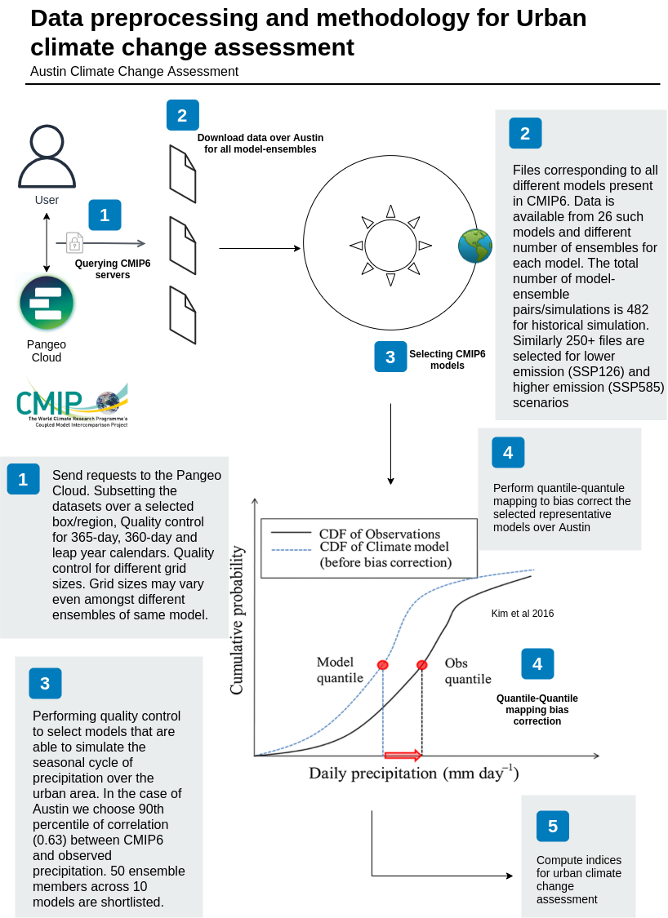

Slide 4
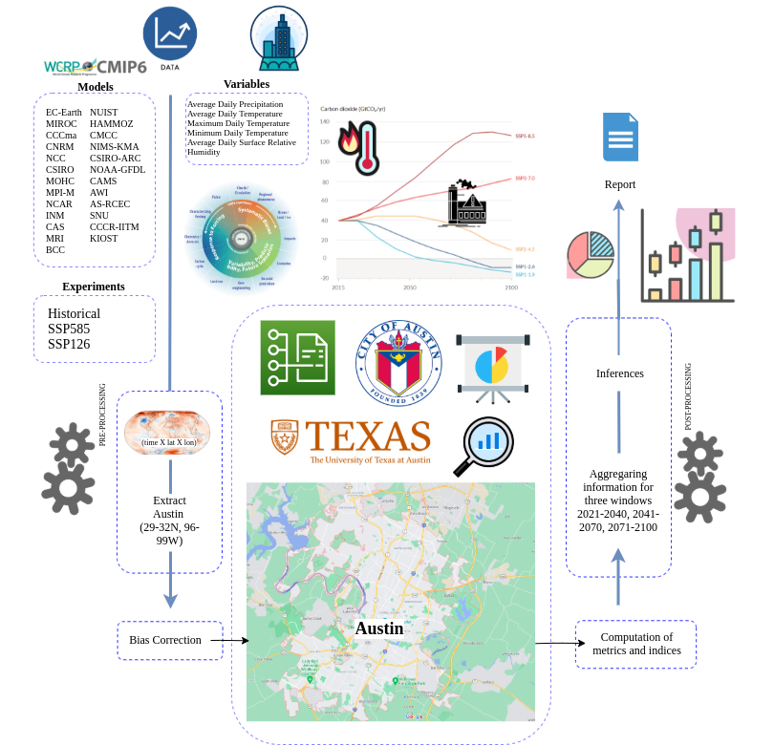

Slide 5
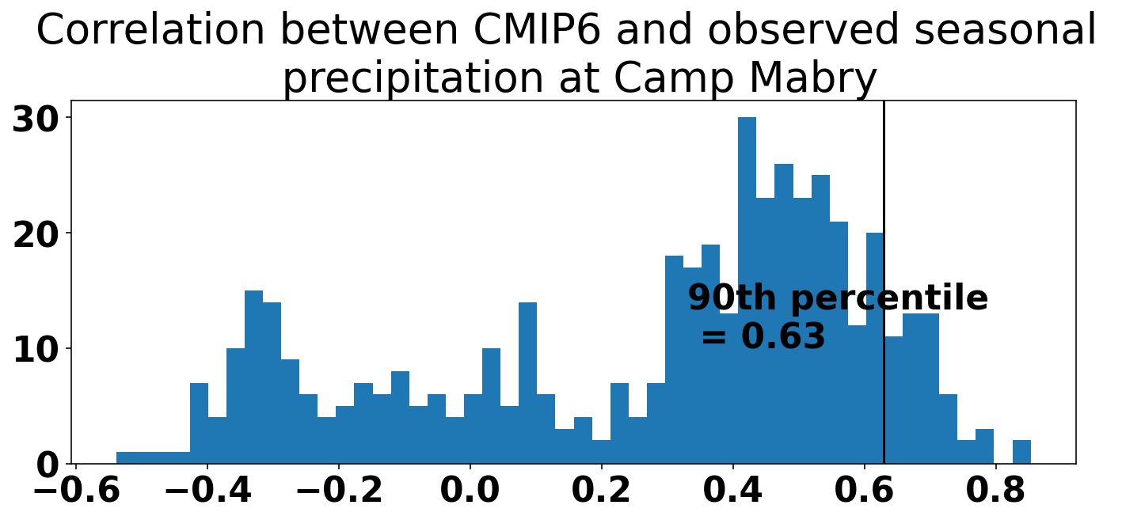

Slide 6
How is the temperature going to change?
Summer maximum temperature is going to remain similar to the present until the mid-century (2041-2070) for the lower emission scenario. For the higher emission scenario during the mid-century, the summer maximum temperature is going to increase by +2-3F. By the late century (2070-2100), the summer maximum temperature will almost be the same in the lower emission scenario while increasing up to +7-8F corresponding to the higher emission scenario.
The number of days with minimum temperature below 32F occur for around 22 times in a year at the Camp Mabry station. These days are going to decrease to 15 (19) times in the higher (lower) emissions scenario in the near term (2021-2040), to 9 (16) times in the higher (lower) emissions scenario in the mid-century (2041-2070) and to 3 (15) times for the higher (lower) emission scenario at the end of the century (2071-2100).
Hot days (>100 F) are going to increase from 10 per year to 14, 44 and 72 in the near-term (2021-2040), medium-term (2041-2070) and end of the century (2071-2100) for the higher emission scenario. The numbers 15,24 and 30 for the lower emission scenario.
The number of very hot days, which are quite rare historically are projected to start occurring in the higher emission scenario for the mid and end of this century. The corresponding numbers are estimated as 1 per year to 9 per year on an average for the higher emission scenario during 2041-2070 and 2071-2100 respectively. These days could go up to 4 and 35 per year for high emissions during the mid and end century.

Slide 7
How is rainfall going to change?
The annual average precipitation is projected to increase the most in the near term (2021-2040) by 40% (20%) in the higher (lower) emission scenario. For the mid and end of the century, the increase is estimated to be ~10% (~20%) for the higher (lower) emission scenario until the end of this century.
The number of dry days is expected to decrease by 10-40 days in the different emission scenarios in future.
The number of days with precipitation greater than 2 inches is projected to increase by about +1 every year for the different emission scenarios until the end of this century (2100).
S.No | Experiment | Window | Daily precipitation intensity (mm/day) | % change relative to historical
1 | historical | 1979-2020 | 9.76
2 | ssp126 | 2021-2040 | 9.89 | 1.33
3 | ssp126 | 2041-2070 | 10.27 | 5.22
4 | ssp126 | 2071-2100 | 10.31 | 5.64
5 | ssp585 | 2021-2040 | 10.41 | 6.66
6 | ssp585 | 2041-2070 | 10.19 | 4.4
7 | ssp585 | 2071-2100 | 10.39 | 6.45

Slide 8
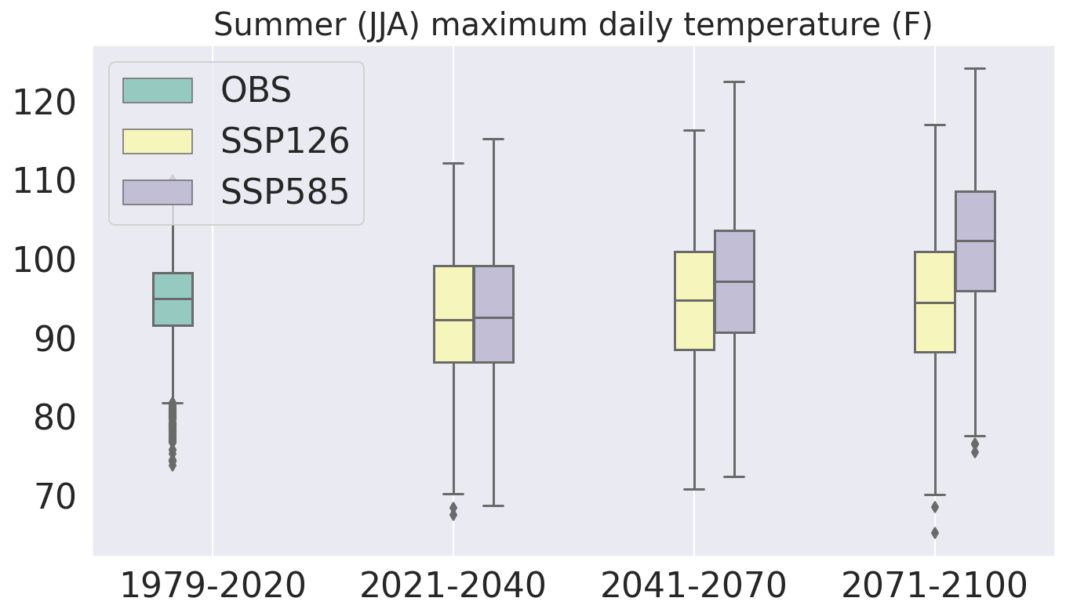

Slide 9
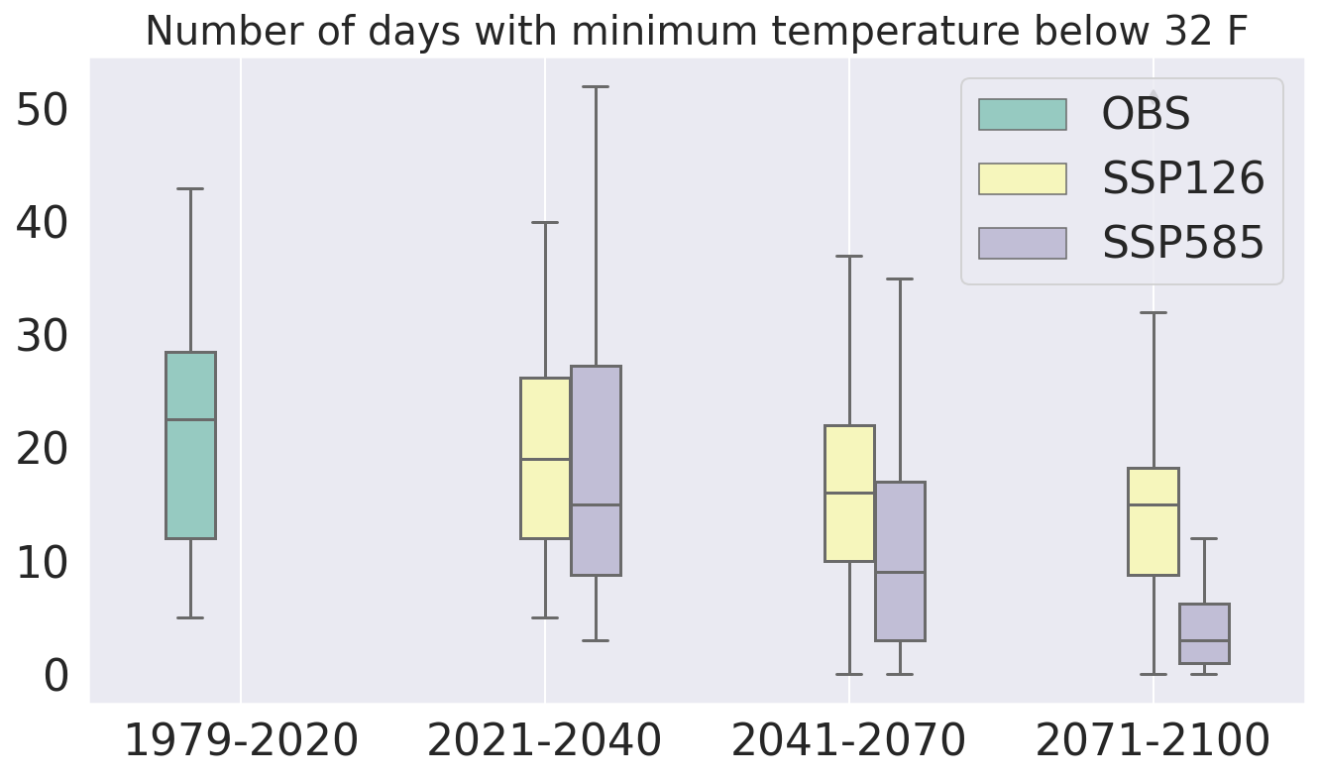

Slide 10
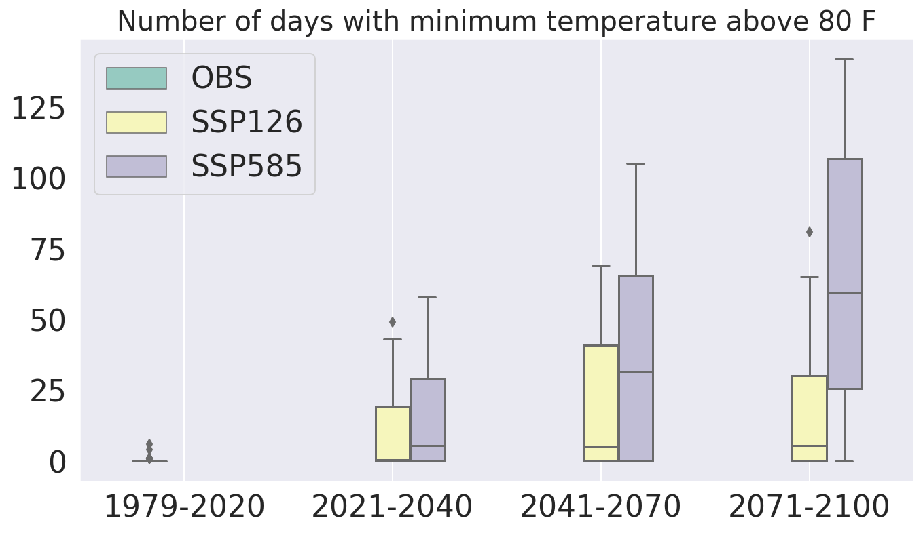

Slide 11
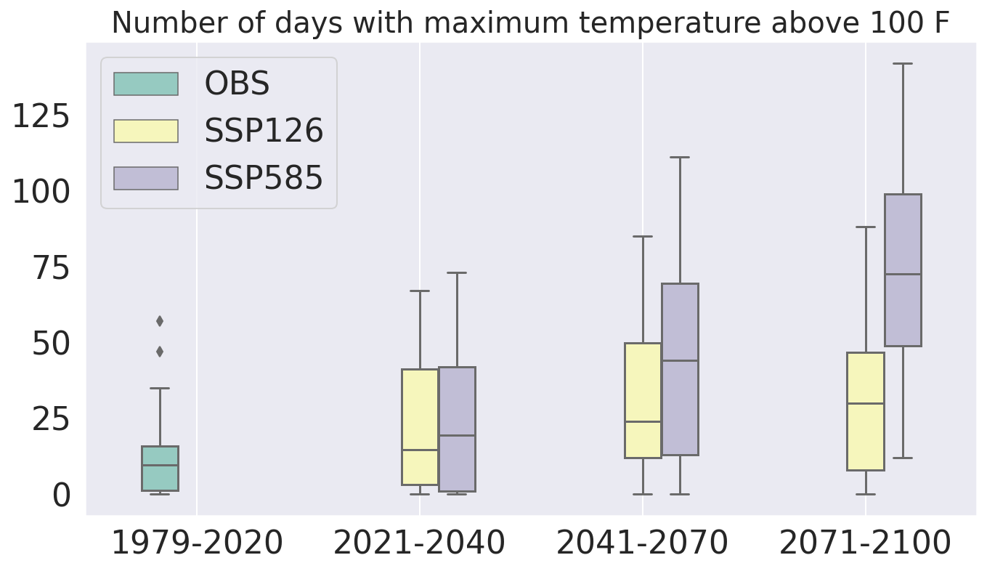

Slide 12
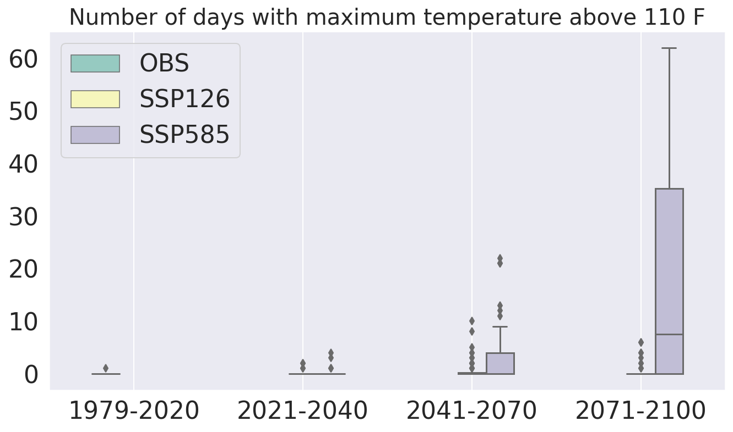

Slide 13
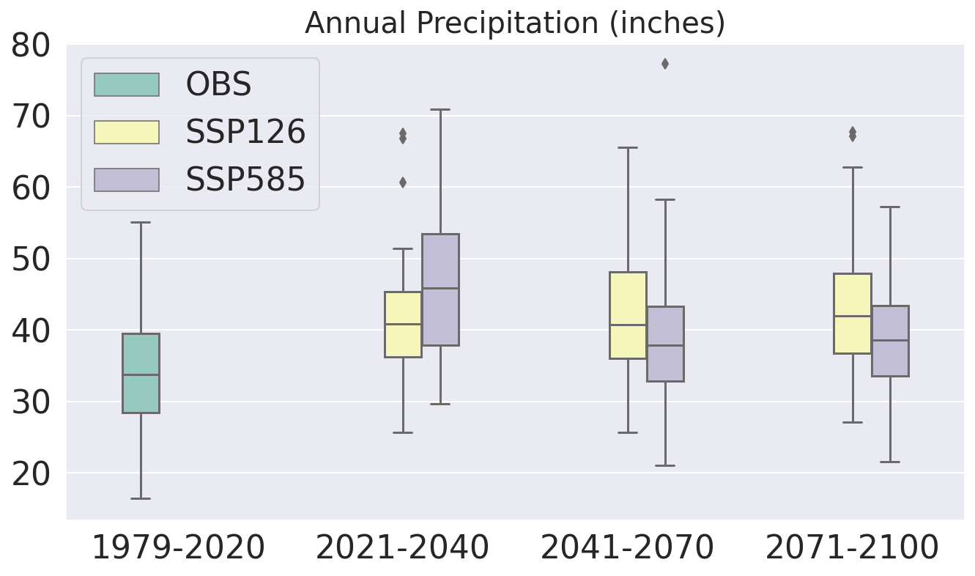

Slide 14
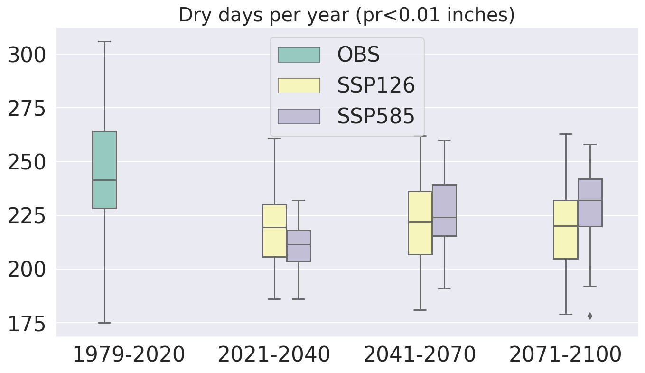

Slide 15
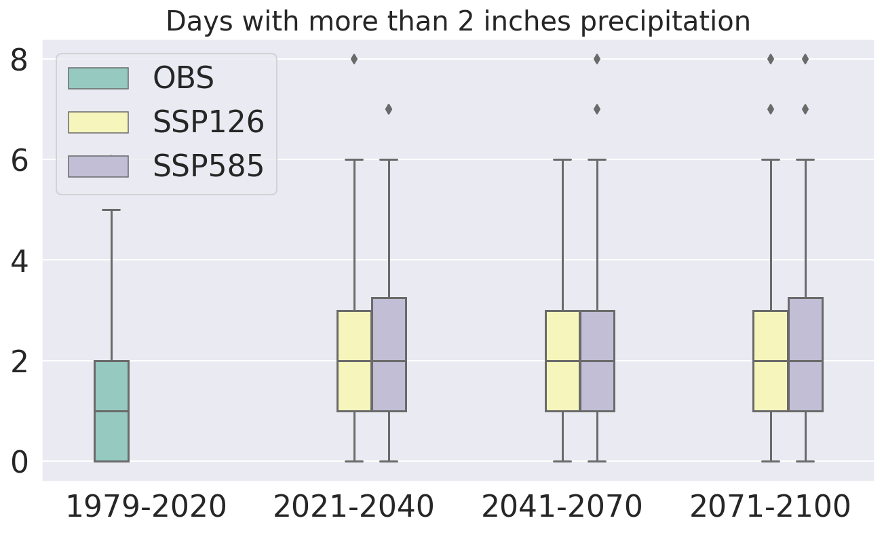

Slide 16
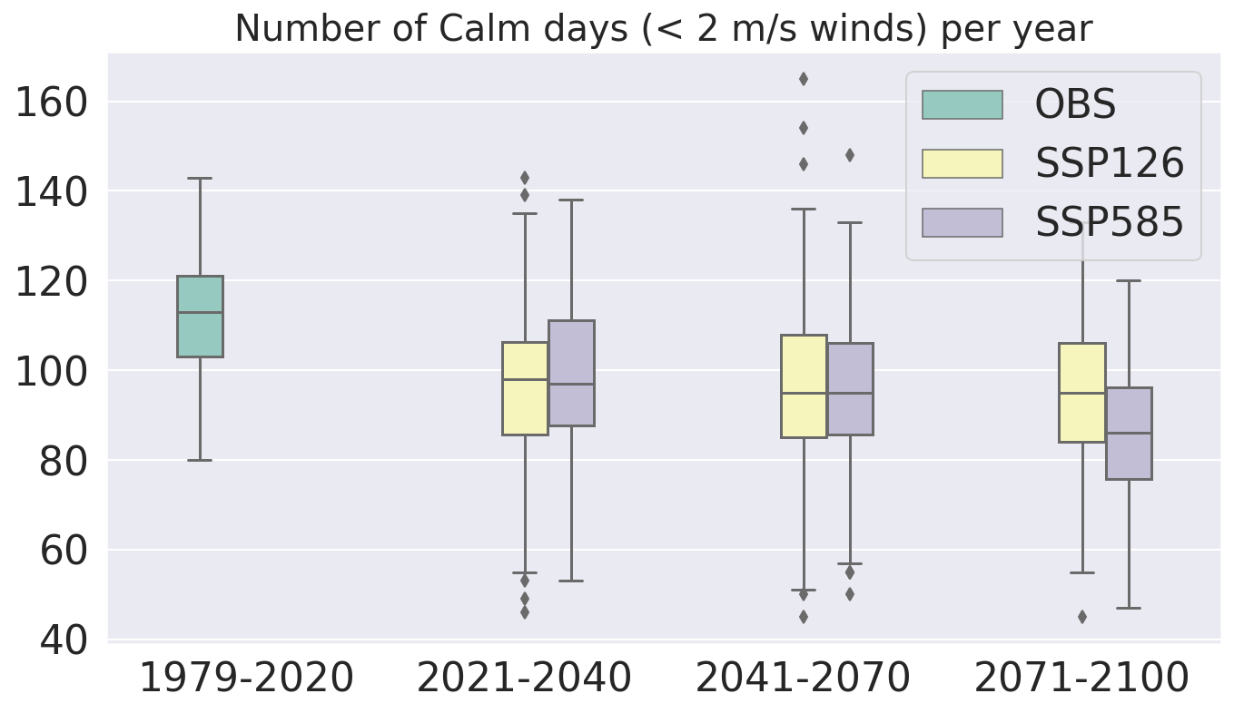

Slide 17
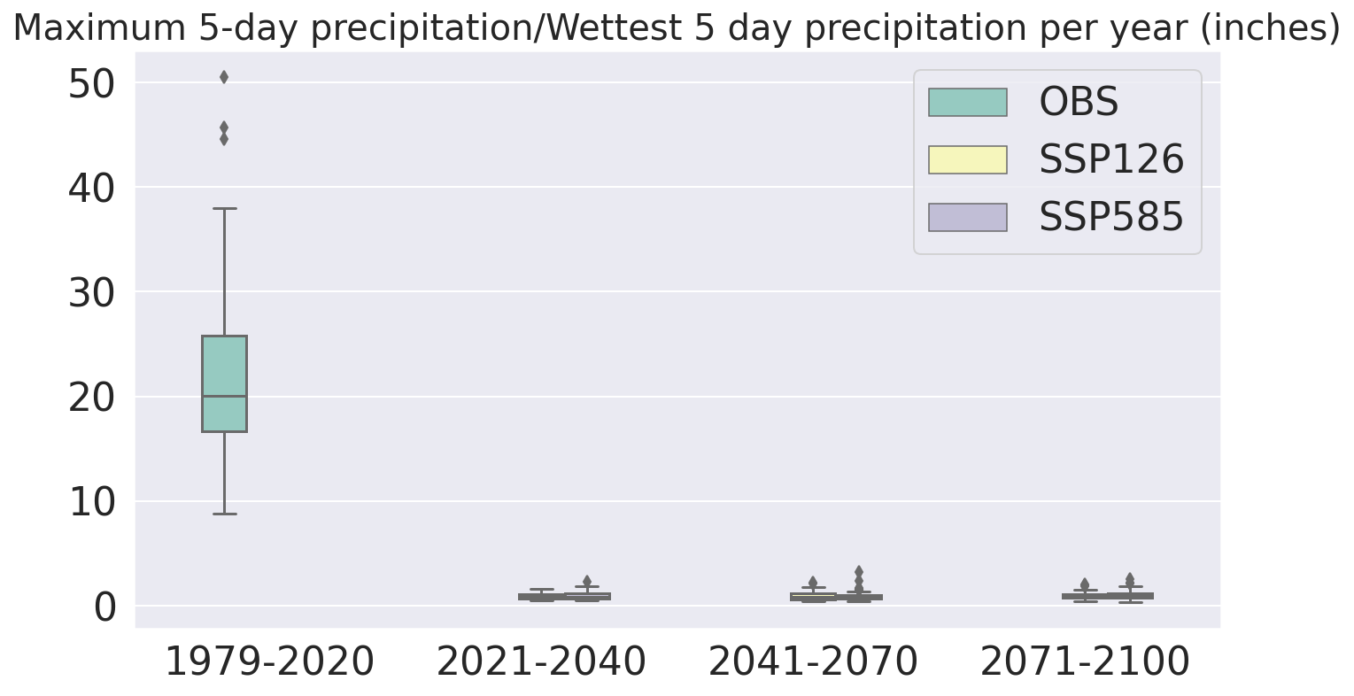

Slide 18
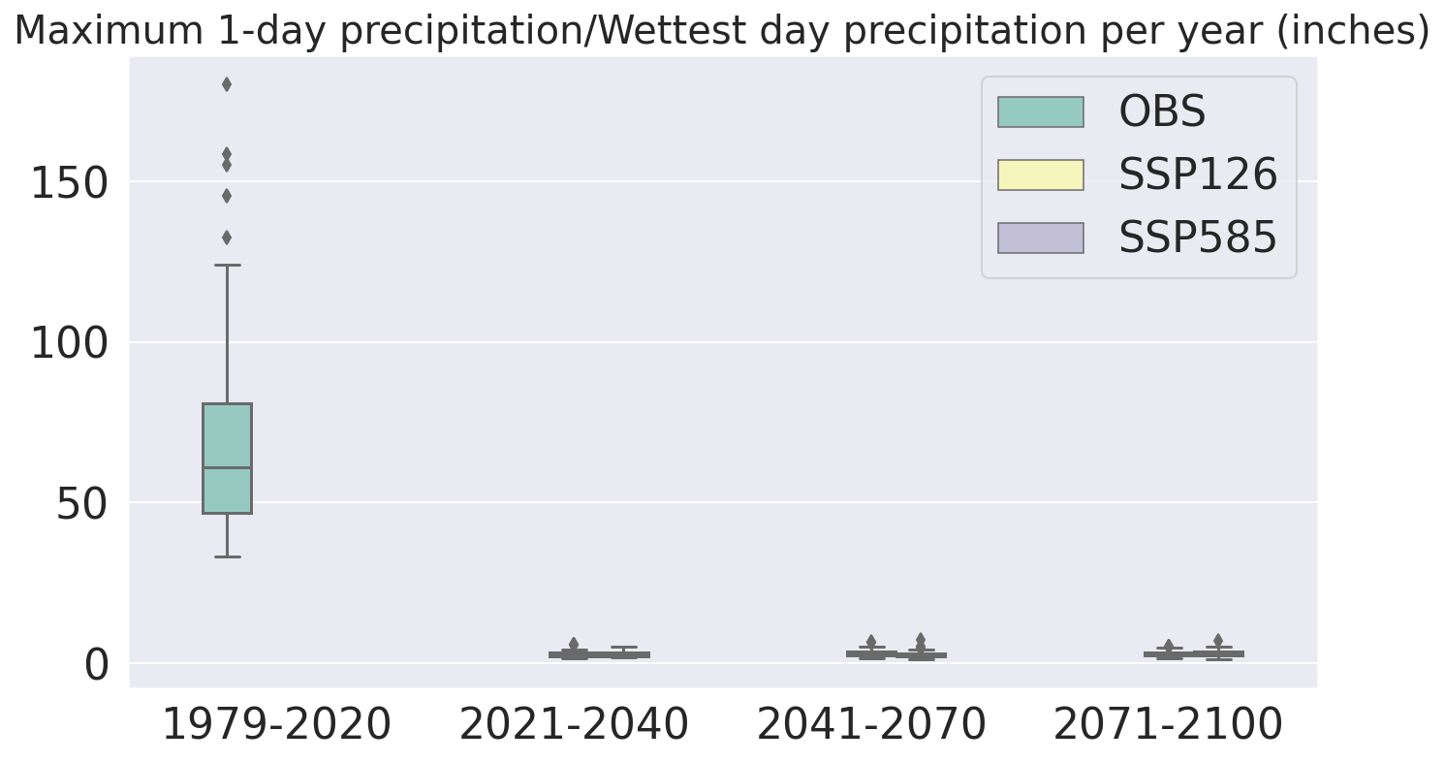

Slide 19
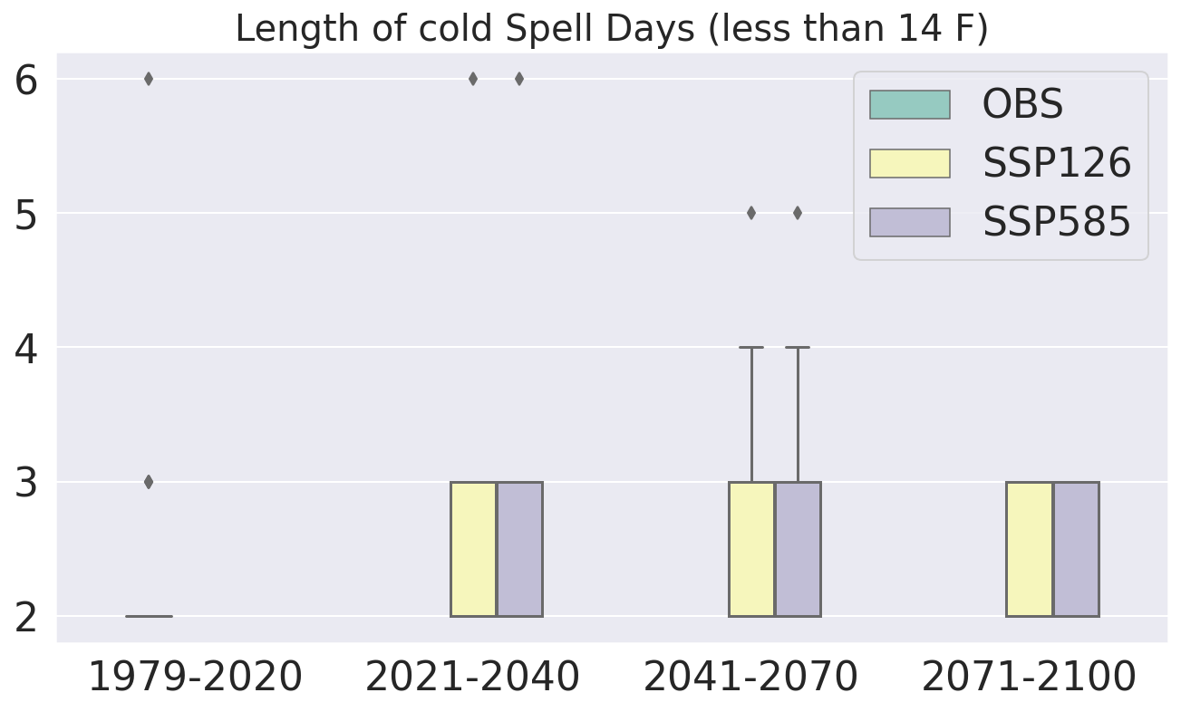

Slide 20
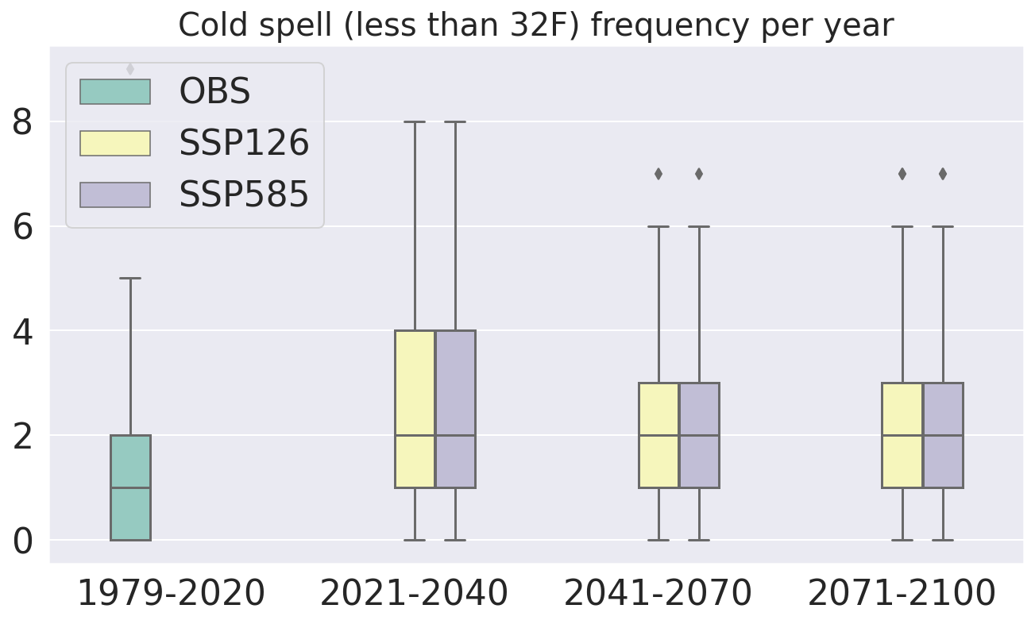

Slide 21
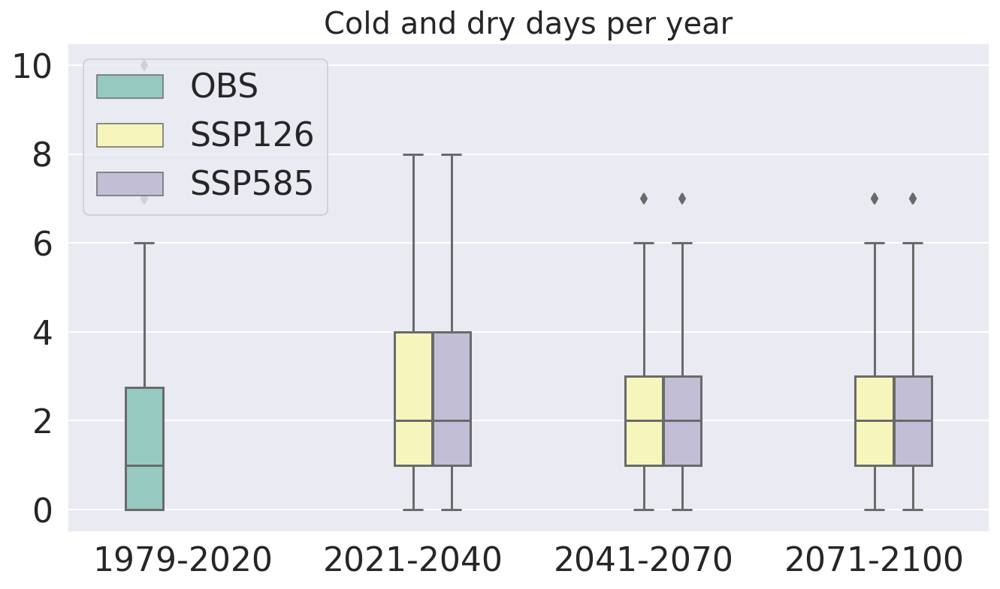

Slide 22


Slide 23
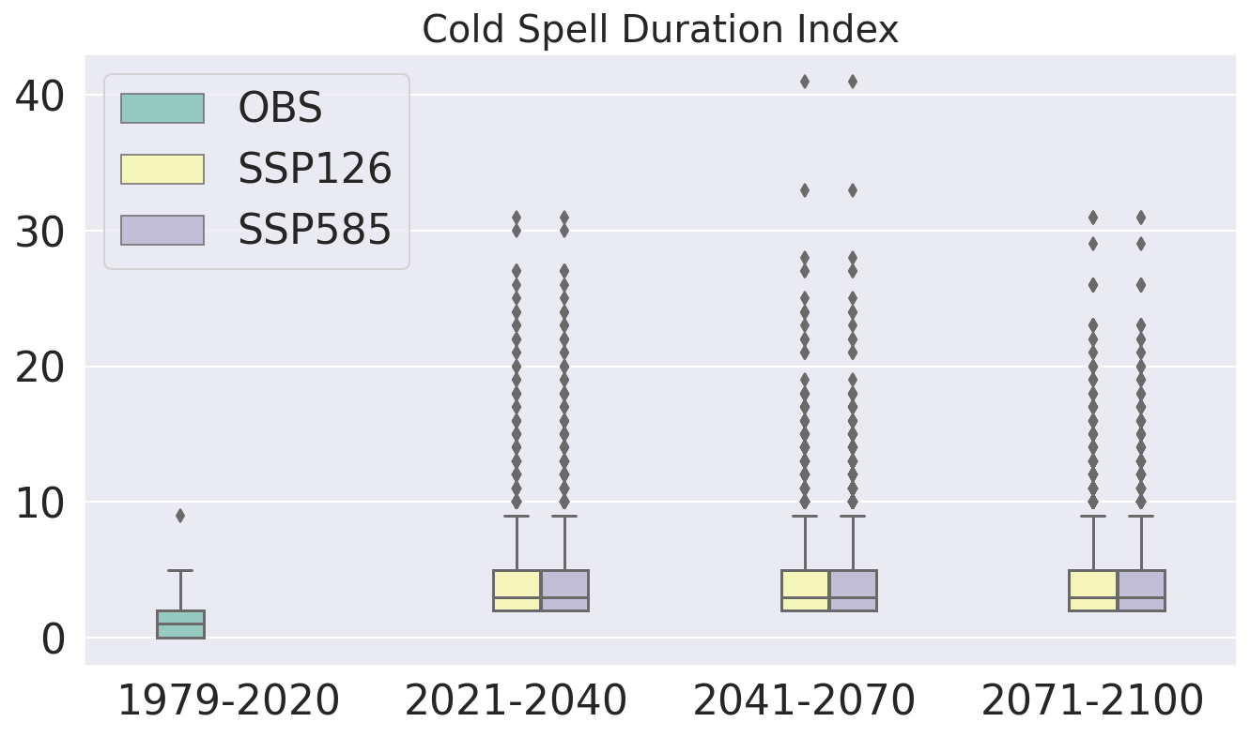

Slide 24
S.No | Experiment | Window | Daily precipitation intensity (mm/day) | % change relative to historical
1 | historical | 1979-2020 | 9.76
2 | ssp126 | 2021-2040 | 9.89 | 1.33
3 | ssp126 | 2041-2070 | 10.27 | 5.22
4 | ssp126 | 2071-2100 | 10.31 | 5.64
5 | ssp585 | 2021-2040 | 10.41 | 6.66
6 | ssp585 | 2041-2070 | 10.19 | 4.4
7 | ssp585 | 2071-2100 | 10.39 | 6.45

Slide 25
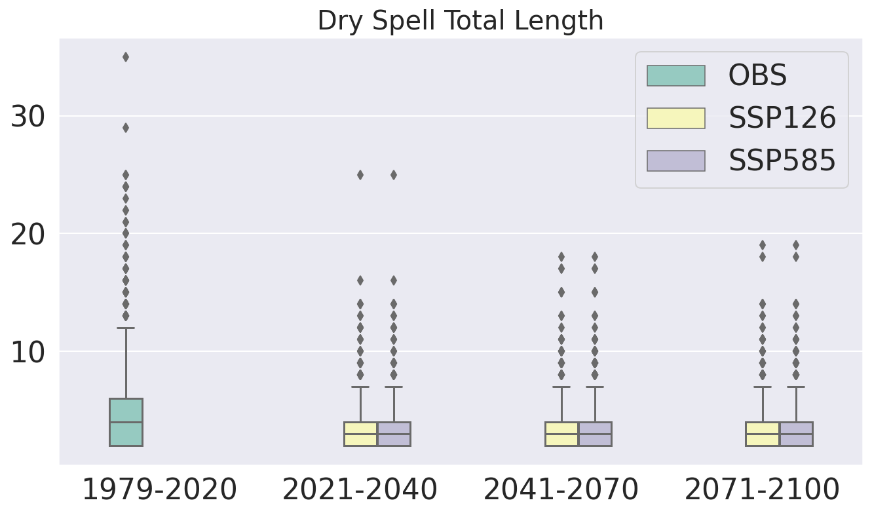

Slide 26
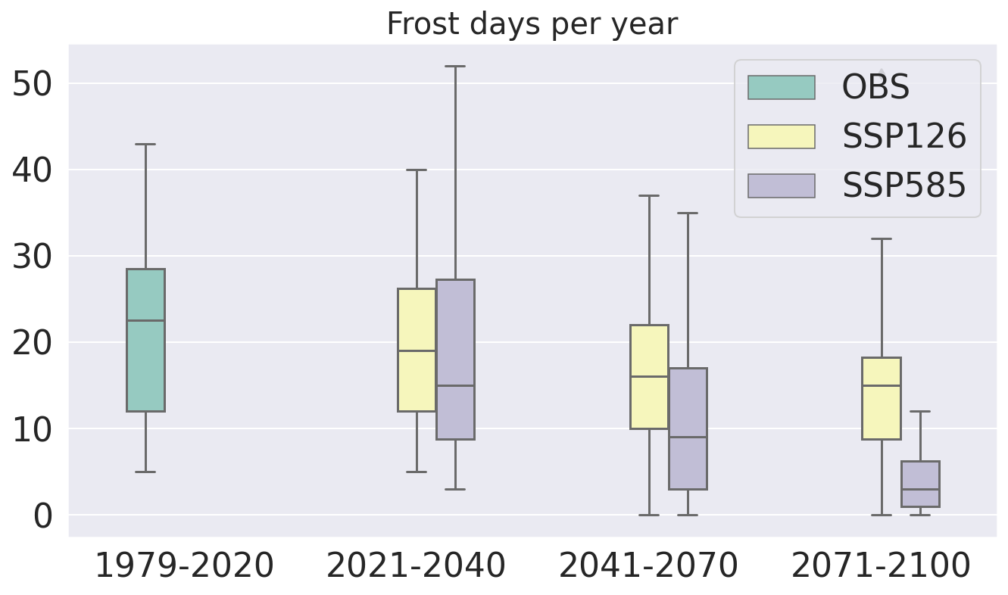

Slide 27
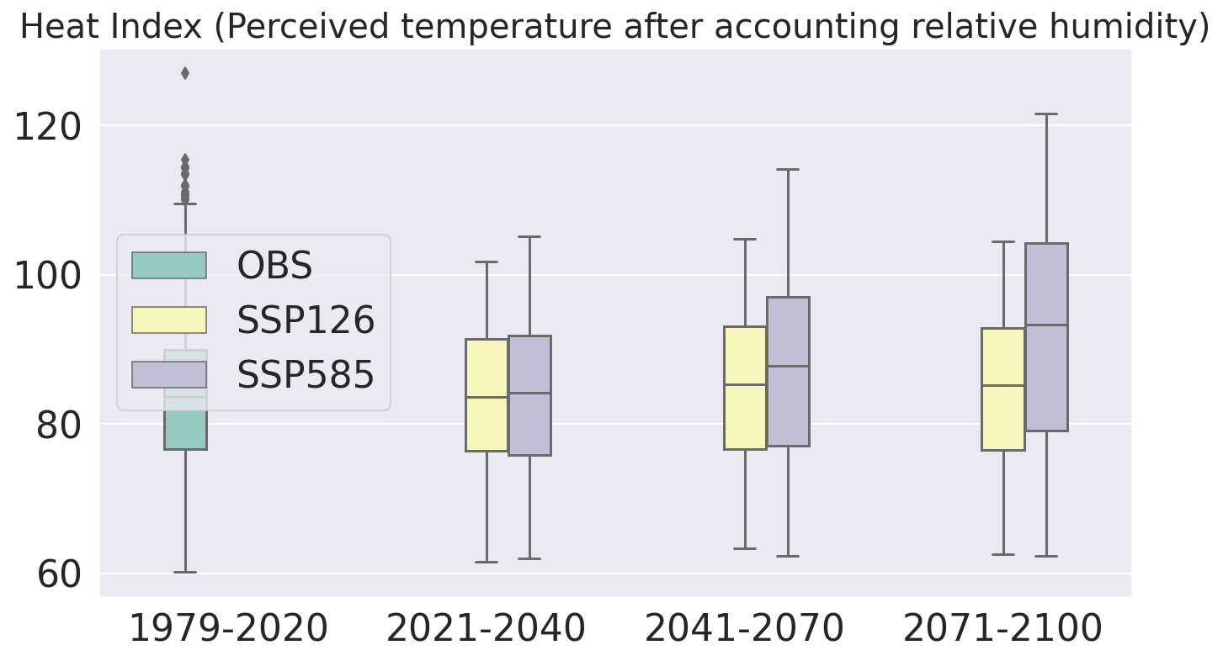

Slide 28
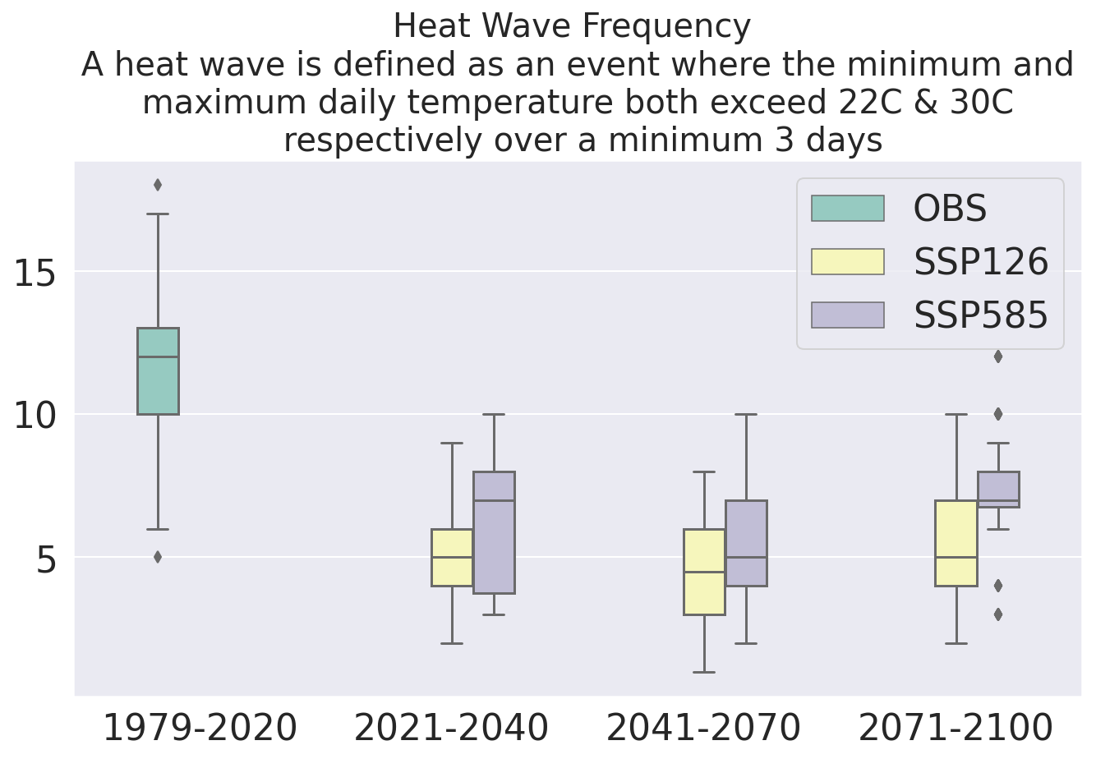

Slide 29
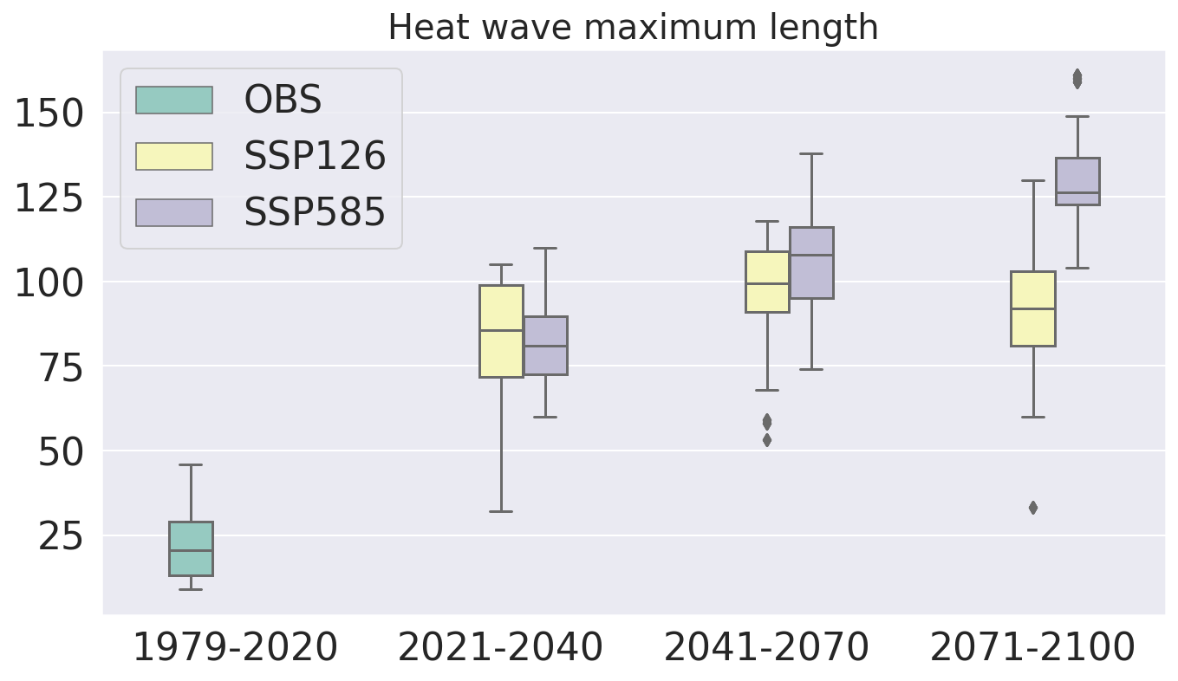

Slide 30
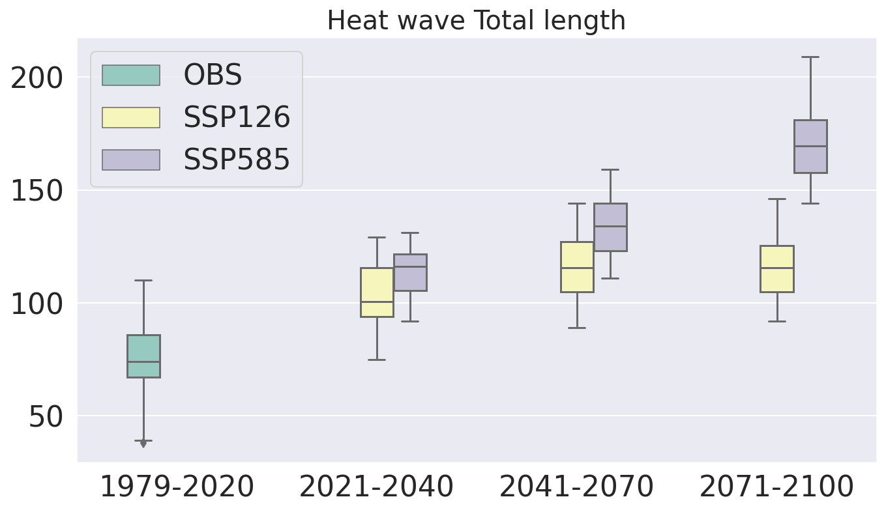

Slide 31
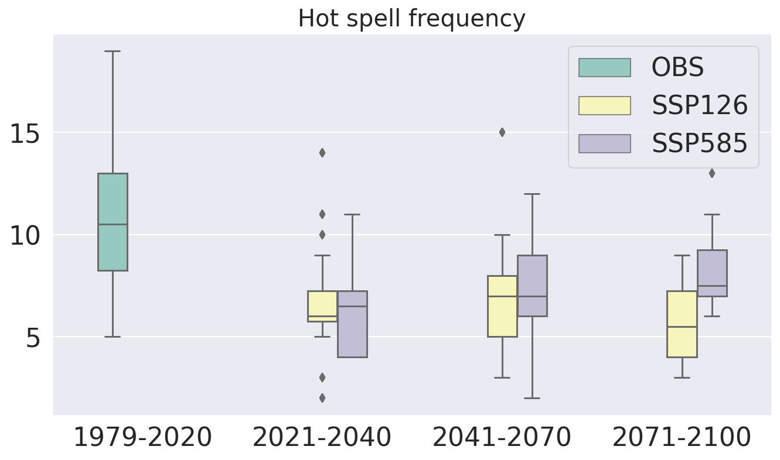

Slide 32
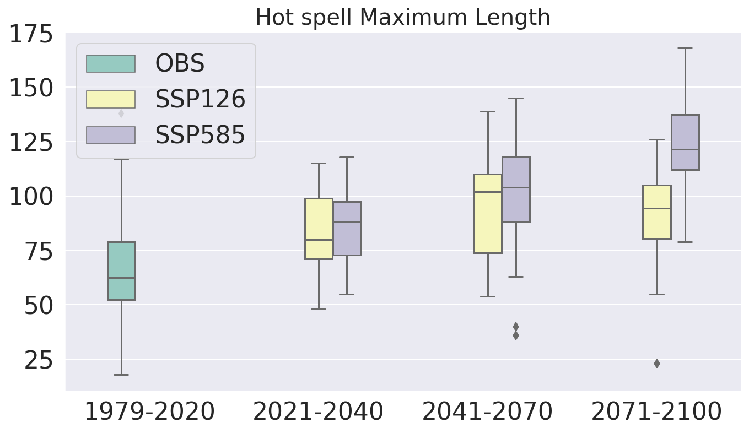

Slide 33

Thank you

Slide 34
Updates from previous meeting
Preliminary temperature & precipitation analysis as communicated by City of Austin completed
Further indices under processing: calm_days, cold_and_dry_days, cold_and_wet_days, cold_spell_days, cold_spell_duration_index, cold_spell_frequency, daily_pr_intensity, daily_temperature_range, daily_temperature_range_variability, days_over_precip_thresh, days_with_snow, dry_days, dry_spell_frequency, dry_spell_total_length, frost_days, frost_season_length, heat_wave_frequency, heat_wave_index, heat_wave_max_length, heat_wave_total_length, hot_spell_frequency, hot_spell_max_length, ice_days, max_1day_precipitation_amount, max_n_day_precipitation_amount, max_pr_intensity, maximum_consecutive_dry_days, maximum_consecutive_frost_days, maximum_consecutive_frost_free_days, maximum_consecutive_wet_days,
Blowing_snow: Number of days where both snowfall over the last days and daily wind speeds are above respective thresholds.
Humidex: The humidex indicates how hot the air feels to an average person, accounting for the effect of humidity. It can be loosely interpreted as the equivalent perceived temperature when the air is dry.
Notes:
COA

Slide 35
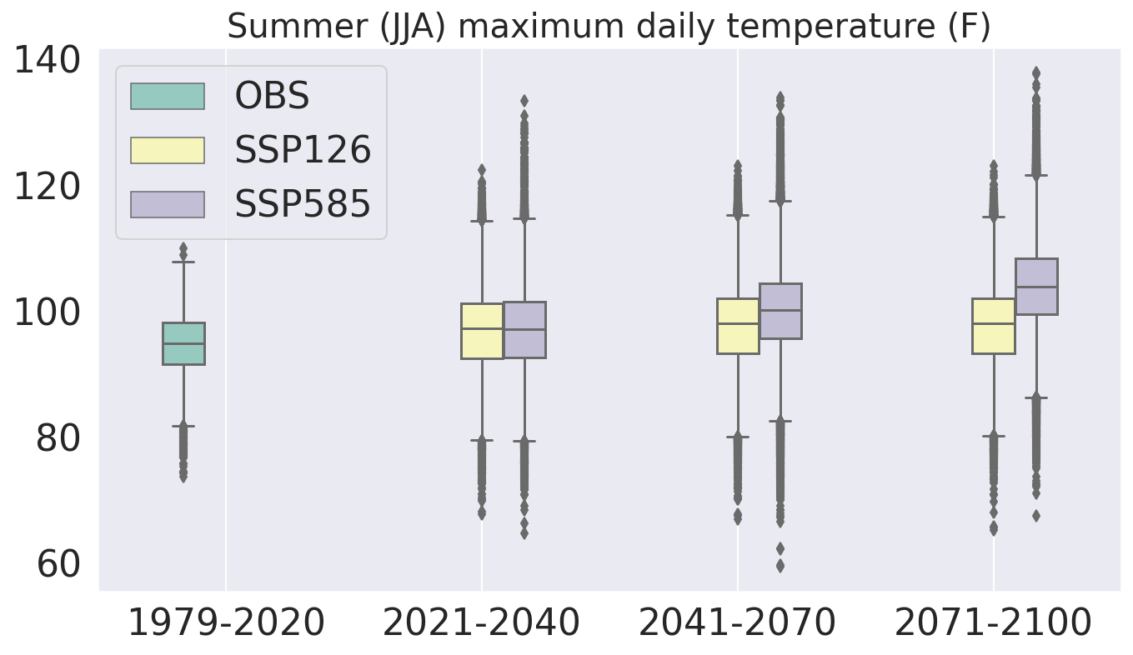

Slide 36
Summer Maximum JJA temperature (F)
Lower emissions: SSP126
Higher emissions: SSP585
~3 degree rise in summer maximum JJA temperature in the next two decades
~4 to 10 degrees rise in the mid and end of century maximum JJA temperature
Scenario/Period | Median
Observations (1979-2020) | 94.93
SSP126 (2021-2040) | 97.32
SSP585 (2021-2040) | 97.17
SSP126 (2041-2070) | 98.01
SSP585 (2041-2070) | 100.13
SSP126 (2071-2100) | 98.01
SSP585 (2071-2100) | 103.90

Slide 37
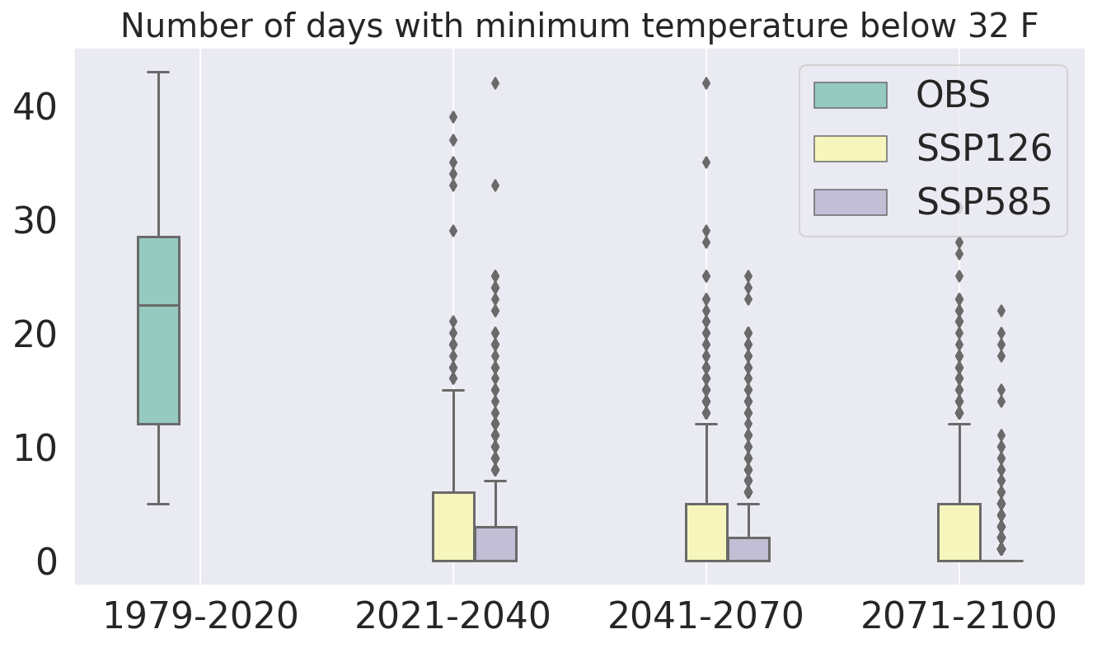

Slide 38
# of Days per year min temperature < 32 F
Lower emissions: SSP126
Higher emissions: SSP585
Median = 22.5 days per year during 1979-2020, zero in the future scenarios
For days with min temp < 32 F, events happening 25 percent times i.e. at 75th percentile would decrease from ~28 to 6(SSP126) and 3(SSP585) in the next two decades. Further decrease in the mid and end of century
Scenario/Period | 75th percentile
Observations (1979-2020) | 28.5
SSP126 (2021-2040) | 6
SSP585 (2021-2040) | 3
SSP126 (2041-2070) | 5
SSP585 (2041-2070) | 2
SSP126 (2071-2100) | 5
SSP585 (2071-2100) | 0

Slide 39
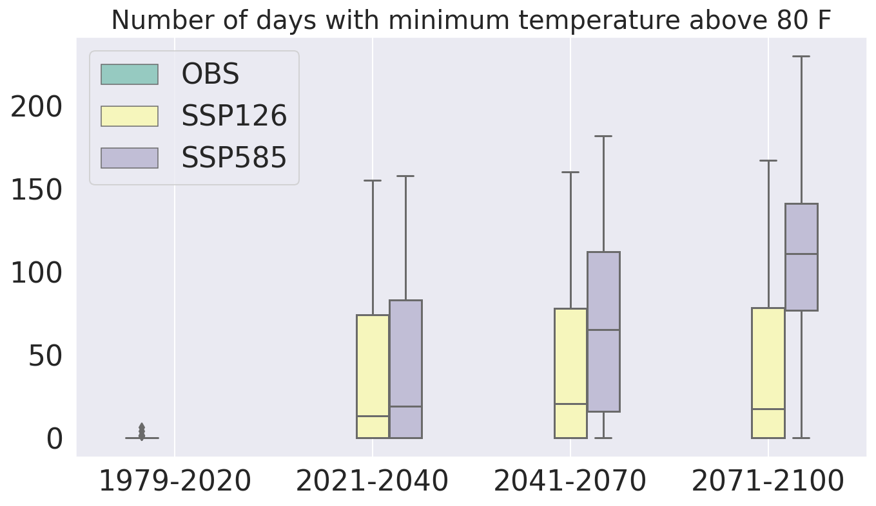

Slide 40
# of Days per year min temperature > 80 F
Lower emissions: SSP126
Higher emissions: SSP585
Zero such number of events when analysing median in the past observations
Increase to 13(16) days per year in SSP126(SSP585) in the next two decades
1-2 months per year in mid century
1-4 months per year for end of the century
Scenario/Period | Median
Observations (1979-2020) | 0
SSP126 (2021-2040) | 13
SSP585 (2021-2040) | 19
SSP126 (2041-2070) | 20.5
SSP585 (2041-2070) | 65
SSP126 (2071-2100) | 17.5
SSP585 (2071-2100) | 111

Slide 41
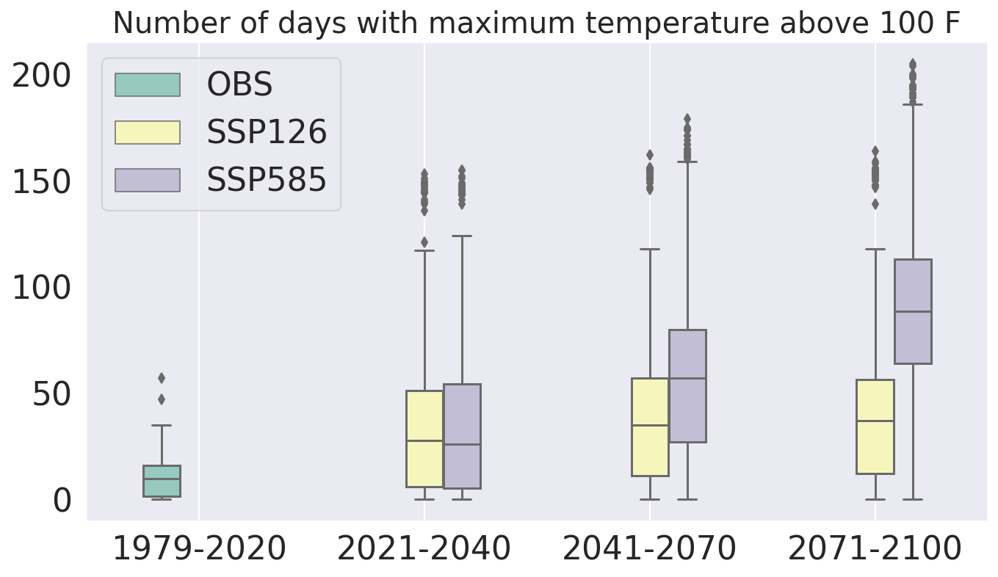

Slide 42
# of Days per year max temperature > 100 F
Lower emissions: SSP126
Higher emissions: SSP585
Doubling of # of days from ~15 in the past observations to ~27 in the next two decades
Increase to 35 (57) for the SSP126 (SSP585) scenario in the mid century. 1-2 months per year above 100F
1-3 months per year above 100 F for end of the century
Scenario/Period | Median
Observations (1979-2020) | 15.75
SSP126 (2021-2040) | 27.5
SSP585 (2021-2040) | 26
SSP126 (2041-2070) | 35
SSP585 (2041-2070) | 57
SSP126 (2071-2100) | 37
SSP585 (2071-2100) | 88.5

Slide 43
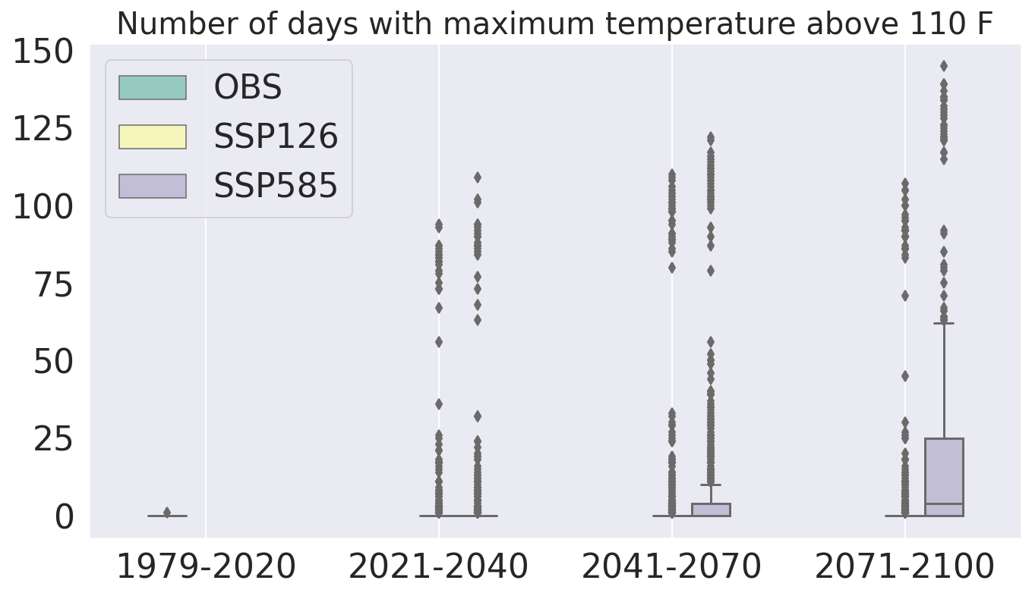

Slide 44
# of Days per year max temperature > 110 F
Lower emissions: SSP126
Higher emissions: SSP585
Median, 75th and 90th percentile = zero for the past observations
90th percentile corresponds to the top 10% events
90th percentile increase to ~7-9 per year in the next two decades
For high emission scenario in mid and end of century, number of 90th percentile days increase to 26 and 55 respectively
Scenario/Period | 90th percentile
Observations (1979-2020) | 0
SSP126 (2021-2040) | 7
SSP585 (2021-2040) | 9
SSP126 (2041-2070) | 9
SSP585 (2041-2070) | 26
SSP126 (2071-2100) | 7
SSP585 (2071-2100) | 55

Slide 45
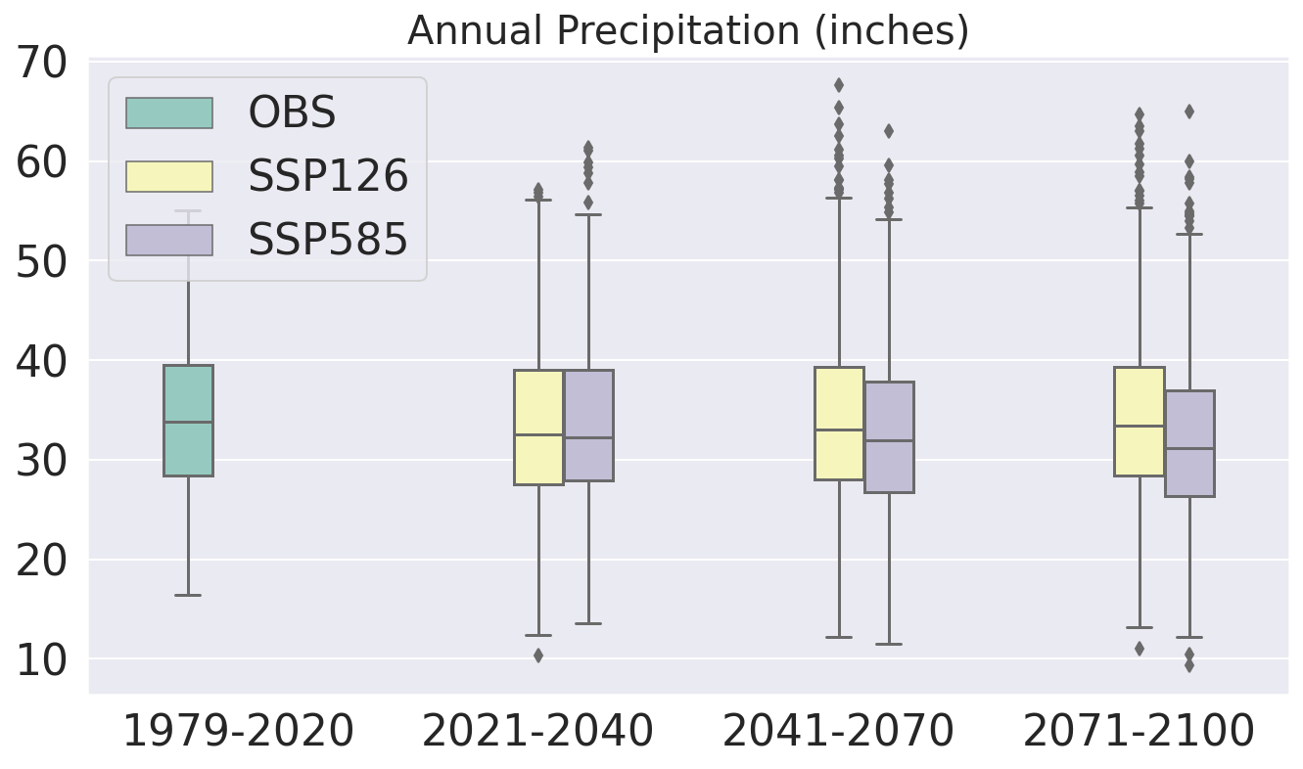

Slide 46
Annual precipitation (inches)
Lower emissions: SSP126
Higher emissions: SSP585
Annual precipitation remains almost the same in future
Scenario/Period | Median
Observations (1979-2020) | 33.76
SSP126 (2021-2040) | 32.48
SSP585 (2021-2040) | 32.26
SSP126 (2041-2070) | 33.05
SSP585 (2041-2070) | 31.91
SSP126 (2071-2100) | 33.43
SSP585 (2071-2100) | 31.17

Slide 47
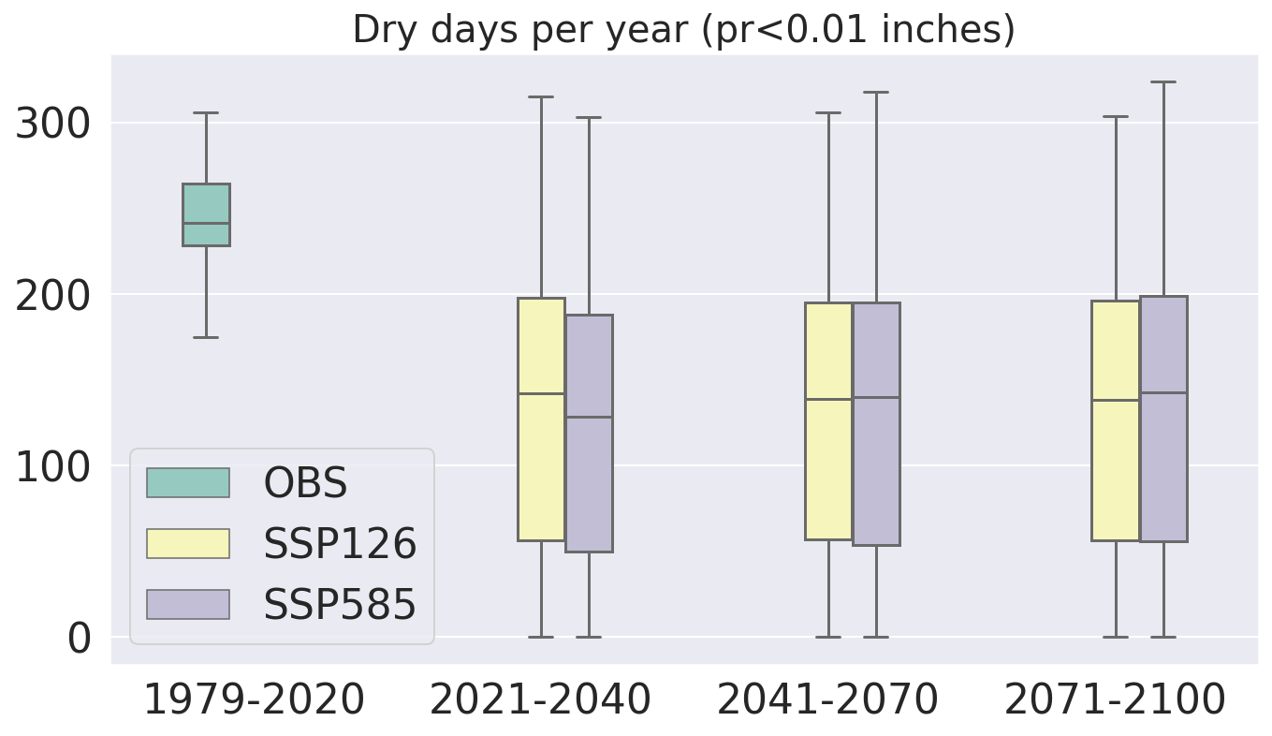

Slide 48
Dry days per year (pr <0.01 inches)
Lower emissions: SSP126
Higher emissions: SSP585
Lesser number of dry days in the next decades, mid and the end of century by ~40%
While in the past observations (1979-2020) ~66% of the year consisted of dry days, only ~38% of the year would consist of dry days in the future
Scenario/Period | Median
Observations (1979-2020) | 241.5
SSP126 (2021-2040) | 142
SSP585 (2021-2040) | 128.5
SSP126 (2041-2070) | 139.0
SSP585 (2041-2070) | 140.0
SSP126 (2071-2100) | 138.0
SSP585 (2071-2100) | 142.5

Slide 49
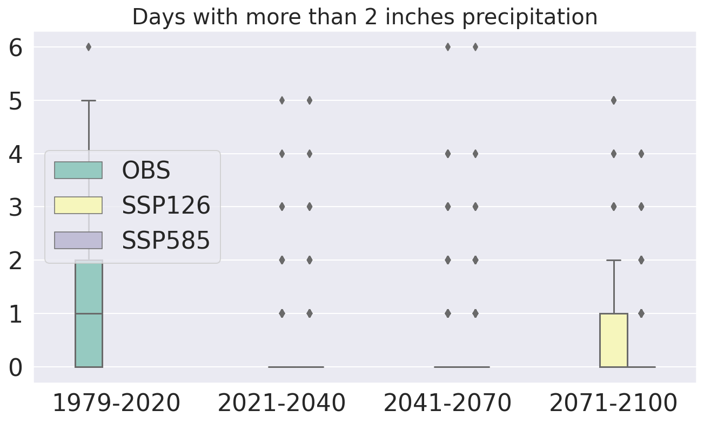

Slide 50
Summary: What is done
Thresholds provided by City of Austin have been generated
Number of dry days will decrease, temperature will increase in general
Number of days per year with minimum daily temperature below 80F would decrease
Number of days with maximum daily temperature above 100F and 110F would increase
There is not much change in the annual precipitation over Austin
Analysis is over Camp Mabry without bias correction

Slide 51
Summary: Way forward
Bias corrected outputs
More metrics such as humidex and wind related indices
Gridded outputs
Validation over multiple stations

Slide 52
Thank you

Slide 53
Previous meeting presentation

Slide 54
Comparison with the Previous Austin climate change assessment
Latest simulations from the CMIP6 are used. Previously, CMIP5 products were used.
Large number of ensembles (450+) have been used in this updated assessment. Previous report does not mention about the number of ensembles used.
More than 25 global models used for this assessment. Previously 9 models were used.
More than 1 exabyte (EB) global data used to extract the information about the climate change assessment over Austin. Possible using efficiently querying data on the cloud.
A first of its kind of analysis using all the CMIP realizations from all models.

Slide 55
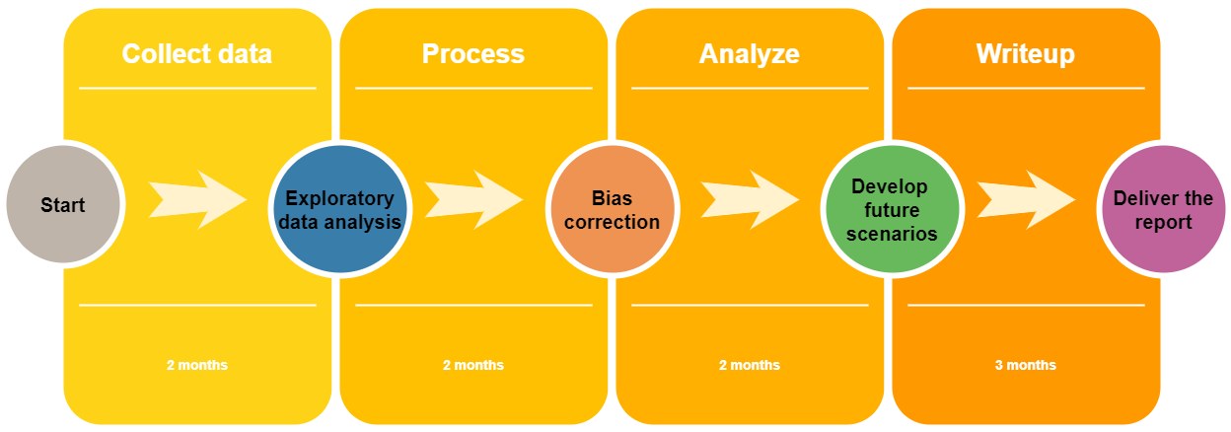
Timeline
We are here
Notes:
Remove days, until draft report 6 months, 6-9 months

Slide 56
Collect data
Observational data (Camp Mabry*)
Period available: 2000-2014
Hourly station data with missing values
Transformed to daily data for daily mean precipitation (Pr, mm/day), maximum daily temperature (Tmax, F), minimum daily temperature (Tmin, F), daily mean temperature (Tmean, F)
Adding more variables such as radiation and winds
* Adding more stations (Austin airport and other stations)

Slide 57
Collect data
~350 PB CMIP6 global data per variable for historical simulations used
Model | # realizations | Model | # realizations
EC-Earth | 84 | NUIST | 5
MIROC | 60 | HAMMOZ | 3
CCCma | 50 | CMCC | 3
CNRM | 42 | NIMS-KMA | 3
NCC | 36 | CSIRO-ARC | 3
CSIRO | 30 | NOAA-GFDL | 3
MOHC | 25 | CAMS | 1
MPI-M | 20 | AWI | 1
NCAR | 19 | AS-RCEC | 1
INM | 11 | SNU | 1
CAS | 8 | CCCR-IITM | 1
MRI | 6 | KIOST | 1
BCC | 6
B. Historical CMIP6 data
450+ simulations available as number of realizations from various global modelling centers
Number of models = 26
Ensemble mean for each model saved for Camp Mabry (2000-2014)
Time considerations for 1 ensemble
Time to just to load the time series at one point ~10-15s
Load and write the point data 1850-2014 : 600s = 10 mins
Load and write the point data for 2000-2014 ~ 60s = 1 min

Slide 58
Collect data
B. Future projections CMIP6 data
SSP126 and SSP585 as high emission and low emission scenarios to be considered (250+ simulations per scenario)
~900 PB CMIP6 data per variable for Scenario simulations analysed
Use of large number of ensembles increases the confidence in the analysis and reduces uncertainties from model biases.

Slide 59
2. Exploratory data analysis
Aggregate future projection data over Camp Mabry* and construct box plots without bias correction
* Adding more stations (Austin airport and other stations)

Slide 60
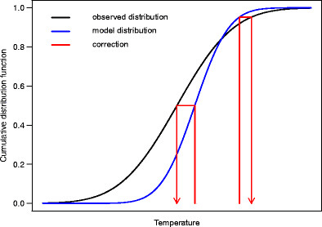
3. Bias correction
Earth system models in CMIP activities have systematic biases which need to be corrected for using the datasets from a planning perspective
Develop bias corrected future projections for each model using historical CMIP6 simulations (#26), station observations and scenario simulations (SSP126 and SSP585)
Previous assessment did not use bias correction
Quantile-Quantile (Q-Q) mapping: a well established technique used for bias correction

Slide 61
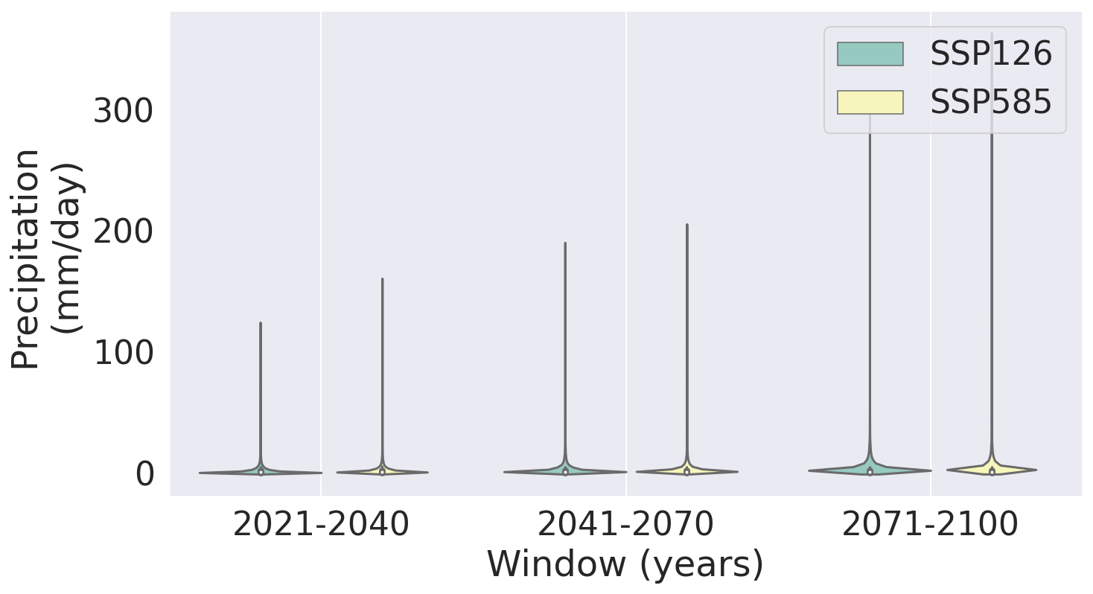
Period | Scenario | Median | 99th %ile | 99.9th %ile | 99.999 %ile
2021-2040 | SSP126 | 0.06 | 21.61 | 50.09 | 122.45
2021-2070 | SSP585 | 0.67 | 20.85 | 49.16 | 136.77
2041-2070 | SSP126 | 0.59 | 22.19 | 52.13 | 161.74
2041-2070 | SSP585 | 0.62 | 20.41 | 48.49 | 163.88
2071-2100 | SSP126 | 0.61 | 21.71 | 53.55 | 170.86
2071-2100 | SSP585 | 0.55 | 20.94 | 50.94 | 238.55

Slide 62
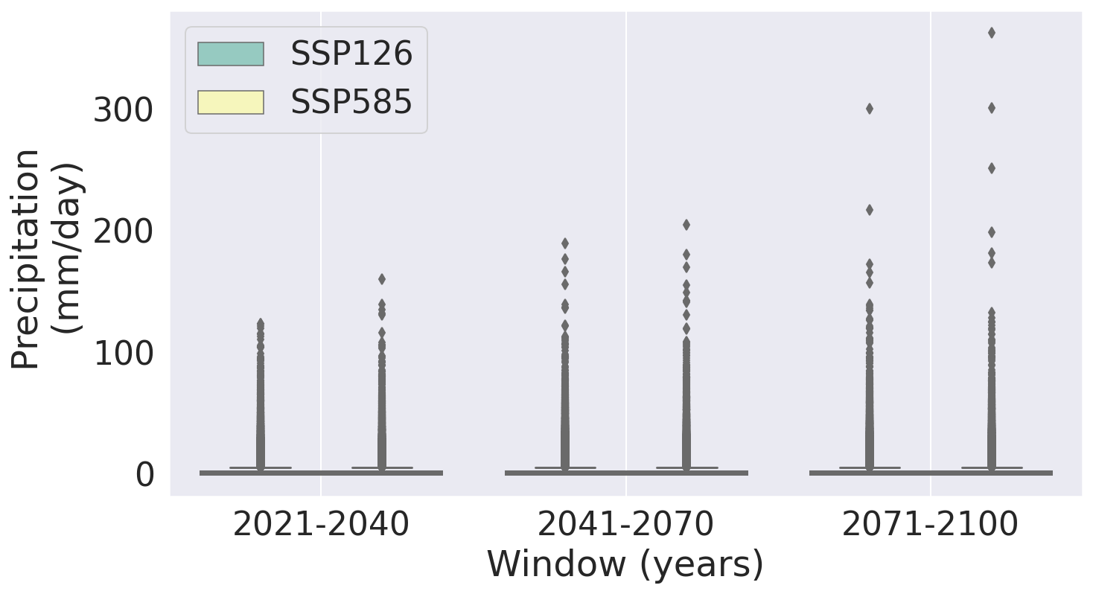
Increasing extreme events (>150 mm/day)
Period | Scenario | Median | 99th %ile | 99.9th %ile | 99.999 %ile
2021-2040 | SSP126 | 0.06 | 21.61 | 50.09 | 122.45
2021-2070 | SSP585 | 0.67 | 20.85 | 49.16 | 136.77
2041-2070 | SSP126 | 0.59 | 22.19 | 52.13 | 161.74
2041-2070 | SSP585 | 0.62 | 20.41 | 48.49 | 163.88
2071-2100 | SSP126 | 0.61 | 21.71 | 53.55 | 170.86
2071-2100 | SSP585 | 0.55 | 20.94 | 50.94 | 238.55

Slide 63
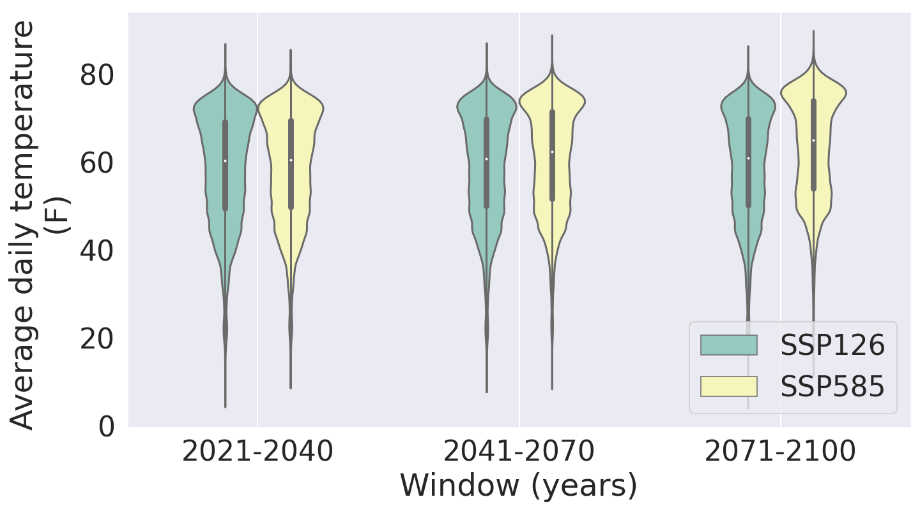
Period | Scenario | Median | 99th %ile | 99.9th %ile | 99.999 %ile
2021-2040 | SSP126 | 60.32 | 76.97 | 79.52 | 83.49
2021-2070 | SSP585 | 60.52 | 76.79 | 79.17 | 83.16
2041-2070 | SSP126 | 60.81 | 77.26 | 79.62 | 83.65
2041-2070 | SSP585 | 62.31 | 78.53 | 81.04 | 85.63
2071-2100 | SSP126 | 60.89 | 77.26 | 79.69 | 83.52
2071-2100 | SSP585 | 65.02 | 80.84 | 83.27 | 86.96
Notes:
Median: once every 2 days
99th %ile: once every 100 days
99.9th %ile: once every 3 years

Slide 64
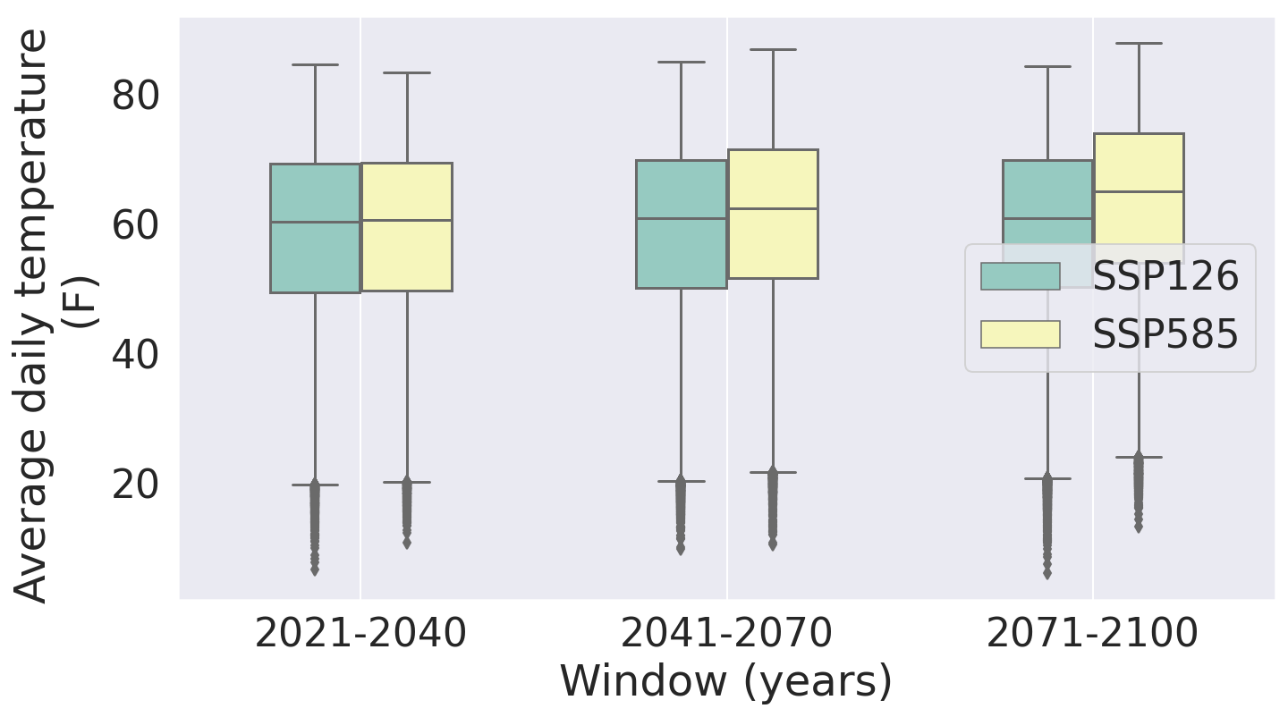
Period | Scenario | Median | 99th %ile | 99.9th %ile | 99.999 %ile
2021-2040 | SSP126 | 60.32 | 76.97 | 79.52 | 83.49
2021-2070 | SSP585 | 60.52 | 76.79 | 79.17 | 83.16
2041-2070 | SSP126 | 60.81 | 77.26 | 79.62 | 83.65
2041-2070 | SSP585 | 62.31 | 78.53 | 81.04 | 85.63
2071-2100 | SSP126 | 60.89 | 77.26 | 79.69 | 83.52
2071-2100 | SSP585 | 65.02 | 80.84 | 83.27 | 86.96
Notes:
Median: once every 2 days
99th %ile: once every 100 days
99.9th %ile: once every 3 years

Slide 65
Timeline
We are here
Notes:
Remove days, until draft report 6 months, 6-9 months

Slide 66
Way forward
Adding more stations for validation in addition to Camp Mabry
Analysing various metrics like frequency of dry days, hot days, very hot days to be analysed
Changes in the surface radiation and wind speeds to be added
Analyse anomalies

Slide 67
Thank you

