Slide 1
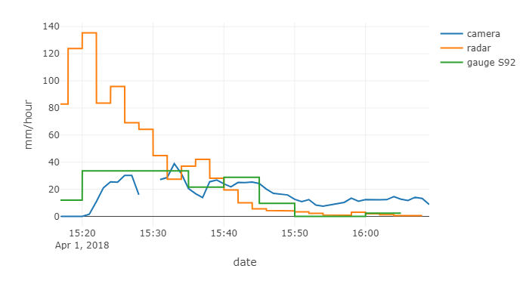
Event 1: 2018-04-01
Time series plot
Video goes here

Slide 2
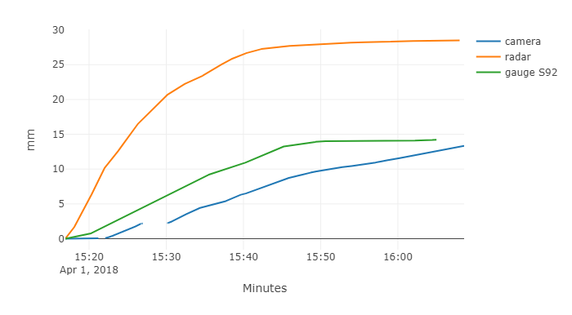
Event 1: 2018-04-01
Cumulative plot
Video goes here

Slide 3
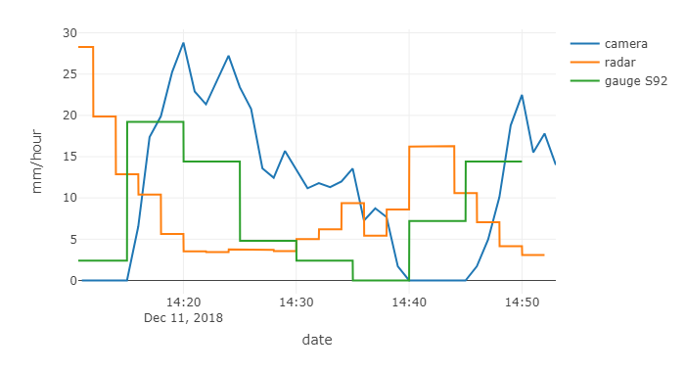
Event 2: 2018-12-11
Time series plot
Video goes here

Slide 4
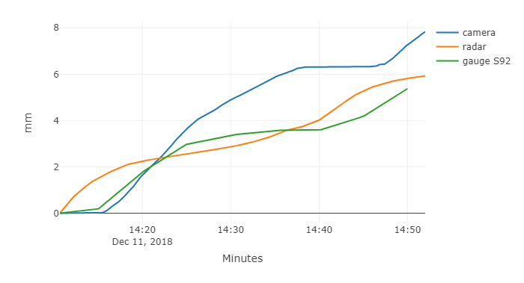
Event 2: 2018-12-11
Cumulative plot
Video goes here

Slide 5
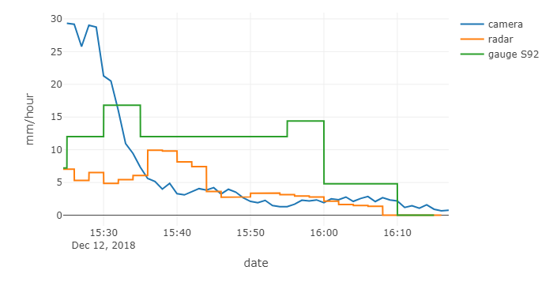
Event 2: 2018-12-12
Time series plot
Video goes here

Slide 6
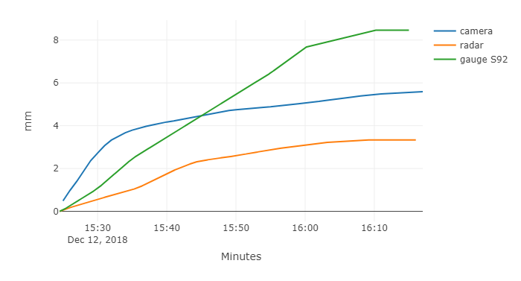
Event 3: 2018-12-12
Cumulative plot
Video goes here

