Slide 1
When large samples act small: Cluster-robust variance estimation and hypothesis testing with few clusters
James E. Pustejovsky UT Austin Educational Psychology Department Quantitative Methods Program pusto@austin.utexas.edu
February 19, 2016
Elizabeth Tipton Columbia University Teachers’ College Dept. of Human Development tipton@tc.columbia.edu

Slide 2
Motivation:
Linear regression with dependent errors
Analysis of multi-stage sample surveys
Cluster-randomized trials
Longitudinal panel data

Slide 3
Cluster-robust variance estimation
A way to estimate sampling variance of regression coefficients when error structure is unknown
Assuming that the data includes G independent clusters of observations.
White (1984); Arellano (1987); Liang & Zeger (1986)
Valid (asymptotically consistent) when the number of clusters (G) is large.
But can misbehave with few clusters (Cameron & Miller, 2015; Imbens & Kolesar, 2015)
Standard errors that are too small
Hypothesis tests with inflated type-I error rates
And it can be hard to tell if your G is big enough

Slide 4
In brief…
McCaffrey, Bell, & Botts (2001) proposed “bias-reduced linearization” (BRL)
Improves bias of standard errors for small G
t-tests with Satterthwaite degrees of freedom
Our work:
Extends BRL so that it works in models with fixed effects
Develops an F-test for multi-parameter hypothesis tests
Demonstrates that BRL outperforms standard CRVE across a wide range of contexts
With our extensions, BRL is a general and “production-ready” approach to cluster-robust hypothesis testing.

Slide 5

Today
“standard” CRVE
Bias-reduced linearization
Satterthwaite t-tests
Our extensions
F-tests
Handling fixed effects
How to make your SEs smaller
Further work
Errrummmm….actually….Your standard errors are too small and your p-values are all WAY too significant.

Slide 6
The model
Suppose we have a regression model where
j = 1,…,G clusters
Errors have unknown variance Var(e_{j})=Σ_{j} for j = 1,…,G clusters.
X might include
Policy indicators
Demographic controls
Fixed effects (for clusters, time periods, etc.)
For today, I’ll assume that regression is estimated by ordinary least squares.

Slide 7
Hypotheses
Our goal will be to test hypotheses about elements of β
Does an intervention have non-zero effects on the outcome?
Do the intervention effects vary across contexts?

Slide 8

Standard cluster-robust variance estimation
OLS coefficient estimates have (unknown) sampling variance
Standard CRVE (sandwich estimator):

Slide 9
Standard robust hypothesis tests
Robust t-test (H₀: β₁ = 0)
Robust (Wald-type) F-test (H₀: Cβ = 0 for q×p matrix C)

Slide 10

Performance of standard tests
Unbalanced covariates
Skewed/leveraged covariates
Unequal cluster sizes

Slide 11
Bias-reduced linearization

Slide 12
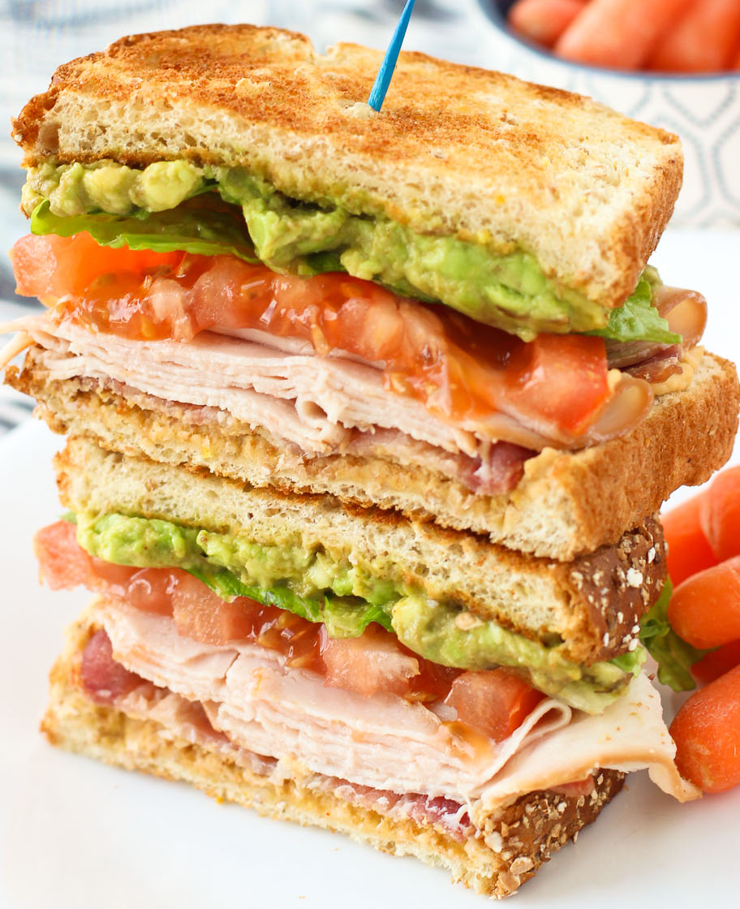
Bias-reduced linearization
McCaffrey, Bell, & Botts (2001) proposed a correction to V^{CR} based on a working model for the error covariance structure.
The corrected variance estimator is where the adjustment matrices A₁,…,A_{G} are chosen so that when the working model is correct.

Slide 13

Working models
“Working independence”, with Σ_{j} = I_{j}
“Working random effect model” assumes
Doesn’t this contradict goal of being robust?
Remarkably, the working model doesn’t matter much.
BRL greatly reduces bias even if the working model is far from the truth.

Slide 14
Hypothesis tests
We could use V^{BRL} in robust t and F statistics, but…
Bias of variance estimator is only part of the problem
t(G-1), F(q, G – 1) often poor approximations for reference distributions
For t-tests, Bell and McCaffrey (2002) propose to use t(v) reference distribution, where with moments estimated based on the working model.

Slide 15
BRL + Satterthwaite t-tests work well

Slide 16
Outstanding problems with BRL
How do you do test multi-parameter hypotheses?
BRL adjustment matrices are sometimes undefined in models with lots of fixed effects.
In models with fixed effects, BRL adjustments depends on how you calculate the coefficient estimates.

Slide 17
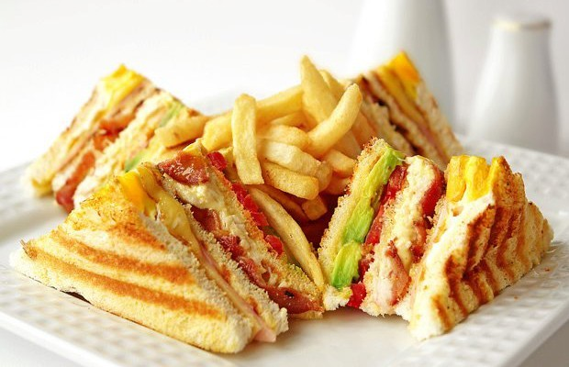
Our work
Notes:
Our work solves these issues, providing a general, “production-ready” approach to cluster-robust hypothesis testing.

Slide 18
Approximate Hotelling Test
We propose a generalization of the Satterthwaite approximation to the multi-dimensional case.
Approximate the distribution of V^{BRL} using a Wishart distribution with degrees of freedom η and I_{q} scale matrix.
Estimate η by matching mean and total variation of V^{BRL}.

Slide 19
AHT maintains close-to-nominal α

Slide 20

Degrees of freedom (η)
For single-dimensional tests, η = v (Satterthwaite df).
Degrees of freedom are diagnostic.
large η indicates large effective sample size
small η (i.e., much less than G – 1) indicates that you’ve got small-sample problems.
Degrees of freedom capture the influence of covariates on the distribution of V^{BRL}
Unbalanced covariates
Skewed/leveraged covariates
Unequal cluster sizes
I got 99 degrees of freedom

Slide 21
Examples

Slide 22
Handling fixed effects models
Consider state-by-year panel data model
Common to treat γ_{i}, ζ_{t} as fixed effects, estimate β by OLS.
Use CRVE to allow for further correlation among errors within each state.
BRL breaks down in this model (Angrist & Pischke, 2009).
Adjustment matrices are not calculable because of rank-deficiency.
We demonstrate that using the Moore-Penrose generalized inverse leads to adjustment matrices that are still unbiased under working model.

Slide 23
Handling fixed effects models
Two ways to calculate OLS estimates in fixed effects models:
Use dummy variables, estimate the full regression.
Absorb the fixed effects, estimate only the remaining coefficents.
BRL gives different results depending on which design matrix you use to calculate A₁,..,A_{G}.
We identify conditions where it is okay to use the absorbed design matrix to calculate A₁,..,A_{G}.
With OLS estimation, it’s okay if you are using a working identity model.
Absorb the within-cluster fixed effects only.

Slide 24
Examples

Slide 25
How to make your SEs smaller
Hierarchical linear modeling
Develop “working” hierarchical models.
Use estimated error structures for weighted least squares (WLS) estimation.
Use BRL standard errors + AHT degrees of freedom
Based on the same working model as for WLS.
Adjustment matrices get a little more complicated, but it all works.

Slide 26
Conclusions
Standard tests based on CRVE do not perform well with few or even a moderate number of clusters.
It can be difficult to tell whether you have enough clusters to trust standard methods because it depends on
The hypothesis being tested.
The structure of the covariates in the model.
Satterthwaite t-test/AHT F-test perform well across a broad range of applications. We recommend that they be used by default.

Slide 27
Future work
Compare BRL + AHT to other recent proposals
Cluster-wild bootstrap (Webb & MacKinnon, 2013)
Containment t-test (Imbragimov & Muller, 2015)
Application to more complex models
Instrumental variables
Cross-classified/multiple-membership models
Software
clubSandwich R package under development (https://github.com/jepusto/clubSandwich)
Need to implement in Stata

Slide 28
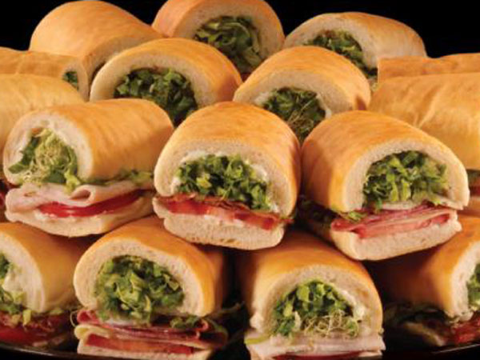
Thank you
pusto@austin.utexas.edu
http://jepusto.github.io/
Working paper available at http://arxiv.org/abs/1601.01981

