Slide 1
When large samples act small: Cluster-robust variance estimation and hypothesis testing with few clusters
James E. Pustejovsky UT Austin Educational Psychology Department Quantitative Methods Program pusto@austin.utexas.edu
February 19, 2016
Elizabeth Tipton Columbia University Teachers’ College Dept. of Human Development tipton@tc.columbia.edu

Slide 2
Regression with dependent errors
Analysis of multi-stage sample surveys
Blanchard & Muller (2015) use ELS:2002 to study the influence of teachers’ perceptions of immigrant/language-minority students on student academic outcomes.
Cavanagh, Schiller, & Riegle-Crumb (2006) use Add Health to study the relationship between family structure and adolescents’ academic status.
Cluster-randomized trials
Burde & Linden (2012) studied effects of village-based schools in Afghanistan by randomizing 31 villages, surveying families.
Longitudinal panel data
Abrevaya & Puzzello (2012) examined effects of cigarette taxes on consumption, nicotine intake, and smoking intensity using NHANES III.
Effects identified by state-level changes in tax rates over time. Data include 26 states.
Notes:
Sarah Blanchard, Chandra Muller. Educational Longitudinal Study of 2002.

Slide 3
Cluster-robust variance estimation
A way to estimate sampling variance of regression coefficients when error structure is unknown
Assuming that the data includes G independent clusters of observations.
White (1984); Arellano (1987); Liang & Zeger (1986)
Valid (asymptotically consistent) when the number of clusters (G) is large.
But can misbehave with few clusters (Cameron & Miller, 2015; Imbens & Kolesar, 2015)
Standard errors that are too small
Hypothesis tests with inflated type-I error rates
And it can be hard to tell if your G is big enough

Slide 4
In brief…
McCaffrey, Bell, & Botts (2001) proposed “bias-reduced linearization” (BRL)
Improves bias of standard errors for small G
t-tests with Satterthwaite degrees of freedom
Our work:
Extends BRL so that it works in models with fixed effects
Develops an F-test for multi-parameter hypothesis tests
Demonstrates that BRL outperforms standard CRVE across a wide range of contexts
With our extensions, BRL is a general and “production-ready” approach to cluster-robust hypothesis testing.

Slide 5

Today
“standard” CRVE
Bias-reduced linearization
Satterthwaite t-tests
Our extensions
F-tests
Handling fixed effects
How to make your SEs smaller
Further work
Errrummmm….actually….Your standard errors are too small and your p-values are all WAY too significant.

Slide 6
The model
Suppose we have a regression model where
j = 1,…,G clusters
Errors have unknown variance Var(e_{j})=Φ_{j} for j = 1,…,G clusters.
X might include
Policy indicators
Demographic controls
Fixed effects (for clusters, time periods, etc.)
For today, I’ll assume that regression is estimated by ordinary least squares.

Slide 7
Hypotheses
Our goal will be to test hypotheses about elements of β
Does an intervention have non-zero effects on the outcome?
Do the intervention effects vary across contexts?

Slide 8

Standard cluster-robust variance estimation
OLS coefficient estimates have (unknown) sampling variance
Standard CRVE (sandwich estimator):

Slide 9
Standard robust hypothesis tests
Robust t-test (H₀: β₁ = 0)
Robust (Wald-type) F-test (H₀: Cβ = 0 for q × p matrix C)

Slide 10

Performance of standard tests
Unbalanced covariates
Skewed/leveraged covariates
Unequal cluster sizes

Slide 11
Bias-reduced linearization

Slide 12
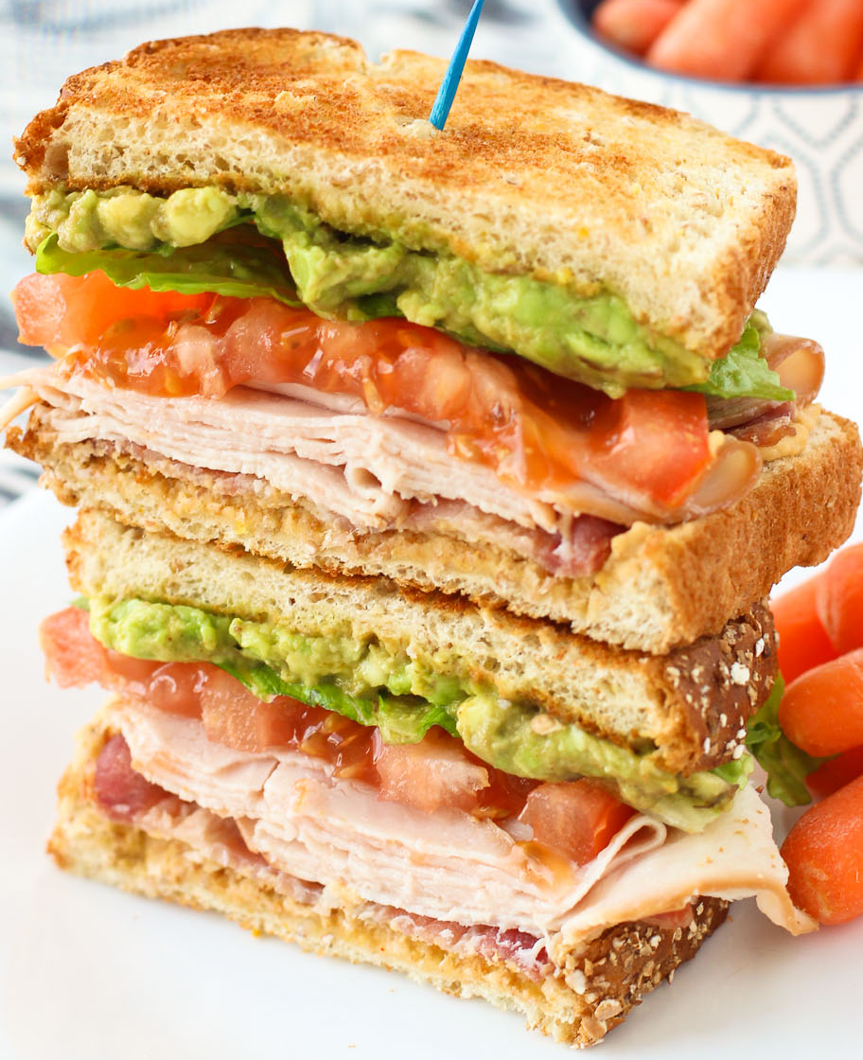
Bias-reduced linearization
McCaffrey, Bell, & Botts (2001) proposed a correction to V^{CR} based on a working model for the error covariance structure.
Given a working model, seek a variance estimator such that
The corrected variance estimator is with adjustment matrices A₁,…,A_{G} chosen to satisfy BRL criterion.

Slide 13

Working models
“Working independence”, with Φ_{j} = I_{j}
“Working random effect model” assumes
Doesn’t this contradict goal of being robust?
Remarkably, the working model doesn’t matter much.
BRL greatly reduces bias even if the working model is far from the truth.
Notes:
Working random effects model assumes a compound symmetric covariance matrix within each cluster.

Slide 14
Hypothesis tests
We could use V^{BRL} in robust t and F statistics, but…
Bias of variance estimator is only part of the problem
t(G-1), F(q, G – 1) often poor approximations for reference distributions
For t-tests, Bell and McCaffrey (2002) propose to use t(v) reference distribution, with Satterthwaite degrees of freedom with moments estimated based on the working model.

Slide 15
BRL + Satterthwaite t-tests work well

Slide 16
Outstanding problems with BRL
How do you do test multi-parameter hypotheses?
BRL adjustment matrices are sometimes undefined in models with lots of fixed effects.
In models with fixed effects, BRL adjustments depends on how you calculate the coefficient estimates.

Slide 17
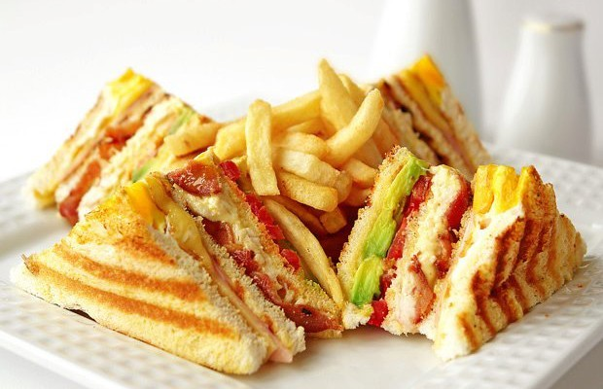
Our work
Notes:
Our work solves these issues, providing a general, “production-ready” approach to cluster-robust hypothesis testing.

Slide 18
Approximate Hotelling Test
We propose a generalization of the Satterthwaite approximation to the multi-dimensional case.
Approximate the distribution of V^{BRL} using a Wishart distribution with degrees of freedom η and I_{q} scale matrix.
Estimate η by matching mean and total variation of V^{BRL}.

Slide 19


AHT maintains close-to-nominal α

Slide 20

Degrees of freedom (η)
For single-dimensional tests, η = v (Satterthwaite df).
Degrees of freedom are diagnostic.
large η indicates large effective sample size
small η (i.e., much less than G – 1) indicates that you’ve got small-sample problems.
Degrees of freedom capture the influence of covariates on the distribution of V^{BRL}
Unbalanced covariates
Skewed/leveraged covariates
Unequal cluster sizes
I got 99 degrees of freedom

Slide 21
Handling fixed effects models
Consider state-by-year panel data model
Common to treat γ_{i}, ζ_{t} as fixed effects, estimate β by OLS.
Use CRVE to allow for further correlation among errors within each state.
BRL breaks down in this model (Angrist & Pischke, 2009).
Adjustment matrices are not calculable because of rank-deficiency.
We demonstrate that the Moore-Penrose generalized inverse can be used to construct adjustment matrices that are still unbiased under the working model.

Slide 22
Handling fixed effects models
Two ways to calculate OLS estimates in fixed effects models:
Use dummy variables, estimate the full regression.
Absorb the fixed effects, estimate only the remaining coefficents.
BRL gives different results depending on which design matrix you use to calculate A₁,..,A_{G}.
We identify conditions where it is okay to use the absorbed design matrix to calculate A₁,..,A_{G}.
With OLS estimation, it’s okay if you are using a working identity model.
Absorb the within-cluster fixed effects only.

Slide 23
But does this matter in practice?

Slide 24
Carpenter & Dobkin (2011)
Study effects of changing minimum legal drinking age on motor vehicle mortality
State-by-year panel from FARS maintained by NHTSA.
Difference-in-differences identification.
Hypothesis | Test | F | df | p-value
Policy effect (q = 1) | Standard | 9.660 | 49.00 | .003
 | Satterthwaite | 9.116 | 24.74 | .006
Hausman test of endogeneity (q = 2) | Standard | 2.930 | 49.00 | .063
 | AHT | 2.489 | 8.69 | .140
Notes:
Fatal Accident Reporting System from National Highway Traffic Safety Administration

Slide 25
Angrist & Lavy (2009)
Cluster-randomized trial in 40 high schools in Israel.
Tested effects of monetary incentives on post-secondary matriculation exam (Bagrut) completion rates.
Longitudinal data, diff-in-diff specification.
Focus on effects for higher-achieving girls
Hypothesis | Test | F | df | p-value
treatment effect (q = 1) | Standard | 5.746 | 34.00 | .022
 | Satterthwaite | 5.169 | 15.86 | .037
Moderation by school sector (q = 2) | Standard | 3.186 | 34.00 | .054
 | AHT | 0.091 | 3.19 | .915
Notes:
Fatal Accident Reporting System from National Highway Traffic Safety Administration

Slide 26
How to make your SEs smaller
Hierarchical linear modeling
Develop “working” hierarchical models.
Use estimated error structures for weighted least squares (WLS) estimation.
Use BRL standard errors + AHT degrees of freedom
Based on the same working model as for WLS.
Adjustment matrices get a little more complicated, but it all works.

Slide 27
Conclusions
Standard tests based on CRVE do not perform well with few or even a moderate number of clusters.
It can be difficult to tell whether you have enough clusters to trust standard methods because it depends on
The hypothesis being tested.
The structure of the covariates in the model.
Satterthwaite t-test/AHT F-test perform well across a broad range of applications. We recommend that they be used by default.

Slide 28
Future work
Compare BRL + AHT to other recent proposals
Cluster-wild bootstrap (Webb & MacKinnon, 2013)
Re-weighted, containment t-test (Imbragimov & Muller, 2015)
Application to more complex models
Instrumental variables
Cross-classified/multiple-membership models
Software
clubSandwich R package under active development (https://github.com/jepusto/clubSandwich)
Need to implement in Stata (Wanna help?)

Slide 29
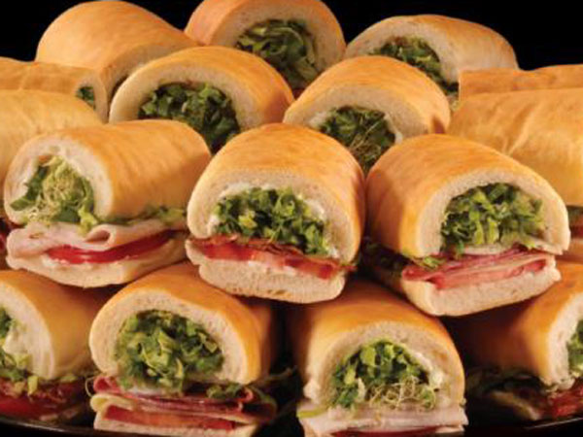
Thank you
pusto@austin.utexas.edu
http://jepusto.github.io/
Working paper available at http://arxiv.org/abs/1601.01981

