Slide 1
When large samples act small: Cluster-robust variance estimation and hypothesis testing with few clusters
James E. Pustejovsky UT Austin Quantitative Methods Program Educational Psychology Department
pusto@austin.utexas.edu
February 19, 2016
Notes:
Thank you. My name is James Pustejovsky, and I’m an assistant professor at UT Austin. This is joint work with my one-time office mate Beth Tipton. Before I begin, I would like to thank Emily Tanner-Smith for inviting me to present this work, and also Sandra-Jo Wilson and the Vanderbilt crew for sharing the example that I’ll show you shortly.
This work is about robust variance estimation, and specifically about making robust variance estimation safe and suitable for everyday use in meta-analysis. I’ll start by giving some background on robust variance estimation, then give a motivating example, then tell you about the small-sample corrections that we’ve developed.

Slide 2
Joint work with Beth Tipton, Teachers College, Columbia University
Small sample methods for cluster-robust variance estimation and hypothesis testing in fixed effects models (Available at http://jepusto.github.io/working_papers/)
Notes:
Robust variance estimation is a technique for constructing standard errors, hypothesis tests, and confidence intervals in regression models--all sorts of regression models—when the variance or dependence structure of the model is potentially mis-specified or unknown. RVE is used across a very wide variety of contexts, including in Biostatistics with generalized estimating equations, where it is called the sandwich estimator, in econometrics, where it is called cluster-robust variance estimation (or the Huber-White estimator), and in analysis of multi-stage sample surveys.
In the context of meta-analysis and meta-regression, RVE is a very attractive tool that has only recently begun to receive attention. Sidik and Jonkman proposed to use RVE in univariate random effects meta-analysis. This is a good idea if the sampling variances of the effect size estimates are inaccurate, as might be the case if the effect sizes come from single-case designs or n-of-1 trials and the analysis does not account for auto-correlation. Hedges, Tipton, and Johnson proposed robust variance estimation for meta-analysis and meta-regression of dependent effect sizes. For example, oftentimes a study will report effect sizes for multiple measures of an outcome construct, but not provide the information needed to determine the correlation between those effect sizes. Without those correlations, fully multi-variate meta-analysis isn’t an option, but RVE is a viable alternative. And there are a number of further compelling use-cases.

Slide 3
Motivation:
Linear regression with dependent errors
Analysis of multi-stage sample surveys
Cluster-randomized trials
Longitudinal panel data

Slide 4
Cluster-robust variance estimation
A way to estimate sampling variance of regression coefficients when error structure is unknown
Assuming that the data includes G independent clusters of observations.
White (1984); Arellano (1987); Liang & Zeger (1986)
Valid (asymptotically consistent) when the number of clusters (G) is large.
But can misbehave with few clusters (Cameron & Miller, 2015; Imbens & Kolesar, 2015)
Standard errors that are too small
Hypothesis tests with inflated type-I error rates
And it can be hard to tell if your G is big enough

Slide 5
In brief…
McCaffrey, Bell, & Botts (2001) proposed “bias-reduced linearization” (BRL)
Improves bias of standard errors for small G
t-tests with Satterthwaite degrees of freedom
Our work:
Extends BRL so that it works in models with fixed effects
Develops an F-test for multi-parameter hypothesis tests
Demonstrates that BRL outperforms standard CRVE across a wide range of contexts

Slide 6

Today
“standard” CRVE
Bias-reduced linearization
Satterthwaite t-tests
Our extensions
F-tests
Handling fixed effects
How to tell whether you have a small sample
How to make your SEs smaller
Further work
Errrummmm….actually….Your standard errors are too small and your p-values are all too significant.

Slide 7
The model
Let’s say you have a regression model where
j = 1,…,G clusters
Errors have unknown variance Var(e_{j})=Σ_{j} for j = 1,…,G clusters.
X might include
Policy indicators
Demographic controls
Fixed effects (for clusters, time periods, etc.)
For today, I’ll assume that regression is estimated by ordinary least squares.

Slide 8
Hypotheses
Our goal will be to test hypotheses about elements of β
Does an intervention have non-zero effects on the outcome?
Do the intervention effects vary across contexts?

Slide 9

Standard cluster-robust variance estimation
OLS coefficient estimates have (unknown) sampling variance
Standard CRVE (sandwich estimator):

Slide 10
Standard robust hypothesis tests
Robust t-test (H₀: β₁ = 0)
Robust (Wald-type) F-test (H₀: Cβ = 0 for q×p matrix C)

Slide 11
Performance of standard tests
Unbalanced covariates
Skewed/leveraged covariates
Unequal cluster sizes

Slide 12
Bias-reduced linearization

Slide 13
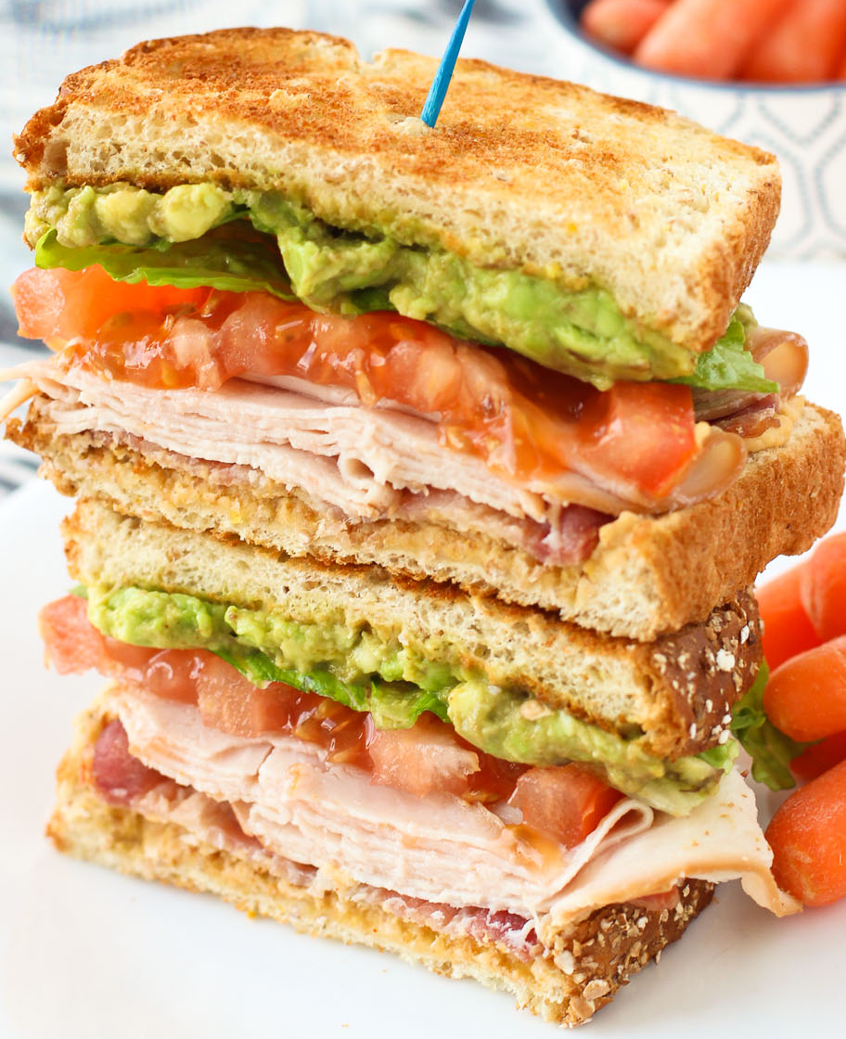
Bias-reduced linearization
McCaffrey, Bell, & Botts (2001) proposed a correction to V^{CR} based on a working model for the error covariance structure.
The corrected variance estimator is where the adjustment matrices A₁,…,A_{G} are chosen so that when the working model is correct.

Slide 14

Working models
“Working independence”, with Σ_{j} = I_{j}
“Working random effect model” assumes
Doesn’t this contradict goal of being robust?
Remarkably, the working model doesn’t actually matter much.
BRL greatly reduces bias even if the working model is far from the truth.

Slide 15
Hypothesis tests
We could use V^{BRL} in robust t and F statistics, but
Bias of variance estimator is only part of the problem
t(G-1), F(q, G – 1) often poor approximations for reference distributions
For t-tests, Bell and McCaffrey (2002) propose to use t(v) reference distribution, where with moments estimated based on the working model.

Slide 16
BRL + Satterthwaite t-tests work well

Slide 17
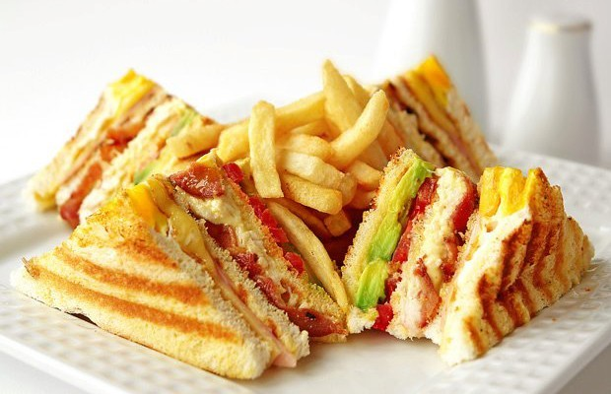
Our work

Slide 18
Outstanding problems with BRL
How do you do test multi-parameter hypotheses?
BRL adjustment matrices are sometimes undefined in models with lots of fixed effects.
In models with fixed effects, BRL adjustments depends on how you calculate the coefficient estimates.
Our work solves these issues, providing a general, “production-ready” approach to cluster-robust hypothesis testing.

Slide 19
Approximate Hotelling Test
We propose a generalization of the Satterthwaite approximation to the multi-dimensional case.
Approximate the distribution of V^{BRL} using a Wishart distribution with degrees of freedom η and I_{q} scale matrix.
Estimate η by matching mean and total variation of V^{BRL}.

Slide 20

Degrees of freedom (η)
For single-dimensional tests, η = v (Satterthwaite df).
Degrees of freedom are diagnostic.
large η indicates large effective sample size
small η (i.e., much less than G – 1) indicates that you’ve got small-sample problems.
Degrees of freedom capture the influence of covariates on the distribution of V^{BRL}
Unbalanced covariates
Skewed/leveraged covariates
Unequal cluster sizes
I got 99 degrees of freedom

Slide 21
AHT maintains close-to-nominal α

Slide 22
Examples

Slide 23
Handling fixed effects models
Consider state-by-year panel data model
Common to treat γ_{i}, ζ_{t} as fixed effects, estimate β by OLS.
Use CRVE to allow for further correlation among errors within each state.
BRL breaks down in this model (Angrist & Pischke, 2009).
Adjustment matrices are not calculable because of rank-deficiency.
We demonstrate that using the Moore-Penrose generalized inverse leads to adjustment matrices that are still unbiased under working model.

Slide 24
Handling fixed effects models
Two ways to calculate OLS estimates in fixed effects models:
Use dummy variables, estimate the full regression.
Absorb the fixed effects, estimate only the remaining coefficents.
BRL gives different results depending on which design matrix you use to calculate A₁,..,A_{G}.
We identify conditions where it is okay to use the absorbed design matrix to calculate A₁,..,A_{G}.
With OLS estimation, it’s okay if you are using a working identity model.
Absorb the within-cluster fixed effects only.

Slide 25
Examples

Slide 26
How to make your SEs smaller

Slide 27
Conclusions and future work

