Slide 1
part I: back ground

Slide 2
Education & Work
Political Science
CUPL
Communication
PKU
Communication
CityUHK
Recommendation Sys.
Baidu Inc.
4
3
4
1
years
A social scientist with computational skills.

Slide 3
R
SPSS
Mathematica
D3.js
NetLogo
Me
Processing
Python
Matlab
Linux
Hadoop

Slide 4
Scaling Laws
Cellular Automata
Renormalization
Markov chain
Self-organized criticality
Statistical Analysis
Growth dynamics of online communities
Data visualization
Flow Network Analysis
Agent based systems
Genetic Programming

Slide 5
part II:: research

Slide 6
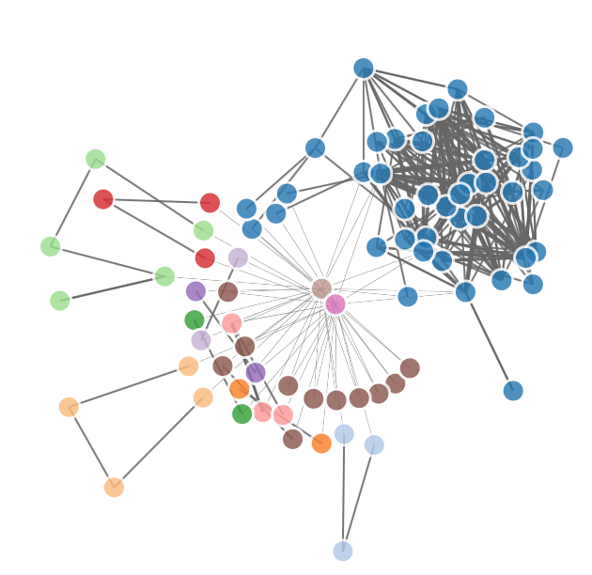
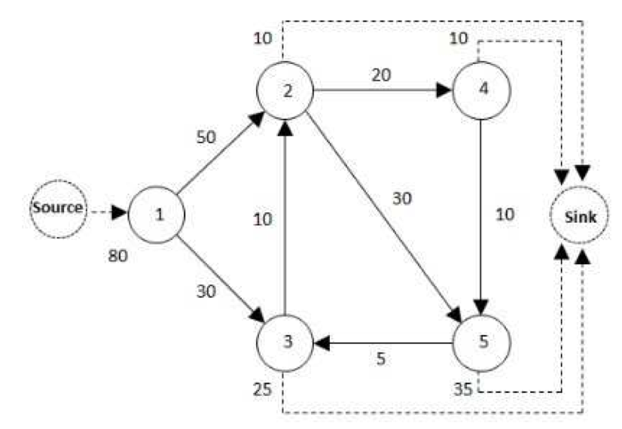
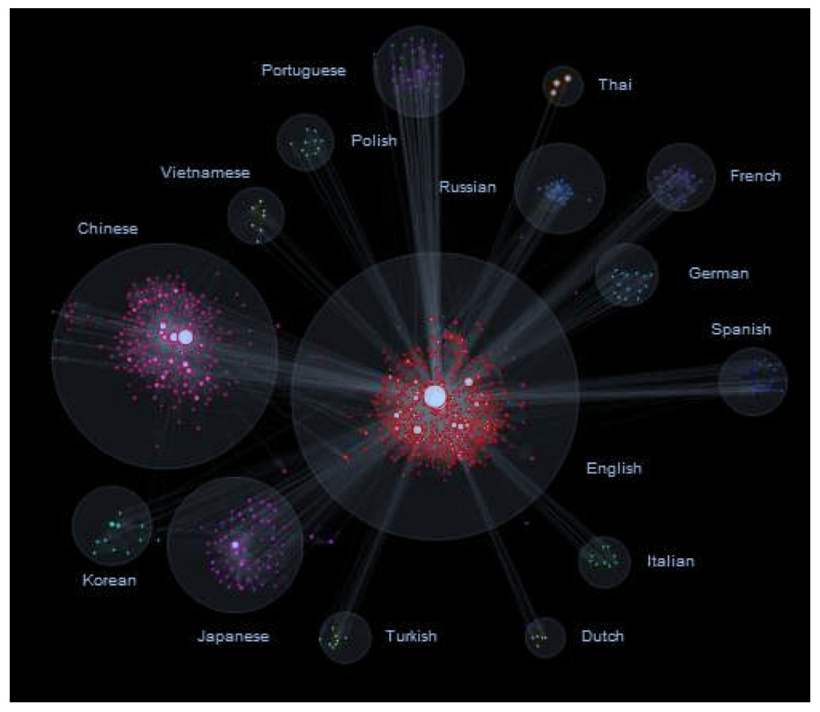
Clickstream networks/
Attention dynamics
Delicious tag network
L. Wu & J. Zhang, 2014
A theoretical clickstream network
Top 1,000 sites network
L. Wu & J. Zhang, 2013

Slide 7
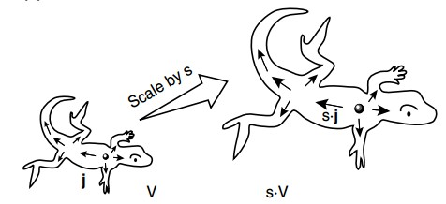
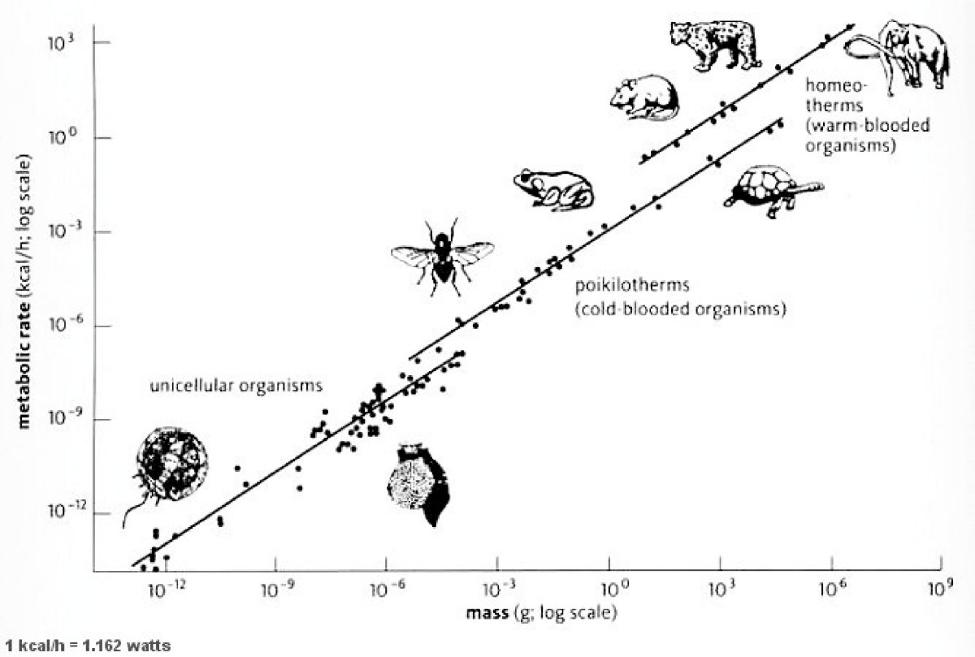
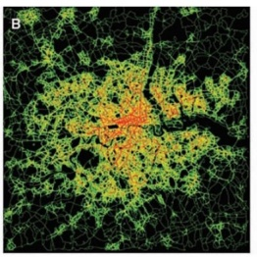
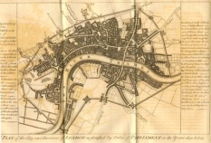

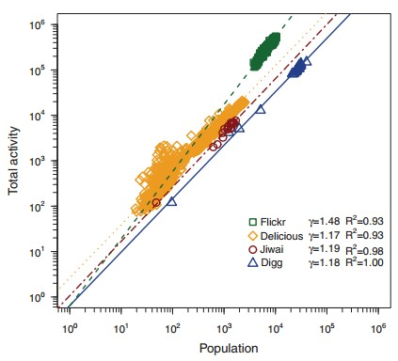
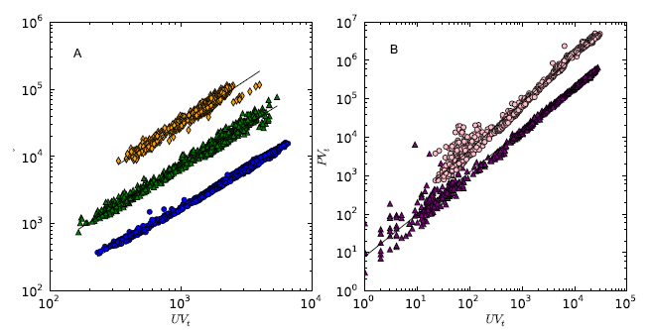
Scaling laws of living organisms, cities, and online communities
Allometric growth
London in 1642
London in 2008
Accelerating growth
Kleiber’s law, 1930s
Bettencourt et al., 2006
Scaling exponent: Efficiency of collaborative production
Input: social attention
Output: Information
Wu 2011; Wu & Zhang 2011, 2013
Wu, Zhang & Zhao, 2013

Slide 8

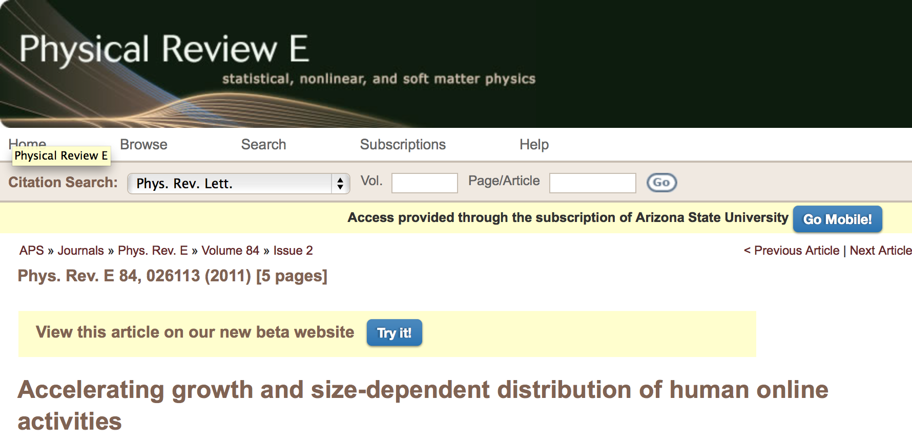
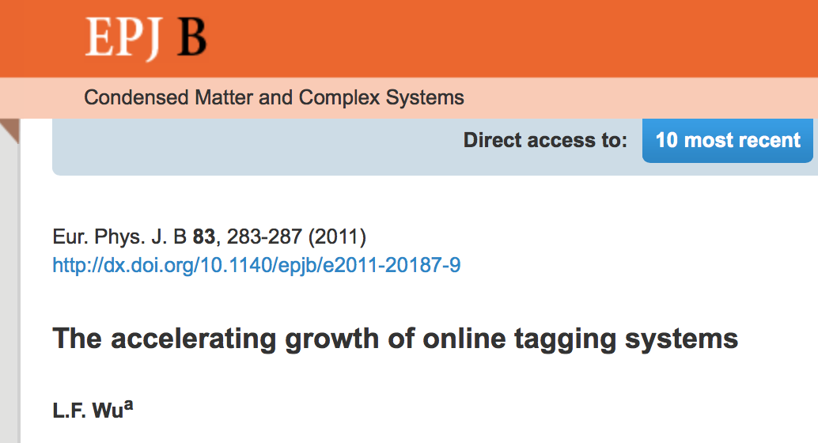

Slide 9
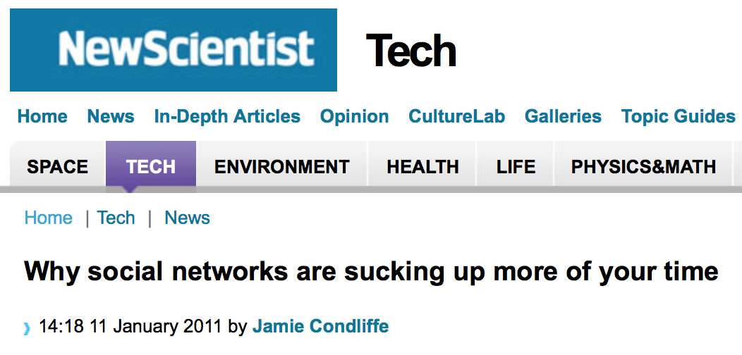
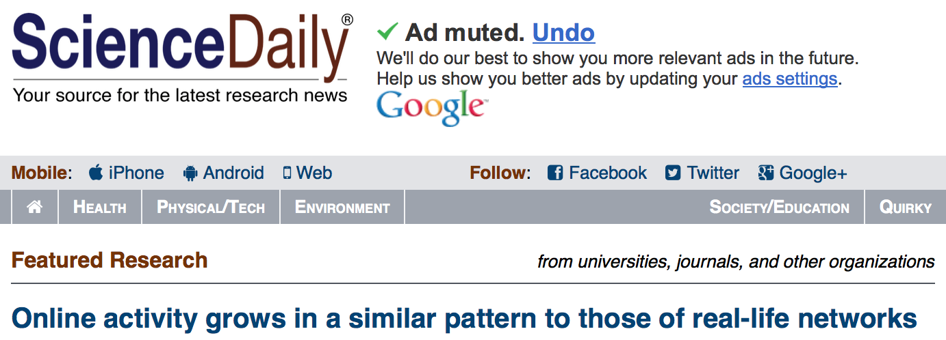
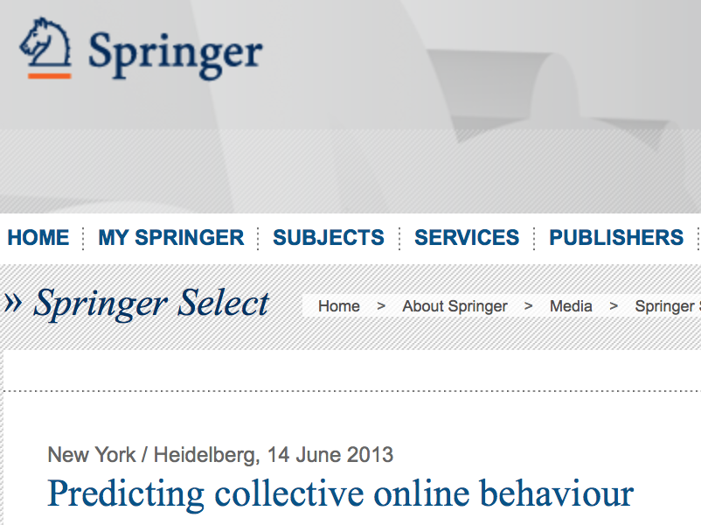

Slide 10
part III: data visualization

Slide 11
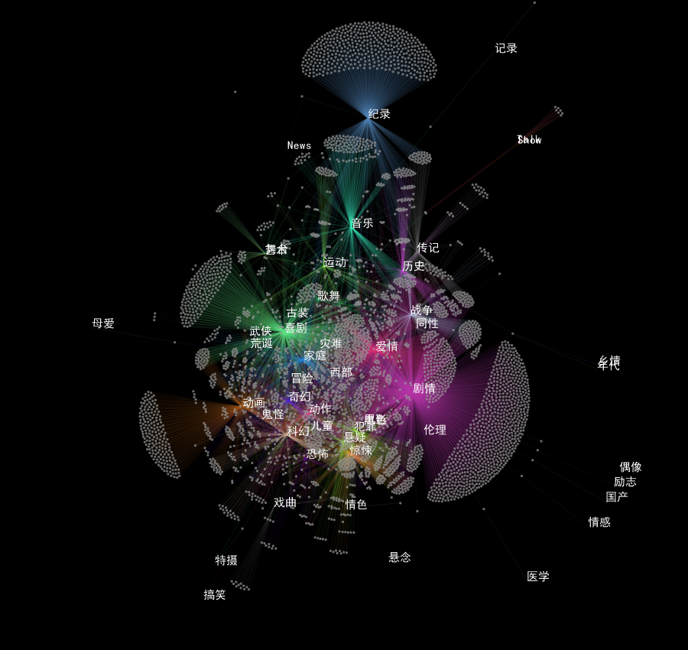
film-tag network

Slide 12
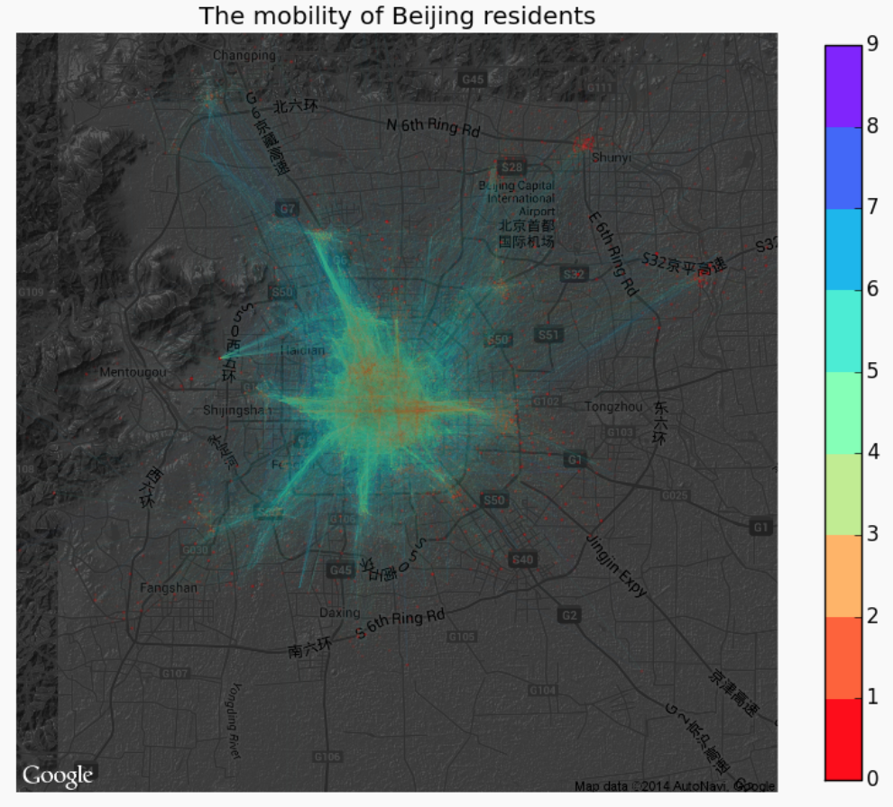
Beijing resident mobility

Slide 13
part IV: social activity

Slide 14

集智俱乐部
Swarm Agents Club (SAC)
Science 2.0 / open source science since 2008
11 core members, 10 study groups
~500 scientist, engineers, and analysts in the ‘Artificial Intelligence’ mail group
New product of SAC lab: real time weather report at minute level
rain.swarma.net
http://www.swarma.org/swarma/

