Slide 1
Write Side of CQRS
A quick introduction with a small program.

Slide 2

Write Side of CQRS
Provides mechanisms in order to read and write entities (advertises, publishers, campaigns, etc) in platform’s universe.

Slide 3
Write Side of CQRS
Abstractions
  Database
    Provides persistent mechanism in order to write/delete a Document/Datum with the notion of StorageUpdate
    Providers of Database component to choose from:
      Kafka
public interface BomDatabase {
CompletableFuture<Void> isReady();
CompletableFuture<Void> write(String topicName, String key, Map<String, byte[]> headers, JsonNode document);
CompletableFuture<Void> delete(String topicName, String key, Map<String, byte[]> headers);
CompletableFuture<Void> latchWrite(String topicName, String key, Map<String, byte[]> headers, JsonNode document);
CompletableFuture<Void> latchDelete(String topicName, String key, Map<String, byte[]> headers);
}

Slide 4
Write Side of CQRS
Basic Abstractions
  Storage (Materialized View)
    It gets updated from Database component periodically (synchronizer)
public interface Storage {
void update(String topicName, StorageUpdate... updates) throws StorageUpdateException;
}
    Provides crud operations on the Documents.
    Delete: StorageUpdate(key = ‘someValue’, sourceNode = null), so when sourceNode is null, synchronizer removes this entry from Storage.
    Providers of Storage component to choose from:
      Elastic Search
      Heap (in-memory ConcurrentHashMap)

Slide 5
Write Side of CQRS
Operations:
  Synchronization Mechanism (Synchronizer)
    The purpose of synchronization is to reflect the current state of Database component to Storage component, that means we have eventual consistency (consistency gaps defined by time interval of synchronizer)
  Latch write operation
    Block until operation has applied and Storage is in sync with Database

Slide 6
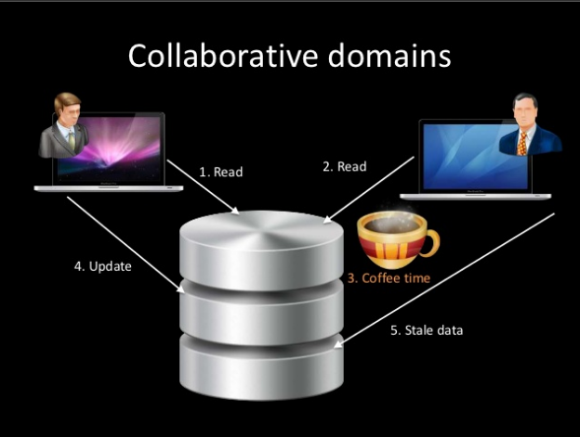
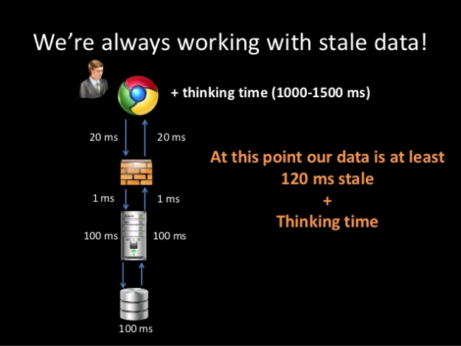
Write Side of CQRS

Slide 7
Write Side of CQRS
Readers
Database
Storage
(materialized view based on app needs)
Synchronizer
Someone could tell that is a naive approach to CQRS and Event Sourcing.
Nice material:
1) https://www.slideshare.net/jeppec/cqrs-why-what-how
2)https://www.slideshare.net/LorenzoNicora/from-c-to-q-one-event-at-the-time-event-sourcing-illustrated
Writers

Slide 8
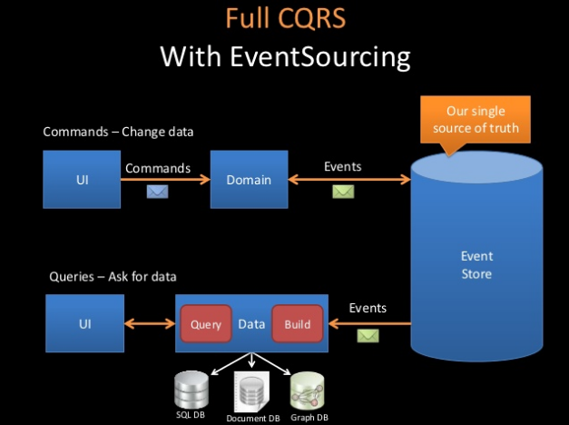
Write Side of CQRS

Slide 9
Write Side of CQRS
Demo time

Slide 10
Thank you!

