Slide 1
Event Materializer
A quick introduction.

Slide 2
Event Materializer
Is a library to keep memory buffer synchronize with external data sources
Core abstractions are the following:
[DataLayer]
← [DataBuffer]
← [DataBuilder]
← [DataSource]

Slide 3
Event Materializer
DataBuffer → class that holds the materialized data from the external datasource
DataLayer → encapsulation over the DataBuffer to give a read-only(immutable) access to it.
DataBuilder → class that is responsible for synchronizing the DataBuffer with external data providers / storage.

Slide 4
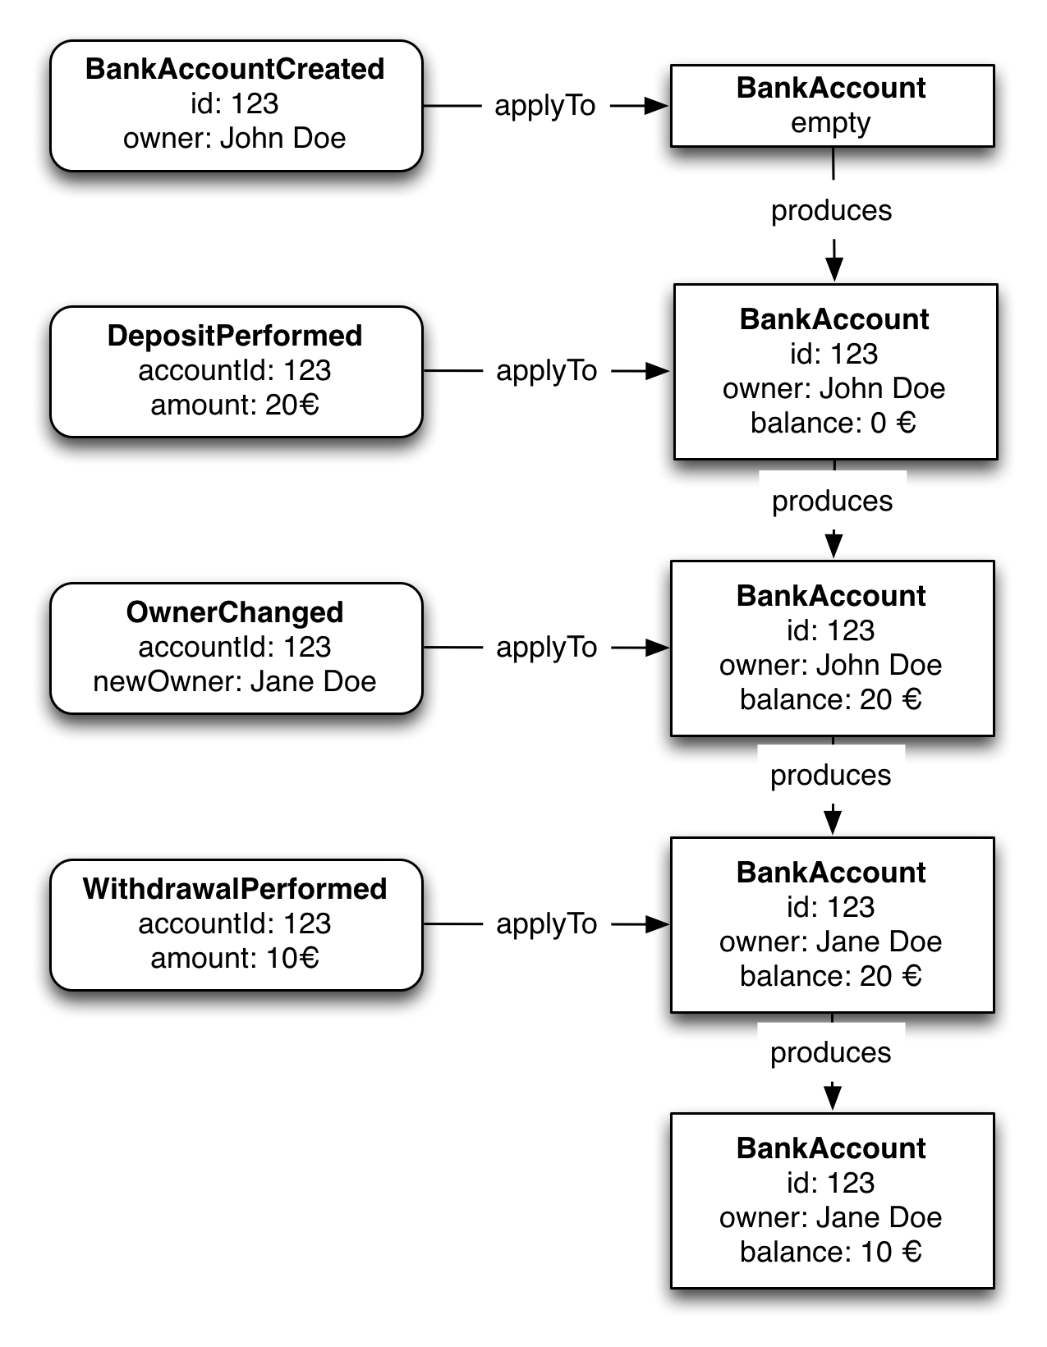
Event Materializer
Is an event sourcing materialization mechanism.

Slide 5
Event Materializer
Event Materializer Core, this library provides the core abstractions:
  DataBuilder
  DataBuffer
  DataLayer
Event Materializer Kafka, this library is a databuilder implementation using a Kafka consumer, for reading from kafka in a more convenient and optimal way.

Slide 6
Event Materializer
Demo time

Slide 7
Thank you!

