Slide 1


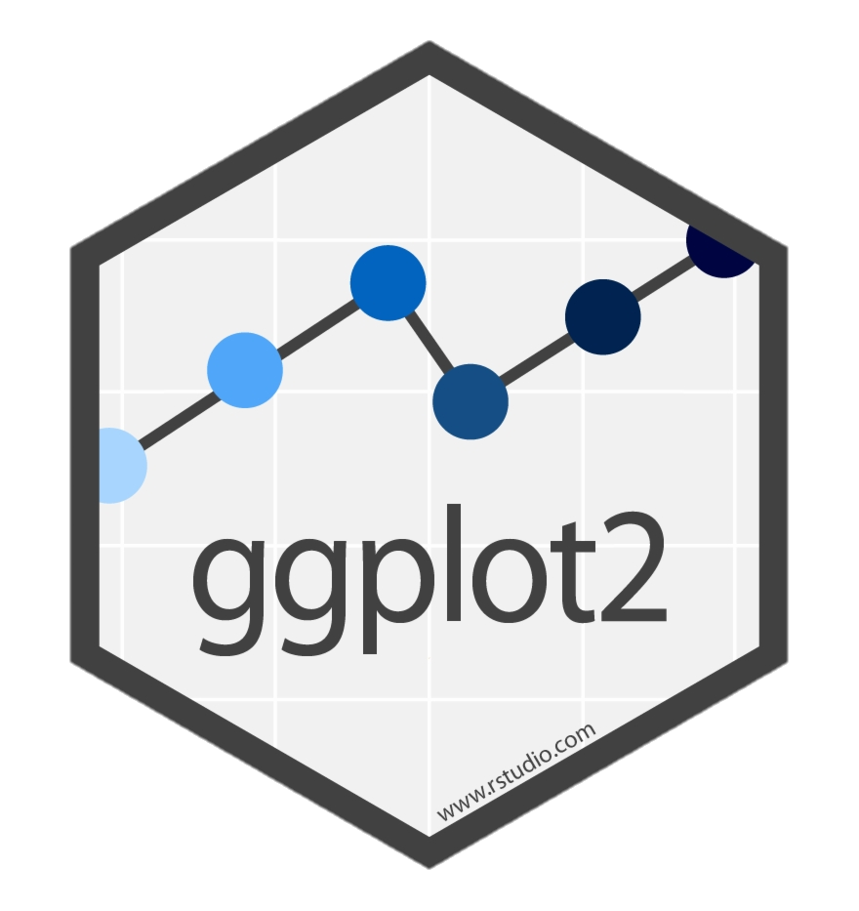

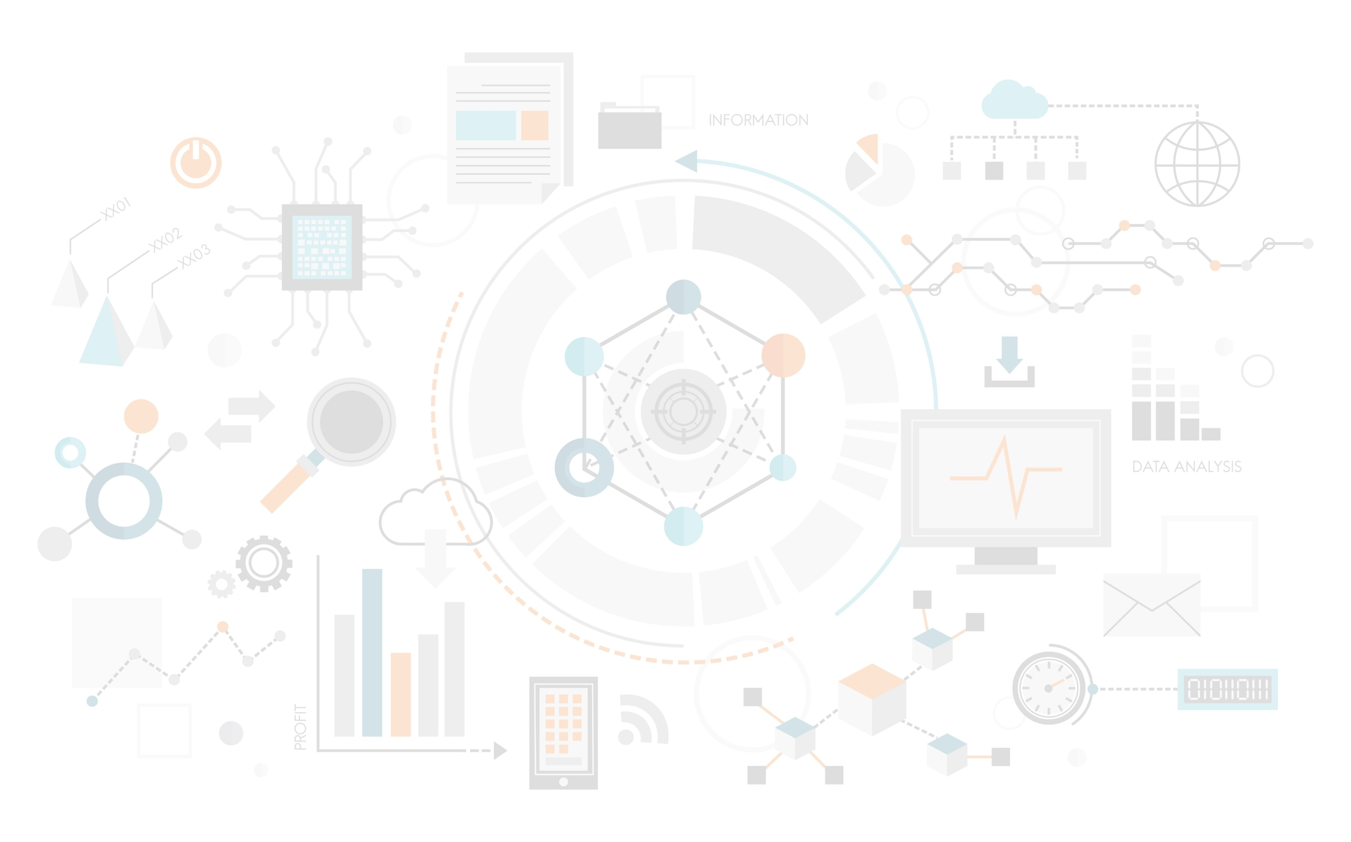
Training workshop on data analysis and visualization with ggplot2 using R

Slide 2

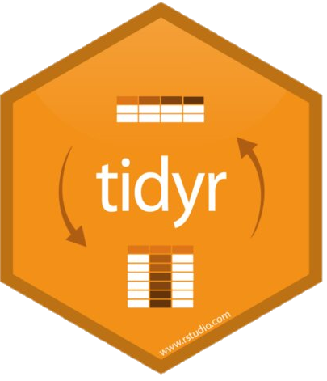

Training workshop on Data Visualization
using ggplot2 in R

