Slide 1




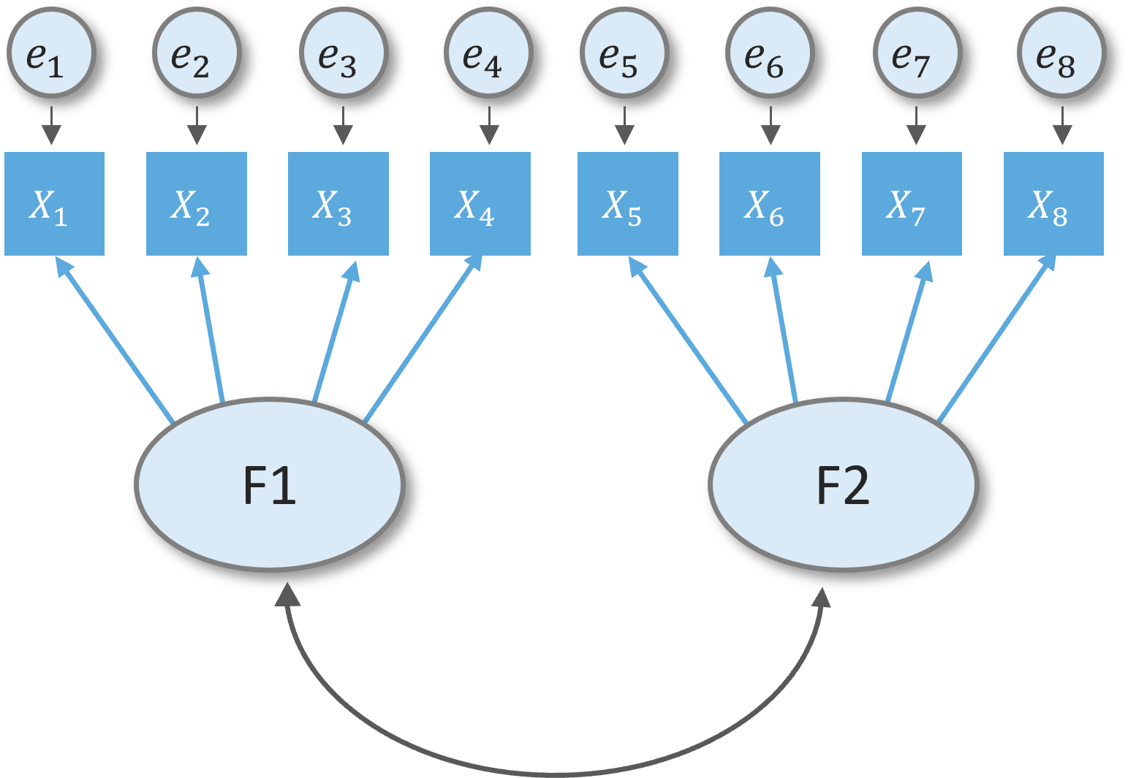
Special lecture on:
Structural equation modelling (SEM): Fundamentals and applications
20 April 2024 | 2:00 – 12:00, CME Boardroom
Christopher Llones, PhD
Post-doctoral fellow
King Mongkut’s Institute of Technology Ladkrabang (KMITL)
Bangkok, Thailand

Slide 2
Structural equation modelling (SEM): Fundamentals and applications
05 June 2024 | 13:00 CME conference room, VSU
Prepared by:
Christopher Llones, PhD

Slide 3

Special lecture on:
Structural equation modelling (SEM): Fundamentals and applications
20 April 2024 | 9:00 – 12:00, CME Boardroom
Christopher Llones, PhD
Post-doctoral fellow
King Mongkut’s Institute of Technology Ladkrabang (KMITL)
Bangkok, Thailand

Slide 4
Research goal
Defining constructs
Exploratory factor analysis (EFA)
Model specification (measurement & structural)
Estimation and model assessment (CB-SEM & PLS-SEM)
Interpretation & reporting of results
Hypotheses formulation
Data collection & preprocessing

Slide 5
Research goal
Defining constructs
Exploratory factor analysis (EFA)
Model specification (measurement & structural)
Estimation and model assessment (CB-SEM & PLS-SEM)
Interpretation & reporting of results
Hypotheses formulation
Data collection & preprocessing

Slide 6
Research goal
Defining constructs
Exploratory factor analysis (EFA)
Model specification (measurement & structural)
Estimation and model assessment (CB-SEM & PLS-SEM)
Interpretation & reporting of results
Hypotheses formulation
Data collection & preprocessing

Slide 7
Research goal
Defining constructs
Exploratory factor analysis (EFA)
Model specification (measurement & structural)
Estimation and model assessment (CB-SEM & PLS-SEM)
Interpretation & reporting of results
Hypotheses formulation
Data collection & preprocessing

Slide 8
Research goal
Defining constructs
Exploratory factor analysis (EFA)
Model specification (measurement & structural)
Estimation and model assessment (CB-SEM & PLS-SEM)
Interpretation & reporting of results
Hypotheses formulation
Data collection & preprocessing

Slide 9
Research goal
Defining constructs
Exploratory factor analysis (EFA)
Model specification (measurement & structural)
Estimation and model assessment (CB-SEM & PLS-SEM)
Interpretation & reporting of results
Hypotheses formulation
Data collection & preprocessing

Slide 10
Research goal
Defining constructs
Exploratory factor analysis (EFA)
Model specification (measurement & structural)
Estimation and model assessment (CB-SEM & PLS-SEM)
Interpretation & reporting of results
Hypotheses formulation
Data collection & preprocessing

Slide 11
Research goal
Defining constructs
Exploratory factor analysis (EFA)
Model specification (measurement & structural)
Estimation and model assessment (CB-SEM & PLS-SEM)
Interpretation & reporting of results
Hypotheses formulation
Data collection & preprocessing

Slide 12
Research goal
Defining constructs
Exploratory factor analysis (EFA)
Model specification (measurement & structural)
Estimation and model assessment (CB-SEM & PLS-SEM)
Interpretation & reporting of results
Hypotheses formulation
Data collection & preprocessing

Slide 13
Research goal
Defining constructs
Exploratory factor analysis (EFA)
Model specification (measurement & structural)
Estimation and model assessment (CB-SEM & PLS-SEM)
Interpretation & reporting of results
Hypotheses formulation
Data collection & preprocessing

Slide 14
Research goal
Defining constructs
Exploratory factor analysis (EFA)
Model specification (measurement & structural)
Estimation and model assessment (CB-SEM & PLS-SEM)
Interpretation & reporting of results
Hypotheses formulation
Data collection & preprocessing

Slide 15
Research goal
Defining constructs
Exploratory factor analysis (EFA)
Model specification (measurement & structural)
Estimation and model assessment (CB-SEM & PLS-SEM)
Interpretation & reporting of results
Hypotheses formulation
Data collection & preprocessing

Slide 16
Research goal
Defining constructs
Exploratory factor analysis (EFA)
Model specification (measurement & structural)
Estimation and model assessment (CB-SEM & PLS-SEM)
Interpretation & reporting of results
Hypotheses formulation
Data collection & preprocessing

Slide 17
Research goal
Defining constructs
Exploratory factor analysis (EFA)
Model specification (measurement & structural)
Estimation and model assessment (CB-SEM & PLS-SEM)
Interpretation & reporting of results
Hypotheses formulation
Data collection & preprocessing

