Slide 1
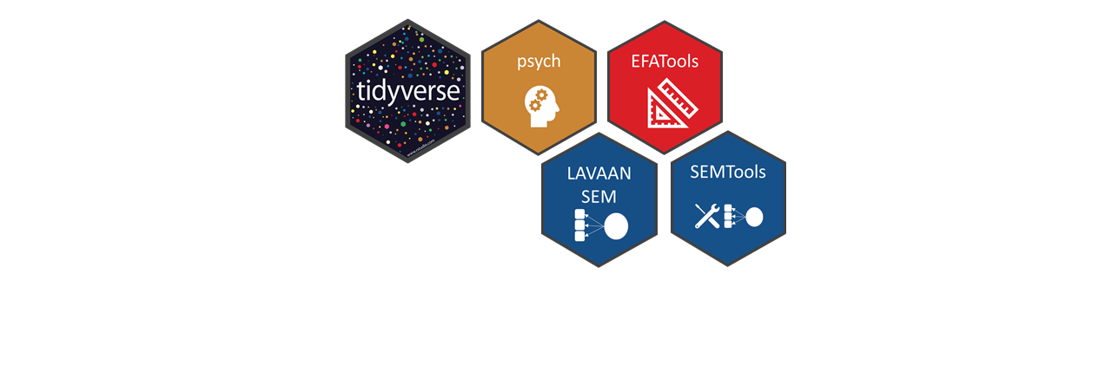
Training Workshop on
Structural Equation Modelling (SEM) using R.

