Slide 1




Slide 2










LAVAAN
SEM
SEMTools
EFATools
psych

Slide 3
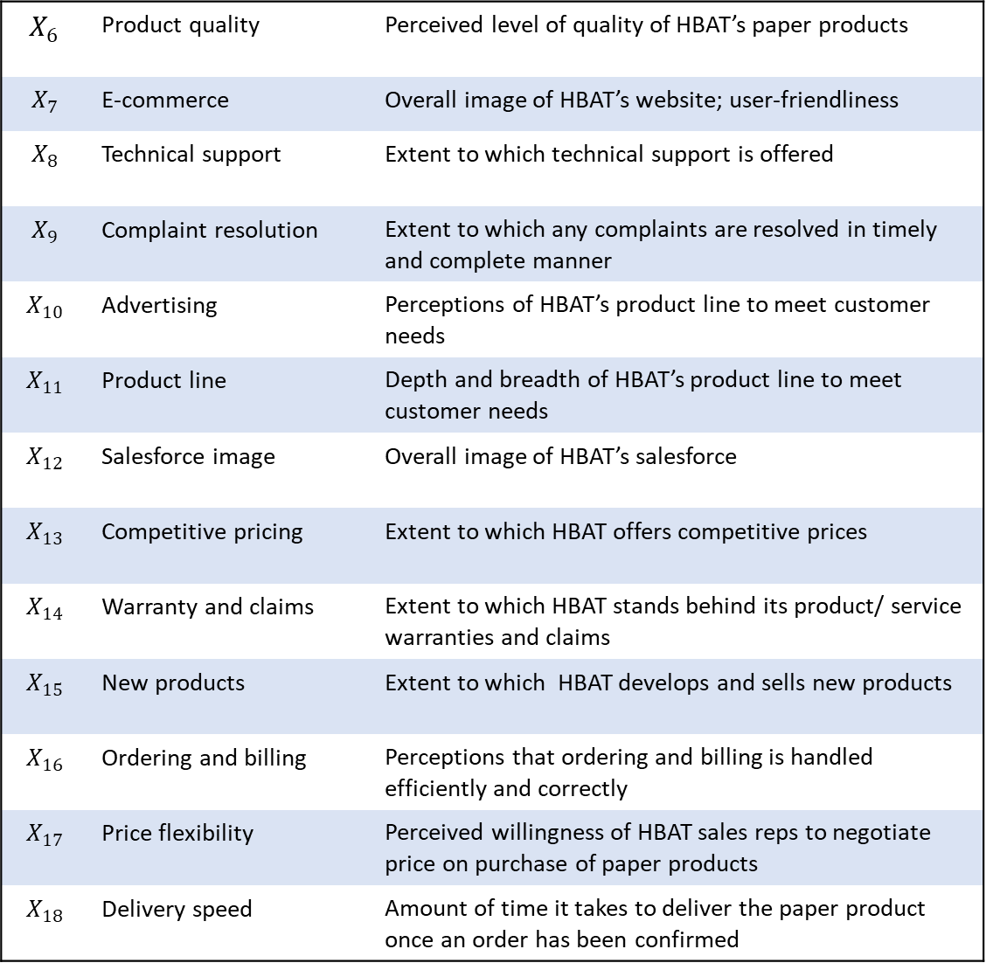
$$X_{6}$$ | Product quality | Perceived level of quality of HBAT’s paper products
$$X_{7}$$ | E-commerce | Overall image of HBAT’s website; user-friendliness
$$X_{8}$$ | Technical support | Extent to which technical support is offered
$$X_{9}$$ | Complaint resolution | Extent to which any complaints are resolved in timely and complete manner
$$X_{10}$$ | Advertising | Perceptions of HBAT’s product line to meet customer needs
$$X_{11}$$ | Product line | Depth and breadth of HBAT’s product line to meet customer needs
$$X_{12}$$ | Salesforce image | Overall image of HBAT’s salesforce
$$X_{13}$$ | Competitive pricing | Extent to which HBAT offers competitive prices
$$X_{14}$$ | Warranty and claims | Extent to which HBAT stands behind its product/ service warranties and claims
$$X_{15}$$ | New products | Extent to which HBAT develops and sells new products
$$X_{16}$$ | Ordering and billing | Perceptions that ordering and billing is handled efficiently and correctly
$$X_{17}$$ | Price flexibility | Perceived willingness of HBAT sales reps to negotiate price on purchase of paper products
$$X_{18}$$ | Delivery speed | Amount of time it takes to deliver the paper product once an order has been confirmed

Slide 4


















$$e_{1}$$
$$e_{1}$$
$$e_{1}$$
$$e_{1}$$
$$X_{1}$$
$$X_{2}$$
$$X_{3}$$
$$X_{4}$$
measured latent variable
Work environment
observed / manifest variable
Job satisfaction
$$e_{1}$$
error variance / disturbance term
Coworker
Covariance / non-directional path
Regression / directional path
$$X_{9}$$
$$X_{10}$$
$$X_{11}$$
$$X_{12}$$
$$X_{5}$$
$$X_{6}$$
$$X_{7}$$
$$X_{8}$$
$$e_{1}$$
$$e_{1}$$
$$e_{1}$$
$$e_{1}$$
$$e_{1}$$
$$e_{1}$$
$$e_{1}$$
$$e_{1}$$

Slide 5
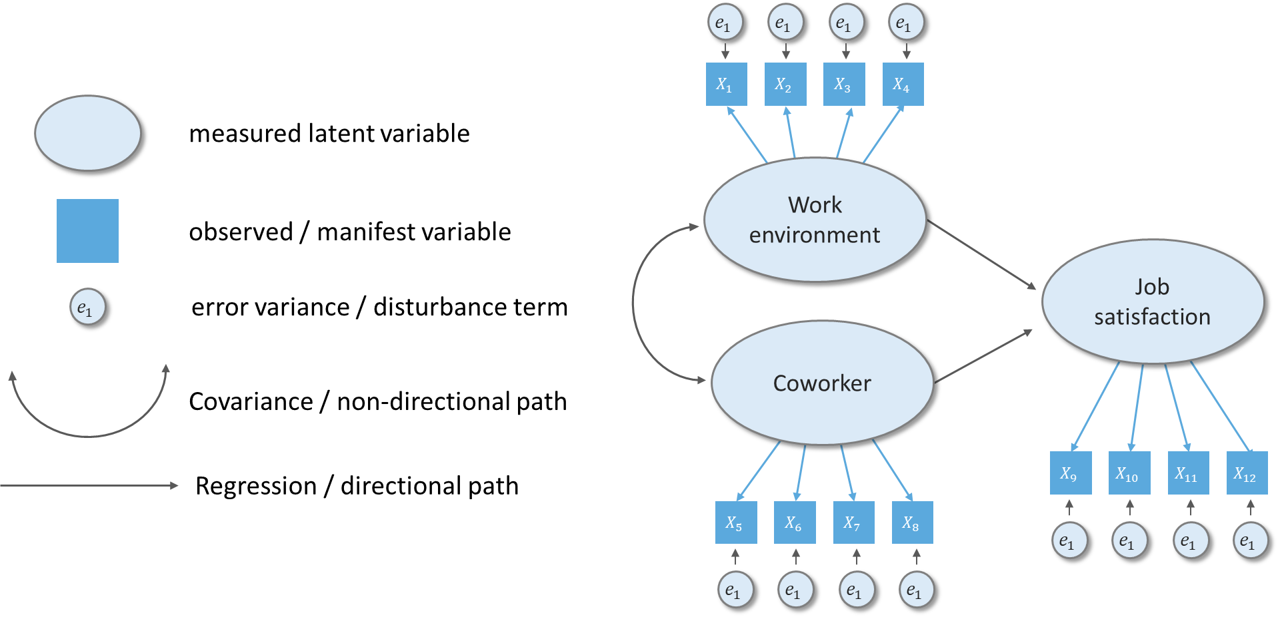

Slide 6














$$e_{1}$$
$$e_{1}$$
$$e_{1}$$
$$e_{1}$$
$$X_{1}$$
$$X_{2}$$
$$X_{3}$$
$$X_{4}$$
Work environment
Job satisfaction
Coworker
$$X_{9}$$
$$X_{10}$$
$$X_{11}$$
$$X_{12}$$
$$X_{5}$$
$$X_{6}$$
$$X_{7}$$
$$X_{8}$$
$$e_{1}$$
$$e_{1}$$
$$e_{1}$$
$$e_{1}$$
$$e_{1}$$
$$e_{1}$$
$$e_{1}$$
$$e_{1}$$

Slide 7
$$e_{1}$$
$$e_{1}$$
$$e_{1}$$
$$e_{1}$$
$$X_{1}$$
$$X_{2}$$
$$X_{3}$$
$$X_{4}$$
Work environment
Job satisfaction
Coworker
$$X_{9}$$
$$X_{10}$$
$$X_{11}$$
$$X_{12}$$
$$X_{5}$$
$$X_{6}$$
$$X_{7}$$
$$X_{8}$$
$$e_{1}$$
$$e_{1}$$
$$e_{1}$$
$$e_{1}$$
$$e_{1}$$
$$e_{1}$$
$$e_{1}$$
$$e_{1}$$

Slide 8
$$e_{1}$$
$$e_{1}$$
$$e_{1}$$
$$e_{1}$$
$$X_{1}$$
$$X_{2}$$
$$X_{3}$$
$$X_{4}$$
Work environment
Job satisfaction
Coworker
$$X_{9}$$
$$X_{10}$$
$$X_{11}$$
$$X_{12}$$
$$X_{5}$$
$$X_{6}$$
$$X_{7}$$
$$X_{8}$$
$$e_{1}$$
$$e_{1}$$
$$e_{1}$$
$$e_{1}$$
$$e_{1}$$
$$e_{1}$$
$$e_{1}$$
$$e_{1}$$

Slide 9
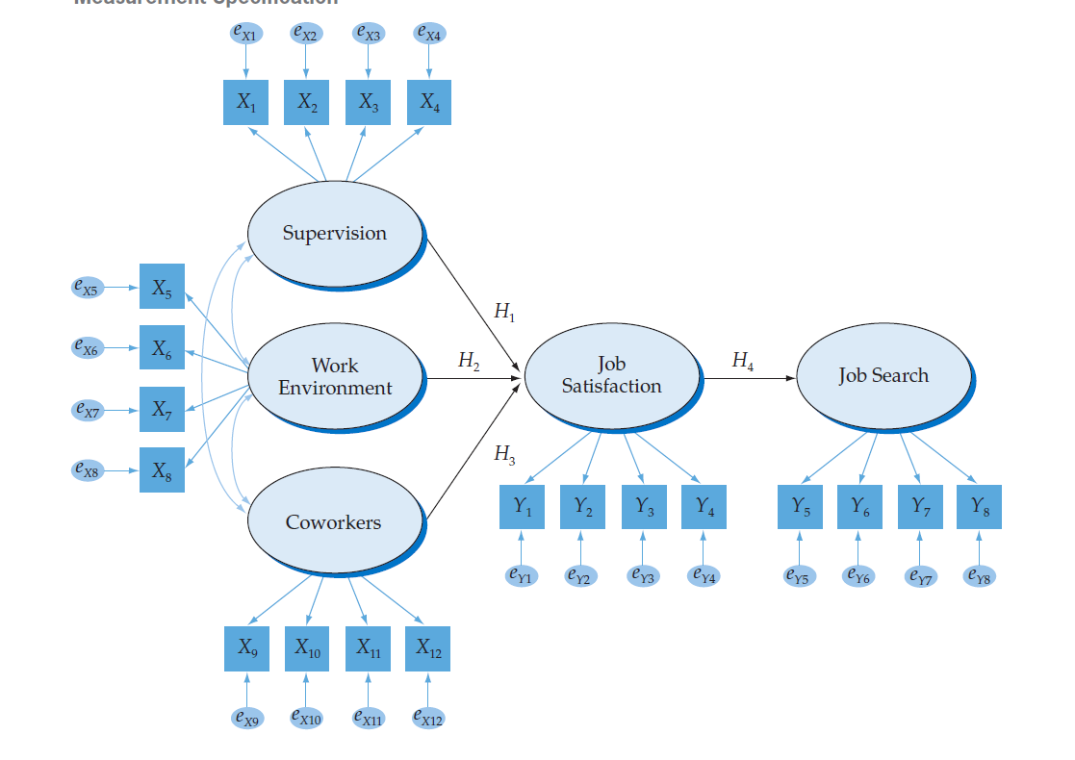
Work environment
Job satisfaction
Coworker

