Slide 1
OADW: Charges for Inpatient Clinical Events
Chris Amendola
March 2022

Slide 2
OADW: Events, Encounters and Claims
View of data informs determination of Categorized Charges

Slide 3
OADW: Charge Related Details
L1_CLAIM
  Most Granular
  Line Charge
  Revenue Codes – assign charge categories

Slide 4
OADW: Charge Related Details
Encounters
L1_CLINICAL_ENCOUNTER
  Zero to many ‘child’ claims
  Has a ‘general’ encounter Total Charge

Slide 5
Calculating Charges for Clinical Events
Claims->Encounters->Event
Summarize Claims for encounters
  Bucket Charges by Revenue Code category
  Charge values without Revenue code assigned an unknown category
      Claims with procedure code (‘999P’)
      All other claims (‘999U’)
Summarize Encounters to Event
  Encounters without claims but with charge assigned an unknown category(‘999T’)
      This is ‘uncategorized’ Encounter Total Charge

Slide 6
Data Details
Specifics
  All non-null Line Charge values are summed
      Positives
      Negatives
      Zero
  Limiting calculation to Non-Payer data sources
      Intended to approach this constraint in the near future
  Currently only computing Charges for the specific Clinical event CUI for Inpatient – CH000106
  New Dictionary created for support - L2_DICT_REV_CAT

Slide 7
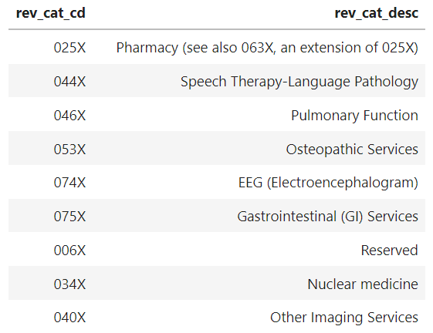
Data Details
  L2_DICT_REV_CAT
  Categories are first three positions of a length-4 specified Revenue Code
  Example:

Slide 8
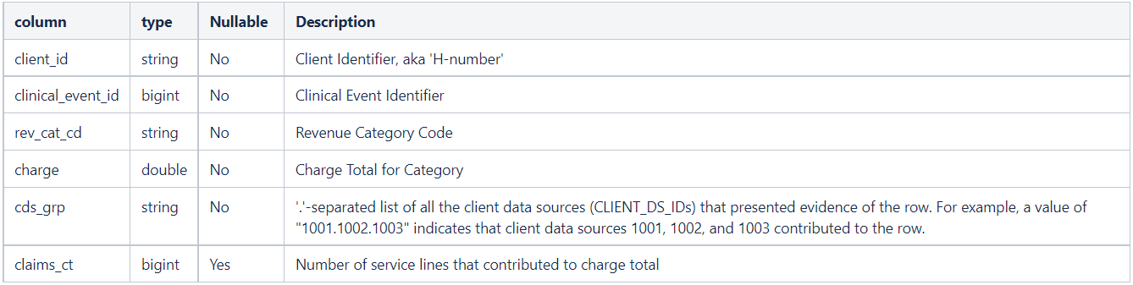
Data Details
l2_pat_clinical_event_charge

Slide 9
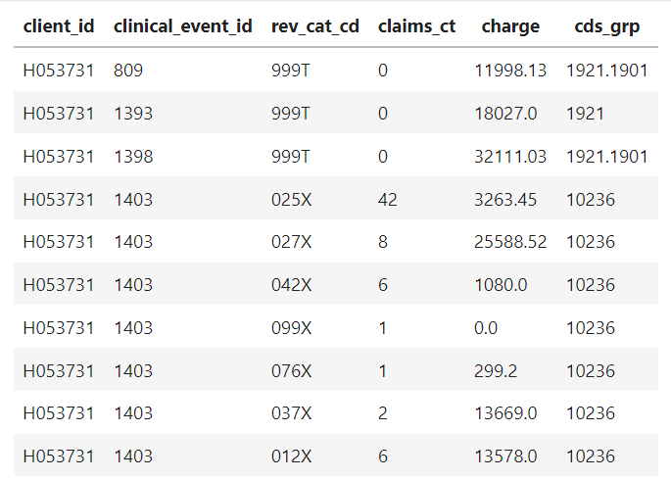
Data Details
l2_pat_clinical_event_charge

