Slide 1
OADW: ICU_Days for Inpatient Clinical Events
Chris Amendola
March 2022

Slide 2
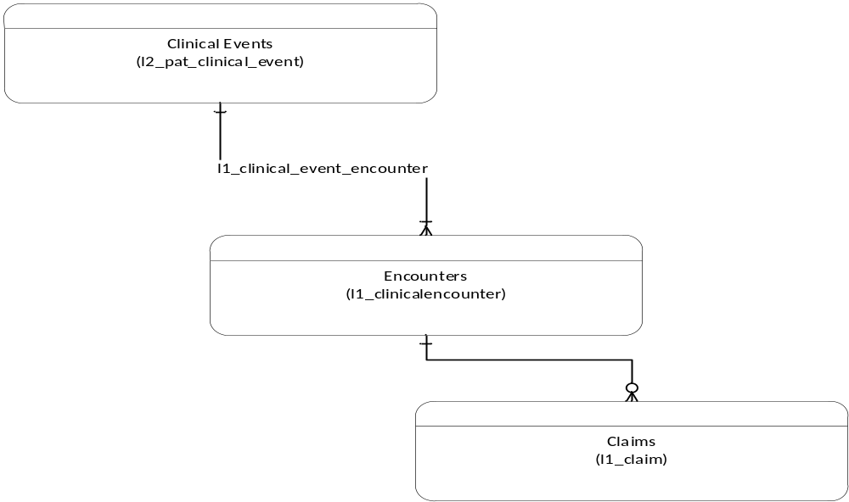
OADW: Events, Encounters and Claims
View of data informs determination of Categorized Quantites

Slide 3
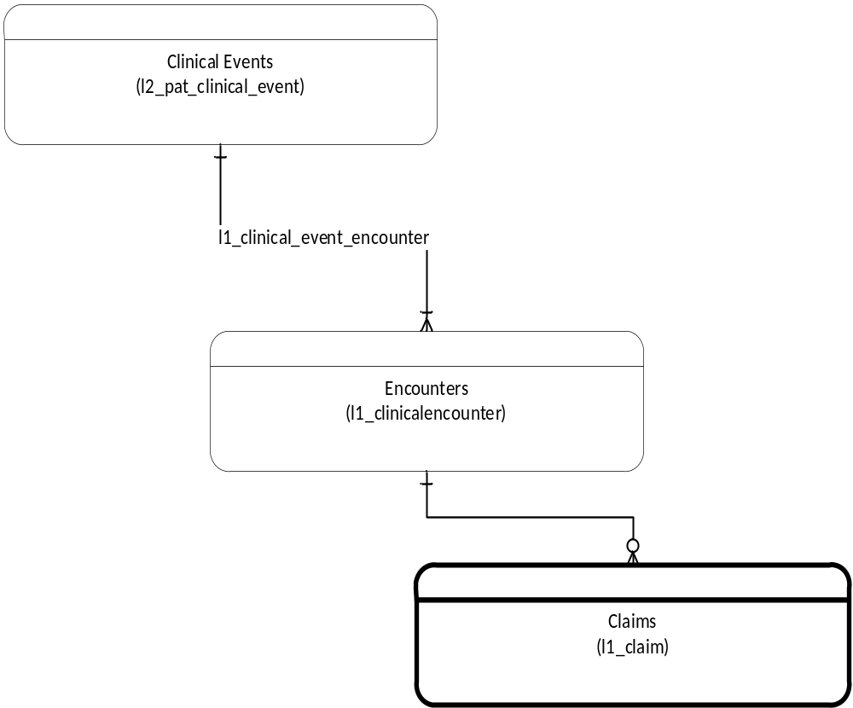
OADW: Charge Related Details
L1_CLAIM
  Most Granular
  Revenue Codes – Determine Rev Code for ICU
  Calculate Days based on Quantity (or possibly from dates)

Slide 4
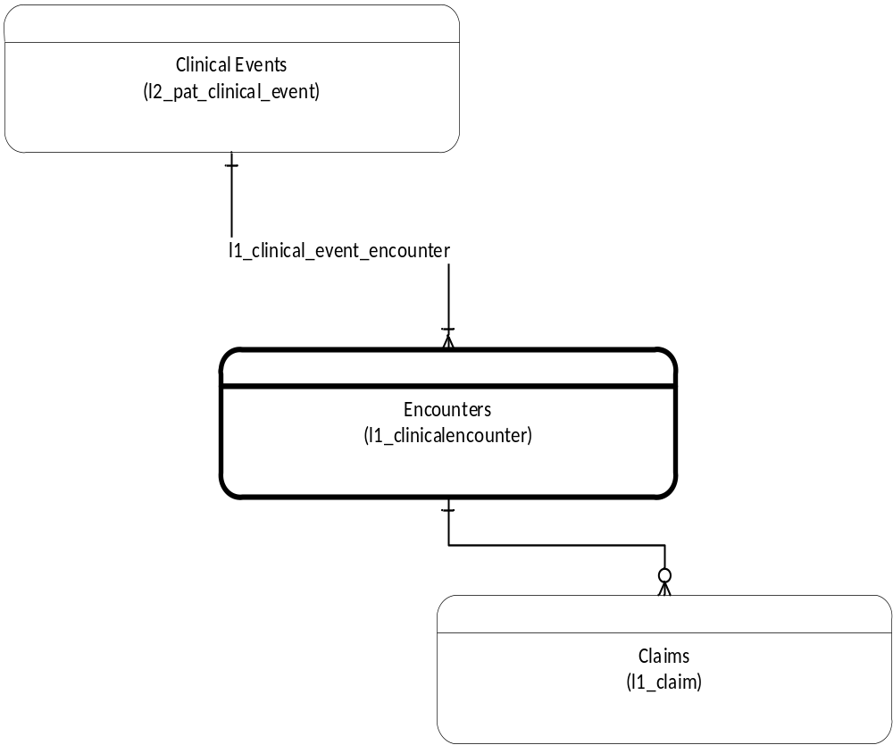
OADW: Charge Related Details
Encounters
L1_CLINICAL_ENCOUNTER
  Zero to many ‘child’ claims

Slide 5
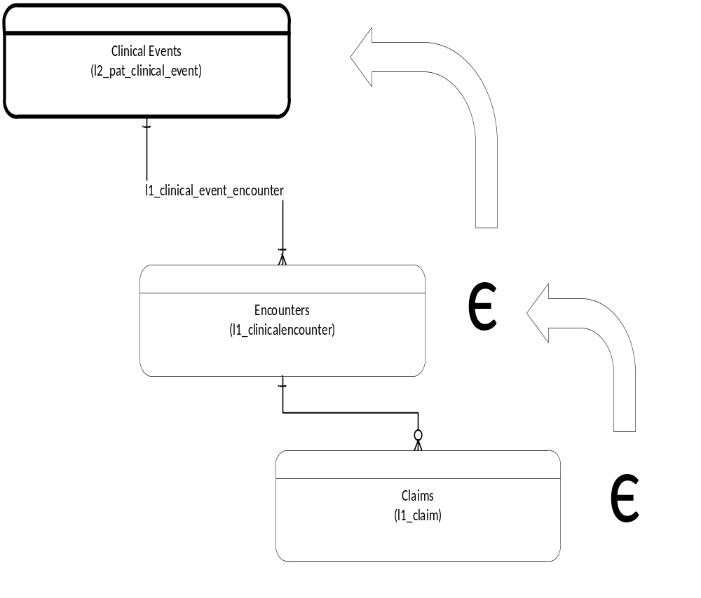
Calculating Charges for Clinical Events
Claims->Encounters->Event
Summarize Claims for encounters
  Identify ICU by Revenue Code category
  Claims days
      Quantity
Summarize Claims to Event
Summarize Encounters to Event

Slide 6
Data Details
Specifics
  Limiting calculation to Non-Payer data sources
      Intended to approach this constraint in the near future
  Currently only computing ICU for the specific Clinical event CUI for Inpatient – CH000106

Slide 7
Validation, Data Availability and Quality
Compare sum-quantity of all stay categories claims to LOS
  Stay Categories
      011X | Room & Board-Private (One Bed)
      012X | Room & Board-Semiprivate (Two-Beds)
      013X | Room & Board-Three and Four Beds
      014X | Room & Board-Deluxe Private
      015X | Room & Board-Ward
      016X | Room & Board-Other
  020X | Intensive Care
      021X | Coronary Care
      017X | Nursery
  Expect LOS to match or be one day longer than sum of the quantity values
      “Three days, two nights”
      “Three days, three nights”

