Slide 1
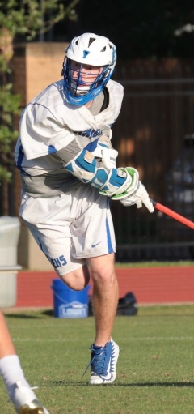
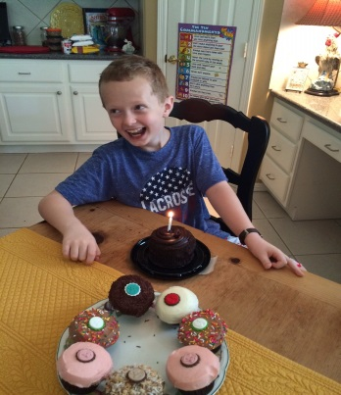
Chris Amendola – Joined Optum Team June 12th 2017
Married to my Wife, Kay, 17 years
Two Sons:
  Gannon-15
  Garrison-10
Houston, TX
Senior IT Data Analytics Consultant, Impact Implementation Team
Co-Moderator of UHG HUB SAS Users Group
Analyst “Hats”
  System
  Programmer
  Data
These days I am in full-on ‘Dad-mode’ and my interests and activities are pretty much whatever my kids are doing ☺
Odd Tidbit about myself:
Caffeine's Effects on Performance and Mood are Independent of Age and Gender.
Amendola CA¹, Gabrieli JD¹, Lieberman HR¹.
Nutr Neurosci. 1998;1(4):269-80. doi: 10.1080/1028415X.1998.11747237.
https://www.ncbi.nlm.nih.gov/pubmed/27414696

Slide 2
Get Abstract presented by Team exCITe
June 29th 2017

Slide 3
My Summary – stealing from Twain
“Success is the resistance to failure, mastery of failure, not the absence of failure.”

Slide 4
Failure as Gravity
The notion of gravity as pervasive and somehow unavoidable is appealing – objective!
Yet the definition they offer of failure adds a subjective component – ‘“mistakes” and unwelcome outcomes that matter’
Failure has a large subjective component – Bronze Medal reactions
Edison and Wozniack never “failed” – since every effort was a learning experience.
  https://hubconnect.uhg.com/docs/DOC-135860

Slide 5
Fear of failure is far more destructive than failure itself.
The five keys to a successful Google team
  Julia Rozovsky, Analyst, GOOGLE PEOPLE OPERATIONS NOVEMBER 17, 2015
  https://rework.withgoogle.com/blog/five-keys-to-a-successful-google-team/
“Who is on a team matters less than how the team members interact, structure their work, and view their contributions.”
#1-Psychological safety: Can we take risks on this team without feeling insecure or embarrassed?

Slide 6
Make sure your reaction to a problem doesn’t create more failure.
How Complex Systems Fail
(Being a Short Treatise on the Nature of Failure; How Failure is Evaluated; How Failure is
Attributed to Proximate Cause; and the Resulting New Understanding of Patient Safety)
Richard I. Cook, MD
Cognitive technologies Laboratory
University of Chicago

Slide 7
Make sure your reaction to a problem doesn’t create more failure.(cont.)
“The evaluations based on such reasoning as ‘root cause’ do not reflect a technical understanding of the nature of failure but rather the social, cultural need to blame specific, localized forces or events for outcomes.”
“Hindsight bias remains the primary obstacle to accident investigation, especially when expert human performance is involved.”
“That practitioner actions are gambles appears clear after accidents; in general, post hoc analysis regards these gambles as poor ones. But the converse: that successful outcomes are also the result of gambles; is not widely appreciated.”

Slide 8
Publish a study that failed to find effects.
Caffeine's Effects on Performance and Mood are Independent of Age and Gender.
  Have to account for age related differences in mood first, but otherwise no differences
  Useful finding because it means experimental designs don’t have to account for age/gender mix in the experimental cohort.

Slide 9
Starter Question:

