Slide 1

Decision Intelligence: Elevating Judgment and Forecasting
Enhancing insights through data-driven decision-making processes
Notes:
---

Slide 2
Introduction & Objectives
Notes:
Defining Decision Intelligence and Its Importance

Slide 3

Defining Decision Intelligence and Its Importance
Integration of Sciences
  Decision Intelligence combines data science, behavioral science, and decision theory to enhance decision-making effectiveness.
Reducing Cognitive Biases
  It helps reduce cognitive traps and biases that distort data interpretation, leading to better decisions.
Structured Probabilistic Reasoning
  Emphasizes structured thinking and probabilistic reasoning to communicate uncertainty transparently.
Strategic Leadership Role
  Enables data professionals to transition from execution to strategic leadership amid complex environments.
Notes:
Decision Intelligence is the integration of data science, behavioral science, and decision theory to improve organizational decision-making. For principal-level data professionals, this concept is critical because it moves beyond building accurate models to influencing strategic decisions that have real-world impact. The importance lies in reducing cognitive traps and biases that can distort interpretation of data and lead to poor decisions. Decision Intelligence emphasizes structured thinking, probabilistic reasoning, and transparent communication of uncertainty. It ensures that data leaders can diagnose decision problems, design robust forecasting methods, and deliver insights that stakeholders trust. By applying these principles, professionals can elevate their role from technical execution to strategic leadership, guiding organizations through complex, uncertain environments with clarity and confidence.

Slide 4
Kahneman: Cognitive Biases & Thinking Systems
Notes:
System 1 vs System 2 and Key Biases

Slide 5

System 1 vs System 2 and Key Biases
Dual Modes of Thinking
  System 1 is fast, intuitive, and automatic, while System 2 is slow, deliberate, and analytical.
Common Cognitive Biases
  Overconfidence, anchoring, and availability heuristic can skew data analysis and decision-making.
Mitigating Biases
  Premortem analysis helps identify hidden assumptions and reduce cognitive blind spots before decisions.
Notes:
Daniel Kahneman’s work in 'Thinking, Fast and Slow' introduces two modes of thinking: System 1 and System 2. System 1 is fast, intuitive, and automatic, while System 2 is slow, deliberate, and analytical. Data professionals often rely on System 2 for rigorous analysis, but System 1 can unconsciously influence judgments, leading to biases. Common biases include overconfidence, where professionals overestimate their predictive accuracy; anchoring, where initial estimates skew subsequent analysis; and availability heuristic, where recent or vivid data disproportionately affects decisions. These biases can undermine even the most sophisticated models. To mitigate them, Kahneman advocates techniques like premortem analysis, which involves imagining a future failure and identifying its causes before making a decision. This proactive approach helps teams uncover hidden assumptions and reduce cognitive blind spots.

Slide 6
Tetlock: Forecasting & Superforecasting
Notes:
Improving Forecast Accuracy Through Structured Methods

Slide 7

Improving Forecast Accuracy Through Structured Methods
Limitations of Expert Predictions
  Experts often perform worse than chance without structured forecasting methods, highlighting the need for rigorous approaches.
Superforecasting Techniques
  Breaking problems down, Bayesian updating, and probabilistic humility improve forecast accuracy significantly.
Continuous Learning and Aggregation
  Superforecasters aggregate diverse viewpoints and learn from feedback for better predictions over time.
Probabilistic Metrics for Evaluation
  Using metrics like the Brier Score helps evaluate and improve the quality of probabilistic forecasts.
Notes:
Philip Tetlock’s research in 'Expert Political Judgment' revealed that experts often perform worse than chance when making predictions without structured methods. His subsequent work on superforecasting identifies practices that significantly improve forecasting accuracy. These include breaking complex problems into smaller components, applying Bayesian updating to revise probabilities as new information emerges, and maintaining probabilistic humility by assigning confidence intervals rather than absolute predictions. Superforecasters also aggregate diverse viewpoints and continuously learn from feedback. For data professionals, adopting these principles means moving beyond deterministic models to probabilistic thinking, using metrics like the Brier Score to evaluate forecast quality. This structured approach enhances credibility and ensures that forecasts are actionable and resilient in uncertain environments.

Slide 8
Spiegelhalter: Risk, Uncertainty & Communication
Notes:
Communicating Uncertainty Effectively

Slide 9
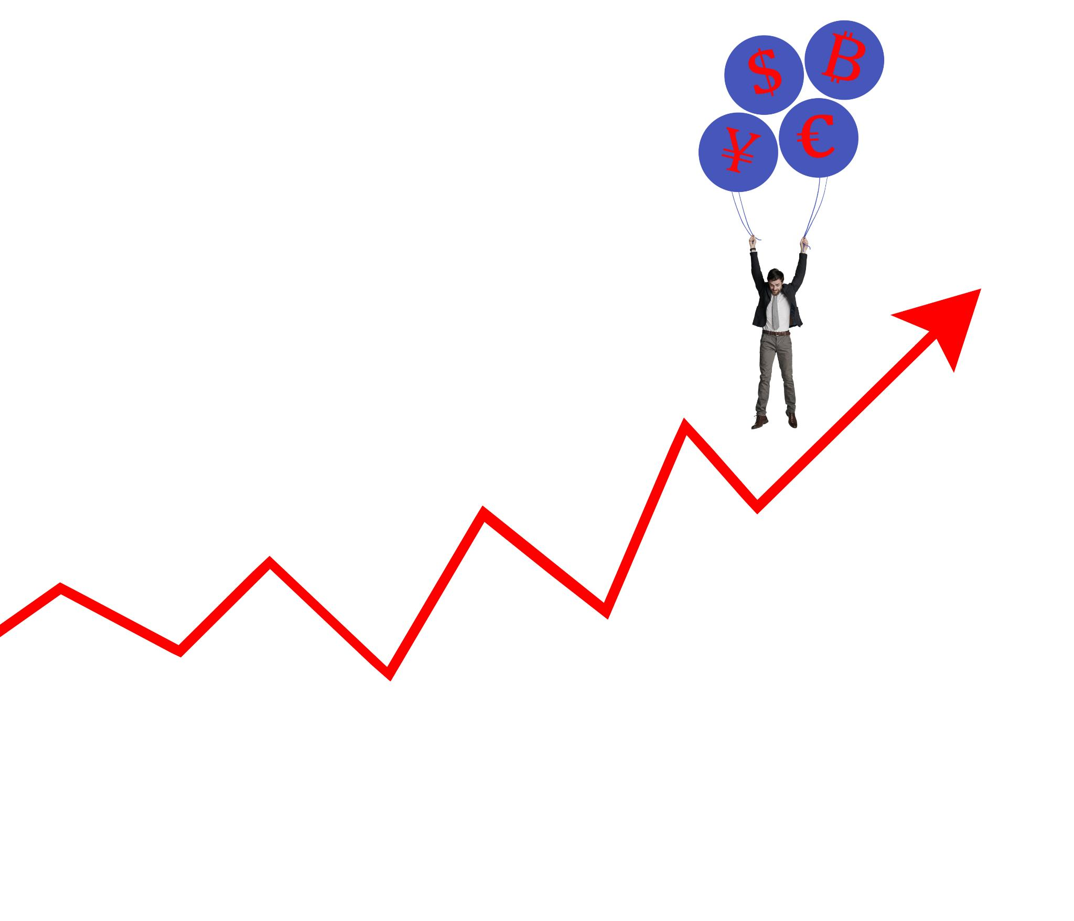
Communicating Uncertainty Effectively
Distinguishing Risk and Uncertainty
  Risk involves measurable probabilities, while uncertainty covers unknown unknowns beyond quantification.
Using Frequency Formats
  Frequency formats like '1 in 100' make probabilities more relatable than vague percentages.
Avoiding False Precision
  Presenting ranges and confidence intervals prevents misleading single-point estimates and false precision.
Building Trust through Clarity
  Clear communication of uncertainty strengthens trust and aids better strategic decisions under uncertainty.
Notes:
David Spiegelhalter emphasizes the distinction between risk and uncertainty: risk involves quantifiable probabilities, while uncertainty refers to unknown unknowns. Communicating these concepts effectively is essential for informed decision-making. Spiegelhalter advocates using frequency formats (e.g., '1 in 100') instead of vague percentages, and visual aids like icon arrays to make probabilities tangible. He warns against false precision, urging professionals to present ranges and confidence intervals rather than single-point estimates. Clear communication of uncertainty builds trust and prevents misinterpretation of data. For principal-level professionals, mastering these techniques ensures that stakeholders understand both the limitations and strengths of predictive models, enabling better strategic decisions under uncertainty.

Slide 10
Integration Framework
Notes:
Combining Insights into a Practical Framework

Slide 11
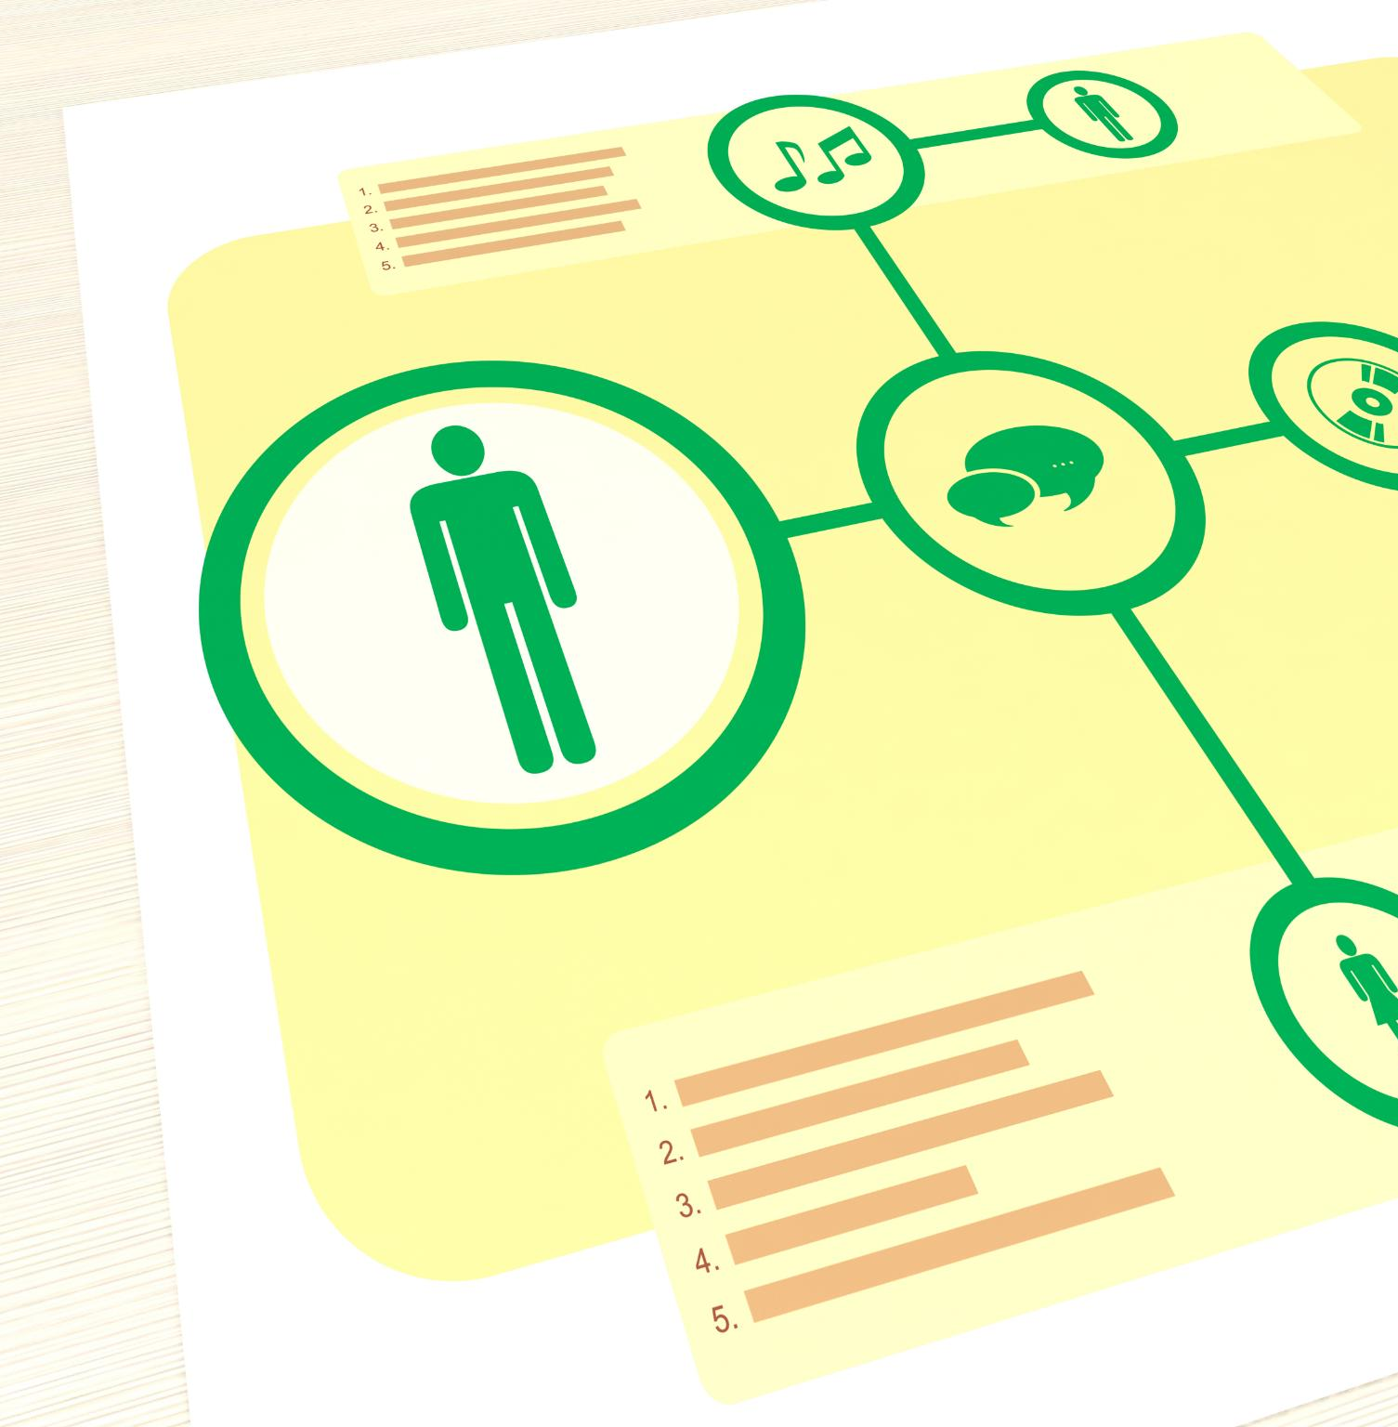
Combining Insights into a Practical Framework
Diagnose Cognitive Biases
  Diagnose focuses on identifying cognitive traps and biases that can distort analysis and decision-making processes.
Design Structured Forecasts
  Design emphasizes structuring forecasts with probabilistic thinking and superforecasting to enhance rigor and adaptability.
Deliver Transparent Communication
  Deliver stresses transparent communication of risk and uncertainty to avoid false precision and build stakeholder trust.
Notes:
The integration of Kahneman, Tetlock, and Spiegelhalter’s insights forms a robust Decision Intelligence framework. It consists of three pillars: Diagnose, Design, and Deliver. Diagnose involves identifying cognitive traps and biases that may distort analysis. Design focuses on structuring forecasts using probabilistic thinking and superforecasting principles, ensuring rigor and adaptability. Deliver emphasizes transparent communication of risk and uncertainty, using Spiegelhalter’s guidelines to avoid false precision and foster stakeholder trust. This framework empowers data leaders to navigate complexity with clarity, combining behavioral insights with analytical rigor. By applying these principles consistently, organizations can make decisions that are not only data-driven but also psychologically sound and strategically robust.

Slide 12
Closing Thoughts
Notes:
Better Minds + Better Methods = Better Decisions

Slide 13
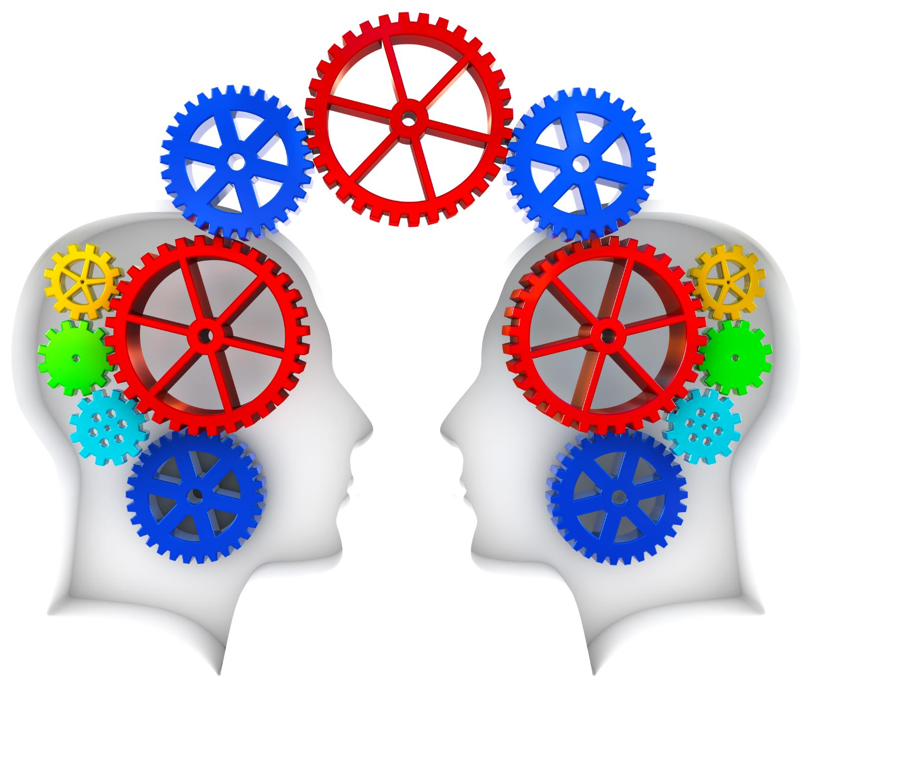
Better Minds + Better Methods = Better Decisions
Cognitive Awareness
  Recognizing and mitigating biases is essential for improving judgment and decision-making quality.
Structured Forecasting
  Using structured forecasting techniques enhances judgment accuracy and reliability in uncertain environments.
Communicating Uncertainty
  Clear communication of uncertainty helps organizations make transparent and resilient decisions.
Synergy for Better Decisions
  Combining behavioral insights with probabilistic methods leads to strategic and informed decision-making.
Notes:
The essence of Decision Intelligence lies in the synergy between cognitive awareness and analytical precision. Kahneman teaches us to recognize and mitigate biases, Tetlock shows how structured forecasting improves judgment, and Spiegelhalter demonstrates the importance of clear communication of uncertainty. Together, these insights enable data professionals to elevate their impact from technical execution to strategic leadership. Better minds, equipped with behavioral understanding, combined with better methods rooted in probabilistic reasoning, lead to better decisions. This approach ensures that organizations thrive in uncertain environments, making choices that are informed, transparent, and resilient.

