Slide 1
Exploratory Analysis Report

Slide 2
Univariate Analysis

Slide 3
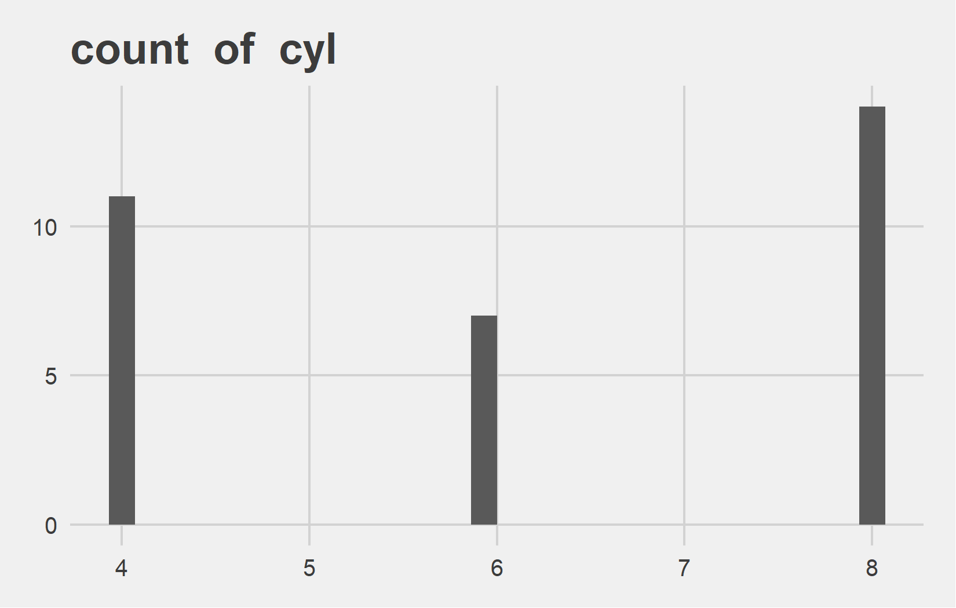
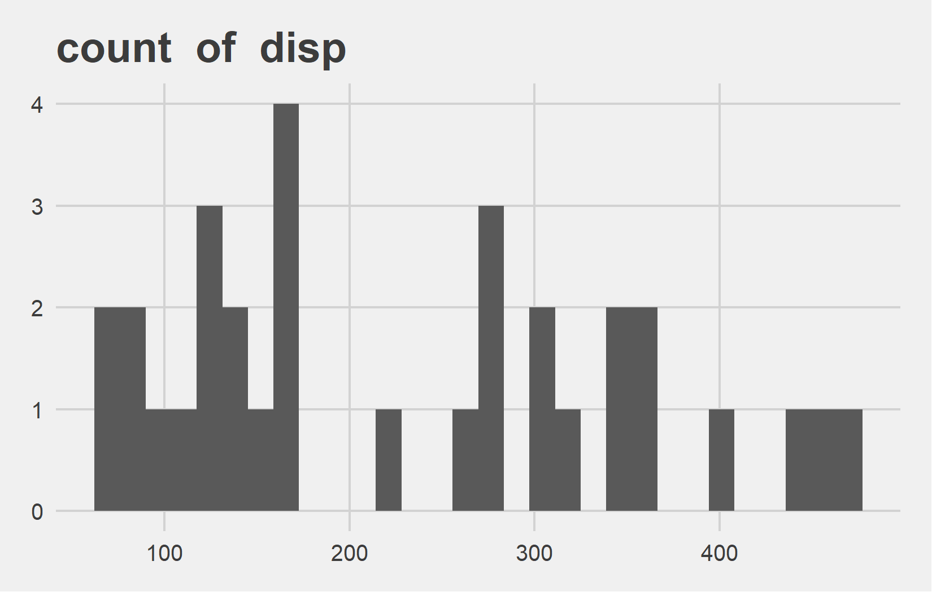
Univariate Analysis Slide 1 of 6
min | 25th | 50th | 75th | max
4 | 4 | 6 | 8 | 8
min | 25th | 50th | 75th | max
71.1 | 120.65 | 196.3 | 334 | 472

Slide 4
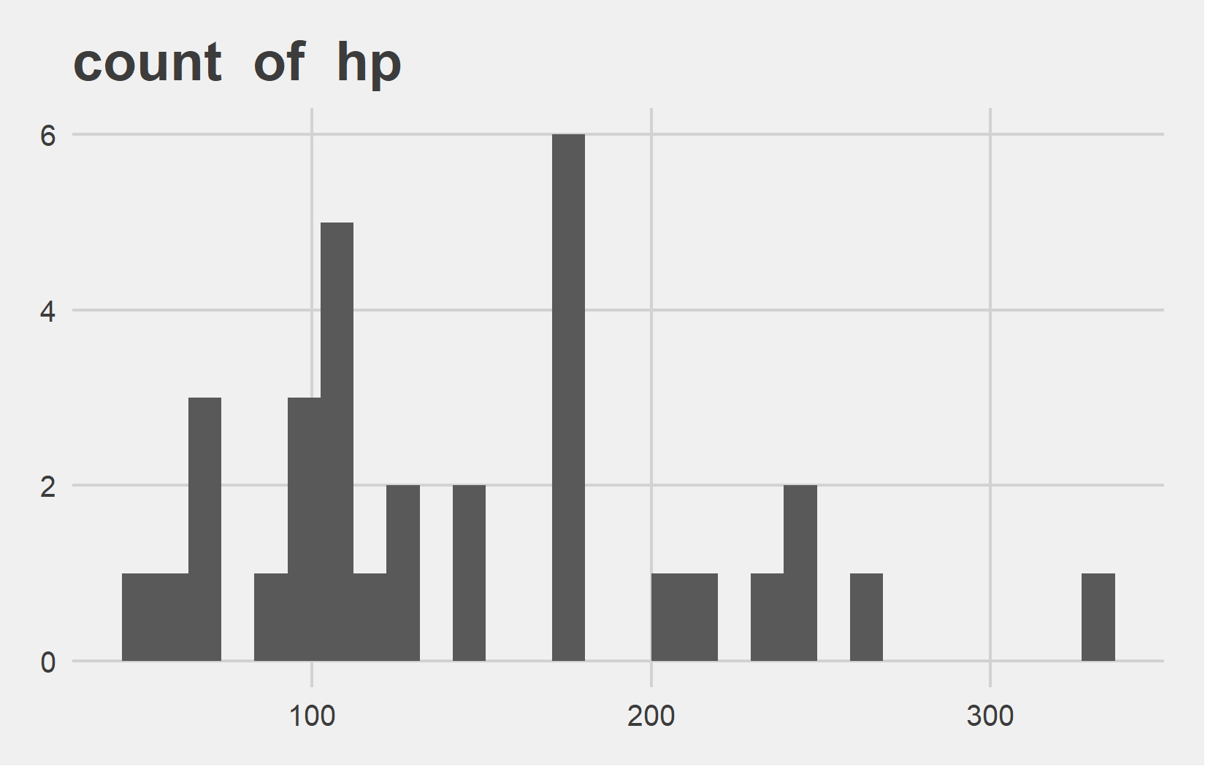
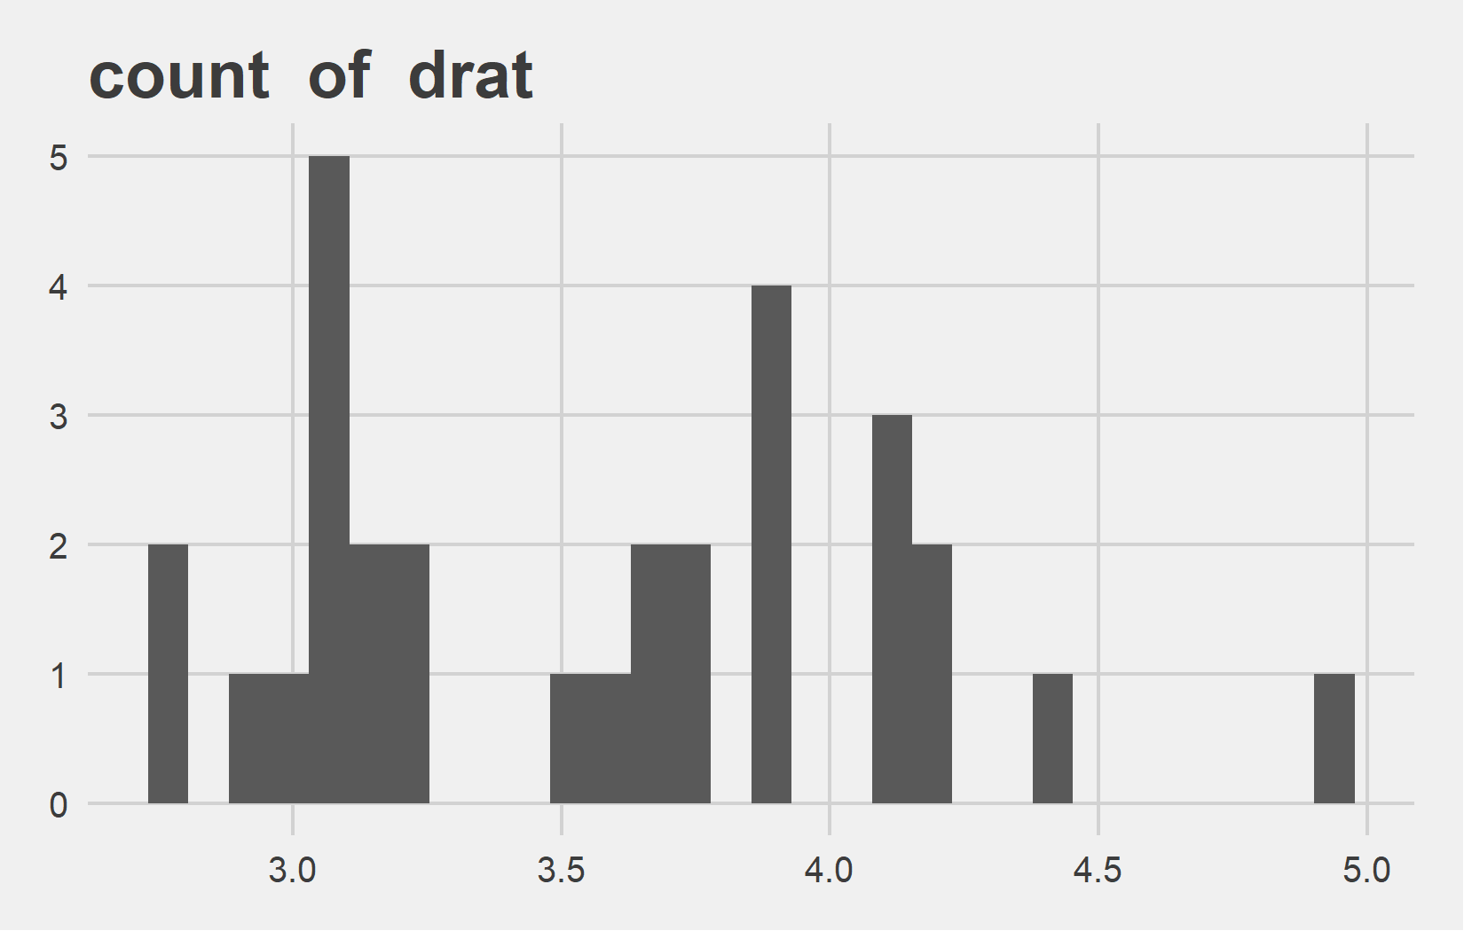
Univariate Analysis Slide 2 of 6
min | 25th | 50th | 75th | max
52 | 96 | 123 | 180 | 335
min | 25th | 50th | 75th | max
2.76 | 3.08 | 3.66 | 3.92 | 4.93

Slide 5
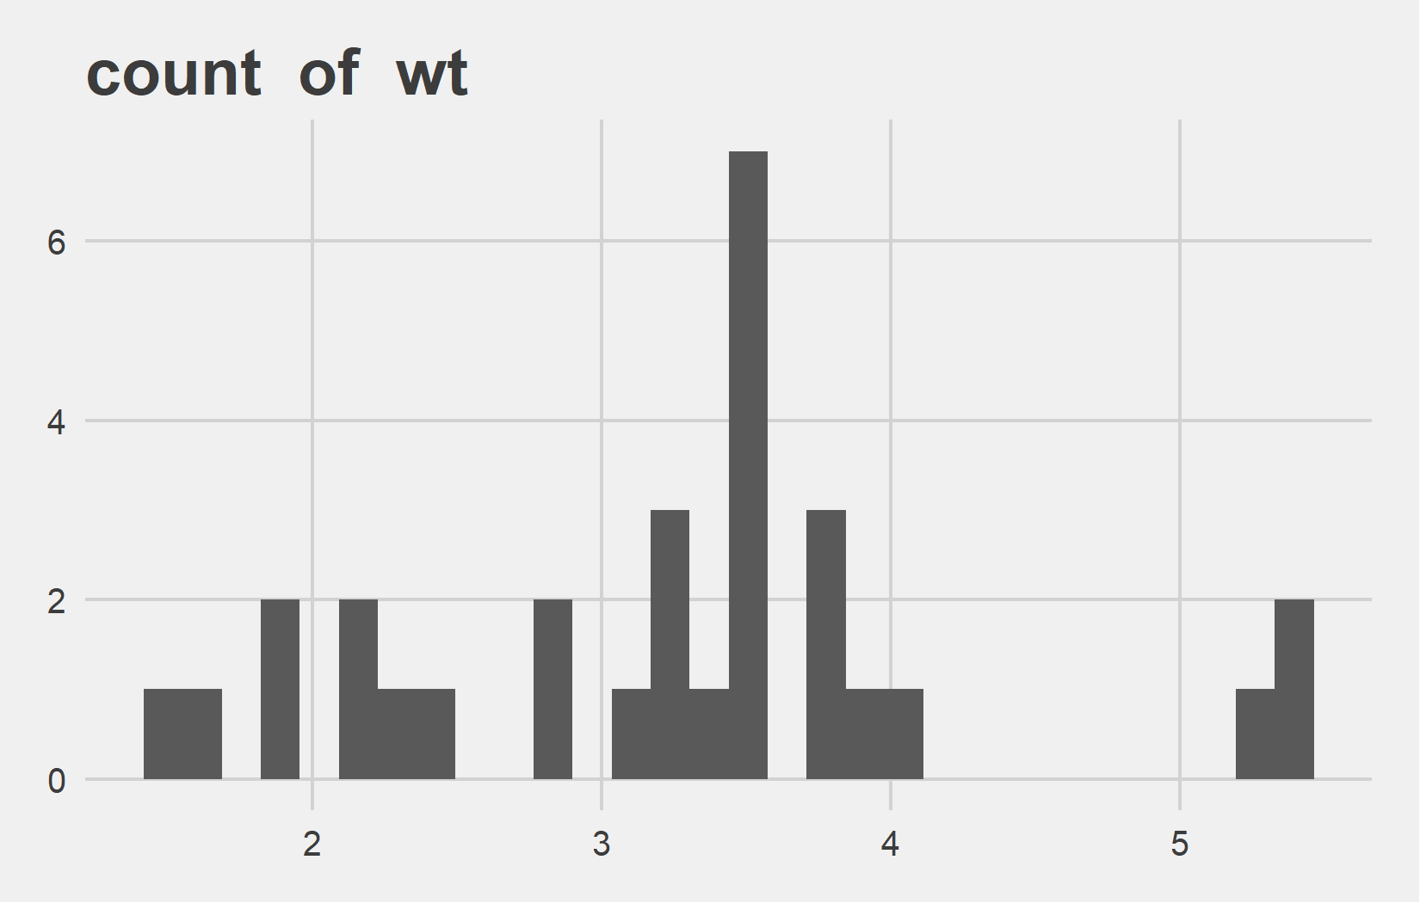
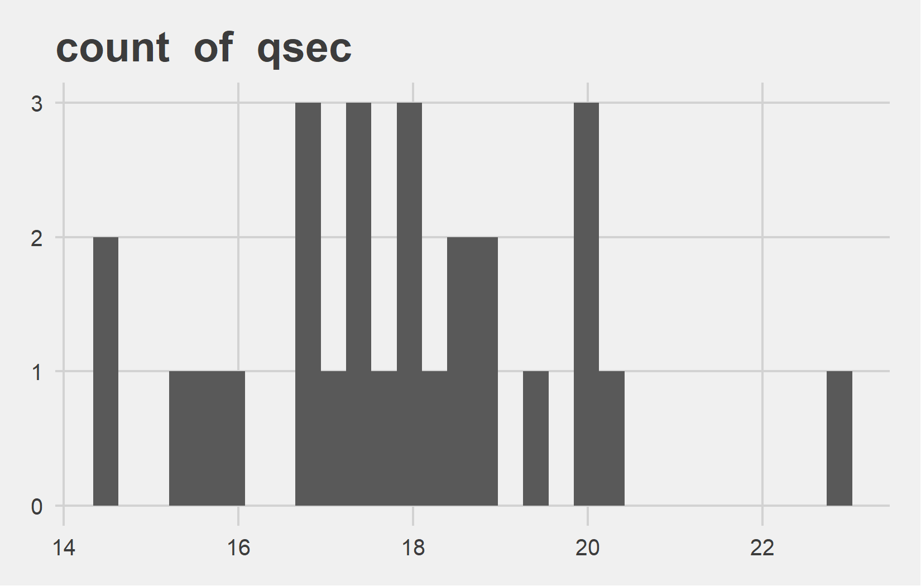
Univariate Analysis Slide 3 of 6
min | 25th | 50th | 75th | max
1.51 | 2.46 | 3.44 | 3.73 | 5.42
min | 25th | 50th | 75th | max
14.5 | 16.88 | 17.82 | 18.9 | 22.9

Slide 6
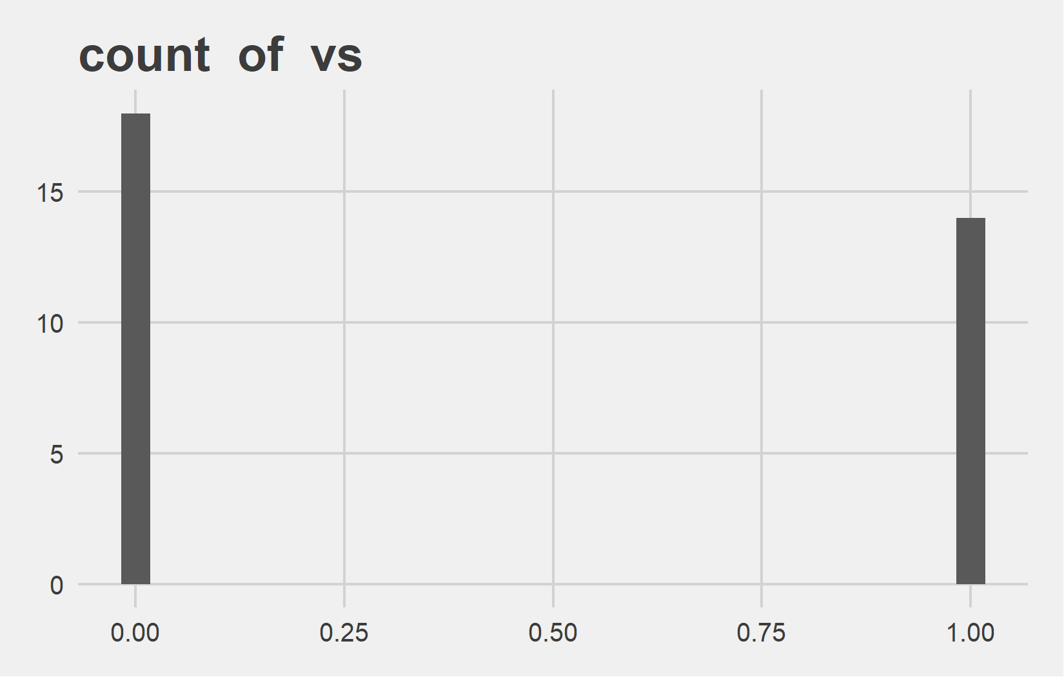
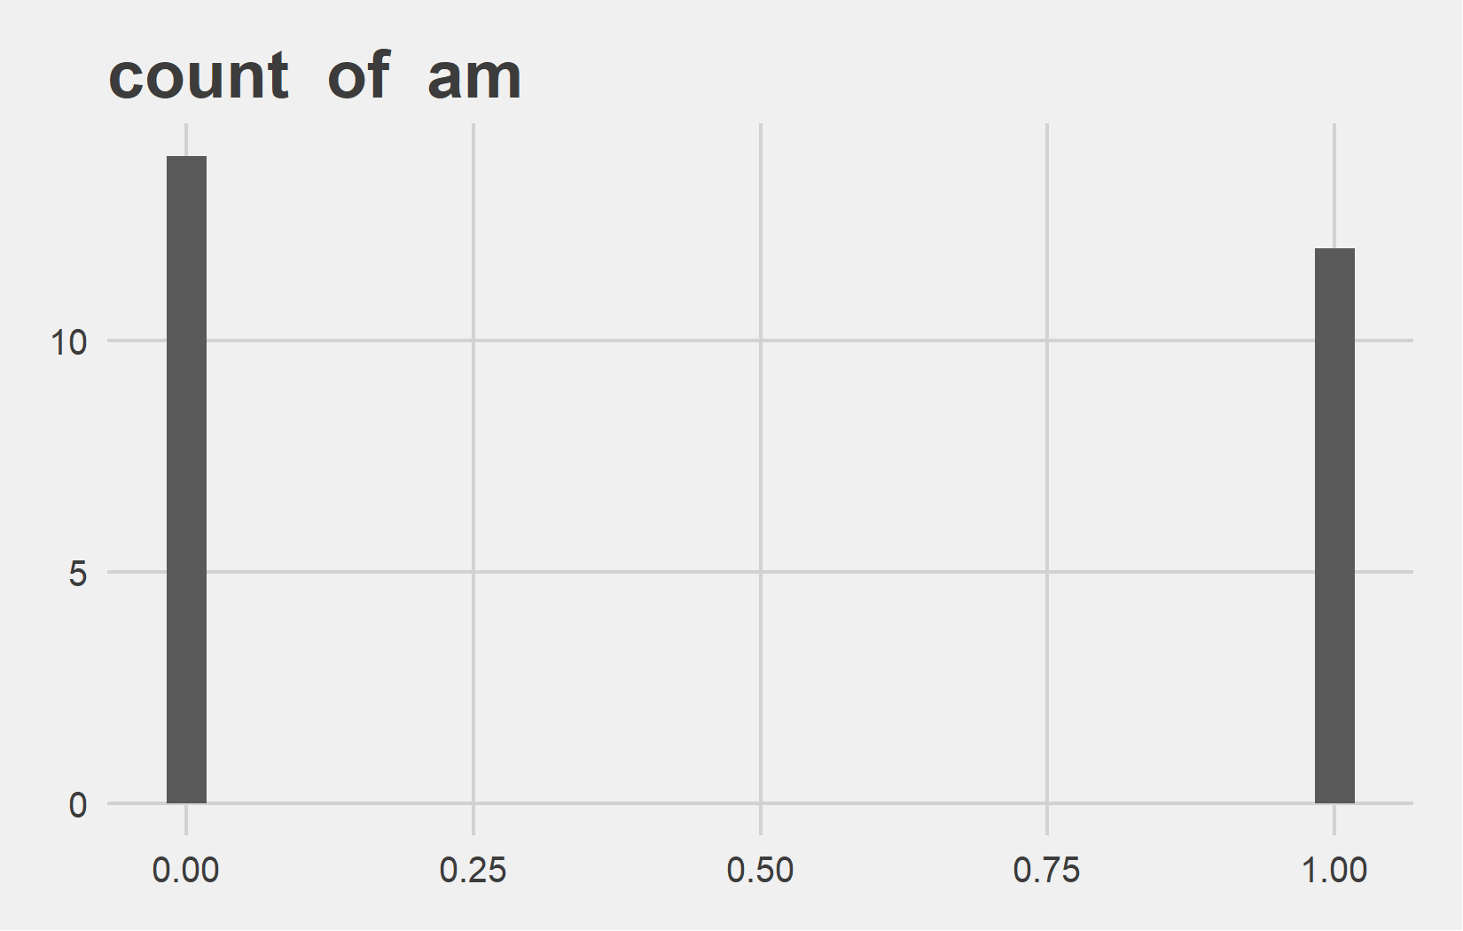
Univariate Analysis Slide 4 of 6
min | 25th | 50th | 75th | max
0 | 0 | 0 | 1 | 1
min | 25th | 50th | 75th | max
0 | 0 | 0 | 1 | 1

Slide 7
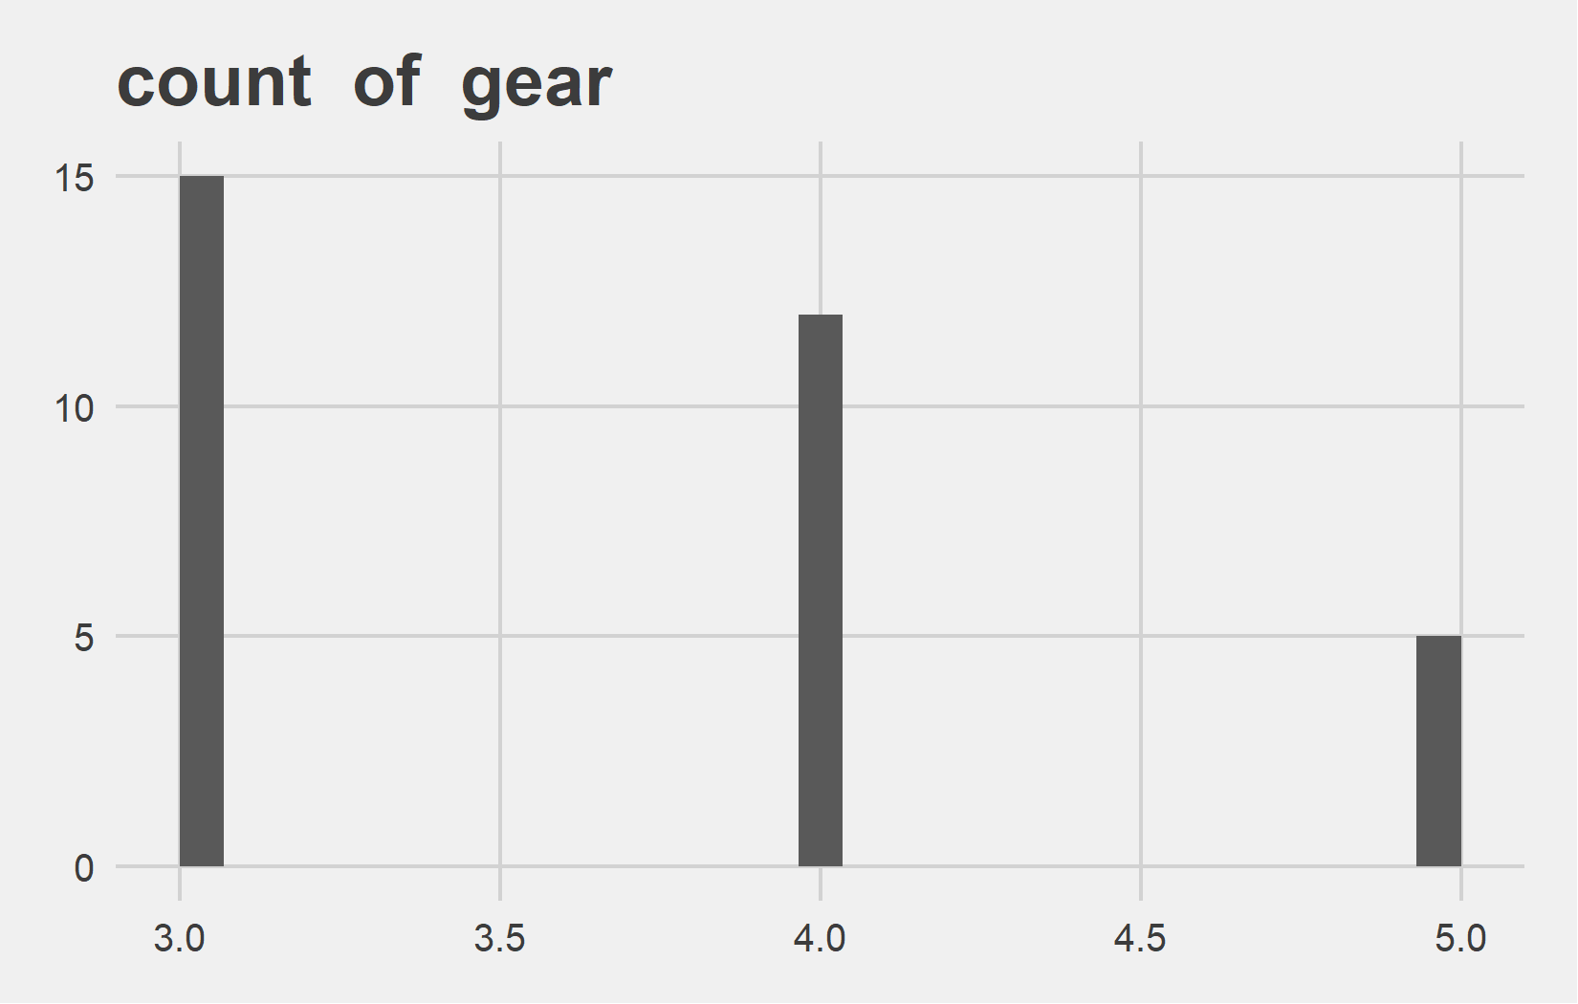
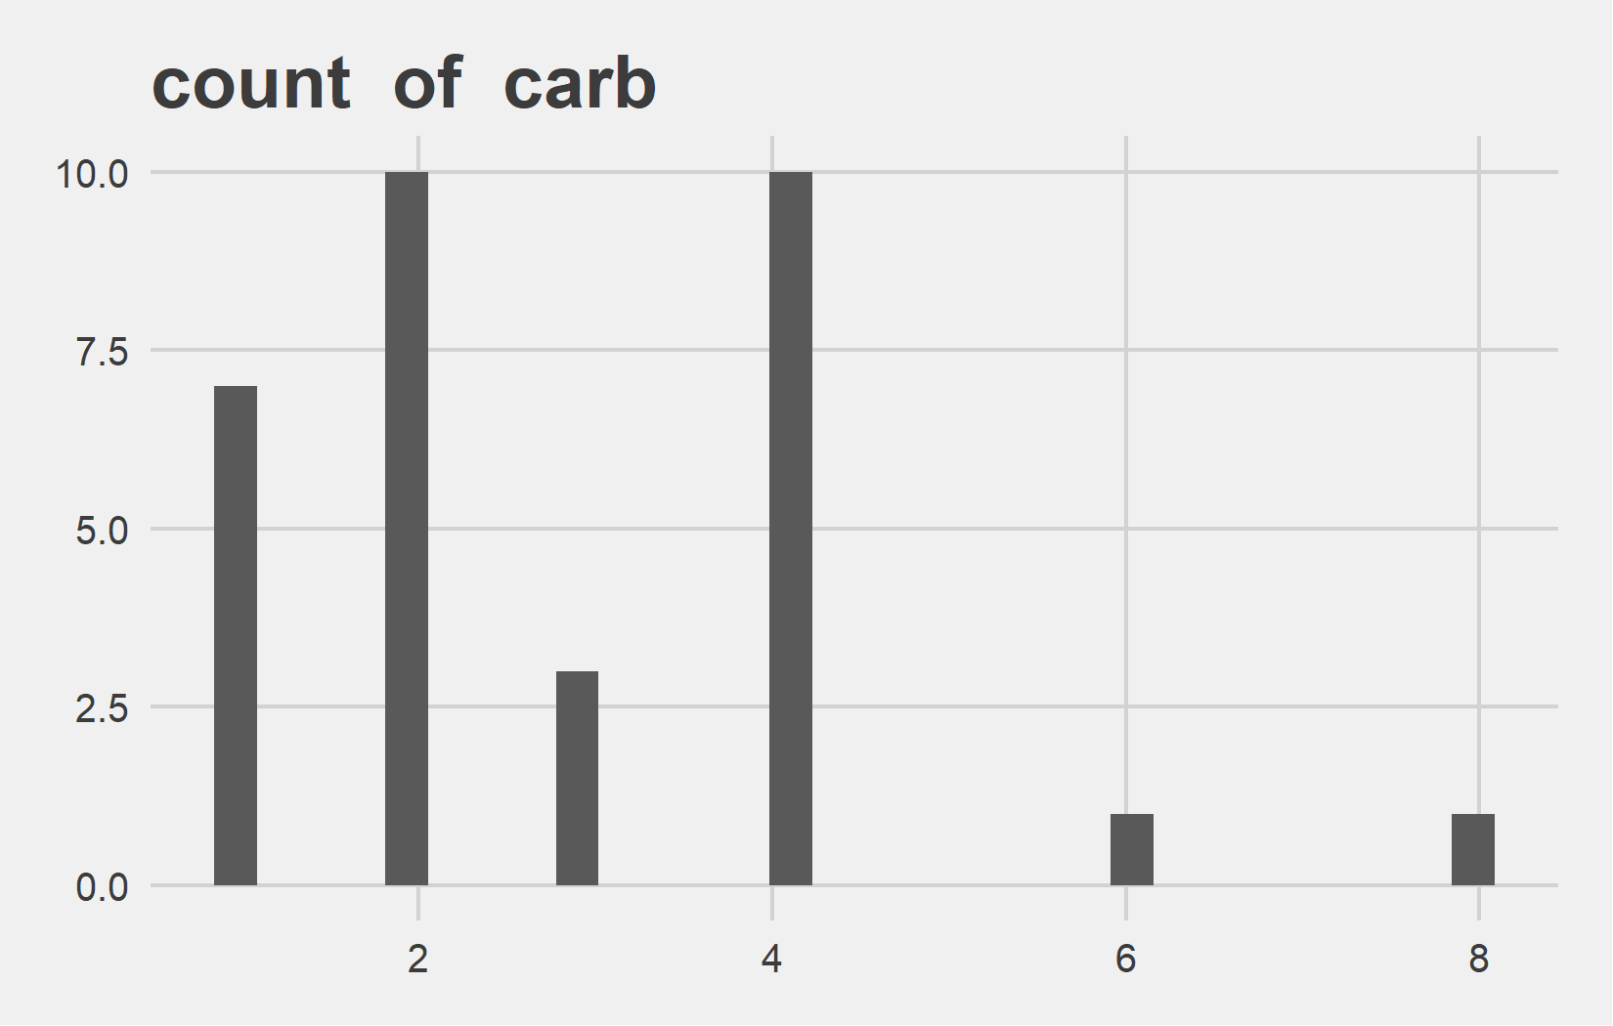
Univariate Analysis Slide 5 of 6
min | 25th | 50th | 75th | max
3 | 3 | 4 | 4 | 5
min | 25th | 50th | 75th | max
1 | 2 | 2 | 4 | 8

Slide 8
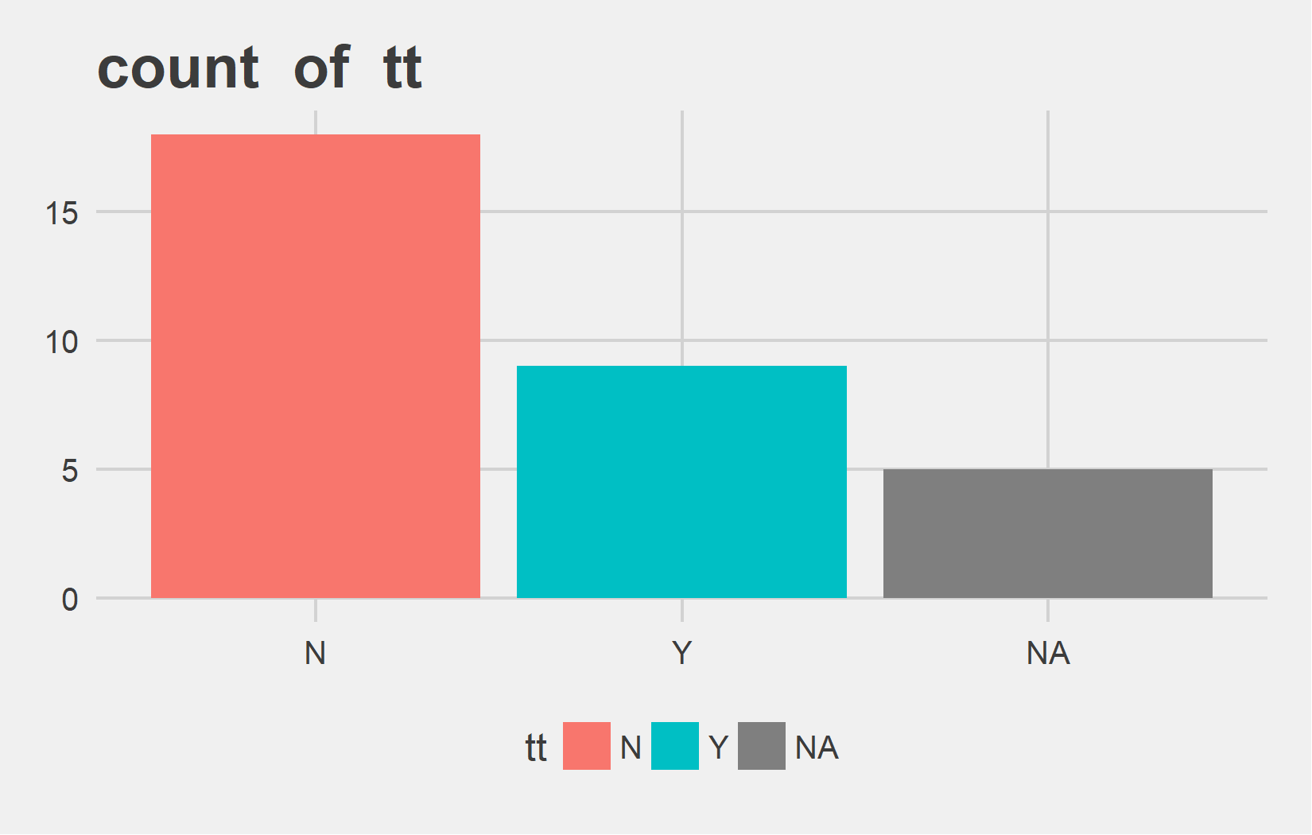
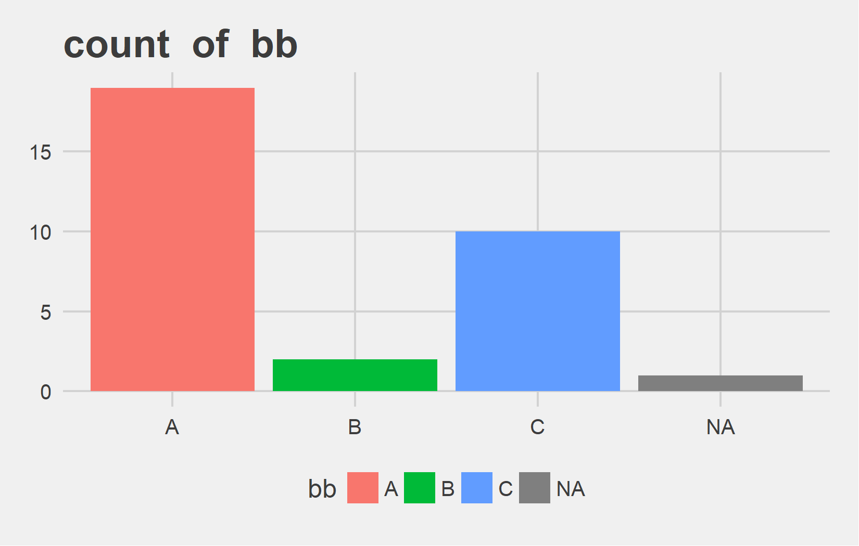
Univariate Analysis Slide 6 of 6
Metric | N | Y
Count | 18 | 9
Perct. | 66.67% | 33.33%
Metric | A | B | C
Count | 19 | 2 | 10
Perct. | 61.29% | 6.45% | 32.26%

Slide 9
Bi-variate analysis

Slide 10
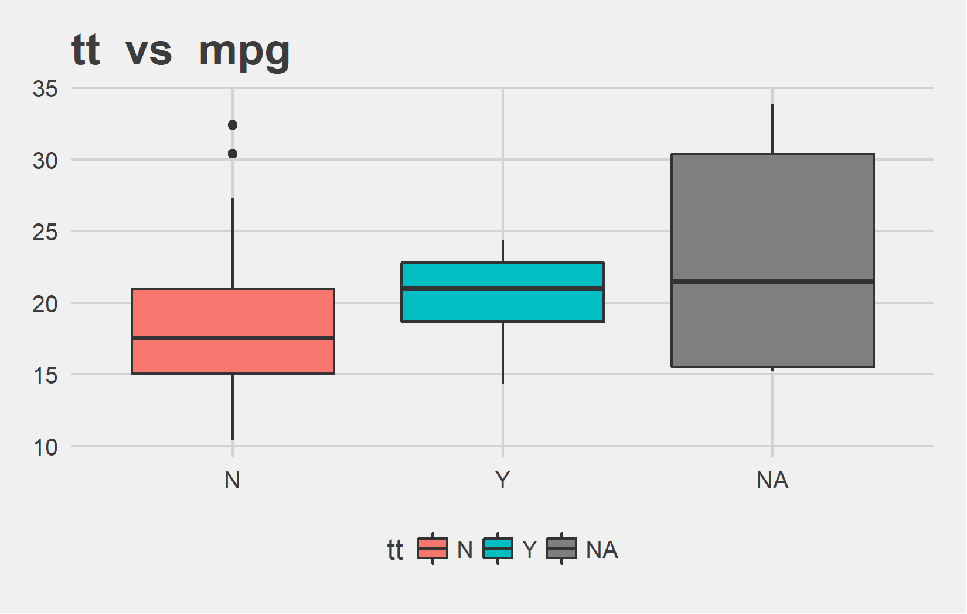
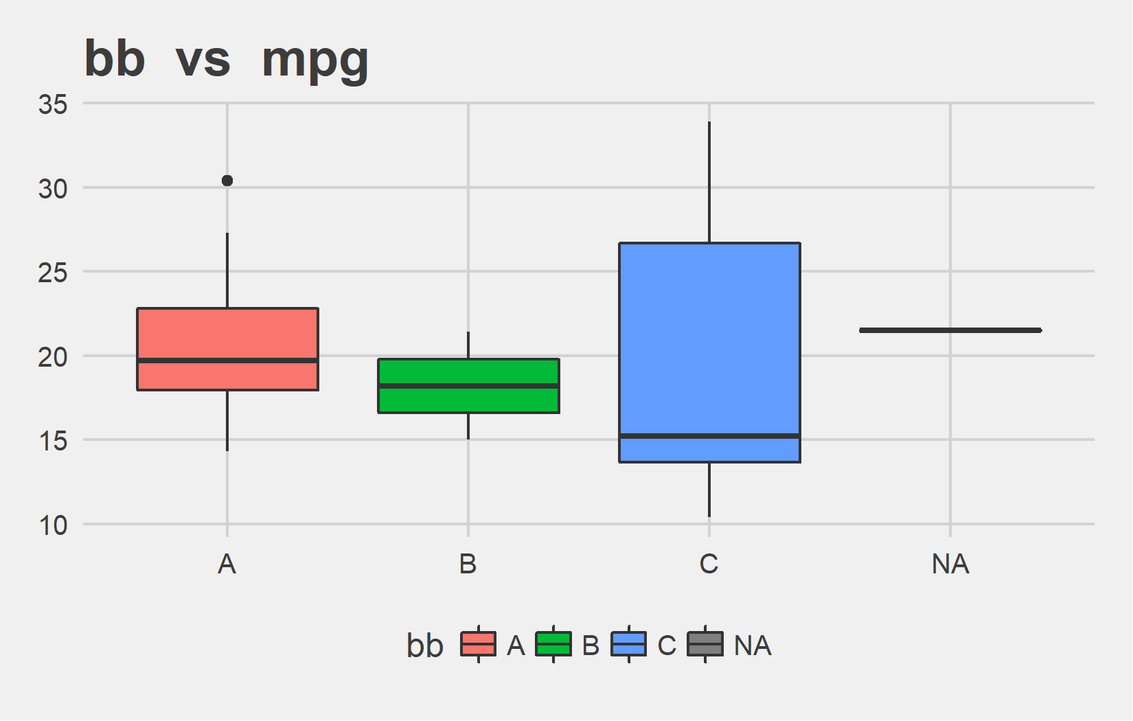
Bi-variate analysis Slide 1 of 6
tt | mean - mpg | median - mpg
N | 18.99 | 17.55
Y | 20.50 | 21.00
 | 23.30 | 21.50
bb | mean - mpg | median - mpg
A | 20.72 | 19.7
B | 18.20 | 18.2
C | 19.14 | 15.2
 | 21.50 | 21.5

Slide 11
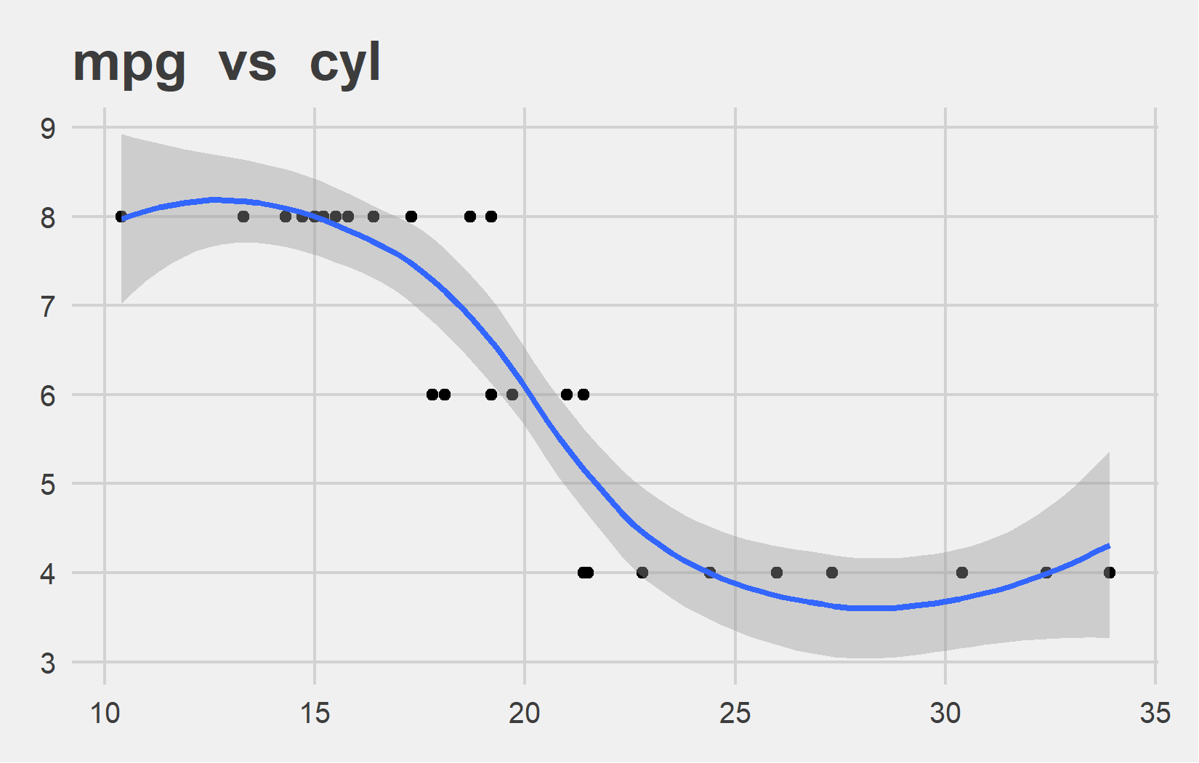
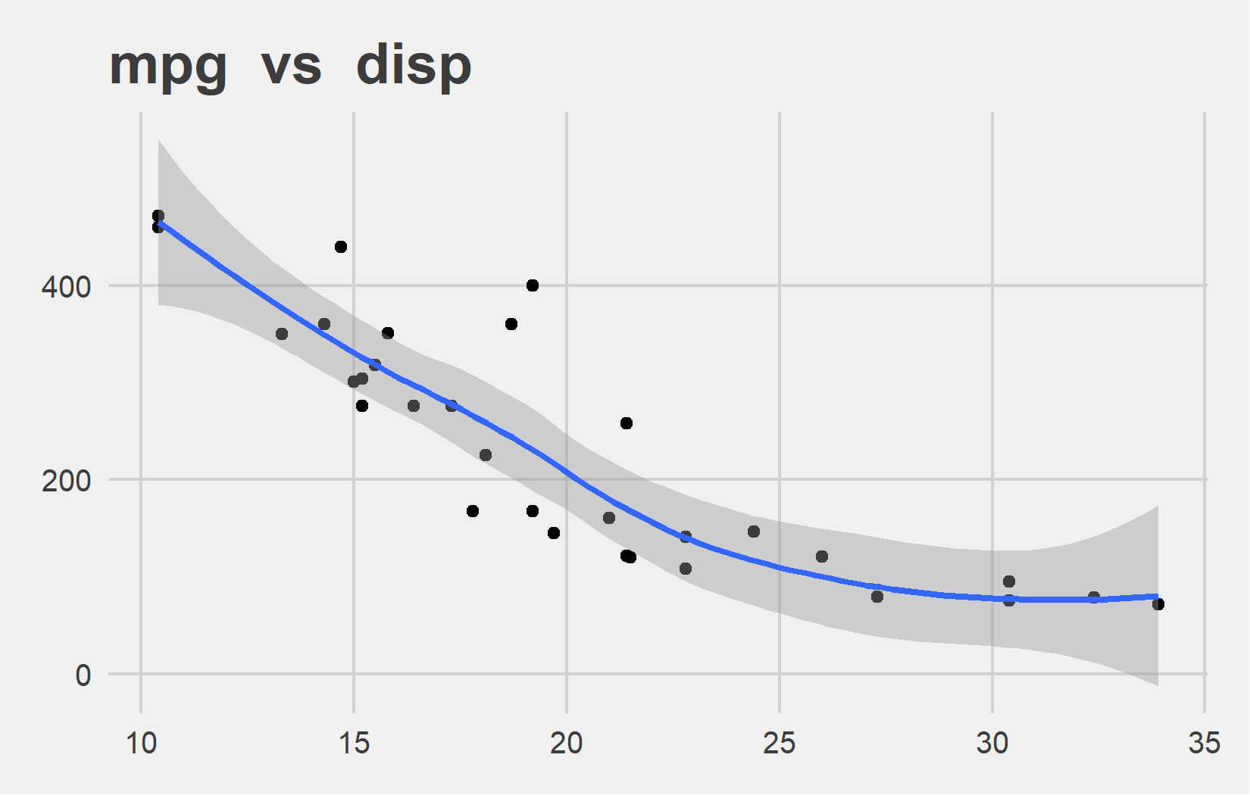
Bi-variate analysis Slide 2 of 6
Feature | Correlation with Target
cyl | -0.852
Feature | Correlation with Target
disp | -0.848

Slide 12
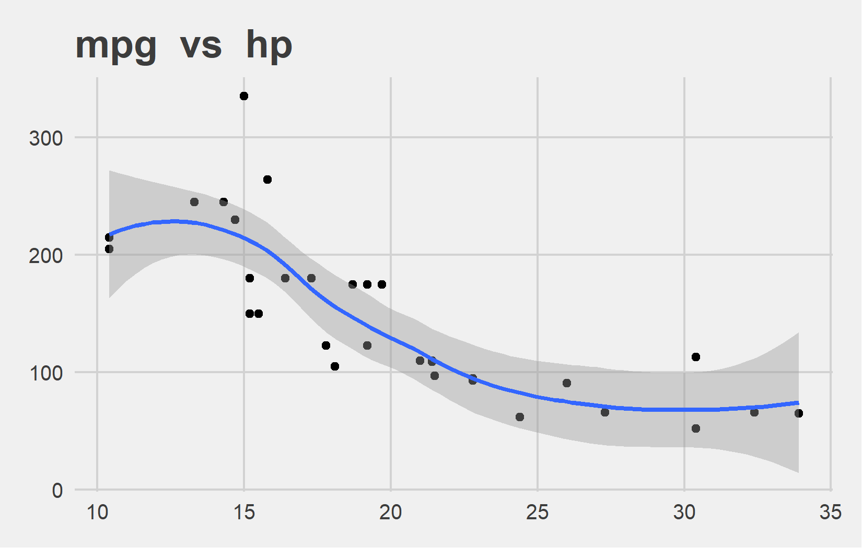
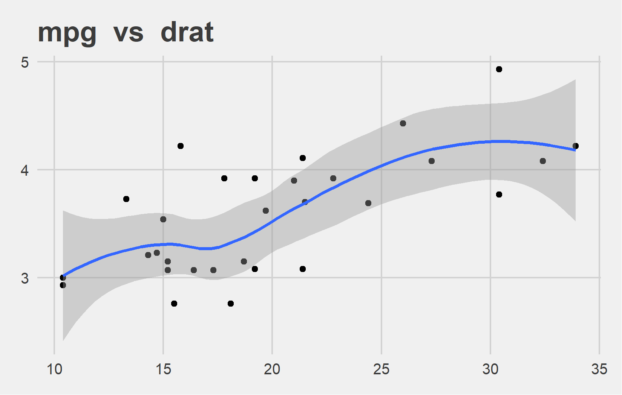
Bi-variate analysis Slide 3 of 6
Feature | Correlation with Target
hp | -0.776
Feature | Correlation with Target
drat | 0.68

Slide 13
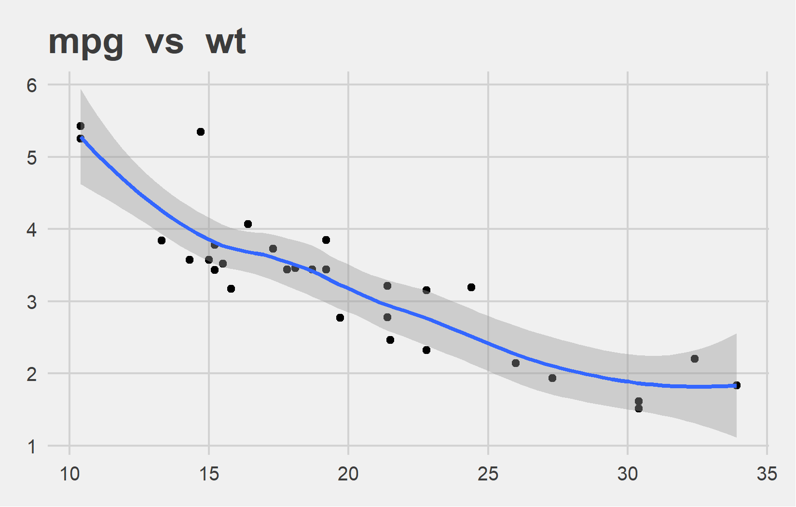
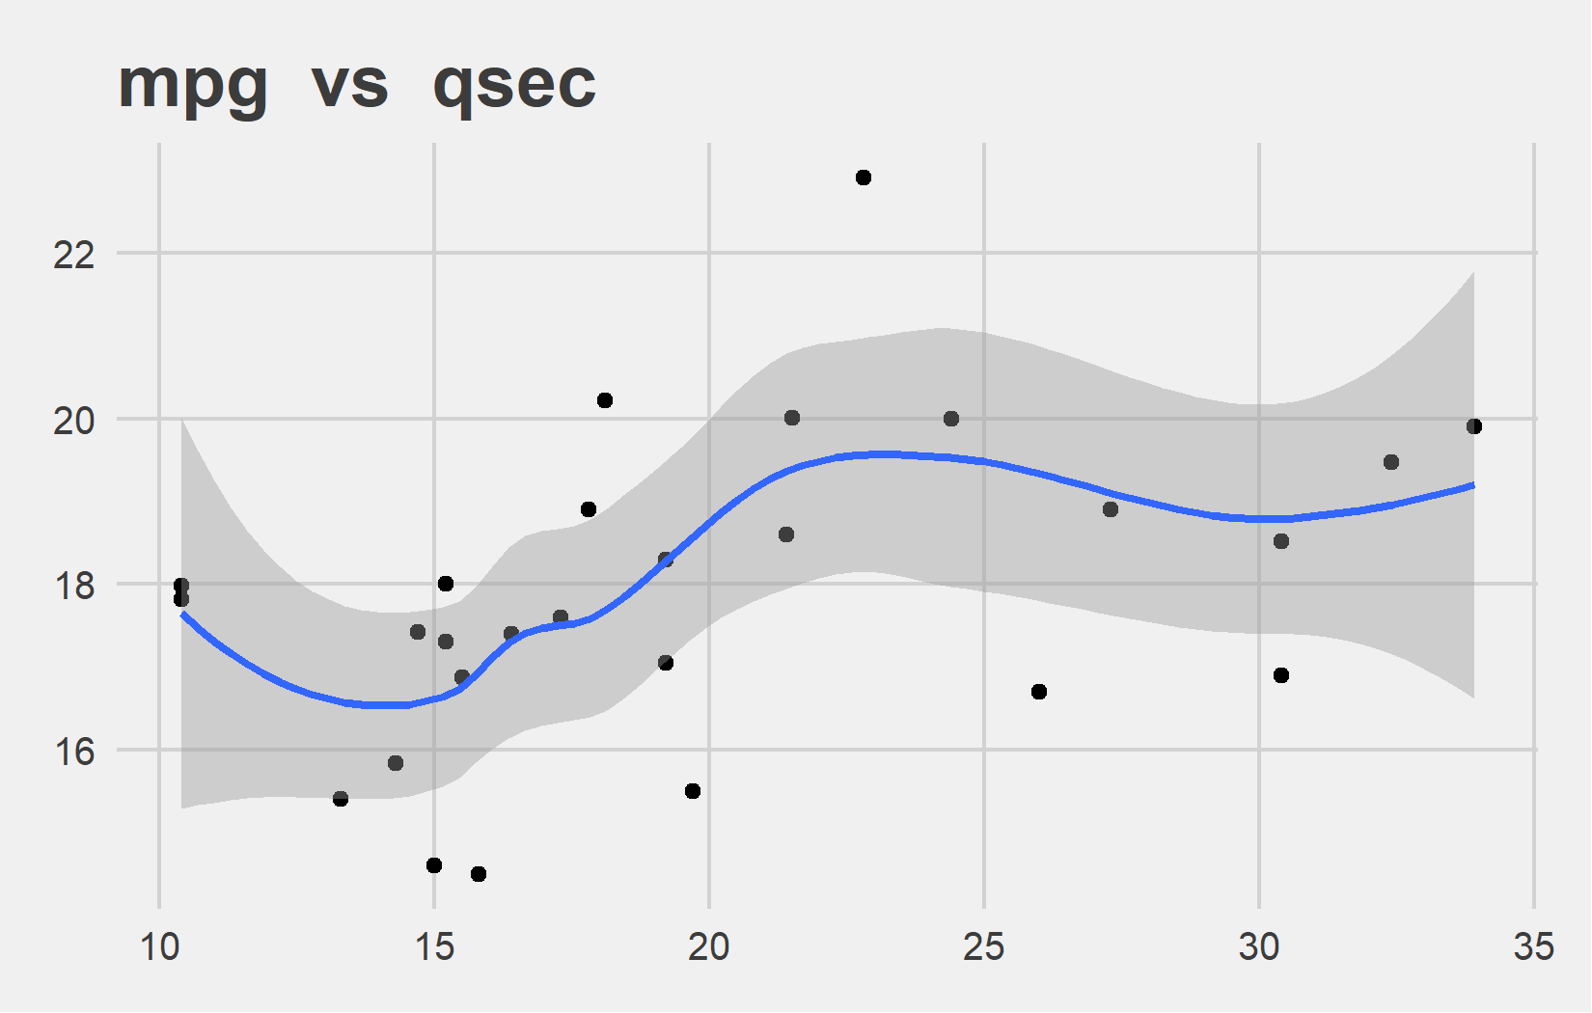
Bi-variate analysis Slide 4 of 6
Feature | Correlation with Target
wt | -0.871
Feature | Correlation with Target
qsec | 0.426

Slide 14
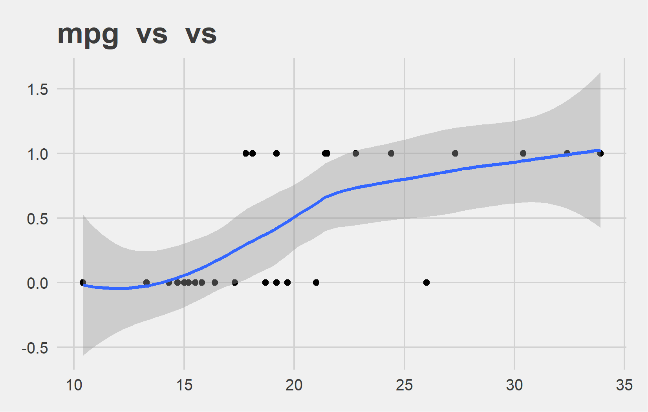
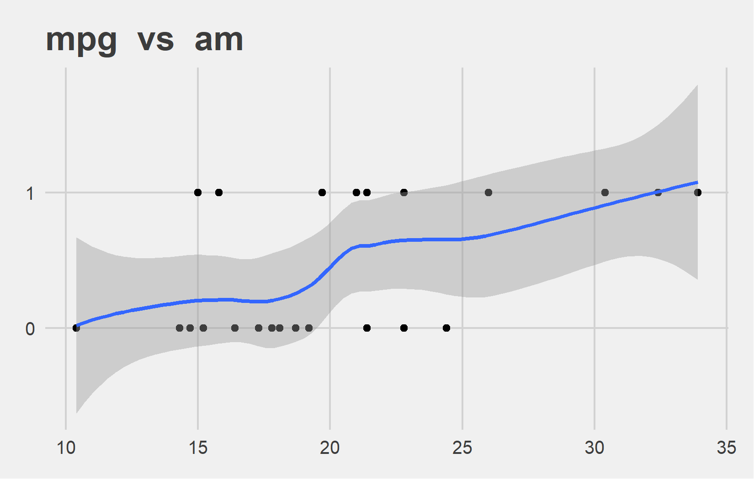
Bi-variate analysis Slide 5 of 6
Feature | Correlation with Target
vs | 0.664
Feature | Correlation with Target
am | 0.563

Slide 15
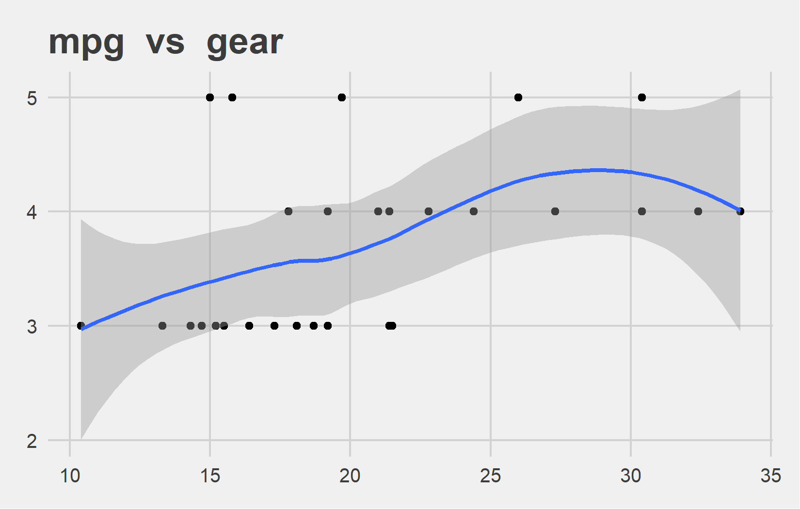
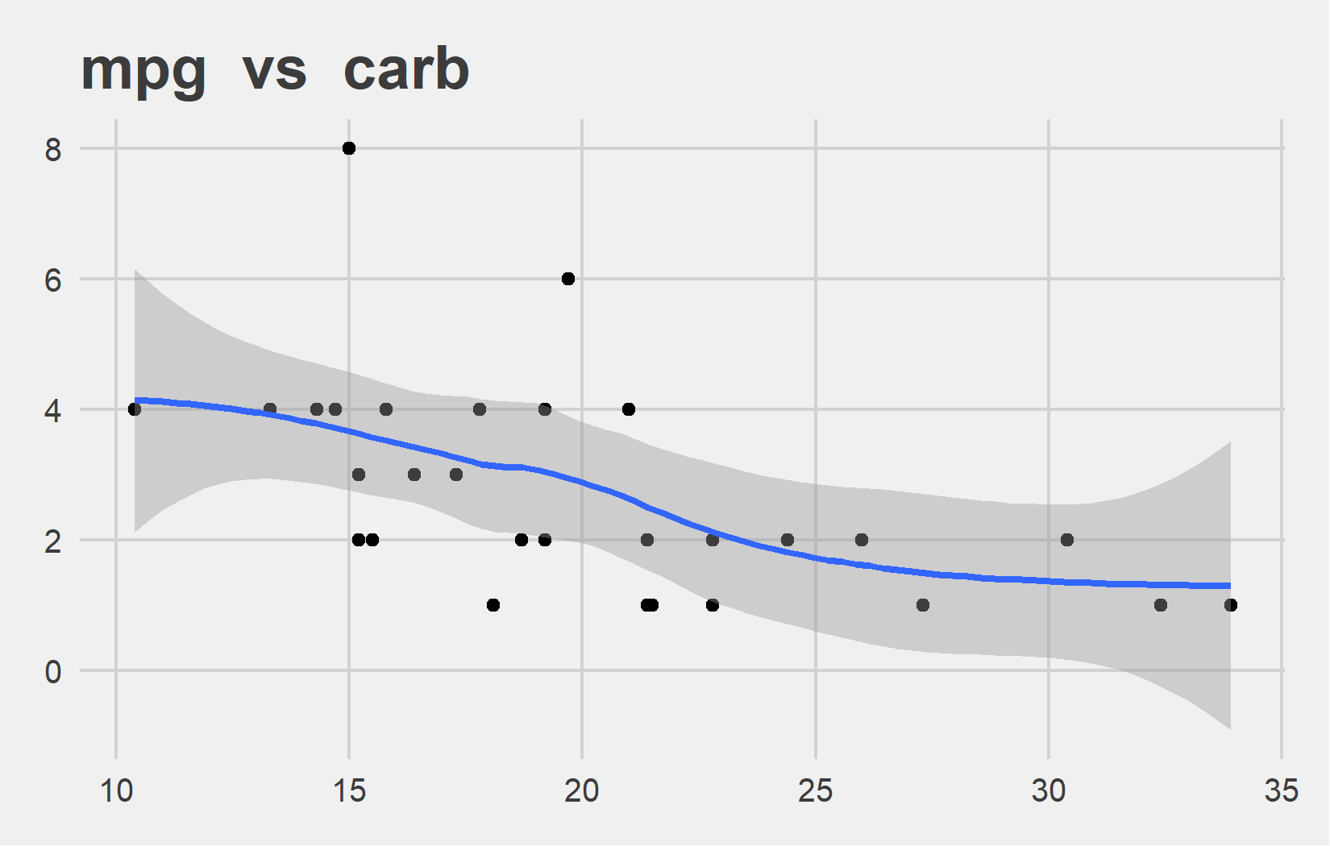
Bi-variate analysis Slide 6 of 6
Feature | Correlation with Target
gear | 0.48
Feature | Correlation with Target
carb | -0.551

