Slide 1
Exploratory Analysis Report

Slide 2
Univariate Analysis

Slide 3
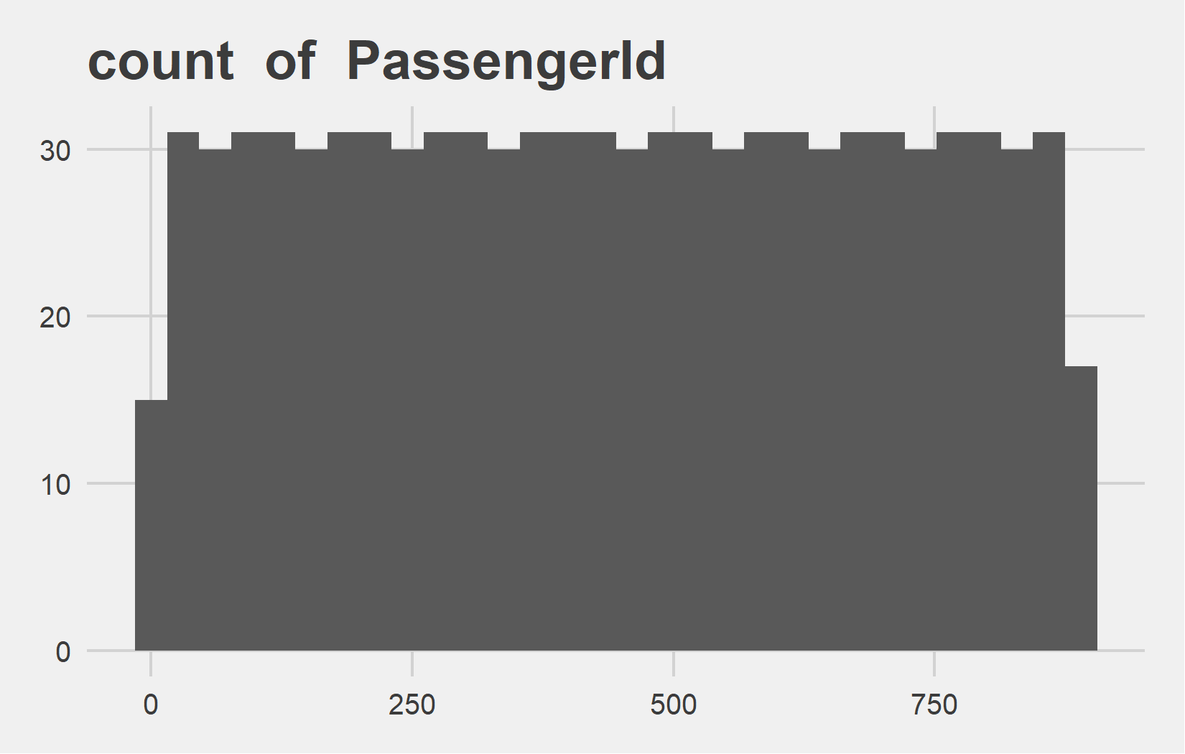
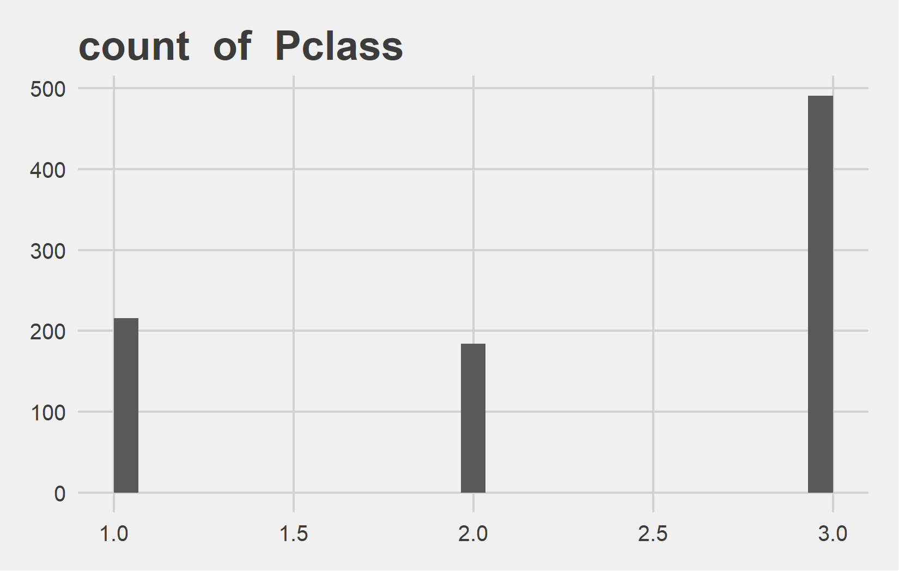
Univariate Analysis Slide 1 of 5
min | 25th | 50th | 75th | max
1 | 223.5 | 446 | 668.5 | 891
min | 25th | 50th | 75th | max
1 | 2 | 3 | 3 | 3

Slide 4
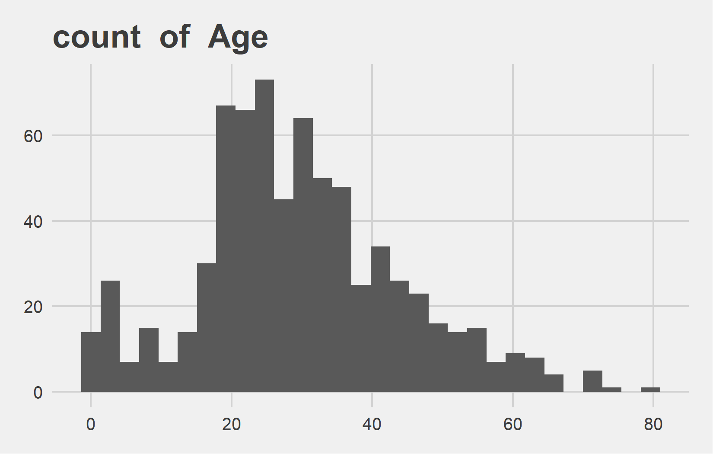
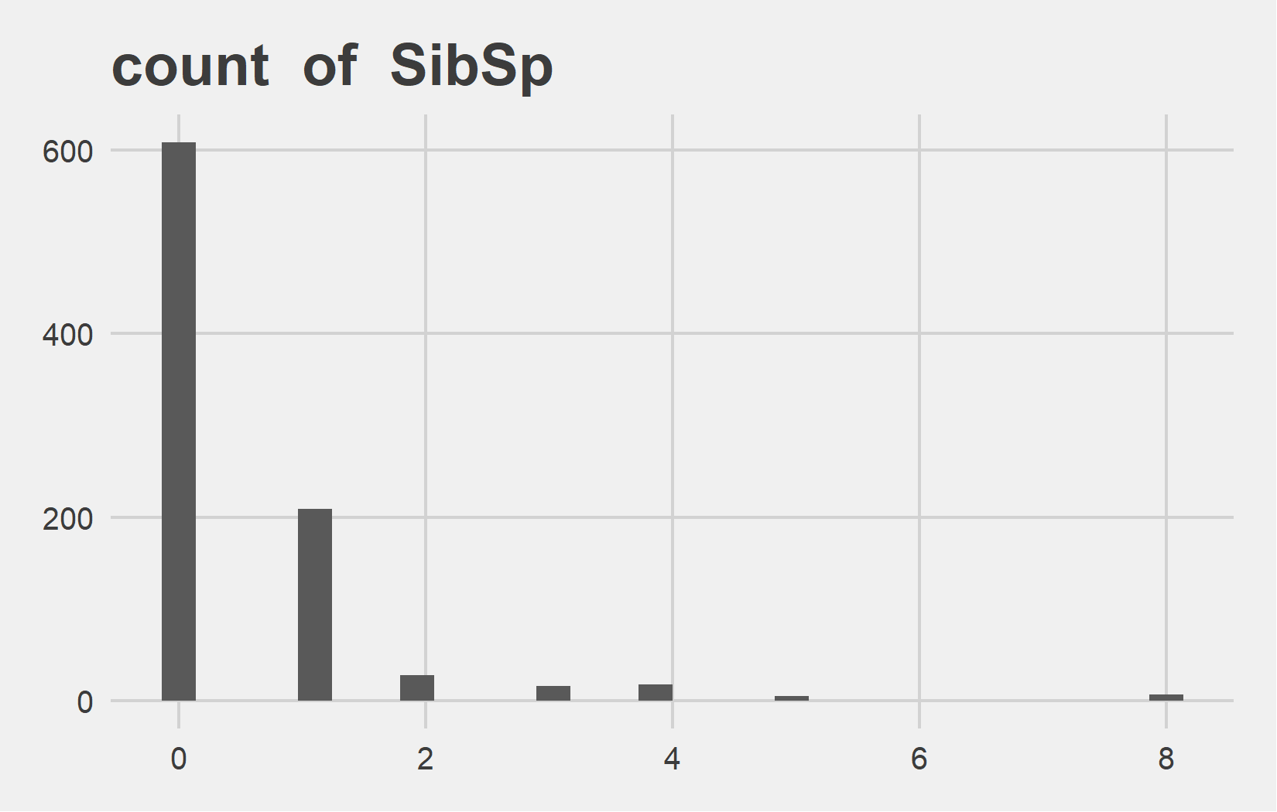
Univariate Analysis Slide 2 of 5
min | 25th | 50th | 75th | max
0.42 | 20 | 28 | 38 | 80
min | 25th | 50th | 75th | max
0 | 0 | 0 | 1 | 8

Slide 5
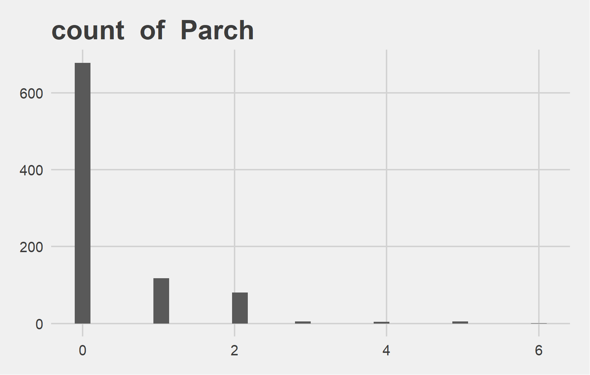
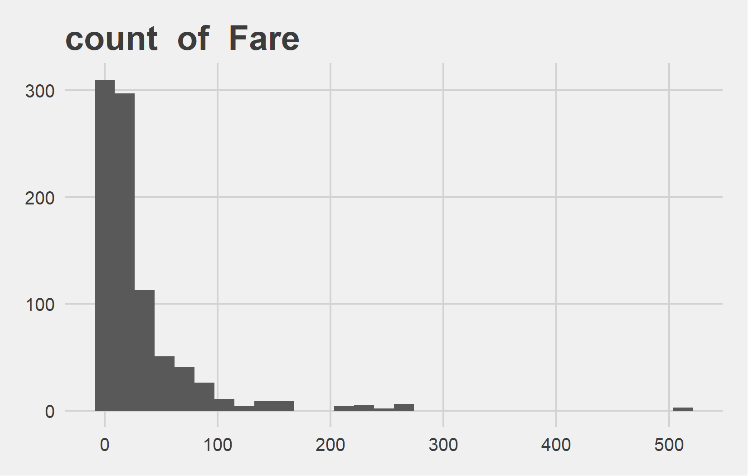
Univariate Analysis Slide 3 of 5
min | 25th | 50th | 75th | max
0 | 0 | 0 | 0 | 6
min | 25th | 50th | 75th | max
0 | 7.91 | 14.45 | 31 | 512.33

Slide 6
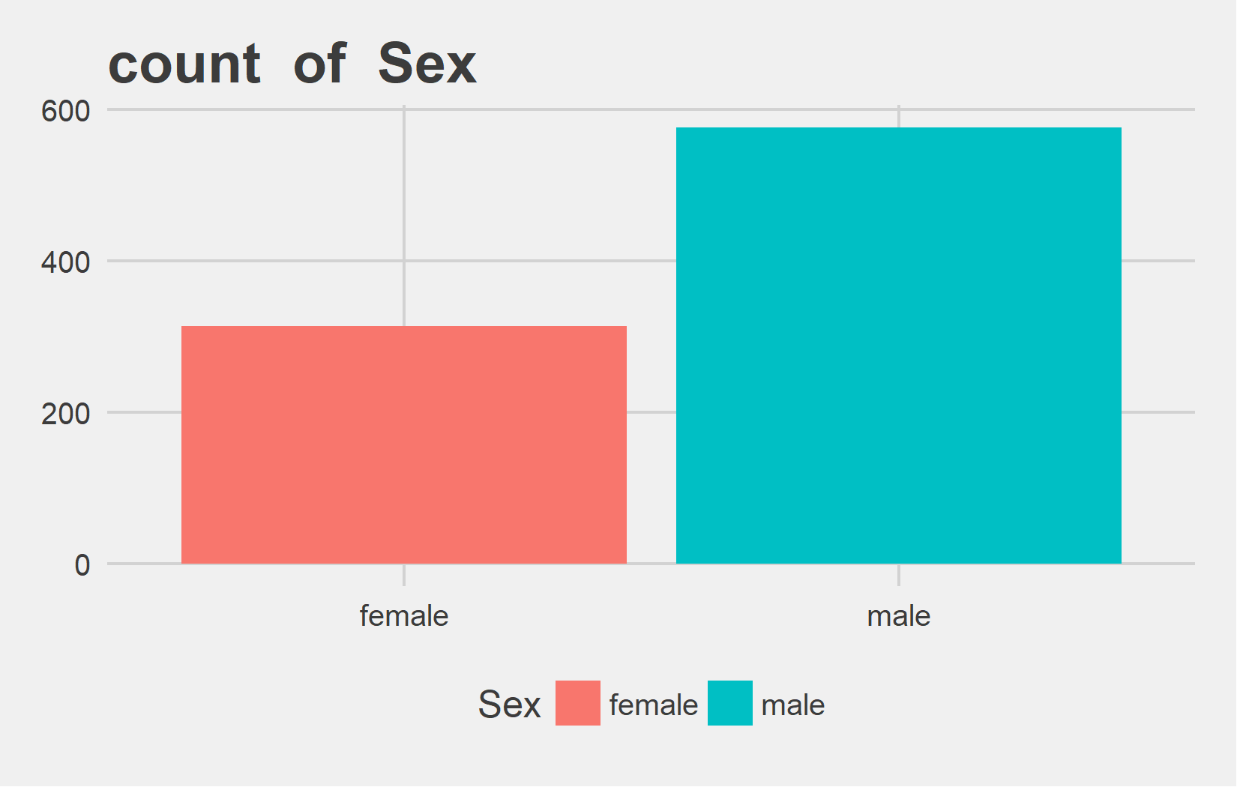
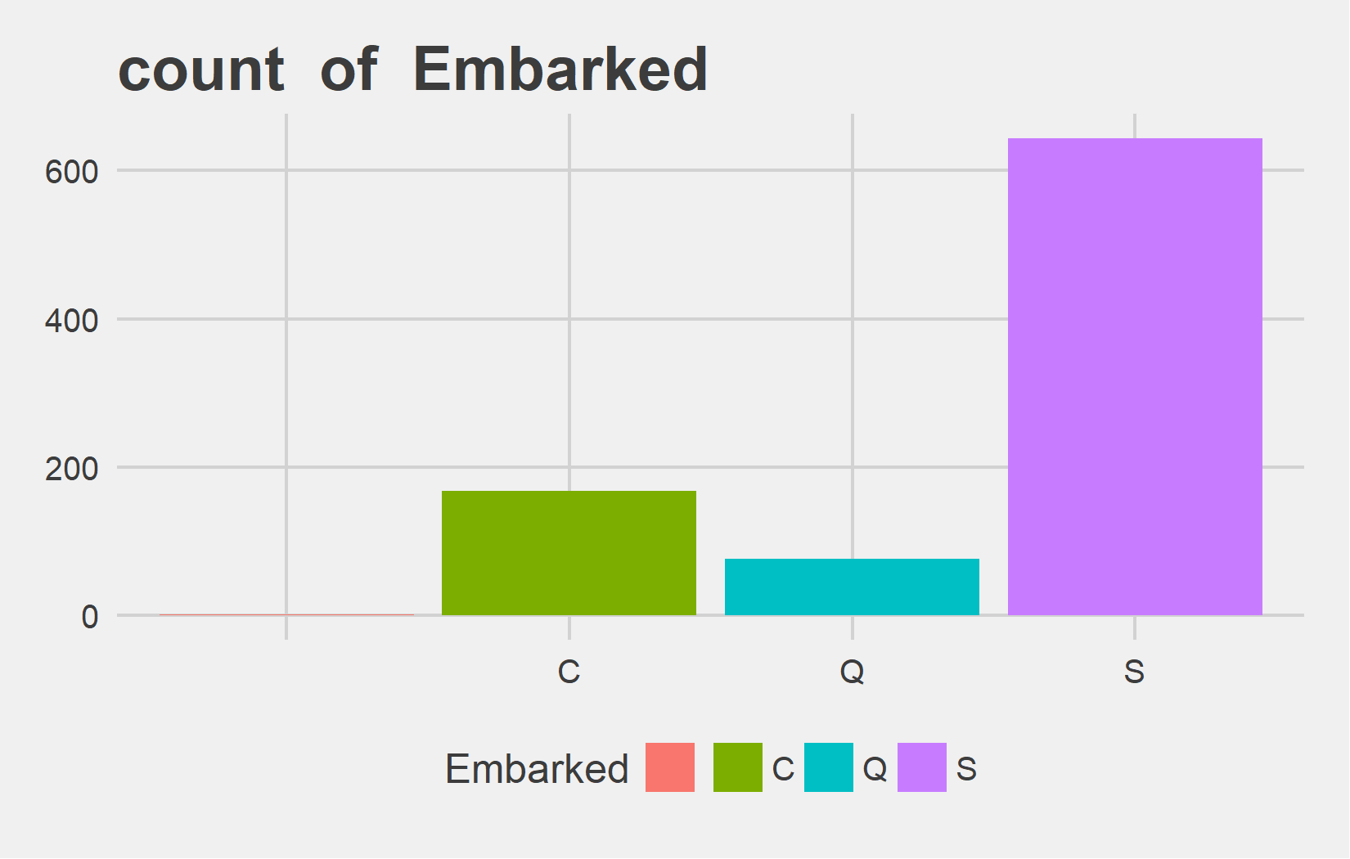
Univariate Analysis Slide 4 of 5
Metric | female | male
Count | 314 | 577
Perct. | 35.24% | 64.76%
Metric | V1 | C | Q | S
Count | 2 | 168 | 77 | 644
Perct. | 0.22% | 18.86% | 8.64% | 72.28%

Slide 7
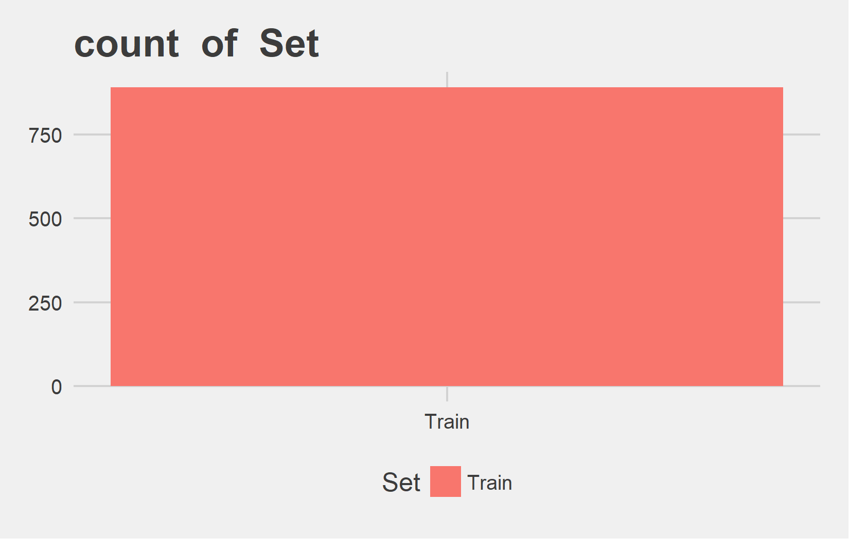
Univariate Analysis Slide 5 of 5
Metric | Train
Count | 891
Perct. | 100%

Slide 8
Bi-variate analysis

Slide 9
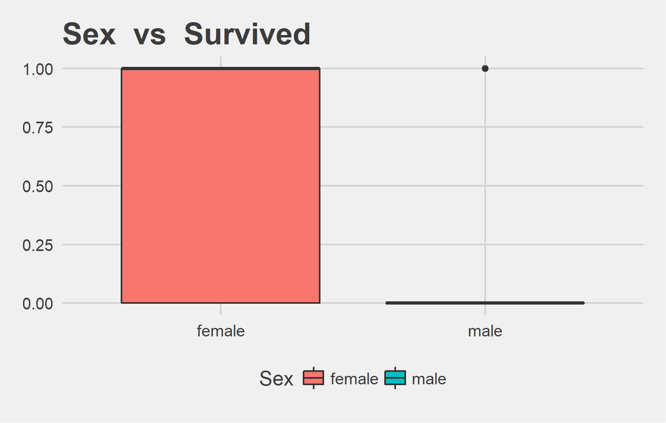
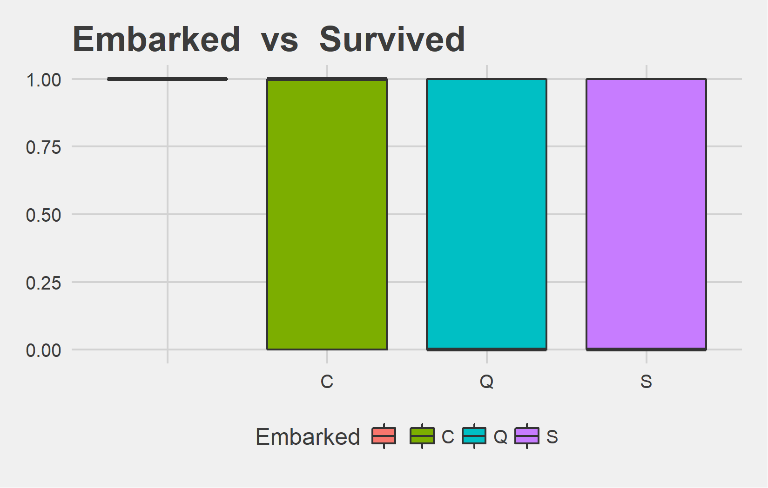
Bi-variate analysis Slide 1 of 5
Sex | mean - Survived | median - Survived
female | 0.74 | 1
male | 0.19 | 0
Embarked | mean - Survived | median - Survived
 | 1.00 | 1
C | 0.55 | 1
Q | 0.39 | 0
S | 0.34 | 0

Slide 10
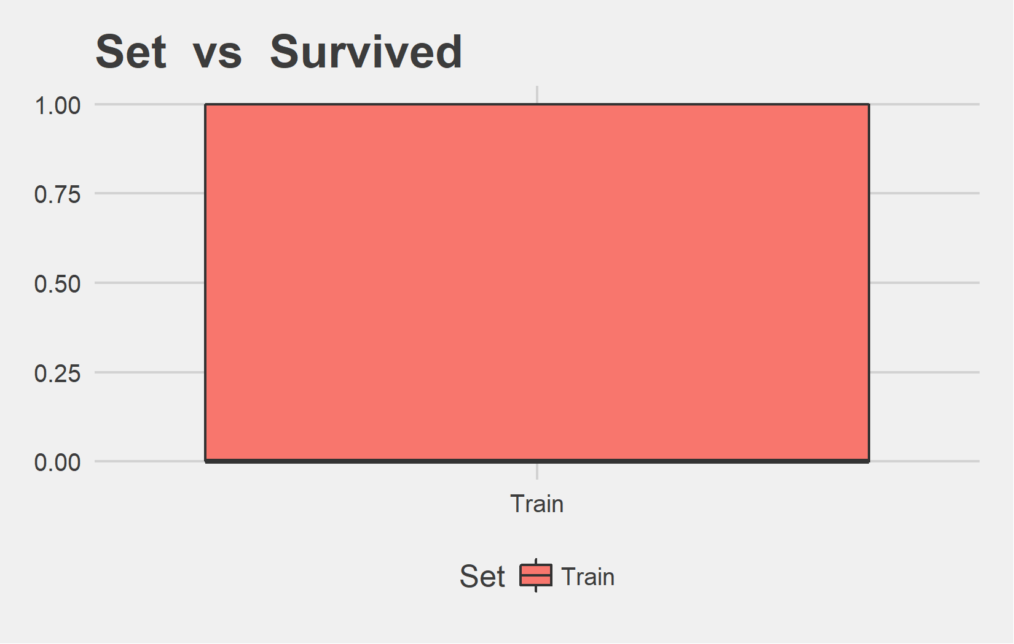
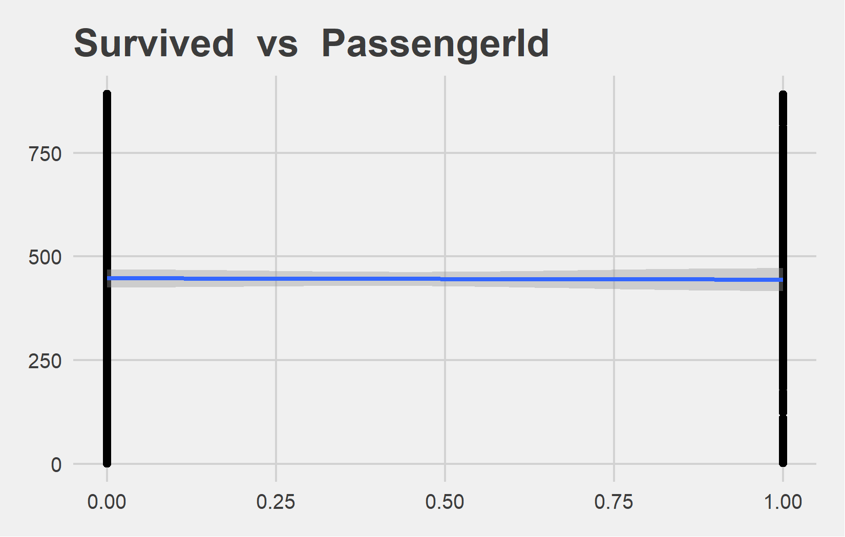
Bi-variate analysis Slide 2 of 5
Set | mean - Survived | median - Survived
Train | 0.38 | 0
Feature | Correlation with Target
PassengerId | -0.005

Slide 11
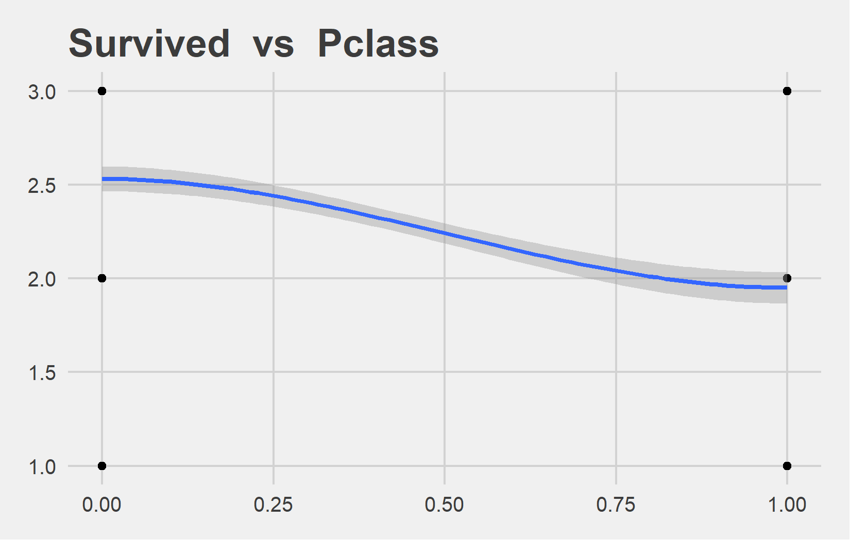
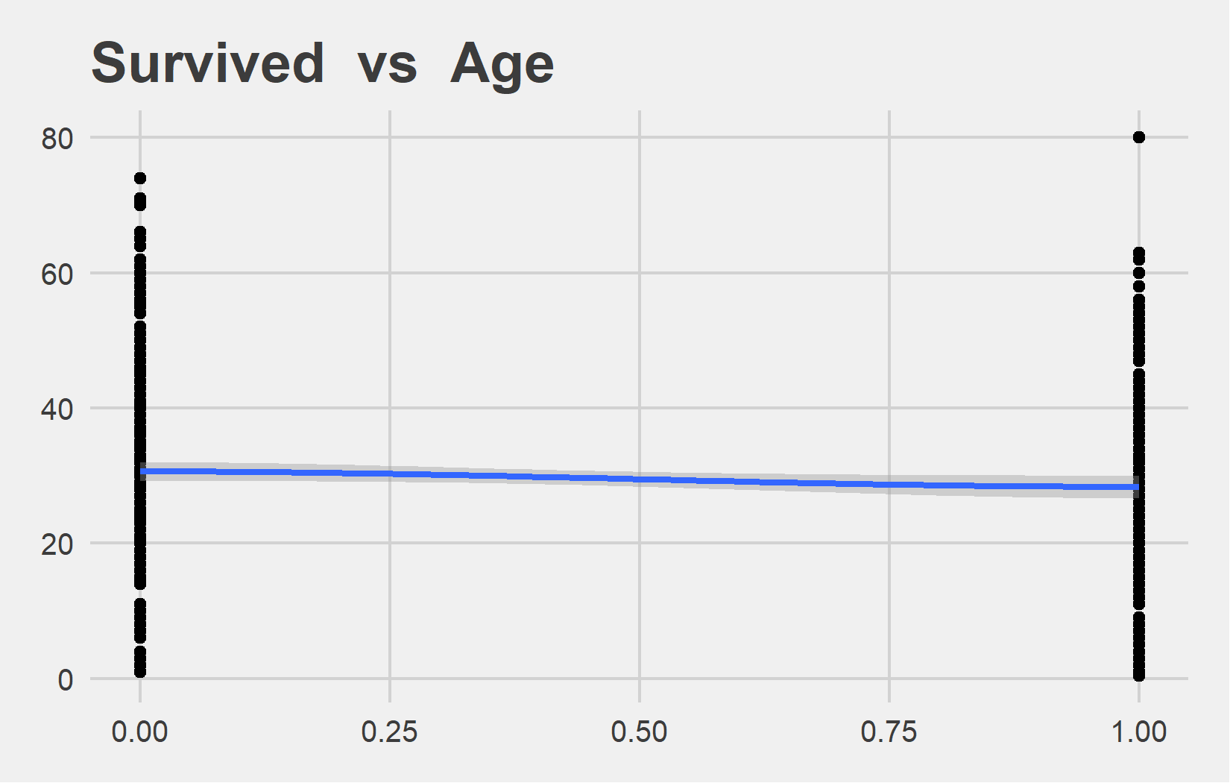
Bi-variate analysis Slide 3 of 5
Feature | Correlation with Target
Pclass | -0.338
Feature | Correlation with Target
Age | -0.077

Slide 12
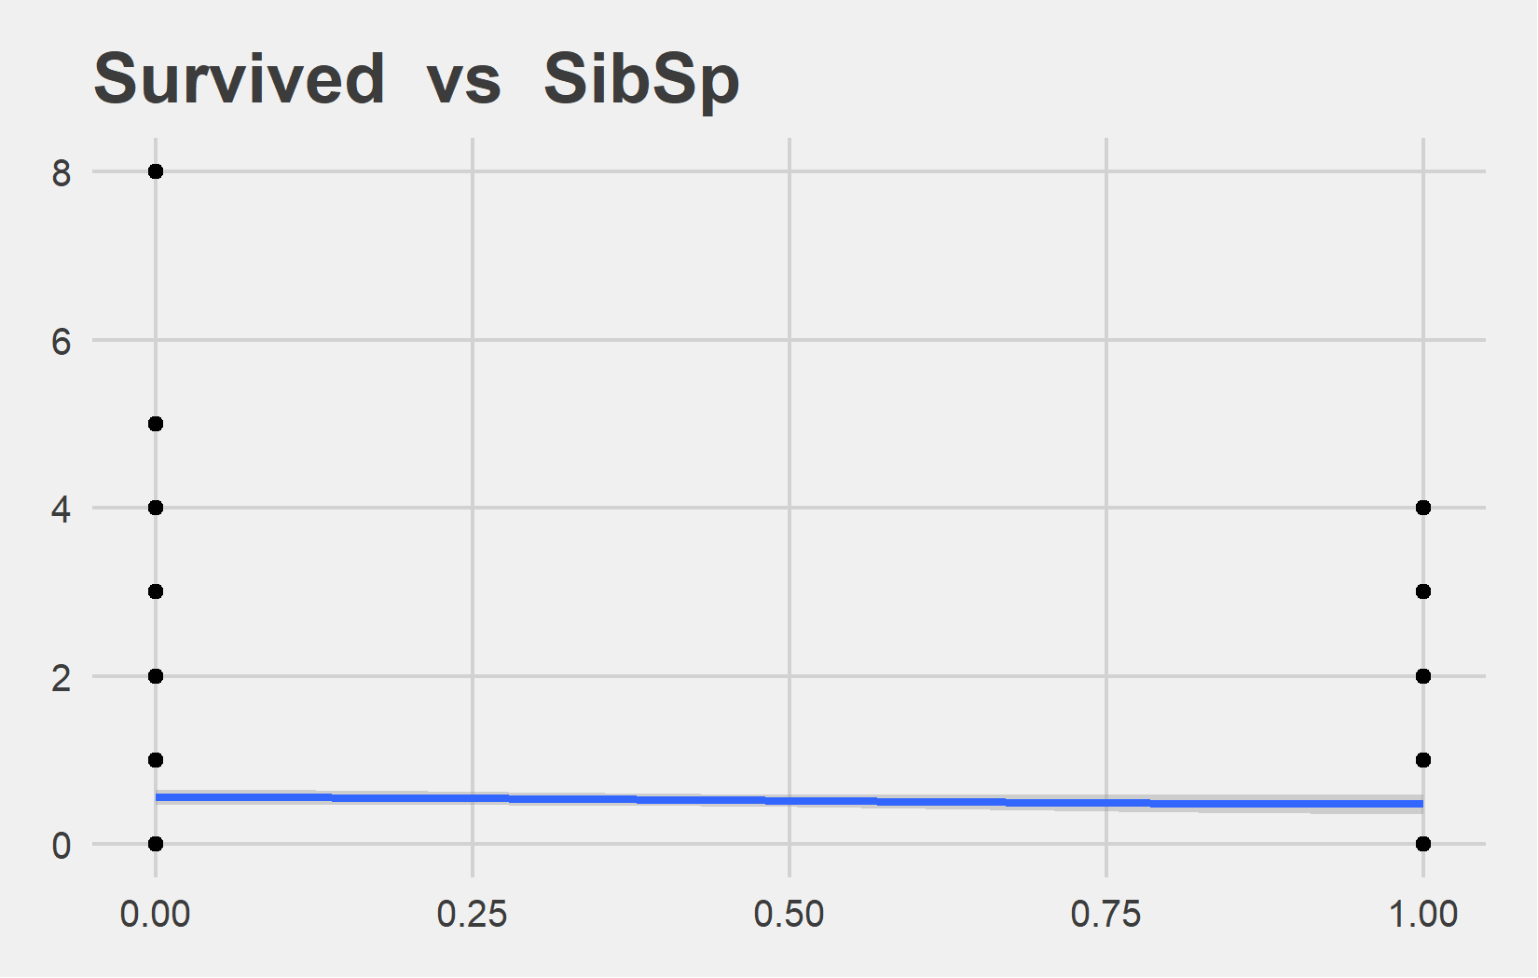
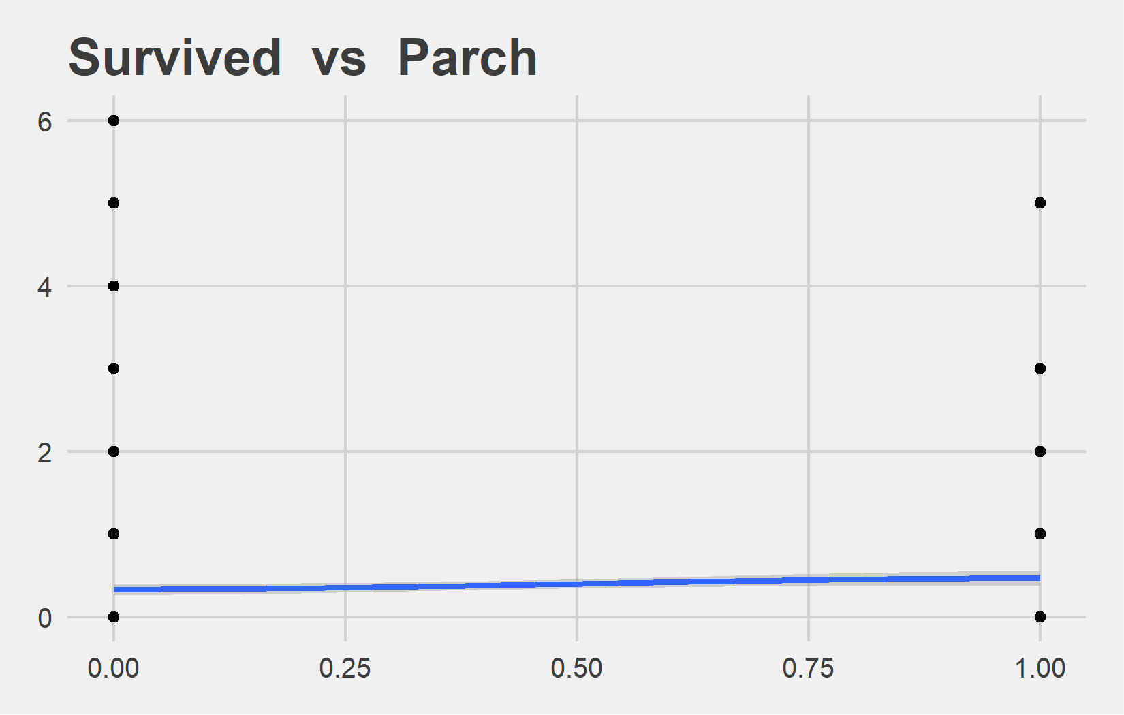
Bi-variate analysis Slide 4 of 5
Feature | Correlation with Target
SibSp | -0.035
Feature | Correlation with Target
Parch | 0.082

Slide 13
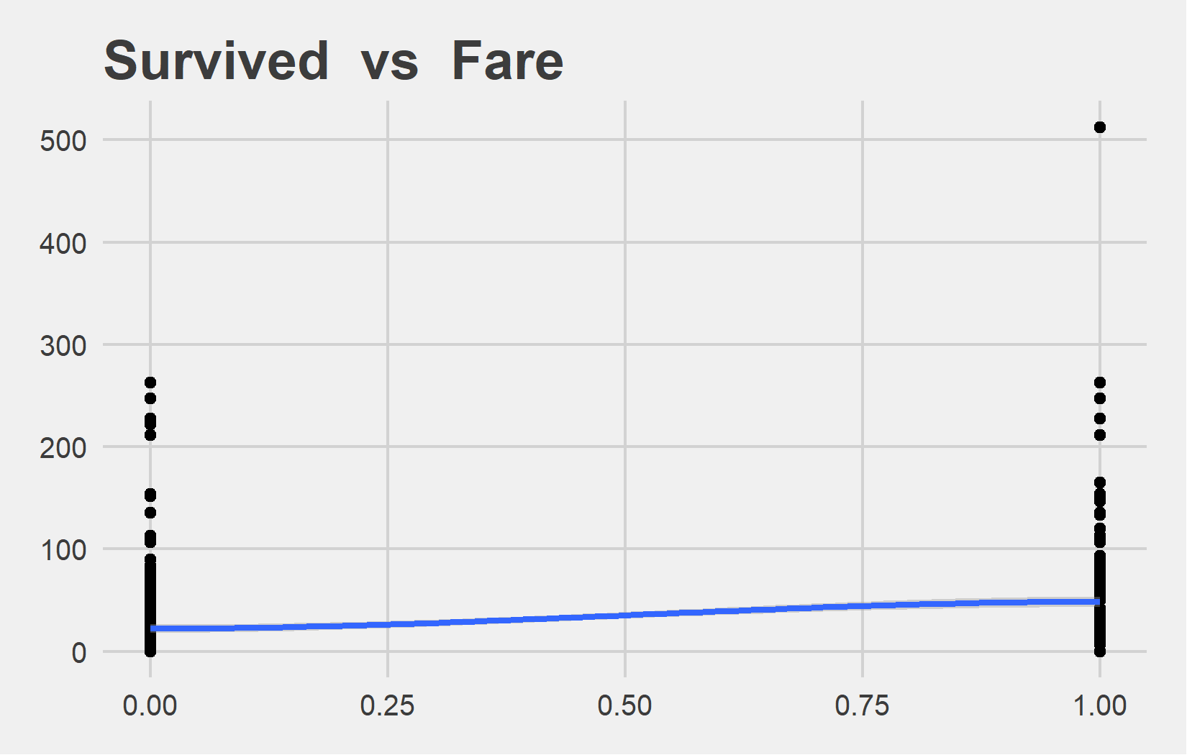
Bi-variate analysis Slide 5 of 5
Feature | Correlation with Target
Fare | 0.257

Slide 14
Bi-variate with Group_var

Slide 15
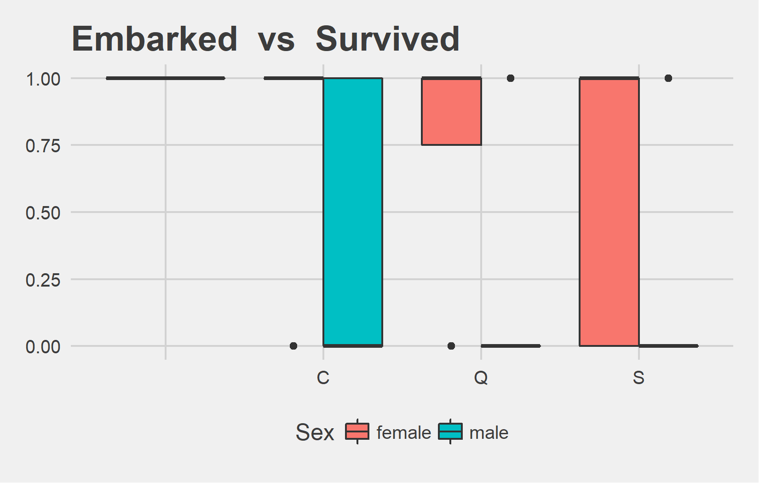
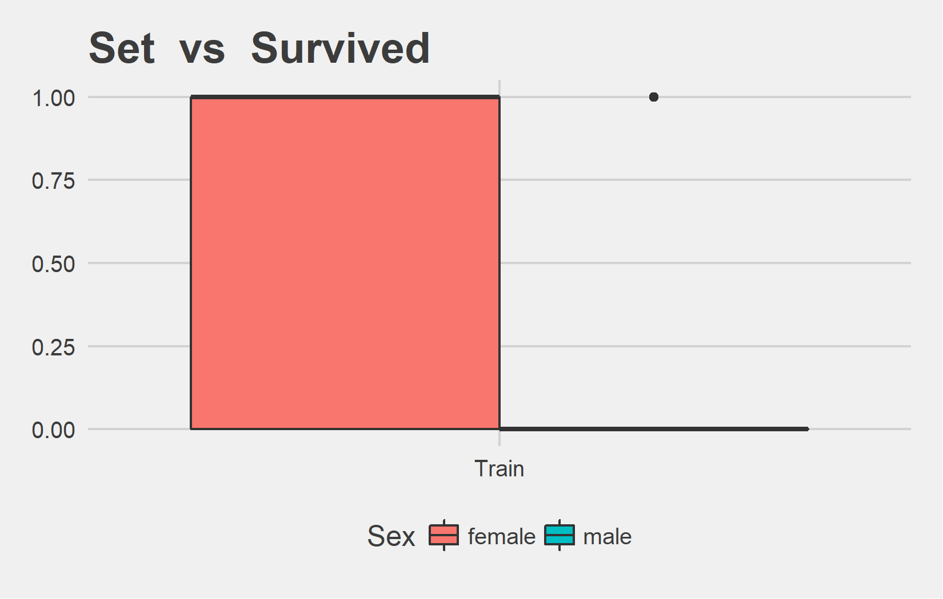
Bi-variate with Group_var Slide 1 of 4
Embarked | Sex | mean_val | median_val
 | female | 1.00 | 1
C | female | 0.88 | 1
C | male | 0.31 | 0
Q | female | 0.75 | 1
Q | male | 0.07 | 0
S | female | 0.69 | 1
S | male | 0.17 | 0
Set | Sex | mean_val | median_val
Train | female | 0.74 | 1
Train | male | 0.19 | 0

Slide 16
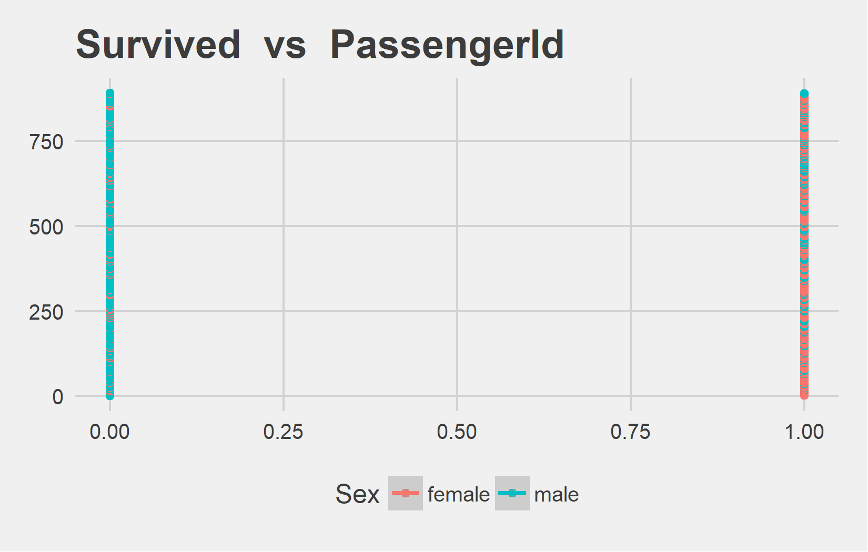
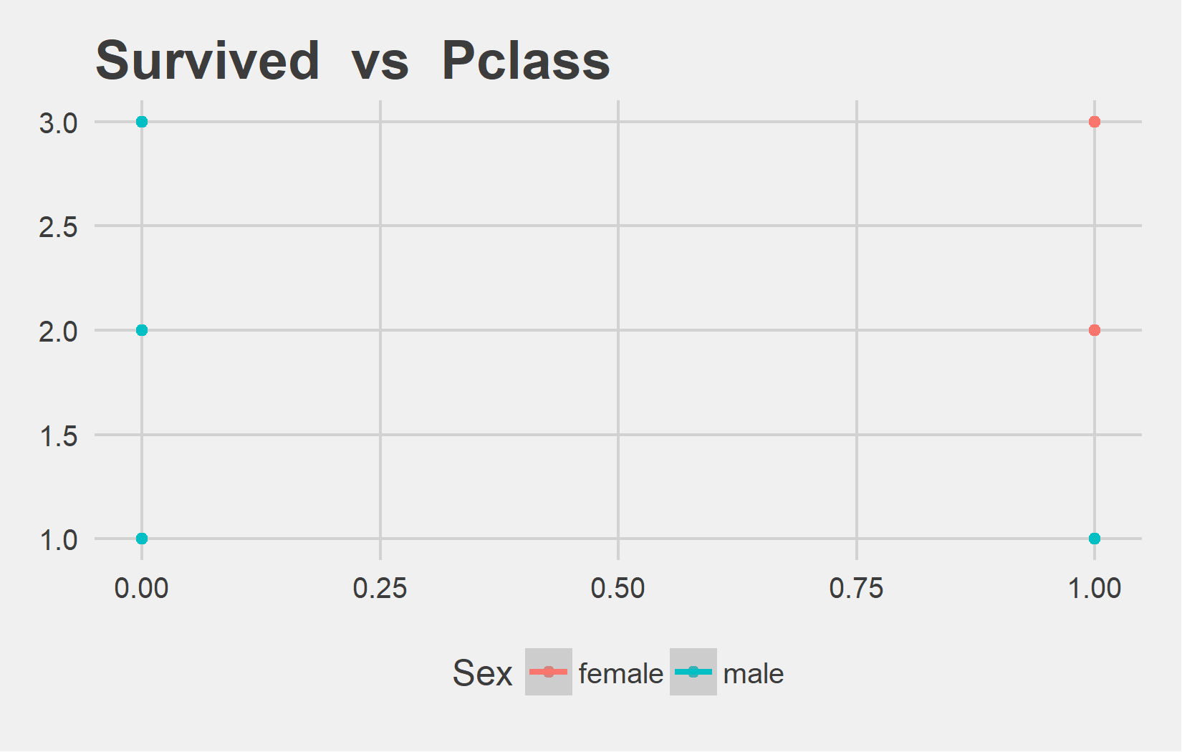
Bi-variate with Group_var Slide 2 of 4
Sex | Correlation with Target
female | -0.008790421
male | 0.040477473
Sex | Correlation with Target
female | -0.4771138
male | -0.2206183

Slide 17
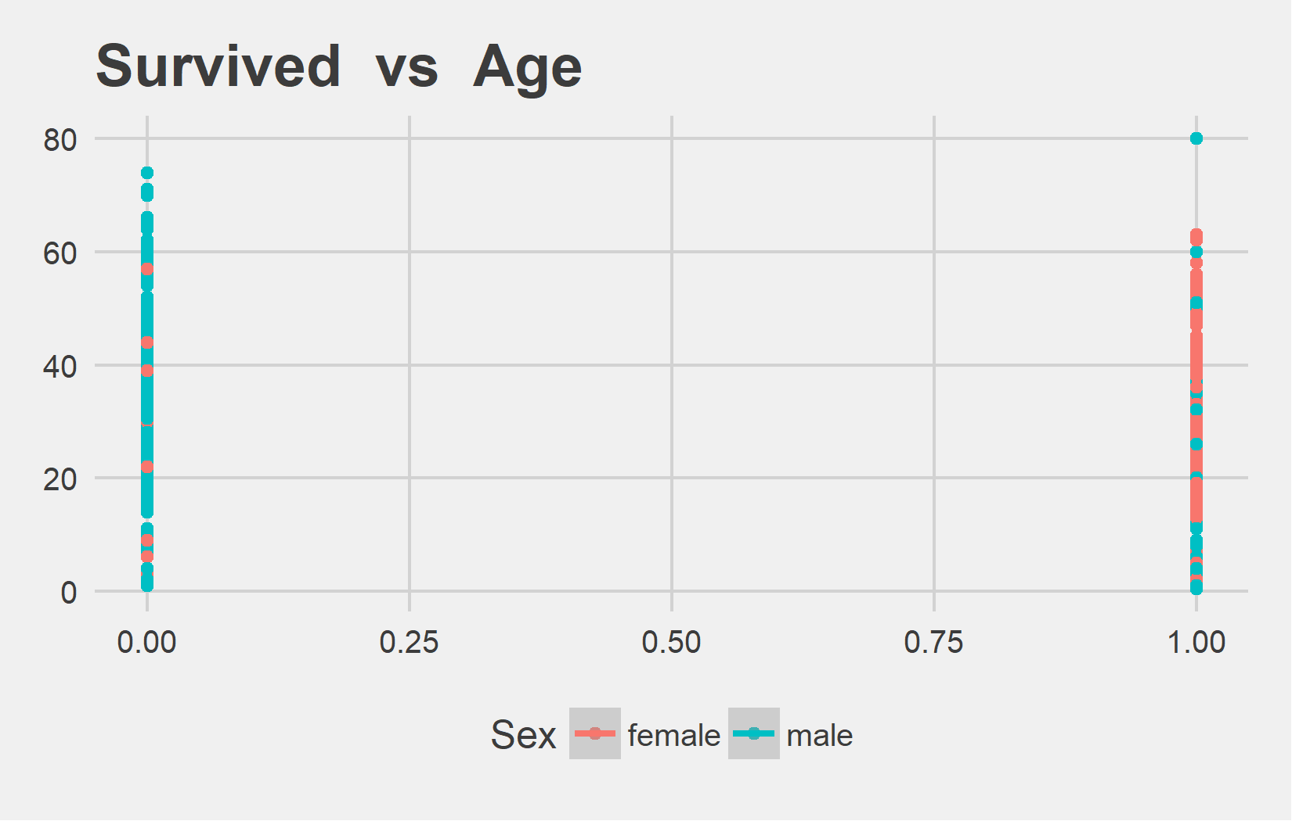
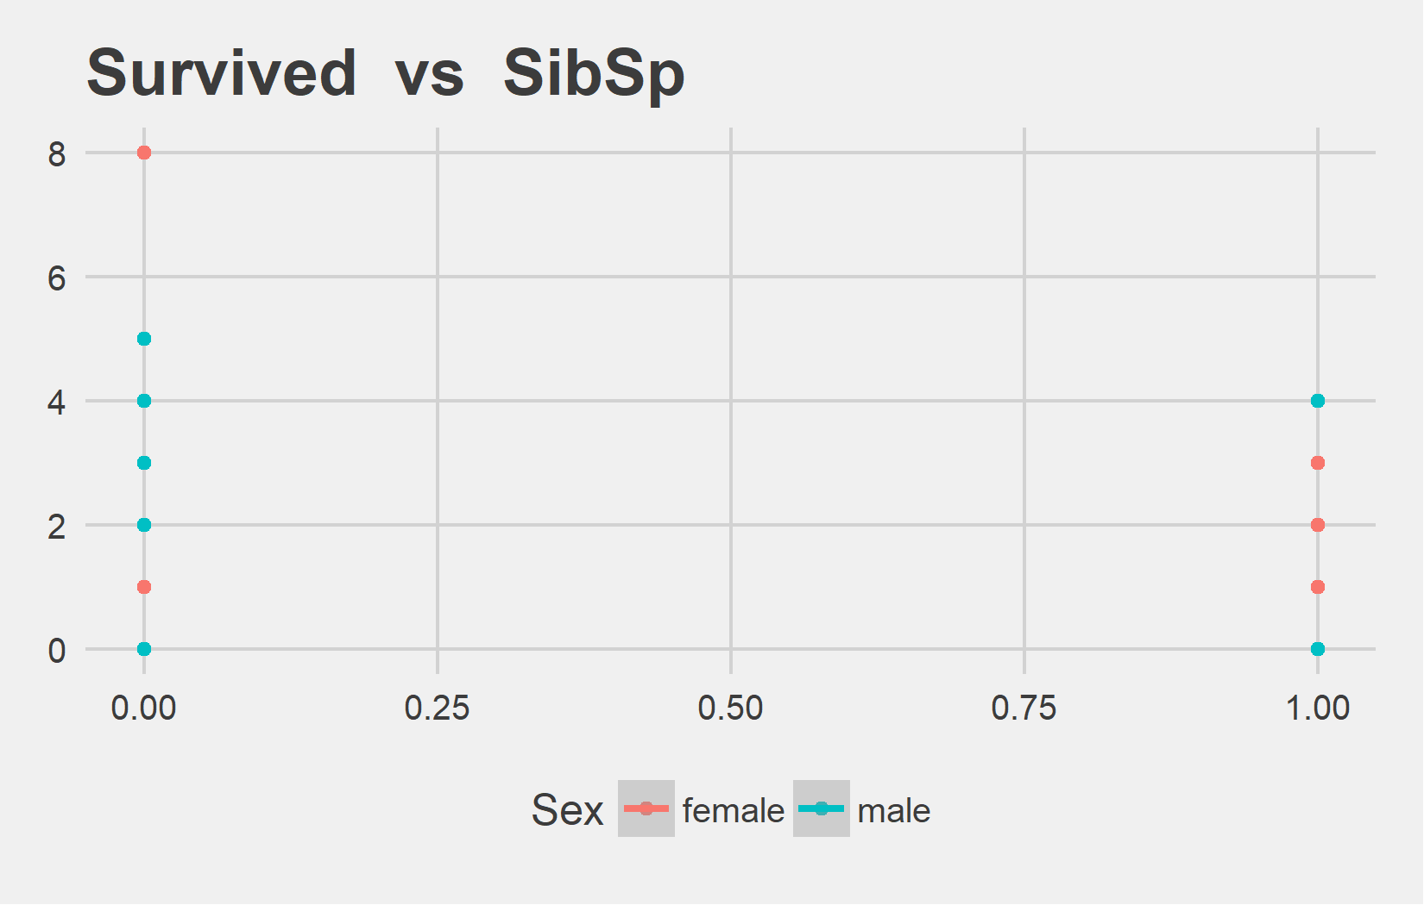
Bi-variate with Group_var Slide 3 of 4
Sex | Correlation with Target
female | 0.1161086
male | -0.1196175
Sex | Correlation with Target
female | -0.26328402
male | -0.02023788

Slide 18
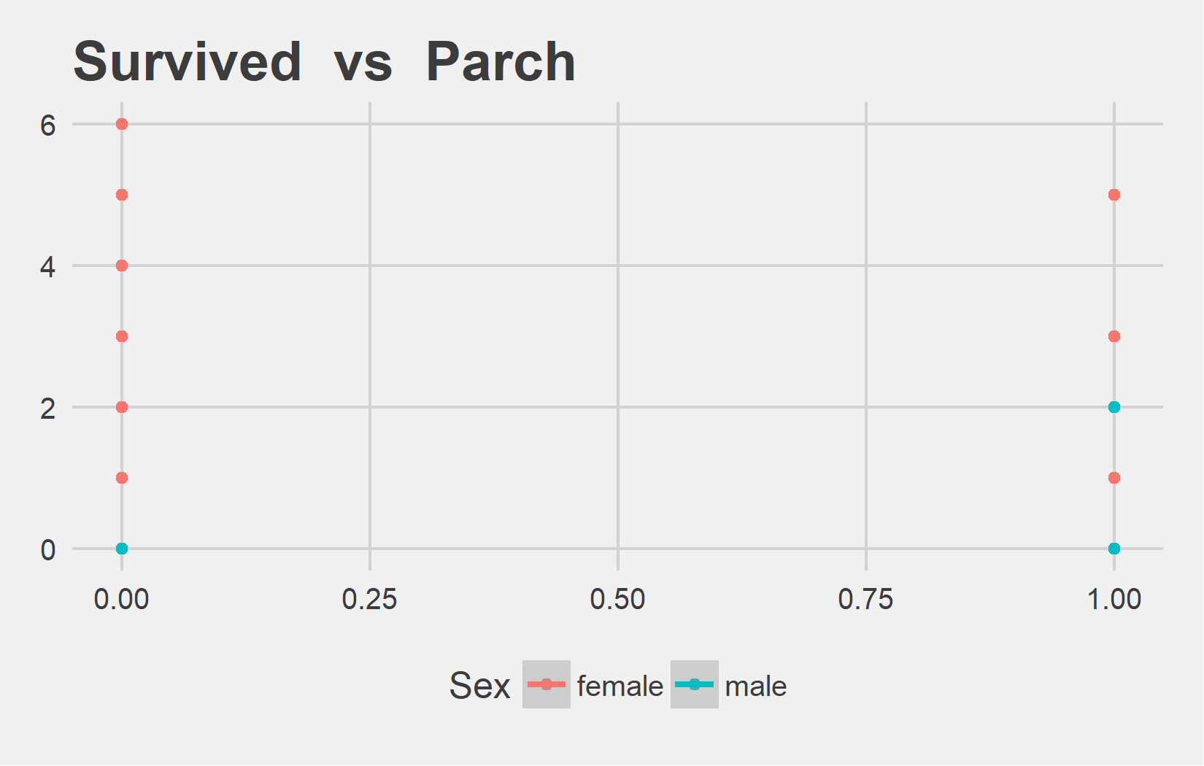
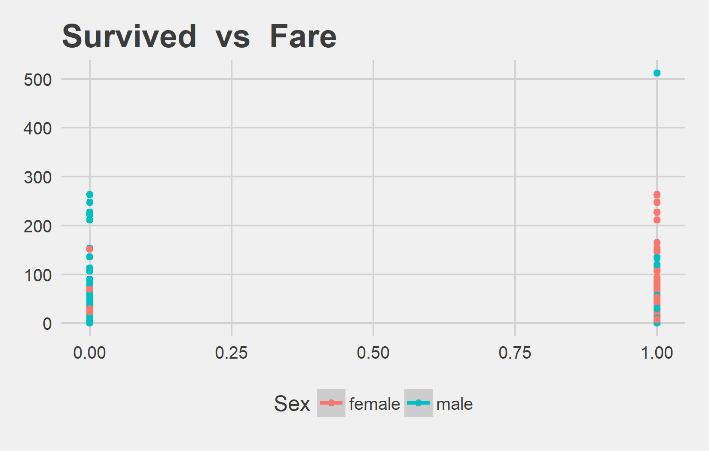
Bi-variate with Group_var Slide 4 of 4
Sex | Correlation with Target
female | -0.22364371
male | 0.09631845
Sex | Correlation with Target
female | 0.2184659
male | 0.1712882

