Slide 1
Exploratory Analysis Report

Slide 2
Univariate Analysis

Slide 3
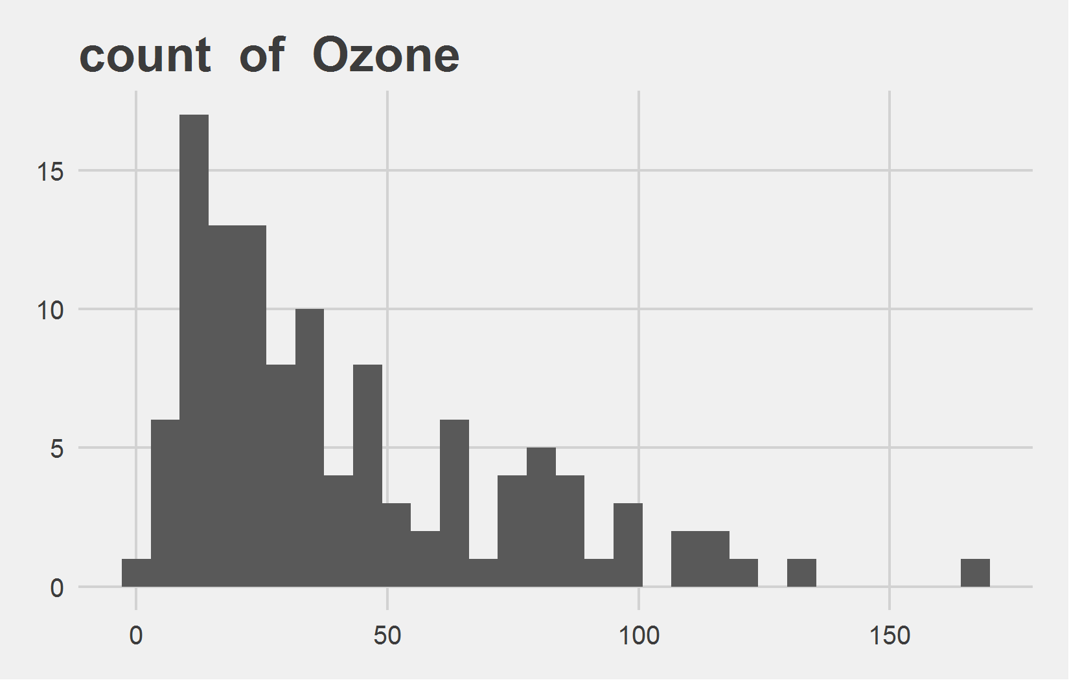
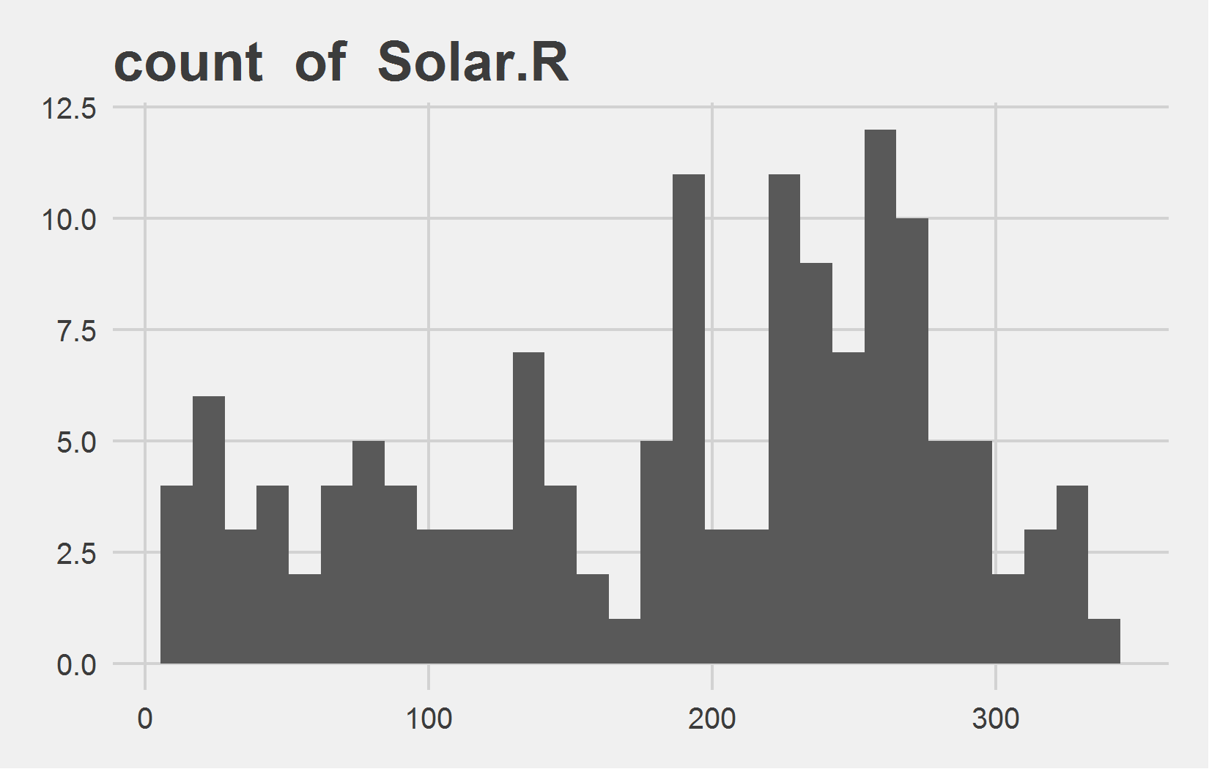
Univariate Analysis Slide 1 of 3
min | 25th | 50th | 75th | max
1 | 18 | 31.5 | 63.5 | 168
min | 25th | 50th | 75th | max
7 | 115 | 205 | 259 | 334

Slide 4
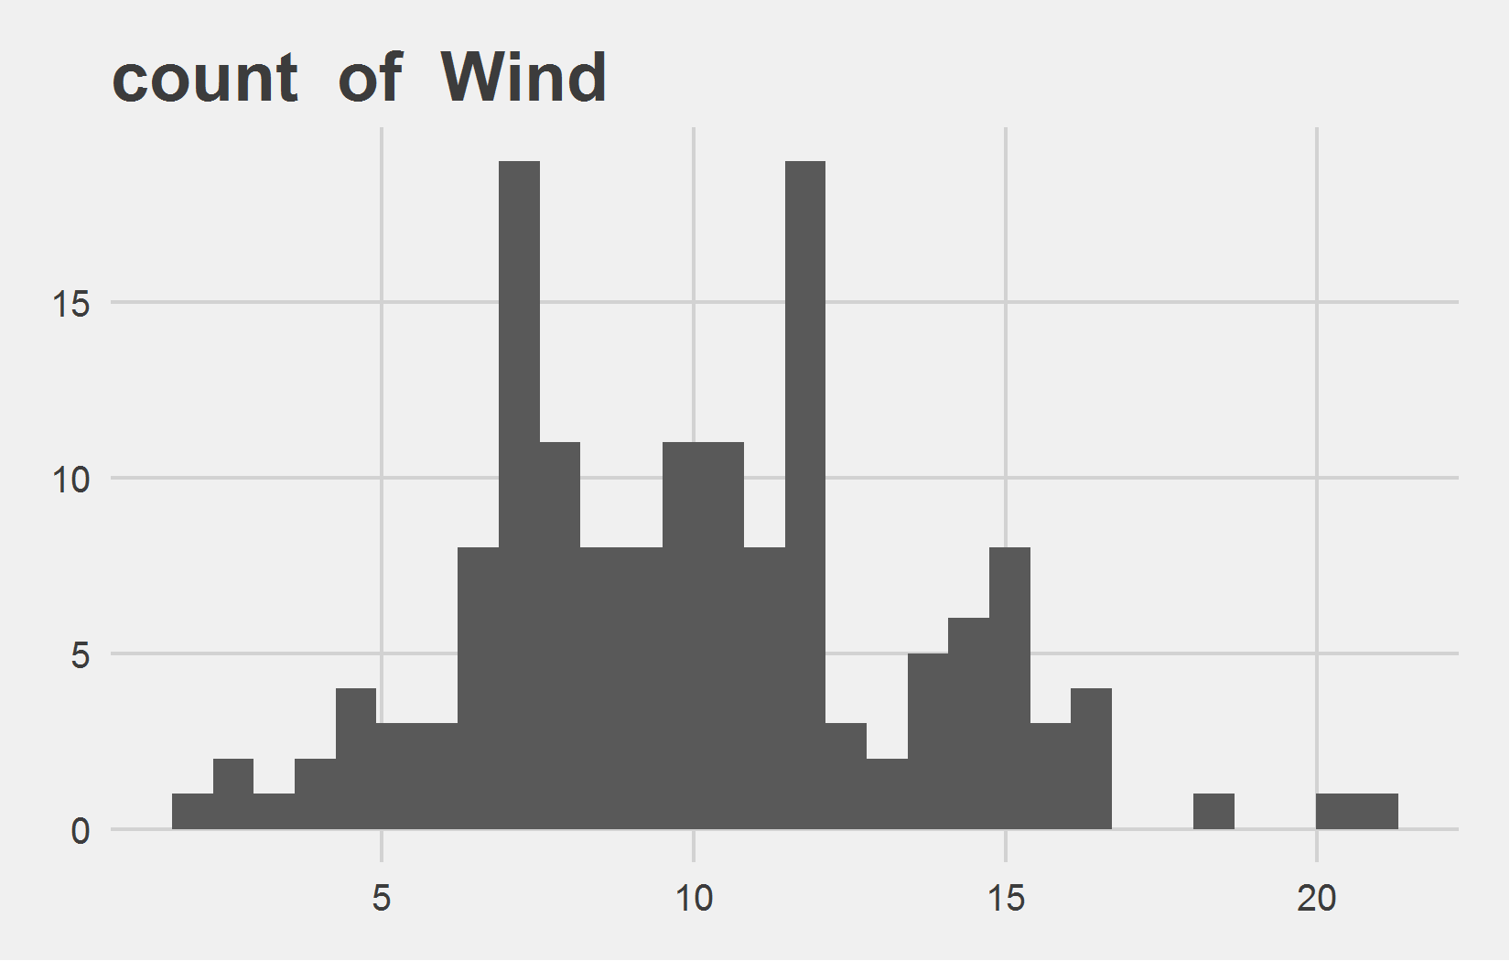
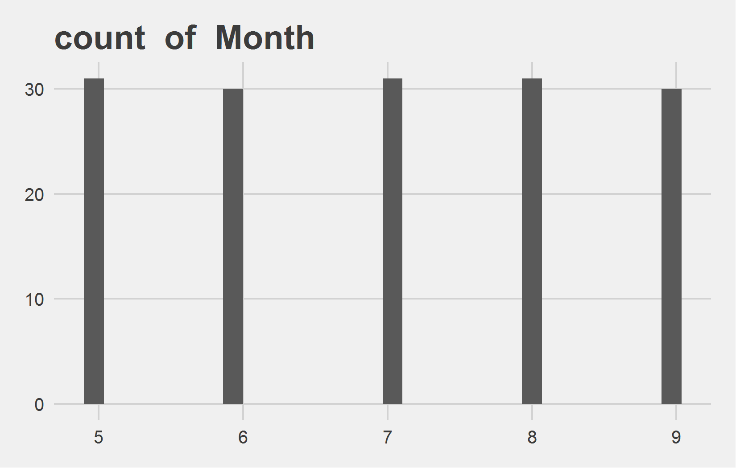
Univariate Analysis Slide 2 of 3
min | 25th | 50th | 75th | max
1.7 | 7.4 | 9.7 | 11.5 | 20.7
min | 25th | 50th | 75th | max
5 | 6 | 7 | 8 | 9

Slide 5
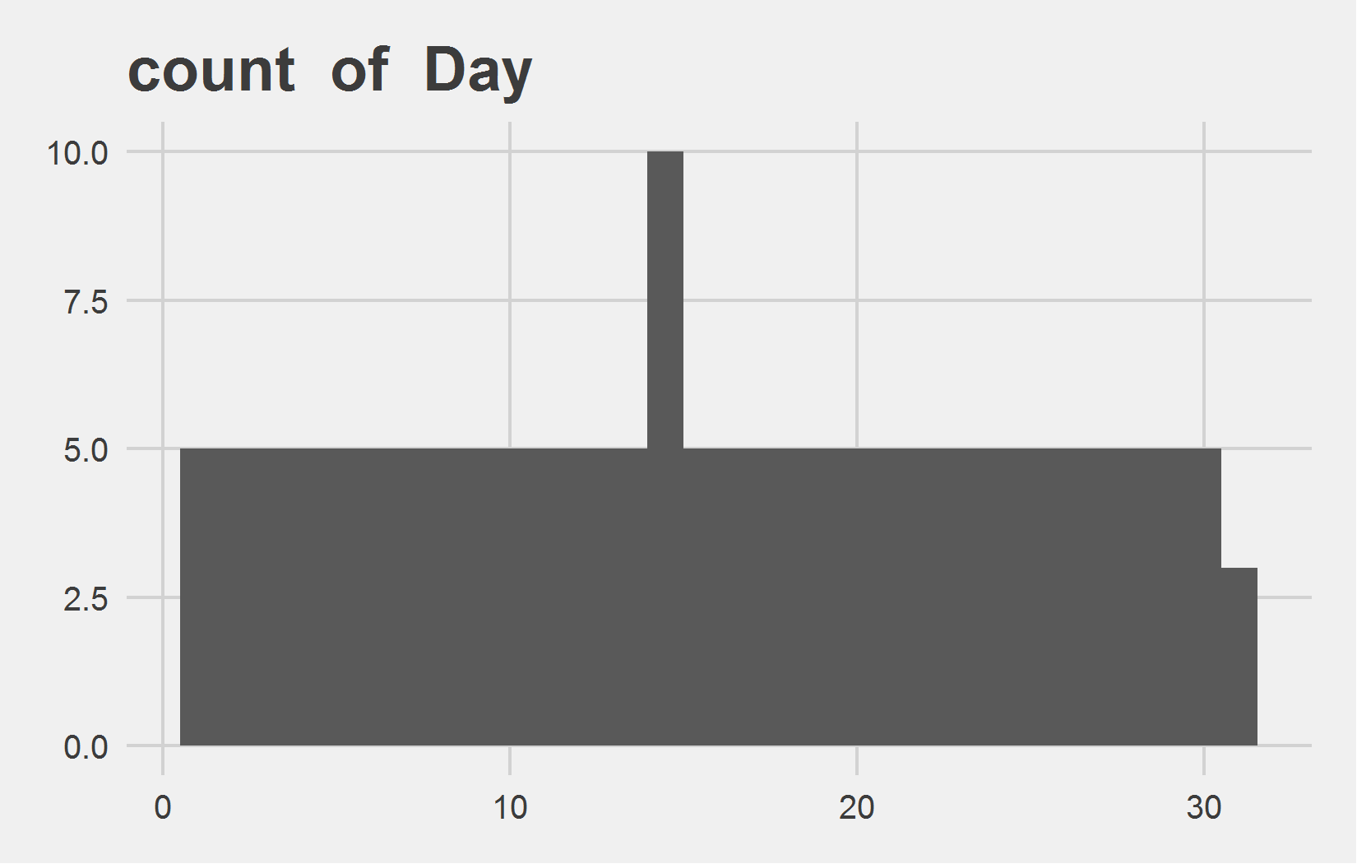
Univariate Analysis Slide 3 of 3
min | 25th | 50th | 75th | max
1 | 8 | 16 | 23 | 31

Slide 6
Bi-variate analysis

Slide 7
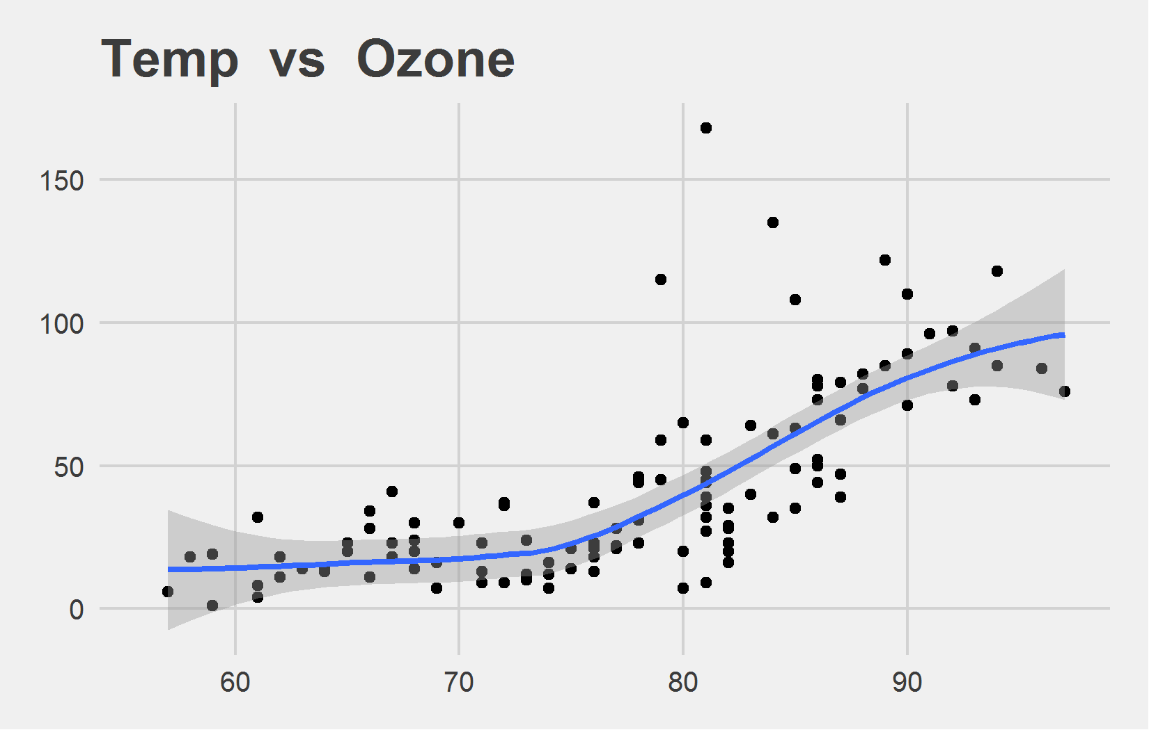
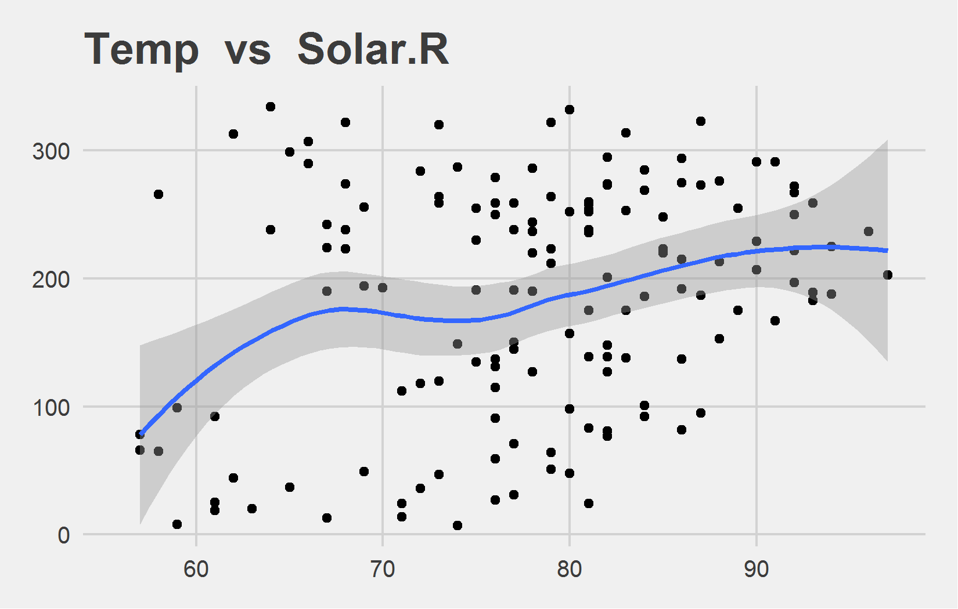
Bi-variate analysis Slide 1 of 3
Feature | Correlation with Target
Ozone | 0.698
Feature | Correlation with Target
Solar.R | 0.276

Slide 8
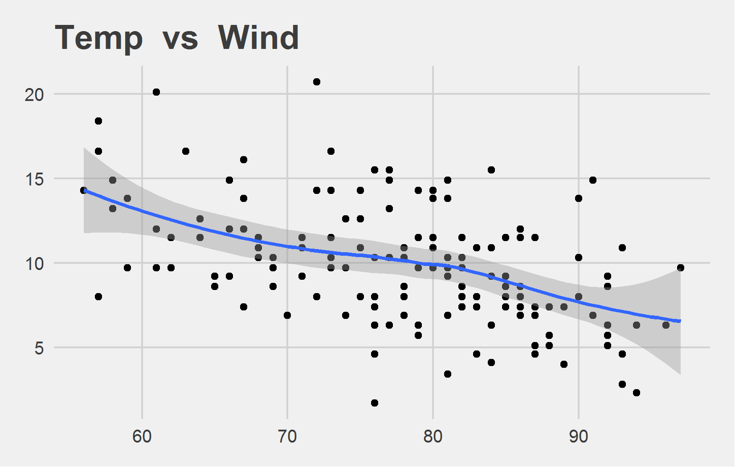
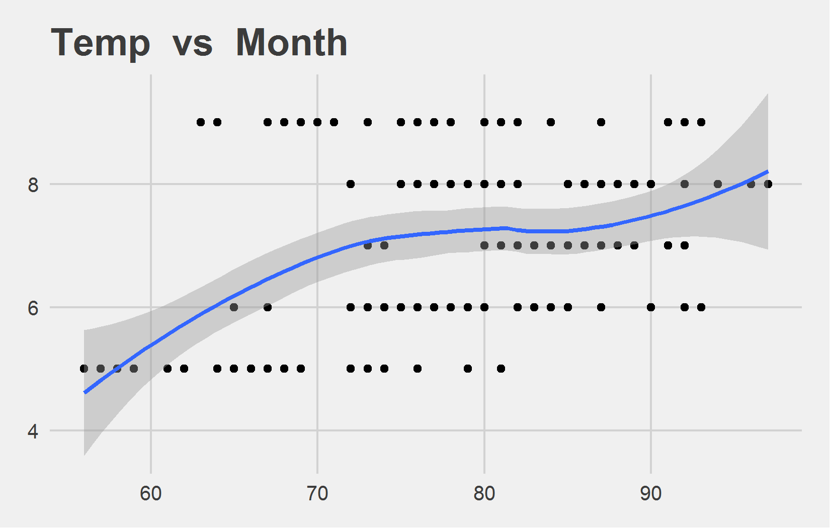
Bi-variate analysis Slide 2 of 3
Feature | Correlation with Target
Wind | -0.458
Feature | Correlation with Target
Month | 0.421

Slide 9
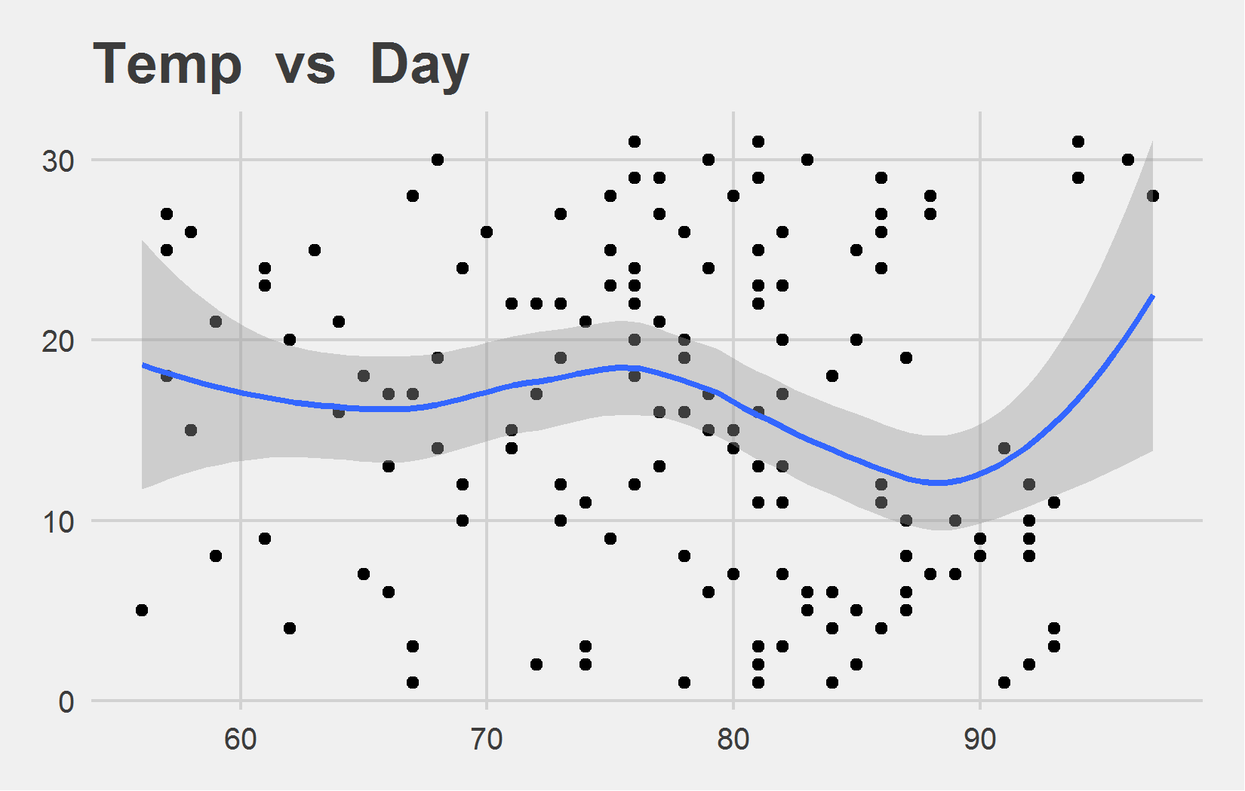
Bi-variate analysis Slide 3 of 3
Feature | Correlation with Target
Day | -0.131

