Slide 1
Exploratory Analysis Report

Slide 2
Univariate Analysis

Slide 3
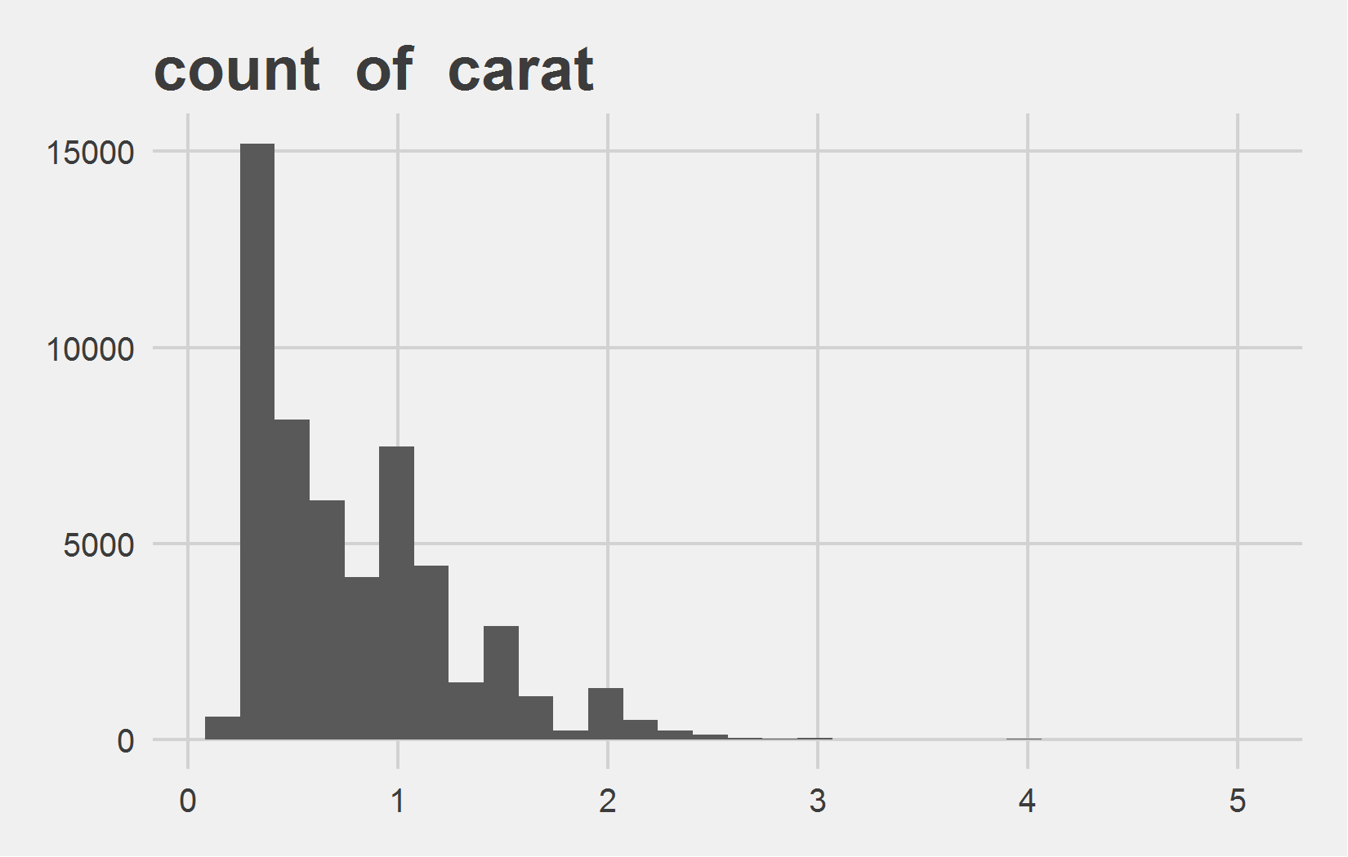
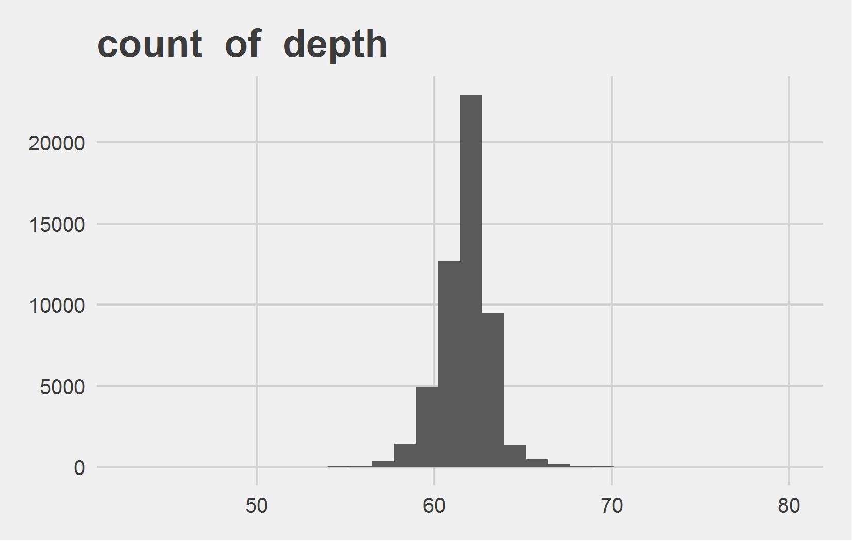
Univariate Analysis Slide 1 of 5
min | 25th | 50th | 75th | max
0.2 | 0.4 | 0.7 | 1.04 | 5.01
min | 25th | 50th | 75th | max
43 | 61 | 61.8 | 62.5 | 79

Slide 4
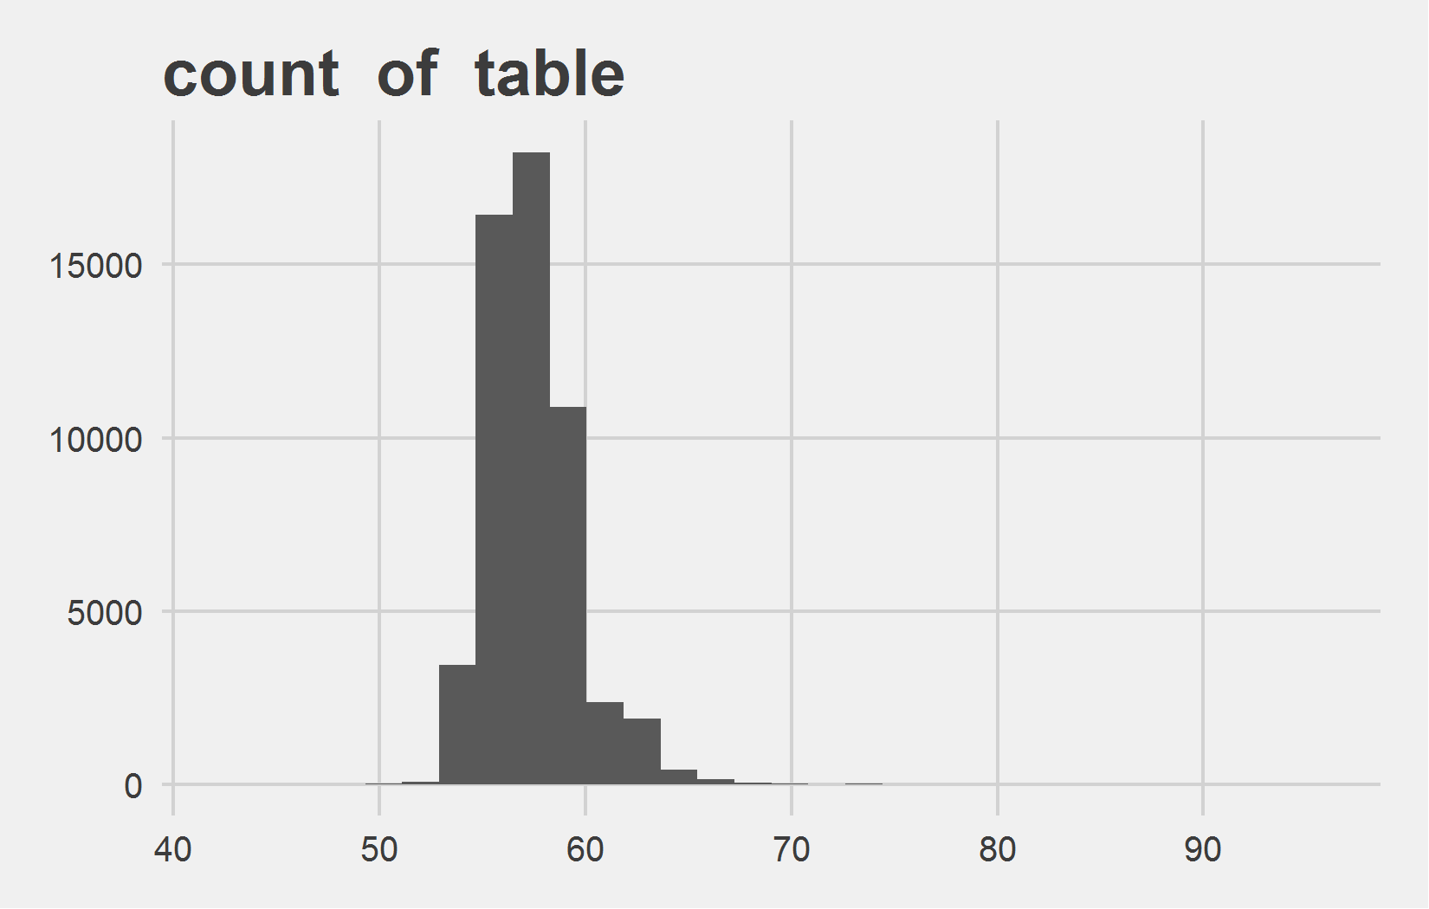
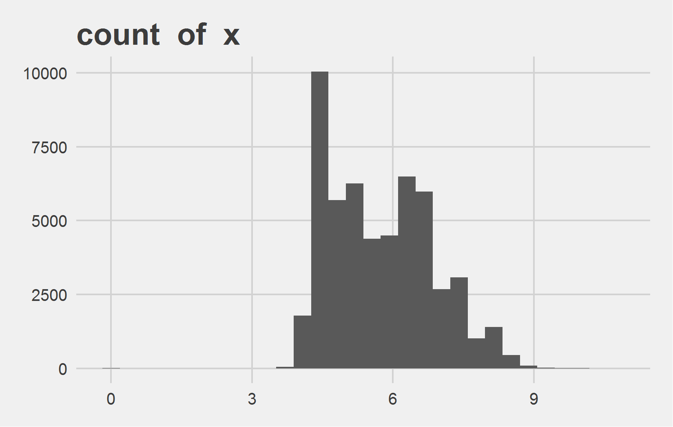
Univariate Analysis Slide 2 of 5
min | 25th | 50th | 75th | max
43 | 56 | 57 | 59 | 95
min | 25th | 50th | 75th | max
0 | 4.71 | 5.7 | 6.54 | 10.74

Slide 5
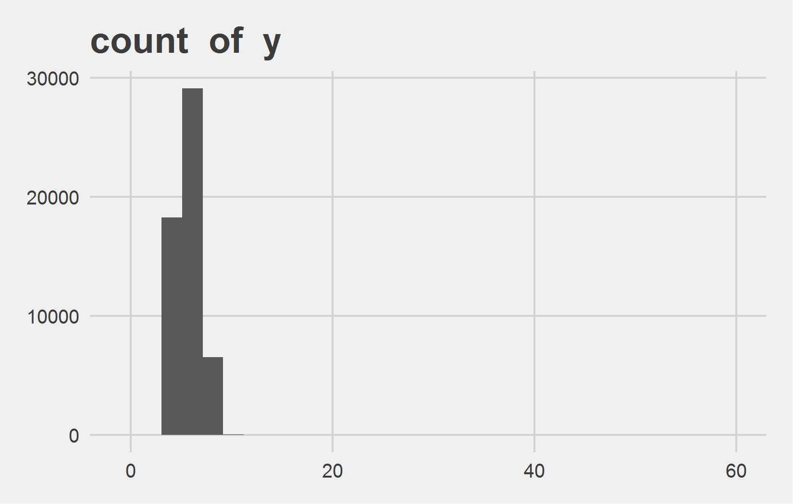
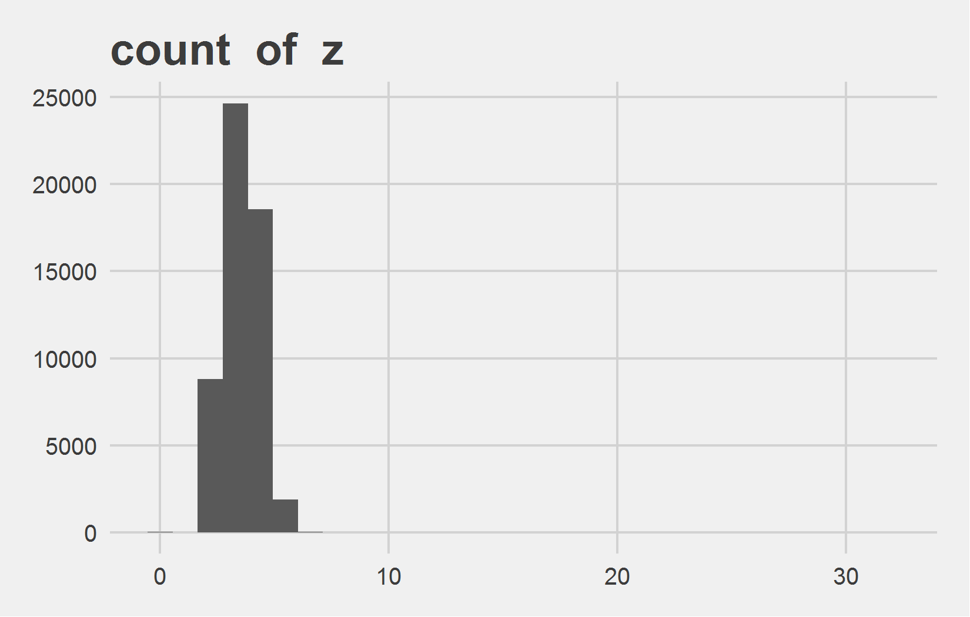
Univariate Analysis Slide 3 of 5
min | 25th | 50th | 75th | max
0 | 4.72 | 5.71 | 6.54 | 58.9
min | 25th | 50th | 75th | max
0 | 2.91 | 3.53 | 4.04 | 31.8

Slide 6
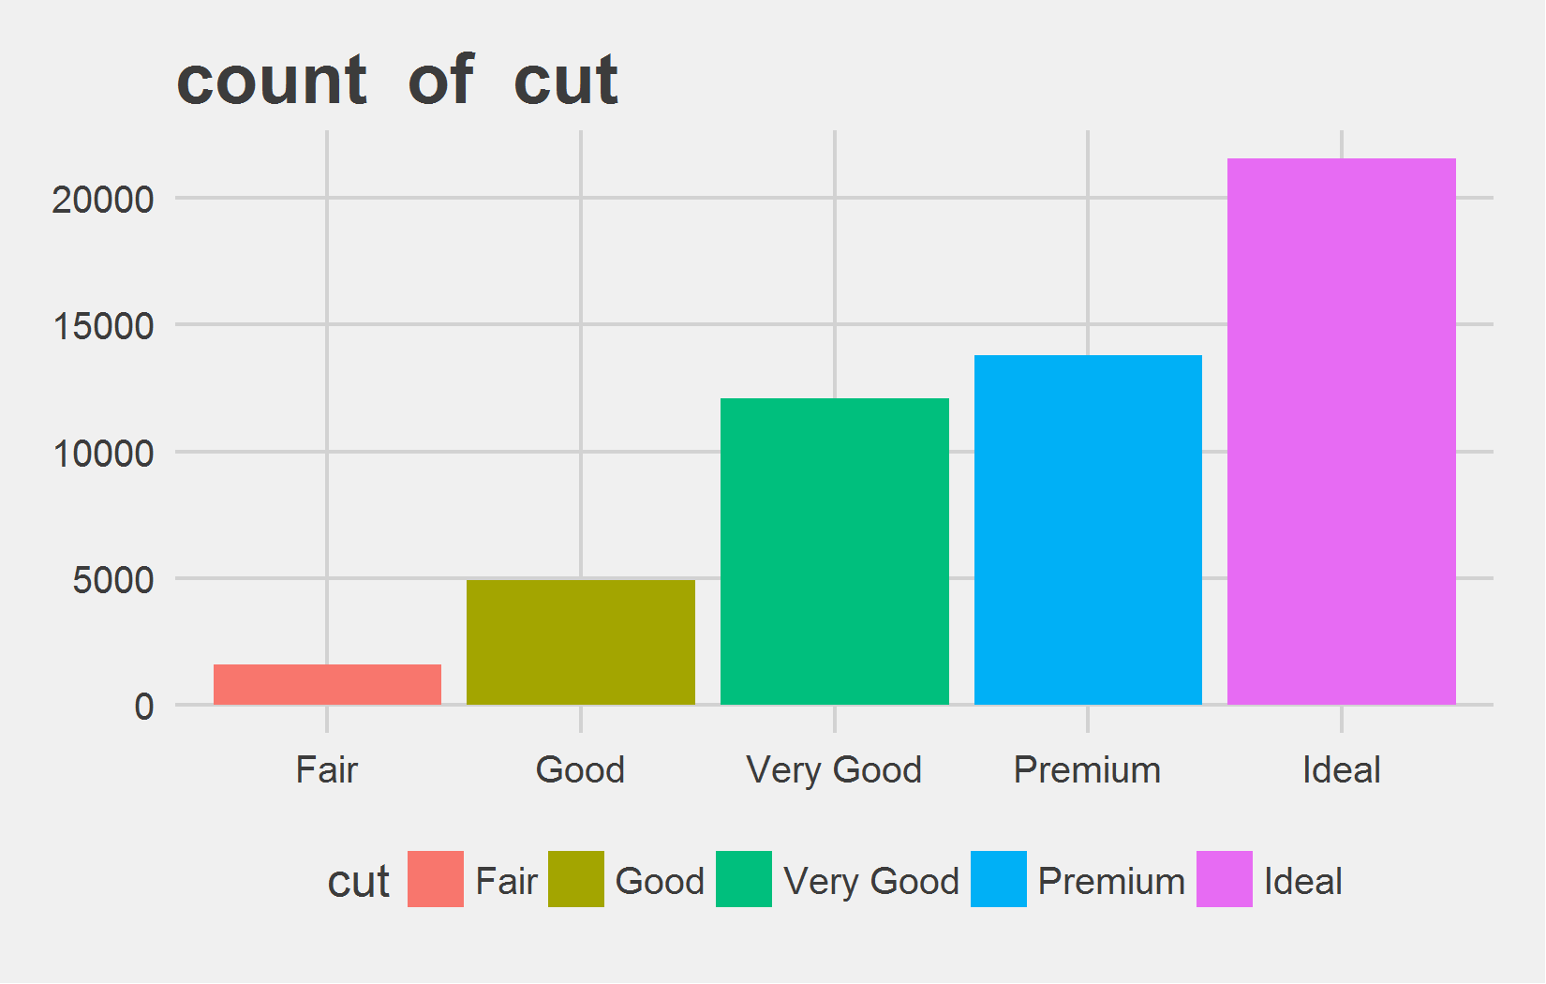
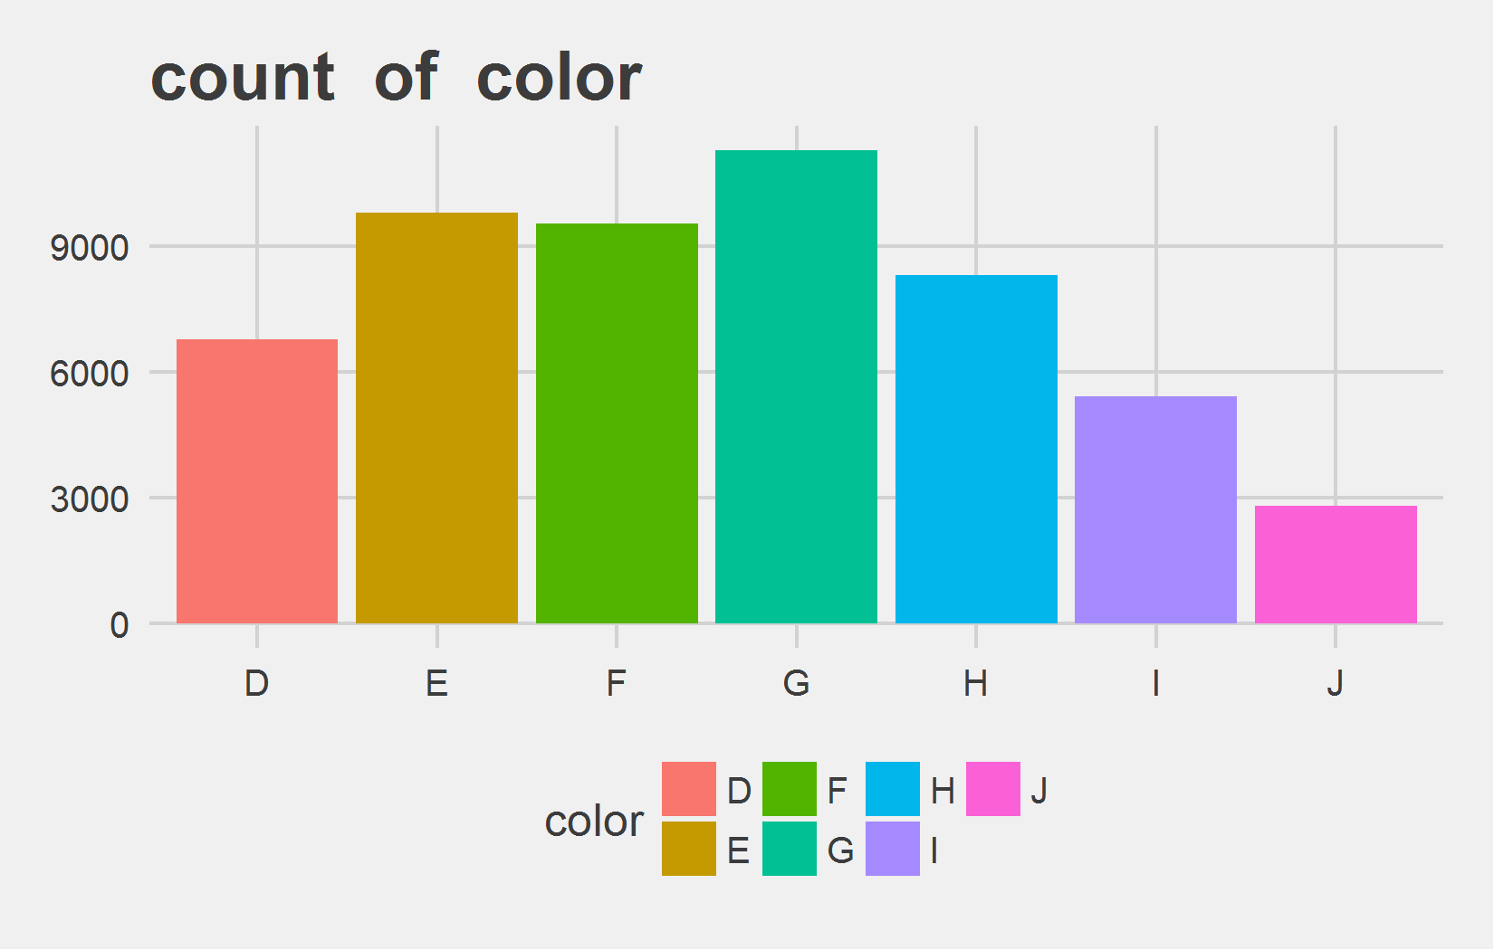
Univariate Analysis Slide 4 of 5
Metric | Fair | Good | Very Good | Premium | Ideal
Count | 1610 | 4906 | 12082 | 13791 | 21551
Perct. | 2.98% | 9.1% | 22.4% | 25.57% | 39.95%
Metric | D | E | F | G | H | I | J
Count | 6775 | 9797 | 9542 | 11292 | 8304 | 5422 | 2808
Perct. | 12.56% | 18.16% | 17.69% | 20.93% | 15.39% | 10.05% | 5.21%

Slide 7
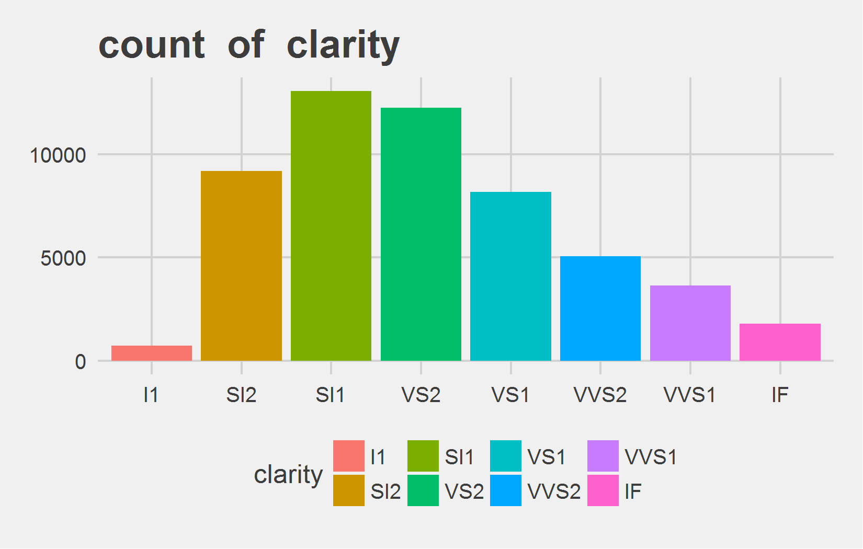
Univariate Analysis Slide 5 of 5
Metric | I1 | SI2 | SI1 | VS2 | VS1 | VVS2 | VVS1 | IF
Count | 741 | 9194 | 13065 | 12258 | 8171 | 5066 | 3655 | 1790
Perct. | 1.37% | 17.04% | 24.22% | 22.73% | 15.15% | 9.39% | 6.78% | 3.32%

Slide 8
Bi-variate analysis

Slide 9
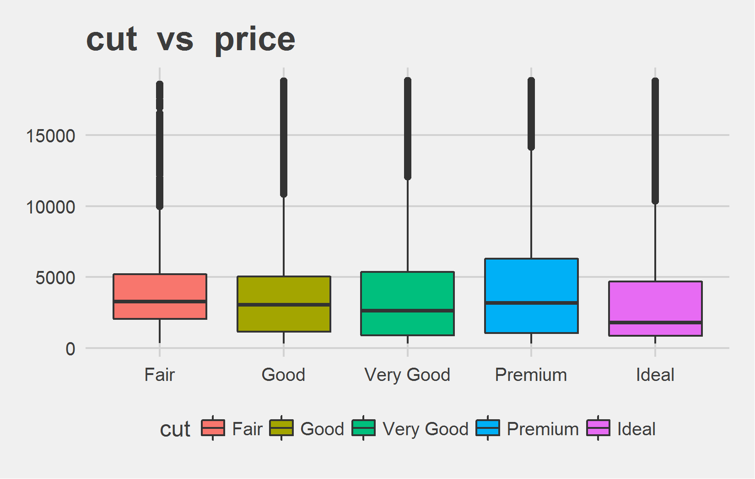
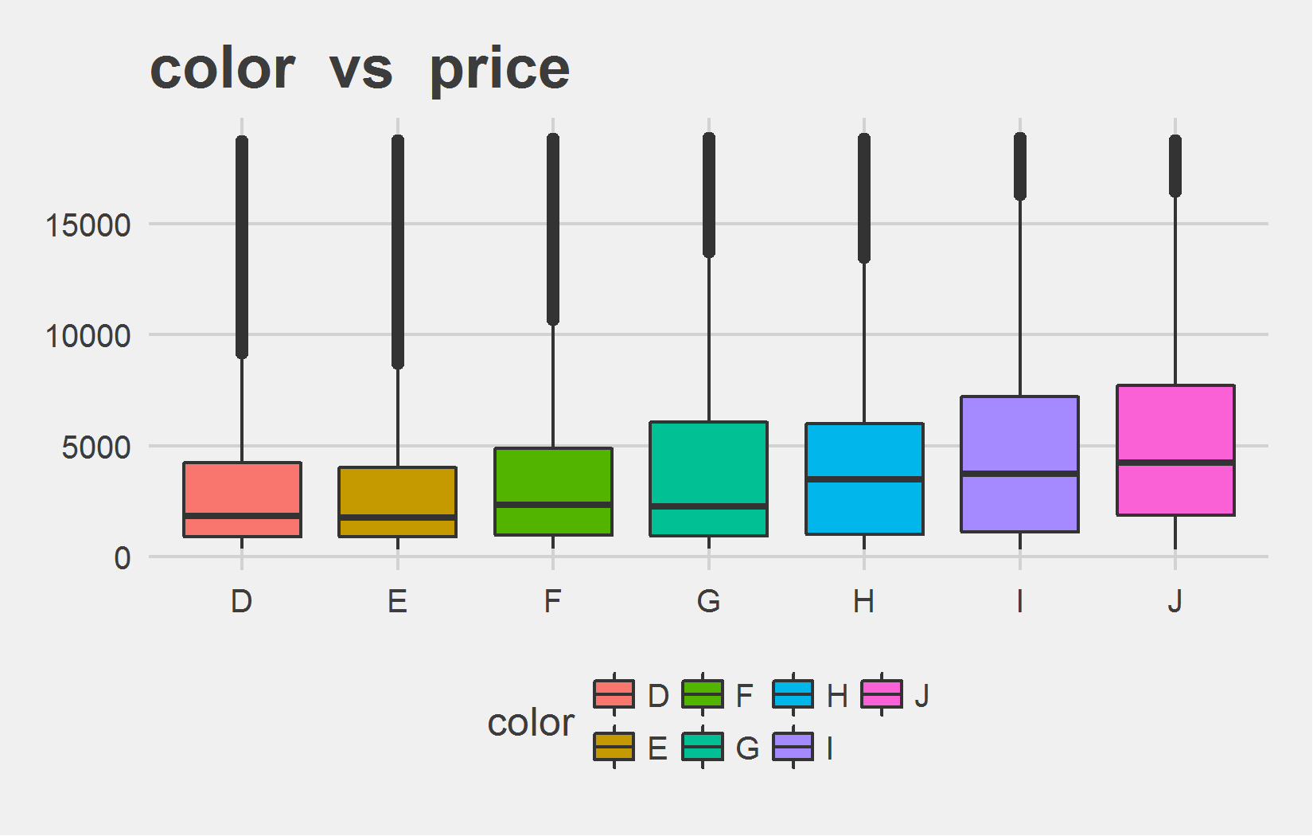
Bi-variate analysis Slide 1 of 5
cut | mean - price | median - price
Fair | 4358.76 | 3282.0
Good | 3928.86 | 3050.5
Very Good | 3981.76 | 2648.0
Premium | 4584.26 | 3185.0
Ideal | 3457.54 | 1810.0
color | mean - price | median - price
D | 3169.95 | 1838.0
E | 3076.75 | 1739.0
F | 3724.89 | 2343.5
G | 3999.14 | 2242.0
H | 4486.67 | 3460.0
I | 5091.87 | 3730.0
J | 5323.82 | 4234.0

Slide 10
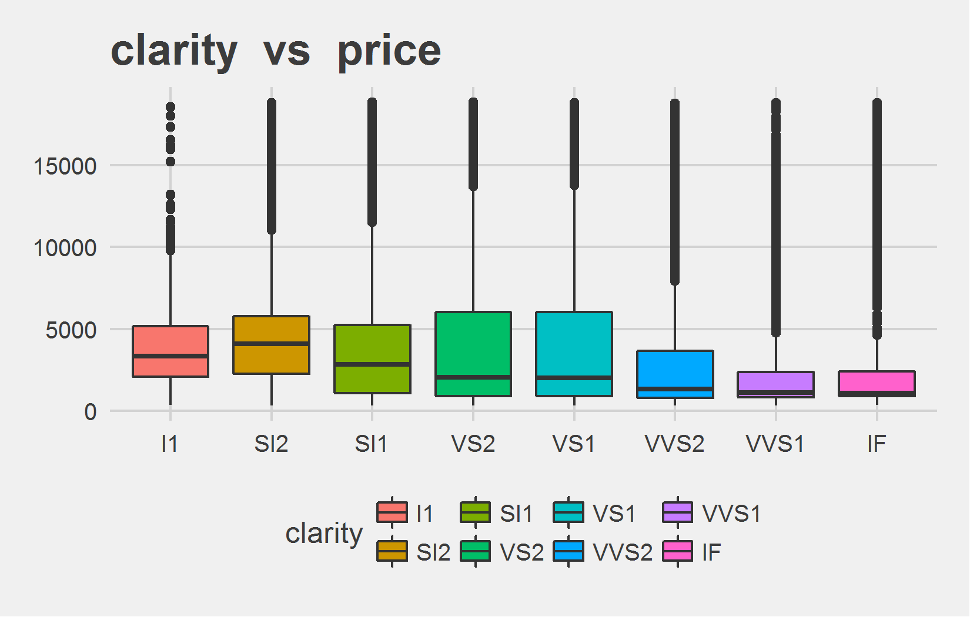
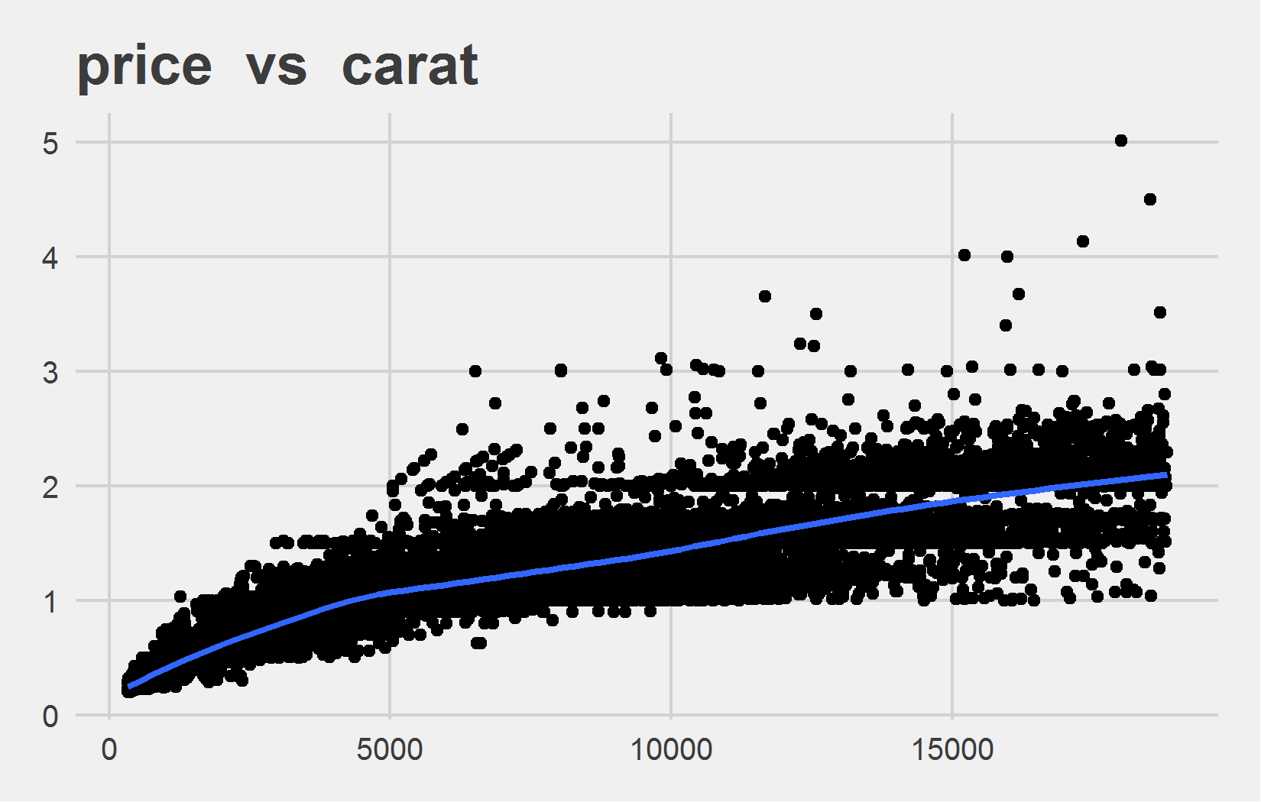
Bi-variate analysis Slide 2 of 5
clarity | mean - price | median - price
I1 | 3924.17 | 3344
SI2 | 5063.03 | 4072
SI1 | 3996.00 | 2822
VS2 | 3924.99 | 2054
VS1 | 3839.46 | 2005
VVS2 | 3283.74 | 1311
VVS1 | 2523.11 | 1093
IF | 2864.84 | 1080
Feature | Correlation with Target
carat | 0.922

Slide 11
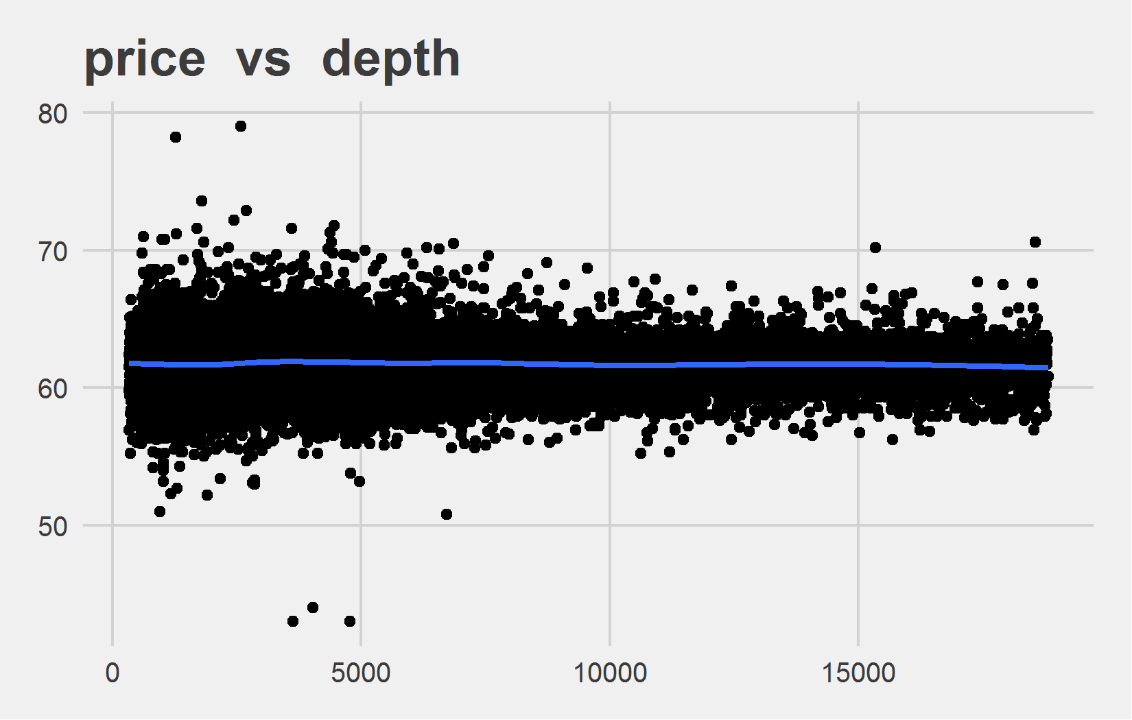
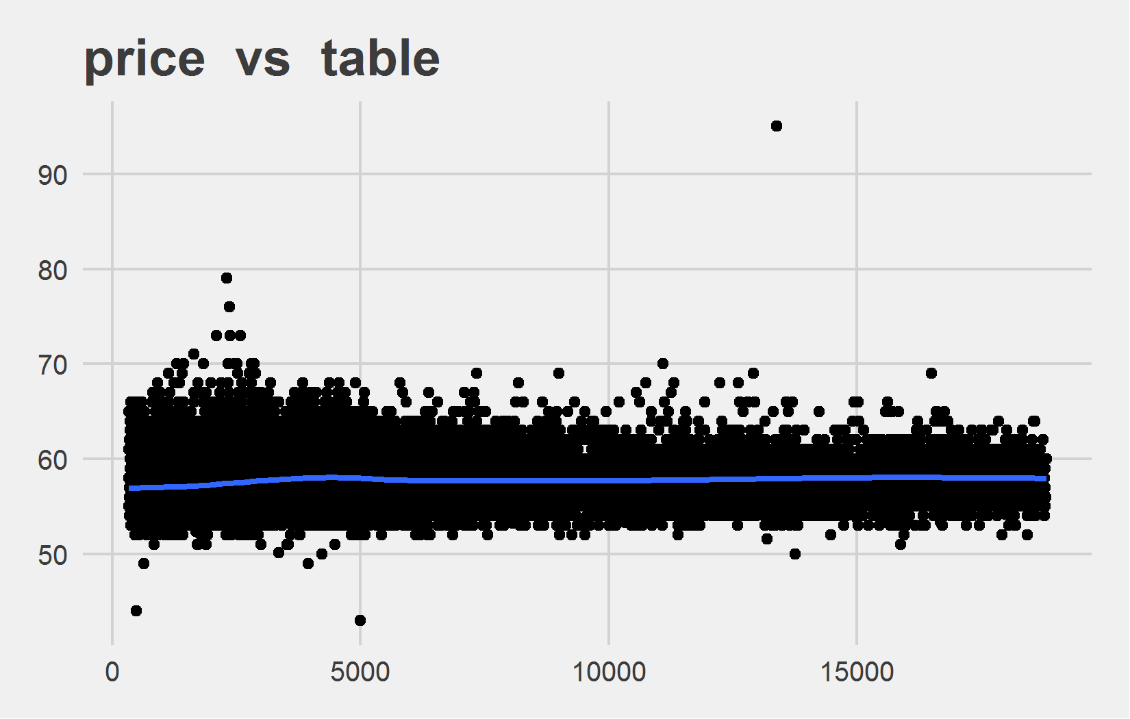
Bi-variate analysis Slide 3 of 5
Feature | Correlation with Target
depth | -0.011
Feature | Correlation with Target
table | 0.127

Slide 12
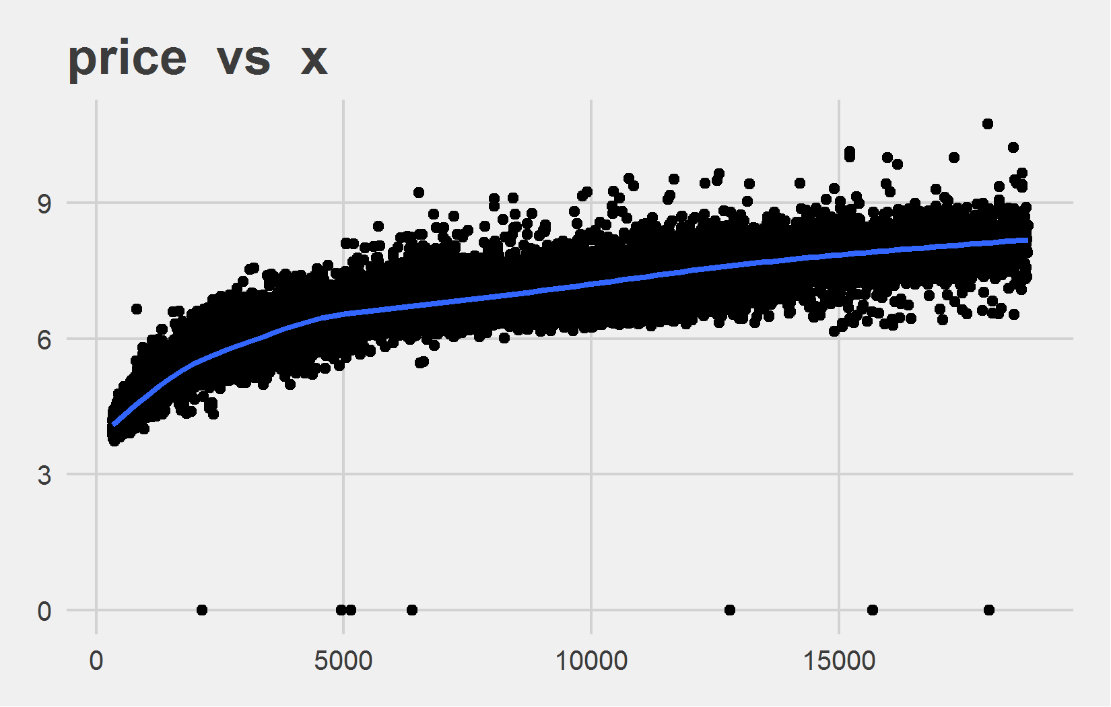
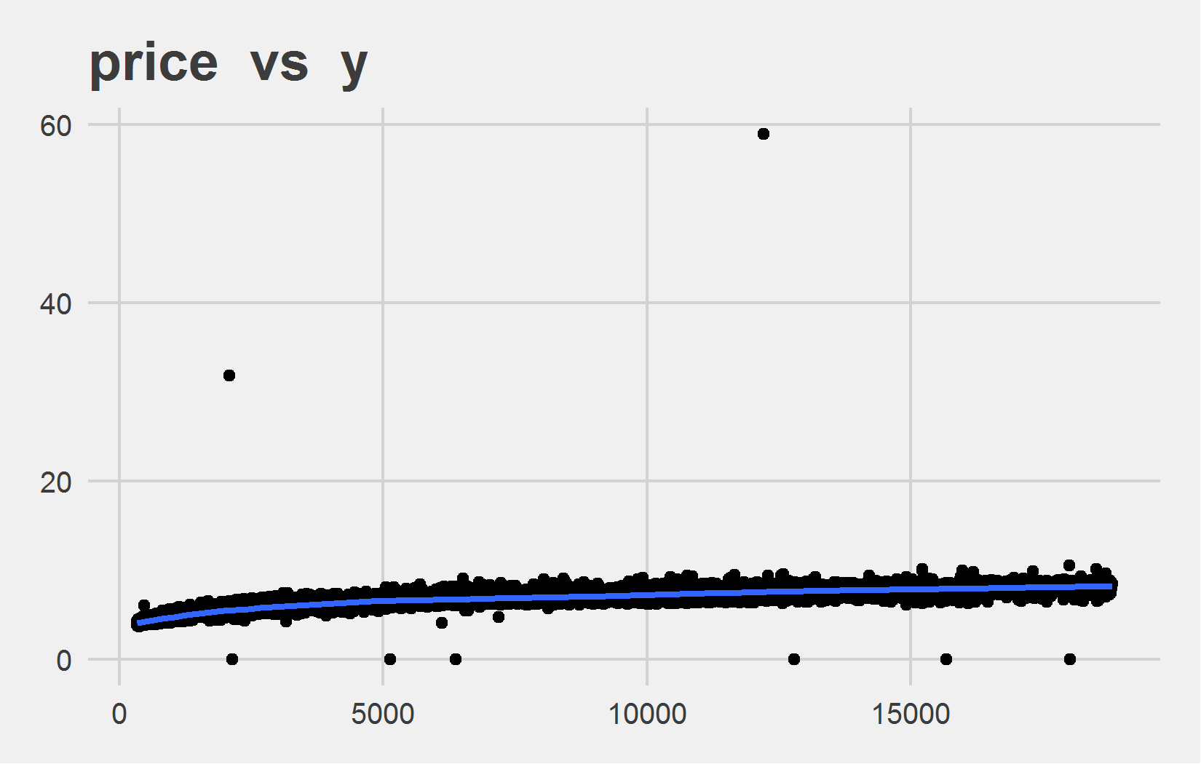
Bi-variate analysis Slide 4 of 5
Feature | Correlation with Target
x | 0.884
Feature | Correlation with Target
y | 0.865

Slide 13
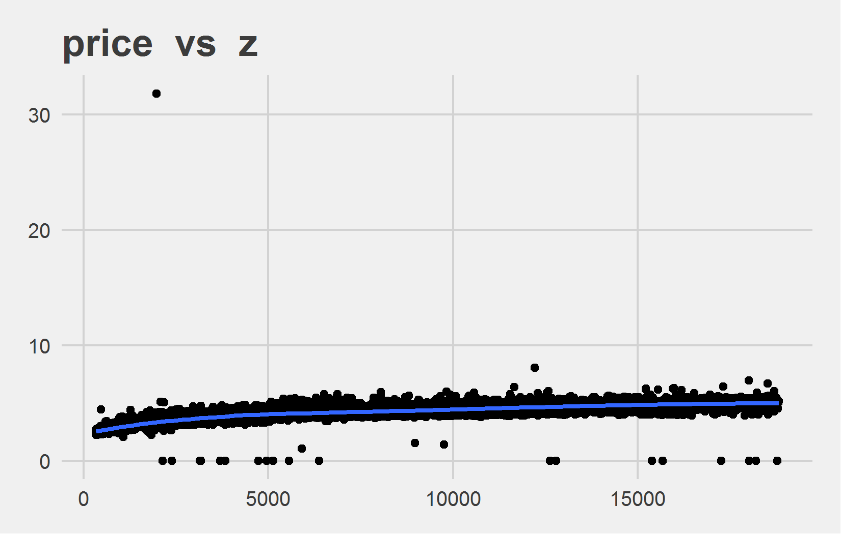
Bi-variate analysis Slide 5 of 5
Feature | Correlation with Target
z | 0.861

