Slide 1
Exploratory Analysis Report

Slide 2
Univariate Analysis

Slide 3
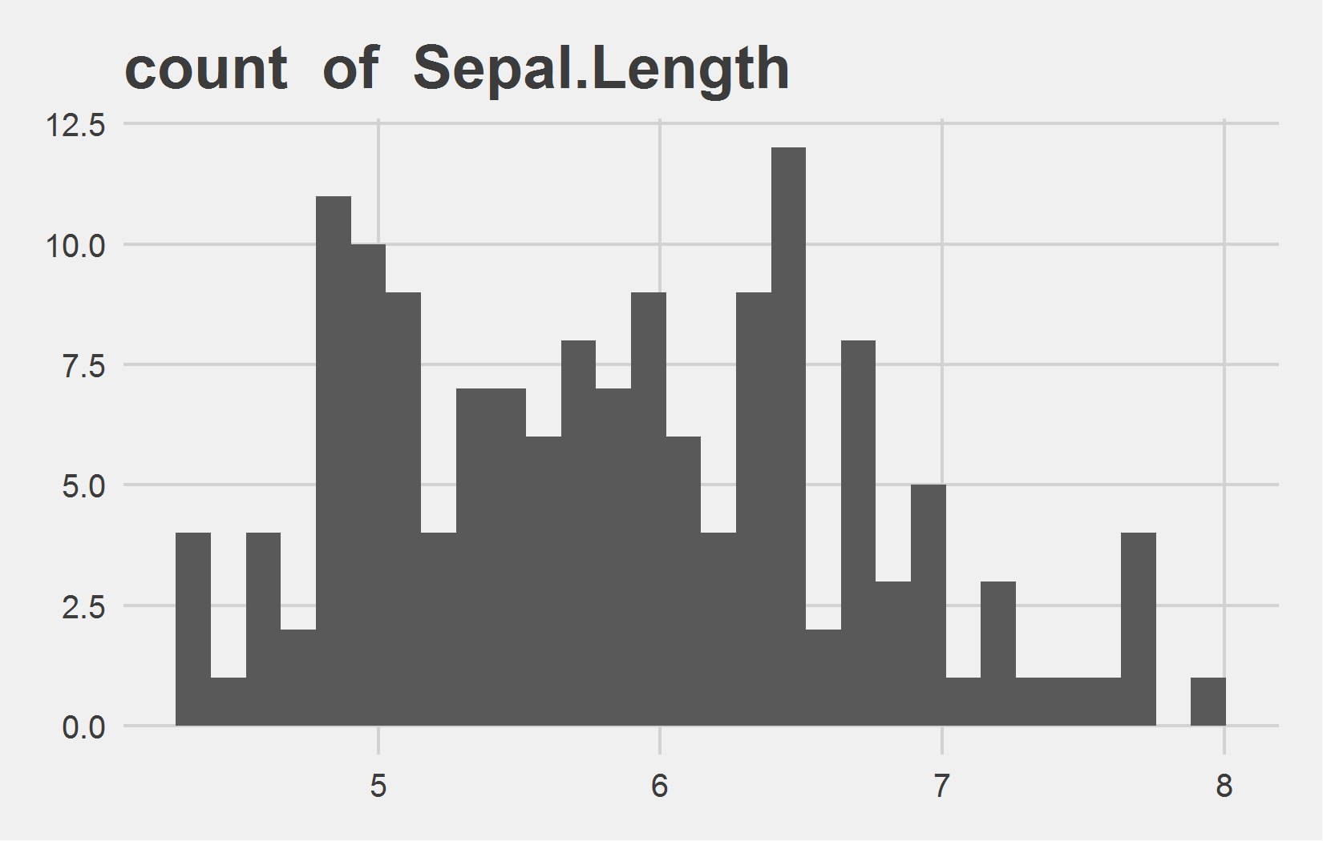
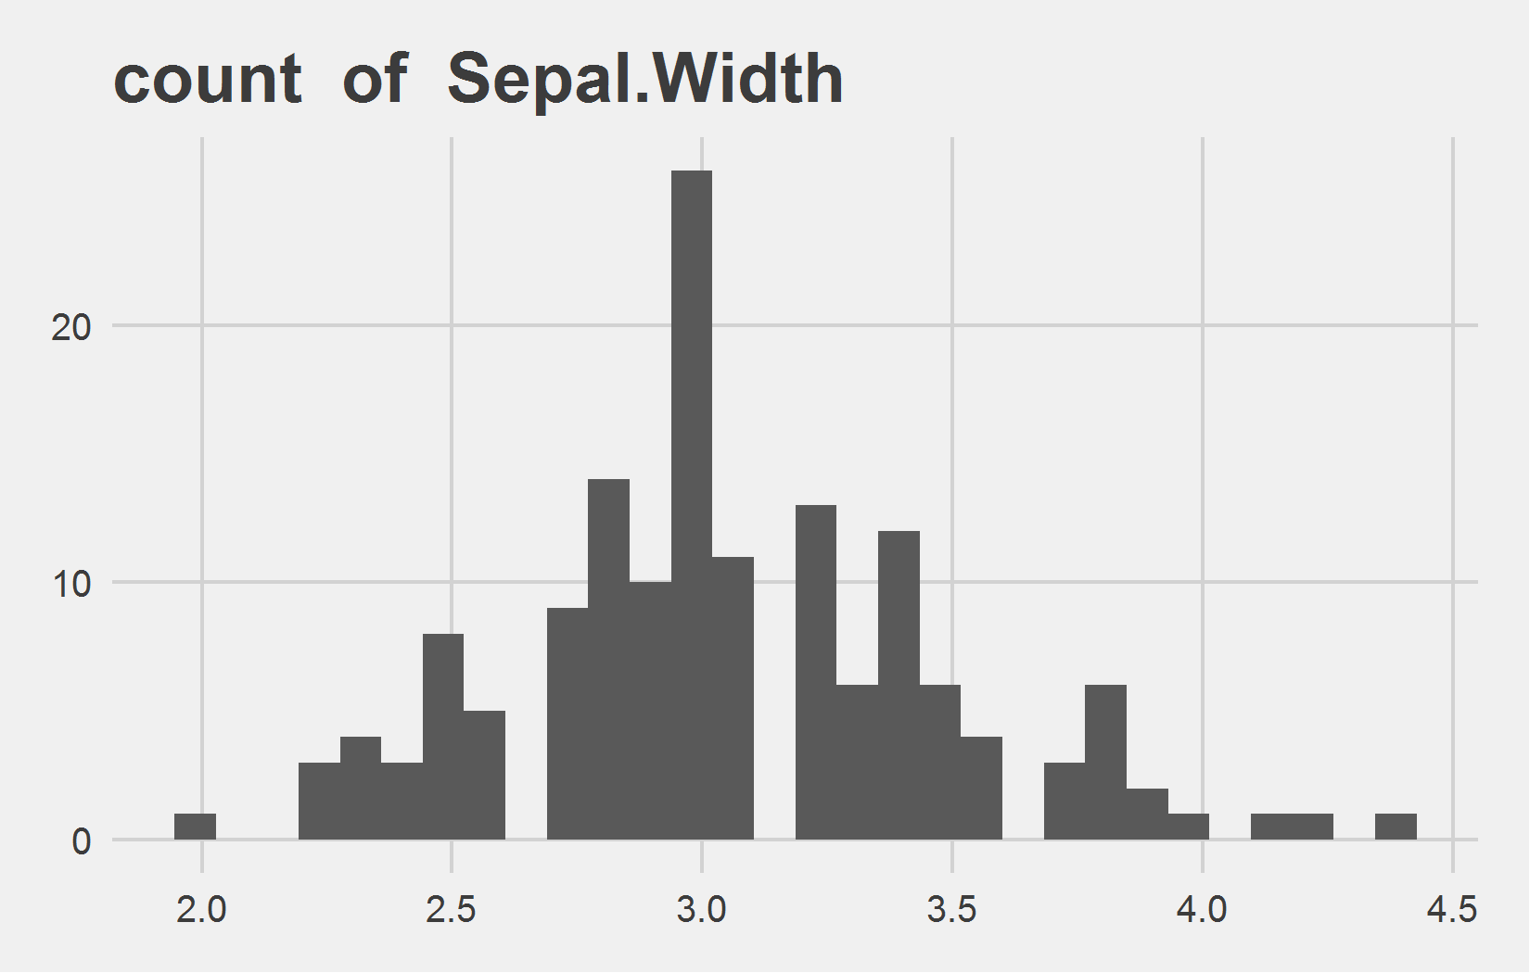
Univariate Analysis Slide 1 of 2
min | 25th | 50th | 75th | max
4.3 | 5.1 | 5.8 | 6.4 | 7.9
min | 25th | 50th | 75th | max
2 | 2.8 | 3 | 3.3 | 4.4

Slide 4
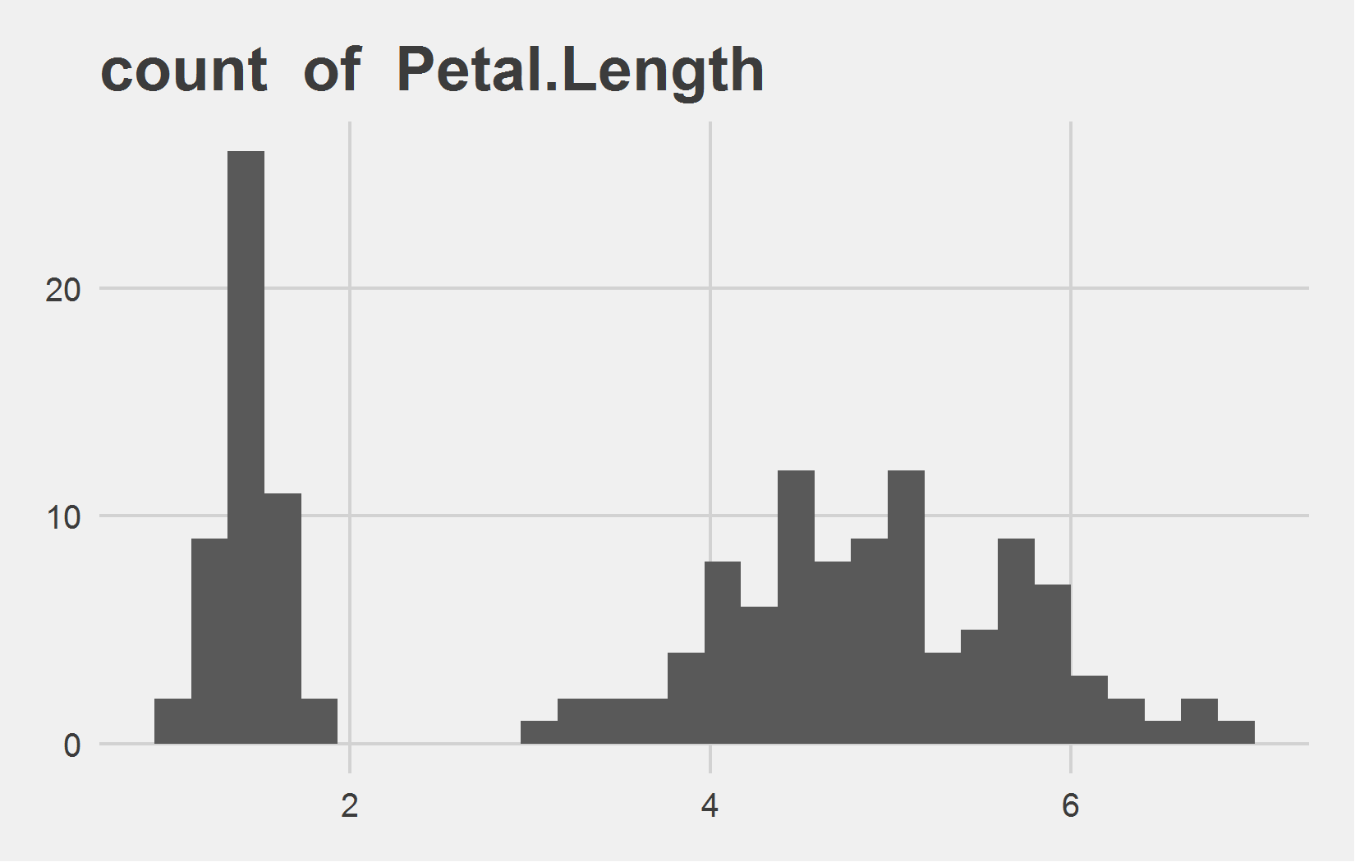
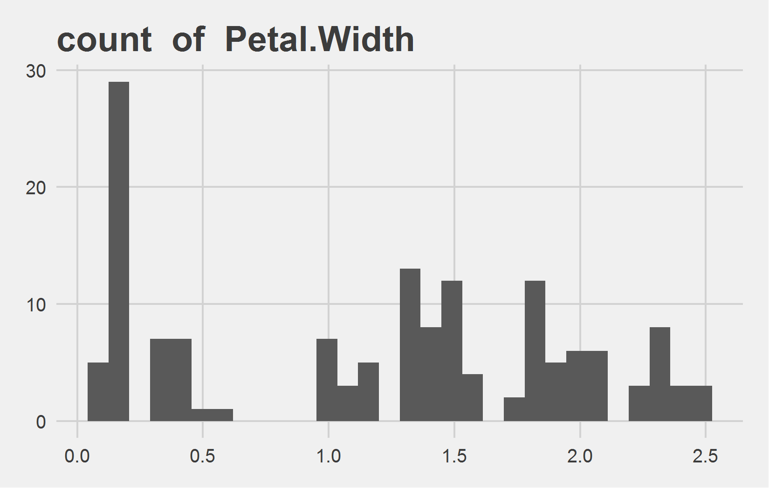
Univariate Analysis Slide 2 of 2
min | 25th | 50th | 75th | max
1 | 1.6 | 4.35 | 5.1 | 6.9
min | 25th | 50th | 75th | max
0.1 | 0.3 | 1.3 | 1.8 | 2.5

Slide 5
Bi-variate analysis

Slide 6
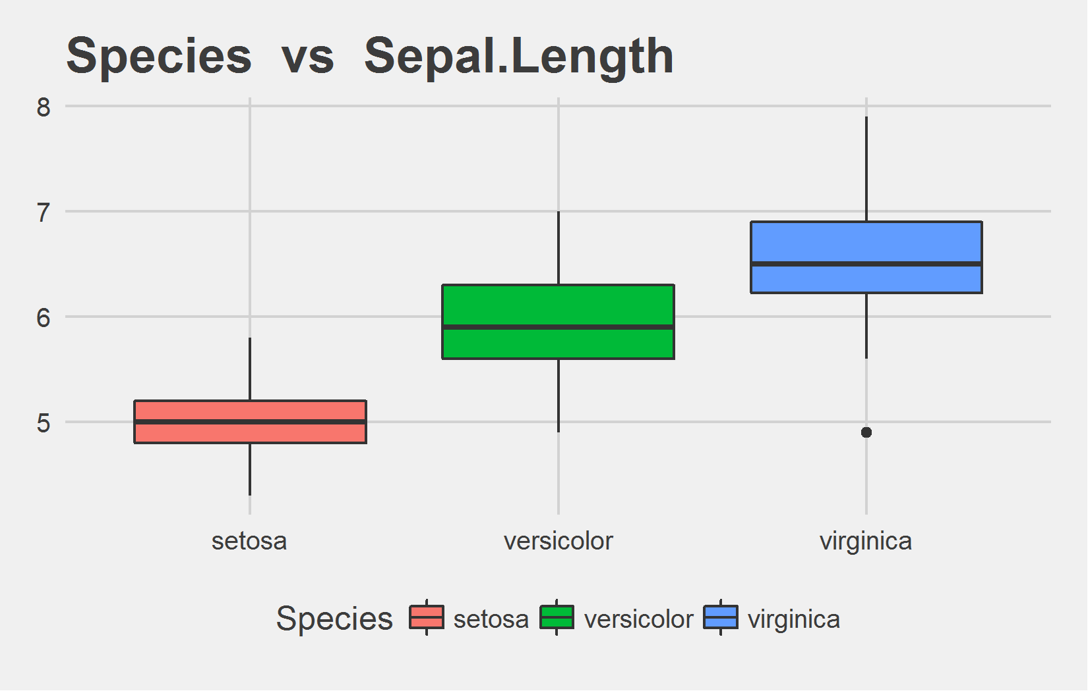
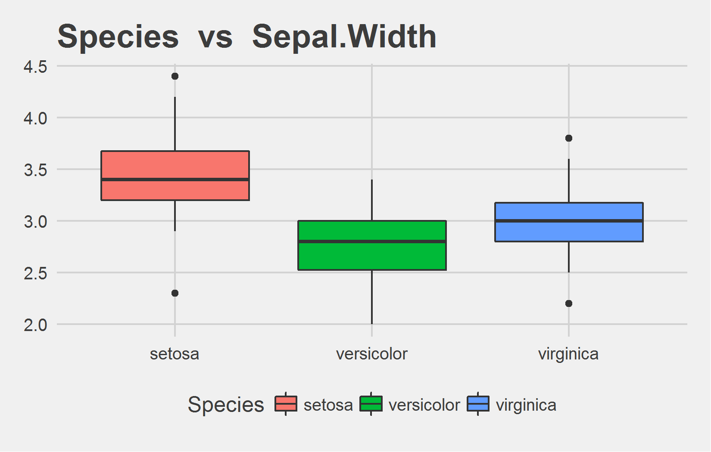
Bi-variate analysis Slide 1 of 2
Species | mean - Sepal.Length | median - Sepal.Length
setosa | 5.01 | 5.0
versicolor | 5.94 | 5.9
virginica | 6.59 | 6.5
Species | mean - Sepal.Width | median - Sepal.Width
setosa | 3.43 | 3.4
versicolor | 2.77 | 2.8
virginica | 2.97 | 3.0

Slide 7
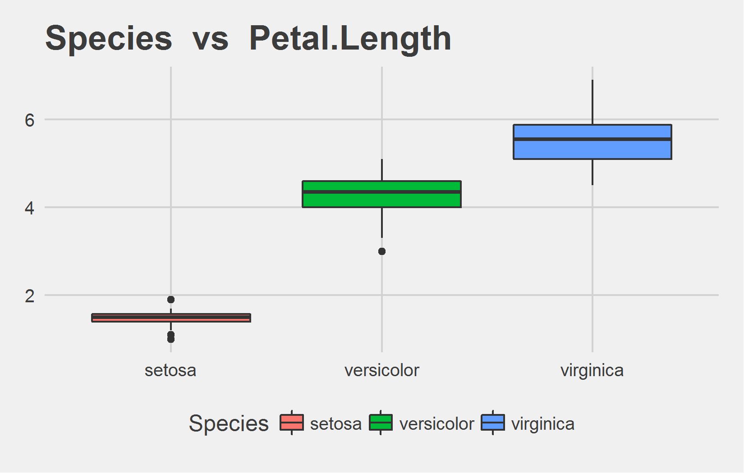
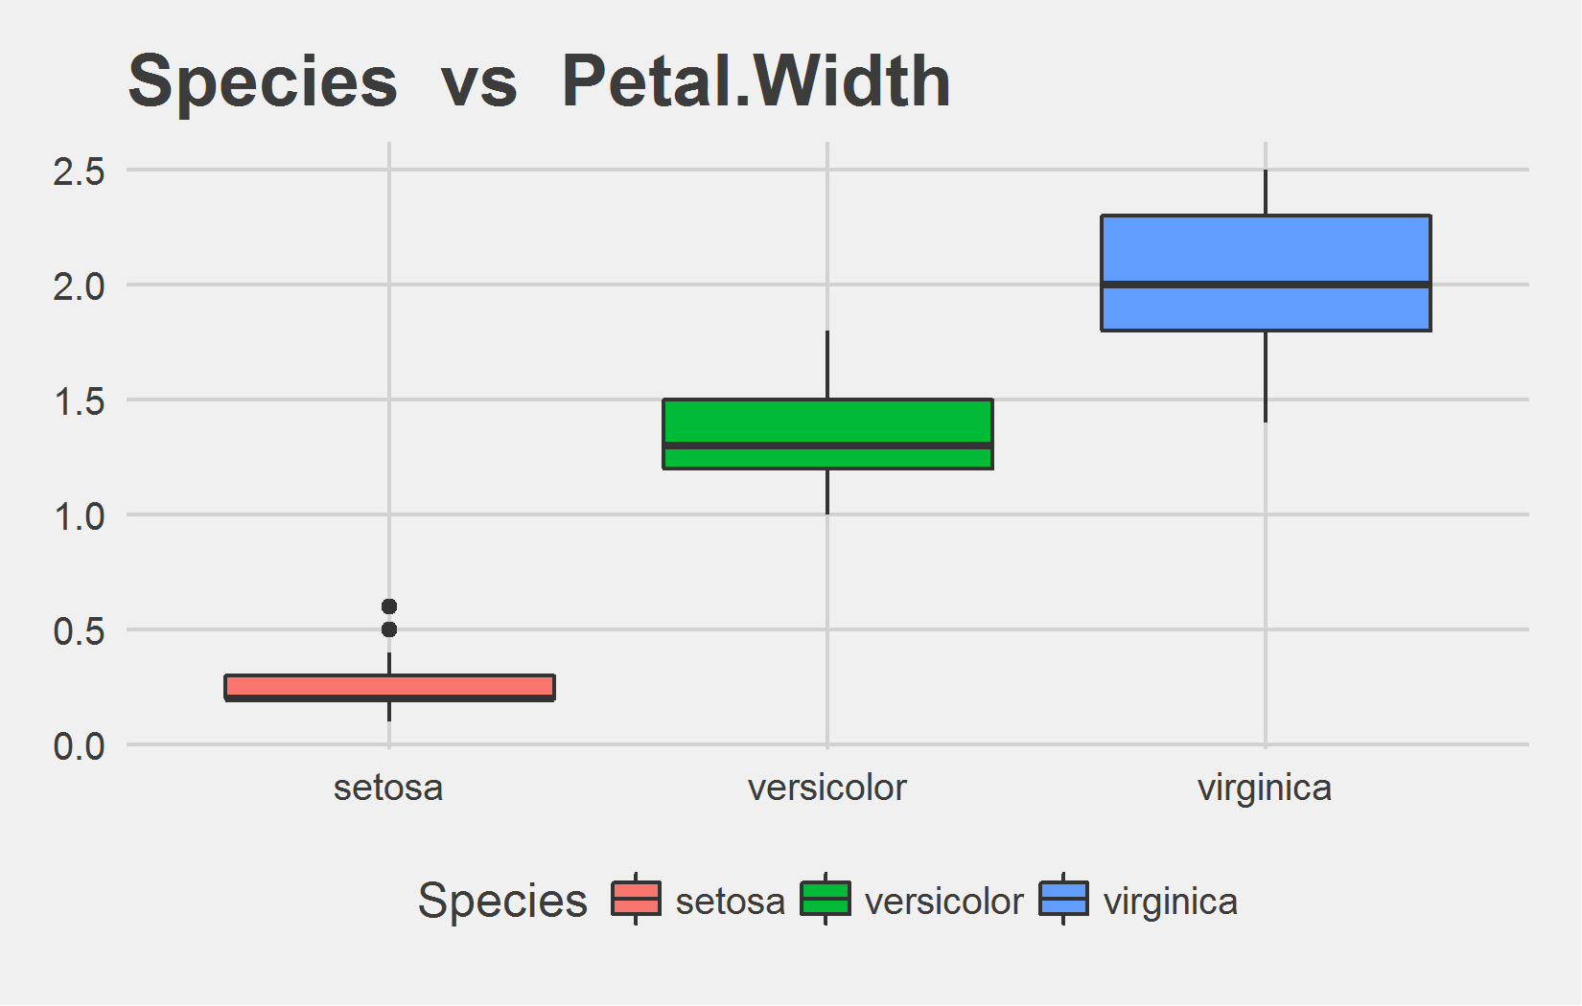
Bi-variate analysis Slide 2 of 2
Species | mean - Petal.Length | median - Petal.Length
setosa | 1.46 | 1.50
versicolor | 4.26 | 4.35
virginica | 5.55 | 5.55
Species | mean - Petal.Width | median - Petal.Width
setosa | 0.25 | 0.2
versicolor | 1.33 | 1.3
virginica | 2.03 | 2.0

