Slide 1
Exploratory Analysis Report

Slide 2
Univariate Analysis

Slide 3
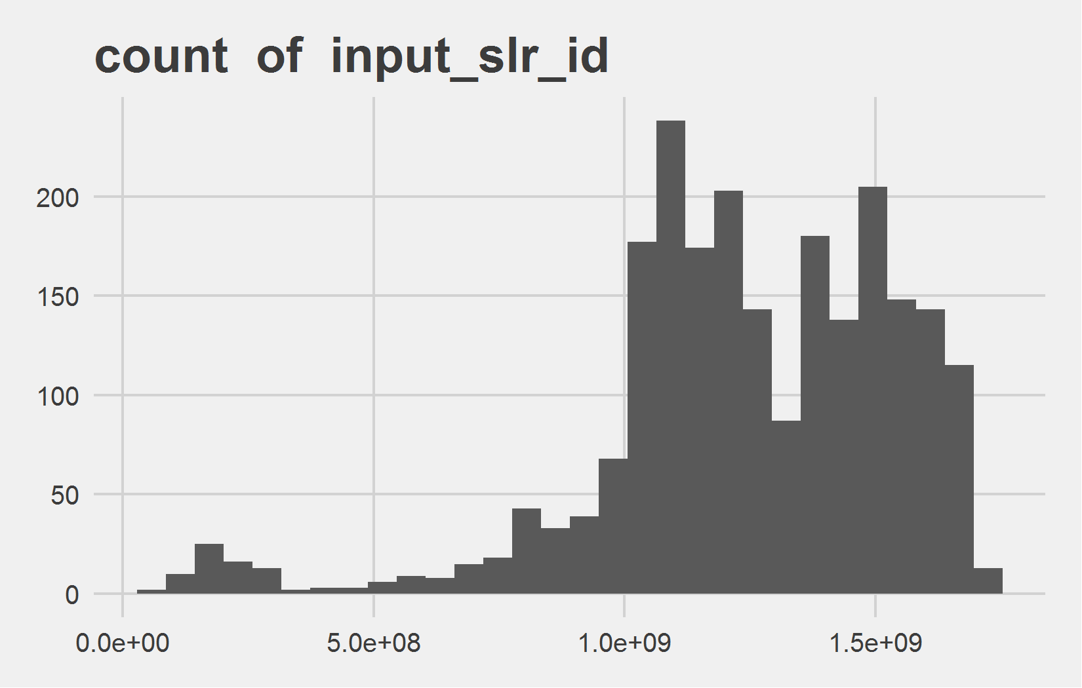
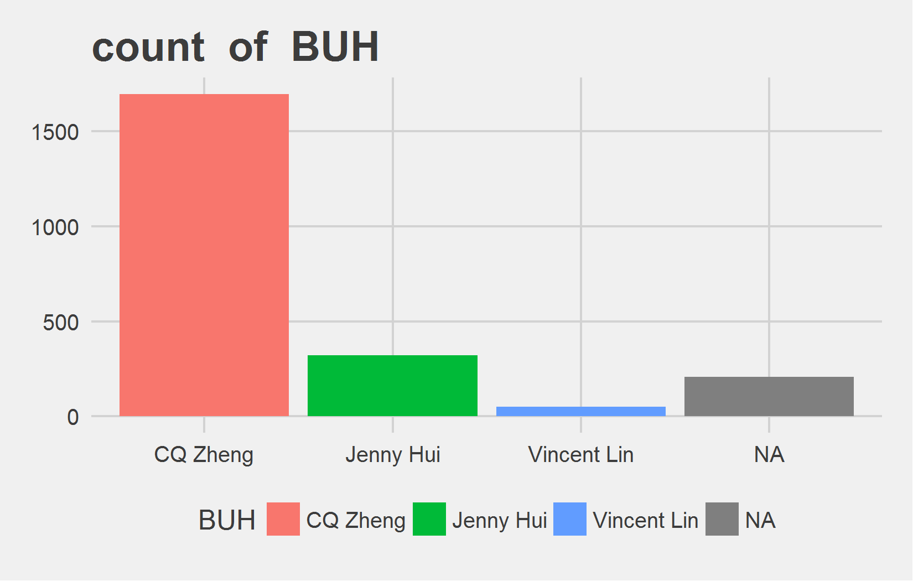
Univariate Analysis Slide 1 of 1
min | 25th | 50th | 75th | max
47771302 | 1090190482 | 1248602132 | 1476850612 | 1714569873
Metric | CQ Zheng | Jenny Hui | Vincent Lin
Count | 1697 | 322 | 51
Perct. | 81.98% | 15.56% | 2.46%

Slide 4
Bi-variate analysis

Slide 5
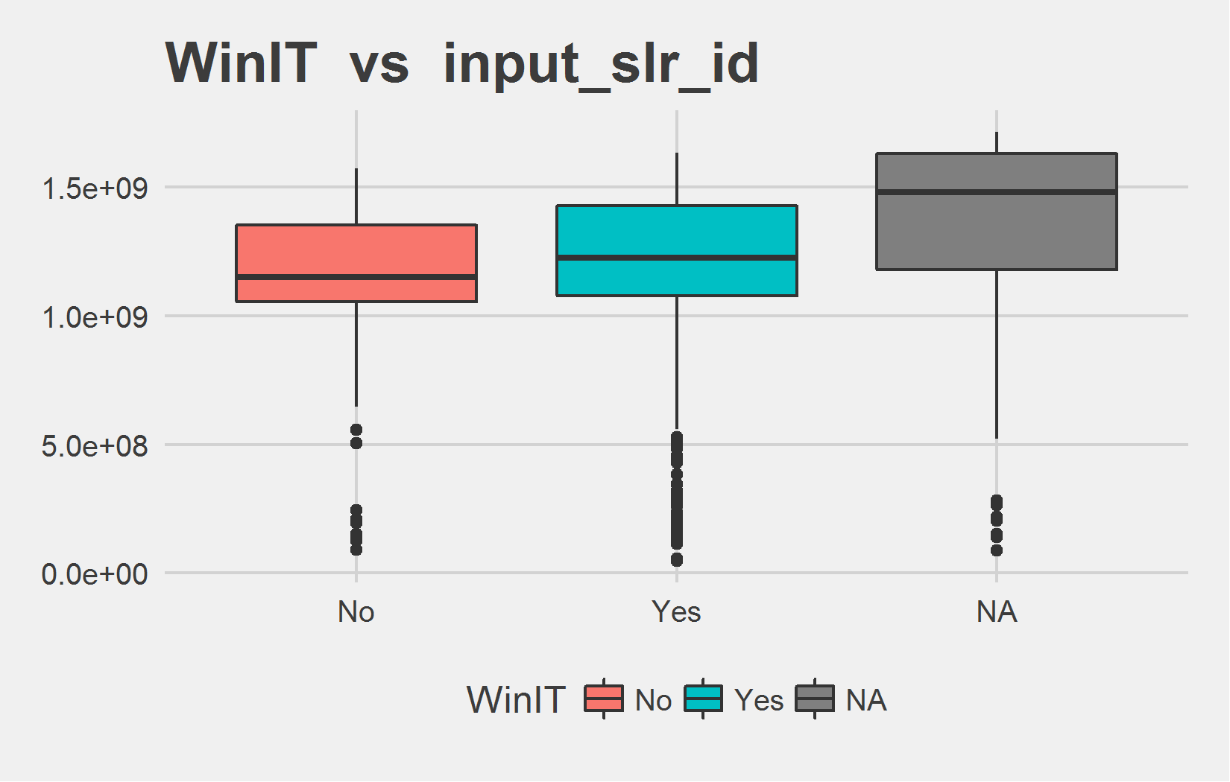
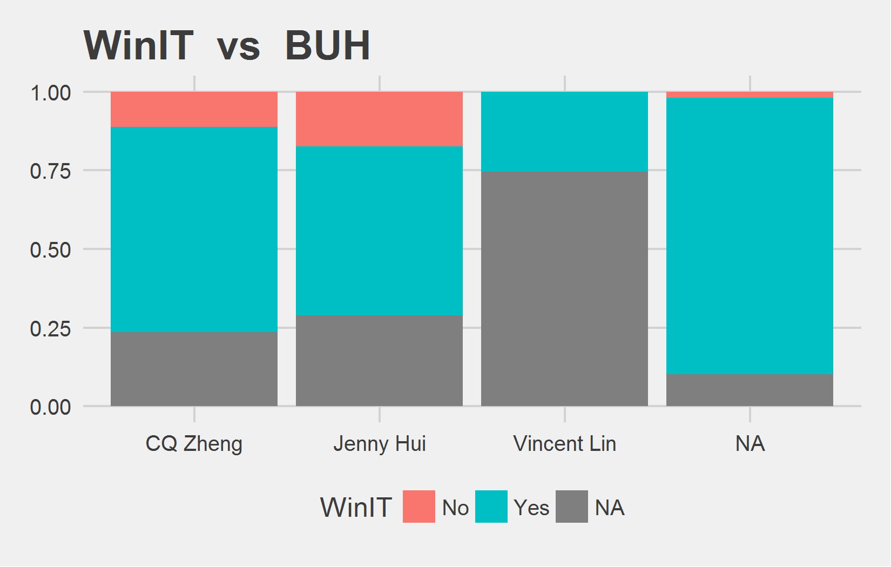
Bi-variate analysis Slide 1 of 1
WinIT | mean - input_slr_id | median - input_slr_id
No | 1141704035 | 1151580852
Yes | 1209172978 | 1225589514
 | 1373763234 | 1479467717
WinIT | CQ Zheng | Jenny Hui | Vincent Lin | <NA> | CQ Zheng | Jenny Hui | Vincent Lin | <NA>
No | 190 | 56 | 0 | 4 | 11.2% | 17.39% | 0% | 1.93%
Yes | 1107 | 173 | 13 | 182 | 65.23% | 53.73% | 25.49% | 87.92%
 | 400 | 93 | 38 | 21 | 23.57% | 28.88% | 74.51% | 10.14%

