Slide 1
DevOps Cloud Computing / Java 12 - 2024
Mag. C. Schäfer
Contact:
office@cgs.at
phone: 0650 9446990

Slide 2
Inhalt
Course Overview
Introduction to DevOps
DevOps Tools
Cloud Computing Basics
AWS Cloud Building Blocks
Microservices Architecture
Containerization with Docker
Infrastructure as Code
Hands-On Activities
Final Assessment

Slide 3
Java DevOps & Cloud Development Overview
DevOps Essentials: Continuous Integration (CI) and Continuous Deployment (CD) processes with tools like Jenkins.
Automation Tools: Practical usage of Ansible for infrastructure and application automation.
Cloud Architecture: Deep dives into IaaS and PaaS models, with a focus on AWS services like EC2, S3, and Kubernetes.
Microservices Development: Best practices for building scalable and resilient applications using frameworks such as Quarkus and Spring Boot.
Containerization and Orchestration: Utilizing Docker and Kubernetes for deployment and scaling.

Slide 4
Cloud Computing - Definition
Cloud computing has revolutionized the way applications are developed, deployed, and scaled. In this module, we introduce cloud computing in the context of Java application development, focusing on its benefits, models, and tools.
What is Cloud Computing?
Cloud computing refers to delivering computing services—servers, storage, databases, networking, software, and analytics—over the Internet ("the cloud"). It enables businesses to scale resources dynamically without managing physical hardware.

Slide 5
Dev-Ops Basics

Slide 6
Introduction to DevOps
Understand Agile and dynamic software development.
Key practices
Continuous Integration (CI) and
Continuous Delivery (CD) are central to modern workflows.

Slide 7
Dev Ops Infinity Loop
Software Test and QS
Testing
Planning
Monitoring
Software Build
Build
Dev
Ops
Operate
Software Development
Code
Release
Deployment

Slide 8
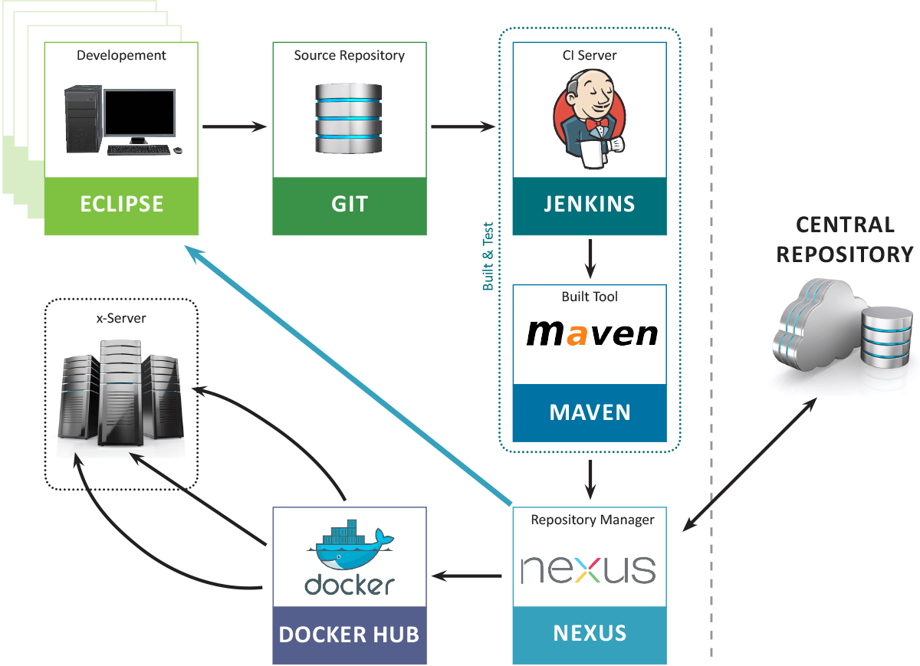
Continous Integration - Basis

Slide 9
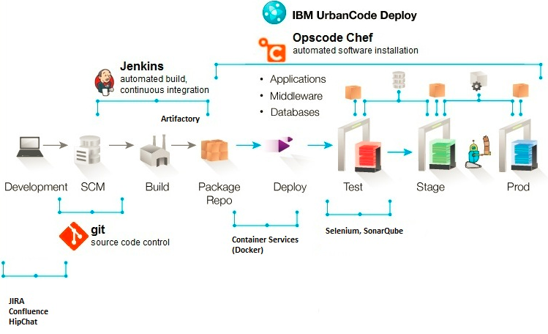
Continuous Integration and Stages
Stages like
Development
Test
Produktion
Help to support CI/CD
Can have various different stacks.

Slide 10
Apache Jenkins - Workflow and Build Management
Continuous Integration and Stages

Slide 11
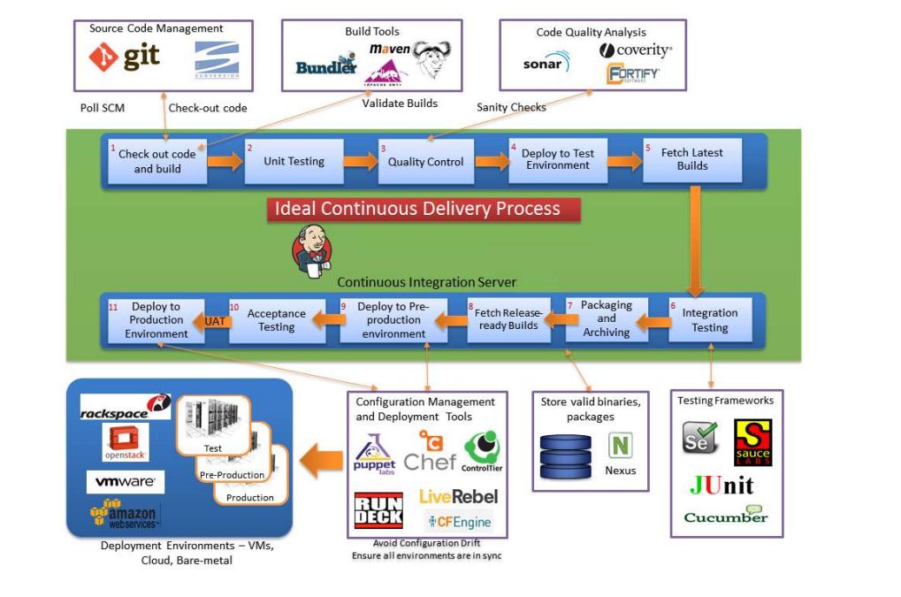
Apache Jenkins - Workflow and Build Management

Slide 12
Cloud Computing - Basics

Slide 13
Cloud Computing - Basics
Infrastructure as a Service (IaaS):
Offers fundamental computing resources such as virtual machines and storage.
Popular platforms include Amazon EC2, Microsoft Azure, and Google Compute Engine.
Platform as a Service (PaaS):
Provides a development platform, including tools and frameworks.
Examples include AWS Elastic Beanstalk and Google App Engine.
Software as a Service (SaaS):
Provides a Software Service as a Cloud Service like Billing, or Banking

Slide 14
Java in the Cloud
Java's platform independence makes it an ideal candidate for cloud environments.
With frameworks like Spring Boot and Quarkus, developers can build microservices optimized for cloud deployment.
Additionally, tools like Docker simplify containerizing Java applications, while Kubernetes ensures efficient orchestration and scaling.

Slide 15
AWS (Amazon Web Services):
Comprehensive services like Amazon EC2, S3, and Lambda for cloud-native Java applications.
Google Cloud Platform:
Tools for AI integration and seamless Kubernetes deployment.
Microsoft Azure:
Robust enterprise-level PaaS for Java.

Slide 16
AWS Web-Service Building Blocks

Slide 17
AWS Cloud Building Blocks

Slide 18
Introduction to Amazon Web Services (AWS) VPC
Amazon Web Services (AWS) Virtual Private Cloud (VPC) allows you to build a secure and isolated virtual network in the cloud. It is the foundational building block for deploying AWS services, ensuring control over your network configuration, traffic, and security.
With AWS VPC, you can:
Define your IP address range.
Create subnets for resource isolation.
Configure route tables, gateways, and firewalls for secure connectivity.
Scale resources in a controlled, private environment.

Slide 19
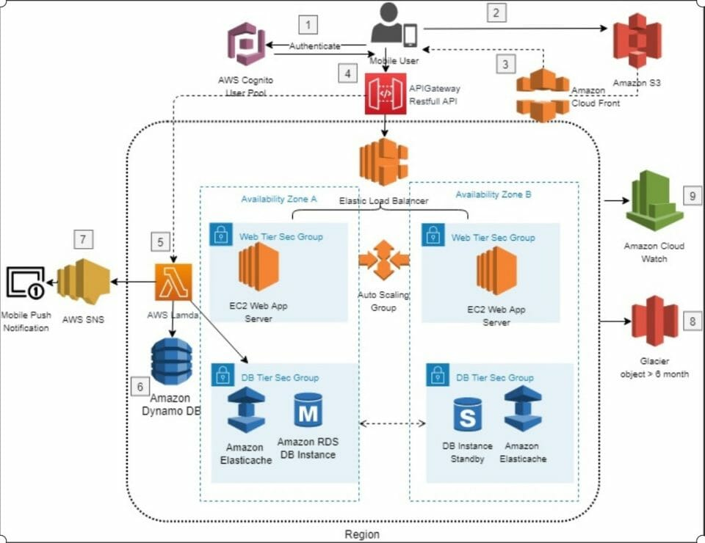
Amazon – Cloud Architecture

Slide 20
Chapter: AWS VPC Building Blocks
Virtual Private Cloud (VPC)
A logically isolated network in AWS.
You define the IP address range using CIDR blocks (e.g., 10.0.0.0/16).
Acts as the foundation for deploying subnets and configuring network components.
2. Subnets
Subdivisions of the VPC's IP range.
Public Subnets:
Accessible from the internet; used for web servers.
Private Subnets:
Isolated from the internet;
used for application and database servers.

Slide 21
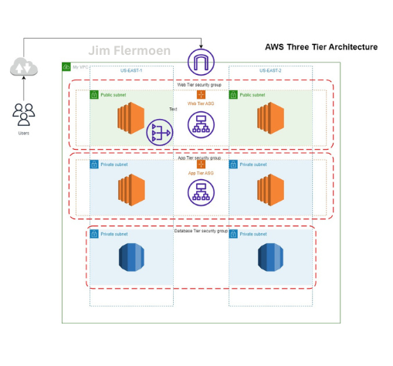
Example: 3 Tier Architecture
A 3-tier architecture example illustrates how to organize a network with separate layers for web, application, and database services, leveraging VPC building blocks for enhanced security and scalability.

Slide 22

Example 3 Tier Network
Web layer
in a public subnet (10.0.1.0/24)
App layers
in private subnet: 10.0.2.0/24
Database layer
private subnet: 10.0.3.0/24
Web Layer: Public Subnet (10.0.1.0/24)
Allows HTTP/HTTPS traffic
Connected to Internet Gateway
Application Layer: Private Subnet (10.0.2.0/24) Allows traffic only from Web Layer
Database Layer: Private Subnet (10.0.3.0/24) Restricts access to Application Layer only

Slide 23
Web Layer:
Deployed in a public subnet (10.0.1.0/24) with an internet gateway.
Security group allows HTTP/HTTPS traffic.
Application Layer:
Deployed in a private subnet (10.0.2.0/24).
Security group permits traffic only from the web layer's private subnet.
Database Layer:
Deployed in a private subnet (10.0.3.0/24).
Security group restricts access to the application layer only.
This setup ensures:
Web servers are accessible to users while app and database layers remain secure.
Clear segregation of concerns with isolated resources for each layer.
Enhanced scalability and security by leveraging VPC components.

Slide 24
Infrastructure as a Code

Slide 25
Infrastructure as Code
Automate provisioning and deployment using
AWS API Client
Terraform
Ansible
Simplify the management of cloud resources

Slide 26
Microservice Architecture

Slide 27
Microservices Architecture – TAG 3
Understand concepts and frameworks for cloud-native microservices
Quarkus.
Spring Boot
Vert.x
Helidon

Slide 28
Containerization with Docker – TAG 4
Learn to create Docker images.
Deploy applications using Kubernetes and AWS Fargate.

Slide 29
Danke für ihre Aufmerksamkeit

Slide 30
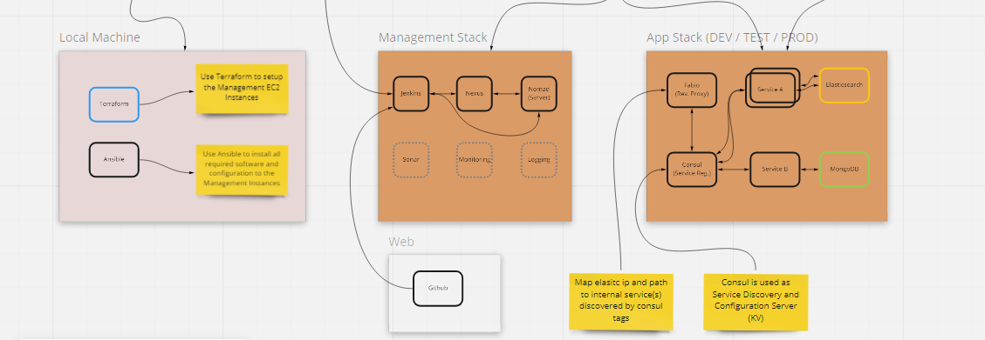
Build vs Product Cloud

