Slide 1


AWS Services
Java Dev-Ops Cloud Training
V.1.0.5 11 - 2024

Slide 2
AWS – Create Postgres DB
Create new Database
Choose Region First
Use Standard Create DB
User Postgres 13.x
Use Dev/Test Template
User pass: postgres / start123!
Enable public IP Adress and access
Open security Group to public access

Slide 3
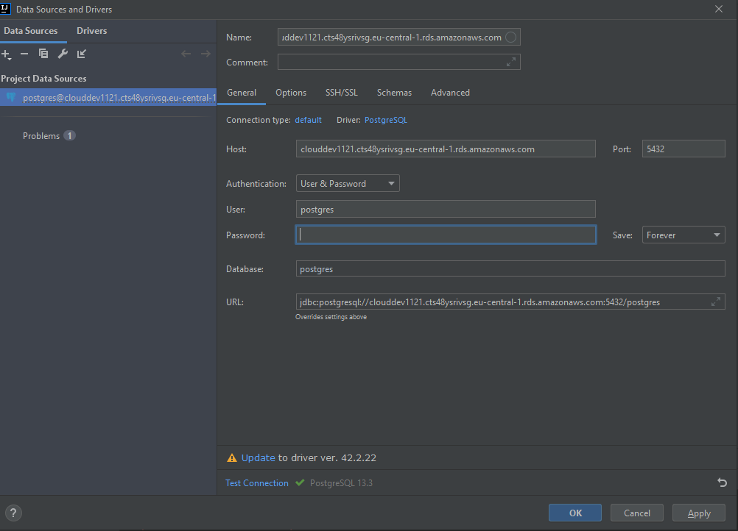
Postgres DB Connect from Intellij
Use Public DNS Record from DB
Username and password
Postgres / start123!

Slide 4
Create DB schema and users
CREATE ROLE sc_rw NOSUPERUSER INHERIT NOCREATEDB NOCREATEROLE NOREPLICATION; -------------------------------------------------- -- SUPERUSER CREATE ROLE sc_admin LOGIN INHERIT NOCREATEDB NOCREATEROLE NOREPLICATION; GRANT sc_rw TO sc_admin; -------------------------------------------------- CREATE ROLE sc_user LOGIN NOSUPERUSER INHERIT NOCREATEDB NOCREATEROLE NOREPLICATION; GRANT sc_rw TO sc_user; -------------------------------------------------- CREATE ROLE sc_ro NOSUPERUSER INHERIT NOCREATEDB NOCREATEROLE NOREPLICATION; -------------------------------------------------- ALTER USER "sc_admin" WITH PASSWORD 'sc_admin'; ALTER USER "sc_user" WITH PASSWORD 'sc_user'; ------------------------------------------------- CREATE DATABASE simplechat WITH OWNER = postgres ENCODING = 'UTF8' CONNECTION LIMIT = -1; GRANT CONNECT, TEMPORARY ON DATABASE simplechat TO public;
GRANT ALL ON DATABASE simplechat TO postgres; GRANT CONNECT ON DATABASE simplechat TO sc_user; GRANT CONNECT ON DATABASE simplechat TO sc_admin;

Slide 5
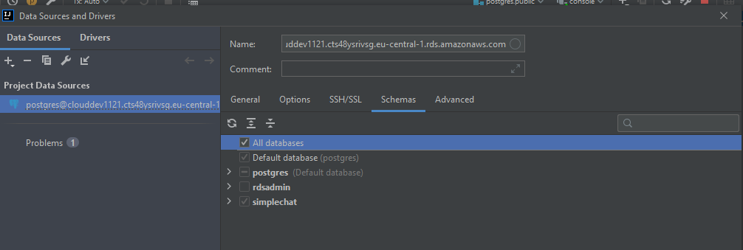
IntelliJ – Configure Schema Visiblity

Slide 6
Danke für Ihre Aufmerksamkeit

