Slide 1
Git and Github Grundlagen
Java Dev-Ops Cloud Training
11 - 2021

Slide 2
Inhalt

Slide 3
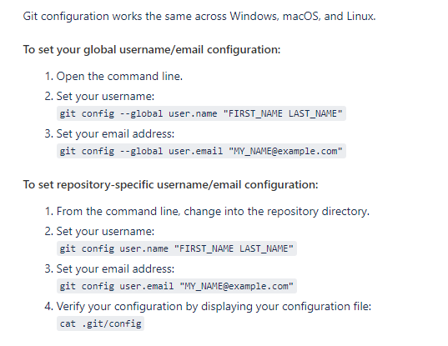
Git client config
git config --global user.name
git config --global user.email

Slide 4
Git import project
Create the remote repository, and get the URL such as git@github.com:/youruser/somename.git or https://github.com/youruser/somename.git
Locally, at the root directory of your source, git init
Locally, add and commit what you want in your initial repo (for everything, git add . then git commit -m 'initial commit comment’)
to attach your remote repo with the name 'origin' (like cloning would do) git remote add origin [URL From Step 1]
Execute git pull origin master to pull the remote branch so that they are in sync.
to push up your master branch (change master to something else for a different branch):
git push origin master

Slide 5
Danke für Ihre Aufmerksamkeit

