Slide 1
Ansible Allgemeine Grundlagen
Java Dev-Ops Cloud Training
11 - 2021

Slide 2
Inhalt
What is Ansible
Why using Ansible
Why Ansible
Ansible – Basic Concept & Architecture
Ansible Use Cases
Ansible Architecture
Ansible Inventory
Ansible Inventory Example
Ansible Playbooks
Ansible Playbook Example
Ansible Variables
Ansible Modules
Ansible Roles
Ansible Configuration Management
Ansible Ad-Hoc Commands

Slide 3
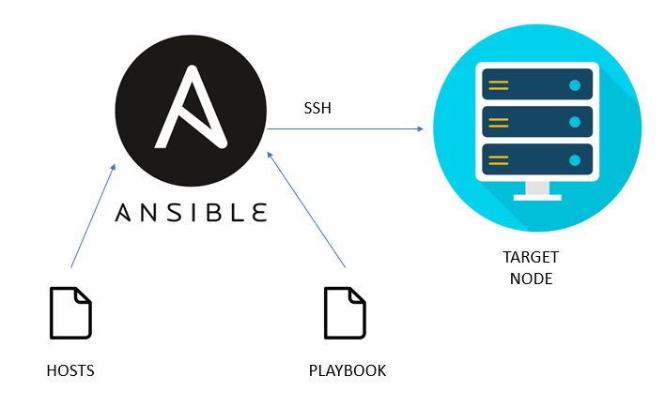
Ansible – Basic Concept & Architecture
Inventory / hosts
Playbook scripts
Ansible server
Managed target nodes

Slide 4
What is Ansible
Ansible is an open-source configuration management and provisioning tool, similar to Chef, Puppet or Salt.
It uses SSH to connect to servers and run the configured Tasks. Ansible lets you control and configure nodes from a single machine.
That makes it different from other management software is that Ansible uses SSH infrastructure. The project was foundedin 2013 and bought by Red Hat in 2015.

Slide 5
Why using Ansible
No Masters
No Agents on manages Instances
Uses ssh to maintain machine instances
Configuration in Yaml
Easy to learn

Slide 6
Why Ansible
No Agent - As long as the box can be ssh’d into and it has python,
it can be configured with Ansible.
Idempotent- Ansible’s whole architecture is structured around the
concept of idempotency. The core idea here is that you only do
things if they are needed and that things are repeatable without
side effects.
Declarative Not Procedural - Other configuration tools tend to be
procedural do this and then do that and so on. Ansible works by
you writing a description of the state of the machine that you want
and then it takes steps to fulfill that description.
Tiny Learning Curve- Ansible is quite easy to learn. It doesn’t
require any extra knowledge.

Slide 7
Ansible Use Cases
Provisioning
Configuration Management
App Deployment
Continuous Delivery
Security & Compliance
Orchestration

Slide 8
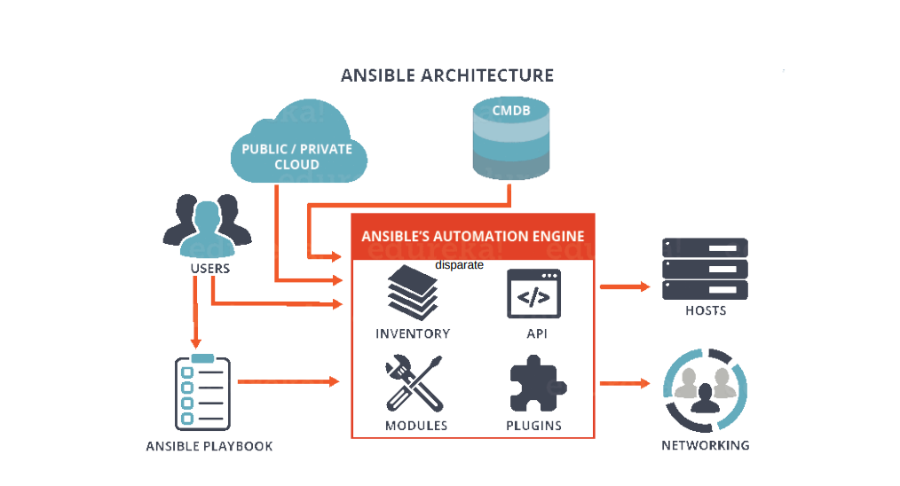
Ansible Architecture

Slide 9
Ansible Inventory
The Inventory is a description of the nodes that can be accessed
by Ansible. By default, the Inventory is described by a
configuration file, whose default location is in./etc/ansible/hosts
The configuration file lists either the IP address or hostname of
each node that is accessible by Ansible.
Every host is assigned to a group such as web servers, db
servers etc.
The inventory file can be in one of many formats
such as yaml, INI etc

Slide 10
Ansible Inventory Example
# Ex 1: Ungrouped hosts, specify before any group headers:
## green.example.com
## blue.example.com
## 192.168.100.1
## 192.168.100.10
# Ex 2: A collection of hosts belonging to the 'webservers' group:
## [webservers]
## alpha.example.org
## beta.example.org
## 192.168.1.100
## 192.168.1.110
# If you have multiple hosts following a pattern, you can specify
# them like this:
## www[001:006].example.com

Slide 11
Ansible Playbooks
Playbooks are simple YAML files.
These files are descriptions of the desired state of your systems. Ansible then does the hard work of getting your systems to that state no matter what state they are currently in.
Playbooks make your installations, upgrades and day-to-day management repeatable and reliable.
Playbooks are simple to write and maintain. Playbooks are written in a natural language so they are very easy to evolve and edit.
Playbook contains Plays.
Plays contain tasks.
tasks call modules.

Slide 12
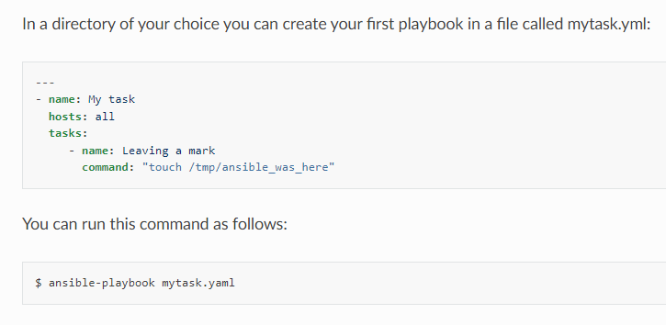
Ansible Playbook Example

Slide 13
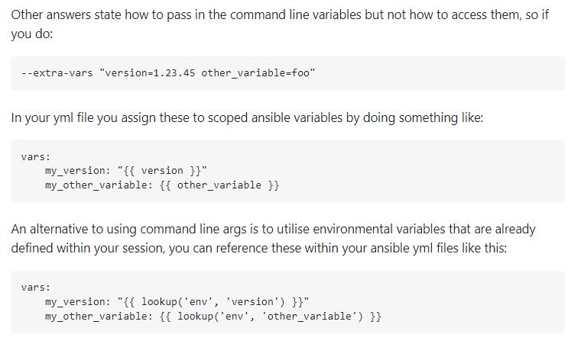
Ansible Variables
See: https://stackoverflow.com/questions/30662069/how-can-i-pass-variable-to-ansible-playbook-in-the-command-line

Slide 14
Ansible Modules
There are over 1000 modules provided by Ansible to automate every part of the environment.
Modules are like plugins that do the actual work in Ansible, they are what gets executed in each playbook task.
Each module is mostly standalone and can be written in a standard scripting language (such as Python, Perl, Ruby, Bash,etc.).
One of the guiding properties of modules is idempotency,
which means that even if an operation is repeated multiple times, it will always place the system into the same state.

Slide 15
Ansible Roles
Roles are a way to group tasks together into one container. We
could have a role for setting up MySQL, another one for configuring iptables etc.
Roles makes it easy to configure hosts. Any role can be performed on any host or group of hosts such as:
- hosts: all roles: - role_1
- role_2

Slide 16
Ansible Configuration Management
Ansible is the simplest solution for configuring the nodes. It’s designed to be minimal in nature, consistent, secure and highly reliable. Any developer, tester or IT manager can easily configure nodes. Any IT person can write playbooks easily.
Ansible configurations are simple data descriptions of your infrastructure (human readable) ensuring everyone on your team will be able to understand the meaning of each configuration task.
Ansible requires nothing more than a password or SSH key in order to start managing systems and can start managing them without installing any agent software.

Slide 17
Ansible Ad-Hoc Commands
$ ansible all -m ping
$ ansible web-group -m ping
$ ansible all -a "/bin/echo hi"
$ ansible all -a "/sbin/reboot" -f 10
$ ansible all -m yum -a "name=nginx state=installed"
$ ansible all -m user -a "name=joe password=wat"
$ ansible all -m service -a "name=nginx state=started"

Slide 18
Ansible Handlers
Handlers are the same as tasks but:
they execute when called by another task.
the task contains a command called notify which indicates that another task is ready to be executed after the present task executes.

Slide 19
Danke für Ihre Aufmerksamkeit

