Slide 1
Ansible Allgemeine Grundlagen
Java Dev-Ops Cloud Training
11 - 2021

Slide 2
Inhalt
Ansible: Howto run a playbook
AWS Create Instance Playbook
Ec2 create playbook
EC2 : Instance Information
EC2 : Instance Creation – Key and Sec Grup
EC2 : Instance Creation – Provision Instance

Slide 3
Ansible: Howto run a playbook
Call ansible-playboo with playbook and ask-vault-pass
ansible-playbook ec2_inst_create.yml --ask-vault-pass --tags create_ec2
Use extra variable for instance name:
ansible-playbook ec2_inst_create.yml --ask-vault-pass --tags create_ec2 --extra-vars "my_inst_name=devops_app_001„

Slide 4
AWS Create Instance Playbook
See Example Playbook: ec2_inst_create.yml
Playbook does
Define varables for region, key and ami
Uses ec2 instance info to gather ec2 instance info
Upload the new public key to AWS
Create security group for new instance
Create Instance: Provision instance(s)

Slide 5
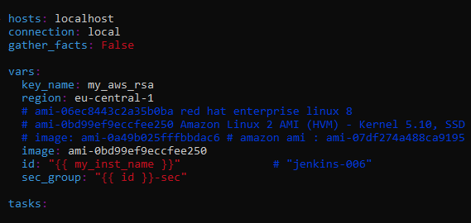
Ec2 create playbook
Define key
Define region
Define AMI Image
Define id
And security group

Slide 6
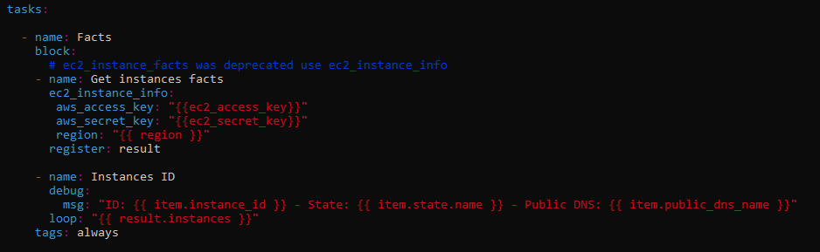
EC2 : Instance Information
Gather infos about all instances in this region
Run alway -> using tag

Slide 7
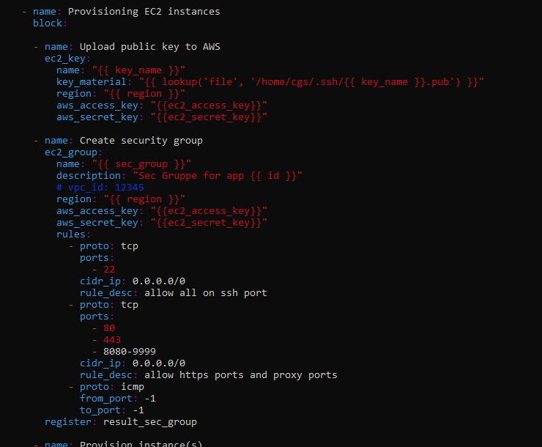
EC2 : Instance Creation – Key and Sec Grup
Upload key
Create Security-Group
With Port and ping access

Slide 8
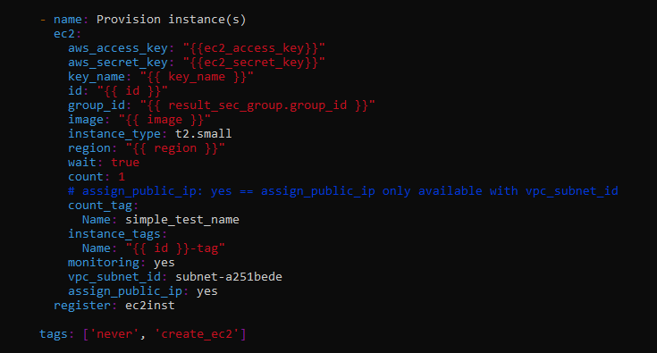
EC2 : Instance Creation – Provision Instance

Slide 9
Danke für Ihre Aufmerksamkeit

