Slide 1
Ansible Development
Java Dev-Ops Cloud Training
11 - 2021

Slide 2
Inhalt

Slide 3
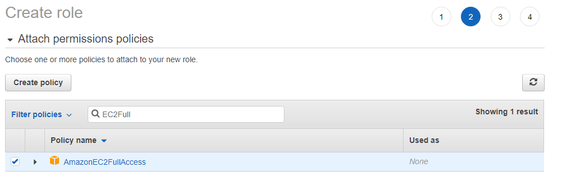
AWS Jenkins Server
IAM Services → Roles -> Create a new Role
Role permissions AmazonEC2FullAccess
Role Name Jenkins-ec2-role

Slide 4
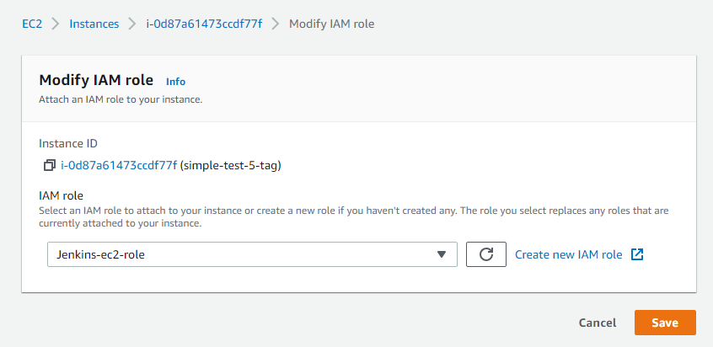
Jenkins Assign IAM Role to Jenkins
Go to Jenkins AWS EC2 Instance
Go to Security -> Modify IAM Role
Add newly created role to EC2

Slide 5
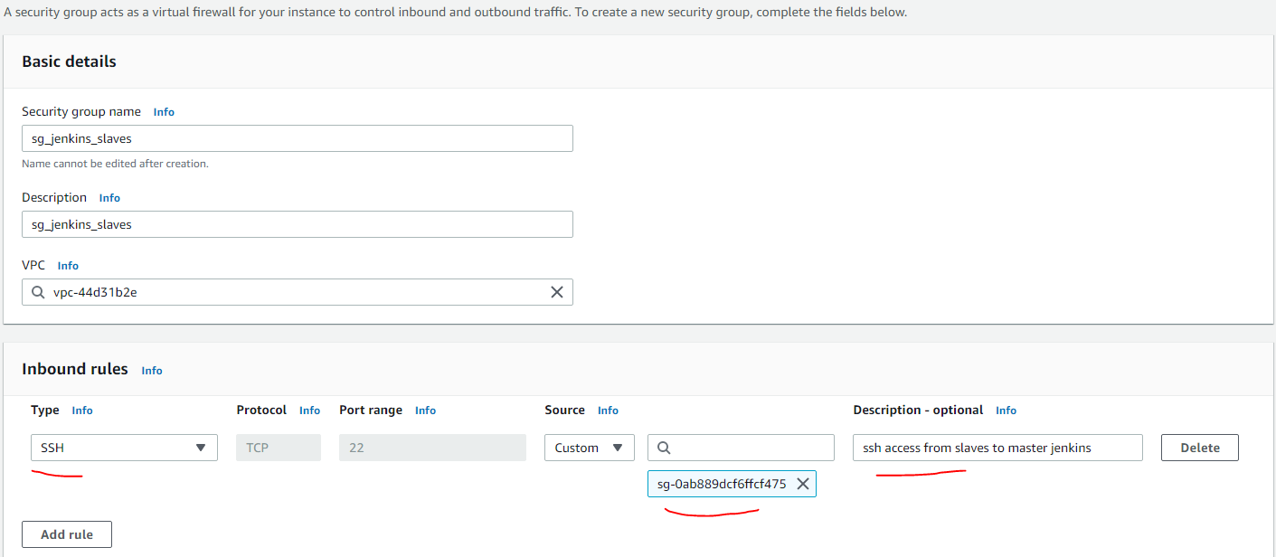
Create Securty Groups for EC2 Slave Instances
Create Security group and inbound rules to ssh to master jenkins

Slide 6
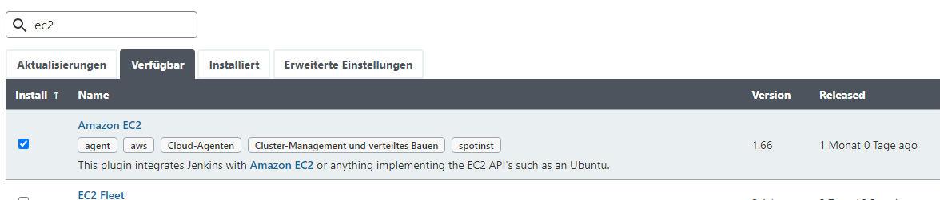
Amazon EC2 Jenkins Plugin
Install the Amazon EC2 Plugin

Slide 7
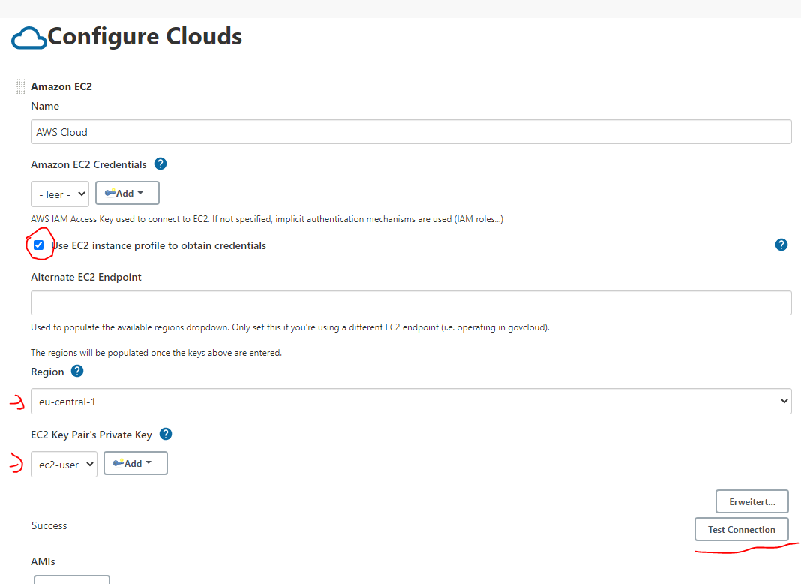
Configure AWS EC2
Use EC2 Instance Profile for credentals
eu-cental-1
Private key as text with user

Slide 8
Configure EC2 Ami
Use same AMI as jenkins master
sg_jenkins_slaves as secuity group

Slide 9
AWS Console
EC2 Service

Slide 10
Danke für Ihre Aufmerksamkeit

