Slide 1
Ansible Development
Java Dev-Ops Cloud Training
11 - 2021

Slide 2
Inhalt
Install new ansible tomcat profile
Ansible EC2 - Basis Instanz erzeugen
Create tomcat host group in hosts
Update install tomcat ansible script
Provision tomcat server on new maschine

Slide 3
Install new ansible tomcat profile
Tomcat als extra Ansible package
https://galaxy.ansible.com/zaxos/tomcat-ansible-role
ansible-galaxy install zaxos.tomcat-ansible-role

Slide 4
Ansible EC2 - Basis Instanz erzeugen
ansible-playbook ec2_inst_create.yml --ask-vault-pass --tags create_ec2 --extra-vars "my_inst_name=devops_tomcat_<NAME>„
Check server is running and get DNS/IP

Slide 5
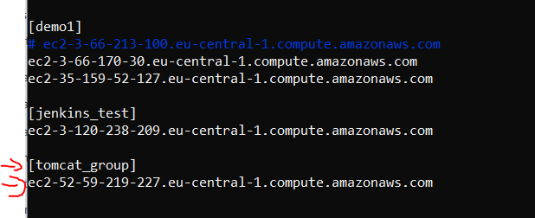
Create tomcat host group in hosts
create a NEW hosts group for the tomcat servers in /etc/ansible/hosts
And add the new server to the group
the public dns name to the group

Slide 6
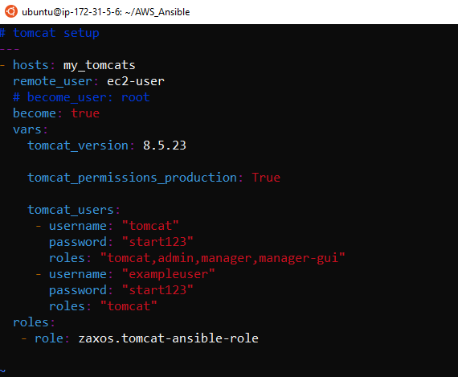
Update install tomcat ansible script
Specify host group for tomcats to my_tomcats
Specify user, passwort and tomcat names, and passwords
Use zaxos tomcat ansible role

Slide 7
Provision tomcat server on new maschine
ansible-playbook install_tomcat.yml --ask-vault-pass

Slide 8
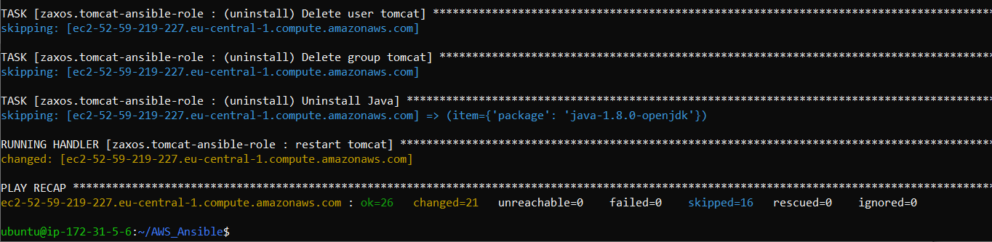
Verify ansible tomcat script output
Verify Ansible Script
Open new Tomcat Console on PORT 8080
For example
http://ec2-52-59-219-227.eu-central-1.compute.amazonaws.com:8080/

Slide 9
Danke für Ihre Aufmerksamkeit

