Slide 1
Microservice Basics/Grundlagen
Java Dev-Ops Cloud Training
11 - 2021

Slide 2
Inhalt

Slide 3
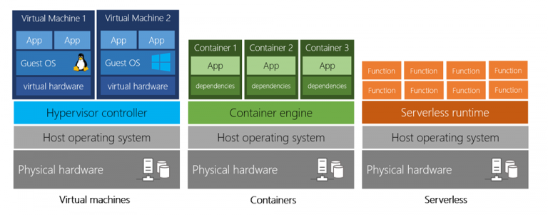
Cloud Computing - Stacks

Slide 4
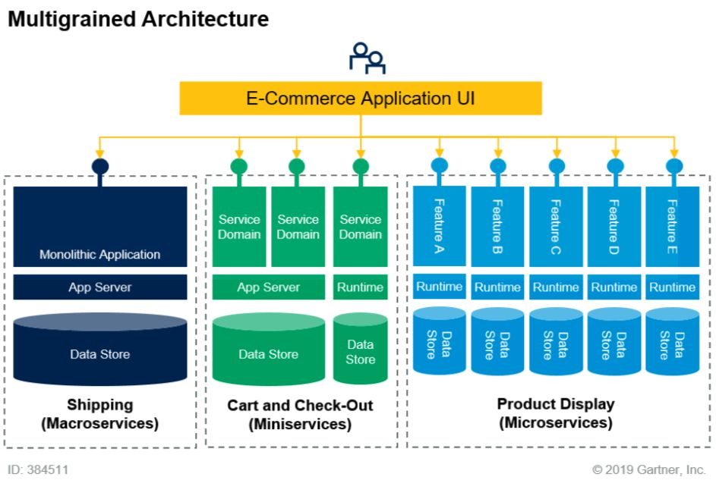
From Monolitic to Micro-Services

Slide 5
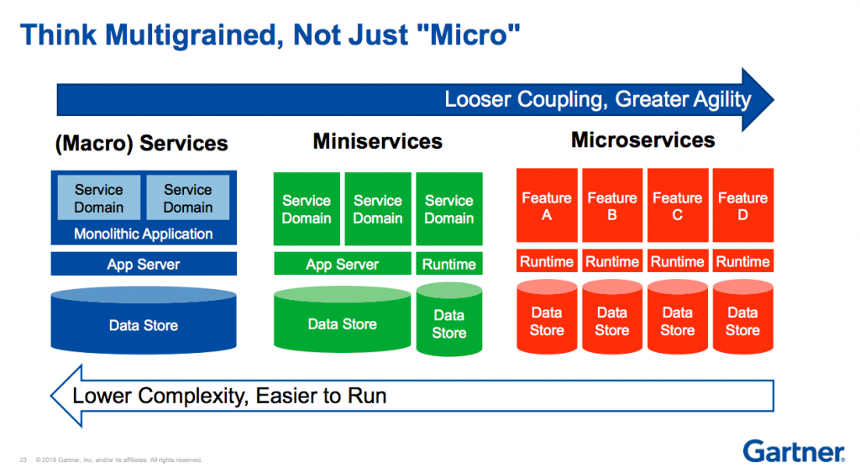
Runtime vs Development Time Complexity

Slide 6
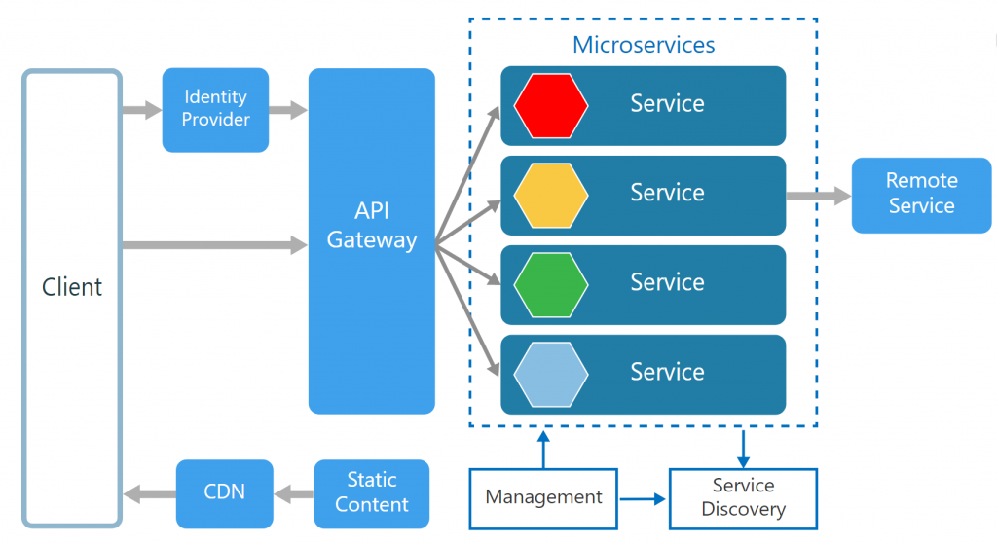
Micro-Service Software Architecture

Slide 7
Danke für Ihre Aufmerksamkeit

