Slide 1
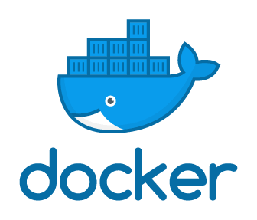
Docker Grundlagen
Java Dev-Ops Cloud Training
11 - 2021

Slide 2
Inhalt
Docker Concepts
Warum Docker ?
Docker - Concept
Docker Architecture
Docker Engine
Docker - Client
Docker Registries
Docker Objects
Docker - Volumes
Docker Networks
Docker Installation
Docker Platform Workflow (Build Images)
Docker CLI – Basic Commands

Slide 3
Docker Concepts

Slide 4
Warum Docker ?
Isolation
• Lightweight
• Simplicity
• Workflow
• Community

Slide 5
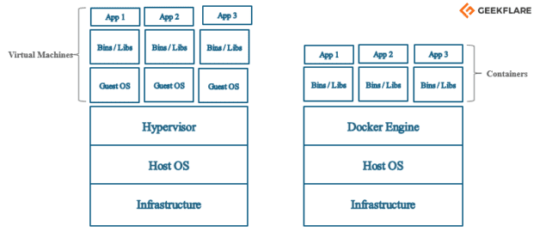
Docker - Concept
previously, we used to create virtual machines, and each VM had an OS which took a lot of space and made it heavy.
Using Docker, you have a single OS, and the resources are shared between the containers. (more lightweight)

Slide 6
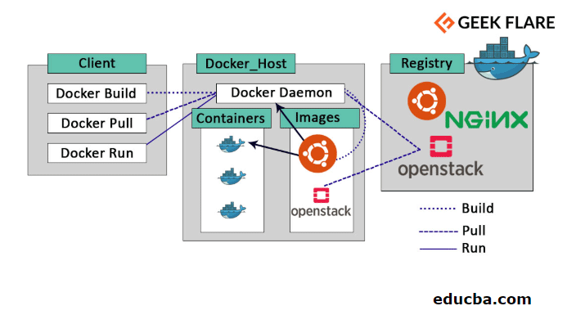
Docker Architecture
Client to manage
Docker-Host-s to run
Registry to mangage docker images

Slide 7
Docker Engine
Is the core part of Docker
Docker Engine is an application which follows client-server architecture. It is installed on the host machine.
There are three components in the Docker Engine:
Server: It is the docker daemon called dockerd. It can create and manage docker images. Containers, networks, etc.
Rest API: It is used to instruct docker daemon what to do.
Command Line Interface (CLI): It is a client which is used to enter docker commands.

Slide 8
Docker - Client
Docker users can interact with Docker through a client.
When any docker commands runs, the client sends them to dockerd daemon, which carries them out.
Docker API is used by Docker commands.
Docker client can communicate with more than one daemon.

Slide 9
Docker Registries
It is the location where the Docker images are stored. It can be a public docker registry or a private docker registry.
Docker Hub is the default place of docker images, its stores’ public registry.
You can also create and run your own private registry
When you execute docker pull or docker run commands, the required docker image is pulled from the configured registry.
When you execute docker push command, the docker image is stored on the configured registry.

Slide 10
Docker Objects
When you are working with Docker, you use:
Images
Containers
Volumes
Networks
as docker objects

Slide 11
Docker - Image
ein Speicherabbild eines Containers.
Das Image selbst besteht aus mehreren Layern, die schreibgeschützt sind und somit nicht verändert werden können.
Ein Image ist portabel, kann in Repositories gespeichert und
mit anderen Nutzern geteilt werden.
Aus einem Image können immer mehrere Container gestartet werden.

Slide 12
Docker - Container
als Container wird die aktive Instanz eines Images bezeichnet.
Der Container wird also gerade ausgeführt und ist beschäftigt.
Sobald der Container kein Programm ausführt oder mit seinem Auftrag fertig ist, wird der Container automatisch beendet.
A container is an instance of an image.
Each container can be identified by its ID.

Slide 13
Docker - Volumes
The persisting data generated by docker and used by Docker containers are stored in Volumes.
They are completely managed by docker through docker CLI or Docker API.
Volume’s content exists outside the lifecycle of a container, so using volume does not increase the size of a container.
You can use -v or –mount flag to start a container with a volume.
In this sample command, you are using testvolume volume with test container.
docker run -d --name testcontainer -v testvolume:/app nginx:latest

Slide 14
Docker Networks
Docker networking is a passage through which all the isolated container communicate. There are mainly five network drivers in docker:
Bridge: It is the default network driver for a container. You use this network when your application is running on standalone containers, i.e. multiple containers communicating with same docker host.
Host: This driver removes the network isolation between docker containers and docker host. It is used when you don’t need any network isolation between host and container.
Overlay: This network enables swarm services to communicate with each other. It is used when the containers are running on different Docker hosts or when swarm services are formed by multiple applications.
None: This driver disables all the networking.
macvlan: This driver assigns mac address to containers to make them look like physical devices. The traffic is routed between containers through their mac addresses. This network is used when you want the containers to look like a physical device. for example, while migrating a VM setup.

Slide 15
Docker Platform Workflow (Build Images)

Slide 16
Docker CLI – Basic Commands
docker build # Build an image from a Dockerfile
docker images # List all images on a Docker host
docker run # Run an image
docker logs –follow # see logs from running container
docker ps # List all running and stopped instances
docker stop # Stop a running instances
docker rm # Remove an instance
docker rmi # Remove an image

Slide 17
Inhalt
Docker Grundlagen
Docker Concepts
Warum Docker ?
Docker Architecture
Docker Engine
Docker - Client
Docker Registries
Docker Objects
Docker - Volumes
Docker Networks
Docker Installation
Docker Platform Workflow (Build Images)
Docker CLI – Basic Commands

Slide 18
Docker Appendix

Slide 19
Docker – Usefull Introduction Links
WHY I LOVE DOCKER… AND WHY YOU’LL LOVE IT TOO https://blog.docker.com/2015/03/why-i-love-docker-and-why-youll-love-it-too/
DOCKER TUTORIAL 1 – INSTALLING DOCKER https://blog.docker.com/2015/03/docker-tutorial-1-installing-docker/
DOCKER TUTORIAL 2 – DOCKER RUN COMMAND BASICS https://blog.docker.com/2015/03/docker-tutorial-2-docker-run-command-basics/
DOCKER TUTORIAL 3 – FUN WITH VOLUMES https://blog.docker.com/2015/04/docker-tutorial-3-fun-with-volumes/
DOCKER TUTORIAL 4 – MORE RUN WITH A COUPLE OF EXTRA GOODIES https://blog.docker.com/2015/04/docker-tutorial-4-more-run-with-a-couple-of-extra-goodies/
DOCKER TUTORIAL 6 – DOCKERFILE (PART 1) https://blog.docker.com/2015/04/docker-tutorial-6-dockerfile-part-1/
DOCKER TUTORIAL 7 – DOCKERFILE (PART 2) https://blog.docker.com/2015/04/docker-tutorial-7-dockerfile-part-2/

Slide 20
Danke für Ihre Aufmerksamkeit

