Slide 1
CS 478 – Tools for Machine Learning and Data Mining
Backpropagation
Notes:
Fall 2004
CS478 - Machine Learning

Slide 2
The Plague of Linear Separability
The good news is:
  Learn-Perceptron is guaranteed to converge to a correct assignment of weights if such an assignment exists
The bad news is:
  Learn-Perceptron can only learn classes that are linearly separable (i.e., separable by a single hyperplane)
The really bad news is:
  There is a very large number of interesting problems that are not linearly separable (e.g., XOR)
Notes:
Fall 2004
CS478 - Machine Learning

Slide 3
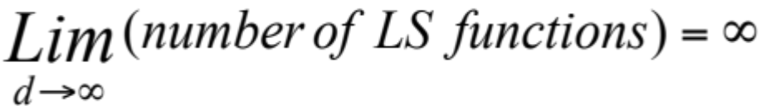
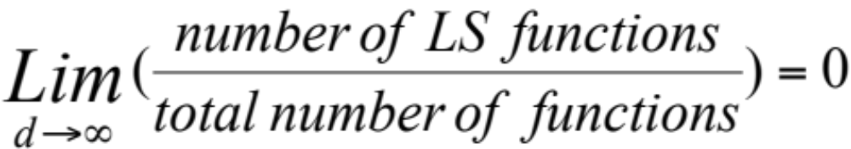
Linear Separability
Let d be the number of inputs
Hence, there are too many functions that escape the algorithm

Slide 4
Historical Perspective
The result on linear separability (Minsky & Papert, 1969) virtually put an end to connectionist research
The solution was obvious: Since multi-layer networks could in principle handle arbitrary problems, one only needed to design a learning algorithm for them
This proved to be a major challenge
AI would have to wait over 15 years for a general purpose NN learning algorithm to be devised by Rumelhart in 1986

Slide 5
Towards a Solution
Main problem:
  Learn-Perceptron implements discrete model of error (i.e., identifies the existence of error and adapts to it)
First thing to do:
  Allow nodes to have real-valued activations (amount of error = difference between computed and target output)
Second thing to do:
  Design learning rule that adjusts weights based on error
Last thing to do:
  Use the learning rule to implement a multi-layer algorithm

Slide 6
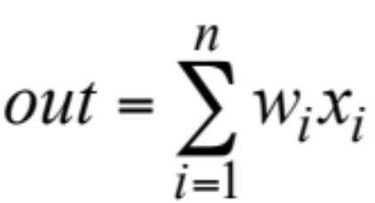

Real-valued Activation
Replace the threshold unit (step function) with a linear unit, where:
Error no longer discrete:
Notes:
No more thresholding.
Fall 2004
CS478 - Machine Learning

Slide 7
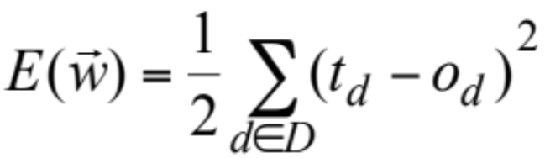
Training Error
We define the training error of a hypothesis, or weight vector, by:
which we will seek to minimize
Notes:
Square and ½ is because we are taking the derivative later.
Fall 2004
CS478 - Machine Learning

Slide 8
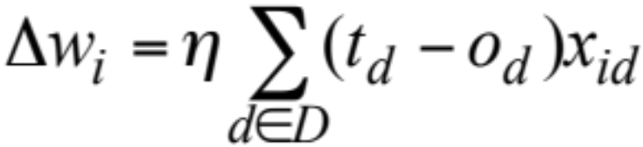
The Delta Rule
Implements gradient descent (i.e., steepest) on the error surface:
Note how the x_{id} multiplicative factor implicitly identifies “active” lines as in Learn-Perceptron

Slide 9
Gradient-descent Learning (b)
Initialize weights to small random values
Repeat
  Initialize each Δwi to 0
  For each training example <x,t>
    Compute output o for x
    For each weight wi
      Δwi ← Δwi + η(t – o)xi
  For each weight wi
    wi ← wi + Δwi
Notes:
B -- Batch
Fall 2004
CS478 - Machine Learning

Slide 10
Gradient-descent Learning (i)
Initialize weights to small random values
Repeat
  For each training example <x,t>
    Compute output o for x
    For each weight wi
      wi ← wi + η(t – o)xi
Notes:
I – Incremental
Change the weight as you go.
Which is better:
I don’t know the jury is out.
Fall 2004
CS478 - Machine Learning

Slide 11
Discussion
Gradient-descent learning (with linear units) requires more than one pass through the training set
The good news is:
  Convergence is guaranteed if the problem is solvable
The bad news is:
  Still produces only linear functions
  Even when used in a multi-layer context
Needs to be further generalized!

Slide 12
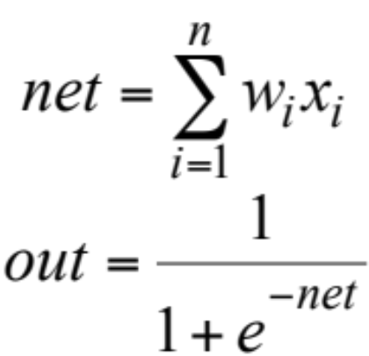
Non-linear Activation
Introduce non-linearity with a sigmoid function:
1. Differentiable (required for gradient-descent)
2. Most unstable in the middle

Slide 13
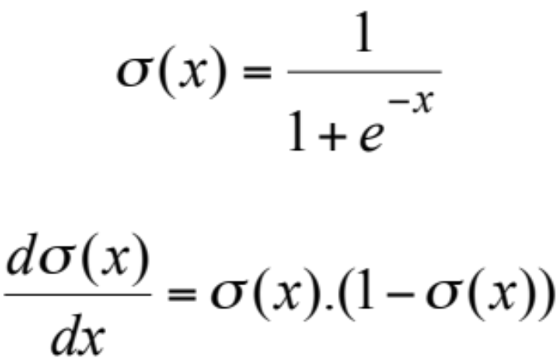
Sigmoid Function
Derivative reaches maximum when output is most unstable. Hence, change will be largest when output is most uncertain.
Notes:
Higher derivate less confident
Low derivate more confident
Fall 2004
CS478 - Machine Learning

Slide 14
Multi-layer Feed-forward NN
i
k
i
k
i
j
k
i
Notes:
Hidden nodes
remove linearity
Nodes not on the input or output
Usually hidden nodes is less than inputs
(#in + #out) / 2.0
Fall 2004
CS478 - Machine Learning

Slide 15
Backpropagation (i)
Repeat
  Present a training instance
  Compute error δk of output units
  For each hidden layer
    Compute error δj using error from next layer
  Update all weights: wij ← wij + Δwij
    where Δwij = ηOiδj
Until (E < CriticalError)

Slide 16
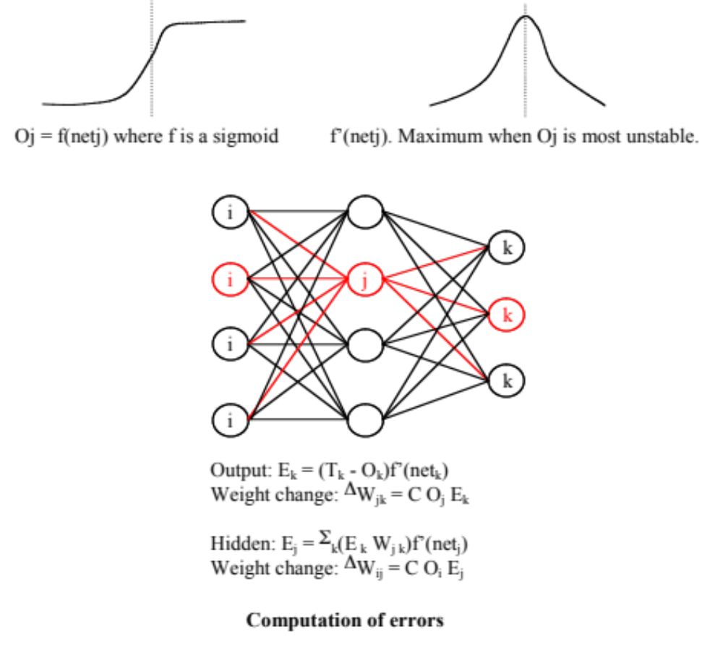
Error Computation
Notes:
F’(net k) = Ok*(1-Ok) – Slide 13
Fall 2004
CS478 - Machine Learning

Slide 17
Example (I)
Consider a simple network composed of:
  3 inputs: a, b, c
  1 hidden node: h
  2 outputs: q, r
Assume η=0.5, all weights are initialized to 0.2 and weight updates are incremental
Consider the training set:
  1 0 1 – 0 1
  0 1 1 – 1 1
4 iterations over the training set

Slide 18
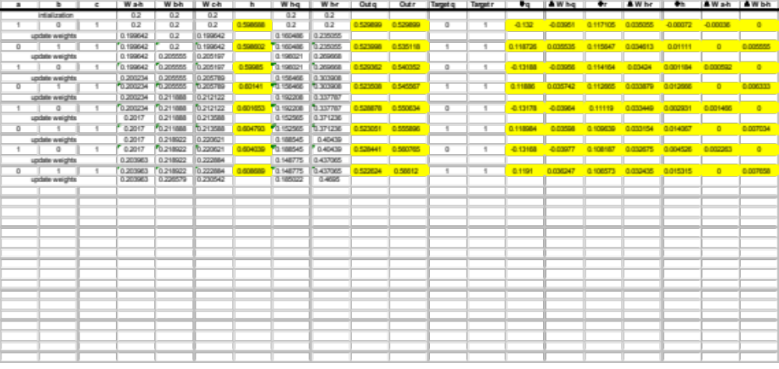
Example (II)

Slide 19

Dealing with Local Minima
No guarantee of convergence to the global minimum
  Use a momentum term:
    Keep moving through small local (global!) minima or along flat regions
  Use the incremental/stochastic version of the algorithm
  Train multiple networks with different starting weights
    Select best on hold-out validation set
    Combine outputs (e.g., weighted average)

Slide 20
Discussion
3-layer backpropagation neural networks are Universal Function Approximators
Backpropagation is the standard
  Extensions have been proposed to automatically set the various parameters (i.e., number of hidden layers, number of nodes per layer, learning rate)
  Dynamic models have been proposed (e.g., ASOCS)
Other neural network models exist: Kohonen maps, Hopfield networks, Boltzmann machines, etc.

