Slide 1
CS 478 – Tools for Machine Learning and Data Mining
Association Rule Mining

Slide 2
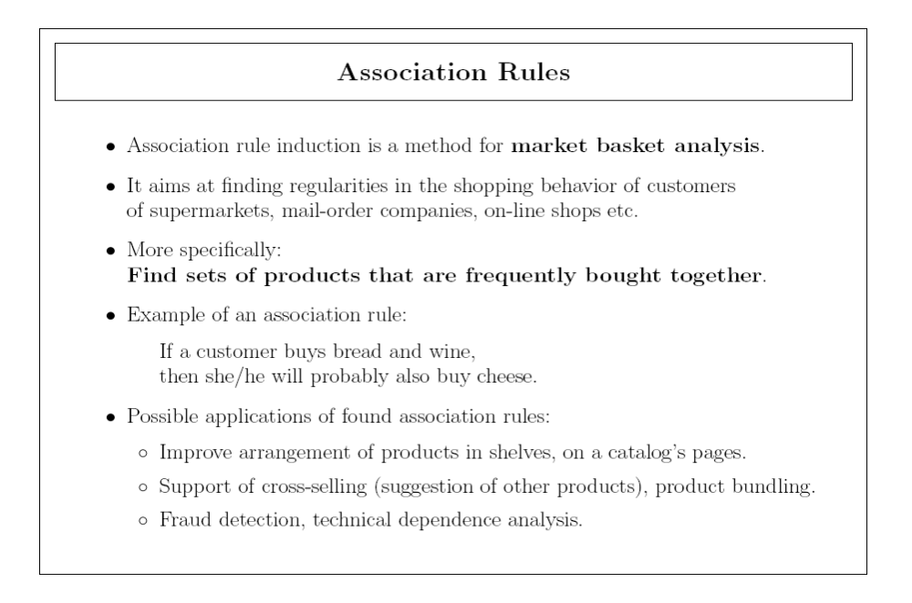

Slide 3
Association Rule Mining
Clearly not limited to market-basket analysis
Associations may be found among any set of attributes
  If a representative votes Yes on issue A and No on issue C, then he/she votes Yes on issue B
  People who read poetry and listen to classical music also go to the theater
May be used in recommender systems
Notes:
One that comes strickly from data minning.

Slide 4
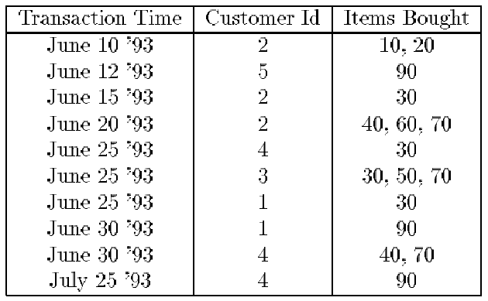
A Market-Basket Analysis Example

Slide 5
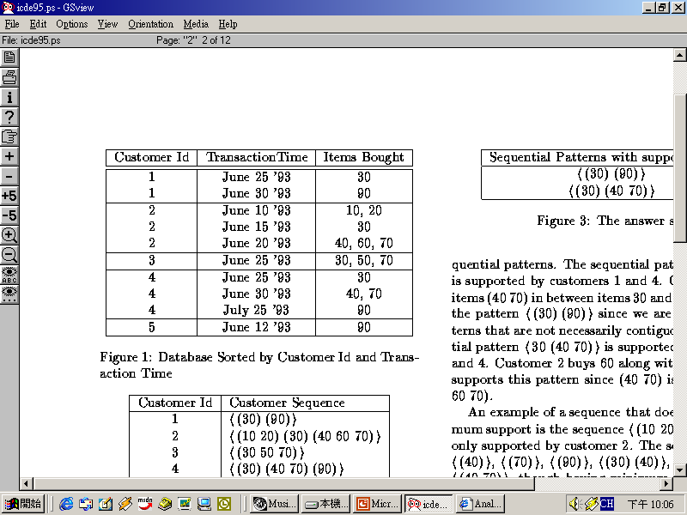
Terminology
Transaction
Item
Itemset

Slide 6
Association Rules
Let U be a set of items
  Let X, Y ⊆ U
  X ∩ Y = ∅
An association rule is an expression of the form X ⇒ Y, whose meaning is:
  If the elements of X occur in some context, then so do the elements of Y

Slide 7
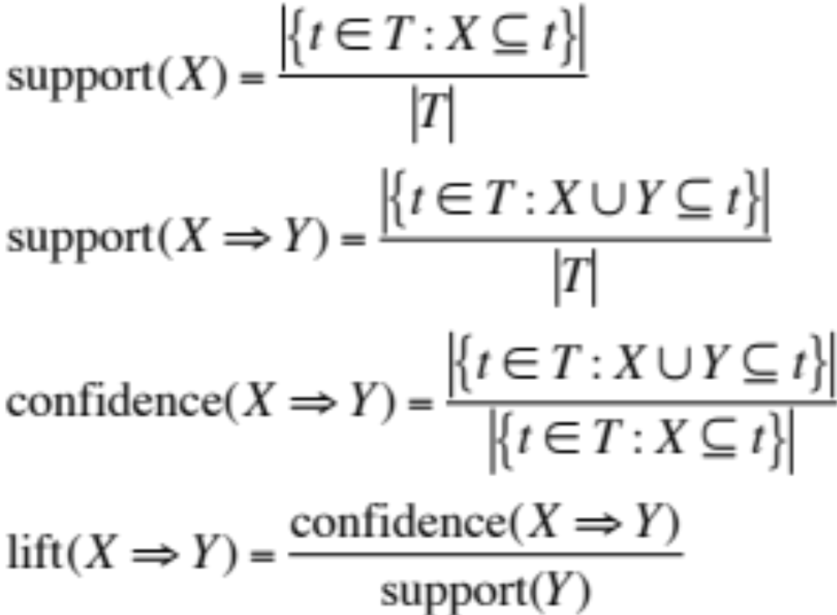
Quality Measures
Let T be the set of all transactions
We define:
Notes:
Quality: of X ⇒ Y
Just how many when through
How offten did the rule occur
Maximize support (x ->Y) ? ::
B->m / (P(m|b))
-----------
X => Y
Support == P(x,y)
Confidence == P(y|x)

Slide 8
Learning Associations
The purpose of association rule learning is to find “interesting” rules, i.e., rules that meet the following two user-defined conditions:
  support(X ⇒ Y) ≥ MinSupport
  confidence(X ⇒ Y) ≥ MinConfidence

Slide 9
Basic Idea
Generate all frequent itemsets satisfying the condition on minimum support
Build all possible rules from these itemsets and check them against the condition on minimum confidence
All the rules above the minimum confidence threshold are returned for further evaluation

Slide 10
Apriori Principle
Theorem:
  If an itemset is frequent, then all of its subsets must also be frequent (the proof is straightforward)
Corollary:
  If an itemset is not frequent, then none of its superset will be frequent
In a bottom up approach, we can discard all non-frequent itemsets

Slide 11
AprioriAll
L₁ ← ∅
For each item I_{j} ∈ I
  count({I_{j}}) = | {T_{i} : I_{j} ∈ T_{i}} |
  If count({I_{j}}) ≥ MinSupport x m
    L₁ ← L₁ ∪ {({I_{j}}, count({I_{j}})}
k ← 2
While L_{k-1} ≠ ∅
  L_{k} ← ∅
  For each (l₁, count(l₁)), (l₂, count(l₂)) ∈ L_{k-1}
    If (l₁ = {j₁, …, j_{k-2}, x} ∧ l₂ = {j₁, …, j_{k-2}, y} ∧ x ≠ y)‏
      l ← {j₁, …, j_{k-2}, x, y}
      count(l) ← | {T_{i} : l ⊆ T_{i} } |
      If count(l) ≥ MinSupport x m
      L_{k} ← L_{k} ∪ {(l, count(l))}
  k ← k + 1
Return L₁∪ L₂∪… ∪L_{k-1}

Slide 12
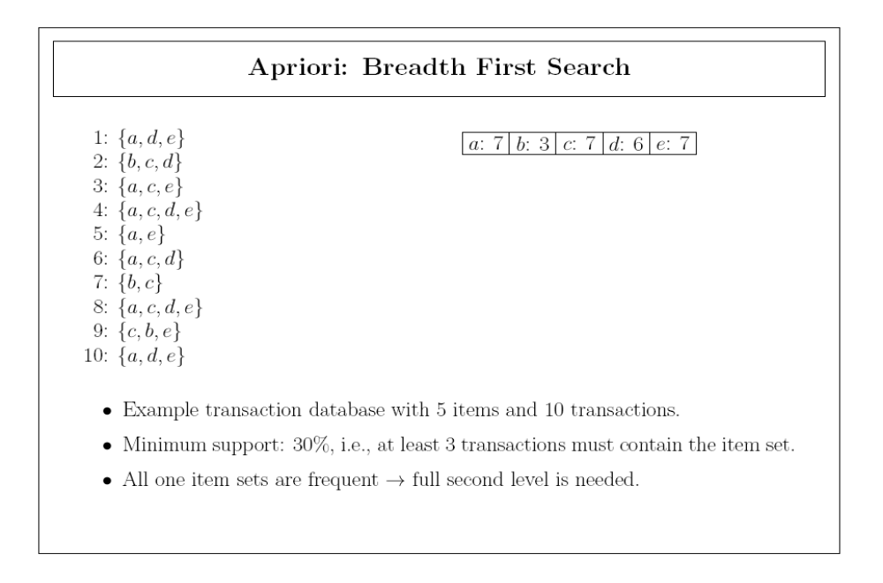

Slide 13
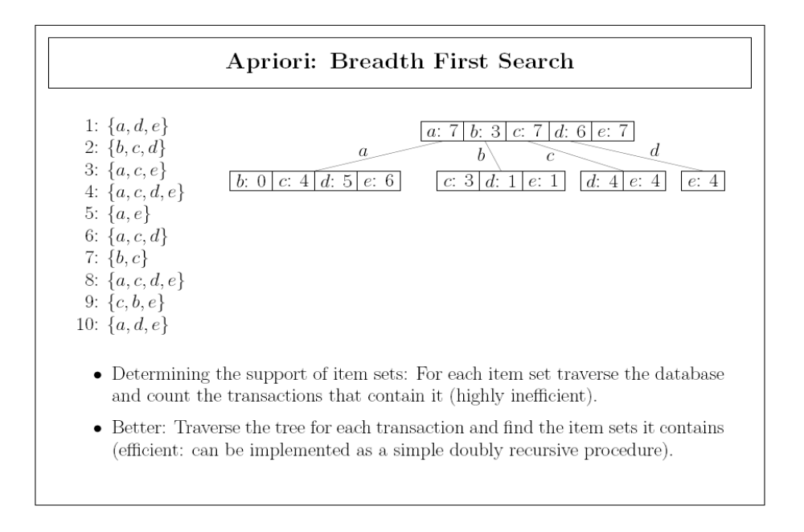

Slide 14
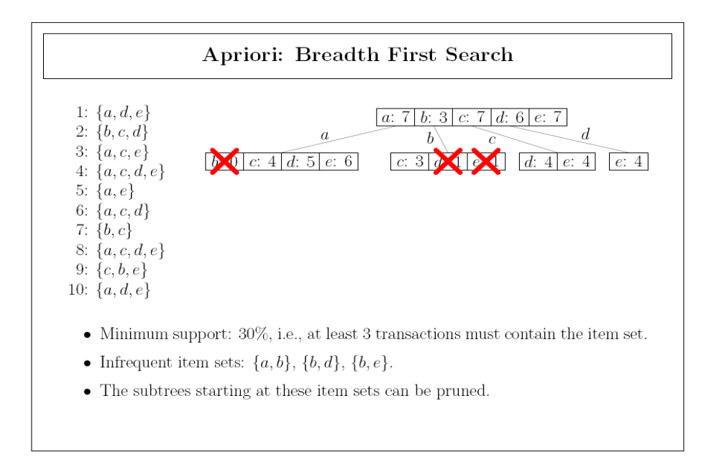

Slide 15
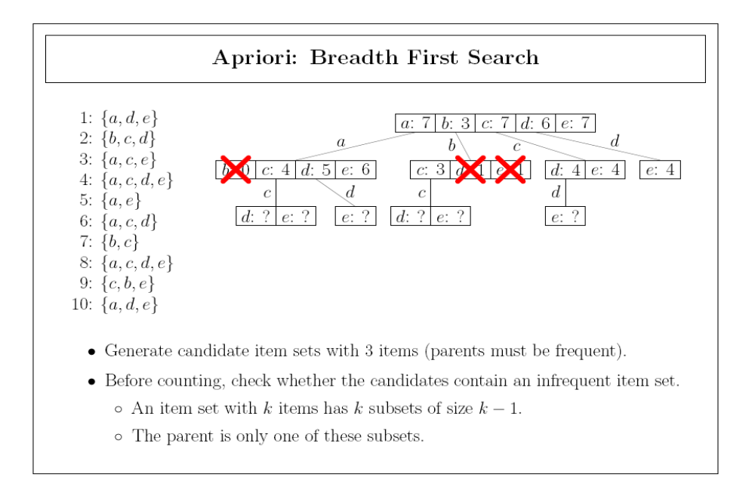

Slide 16
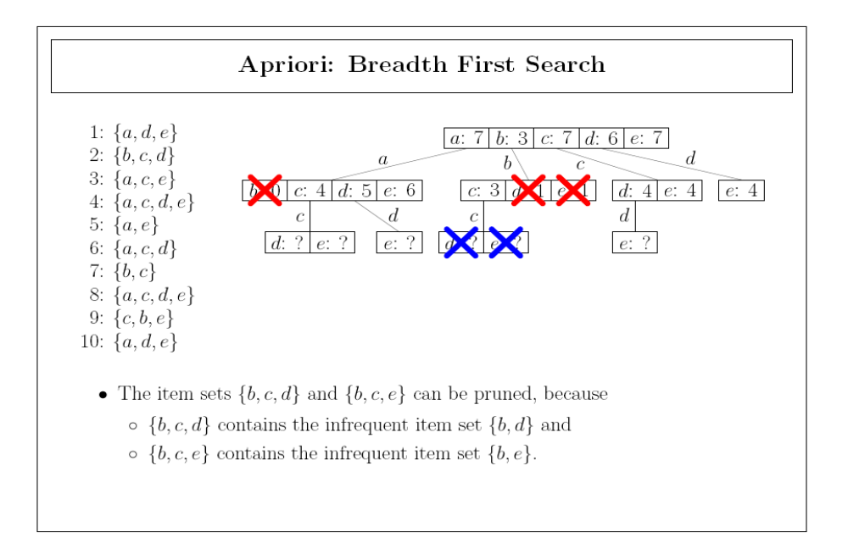

Slide 17
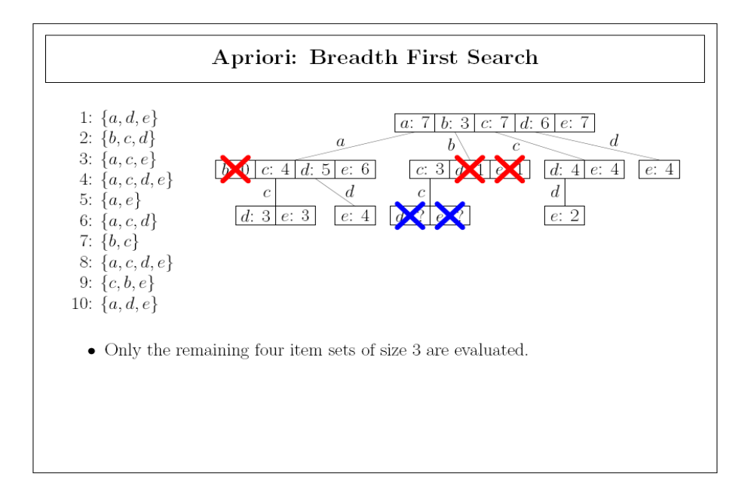

Slide 18
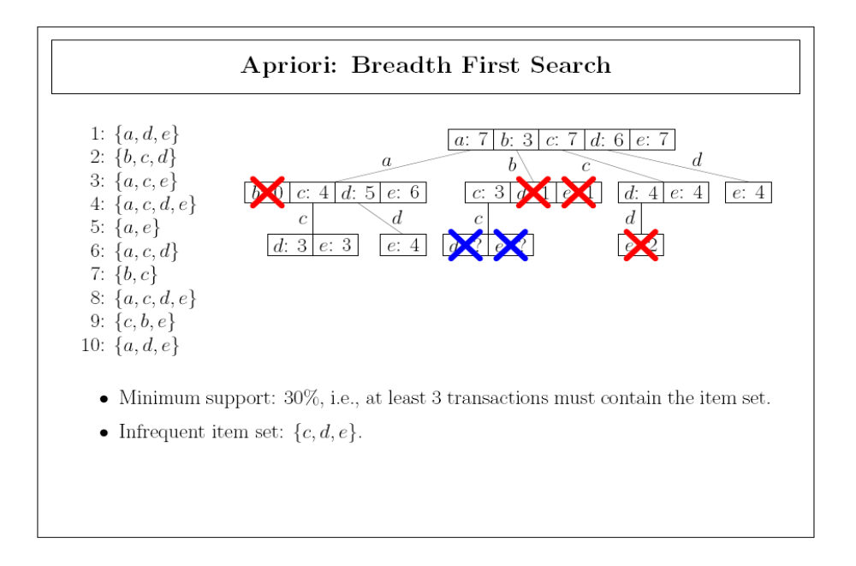

Slide 19
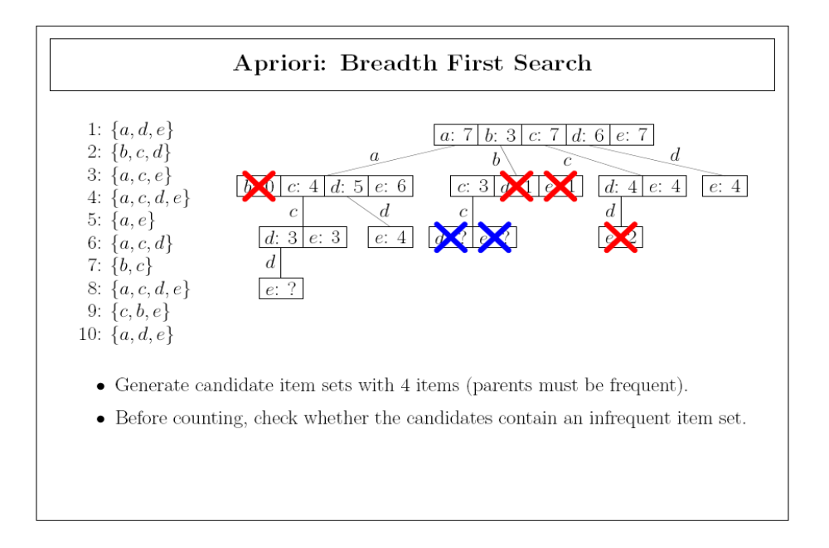

Slide 20
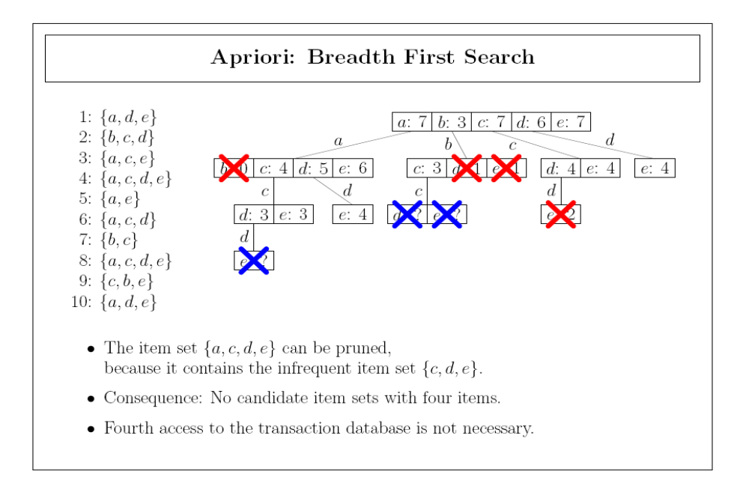

Slide 21
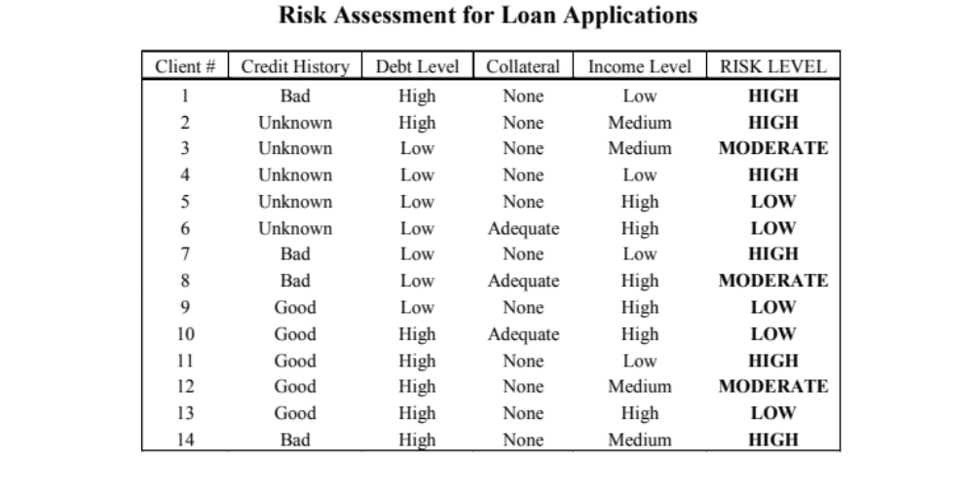
Illustrative Training Set

Slide 22
Running Apriori (I)
Items:
  (CH=Bad, .29) (CH=Unknown, .36) (CH=Good, .36)
  (DL=Low, .5) (DL=High, .5)
  (C=None, .79) (C=Adequate, .21)
  (IL=Low, .29) (IL=Medium, .29) (IL=High, .43)
  (RL=High, .43) (RL=Moderate, .21) (RL=Low, .36)
Choose MinSupport=.4 and MinConfidence=.8

Slide 23
Running Apriori (II)
L1 = {(DL=Low, .5); (DL=High, .5); (C=None, .79); (IL=High, .43); (RL=High, .43)}
L2 = {(DL=High + C=None, .43)}
L3 = {}

Slide 24
Running Apriori (III)
Two possible rules:
  DL = High ⇒ C = None (A)
  C = None ⇒ DL = High (B)
Confidences:
  Conf(A) = .86 Retain
  Conf(B) = .54 Ignore

Slide 25
Summary
Note the following about Apriori:
  A “true” data mining algorithm.
  Despite popularity, real reported applications are few
  Easy to implement with a sparse matrix and simple sums
  Computationally expensive
    Actual run-time depends on MinSupport
    In the worst-case, time complexity is O(2^{n})
  Not strictly an associations learner
    Induces rules, which are inherently unidirectional
    There are alternatives (e.g., GRI)

