Slide 1
CS 478 – Tools for Machine Learning and Data Mining
Perceptron
Notes:
Fall 2004
CS478 - Machine Learning

Slide 2
Neural Networks
Sub-symbolic approach:
  Does not use symbols to denote objects
  Views intelligence/learning as arising from the collective behavior of a large number of simple, interacting components
Motivated by biological plausibility (i.e., brain-like)

Slide 3
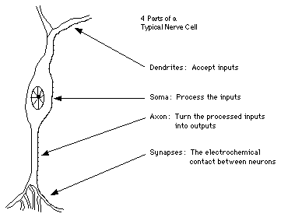
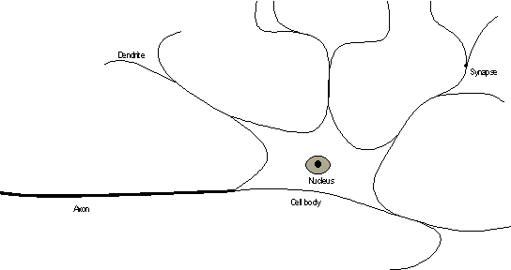
Natural Neuron

Slide 4
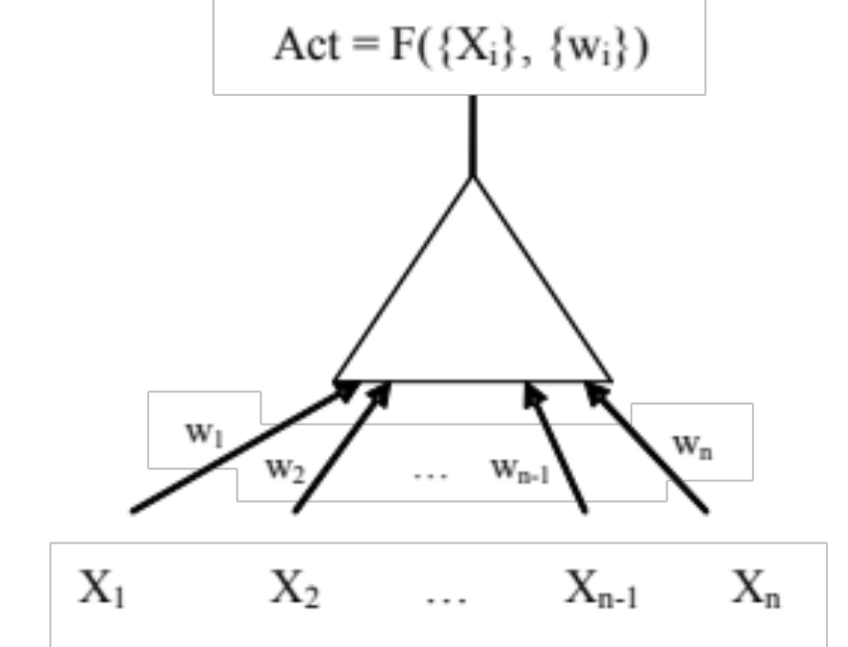
Artificial Neuron
Captures the essence of the natural neuron

Slide 5
Natural vs Artificial
Dendrites
Synapses
Soma’s chemical reaction
Axon
Input values X_{i} from the environment or other neurons
Real-valued weights w_{i} associated with each input
Function F({X_{i}},{w_{i}}) computing activation as a function of input values and weights
Activation value that may serve as input to other neurons

Slide 6
NN Characteristics
(Artificial) neural networks are sets of (highly) interconnected artificial neurons (i.e., simple computational units)
Characteristics
  Massive parallelism
  Distributed knowledge representation (i.e., implicit in patterns of interactions)
  Graceful degradation (e.g., grandmother cell)
  Less susceptible to brittleness
  Noise tolerant
  Opaque (i.e., black box)

Slide 7
Network Topology
Pattern of interconnections between neurons: primary source of inductive bias
Characteristics
  Interconnectivity (fully connected, mesh, etc.)
  Number of layers
  Number of neurons per layer
  Fixed vs. dynamic

Slide 8
NN Learning
Learning is effected by one or a combination of several mechanisms:
  Weight updates
  Changes in activation functions
  Changes in overall topology
Notes:
Changes how things are connected.
Change the nodes.
Change the weights.
Most only change the Weight!
Fall 2004
CS478 - Machine Learning

Slide 9
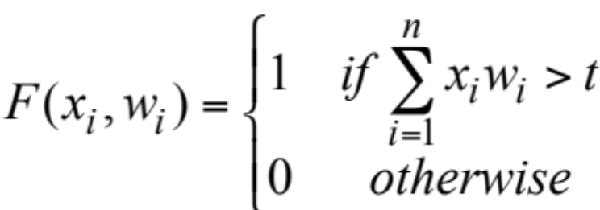
Perceptrons (1958)
The simplest class of neural networks
Single-layer, i.e., only one set of weight connections between inputs and outputs
Binary inputs
Boolean activation levels
Notes:
Everything is binary.
Fall 2004
CS478 - Machine Learning

Slide 10
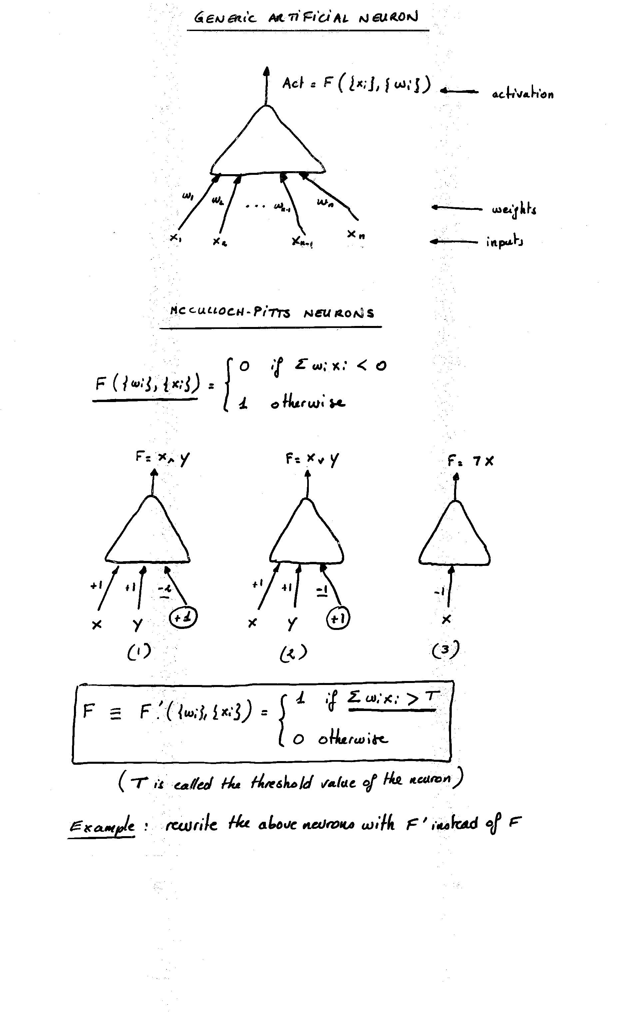

Slide 11
Learning for Perceptrons
Algorithm devised by Rosenblatt in 1958
Given an example (i.e., labeled input pattern):
  Compute output
  Check output against target
  Adapt weights when different
Notes:
Cool but inefficient!
We have to iterate on the data set multiple times.
Fall 2004
CS478 - Machine Learning

Slide 12
Learn-Perceptron
d ← some constant (the learning rate)
Initialize weights (typically random)
For each new training example with target output T
  For each node (parallel for loop)
    Compute activation F
    If (F=T) then Done
    Else if (F=0 and T=1) then Increment weights on active lines by d
    Else Decrement weights on active lines by d

Slide 13
Intuition
Learn-Perceptron slowly (depending on the value of d) moves weights closer to the target output
Several iterations over the training set may be required

Slide 14
Example
Consider a 3-input, 1-output perceptron
Let d=1 and t=0.9
Initialize the weights to 0
Build the perceptron (i.e., learn the weights) for the following training set:
  0 0 1 → 0
  1 1 1 → 1
  1 0 1 → 1
  0 1 1 → 0
Notes:
Only change the inputs by something that affects the answer.
Fall 2004
CS478 - Machine Learning

Slide 15
More Functions
Repeat the previous exercise with the following training set:
  0 0 → 0
  1 0 → 1
  1 1 → 0
  0 1 → 1
What do you observe? Why?

