Slide 1
CS 478 – Tools for Machine Learning and Data Mining
  Linear and Logistic Regression
  (Adapted from various sources)
  (e.g., Luiz Pessoa PY 206 class at Brown University)

Slide 2
Regression
A form of statistical modeling that attempts to evaluate the relationship between one variable (termed the dependent variable) and one or more other variables (termed the independent variables). It is a form of global analysis as it only produces a single equation for the relationship.
A model for predicting one variable from another.

Slide 3
Linear Regression
Regression used to fit a linear model to data where the dependent variable is continuous:
Given a set of points (Xi,Yi), we wish to find a linear function (or line in 2 dimensions) that “goes through” these points.
In general, the points are not exactly aligned:
  Find line that best fits the points
Notes:
E == error
b0 = intercetp

Slide 4
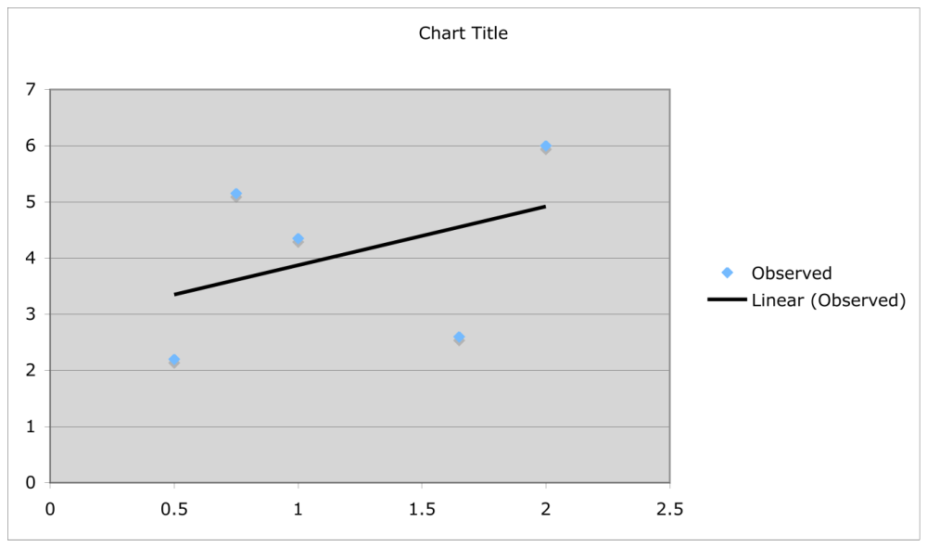
Residue
Error or residue:
  Observed value - Predicted value

Slide 5
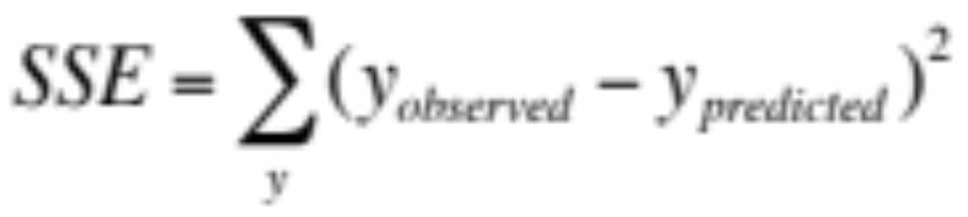
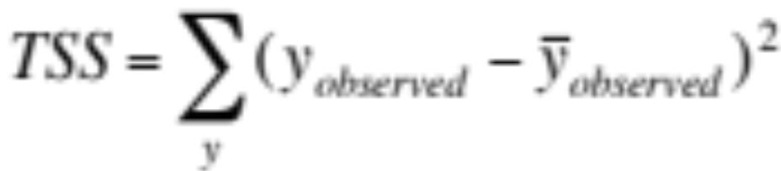
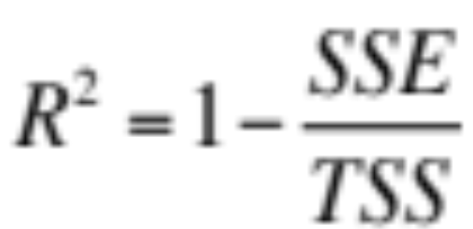
Sum-squared Error (SSE)

Slide 6
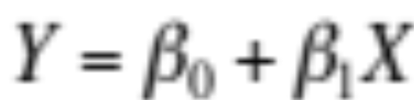
What is Best Fit?
The smaller the SSE, the better the fit
Hence,
  Linear regression attempts to minimize SSE (or similarly to maximize R2)
Assume 2 dimensions

Slide 7
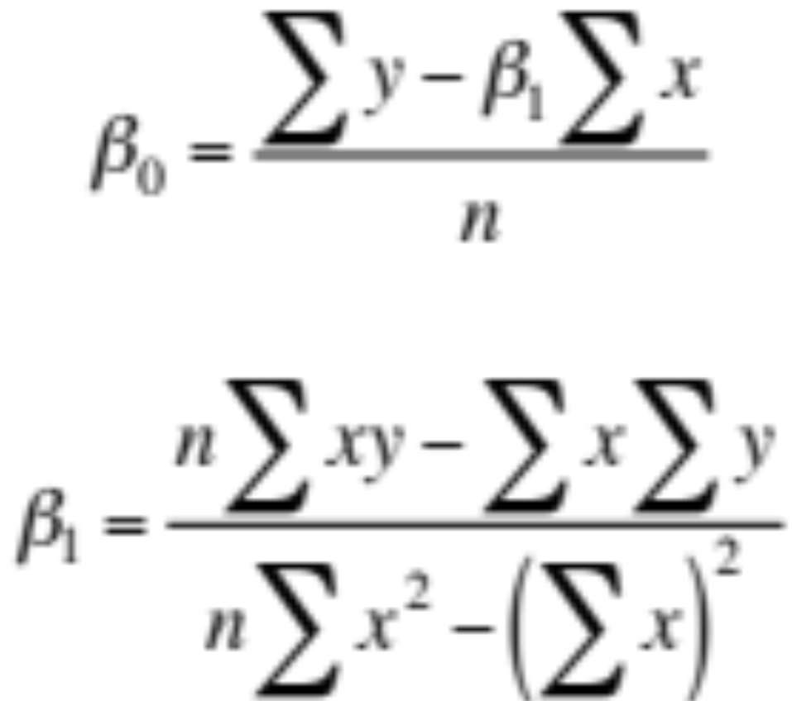
Analytical Solution

Slide 8
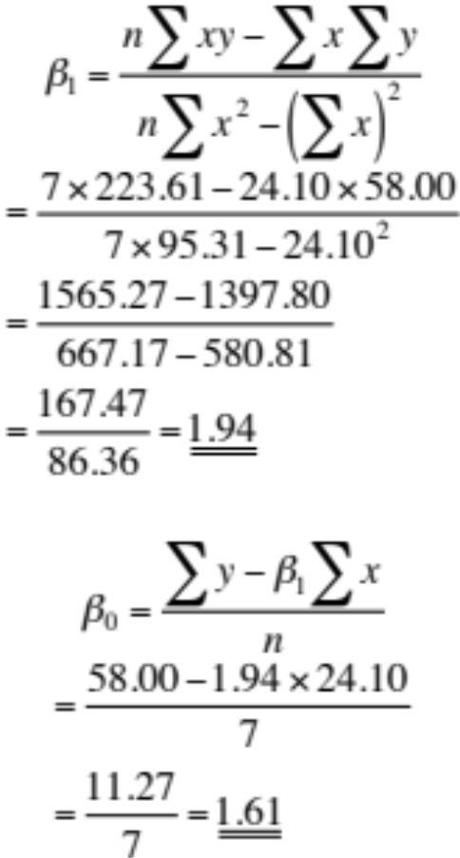
Example (I)
x | y | x^2 | xy
1.20 | 4.00 | 1.44 | 4.80
2.30 | 5.60 | 5.29 | 12.88
3.10 | 7.90 | 9.61 | 24.49
3.40 | 8.00 | 11.56 | 27.20
4.00 | 10.10 | 16.00 | 40.40
4.60 | 10.40 | 21.16 | 47.84
5.50 | 12.00 | 30.25 | 66.00
24.10 | 58.00 | 95.31 | 223.61
Target: y=2x+1.5

Slide 9
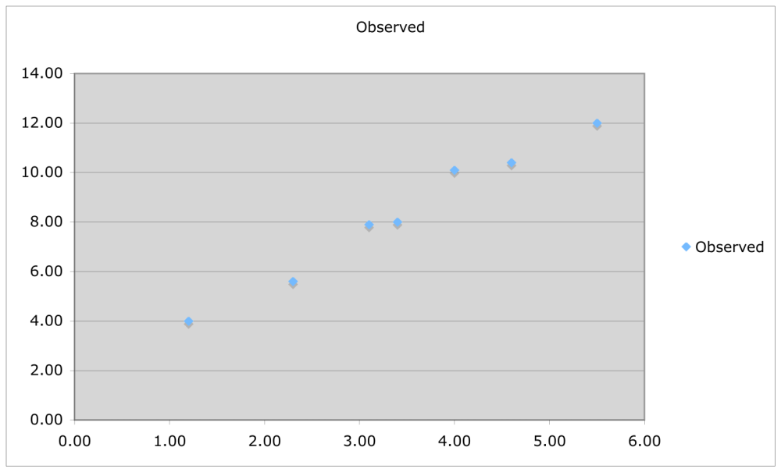
Example (II)

Slide 10
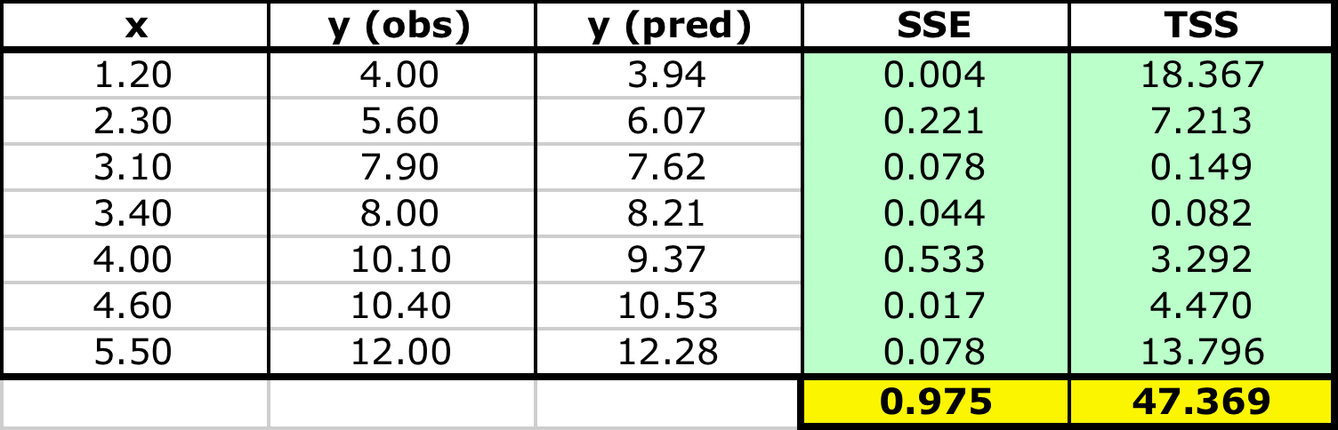
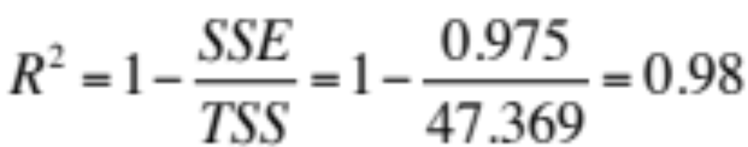
Example (III)

Slide 11
Logistic Regression
Regression used to fit a curve to data in which the dependent variable is binary, or dichotomous
Typical application: Medicine
  We might want to predict response to treatment, where we might code survivors as 1 and those who don’t survive as 0

Slide 12
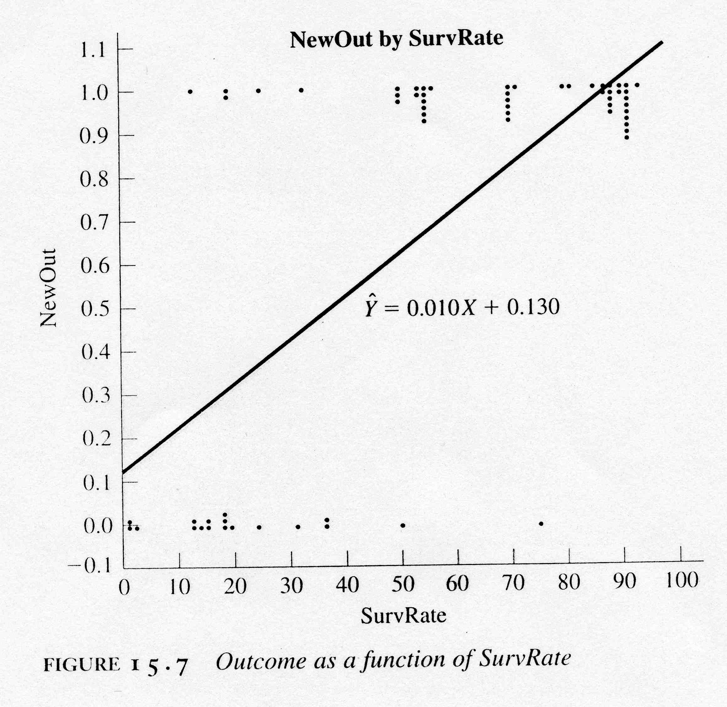
Example
Observations:
For each value of SurvRate, the number of dots is the number of patients with that value of NewOut
Regression:
Standard linear regression
Problem: extending the regression line a few units left or right along
the X axis produces predicted probabilities that fall outside of [0,1]

Slide 13
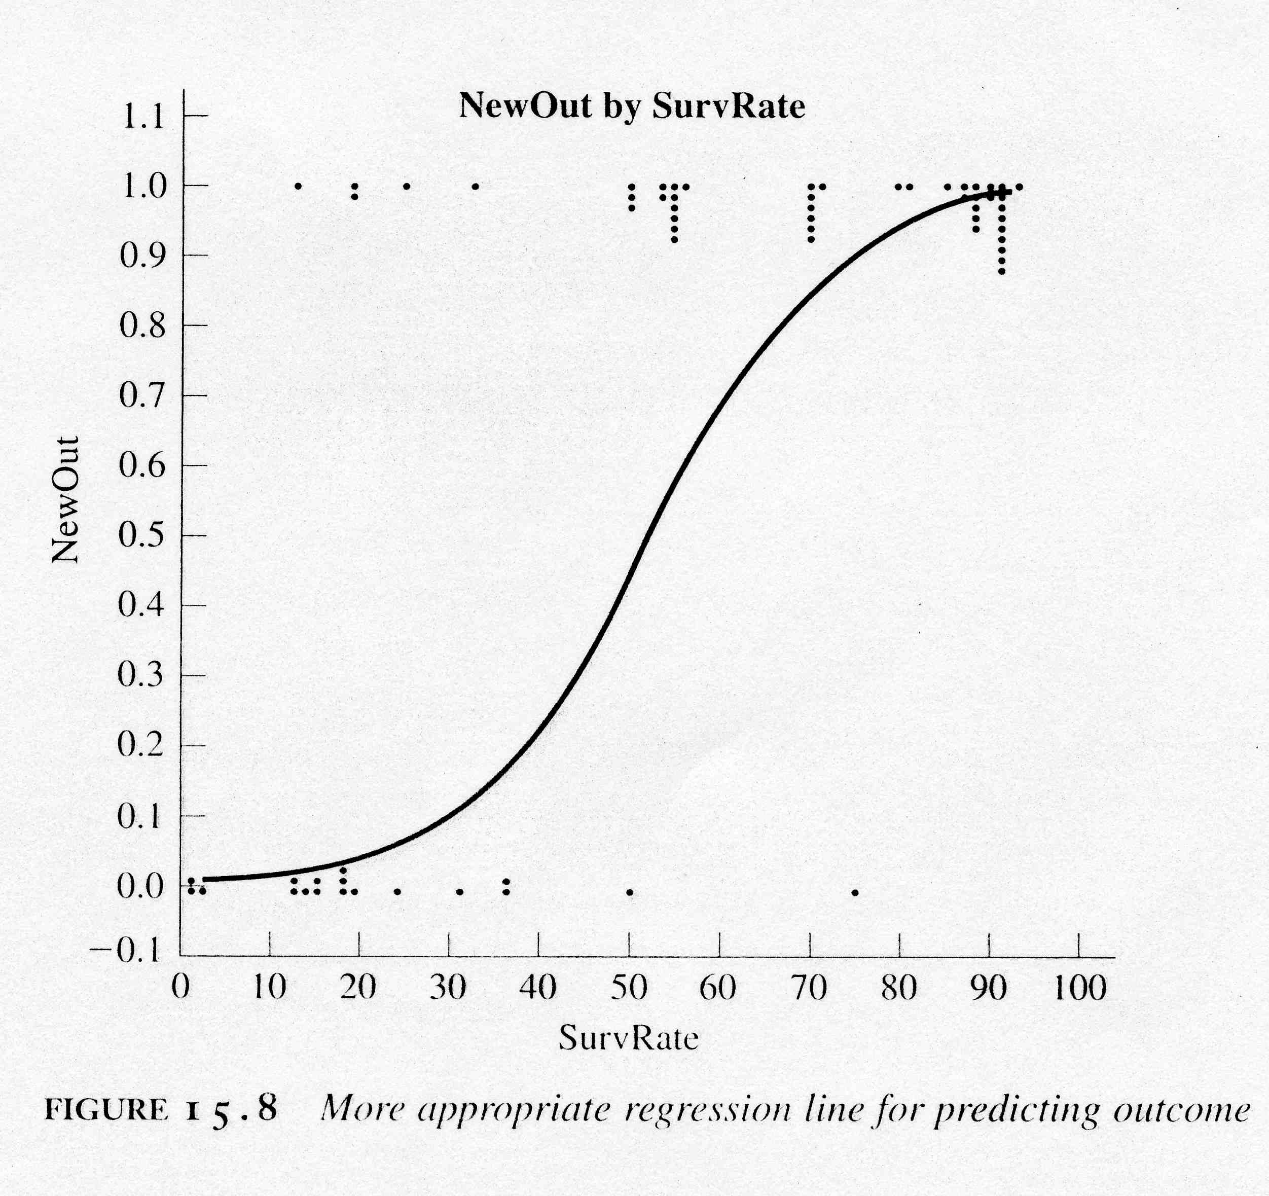
A Better Solution
Regression Curve:
Sigmoid function!
(bounded by asymptotes y=0 and y=1)
Notes:
We have a binary class.
Use a sigmoid function
…

Slide 14
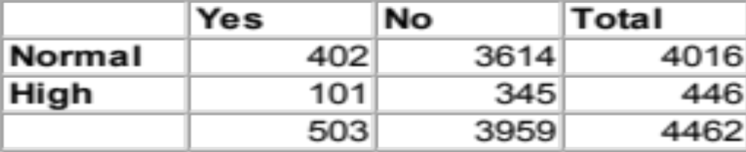
Odds
Given some event with probability p of being 1, the odds of that event are given by:
Consider the following data
The odds of being delinquent if you are in the Normal group are:
    pdelinquent/(1–pdelinquent) = (402/4016) / (1 - (402/4016)) = 0.1001 / 0.8889 = 0.111
odds = p / (1–p)
Delinquent
Testosterone
Notes:
We need to transform our space

Slide 15
Odds Ratio
The odds of being not delinquent in the Normal group is the reciprocal of this:
  0.8999/0.1001 = 8.99
Now, for the High testosterone group
  odds(delinquent) = 101/345 = 0.293
  odds(not delinquent) = 345/101 = 3.416
When we go from Normal to High, the odds of being delinquent nearly triple:
  Odds ratio: 0.293/0.111 = 2.64
  2.64 times more likely to be delinquent with high testosterone levels

Slide 16
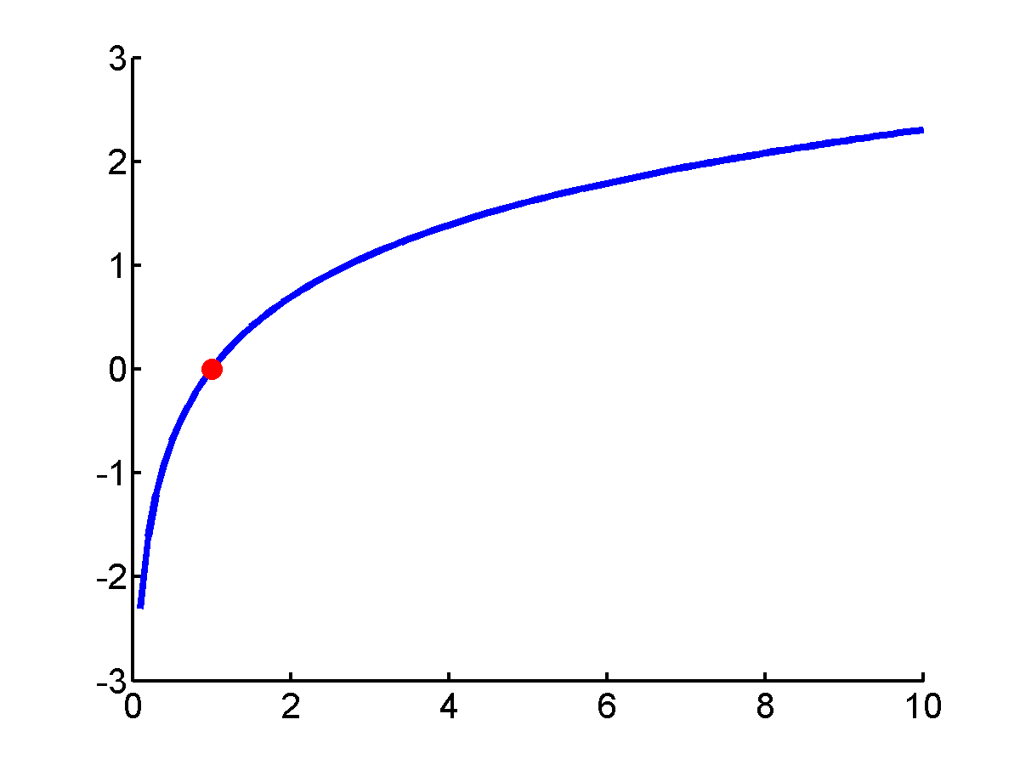
Logit Transform
The logit is the natural log of the odds
logit(p) = ln(odds) = ln (p/(1-p))

Slide 17
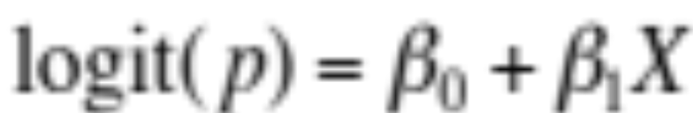
Logistic Regression
In logistic regression, we seek a model:
That is, the log odds (logit) is assumed to be linearly related to the independent variable X
So, now we can focus on solving an ordinary (linear) regression!

Slide 18
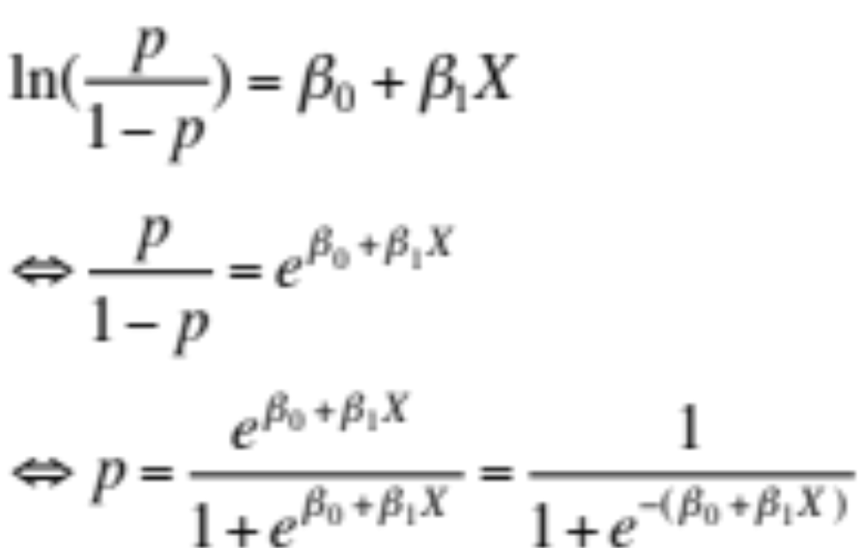
Recovering Probabilities
which gives p as a sigmoid function!

Slide 19
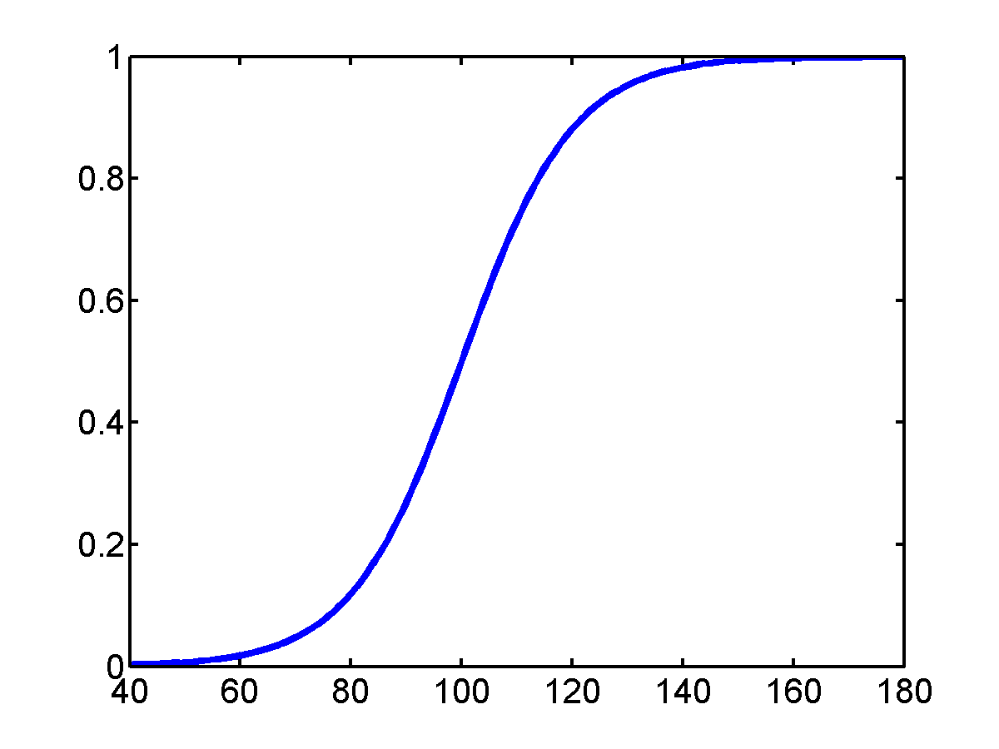
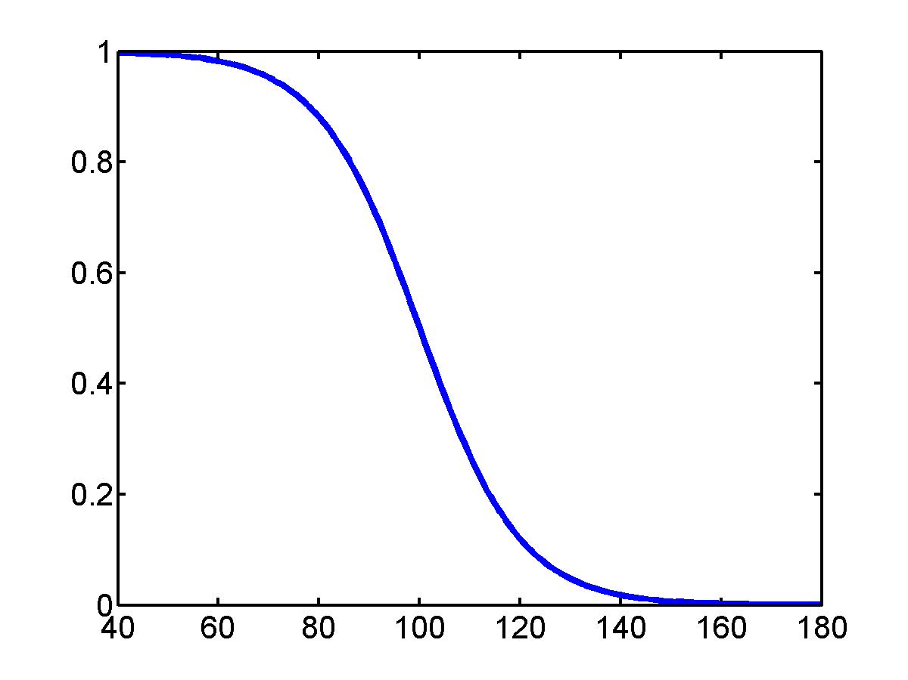
Logistic Response Function
When the response variable is binary, the shape of the response function is often sigmoidal:

Slide 20
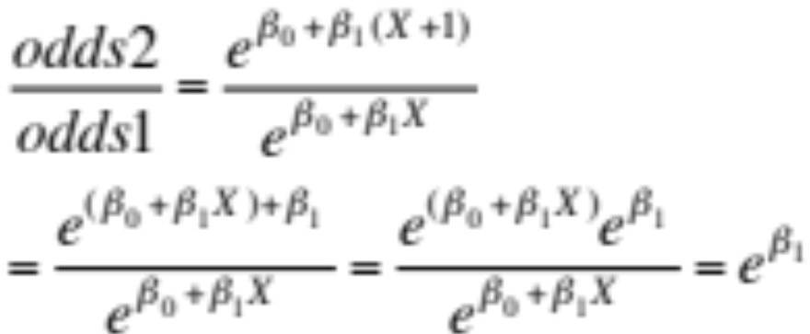
Interpretation of β1
Let:
  odds1 = odds for value X (p/(1–p))
  odds2 = odds for value X + 1 unit
Then:
Hence, the exponent of the slope describes the proportionate rate at which the predicted odds ratio changes with each successive unit of X

Slide 21
Sample Calculations
Suppose a cancer study yields:
  log odds = –2.6837 + 0.0812 SurvRate
Consider a patient with SurvRate = 40
  log odds = –2.6837 + 0.0812(40) = 0.5643
  odds = e^{0.5643} = 1.758
  patient is 1.758 times more likely to be improved than not
Consider another patient with SurvRate = 41
  log odds = –2.6837 + 0.0812(41) = 0.6455
  odds = e^{0.6455} = 1.907
  patient’s odds are 1.907/1.758 = 1.0846 times (or 8.5%) better than those of the previous patient
Using probabilities
  p40 = 0.6374 and p41 = 0.6560
  Improvements appear different with odds and with p

Slide 22
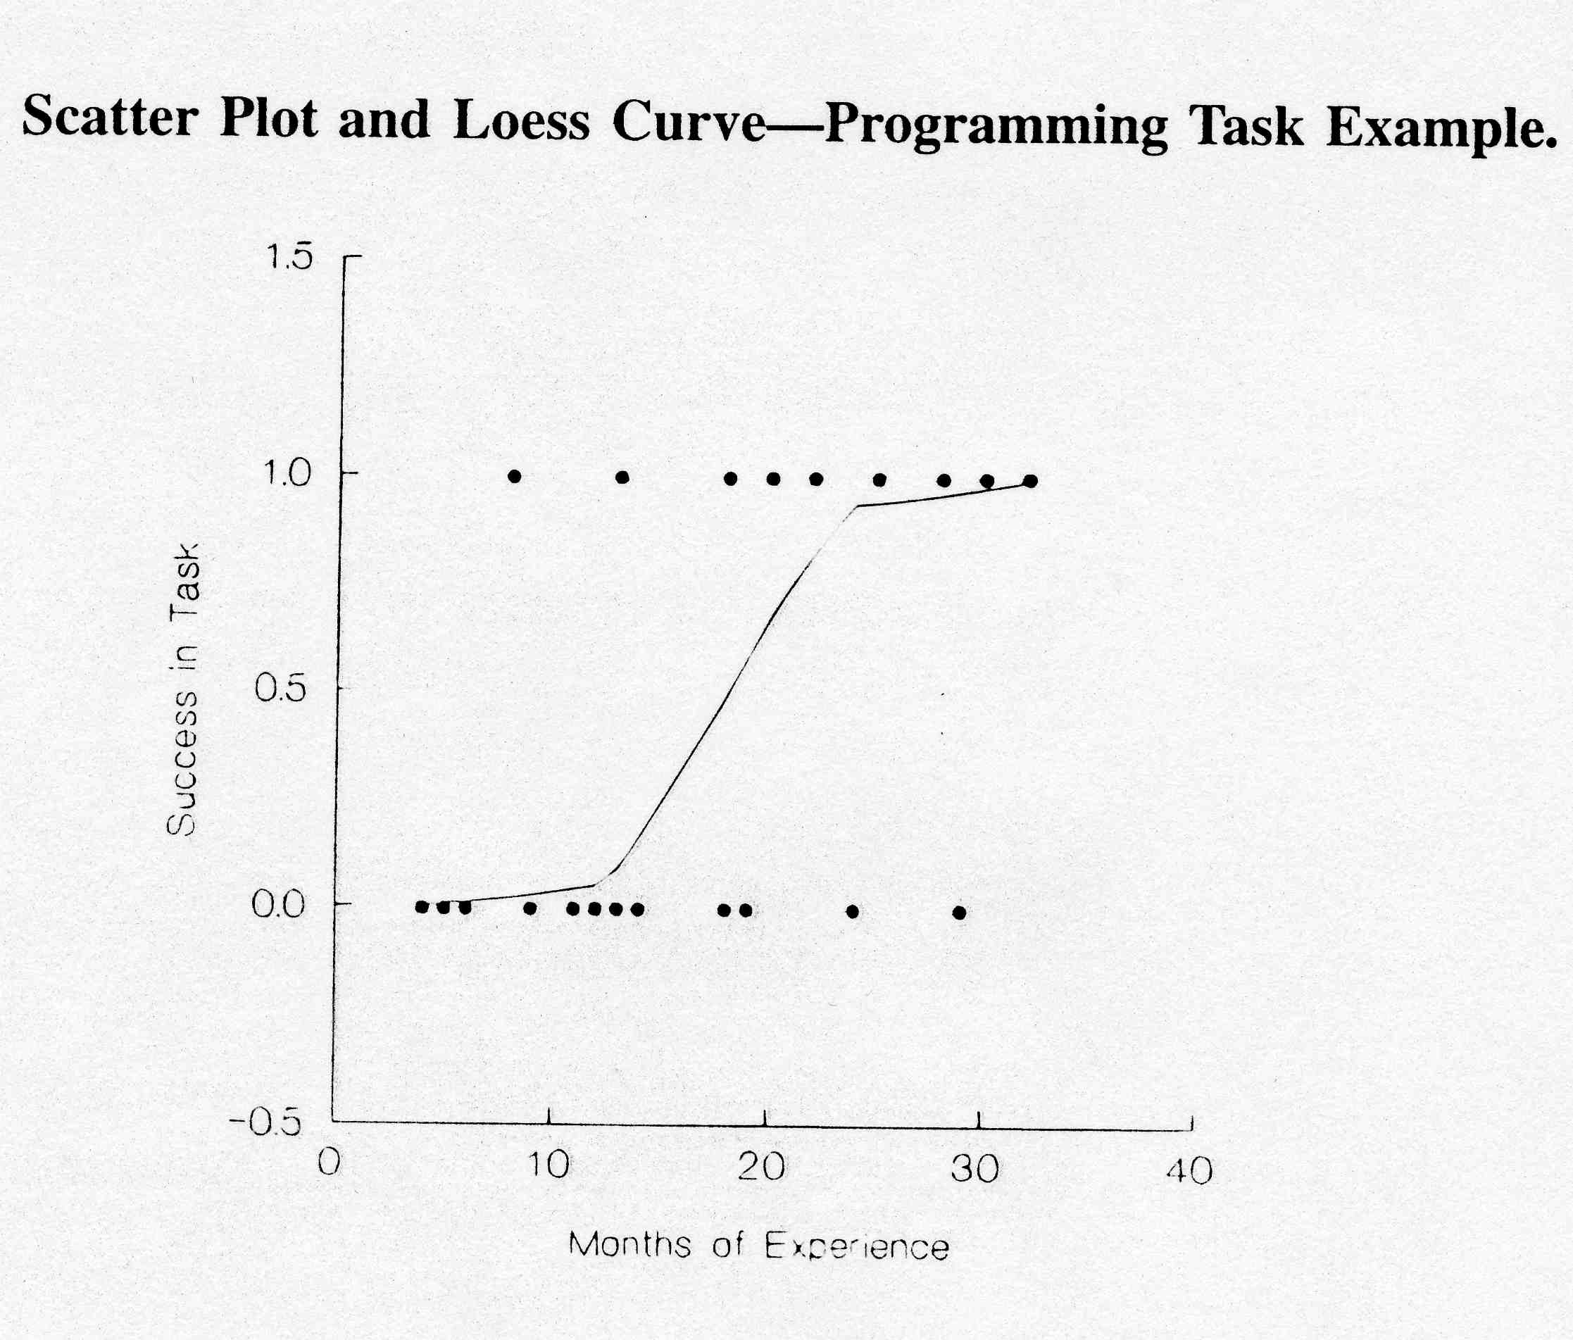
Example 1 (I)
A systems analyst studied the effect of computer programming experience on ability to complete a task within a specified time
Twenty-five persons selected for the study, with varying amounts of computer experience (in months)
Results are coded in binary fashion: Y = 1 if task completed successfully; Y = 0, otherwise
Loess: form of local regression

Slide 23
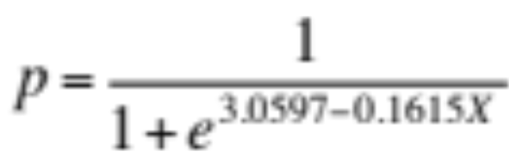
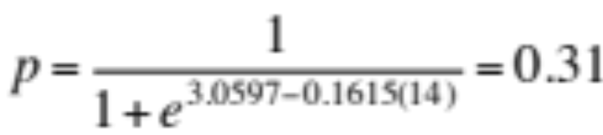
Example 1 (II)
Results from a standard package give:
  β0 = –3.0597 and β1 = 0.1615
Estimated logistic regression function:
For example, the fitted value for X = 14 is:
(Estimated probability that a person with 14 months experience will
successfully complete the task)

Slide 24
Example 1 (III)
We know that the probability of success increases sharply with experience
  Odds ratio: exp(β1) = e0.1615 = 1.175
  Odds increase by 17.5% with each additional month of experience
A unit increase of one month is quite small, and we might want to know the change in odds for a longer difference in time
  For c units of X: exp(cβ1)

Slide 25
Example 1 (IV)
Suppose we want to compare individuals with relatively little experience to those with extensive experience, say 10 months versus 25 months (c = 15)
  Odds ratio: e15x0.1615 = 11.3
  Odds of completing the task increase 11-fold!

Slide 26
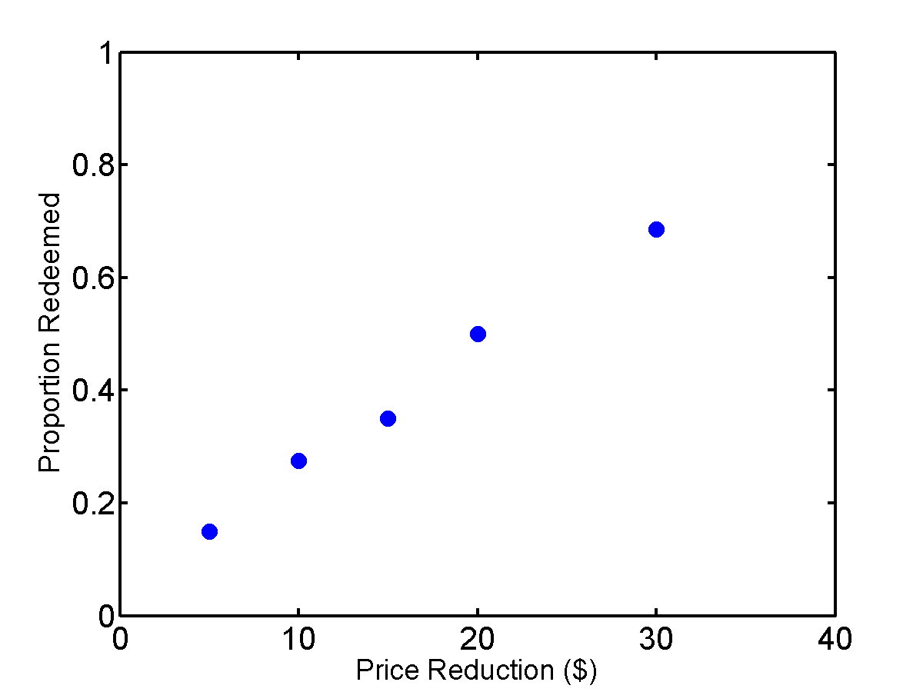
Example 2 (I)
In a study of the effectiveness of coupons offering a price reduction, 1,000 homes were selected and coupons mailed
Coupon price reductions: 5, 10, 15, 20, and 30 dollars
200 homes assigned at random to each coupon value
X: amount of price reduction
Y: binary variable indicating whether or not coupon was redeemed

Slide 27
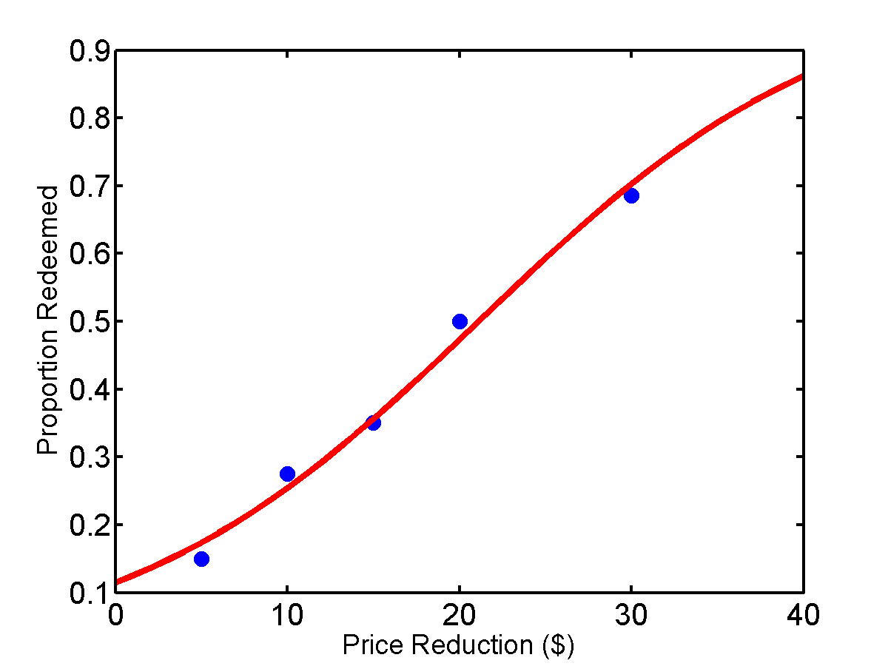
Example 2 (II)
Fitted response function
  β₀ = -2.04 and β₁ = 0.097
Odds ratio: exp(β₁) = e^{0.097} = 1.102
Odds of a coupon being redeemed are estimated to increase by 10.2% with each $1 increase in the coupon value (i.e., $1 in price reduction)

Slide 28
Putting it to Work
For each value of X, you may not have probability but rather a number of <x,y> pairs from which you can extract frequencies and hence probabilities
  Raw data: <12,0>, <12,1>, <14,0>, <12,1>, <14,1>, <14,1>, <12,0>, <12,0>
  Probability data (p=1, 3rd entry is number of occurrences in raw data): <12, 0.4, 5>, <14, 0.66, 3>
  Odds ratio data…

Slide 29
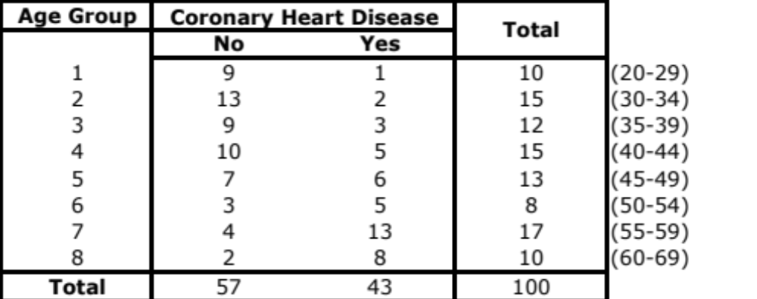
Coronary Heart Disease (I)

Slide 30
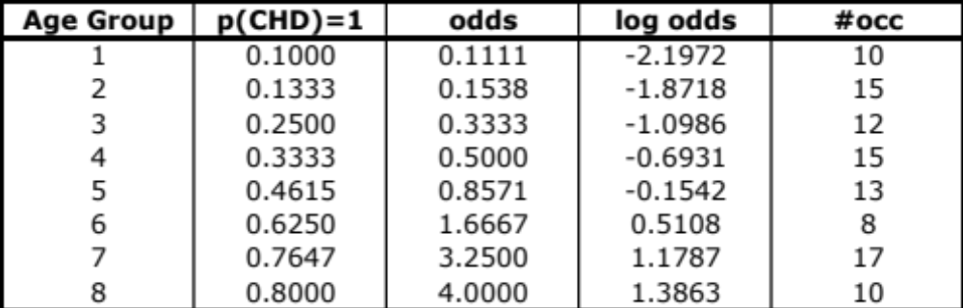
Coronary Heart Disease (II)

Slide 31
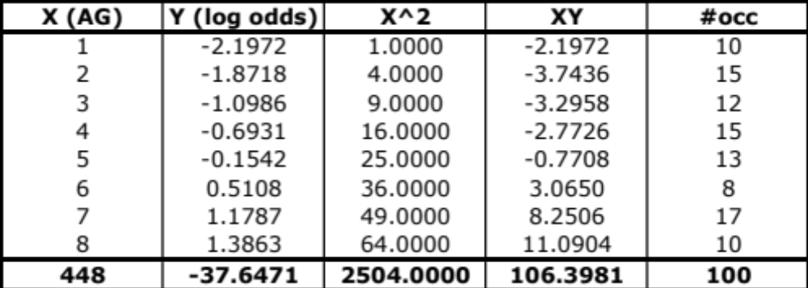
Coronary Heart Disease (III)
Note: the sums reflect the number of occurrences
(Sum(X) = X1.#occ(X1)+…+X8.#occ(X8), etc.)

Slide 32
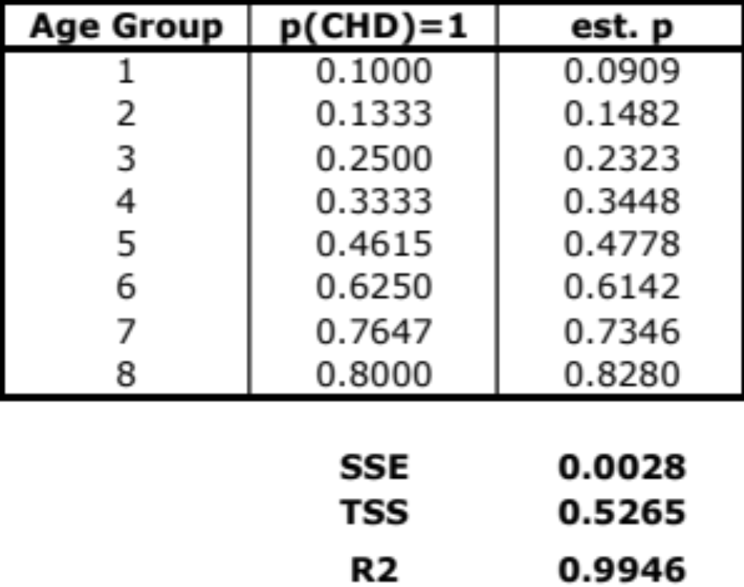
Coronary Heart Disease (IV)
Results from regression:
  β0 = -2.856 and β1 = 0.5535

Slide 33
Summary
Regression is a powerful data mining technique
  It provides prediction
  It offers insight on the relative power of each variable
We have focused on the case of a single independent variable
  What about the general case?

