Slide 1
CS 478 – Tools for Machine Learning and Data Mining
Data Manipulation
(Adapted various sources, including G. Piatetsky-Shapiro,
Biologically Inspired Intelligent Systems (Lecture 7) and R. Gutierrez-Osuna’s Lecture)

Slide 2
Type Conversion
Some tools can deal with nominal values internally, other methods (neural nets, regression, nearest neighbor) require/fare better with numeric inputs
Some methods require discrete values (most versions of Naïve Bayes, CHAID)
Different encodings likely to produce different results
Only show some here
Notes:
Take away

Slide 3
Conversion: Ordinal to Boolean
Allows ordinal attribute with n values to be coded using n–1 boolean attributes
Example: attribute “temperature”
Original data
Transformed data
Temperature
Cold
Medium
Hot
Temperature > cold | Temperature > medium
False | False
True | False
True | True


Slide 4
Conversion: Binary to Numeric
Allows binary attribute to be coded as a number
Example: attribute “gender”
  Original data: gender = {M, F}
  Transformed data: genderN = {0, 1}

Slide 5
Conversion: Ordinal to Numeric
Allows ordinal attribute to be coded as a number, preserving natural order
Example: attribute “grade”
  Original data: grade = {A, A-, B+, …}
  Transformed data: GPA = {4.0, 3.7, 3.3, …
Why preserve natural order?
  To allow meaningful comparisons, e.g., grade > 3.5

Slide 6
Conversion: Nominal to Numeric
Allows nominal attribute with small number of values (<20) to be coded as a number
Example: attribute “color”
  Original data: Color = {Red, Orange, Yellow, …}
  Transformed data: for each value v create a binary flag variable Cv , which is 1 if Color=v, 0 otherwise
ID | Color | …
371 | red
433 | yellow
ID | C_red | C_orange | C_yellow | …
371 | 1 | 0 | 0
433 | 0 | 0 | 1

Slide 7
Conversion: Nominal to Numeric
Allows nominal attribute with large number of values to be coded as a number
Ignore ID-like fields whose values are unique for each record
For other fields, group values “naturally”
  E.g., 50 US States → 3 or 5 regions
  E.g., Profession → select most frequent ones, group the rest
Create binary flags for selected values

Slide 8
Discretization: Equal-Width
Temperature values:
64 65 68 69 70 71 72 72 75 75 80 81 83 85
May produce clumping if data is skewed
Count
4
2
2
2
0
2
2
[64,67) [67,70) [70,73) [73,76) [76,79) [79,82) [82,85]

Slide 9
Discretization: Equal-Height
Temperature values:
64 65 68 69 70 71 72 72 75 75 80 81 83 85
Gives more intuitive breakpoints
  don’t split frequent values across bins
  create separate bins for special values (e.g., 0)
Count
4
4
4
2
[64 .. .. .. .. 69] [70 .. 72] [73 .. .. .. .. .. .. .. .. 81] [83 .. 85]

Slide 10
Discretization: Class-dependent
Eibe – min of 3 values per bucket
64 65 68 69 70 71 72 72 75 75 80 81 83 85
Yes No Yes Yes Yes No No No Yes Yes No Yes Yes No
64
85

Slide 11
Other Transformations
Standardization
  Transform values into the number of standard deviations from the mean
  New value = (current value - average) / standard deviation
Normalization
  All values are made to fall within a certain range
  Typically: new value = (current value - min value) / range
Neither one affects ordering!

Slide 12
Precision “Illusion”
Example: gene expression may be reported as X83 = 193.3742, but measurement error may be +/- 20
Actual value is in [173, 213] range, so it is appropriate to round the data to 190
Do not assume that every reported digit is significant!

Slide 13
Date Handling
YYYYMMDD has problems:
  Does not preserve intervals (e.g., 20040201 - 20040131 ≠ 20040131 – 20040130)
  Can introduce bias into models
Could use Unix system date (number of seconds since 1970) or SAS date (number of days since Jan 1, 1960)
  Values are not obvious
  Does not help intuition and knowledge discovery
  Harder to verify, easier to make an error

Slide 14
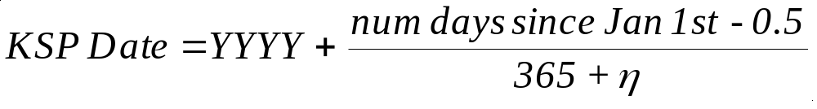
Unified Date Format
Where η=1 if leap year, and 0 otherwise
Advantages
  Preserves intervals (almost)
  Year and quarter are obvious
    Sep 24, 2003 is 2003 + (267-0.5)/365= 2003.7301
  Consistent with date starting at noon
  Can be extended to include time

Slide 15
Missing Values
Types: unknown, unrecorded, irrelevant
    malfunctioning equipment
    changes in experimental design
    collation of different datasets
    measurement not possible
Name | Age | Sex | Pregnant | …
Mary | 25 | F | N
Jane | 27 | F | -
Joe | 30 | M | -
Anna | 2 | F | -
In medical data, value for Pregnant attribute for Jane is missing, while for Joe or Anna should be considered Not applicable
Notes:
These are different types of information.
Fixing data is not as simple as it looks.

Slide 16
Missing Values
Handling methods:
  Remove records with missing values
  Treat as separate value
  Treat as don’t know
  Treat as don’t care
  Use imputation techniques
    Mode, Median, Average
    Regression
  Danger: BIAS

Slide 17
Outliers and Errors
Outliers are values thought to be out of range
Approaches:
  Do nothing
  Enforce upper and lower bounds
  Let binning handle the problem

Slide 18
Cross-referencing Data Sources
Global statistical data vs. own data
  Compare given first name with first name distribution (e.g., Census Bureau) to discover unlikely dates of birth
  Example: My DB contains a Jerome reported to have been born in 1962, yet there were no Jerome born that year
Notes:
How do we fix some of these issues.

Slide 19
Class Imbalance
Sometimes, class distribution is skewed
  Monthly attrition: 97% stay, 3% defect
  Medical diagnosis: 90% healthy, 10% disease
  eCommerce: 99% don’t buy, 1% buy
  Security: >99.99% of Americans are not terrorists
Similar situation with multiple classes
Majority class classifier can be 97% correct, yet completely useless
Notes:
Undersample: eCommerce only use 1% of the don’t buy’s

Slide 20
Class Imbalance
Two classes
  Undersample (select desired number of minority class instances, add equal number of randomly selected majority class)
  Oversample (select desired number of majority class, sample minority class with replacement)
  Use boosting, cost-sensitive learning, etc.
Generalize to multiple classes
  Approximately equal proportions of each class in training and test sets (stratification)

Slide 21
False Predictors / Information Leakers
Fields correlated to target behavior, which describe events that happen at the same time or after the target behavior
Examples:
  Service cancellation date is a leaker when predicting attriters
  Student final grade is a leaker for the task of predicting whether the student passed the course
Notes:
SOURCE field in ALL/AML data

Slide 22
False Predictor Detection
For each field
  Build decision stumps for each field (or compute correlation with the target field)
  Rank by decreasing accuracy (or correlation)
Identify suspects: fields whose accuracy is close to 100% (Note: the threshold is domain dependent)
Verify top “suspects” with domain expert and remove as needed

Slide 23
(Almost) Key Fields
Remove fields with no or little variability
  Rule of thumb: remove a field where almost all values are the same (e.g., null), except possibly in minp% or less of all records
  minp% could be 0.5% or more generally less than 5% of the number of targets of the smallest class

Slide 24
Summary
Good data preparation is key to producing valid and reliable models

Slide 25
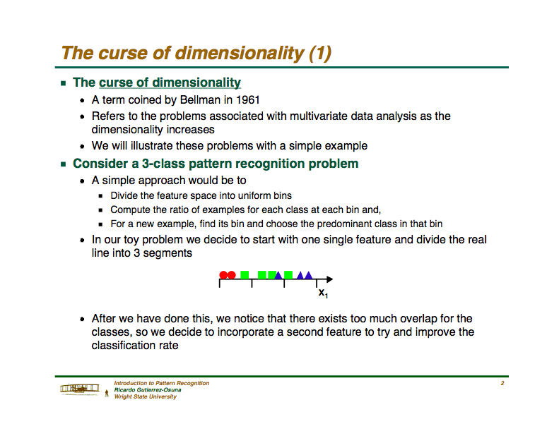

Slide 26
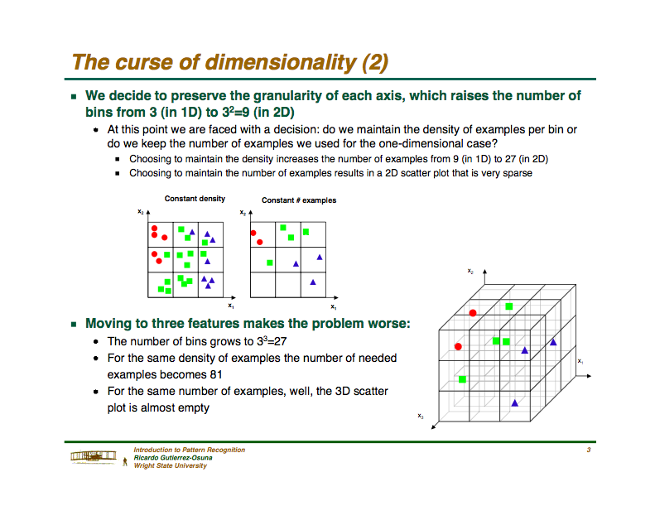

Slide 27
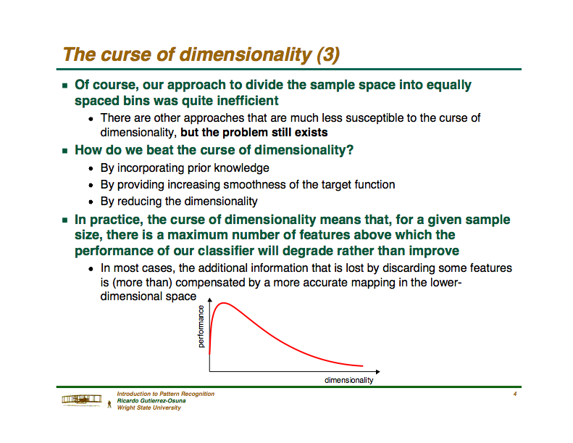

Slide 28
Dimensionality Reduction
Two typical solutions:
  Feature selection
    Considers only a subset of available features
    Requires some selection function
  Feature extraction/transformation
    Creates new features from existing ones
    Requires some combination function
Notes:
Selection – pick 10
Extraction – here are 10 – but we’ll make some you may get 10 new ones

Slide 29
Feature Selection
Goal: Find “best” subset of features
Two approaches
  Wrapper-based
    Uses learning algorithm
    Accuracy used as “goodness” criterion
  Filter-based
    Is independent of the learning algorithm
    Merit heuristic used as “goodness” criterion
Problem: can’t try all subsets!
Notes:
Run it through the algorithm and throw away attributes as things inprove
Filter –basesd
doesn’t use the learning algorithm
uses a different huristic

Slide 30
1-Field Accuracy Feature Selection
Select top N fields using 1-field predictive accuracy (e.g., using Decision Stump)
What is a good N?
  Rule of thumb: keep top 50 fields
Ignores interactions among features

Slide 31
Wrapper-based Feature Selection
Split dataset into training and test sets
Using training set only:
    BestF = {} and MaxAcc = 0
    While accuracy improves or stopping condition not met
      Fsub = subset of features [often best-first search]
      Project training set onto Fsub
      CurAcc = cross-validation estimate of accuracy of learner on transformed training set
      If CurAcc > MaxAcc then BestF = Fsub
    Project both training and test sets onto BestF

Slide 32
Filter-based Feature Selection
Split dataset into training and test sets
Using training set only:
    BestF = {} and MaxMerit = 0
    While Merit improves or stopping condition not met
      Fsub = subset of features
      CurMerit = heuristic value of goodness of Fsub
      If CurMerit > MaxMerit then BestF = Fsub
    Project both training and test sets onto BestF

Slide 33
Feature Extraction
Goal: Create a smaller set of new features by combining existing ones
Better to have a fair modeling method and good variables, than to have the best modeling method and poor variables
Look at one method here

Slide 34
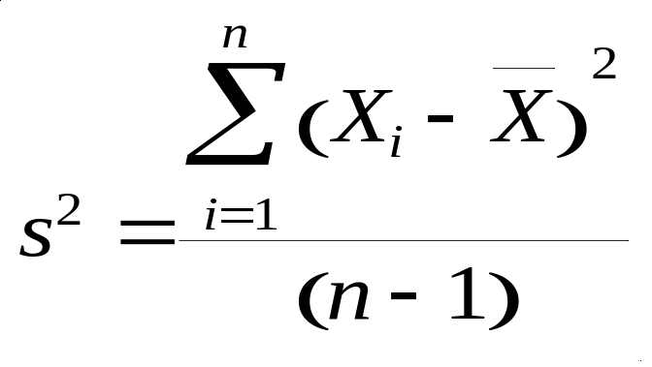
Variance
A measure of the spread of the data in a data set
Variance is claimed to be the original statistical measure of spread of data.

Slide 35
Covariance
Variance – measure of the deviation from the mean for points in one dimension, e.g., heights
Covariance – a measure of how much each of the dimensions varies from the mean with respect to each other.
Covariance is measured between 2 dimensions to see if there is a relationship between the 2 dimensions, e.g., number of hours studied & grade obtained.
The covariance between one dimension and itself is the variance

Slide 36
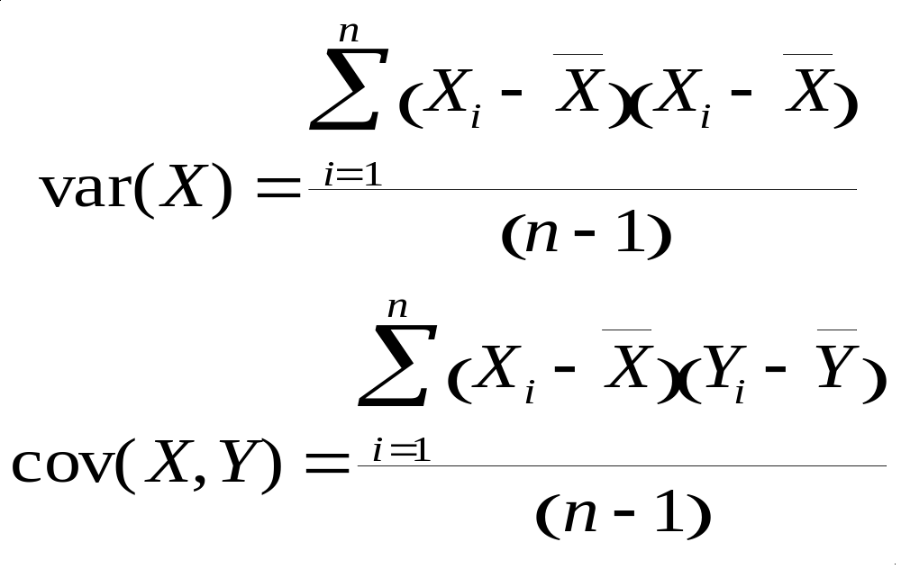
Covariance
So, if you had a 3-dimensional data set (x,y,z), then you could measure the covariance between the x and y dimensions, the y and z dimensions, and the x and z dimensions.

Slide 37
Covariance
What is the interpretation of covariance calculations?
Say you have a 2-dimensional data set
  X: number of hours studied for a subject
  Y: marks obtained in that subject
And assume the covariance value (between X and Y) is: 104.53
What does this value mean?

Slide 38
Covariance
Exact value is not as important as its sign.
A positive value of covariance indicates that both dimensions increase or decrease together, e.g., as the number of hours studied increases, the grades in that subject also increase.
A negative value indicates while one increases the other decreases, or vice-versa, e.g., active social life at BYU vs. performance in CS Dept.
If covariance is zero: the two dimensions are independent of each other, e.g., heights of students vs. grades obtained in a subject.

Slide 39
Covariance
Why bother with calculating (expensive) covariance when we could just plot the 2 values to see their relationship?
Covariance calculations are used to find relationships between dimensions in high dimensional data sets (usually greater than 3) where visualization is difficult.

Slide 40
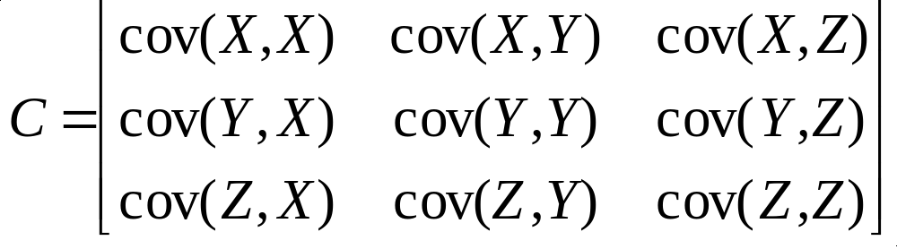
Covariance Matrix
Representing covariance among dimensions as a matrix, e.g., for 3 dimensions:
Properties:
  Diagonal: variances of the variables
  cov(X,Y)=cov(Y,X), hence matrix is symmetrical about the diagonal (upper triangular)
  n-dimensional data will result in nxn covariance matrix

Slide 41
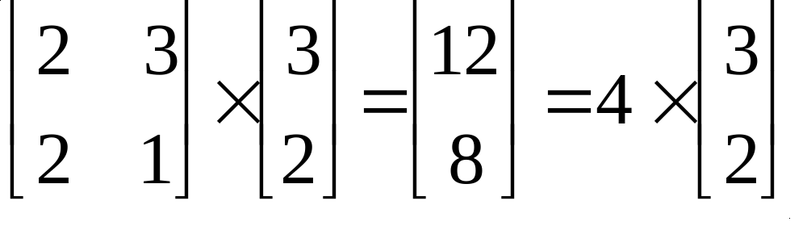
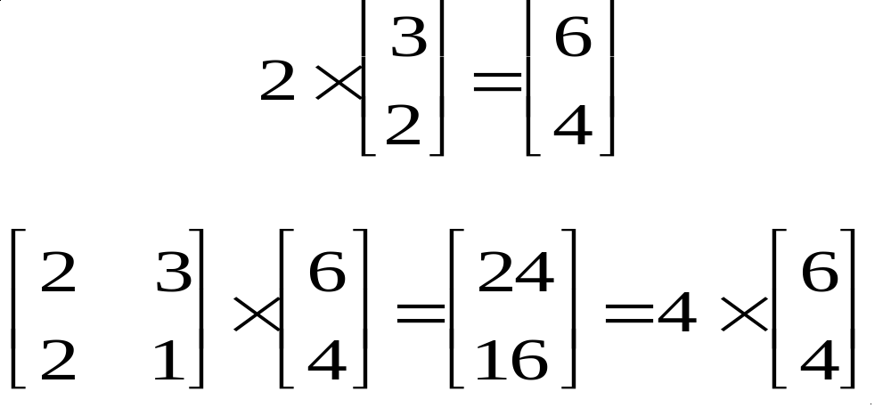
Transformation Matrices
Consider the following:
The square (transformation) matrix scales (3,2)
Now assume we take a multiple of (3,2)

Slide 42
Transformation Matrices
Scale vector (3,2) by a value 2 to get (6,4)
Multiply by the square transformation matrix
And we see that the result is still scaled by 4.
WHY?
A vector consists of both length and direction. Scaling a vector only changes its length and not its direction. This is an important observation in the transformation of matrices leading to formation of eigenvectors and eigenvalues.
Irrespective of how much we scale (3,2) by, the solution (under the given transformation matrix) is always a multiple of 4.

Slide 43
Eigenvalue Problem
The eigenvalue problem is any problem having the following form:
A . v = λ . v
A: n x n matrix
v: n x 1 non-zero vector
λ: scalar
Any value of λ for which this equation has a solution is called the eigenvalue of A and the vector v which corresponds to this value is called the eigenvector of A.

Slide 44
Eigenvalue Problem
Going back to our example:
A . v = λ . v
Therefore, (3,2) is an eigenvector of the square matrix A and 4 is an eigenvalue of A
The question is:
Given matrix A, how can we calculate the eigenvector and eigenvalues for A?

Slide 45
Calculating Eigenvectors & Eigenvalues
Simple matrix algebra shows that:
A . v = λ . v
⇔ A . v - λ . I . v = 0
⇔ (A - λ . I ). v = 0
Finding the roots of |A - λ . I| will give the eigenvalues and for each of these eigenvalues there will be an eigenvector
Example …

Slide 46
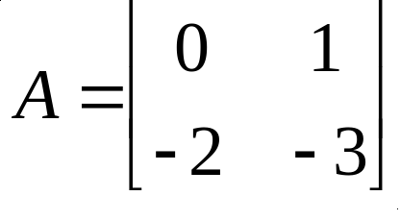
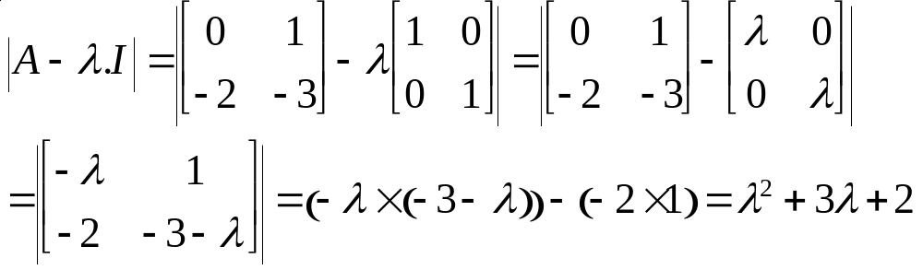
Calculating Eigenvectors & Eigenvalues
Let
Then:
And setting the determinant to 0, we obtain 2 eigenvalues:
λ₁ = -1 and λ₂ = -2

Slide 47
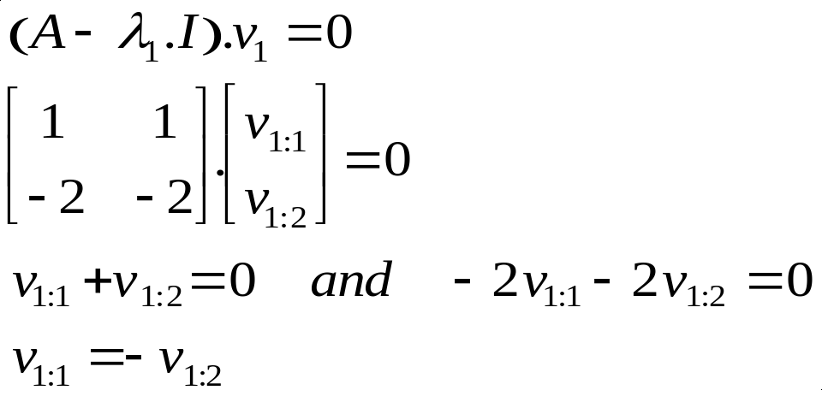
Calculating Eigenvectors & Eigenvalues
For λ₁ the eigenvector is:
Therefore the first eigenvector is any column vector in which the two elements have equal magnitude and opposite sign.

Slide 48
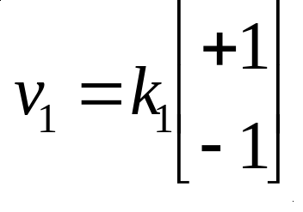
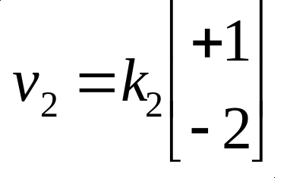
Calculating Eigenvectors & Eigenvalues
Therefore eigenvector v₁ is
where k₁ is some constant.
Similarly we find that eigenvector v₂
where k₂ is some constant.

Slide 49
Properties of Eigenvectors and Eigenvalues
Eigenvectors can only be found for square matrices and not every square matrix has eigenvectors.
Given an n x n matrix (with eigenvectors), we can find n eigenvectors.
All eigenvectors of a symmetric* matrix are perpendicular to each other, no matter how many dimensions we have.
In practice eigenvectors are normalized to have unit length.
*Note: covariance matrices are symmetric!

Slide 50
PCA
Principal components analysis (PCA) is a linear transformation that chooses a new coordinate system for the data set such that
  The greatest variance by any projection of the data set comes to lie on the first axis (then called the first principal component)
  The second greatest variance on the second axis
  Etc.
PCA can be used for reducing dimensionality by eliminating the later principal components

Slide 51
PCA
By finding the eigenvalues and eigenvectors of the covariance matrix, we find that the eigenvectors with the largest eigenvalues correspond to the dimensions that have the strongest correlation in the dataset
These are the principal components

Slide 52
PCA Process – STEP 1
Subtract the mean from each of the dimensions
This produces a data set whose mean is zero.
Subtracting the mean makes variance and covariance calculation easier by simplifying their equations.
The variance and co-variance values are not affected by the mean value.

Slide 53
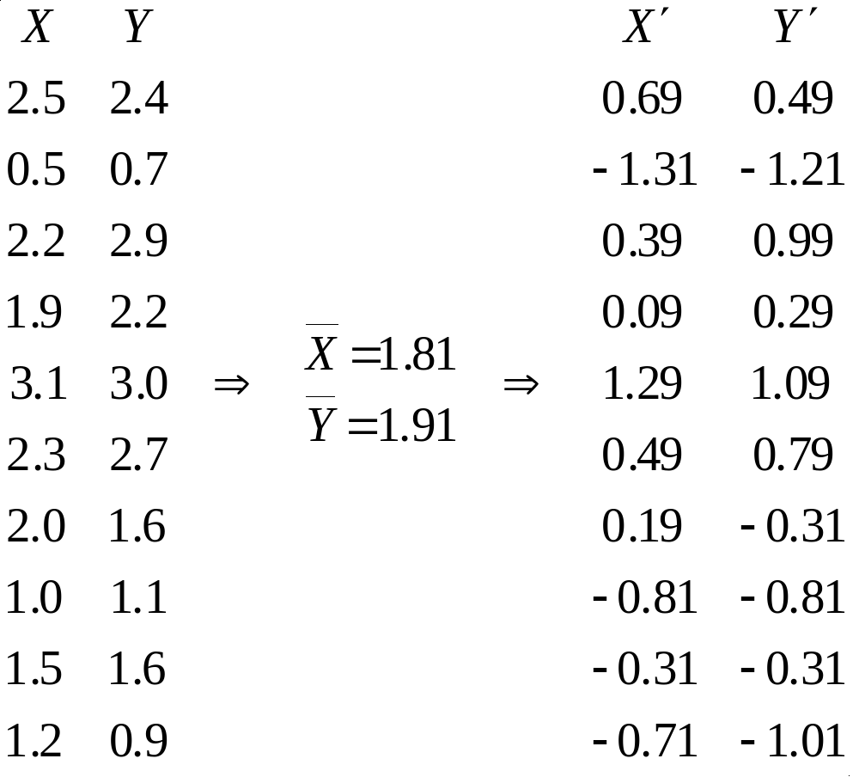
PCA Process – STEP 1
http://kybele.psych.cornell.edu/~edelman/Psych-465-Spring-2003/PCA-tutorial.pdf

Slide 54
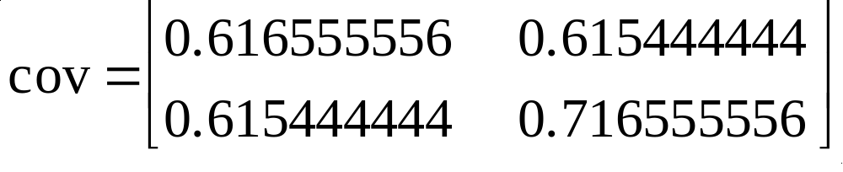
PCA Process – STEP 2
Calculate the covariance matrix
Since the non-diagonal elements in this covariance matrix are positive, we should expect that both the X and Y variables increase together.
Since it is symmetric, we expect the eigenvectors to be orthogonal.

Slide 55
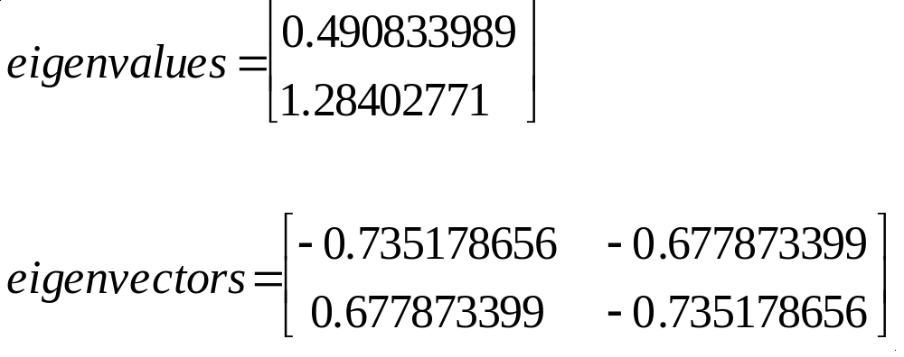
PCA Process – STEP 3
Calculate the eigenvectors and eigenvalues of the covariance matrix

Slide 56
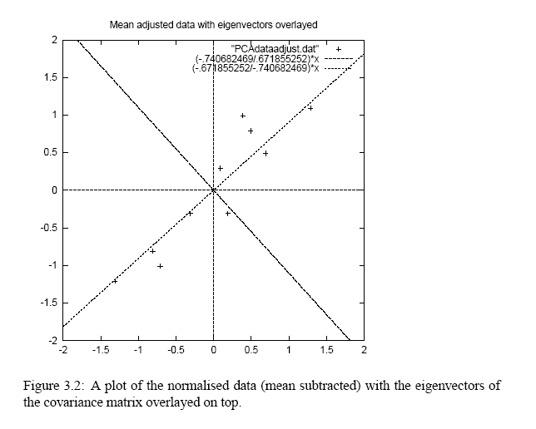
PCA Process – STEP 3
Eigenvectors are plotted as diagonal dotted lines on the plot. (note: they are perpendicular to each other).
One of the eigenvectors goes through the middle of the points, like drawing a line of best fit.
The second eigenvector gives us the other, less important, pattern in the data, that all the points follow the main line, but are off to the side of the main line by some amount.

Slide 57
PCA Process – STEP 4
Reduce dimensionality and form feature vector
The eigenvector with the highest eigenvalue is the principal component of the data set.
In our example, the eigenvector with the largest eigenvalue is the one that points down the middle of the data.
Once eigenvectors are found from the covariance matrix, the next step is to order them by eigenvalue, highest to lowest. This gives the components in order of significance.

Slide 58
PCA Process – STEP 4
Now, if you’d like, you can decide to ignore the components of lesser significance.
You do lose some information, but if the eigenvalues are small, you don’t lose much
n dimensions in your data
calculate n eigenvectors and eigenvalues
choose only the first p eigenvectors
final data set has only p dimensions.

Slide 59
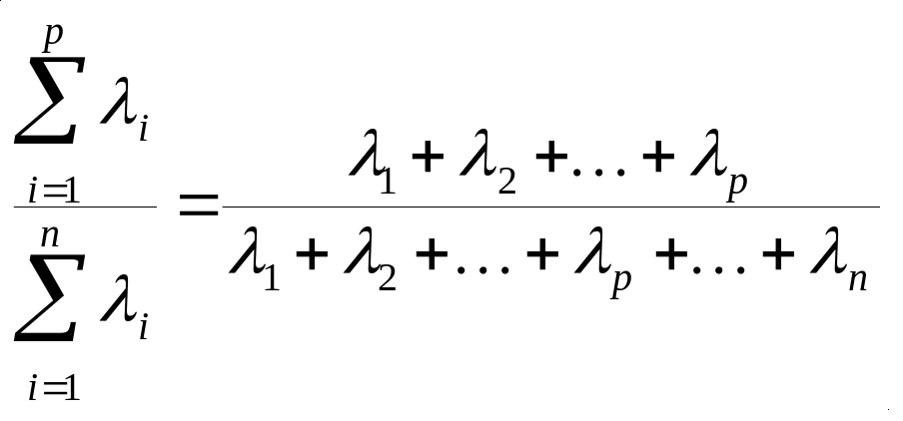
PCA Process – STEP 4
When the λ_{i}’s are sorted in descending order, the proportion of variance explained by the p principal components is:
If the dimensions are highly correlated, there will be a small number of eigenvectors with large eigenvalues and p will be much smaller than n.
If the dimensions are not correlated, p will be as large as n and PCA does not help.

Slide 60
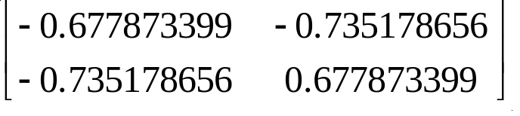
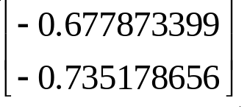
PCA Process – STEP 4
Feature Vector
FeatureVector = (λ₁ λ₂ λ₃ … λ_{p})
(take the eigenvectors to keep from the ordered list of eigenvectors, and form a matrix with these eigenvectors in the columns)
We can either form a feature vector with both of the eigenvectors:
or, we can choose to leave out the smaller, less significant component and only have a single column:

Slide 61
PCA Process – STEP 5
Derive the new data
FinalData = RowFeatureVector x RowZeroMeanData
RowFeatureVector is the matrix with the eigenvectors in the columns transposed so that the eigenvectors are now in the rows, with the most significant eigenvector at the top
RowZeroMeanData is the mean-adjusted data transposed, i.e., the data items are in each column, with each row holding a separate dimension

Slide 62
PCA Process – STEP 5
FinalData is the final data set, with data items in columns, and dimensions along rows.
What does this give us?
The original data solely in terms of the vectors we chose.
We have changed our data from being in terms of the axes X and Y, to now be in terms of our 2 eigenvectors.

Slide 63
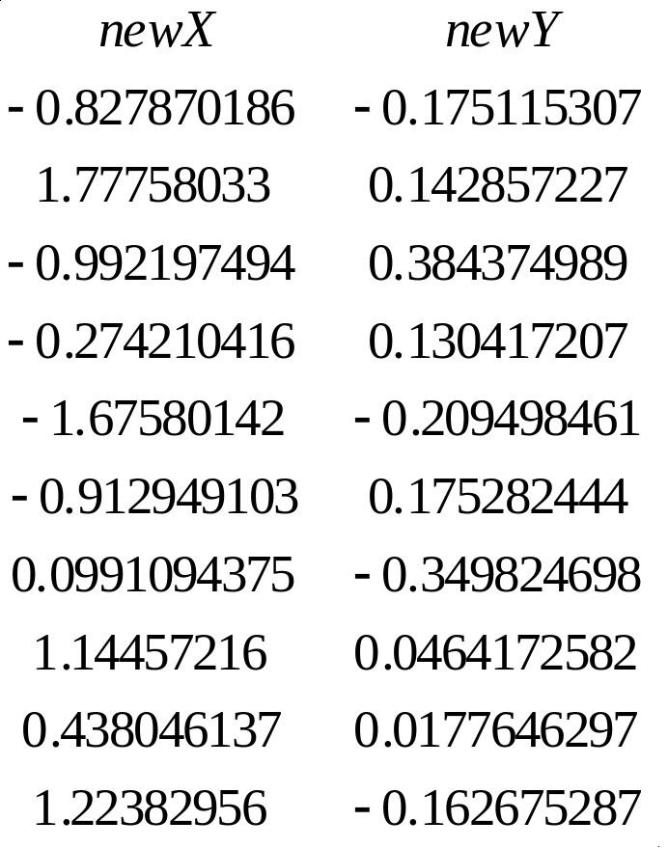
PCA Process – STEP 5
FinalData (transpose: dimensions along columns)

Slide 64
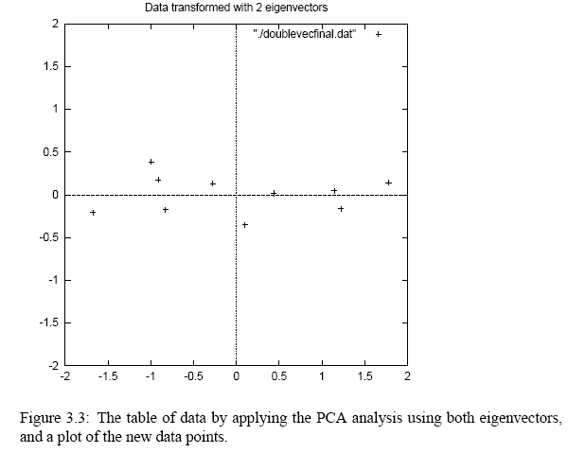
PCA Process – STEP 5

Slide 65
Reconstruction of Original Data
Recall that:
FinalData = RowFeatureVector x RowZeroMeanData
Then:
RowZeroMeanData = RowFeatureVector⁻¹ x FinalData
And thus:
RowOriginalData = (RowFeatureVector⁻¹ x FinalData) + OriginalMean
If we use unit eigenvectors, the inverse is the same as the transpose (hence, easier).

Slide 66
Reconstruction of Original Data
If we reduce the dimensionality (i.e., p<n), obviously, when reconstructing the data we lose those dimensions we chose to discard.
In our example let us assume that we considered only a single eigenvector.
The final data is newX only and the reconstruction yields…

Slide 67
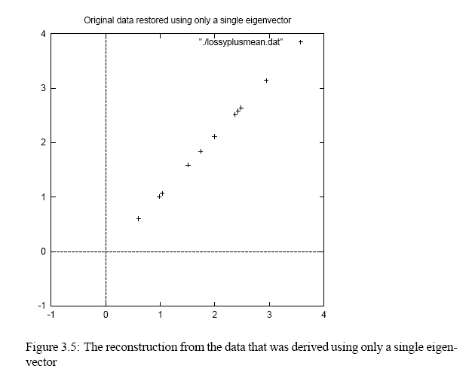
Reconstruction of original Data
The variation along the principal component is preserved.
The variation along the other component has been lost.

Slide 68
