Slide 1
Feistel Model
CS 465
Last Updated: Aug 27, 2013

Slide 2
Feistel Cipher Structure
Described by Horst Feistel (IBM) in 1973
Many symmetric encryption algorithms use this structure
DES, IDEA, Blowfish, RC6, MARS, Twofish
Not AES
Substitution-permutation network
Block cipher
Features – block size, key size, number of rounds, sub-key generation algorithm, round function
Decryption is essentially the same as encryption
Input: ciphertext
Use sub-keys in reverse order
Sources
Stallings NSE Fig 2.2 (next slide)
Wikipedie: Feistel Cipher

Slide 3
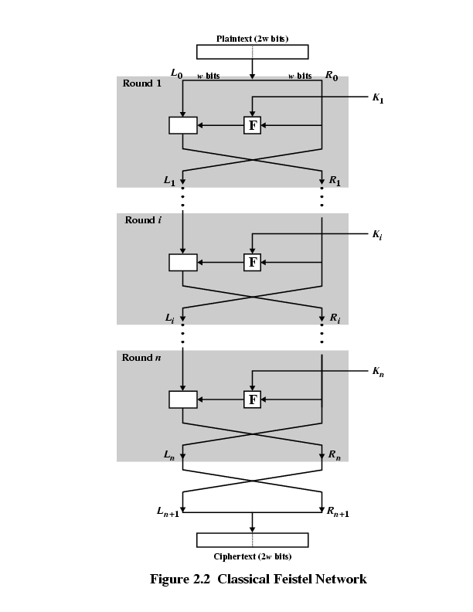
Source: Network Security Essentials (Stallings)

Slide 4
Source: Network Security Essentials (Stallings)

Slide 5
The Feistel Network Round Function (F)
The Feistel network is guaranteed to be reversible if we can reconstruct its inputs, which are derived from the key
It doesn’t matter how complicated or simple F is or if it can be inverted

Slide 6
Proof of Feistel Network
On the board
What is the disadvantage of a 1-round Feistel network?

