Slide 1
MAC: Message Authentication Code
CS 465
Last Updated: Sep 18, 2013

Slide 2
What Assurrances are Provided by Symmetric Encryption?
Authentication?
Confidentiality?
Integrity?
Non-repudiation?

Slide 3
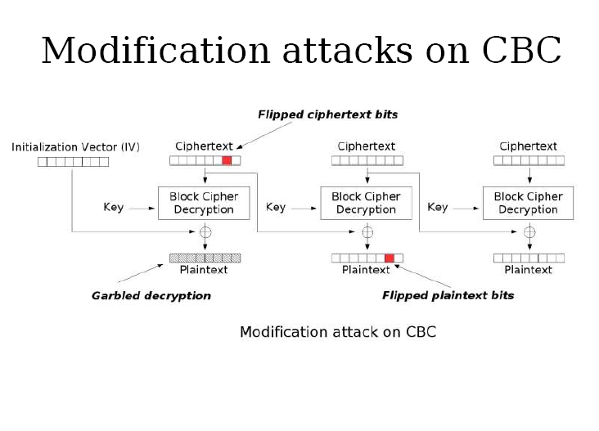
Bit Flipping Attacks (Block Cipher)

Slide 4
Bit Flipping Attacks (Stream Cipher)
Plaintext: ACCT_NO:123-45-6789 ADD:100
Ciphertext:
15b1206b7efa68b9 89 c87357507e3a27a138ca dc b2a1bb f8 eebee5

Slide 5
Goals of Message Authentication
Assure that the message has not been altered
Assure the source of the message is authentic
Optional – Timeliness of the message

Slide 6
Message Authentication: Ciphertext vs. Plaintext
Authentication of encrypted messages
Include an error-detection code in plaintext message
Authentication of plaintext messages
Authentication without confidentiality
Attach a key-based error-detection code to plaintext message

Slide 7
Message Authentication Code (MAC)
Dear BYU,
Thank you so much for offering such an awesome computer security course.
Sincerely,
Joe Student
Dear BYU,
Thank you so much for offering such an awesome computer security course.
Sincerely,
Joe Student
MAC Algorithm
This message really is from me and hasn’t been modified.
Key

Slide 8
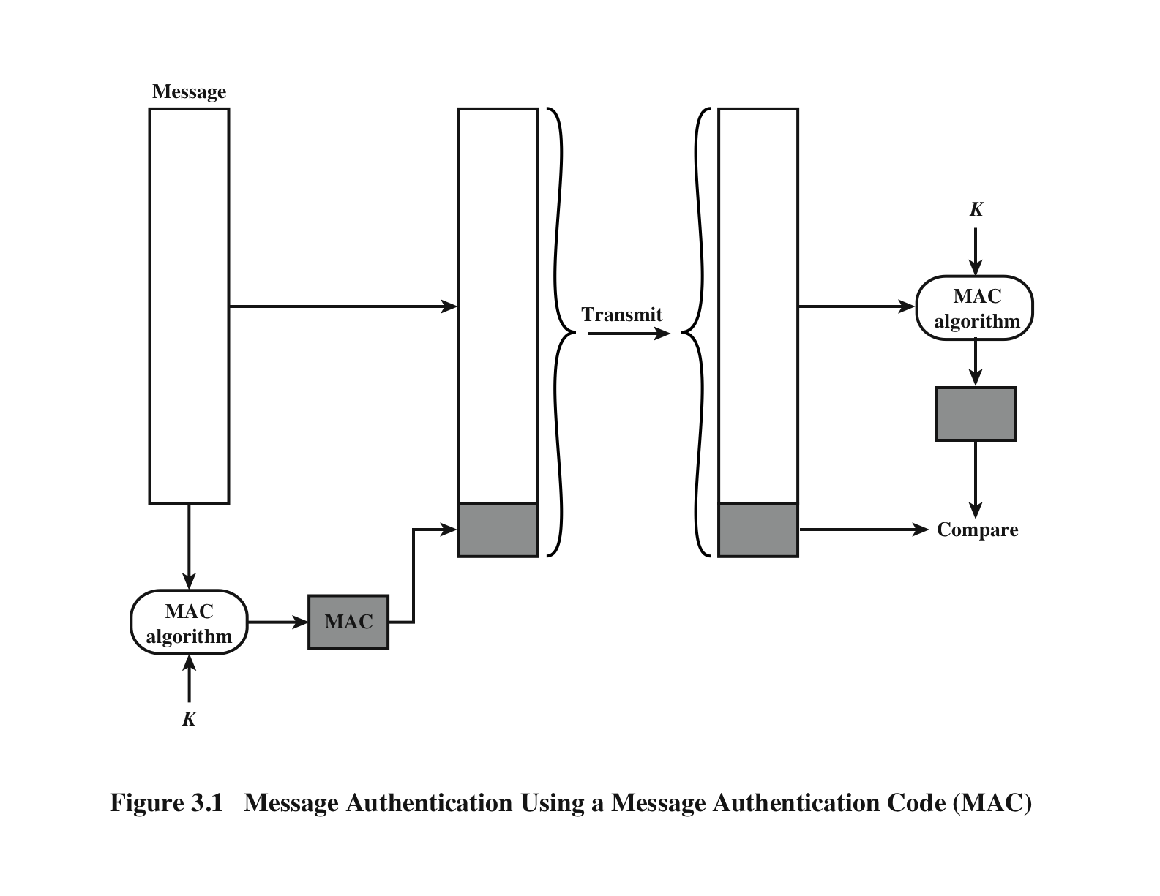
Message Authentication Code (MAC)
Source: Network Security Essentials (Stallings)

Slide 9
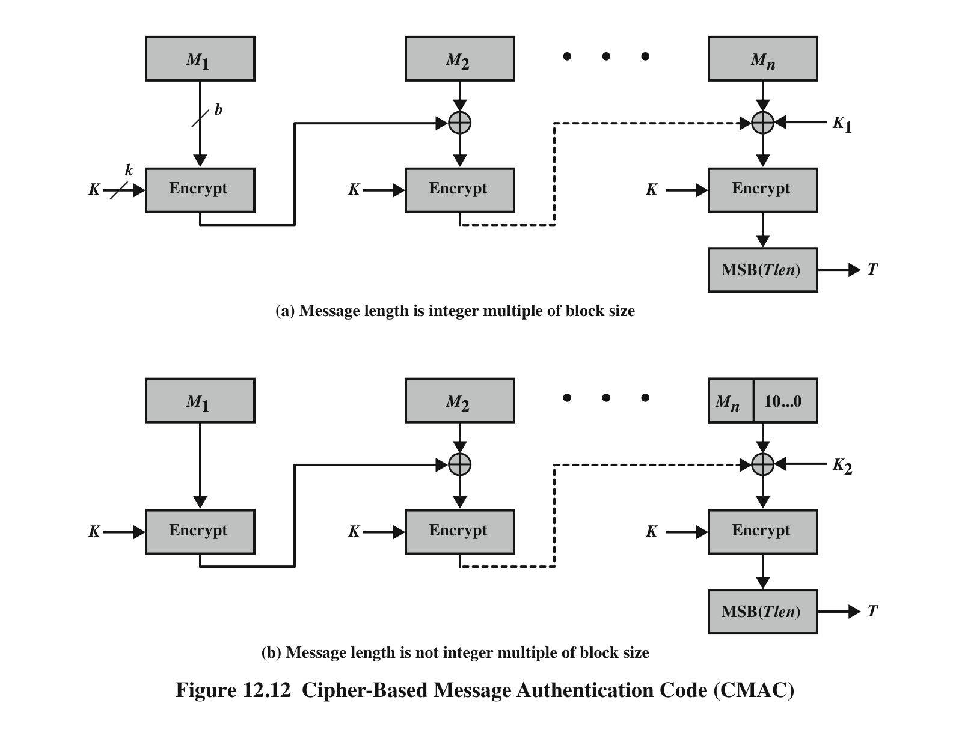
MAC Creation with Block Cipher

Slide 10
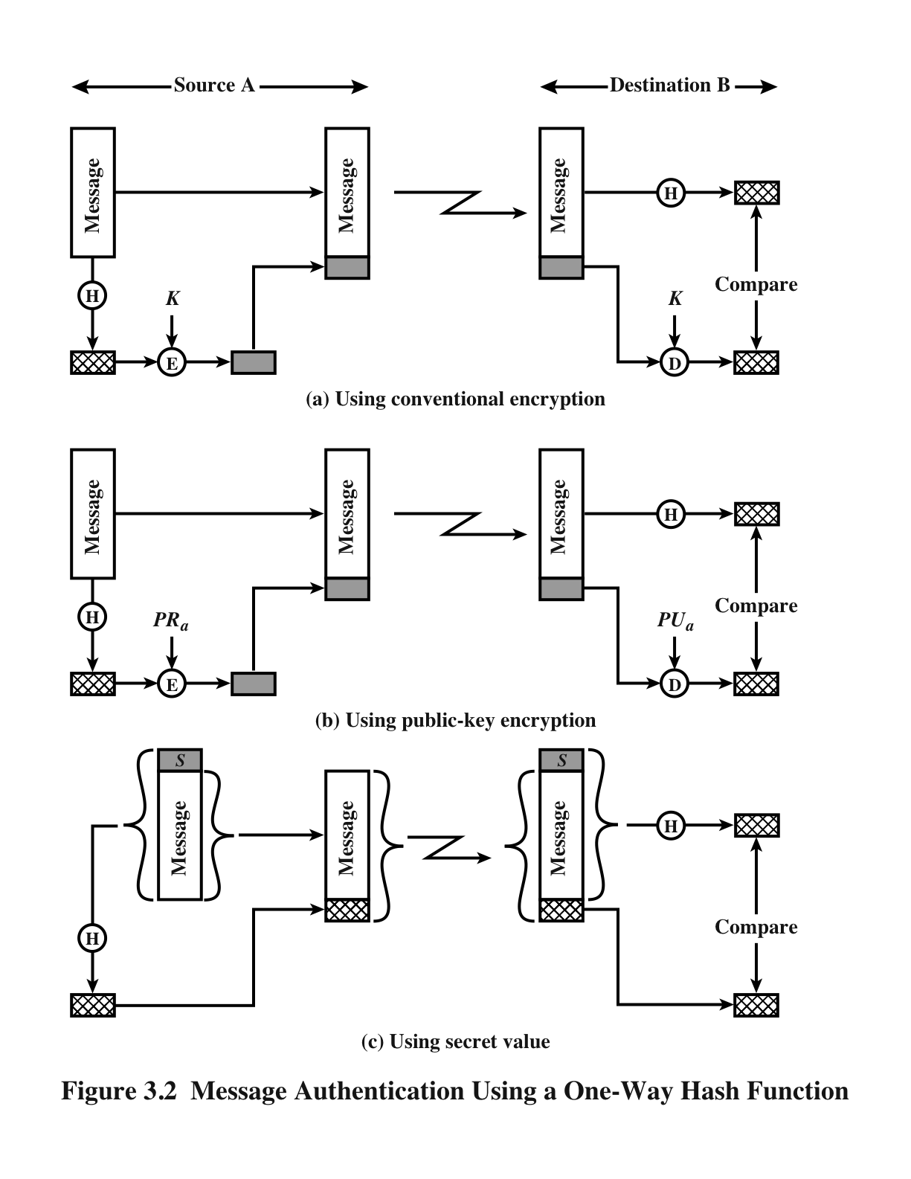
Three Ways to Implement a MAC
CBC-MAC
Use CBC mode and a block cipher
Expensive
Hash the message and encrypt the digest
Source: Network Security Essentials (Stallings)

Slide 11
Three Ways to Implement a MAC
CBC-MAC
Hash the message and encrypt the digest
Hash the message along with a shared key
MAC generated using hashing is known as an HMAC
Source: Network Security Essentials (Stallings)

Slide 12
Design Flaw!
Cryptographers recommend against this kind of HMAC using modern hash functions
Vulnerable to a message extension attack
An example of an implementation weaknesses in the algorithm

Slide 13
Iterative Hash Function
Popular hash functions (MD5, SHA-1) use an iterative implementation technique known as the Merkle-Damgård construction

Slide 14
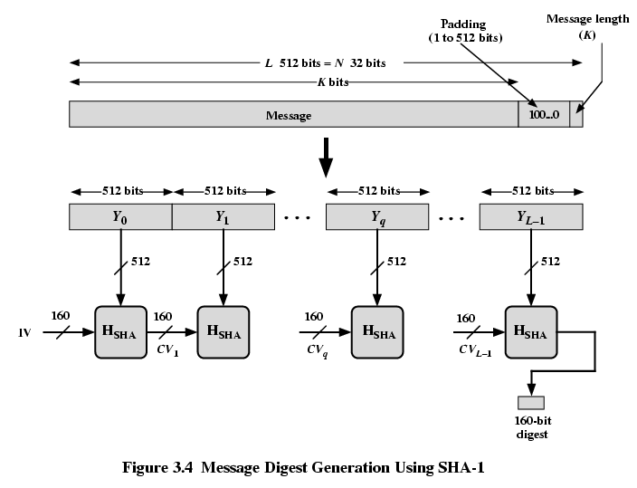

Slide 15
Alice and Bob
Alice and Bob share a key K
Alice sends message M₁ to Bob such that Bob knows it came from Alice
Alice computes H(K || M₁) = d₁
Alice sends M₁ and d₁ to Bob
Bob verifies the message
Bob computes H(K || M₁) = d₂ and compares d₁ to d₂. If they match, the message came from Alice.
Or did it????

Slide 16
HMAC
Because of the message extension attack vulnerability, the government standard HMAC algorithm guards against this threat
FIPS 198
RFC 2104

Slide 17
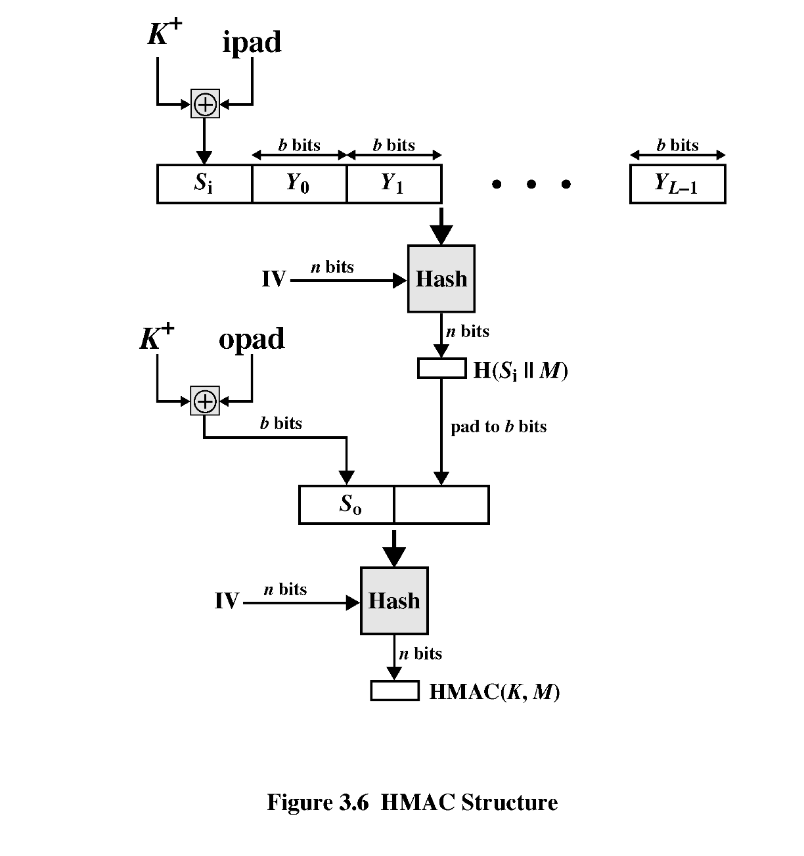
HMAC
H(K || H(K || M))

