Slide 1
Naïve Bayes
Notes:
Fall 2004
CS478 - Machine Learning

Slide 2
Bayesian Reasoning
Bayesian reasoning provides a probabilistic approach to inference. It is based on the assumption that the quantities of interest are governed by probability distributions and that optimal decisions can be made by reasoning about these probabilities together with observed data.

Slide 3
Probabilistic Learning
In ML, we are often interested in determining the best hypothesis from some space H, given the observed training data D.
One way to specify what is meant by the best hypothesis is to say that we demand the most probable hypothesis, given the data D together with any initial knowledge about the prior probabilities of the various hypotheses in H.

Slide 4
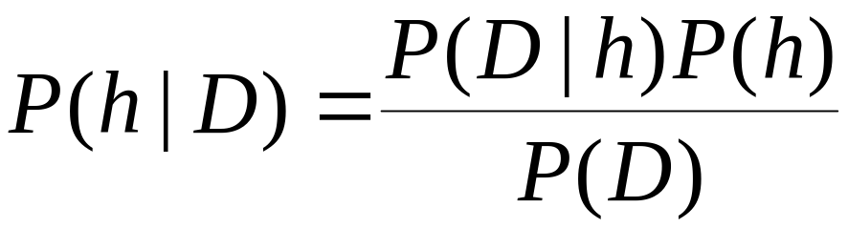
Bayes Theorem
Bayes theorem is the cornerstone of Bayesian learning methods
It provides a way of calculating the posterior probability P(h | D), from the prior probabilities P(h), P(D) and P(D | h), as follows:

Slide 5
Using Bayes Theorem (I)
Suppose I wish to know whether someone is telling the truth or lying about some issue X
  The available data is from a lie detector with two possible outcomes: truthful and liar
  I also have prior knowledge that over the entire population, 21% lie about X
  Finally, I know the lie detector is imperfect: it returns truthful in only 94% of the cases where people actually told the truth and liar in only 87% of the cases where people where actually lying

Slide 6
Using Bayes Theorem (II)
P(tells the truth about X) = 0.79
P(truthful | lies about X) = 0.07
P(truthful | tells the truth about X) = 0.85
P(lies about X) = 0.21
P(liar | lies about X) = 0.93
P(liar | tells the truth about X) = 0.15

Slide 7
Using Bayes Theorem (III)
Suppose a new person is asked about X and the lie detector returns liar
Should we conclude the person is indeed lying about X or not
What we need is to compare:
  P(lies about X | liar)
  P(tells the truth about X | liar)

Slide 8
Using Bayes Theorem (IV)
By Bayes Theorem:
  P(lies about X | liar) =
  [P(liar | lies about X).P(lies about X)]/P(liar)
  P(tells the truth about X | liar) =
  [P(liar | tells the truth about X).P(tells the truth about X)]/P(liar)
All probabilities are given explicitly, except for P(liar) which is easily computed (theorem of total probability):
  P(liar) = P(liar | lies about X).P(lies about X) + P(liar | tells the truth about X).P(tells the truth about X)

Slide 9
Using Bayes Theorem (V)
Computing, we get:
  P(liar) = 0.93x0.21 + 0.15x0.89 = 0.329
  P(lies about X | liar) = [0.93x0.21]/0.329 = 0.594
  P(tells the truth about X | liar) = [0.15x0.89]/0.329 = 0.406
And we would conclude that the person was indeed lying about X

Slide 10
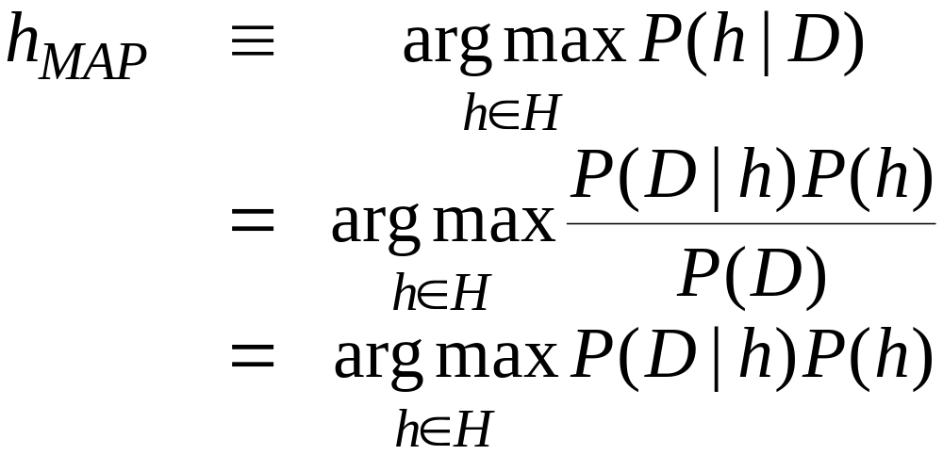
Intuition
How did we make our decision?
  We chose the/a maximally probable or maximum a posteriori (MAP) hypothesis, namely:

Slide 11
Brute-force MAP Learning
For each hypothesis h∈H
  Calculate P(h | D) // using Bayes Theorem
Return h_{MAP}=argmax_{h∈H} P(h | D)
Guaranteed “best” BUT often impractical for large hypothesis spaces: mainly used as a standard to gauge the performance of other learners

Slide 12
Remarks
The Brute-Force MAP learning algorithm answers the question of: which is the most probable hypothesis given the training data?'
Often, it is the related question of: which is the most probable classification of the new query instance given the training data?' that is most significant.
In general, the most probable classification of the new instance is obtained by combining the predictions of all hypotheses, weighted by their posterior probabilities.

Slide 13
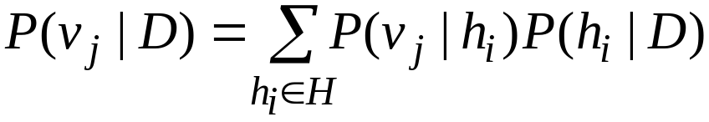
Bayes Optimal Classification (I)
If the possible classification of the new instance can take on any value v_{j} from some set V, then the probability P(v_{j} | D) that the correct classification for the new instance is v_{j} , is just:
Clearly, the optimal classification of the new instance is the value v_{j}, for which P(v_{j} | D) is maximum, which gives rise to the following algorithm to classify query instances.

Slide 14
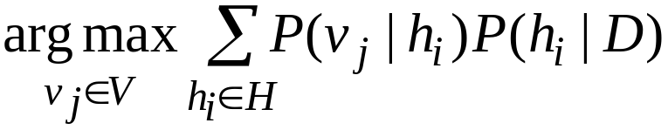
Bayes Optimal Classification (II)
Return
No other classification method using the same hypothesis space and same prior knowledge can outperform this method on average, since it maximizes the probability that the new instance is classified correctly, given the available data, hypothesis space and prior probabilities over the hypotheses.
The algorithm however, is impractical for large hypothesis spaces.

Slide 15
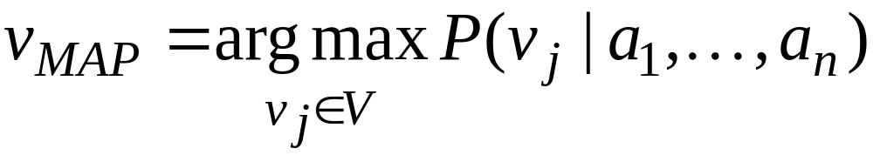
Naïve Bayes Learning (I)
The naive Bayes learner is a practical Bayesian learning method.
It applies to learning tasks where instances are conjunction of attribute values and the target function takes its values from some finite set V.
The Bayesian approach consists in assigning to a new query instance the most probable target value, v_{MAP}, given the attribute values a₁, …, a_{n} that describe the instance, i.e.,

Slide 16
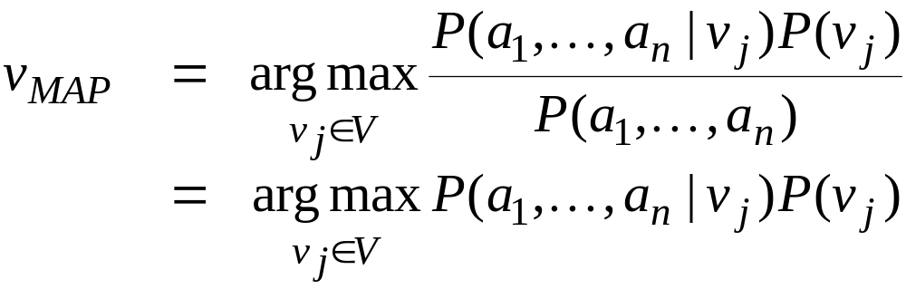
Naïve Bayes Learning (II)
Using Bayes theorem, this can be reformulated as:
Finally, we make the further simplifying assumption that the attribute values are conditionally independent given the target value. Hence, one can write the conjunctive conditional probability as a product of simple conditional probabilities.

Slide 17
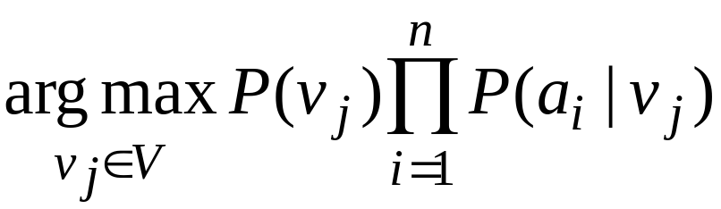
Naïve Bayes Learning (III)
Return
The naive Bayes learning method involves a learning step in which the various P(v_{j}) and P(a_{i} | v_{j}) terms are estimated, based on their frequencies over the training data.
These estimates are then used in the above formula to classify each new query instance.
Whenever the assumption of conditional independence is satisfied, the naive Bayes classification is identical to the MAP classification.

Slide 18
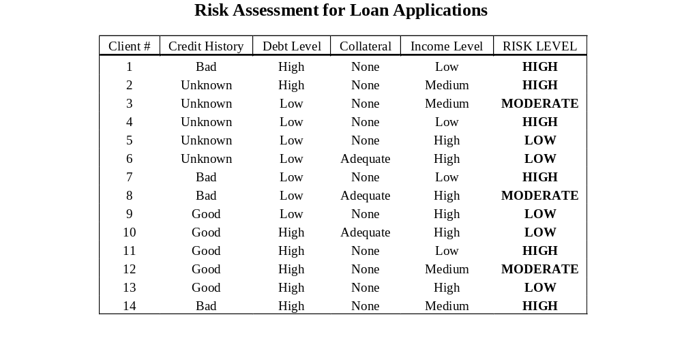
Illustration (I)

Slide 19
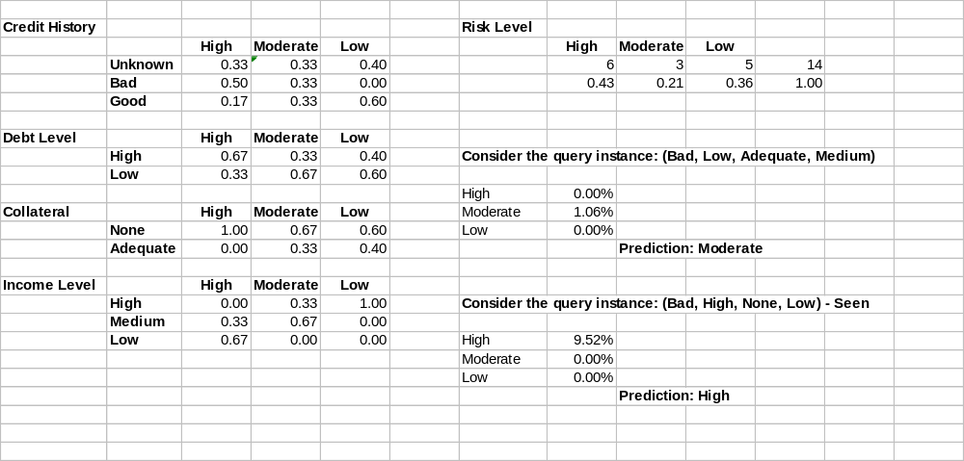
Illustration (II)

Slide 20
How is NB Incremental?
No training instances are stored
Model consists of summary statistics that are sufficient to compute prediction
Adding a new training instance only affects summary statistics, which may be updated incrementally

Slide 21
Estimating Probabilities
We have so far estimated P(X=x | Y=y) by the fraction n_{x|y}/n_{y}, where n_{y} is the number of instances for which Y=y and n_{x|y} is the number of these for which X=x
This is a problem when n_{x} is small
  E.g., assume P(X=x | Y=y)=0.05 and the training set is s.t. that n_{y}=5. Then it is highly probable that n_{x|y}=0
  The fraction is thus an underestimate of the actual probability
  It will dominate the Bayes classifier for all new queries with X=x

Slide 22
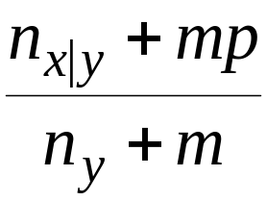
m-estimate
Replace n_{x|y}/n_{y} by:
Where p is our prior estimate of the probability we wish to determine and m is a constant
  Typically, p = 1/k (where k is the number of possible values of X)
  m acts as a weight (similar to adding m virtual instances distributed according to p)

Slide 23
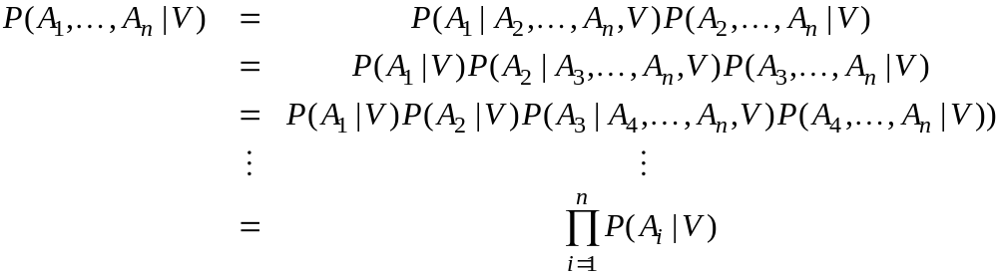
Revisiting Conditional Independence
Definition: X is conditionally independent of Y given Z iff P(X | Y, Z) = P(X | Z)
NB assumes that all attributes are conditionally independent, given the class. Hence,

Slide 24
What if ?
In many cases, the NB assumption is overly restrictive
What we need is a way of handling independence or dependence over subsets of attributes
  Joint probability distribution
    Defined over Y₁ x Y₂ x … x Y_{n}
    Specifies the probability of each variable binding

Slide 25
Bayesian Belief Network
Directed acyclic graph:
  Nodes represent variables in the joint space
  Arcs represent the assertion that the variable is conditionally independent of it non descendants in the network given its immediate predecessors in the network
  A conditional probability table is also given for each variable: P(V | immediate predecessors)
Refer to section 6.11

